Slide 1

. ..
.
Group:5
1.Salman Farshi
.
Superviser : Intisar Tahmid Naheen

Slide 2
H
ff
Predicting the winner of t20 world cup 2021 using Machine learning
Dd

Slide 3
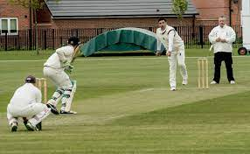
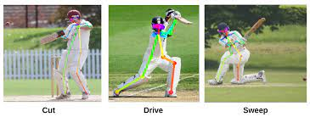
.
Why Machine learning in cricket?

Slide 4



.
Data collection
.
Danniel
Reynolds
UI Design
WORKED
PORTFOLIO
Envato
Address
FOCUS
December 2016
Dima Isakov
,
2015/2016
San Francisco
PUBLISHED
Designer

Slide 5
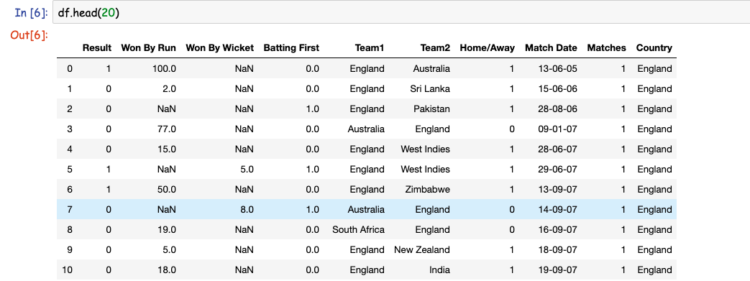
AIDA
Data preposessing
This is the collected raw data

Slide 6
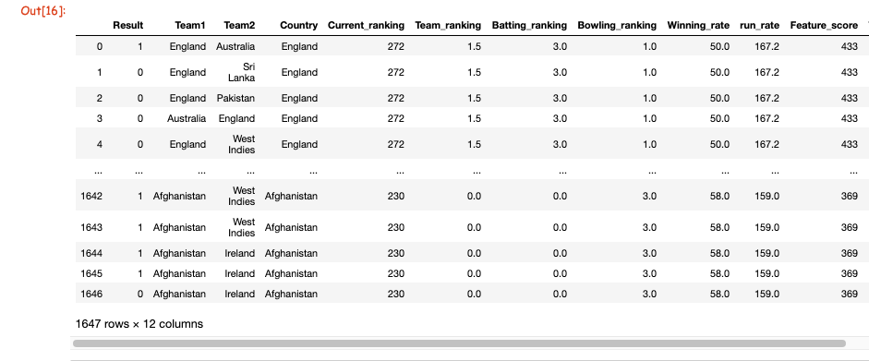
AIDA
Data preposessing
This is the prepossed data
80% times 70% works

Slide 7
AIDA
What have been done for preposessing
1 . Convert exel file to csv
2 . Replace null values
3 Make columns from slicing exixting columns
4 Adding more features columns
5 Manupulating columns values

Slide 8
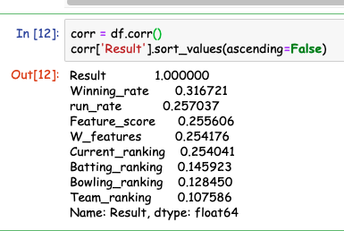
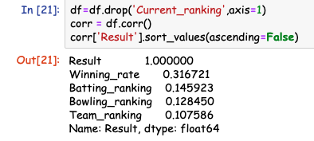
Features Engineering
AIDA
This is the second most time consuming matter for this project . I have done a lot test just to ensure some importing features . End of the day I found the most importance features :
According to my test and diifferemt types of research papers , the most important features of this project are :
Winning_rate 0.316721
run_rate 0.257037
Feature_score 0.255606
W_features 0.254176
Current_ranking 0.254041 Batting_
ranking 0.145923
Bowling_ranking 0.128450
Team_ranking 0.107586

Slide 9
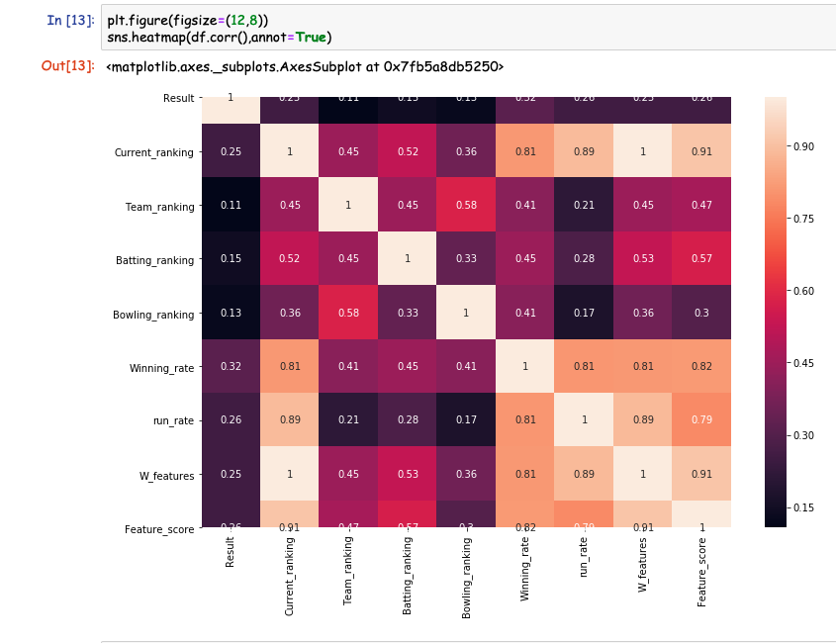
.
Correlation Matrix

Slide 10
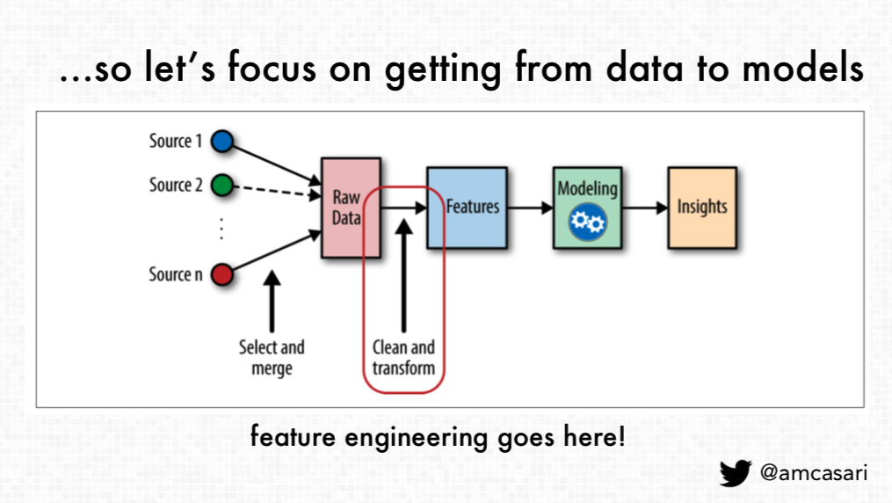
AIDA
What have been done for Feature Engineering
02.
Various versions have evolved over the years, sometimes.
04.
Various versions have evolved over the years, sometimes.
03.
Various versions have evolved over the years, sometimes.
01.
Various versions have evolved over the years, sometimes.
1 Find out importance features
2 Test and update the features
3 Scaling the features
4. Transform categorical data using
one hot enconding

Slide 11
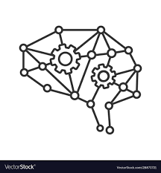
AIDA
Model Selection
02.
Various versions have evolved over the years, sometimes.
Various versions have evolved over the years, sometimes.
03.
Various versions have evolved over the years, sometimes.
1 Support vector classifier
2 Random forest classifers
3.kKNeighborsClassifier
4 logistric Regressor
01.
Various versions have evolved over the years, sometimes.

Slide 12
AIDA
Model Selection
Without best parameter
02.
Various versions have evolved over the years, sometimes.
With best parameter
Various versions have evolved over the years, sometimes.
03.
Various versions have evolved over the years, sometimes.
01.
Various versions have evolved over the years, sometimes.
1 Support vector classifier 62%
2 Random forest classifers 59 %
3.kKNeighborsClassifier 58%
4 logistric Regressor 62%
1 Support vector classifier 62%
2 Random forest classifers 58 %
3.kKNeighborsClassifier 63%
4 logistric Regressor 64%

Slide 13
Thanks

