Slide 1
CS2014
Systems Programming
Lectures:
Stephen Farrell
stephen.farrell@cs.tcd.ie, x2354
Room: WR3.4 (impossible to find!)
Teaching Assistant:
Christian Cabrera
cabrerac@scss.tcd.ie, xNNNN
See Christian @ labs

Slide 2
C Programming
Learn by doing!
If you do the assignments for the course and revise before the exam, you’ll be just fine
But, the real goal is that you end up being able to tackle programming tasks as you hit them later in your studies and later in life
C programming history mirrors that of Unix
C is a fine language to use in many cases, especially if you have some h/w interfacing to do or need maximal portability, or both.
Learn by doing! (Did I say that already?)

Slide 3
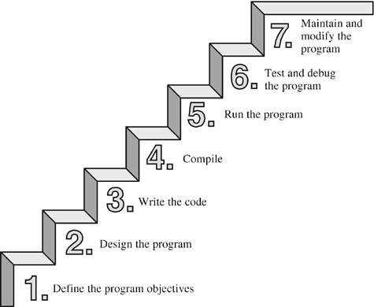
View #1: steps/waterfall
https://www.9wy.net/onlinebook/CPrimerPlus5/ch01lev1sec6.html
A circa 2004 view

Slide 4
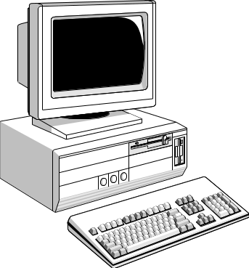
View #2: tools/objects
Edit
Program
Source
Code
Compile
Object
Code
Library
Files
Executable
Link Object
Code
https://www.scss.tcd.ie/David.Gregg/cs2014/notes/

Slide 5
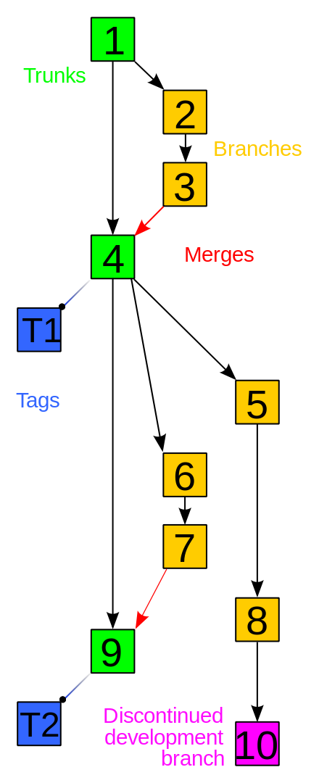
View #3: version control
All source objects (.c, .h, Makefiles) are versioned
Maybe also object code files, libraries, binaries, and test data/test cases
You probably have to deal with lots and lots of versioned things as part of a maybe-large team
You almost certainly have to deal with code for some duration (e.g. 1-2 years) that’s only a small part of the overall lifetime of the code (e.g. 20-30 years)

Slide 6
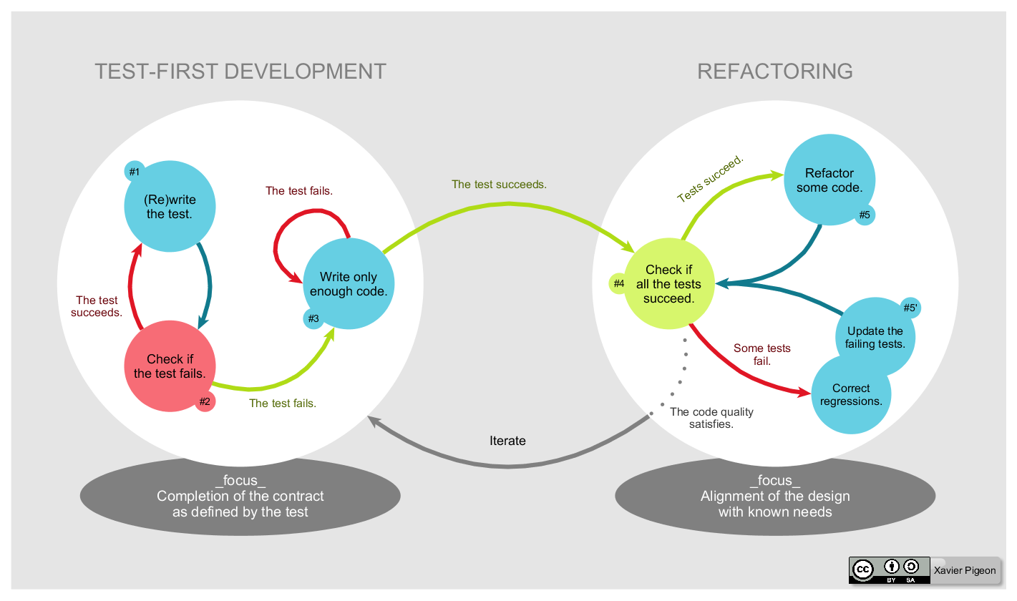
View #4: Test Driven Development
Diagram above: https://upload.wikimedia.org/wikipedia/commons/0/0b/TDD_Global_Lifecycle.png
Also: an “amusing” pressie: https://www.slideshare.net/amritayan/test-driven-development-in-c

Slide 7
Not Software engineering, but Programming
We could continue with software engineering paradigms and methodologies forever
Some wise people care a lot about this stuff
  I’m not very wise, so only care a bit:-)
Meanwhile, let’s learn the rudiments of programming needed in all cases
We still need a few more concepts first though...
  Sorry

Slide 8
A few more concepts
Better drawn on the board than in a slide so I’ll do that as we go...
Stack, heap, memory management
Debugging, gdb, “gcc -g”
Build, Makefile, make
Inputs, outputs: stdin, stdout, stderr
  File handling
Command line arguments, argc/argv
Expressions and statements: if, while, for, conditionals
Let’s learn as we go...

Slide 9
C Programming Examples
Ok, let’s go play with some examples
So with that, we’ll head over to:
  https://down.dsg.cs.tcd.ie/cs2014/examples/c-progs/README.html

