Slide 1
CS2014
Systems Programming
Lectures:
Stephen Farrell
stephen.farrell@cs.tcd.ie, x2354
Room: WR3.4 (impossible to find!)
Teaching Assistant:
Christian Cabrera
cabrerac@scss.tcd.ie, xNNNN
See Christian @ labs

Slide 2
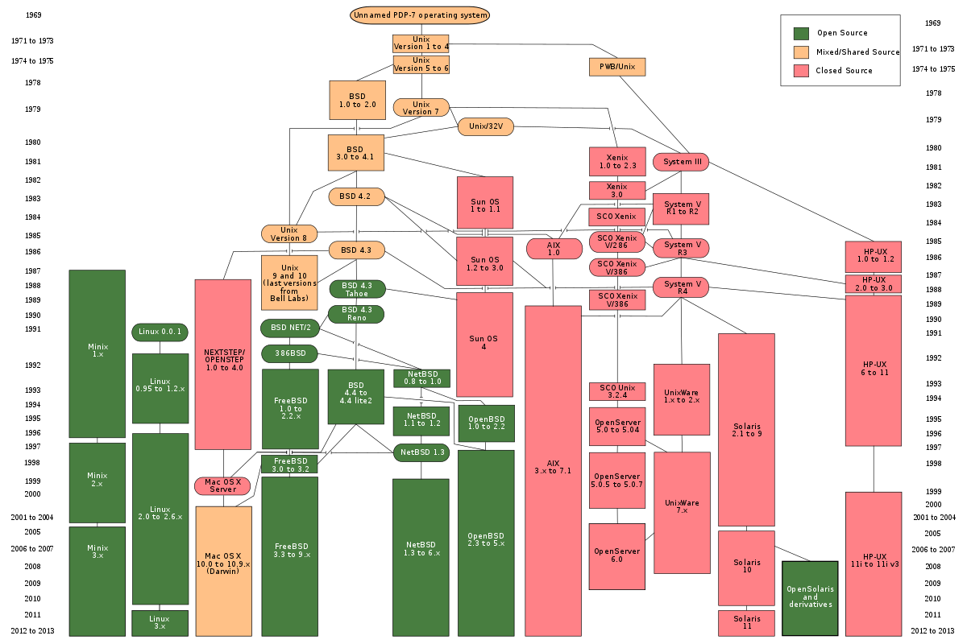
Operating Systems Stuff
https://en.wikipedia.org/wiki/File:Unix_history-simple.svg

Slide 3
Operating Systems Stuff
There’s lots of history!
  Previous slides omits lots, e.g. SINIX was a Siemens-Nixdorf variant I used work on
    https://en.wikipedia.org/wiki/SINIX
Just Linux has loads and loads of distros...
  https://upload.wikimedia.org/wikipedia/commons/1/1b/Linux_Distribution_Timeline.svg
The ones I currently care about:
  Ubuntu (installed on LG12 lab machines)
  OpenWRT

Slide 4
Linux: getting-started
Ubuntu desktop GUI is fairly obvious
Command line may be less familiar to some of you, but is what we’ll be using
Hint#1: Ctrl-alt-t gets you a command line...
And with that, we’ll head over to:
  https://down.dsg.cs.tcd.ie/cs2014/examples/shell/README.html

