Slide 1
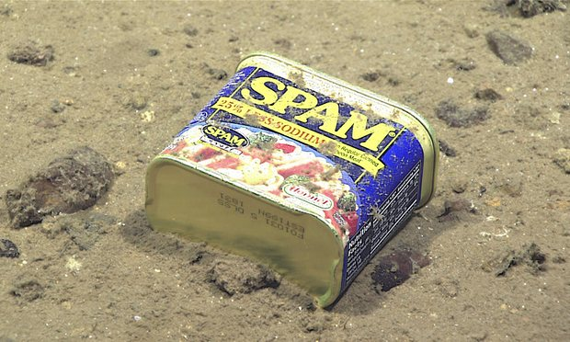
Mail and SPAM
…just can’t seem to get enough…
https://www.theguardian.com/environment/2017/feb/13/extraordinary-levels-of-toxic-pollution-found-in-10km-deep-mariana-trench#img-1

Slide 2
Next hour(-ish)
Mail architecture & mail transport security
What is spam?
  How much is there?
How is it created/inserted?
How might it be mitigated?
  Some ways…
Future…
And while we’re at it, we’ll cover a load of stuff about email in general

Slide 3
Materials
Additional slides:
  Jim Fenton’s slides https://down.dsg.cs.tcd.ie/cs7053/lectures/fenton.pdf
  Murray Kucherawy’s slides: https://down.dsg.cs.tcd.ie/cs7053/lectures/slides-87-dmarc-3.pdf
DomainKeys
  http://dkim.org/ (still no https!)
  One anti-spam technique
    Note: I helped out there
Misc silliness:
    https://www.spam.com/
    https://down.dsg.cs.tcd.ie/ubc206/spam/spam-song.wav

Slide 4
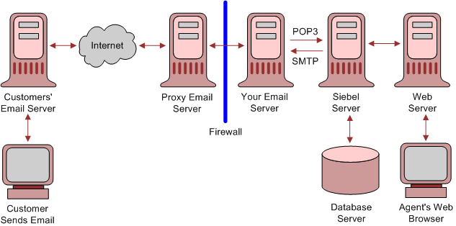
Email Architecture
See RFC 5598
https://docs.oracle.com/cd/E63029_01/books/SecurHarden/img/architecture_email_v.gif

Slide 5
Another architectural view
DNS
MX
Blocklists
Mail Transfer
Agent (MTA)
Mail Transfer
Agent (MTA)
Mail Transfer
Agent (MTA)
Message
Store (MS)
Transfer (SMTP/25)
Submission (SMTP/587)
Reading (IMAP/143)
Mail User
Agent (MUA)
Mail User
Agent (MUA)

Slide 6
Drive-by Terminology
MUA, MTA, MSA, MDA, MS …
  MSA: Mail submission agent
  MDA: Mail delivery agent
Message envelope
Forwarder, exploder, …
Message headers:
  From:, Sender:, Resent-From:
2821/2822
  EHLO/HELO

Slide 7
Mail Transport Security
DNS
MX
Blocklists
Mail Transfer
Agent (MTA)
Mail Transfer
Agent (MTA)
Mail Transfer
Agent (MTA)
Message
Store (MS)
Transfer (SMTP/25)
Submission (SMTP/587)
Reading (IMAP/143)
Mail User
Agent (MUA)
Mail User
Agent (MUA)
TLS
Mail Transport Security sometimes described as “hop-by-hop security”

Slide 8
Mail Transport Security Stats
Gmail publish “transparency report” stats
  https://transparencyreport.google.com/safer-email/overview
Other service providers see commensurate numbers
Recently: 89% of outbound and 93% of inbound are protected via some form of TLS
  Note: “Some form” == possibly opportunistic!
Regional variations remain

Slide 9
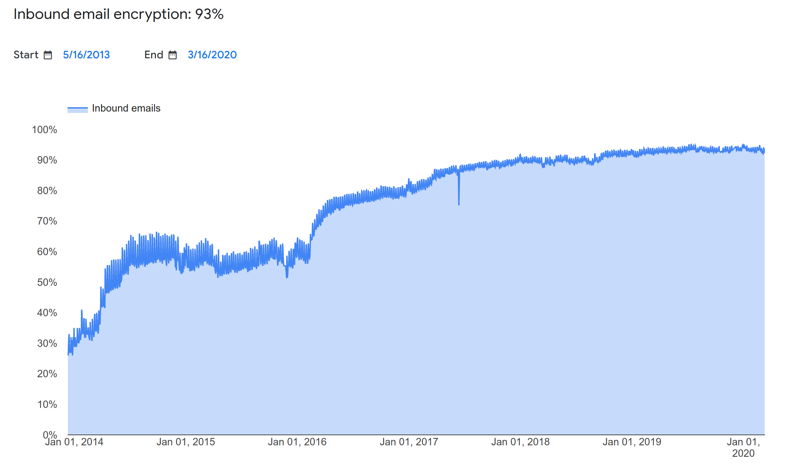
HBH over time (still @gmail)

Slide 10
Opportunistic SMTP/TLS (1)
Sending MTA looks up MX RR of recipient’s DNS domain
MX name might not be same as recipient’s domain, e.g., tcd.ie’s MX is msft/outlook
Sending MTA is TLS client, receiving MTA is TLS server.
Question: which name to require in TLS server cert? MX name or recipient domain?
Answer: many receiving domains outsource MX to someone big and good at anti-spam meaning sending MTA has to deal with MX names and can’t insist MX be able to serve TLS certificate of recipient domain.

Slide 11
Opportunistic SMTP/TLS (2)
Today many MX’s still serve self-signed certificates or expired certificates or certificates signed by some CA not trusted by sending MTA (e.g. a corporate CA).
For all the above reasons, SMTP/TLS is often still “opportunistic” in that MTAs enable it, but don’t impose the same level of checks as are done on the web
Note: on the web, there’s often a warm body who can see/react to errors or warnings – there is no human user present when a sending MTA tries to establish SMTP/TLS with a receiving MTA.

Slide 12
MTA-STS
To improve on opportunistic SMTP/TLS we need receiving MTAs to publish a signal that it’s ok for sending MTAs to be more strict
MTA Strict Transport Security (RFC 8461) defines a way to publish that information in the DNS (so sending MTA can look for it before starting to connect)
  Modelled on HSTS and DKIM
Important: has a “testing” phase and defines how sending MTAs can report stats occasionally

Slide 13
What is spam?
Various acronyms:
  Unsolicited bulk email (UBE)
  Unsolicited commercial email (UCE)
Spam is bad:
  Resource consumption
    Filters, scanners etc. cost time & money
  Malware
  Phishing attempts

Slide 14
Sometimes hard to know…
HILARY TERM GREETINGS FROM THE COLLEGE CHAPLAINS The College Chaplains send best wishes to all, and would like to bring the following upcoming events to your attention. They are open to any students or staff members who wish to join us. …

Slide 15
Original spam tricks
Just send email!
  Ahh…the naivety of it all!
Email to list
  Listservers got better, e.g. subscriber only with controlled subscription
Forge headers
Send via open relay
  Used to be a lot of these, very few now
    toad.com is (or was) an exception!

Slide 16
More spam tricks…
Confusion:
  accounts@paypa1.com
  support@eboy.com
  postmaster@boi-support.com
  About to get worse thanks to I18N
  security@bigbаnk.com
  ^ Unicode 0430 is cryllic small ‘a’
Throwaway domains/addresses
Zombie’d hosts
BGP spoofing
Fake ISPs

Slide 17
Yet more
HTML messing
  Colour-related
  Relay sites
  Encoded URIs
  Font size 0: break words with zero width spaces

Slide 18
How much spam is there?
Lots
  Hard to get good figures, these are ones I’ve overheard
ISP backbones:
  70% + of email traffic
Delivered mail:
  40% + delivered
Increasing or not?
  Harder to tell if MTAs silently filter

Slide 19
How to solve spam…
Over to you…
But beware of FUSSP
  https://www.dmuth.org/fussp/

Slide 20
Recent Anti-spam techniques
Content filtering (Bayesian, etc.)
  Misc. AI magic
DNS Black Lists (SORBS, DNSBL)
Register of known spam operators (ROKSO)
Greylisting
  All in widespread use today
Sender Policy Framework (SPF)
Domain Keys Identified Mail (DKIM)
  I’ll use Jim’s slides for these.
DMARC!!! Argh!!!
  I’ll use Murray’s slides for that.

Slide 21
DMARC Downsides
So DMARC sounds great but, there are valid and (to some) important uses of 3rd party sending:
  Mailing lists, alumni addresses
Mailing lists are the main tool for discussing how Internet standards (incl. Mail, incl. DKIM, incl. DMARC) should work, so breaking those seems dim
But some mail service providers will prefer to reduce their costs even so:
  https://www.pcworld.com/article/2141120/yahoo-email-antispoofing-policy-breaks-mailing-lists.html
  https://wiki.asrg.sp.am/wiki/Mitigating_DMARC_damage_to_third_party_mail

Slide 22
DMARC Downsides (2)
When sender to list is from a domain that publishes “p=reject” policy list-recipients may bounce the mail, leading to non-delivery, but also, after a few such bounces, leading the mailing list to unsubscribe the sender
  Result: <user>@yahoo.com can no longer participate in e.g. IETF
Risk: If gmail.com published “p=reject” that would likely cause havoc for organisations that depend on mailing lists
  Google have said they won’t until the impact of that would be reduced sufficiently
Workarounds
  Use gmail or a vanity sending domain you control
  mailing list re-writes sender’s address, e.g. to first.last=40example.com@dmarc.ietf.org
“Solution” for DMARC downsides (ARC) involves DKIM signing by sender’s MTA and a 2nd DKIM(-like) signature from list agent, but is complex, and interpreting ARC protections on a message is even more complex so not clear if ARC will get deployment
  Authenticated Received Chain (ARC) is RFC 8617

Slide 23
DKIM vs DNSSEC
DNSSEC DS requires talking to parent domain, chains up to signed root zone
  ~1% deployment
DKIM publishes public key in DNS in TXT record with no additional DNS security
  Today DKIM is almost mandatory if you want your email delivered
  Partly, that’s due to the power of the major mail service providers
  Spam and phishing still exist and are not “solved”
Think about the pros and cons?

Slide 24
SPAM summary
Mail is a historically and currently important Internet application
Hop-by-hop/transport security for mail has significantly improved since 2013, end-to-end security for mail is still moribund (and staying so, sadly)
SPAM/Anti-SPAM is an arms-race, beware the FUSSP!
  http://www.circleid.com/posts/20131226_the_naive_arrogance_of_fussps/
SPF and DKIM are fairly deployable and widely used
DMARC is good for some but not all

