Slide 1
Firewalls and Intrusion Detection Systems
Based on Lecture by
Debabrata Dash
(Original at http://www.cs.cmu.edu/~srini/15-441/S05/lectures/26-security2.ppt)

Slide 2
Firewalls
Lots of vulnerabilities on hosts in network
Users don’t keep systems up to date
  Lots of patches
  Lots of exploits in wild (no patch for them)
Solution?
  Limit access to the network
  Put firewalls across the perimeter of the network

Slide 3
Firewalls (contd…)
Firewall inspects traffic through it
Allows traffic specified in the policy
Drops everything else
Two Types
  Packet Filters, Proxies
Internal Network
Firewall
Internet

Slide 4
Packet Filters
Packet filter selectively passes packets from one network interface to another
Usually done within a router between external and internal networks
  screening router
Can be done by a dedicated network element
  packet filtering bridge
  harder to detect and attack than screening routers

Slide 5
Packet Filters Contd.
Data Available
  IP source and destination addresses
  Transport protocol (TCP, UDP, or ICMP)
  TCP/UDP source and destination ports
  ICMP message type
  Packet options (Fragment Size etc.)
Actions Available
  Allow the packet to go through
  Drop the packet (Notify Sender/Drop Silently)
  Alter the packet (NAT?)
  Log information about the packet

Slide 6
Packet Filters Contd.
Example filters
  Block all packets from outside except for SMTP servers
  Block all traffic to a list of domains
  Block all connections from a specified domain

Slide 7
DMZ
Stands for “demilitarized zone”.
A subnetwork that is separated from the internal network by one or more firewalls.
It contains external-facing services such as mail servers and web servers.
It also may contain an IDS, DNS Servers and SSL accelerators.
It's purpose is to help protect the internal network from outside attacks.

Slide 8
Typical Firewall Configuration
Internet
Internal hosts can access DMZ and Internet
External hosts can access DMZ only, not Intranet
DMZ hosts can access Internet only
Advantages?
  If a service gets compromised in DMZ it cannot affect internal hosts
DMZ
X
X
Intranet

Slide 9
Example Firewall Rules
Stateless packet filtering firewall
Rule → (Condition, Action)
Rules are processed in top-down order
  If a condition satisfied – action is taken

Slide 10
Sample Firewall Rule
Allow SSH from external hosts to internal hosts
  Two rules
    Inbound and outbound
  How to know a packet is for SSH?
    Inbound: src-port>1023, dst-port=22
    Outbound: src-port=22, dst-port>1023
    Protocol=TCP
  Ack Set?
  Problems?
Client
Server
SYN
SYN/ACK
ACK
Rule
Dir
Src Addr
Src Port
Dst Addr
Dst Port
Proto
Ack Set?
Action
SSH-1
In
Ext
> 1023
Int
22
TCP
Any
Allow
SSH-2
Out
Int
22
Ext
> 1023
TCP
Yes
Alow

Slide 11
Default Firewall Rules
Egress Filtering
  Outbound traffic from external address → Drop
  Benefits?
Ingress Filtering
  Inbound Traffic from internal address → Drop
  Benefits?
Default Deny
  Why?
Rule
Dir
Src Addr
Src Port
Dst Addr
Dst Port
Proto
Ack Set?
Action
Egress
Out
Ext
Any
Ext
Any
Any
Any
Deny
Ingress
In
Int
Any
Int
Any
Any
Any
Deny
Default
Any
Any
Any
Any
Any
Any
Any
Deny

Slide 12
Packet Filters
Advantages
  Transparent to application/user
  Simple packet filters can be efficient
Disadvantages
  Usually fail open
  Very hard to configure the rules
  Doesn’t have enough information to take actions
    Does port 22 always mean SSH?
    Who is the user accessing the SSH?

Slide 13
Alternatives
Stateful packet filters
  Keep the connection states
  Easier to specify rules
  More popular
  Problems?
    State explosion
    State for UDP/ICMP?

Slide 14
Alternatives
Proxy Firewalls
  Two connections instead of one
  Either at transport level
    SOCKS proxy
  Or at application level
    HTTP proxy
Requires applications (or dynamically linked libraries) to be modified to use the proxy

Slide 15
Proxy Firewall
Data Available
  Application level information
  User information
Advantages?
  Better policy enforcement
  Better logging
  Fail closed
Disadvantages?
  Doesn’t perform as well
  One proxy for each application
  Client modification

Slide 16
Outline
Security Vulnerabilities
DoS and DDoS
Firewalls
Intrusion Detection Systems
You are here

Slide 17
Intrusion Detection Systems
Firewalls allow traffic only to legitimate hosts and services
Traffic to the legitimate hosts/services can have attacks
  CodeReds on IIS
Solution?
  Intrusion Detection Systems
  Monitor data and behavior
  Report when identify attacks

Slide 18
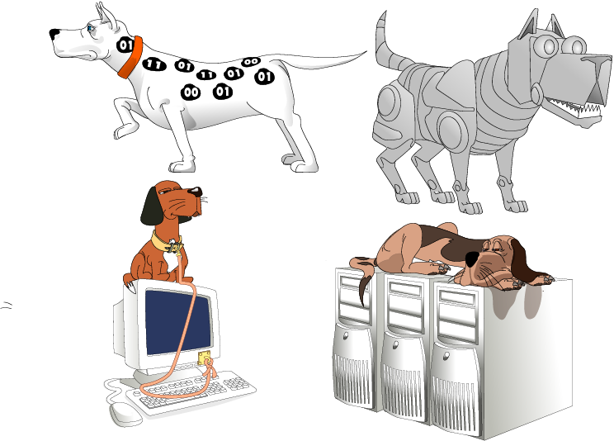
Types of IDS
Signature-based
Anomaly-based
Host-based
Network-based

Slide 19
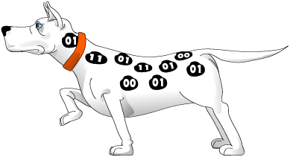
Signature-based IDS
Characteristics
  Uses known pattern matching
  to signify attack
Advantages?
  Widely available
  Fairly fast
  Easy to implement
  Easy to update
Disadvantages?
  Cannot detect attacks for which it has no signature

Slide 20

Anomaly-based IDS
Characteristics
  Uses statistical model or machine learning engine to characterize normal usage behaviors
  Recognizes departures from normal as potential intrusions
Advantages?
  Can detect attempts to exploit new and unforeseen vulnerabilities
  Can recognize authorized usage that falls outside the normal pattern
Disadvantages?
  Generally slower, more resource intensive compared to signature-based IDS
  Greater complexity, difficult to configure
  Higher percentages of false alerts

Slide 21

Network-based IDS
Characteristics
  NIDS examine raw packets in the network passively and triggers alerts
Advantages?
  Easy deployment
  Unobtrusive
  Difficult to evade if done at low level of network operation
Disadvantages?
  Fail Open
  Different hosts process packets differently
  NIDS needs to create traffic seen at the end host
  Need to have the complete network topology and complete host behavior

Slide 22
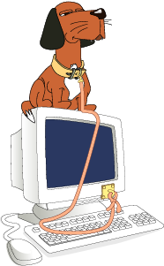
Host-based IDS
Characteristics
  Runs on single host
  Can analyze audit-trails, logs, integrity of files and directories, etc.
Advantages
  More accurate than NIDS
  Less volume of traffic so less overhead
Disadvantages
  Deployment is expensive
  What happens when host get compromised?

