Slide 1
Standard Security Protocols
Going up the stack:
TLS, IPsec, Kerberos and all that

Slide 2
Next hour...
Yawning
Why standards?
Standards Development Organisations (aka alphabet soup)
Couple of examples
When to standardise?

Slide 3
Why?
Generic reasons:
  Multi-Vendor Interoperability
  “Open”-ness
Security Reasons
  Remember: Crypto => Interop is hard!
  Review: Many (non-security) standards decrease security
NB: Not everything needs to be standardised!

Slide 4
A Possibly New Why?
Human Rights Protocol Considerations Research Group
  https://irtf.org/hrpc
“Rethinking Privacy Online and Human Rights: The Internet’s Standardisation Bodies as the Guardians of Privacy Online in the Face of Mass Surveillance”
  Adamantia Rachovitsa, Conference Paper No.5/2016 2016 ESIL Research Forum, Istanbul, 21-22 April 2016 (see materials page for copy and link to original)

Slide 5
Why?
Generic reasons:
  Multi-Vendor Interoperability
  “Open”-ness
Security Reasons
  Remember: Crypto => Interop is hard!
  Review: Many (non-security) standards decrease security
NB: Not everything needs to be standardised!

Slide 6
Why?
Generic reasons:
  Multi-Vendor Interoperability
  “Open”-ness
Security Reasons
  Remember: Crypto => Interop is hard!
  Review: Many (non-security) standards decrease security
NB: Not everything needs to be standardised!

Slide 7
Relevant Types of Organisation
International organisations
  e.g.: UN/ITU, ISO
"Open" Internet Standards Development Organisations
  e.g.: IEEE, IETF, W3C
Commercial Enterprise Driven SDOs
  e.g.: OASIS, FIDO Alliance
Company-specific pet projects
  e.g.: FB Free basics
Open-source projects
  e.g.: Apache
Open-source commercial alliances
  e.g.: OpenStack
Operational entities:
  e.g. ICANN, RIPE, ARIN,...
Topic specific alliances
  e.g. M3AAWG

Slide 8
Types of standards
All SDOs have difference categories of standard
  RFC1149; http://www.blug.linux.no/rfc1149
  Draft versions may be published or not, long-lived or not, rubbish or not
Almost all interesting standards are openly available - some for a fee!
But note: All SDOs have some business model, even the best ones:-)

Slide 9
ISO/ITU-T
National bodies are members (NIST, Enterprise-Ireland)
https://www.iso.org https://www.itu.int
Security stuff:
  Child online protection (ITU?)
  Cryptographic mechanisms (ISO)
  Even more X.509 (PKI stuff ITU-T)
  Various ITU telephony specs
    Some inheriting from/profiling IETF

Slide 10
Internet Engineering Task Force (IETF)
No members: a group of individuals developing the Internet
https://www.ietf.org https://www.irtf.org
Security:
  About 1-2 dozen of about 100 working groups usually doing interesting security stuff
Best of a bad lot really! (But I would say that:-)

Slide 11
World-Wide-Web Consortium (W3C)
Membership organisation ($5-50k per annum) plus strong “team” plus invited experts
https://www.w3.org
Some interesting old security groups
  XML Sig, Enc, XKMS
Currently:
  WebCrypto, WebAppSec, WebRTC
  Focus more on browser APIs and not protocols

Slide 12
IEEE Standards Association
Individual memberships but meeting attendance counts
https://www.ieee.org/
Security:
  IEEE 802 – various security things, WPA etc.
  New privacy study group looking at MAC address randomisation

Slide 13
OASIS
Membership organisation ($5-10k per annum)
https://www.oasis-open.org/
Vendor driven
“Cyber threat intelligence” (CTI)
Lots of oldish security groups:
  SAML, XrML, XACML, WSS, DSS

Slide 14
Others
Trusted Computing Group https://www.trustedcomputinggroup.org/
Bluetooth https://www.bluetooth.com/
3GPP http://www.3gpp.org/
GSMA http://www.gsma.org/
ANSI https://www.ansi.org
ETSI https://www.etsi.org
Open Mobile Alliance http://www.oma.org

Slide 15
“Good" examples
Really good: RFC822/2822/5322 – Mail message format
Middling: RFC3185 “Re-use of CMS Content Encryption Keys”
    (Ahem!) Co-author present :-)
    Length: 10pp (-crud=3pp)
    Duration: ~18 months
    Purpose: Fix a problem for RADIUS/Diameter
    BUT: Zero implementations

Slide 16
“Bad” examples
Many to choose from
IETF: IKE
IEEE: WEP (or is it?)

Slide 17

WEP Encapsulation
802.11 Hdr
Data
Encapsulate
Decapsulate
802.11 Hdr
IV
Data
ICV
WEP Encapsulation Summary:
Encryption Algorithm = RC4
Per-packet encryption key = 24-bit IV concatenated to a pre-shared key
WEP allows IV to be reused with any frame
Data integrity provided by CRC-32 of the plaintext data (the “ICV”)
Data and ICV are encrypted under the per-packet encryption key

Slide 18
Properties of Vernam Ciphers (1)
The WEP encryption algorithm RC4 is a Vernam Cipher:
Pseudo-random number generator
Encryption Key K
Random byte b
Plaintext data byte p
Ciphertext data byte p
⊕
Decryption works the same way: p = c ⊕ b

Slide 19
Properties of Vernam Ciphers (2)
Thought experiment 1: what happens when p₁ and p'₂ are encrypted under the same “random” byte b?
c'_{1'} = p'₁ ⊕ b
c₂ = p₂ ⊕ b
Then:
c'₁ ⊕ c₂ = (p'₁ ⊕ b) ⊕ (p₂ ⊕ b) = p'₁ ⊕ p₂
Conclusion: it is a very bad idea to encrypt any two bytes of data using the same byte output by a Vernam Cipher PRNG.
Ever.

Slide 20
How to Read WEP Encrypted Traffic (1)
802.11 Hdr
IV
Data
ICV
24 luxurious bits
Encrypted under Key +IV using a Vernam Cipher
By the Birthday Paradox, probability P_{n} two packets will share same IV after n packets is P₂ = 1/2²⁴ after two frames and P_{n} = P_{n–1} + (n–1)(1–P_{n–1})/ 2²⁴ for n > 2.
50% chance of a collision exists already after only 4823 packets!!!
Pattern recognition can disentangle the XOR’d recovered plaintext.
Recovered ICV can tell you when you’ve disentangled plaintext correctly.
After only a few hours of observation, you can recover all 2²⁴ key streams.

Slide 21
How to Read WEP Encrypted Traffic (2)
Ways to accelerate the process:
  Send spam into the network: no pattern recognition required!
  Get the victim to send e-mail to you
    The AP creates the plaintext for you!
  Decrypt packets from one Station to another via an Access Point
    If you know the plaintext on one leg of the journey, you can recover the key stream immediately on the other
  Etc., etc., etc.

Slide 22
When to standardise
When many vendor's products have to talk a protocol
  HTTP, SMTP,... (many, many examples)
When one vendor has to use another vendor's API
  WebRTC, PKCS#11
When serious review is required
  Routing changes like RED, AES alg.

Slide 23
When not to...
When you just want your name in “lights”
When your clever algorithm is the tenth way to do the job
When your scheme is patented
  Or secretly about to be patented!
When no-one cares
See RFC 6417 for guidance for researchers

Slide 24
Questions
Question: How many cryptographic algorithms should we standardise and when?
Question: WEP was broken when deployed, and then fixed. Same is true of SSL/TLS. Was that better or worse than IPsec/IKE which took 10 years to develop?

Slide 25
Standard Security Structures and Protocols
PKI, S/MIME, SSL, Kerberos, IPsec and all that jazz

Slide 26
Materials
Lots of RFCs
https://datatracker.ietf.org/wg/
Bleichenbacher/"Avoiding the million-message”

Slide 27
Next hour(s)...
PKI model and protocols
SMIME formats and secure email
SSL/TLS protocol
IPsec
Kerberos
Knowing one of these
in detail is enough for
exam purposes

Slide 28
Public Key Infrastructure (PKI)
Key management is a scaling problem
Possible to push “trust” (bad term!) up to a certification authority (CA)
“Trust” here is: CA is responsible for binding information about an entity (esp. Name) with a public key
  Anyone who trusts that CA for that purpose can then check that entity's signature or encrypt to it

Slide 29
PKI History
Original public key concept involved publishing public keys in a newspaper
Computing equivalent suggested in early 1980's
First standard was X.509 in 1988
IETF X.509 profile is in RFC 5280
Used by TLS, S/MIME and lots of other protocols

Slide 30
X.509-based PKI Problems
Everyone sensible hates this stuff
  It's really old, gnarly & horrible
Every now and then someone suggests replacing it with <foo>
  So far, no <foo> has been sufficiently better to displace X.509 based PKI (sadly)
Maybe in 5-10 years it'll be less important, but for now we have to suffer with it.

Slide 31
Certificates (1)
Certificate ::= SEQUENCE {
tbsCertificate TBSCertificate,
signatureAlgorithm AlgorithmIdentifier,
signatureValue BIT STRING }
Who knows what ASN.1 is?
  An abstract syntax notation
  With tag, length value encoding schemes (BER, DER, PER)
    SEQUENCE -> 0x30, INTEGER -> 0x02
  PITA

Slide 32
Certificates (2)
TBSCertificate ::= SEQUENCE {
version [0] EXPLICIT Version DEFAULT v1,
serialNumber CertificateSerialNumber,
signature AlgorithmIdentifier,
issuer Name,
validity Validity,
subject Name,
subjectPublicKeyInfo SubjectPublicKeyInfo,
issuerUniqueID [1]IMPLICIT UniqueIdentifier OPTIONAL,
subjectUniqueID[2]IMPLICIT UniqueIdentifier OPTIONAL,
-- If present, version MUST be v2 or v3
extensions [3] EXPLICIT Extensions OPTIONAL
-- If present, version MUST be v3
}

Slide 33
Certificate Revocation Lists
  A black-list of "bad" certificate serial numbers (plus list- and entry-extensions)
  Periodically issued by a CA
  Revocation = putting on black-list
  Also via on-line certificate status protocol (OCSP)
  Reasons to revoke: Key compromise, Key loss, Change of function, Uninstall web server...

Slide 34
To check a certificate
Start with a (set of) trusted CAs
Progress down certification path:
  Is next-signature ok with previous public?
  Is certifcate revoked?
  Continue
Missing lots (see rfc5280)
  E.g. Policy mappings (yuk!)

Slide 35
PKI Entities
+---+
| C | +------------+
| e | <-------------------->| End entity |
| r | Operational +------------+
| t | transactions ^
| i | and management | Management
| f | transactions | transactions PKI
| i | | users
| c | v
| a | ======================= +--+------------+ ==============
| t | ^ ^
| e | | | PKI
| | v | management
| & | +------+ | entities
| | <---------------------| RA |<----+ |
| C | Publish certificate +------+ | |
| R | | |
| L | | |
| | v v
| R | +------------+
| e | <------------------------------| CA |
| p | Publish certificate +------------+
| o | Publish CRL ^ ^
| s | | | Management
| i | +------------+ | | transactions
| t | <--------------| CRL Issuer |<----+ |
| o | Publish CRL +------------+ v
| r | +------+
| y | | CA |
+---+ +------+

Slide 36
PKI Protocols
  You need some to operate a PKI
  Registration: PKCS#10, proprietary, CMP, CMC, EST and now ACME
  Certificate retrieval: LDAP, DAP, HTTP, FTP, DPD
  Certificate validation: OCSP, DPV, CRL processing
  XKMS was a W3C attempt to do similar things
    Deployment didn't happen

Slide 37
Roots/Trust Points
Applications using PKI need to have a set of root CA public keys they “trust”
Browsers have those – each with O(100) CAs in the list
In/ex-clusion is highly political
  https://cabforum.org/ is a venue for some of that politics
Other applications and OSes handle this similarly

Slide 38
Some good news though...
https://letsencrypt.org/ operating a free CA
  Public beta since Dec 2015
ACME protocol for automated certificate management
  JSON based
  https://tools.ietf.org/wg/acme/
We'll see if it works this time;-)

Slide 39
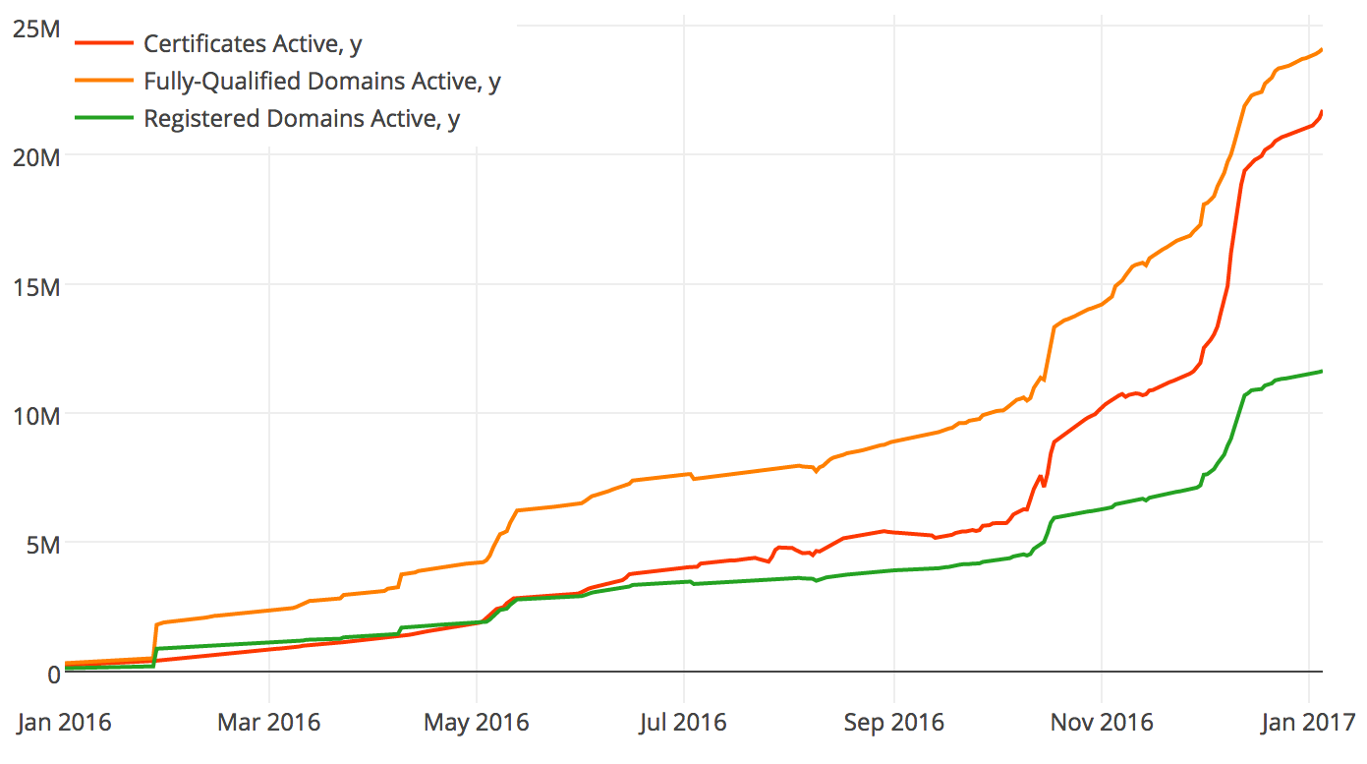
Some good news though...

Slide 40
Certificate Transparency (CT)
There have been cases where CA’s have been hacked or misbehave (later)
CT is an attempt to improve the WebPKI (underlying https)
  RFC6962 → https://tools.ietf.org/wg/trans/
Idea: append-only public logs of all certificates issued to allow detection of mis-issuance
  https://crt.sh/

Slide 41
Attribute certificates
Kind of a PKI-wart
Certificate-like thing which has attributes instead of a subjectPublicKey
Treat as experimental if you ever hear about them
Can be used for role-based access control etc.

Slide 42
PKI Summary
Mix of mature and new technology
  Plenty of products/services and significant deployment experience
Deployment and application integration problems exist
  Can be overcome but expensive
Still technology-of-choice for scalable key management
Improvement is possible: e.g. ACME/CT

Slide 43
S/MIME
There's a history here too!
  PGP, PEM and MOSS
  RSADSI's PKCS#7 based proposal
  DKIM is a yet another development in this space
Cryptographic Message Syntax (CMS) is the basis for S/MIME and other secure applications
So S/MIME = CMS + Message-Specification + Certificate-specification

Slide 44
CMS
How to MAC, sign and/or encrypt data in an ASN.1 oriented way
  E.g. CMS defines:
    SignedData
    EnvelopedData
  XML and JSON equivalents started from here
Algorithms and options like in PKI
Latest CMS specification: RFC 5652

Slide 45
PKCS#1 v1.5 Padding
RSA modulus: n=pq of length k bytes;
i.e. 256 ** (k-1)₁< n < 256 ** k_{k}
most significant byte
least significant byte
00
02
Padding string
00
message
at least 8 bytes
k bytes

Slide 46
CMS SignedData (1)
SignedData ::= SEQUENCE {
version CMSVersion,
digestAlgorithms DigestAlgorithmIdentifiers,
encapContentInfo EncapsulatedContentInfo,
certificates [0] IMPLICIT CertificateSet
OPTIONAL,
crls [1] IMPLICIT CertificateRevocationLists
OPTIONAL,
signerInfos SignerInfos }

Slide 47
CMS SignedData (2)
SignerInfo ::= SEQUENCE {
version CMSVersion,
sid SignerIdentifier,
digestAlgorithm DigestAlgorithmIdentifier,
signedAttrs [0] IMPLICIT SignedAttributes OPTIONAL,
signatureAlgorithm SignatureAlgorithmIdentifier,
signature SignatureValue,
unsignedAttrs [1] IMPLICIT UnsignedAttributes OPTIONAL }
SignerIdentifier ::= CHOICE {
issuerAndSerialNumber IssuerAndSerialNumber,
subjectKeyIdentifier [0] SubjectKeyIdentifier }
SignedAttributes ::= SET SIZE (1..MAX) OF Attribute
UnsignedAttributes ::= SET SIZE (1..MAX) OF Attribute
Attribute ::= SEQUENCE {
attrType OBJECT IDENTIFIER,
attrValues SET OF AttributeValue }
AttributeValue ::= ANY
SignatureValue ::= OCTET STRING

Slide 48
CMS Message Specification
Latest specification is RFC 5751
Tells you how to:
  Start with a MIME message
  Treat that as like plaintext the CMS way
  Then take the resulting bytes and make them into a MIME message
Note: LARGE messages exist
  Have to handle BER as well as DER

Slide 49
CMS Certificate Specification
Latest specification is rfc5750
Tells you how to interface an s/mime mail user agent with a PKI
Tells you how to interpret PKIX RFCs for secure mail purposes
  E.g. How to include email addresses in certificates
Model to be followed

Slide 50
CMS Deployment
Most MUAs suport s/mime either built-in or as an option
  There are also “plug-in” products
And mostly then can work together
But secure mail is not ubiquitous
  Why?

Slide 51
e2e email security barriers
Designs pre-date web user agent which changes trust model (where's the private key kept? Needs new infrastructure)
Needs all major email service providers (yahoo, hotmail, gmail) to deploy the same thing which also needs to be implemented by all major user agent developers (microsoft, mozilla, apple, google)
Public key retrieval needs to be fixed (doable if the above done, but a killer if not done), likely with some new PKI (doable but who's gonna pay?)
Mail headers need to be protected as users don't get that S/MIME and PGP only protect body and not e.g. Subject, From (new enveloping protocol needed, can be done but kludgy)
We need to unify S/MIME and PGP or pick one or we'll lose interop (it's ok if the other soldiers on for some niches)
Users don't care much, so it has to be entirely transparent for them (needs significant UI work, co-ordinated across MUAs and significant web-UAs)

Slide 52
Transport Layer Security (TLS)
Secure Sockets Layer (SSL): General Purpose Network Security Protocol proposed by Netscape in 1994.
Designed to work with any application that uses sockets to communicate e.g., ftp, http, nntp, telnet...
  Platform independent, application independent negotiations
SSL standardised as Transport Layer Security (TLS)
  Latest is TLS1.2: RFC 5246
  Oddly: RFC6101 is SSL3.0!

Slide 53
TLS - services provided
Server Authentication - Buyer can believe they are dealing with a bona fide merchant
  (Optional) Client authentication
  Digital certificates (X.509)
Message Encryption - Buyer can send credit card details across the network without fear of interception
  Also message integrity and freshness
Relatively transparent to the user and application developer

Slide 54
Components of the TLS Protocol
TLS broken into 4 interrelated sub-protocols
Application
Application
Secure Socket Layer
Alert
Handshake
Alert
Handshake
Dialogs
A_Data
Change
A_Data
Change
Cipher
Cipher
Normal TCP/IP Socket
Normal TCP/IP Socket

Slide 55
The Handshake Protocol
Negotiate Compression Method and Cipher Suite
Swap random quantities
Client obtains server certificate path
Client invents PreMasterSecret (48 bytes) and securely sends it to the server
Keys Calculated by both
Finished message using new algorithms
Data send in A_Data Units
Client
Server
Client_Hello[Client_Random, SessionID,
CipherSuites, CompressionMethods]
Server_Hello[Server_Random, SessionID,
CipherSuites, CompressionMethod]
Certificate[Server_Cert]
Server_Hello_Done[]
Client_Key_Exchange[{PreMasterSecret}PKserver]
Change_Cipher_Spec[]
Finished[]
Change_Cipher_Spec[]
Finished[]
Application_Data[*]

Slide 56
Handshake Protocol
summary
client
server
ClientHello
ServerHello
Certificate*
CertificateRequest*
ServerKeyExchange*
Certificate*
ClientKeyExchange
CertificateVerify*
change cipher spec
Finished
change cipher spec
Finished
Application Data
Application Data
* Indicates optional or situation dependent messages that are not always sent

Slide 57
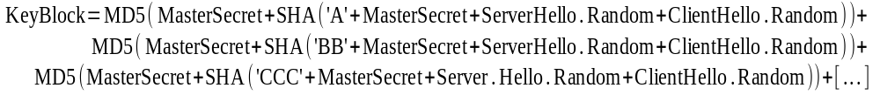
Computing the Keys from the Pre-MasterSecret
First compute MasterSecret
MasterSecret = f(PreMasterSecret, Client.Random, Server.Random)
MasterSecret Used to prime key-generator
KeyBlock = f(MasterSecret, Client.Random, Server.Random)
Client_MAC_Secret
Partition key-stream
into individual
quantities
Server_MAC_Secret
Client_Key
KeyBlock
Server_Key
Client_Stream_Key
Server_Stream_Key

Slide 58
Applying the Keys to Application Data (Record Layer)
Fragment of User Data
Divide stream into blocks
<= 2₁₄ Bytes
Compress
Compressed Fragment
PAD
Compute MAC
Compressed Fragment
MAC
PAD
Length
Block Cipher (with padding) or Stream Cipher
Application Data Ind.
Protocol Version
Payload Length
Encrypted Payload

Slide 59
Ciphersuites
SSL/TLS supports various cryptographic options
  Digest algorithms, key transport, ...
Design decision was to represent all choices made in a single value
  Ciphersuite – a 16 bit number
  TLS_RSA_WITH_3DES_EDE_CBC_SHA
Interesting consequences...

Slide 60
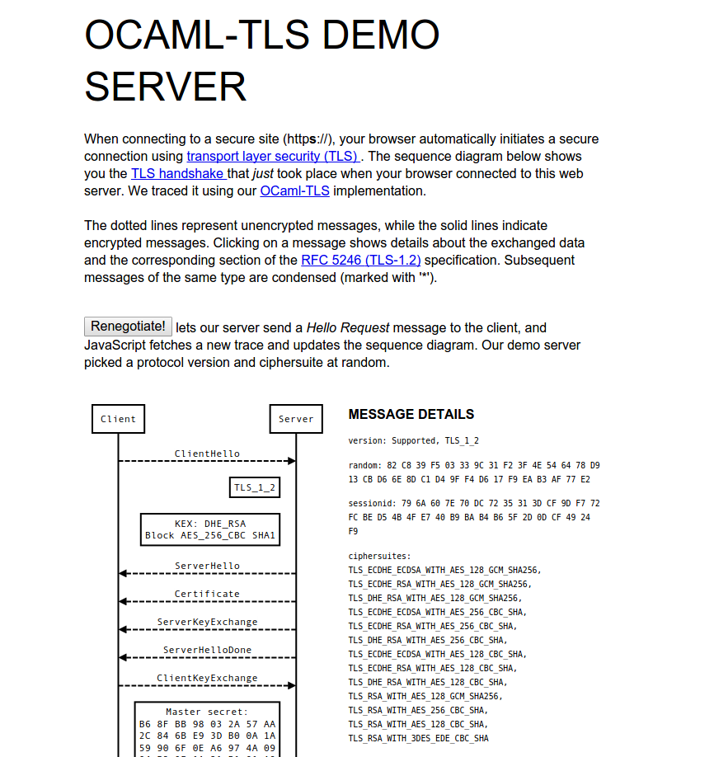
A TLS Handshake Visualisation
https://tls.openmirage.org/
Shows the messages you exchange with that server and references bits of text from RFC 5246.
If you allow JS, you can click
the arrows.
Nice!
2017 update: site sadly seems a
bit broken now

Slide 61
Bleichenbacher
“Materials” section has a full paper & ppt
  If you completely understand the attack, you're doing very well!
Basis
  PKCS#1 v1.5 padding adds formatting to the data
  If I have an “oracle” that'll attempt decryption and tell me when the recovered plaintext has the PKCS#1 v1.5 padding then I gain knowledge
This happened with TLS!
  “Million message” attack

Slide 62

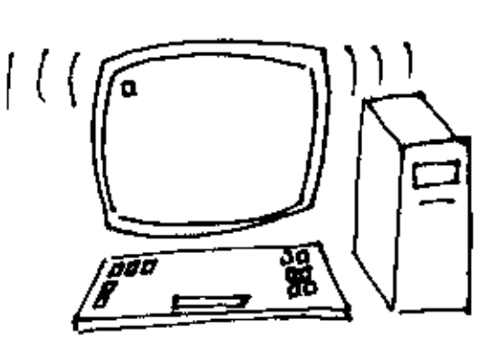
How the attack works: Overview
Eve
d
Bob
M=C ??
e
C =CS (mod n)
i
i
R
If a message C is PKCS conforming then
I
2*256**(k-2)_{k-2}-1 < MS < 3*256**(k-2)₋₂
This is an adaptive chosen-ciphertext attack
RFC3218 describes the attack and ways to avoid it.

Slide 63
Deployment of TLS
Mid '90's: Used in Netscape Commerce Server
  International “Step-up” encryption: Strong crypto for international banks, with special Verisign certificate
  Built into Communicator 4.0 and later
Now: Basically everywhere, Standard part of Web browsers, servers and development platofrms (PHP, python etc.)
  secure online trading, banking, commerce...
Certificates being issued by a variety of Trusted Third Parties (TTP)
  VeriSign, Cybertrust/Baltimore OMNIRoot

Slide 64
Recent TLS Developments
TLS WG no longer in maintenance mode as work on TLS 1.3 nearing completion (more on that later)
Datagram TLS (DTLS) for use with connectionless applications (e.g. RTP) is RFC 6347

Slide 65
TLS: Oh Crap!
TLS allows for re-negotiation and resuming sessions
Resume: re-use pre-master secret for speed
Re-negotiate: change ciphersuite
  Move from “export” -> “strong” crypto
  Move from anonymous -> client-authenticated
    1st anon session protects client identity

Slide 66
TLS Re-nego Bug
RFC 5746 (Feb 2010) fixes a problem found in August '09 and published in Nov '09
  “emergency” fix
Problem: lack of binding between TLS sessions before/after re-nego
Client Attacker Server
------ ------- ------
<----------- Handshake ---------->
<======= Initial Traffic ========>
<-------------------------- Handshake ============================>
<======================== Client Traffic ==========================>

Slide 67
Recent(ish) TLS-relevant Stuff
IETF dane WG: http://tools.ietf.org/wg/dane
  TLSA RR: hashes of keys in DNS (4 options)
  Requires DNSSEC
  Provide additional assurance that the right key is being used for TLS, or avoids use of CAs
IETF websec WG:
  Key-pinning in HTTP (HPKP): RFC 7469
  Strict Transport Security (HSTS): RFC 6797
OSCP Stapling (RFCs 6066, 6961)

Slide 68
IP Security (Ipsec)
Took sooooo looooong and produced such a complex outome that they have a 2011 document roadmap (rfc6071).
Start with rfc 4301, the security architecture
Main moving parts: AH (RFC 4302), ESP (RFC 4303), and IKEv2 (RFC 5996)
    AH mostly deprecated
    IKE -> IKEv2 due to IKE/ISAKMP/... complexity, do NOT bother with IKEv1
So, we'll only look at ESP & IKEv2

Slide 69
Ipsec overview
“Security Architecture” rfc4301
  Key exchange, data encryption and data integrity mechanisms at the IP layer
Optional as part of an IPv4 stack
  Mandatory to implement as part of IPv6 stacks
Tunnel/Transport modes
  VPNs using tunnel mode common
Security policy DB
  How to handle (un)protected packets

Slide 70
ESP – Encapsulated Security Payload
0 1 2 3
0 1 2 3 4 5 6 7 8 9 0 1 2 3 4 5 6 7 8 9 0 1 2 3 4 5 6 7 8 9 0 1
+-+-+-+-+-+-+-+-+-+-+-+-+-+-+-+-+-+-+-+-+-+-+-+-+-+-+-+-+-+-+-+-+ ----
| Security Parameters Index (SPI) | ^Auth.
+-+-+-+-+-+-+-+-+-+-+-+-+-+-+-+-+-+-+-+-+-+-+-+-+-+-+-+-+-+-+-+-+ |Cov-
| Sequence Number | |erage
+-+-+-+-+-+-+-+-+-+-+-+-+-+-+-+-+-+-+-+-+-+-+-+-+-+-+-+-+-+-+-+-+ | ----
| Payload Data* (variable) | | ^
~ ~ | |
| | |Conf.
+ +-+-+-+-+-+-+-+-+-+-+-+-+-+-+-+-+-+-+-+-+-+-+-+-+ |Cov-
| | Padding (0-255 bytes) | |erage*
+-+-+-+-+-+-+-+-+ +-+-+-+-+-+-+-+-+-+-+-+-+-+-+-+-+ | |
| | Pad Length | Next Header | v v
+-+-+-+-+-+-+-+-+-+-+-+-+-+-+-+-+-+-+-+-+-+-+-+-+-+-+-+-+-+-+-+-+ ------
| Authentication Data (variable) |
~ ~
| |
+-+-+-+-+-+-+-+-+-+-+-+-+-+-+-+-+-+-+-+-+-+-+-+-+-+-+-+-+-+-+-+-+

Slide 71
ESP terms
Specification: rfc4303
SPI selects amongst different
  Algorithms; Keys; etc.
  SPI (+ dest. IP) = Security Association (SA)
Seq# for anti-replay
  Never cycles (new SA needed)
Next header specifies payload protocol
SA's are directional
  So we use different keys between Alice and Bob as compared to between Bob and Alice

Slide 72
ESP – some features
ESP allows some basic level of traffic hiding
  Padding (up to 255 bytes) to disguise data length
  Tunnel mode between gateways
Data expansion
  About +19 bytes per packet, possibly worse
  Can be serious (telnet)

Slide 73
IKE - Internet Key Exchange
IKEv1 (rfc2409) is a mess of:
  ISAKMP (rfc2408)
  OAKLEY (rfc2412) and SKEME (not an rfc)
  DOI (rfc2407)
IKEv2 (RFC 7296) is a single document that's much better
  But is 142 pages long;-(
Wasn't that simple!

Slide 74
IKEv2 (1)
Provides protocol
  Mutually authenticate
  Exchange keys
Based on:
  D-H and
  Pre-shared secrets or RSA

Slide 75
IKEv2 (2)
Establishes an IKE-SA and one (or more) CHILD-SA
Generally requires 4 or 6 messages
  IKE_SA_INIT (req/rep)
  IKE_AUTH (req/rep)
  CREATE_CHILD_SA (req/rep)

Slide 76
IKEv2 Phase1
IKE_SA_INIT & IKE_AUTH
Initiator Responder
----------- ---------
HDR, SAi1, KEi, Ni -->
<-- HDR, SAr1, KEr, Nr, [CERTREQ]
HDR, SK {IDi, [CERT,] [CERTREQ,] [IDr,] AUTH, SAi2, TSi, TSr} -->
<-- HDR, SK {IDr, [CERT,] AUTH,
SAr2, TSi, TSr}

Slide 77
IKEv2 Phase2
CREATE_CHILD_SA
Initiator Responder
----------- ---------
HDR, SK {SA, Ni,[Kei],[TSi,Tsr]} -->
<-- HDR, SK {SA, Nr,[Ker],[Tsi, TSr]}

Slide 78
Some IKEv2 Features
Not IKEv1!
Uses ESP to protect things
Misc:
  PFS, NAT-capable, Traffic Selectors, Liveness checks, Cookies
Still a bit clunky though!
  E.g. Compression (rfc2393), ESP and then AH nested SAs

Slide 79
IPsec summary
Tunnel mode widely used for VPNs and works just fine
  Transport mode hardly used at all
IKE interop today isn't perfect (with certs), but is ok
  Some vendor-specific stuff, e.g. For RADIUS/legacy auth
Deployment issues:
  Windows, NAT, Firewall, ECN, Opportunistic Keying, APIs
  IKEv2 work aims to address a bunch (but not all!) of these

Slide 80
Kerberos
Originally developed as part of MIT project athena
  RFC4120 (but RFC1510 may be easier)
Designed for many users working with few(-ish) servers
  Largely symmetric key (shared secret) based
Based around clients interacting with a Key Distribution Centre (KDC) aka:
  Authentication server (AS)
  Ticket Granting Server (TGS)

Slide 81
Kerberos
Uses ASN.1 again! (sort-of)
Latest spec: RFC 4120
Typical use:
  Client sends AS_REQ to KDC gets AS_REP containing TGT
  Client sends TGS_REQ to KDC (includes TGT) and gets TGS_REP (including Ticket)
  Client sends KRB_SAFE to server including Ticket

Slide 82
A Ticket
Ticket ::= [APPLICATION 1] SEQUENCE {
tkt-vno [0] INTEGER (5),
realm [1] Realm,
sname [2] PrincipalName,
enc-part [3] EncryptedData -- EncTicketPart }
-- Encrypted part of ticket
EncTicketPart ::= [APPLICATION 3] SEQUENCE {
flags [0] TicketFlags,
key [1] EncryptionKey,
crealm [2] Realm,
cname [3] PrincipalName,
transited [4] TransitedEncoding,
authtime [5] KerberosTime,
starttime [6] KerberosTime OPTIONAL,
endtime [7] KerberosTime,
renew-till [8] KerberosTime OPTIONAL,
caddr [9] HostAddresses OPTIONAL,
authorization-data [10]
AuthorizationData OPTIONAL }

Slide 83
Kerberos Things to Note
Loose clock sync. Required
Kerberos realm is like but not the same as a DNS domain
Inter-realm and public key based operation defined but not used that often
Used in Windows NT security and later (KDC is part of ActiveDirectory)
Various authorization data extension have been done over the years
AS_REQ can contain dictionary attackable password or something better (usually the former;-()

Slide 84
Mix'n'match
PKI vs. Shared-secret vs. Trusted public keys
TLS vs IPsec vs S/MIME vs CMS
When should you pick which?

