Slide 1
CS7NS5/CSU44032
Security & privacy
Stephen Farrell
stephen.farrell@cs.tcd.ie
(still in the spare room;-)
Course materials:
https://down.dsg.cs.tcd.ie/cs7053/
https://github.com/sftcd/cs7053
Slideware + some papers
Notes:
Who I am!
Who are you?

Slide 2
Course Outline
Introduction
Security and privacy concepts
(Enough) cryptography (AES, RSA, ...)
(To grok) core security standards (DNS, TLS,…)
  ...and where those are headed
Stuff that's interesting for the last few weeks (liable to change)
  Centralisation
  Maybe COVID tracking apps?

Slide 3
Computer and Network Security is...
...a good thing to study (“one born every minute”, and some of those are programmers!)‏
...something with more and more impact (scaling factor is about the same as the Internet)‏
...a part of risk management

Slide 4
Privacy is...
...nowhere near as well understood
...an issue for people and not companies‏
...not clearly a part of risk management, but related
  I’m unsure if risk analysis is a good approach to address privacy

Slide 5
Risk Management
Risks (bad things)‏
  Disclosure of trade secrets
  Sabotage (information or hardware)‏
  Denial of service
  Accidents (fire, flooding, earth quakes, …)‏
Solutions (not always good things)‏
  Security policies and mechanisms
  Physical security (locks, guards, CCTV, …)‏
  Formal specification/verification of software
  Halon, UPS, off-site backups

Slide 6
Vulnerabilities
Many risks arise due to the existence of vulnerabilities in computer systems
All systems have vulnerabilities, our goal is not to remove absolutely all of them, but to control their impact
  Reducing numbers is good
  Can also isolate parts of the system (e.g. Firewalling)‏

Slide 7
Vulnerabilities
Most common:
  Scripting user agents
  Buffer overruns
  XSS & Injection (e.g. SQL injection)
  Insecure default settings
Uncommon, but interesting:
  Acoustic side-channel key extraction,
    Genkin, Shamir & Tromer
  https://eprint.iacr.org/2013/857.pdf

Slide 8
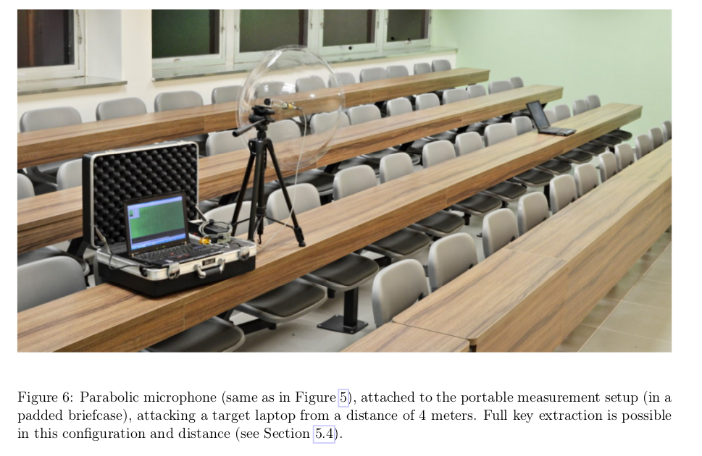
Sssshhhh....

Slide 9
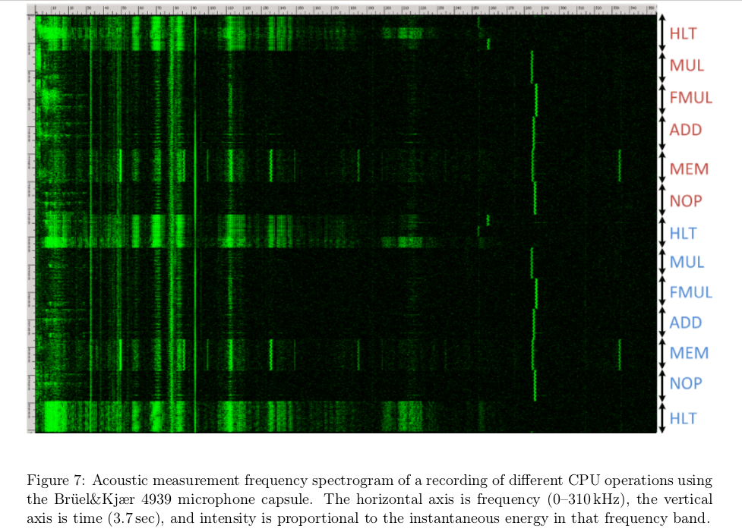

Slide 10
Good/Bad Actors
Systems have users
  Normal, administrative, “root”
Networks have nodes
  “Inside”, “outside”, trusted...
Attackers
  Can be one of the above, or not...
  Hijacked ISP router, compromised SIM card factory, bot etc.

Slide 11
Possible Bad Actors
Disgruntled employees (plenty)‏
Crackers (hackers)‏
Script-Kiddies (cracker wannabes)‏
Spies (industrial and military)‏
Criminals (thieves, organized crime)‏
Terrorists
Governments
Bait’n’switchers

Slide 12
Possible Exploits
Force legitimate user to reveal passwords
Social engineering
Recruit legitimate user
Sabotage (fire, electricity, …)‏
Sifting through garbage
Attacking the network (network threats)
Install malware‏

Slide 13
Active/Passive Attacks
Active attacks
  Fabrication, modification, deletion, replay of messages
Passive attacks
  eavesdropping/traffic analysis
  can be off-line (e.g. weak encryption)‏
Different protocol mechanisms are used to counter these

Slide 14
Summing up risk
Risk is a function of the cost of threats and their probability of occurrence
  Which function can be debated
  High/Medium/Low
    For both costs and probabilities
Threats occur when a vulnerability is exploited

Slide 15
Privacy
Less well understood than security
Who cares? About what?
  Governments, marketers and large corporates do “care deeply” about your (lack of) privacy
How to protect that?
  Encrypt things in transit and storage
  Short-lived dynamic identifiers are better than long-lived static identifiers
  Just don't (require) identification

Slide 16
Other terms not yet mentioned
Snowdonia/pervasive monitoring
Usable Security
Trusted computing
Digital rights management

Slide 17
A cyber-warning
With few exceptions people who say cyber-blah have little or no clue
  Or feel forced to succumb to “the market”
Cyber-foo is a marketing term for almost all foo
  Avoid using it
  When you hear it, be suspicious

Slide 18
Risk Analysis Process
Many variations exist, mostly they resemble:
  Identify assets
  Identify risks and vulnerabilities
  Consider probabilities
  Consider consequent costs/losses
  Rank risks
  Develop mitigation(s) for highest ranked risk(s)
  Iterate, until effort exhausted or time up
    All the time recording what you’ve done

