Slide 1
Security & Privacy
Stephen Farrell
stephen.farrell@cs.tcd.ie
Course materials:
https://down.dsg.cs.tcd.ie/cs7053/
https://github.com/sftcd/cs7053
Slideware + some papers
Notes:
Who I am!
Who are you?

Slide 2
Computer Security Concepts
Introduction of some basic concepts and terminology in computer security

Slide 3
Next hour(s)...
A bit more history...
Application layer security
Security evaluation
Network security
Identification & Authentication

Slide 4
Computer Security Goals
Traditional Security Goals: "CIA"
  Confidentiality
    Keeping secrets
  Integrity
    Preventing unauthorised modifications
    Keeping data consistent
  Authentication/Assurance/Availability
    The meaning of the “A” depends upon who you ask!

Slide 5
Services and mechanisms
From the old “OSI” world, we've inherited two (sometimes confusing) concepts:
  Security service: provides a security function to the system, based on the use of security mechanisms, e.g. confidentiality
  Security mechanism is a technique, or protocol etc. which can be used to provide a service, e.g. encryption, access control

Slide 6
Services/Mechanisms
Confidentiality
    Access control
    Cryptography
    Secure communication channels
Integrity
    Checksums
    Digital signatures
    Secure communication channels
Availability
    Designing secure software and communication protocols
    Load balancing
    Anti-DDoS services

Slide 7
Structure of Military Security
Information is classified according to national security
The classification is clearly labeled on the binder
All classified information is stored in a safe
All users are “cleared” to see information up to a certain level
Users have to prove their clearance to withdraw the binder from the safe
Additional compartments enforce the need-to-know principle

Slide 8
Creating New Information
New files are labelled with the classification of the most secret component
Aggregation of unclassified information may generate a “top secret” file
Sanitization downgrades the label of existing information

Slide 9
Effects of Automation
Simplifies copying, editing, distribution and reading of documents
Active tools are used in above tasks
  Trojan horses
  Trapdoors
  Leaking information
Labeling information is difficult (no stamp)‏

Slide 10
Old Problems Aggravated
Aggregation
  it is easier to aggregate information from a vast set of information
Authentication
  it is more difficult for a computer to identify a person (partly solved)‏
Browsing
  it is easier to read all files in a file system than all files in a safe
Integrity
  modification is harder to detect (mostly solved)‏
Copying
  digital copies are indistinguishable from the originals (really there are no originals at all!)‏
Denial of Service
  denial of service is a notorious characteristic of computer systems

Slide 11
Multilevel Secure Systems
The “Holy Grail” in military security
Separate users with different clearance levels on the same computer system
Access control is mandatory (policy is defined and enforced by the system) as opposed to discretionary (policy is defined by the user)‏
Disclosure of information is guaranteed through confinement

Slide 12
Confinement
Isolate the running process with the minimal set of access rights needed to complete its task (principle of least privilege)‏
Control all communication channels:
  Storage Channels
    communication through persistent storage
  Legitimate Communication Channels
    message passing, RPC, RMI, …
    Cut'n'paste
  Covert Channels

Slide 13
Covert Channels
Hidden means of communication, that allows information to be leaked to third parties
Some types:
  Timing Channels
    observable differences in system utilization
  Inference Channels
    intersection of non-classified information
  Fabrication Channels
    aggregation of non-classified information

Slide 14
Security Perimeters
users, remote workstations, the Internet
subjects
System Boundary
user programs
Security Perimeter
servers
Operating System
services
Trusted Computing Base
objects
Reference Monitor

Slide 15
Attack Surface
Intuition: more possible ways in which attacks can be attempted => more likely an attack may succeed
  Listener on a port, Callable API, Command line arguments,...
Think of the potential attack points as if they formed a geometric construct: the attack surface
  Smaller attack surface == better! (probably)
  Useful relative metric as you evolve a system
  Argues (to an extent) against over-generic tools/re-use (e.g. CMS for web sites perhaps)
Dec 2018 survey paper (paywall):
  https://doi.org/10.1016/j.infsof.2018.07.008
OWASP guidance:
  https://www.owasp.org/index.php/Attack_Surface_Analysis_Cheat_Sheet
Michael Howard concept from 2003:
  https://docs.microsoft.com/en-us/previous-versions/ms972812(v=msdn.10)

Slide 16
Sidebar: Operating Systems
Won't cover OSes or virtualisation much as issues are very system dependent
  UNIXes, incl. GNU/Linux, OpenWRT, Apple iOS/OS X, Android, flavours of busybox, Windows, Cisco IOS, JunOS,...
Basic idea is to isolate processes (users are represented as processes) and privileges
Cross-boundary vulns have most impact
Local privilege escalation attacks: meh
Remote code execution (RCE) or break out of VM/browser sandbox: BIG deal!
Recent work on side-channels (spectre/meltdown etc.) tells us speed and security trade-offs have been mismanaged in many environments for many years

Slide 17
Commercial Security
Historically the military paid more for security, were more accepting of the inconvenience (which almost all security mechanisms introduce), and had a chain-of-command upon which to fall back
Co-operating commercial enterprises have none of these

Slide 18
The 1988 Internet worm
Propagated (mainly) via SMTP
  using the DEBUG build of sendmail (then the prevalent mail server)‏
  Also exploited fingerd problems
It killed the Internet for a whole day!
Spafford: “The Internet worm program: An analysis” well worth a read
  https://down.dsg.cs.tcd.ie/cs7053/materials/spafford88internet.pdf

Slide 19
Typical Enterprise Security Model (circa 1995)‏
System and network administrators setup and manage users and applications
DCE exemplifies this approach
  http://www.opengroup.org/dce/
    Interesting that URL still works
  Kerberos (RFC4120) – still persists as part of MSFT windows and a few other systems

Slide 20
Problems with the 1990’s enterprise security model
Generally assumed a homogeneous network and set of applications
  Which was false
Assumption that all users and applications are centrally managed
Deployment showed up performance and usability issues

Slide 21
Security APIs
Periodically someone tries to develop an API to “hide” security
Has worked fine for cryptographic primitives
  MS-CAPI, PKCS#11, JCE
  Javascript WebCrypto API
Not so successful for higher layer functions
  GSS-API, SPKM

Slide 22
Sidebar: Crypto makes interop hard
It is much easier to get a system to work in “insecure” mode, compared to “secure” mode
  And much, much easier if secure mode involves cryptography
This is a general problem which leads many people to turn off security
Answer: develop with the crypto turned on
Bear it in mind as you design things

Slide 23
Along came the web
The number of connected hosts rose exponentially for a while
Highlights security issues with:
  Proxies (various bad things can happen at a proxy)‏
  Tunnelling (“protocol-X” over HTTP)‏
  Having a ubiquitous tunnel end-point on many machines
  Browser security models

Slide 24
Security Evaluation and Network security
Customers need some confidence that the system or network that they are about to purchase is “secure”.

Slide 25
Security Evaluation Criteria
[TCSEC] Department of Defence Trusted Computer Systems Evaluation Criteria (Orange Book)
  https://csrc.nist.gov/publications/secpubs/rainbow/ OOPS! Jan 2019 US Govt. Shutdown ;-
[ITSEC] IT Security (UK, NL, FR, DE)
https://www.bsi.bund.de/SharedDocs/Downloads/DE/BSI/Zertifizierung/ITSicherheitskriterien/itsec-en_pdf.pdf?__blob=publicationFile
[Others] CTCPEC (Canada) JCSEC (Japan)‏[CC]
[CC] Common Criteria (ISO IS 15408)‏
  https://www.commoncriteriaportal.org/files/ccfiles/CCPART1V3.1R5.pdf

Slide 26
Security Evaluation
How do we compare the security of different computer systems?
  Different authentication mechanisms
    Kerberos, passwords, smart cards, …
  Different access control mechanisms
    Access Control Lists, Role-Based Access Control, …
  Different cryptographic algorithms
    DES, AES, RSA, ECC, D-H, Curve25519…

Slide 27
“Orange Book” Classification
Class
Title
Key Features
A1
Verified Design
Formal top-level specification and verification, formal covert channel analysis, informal code correspondence demonstration
B3
Security Domains
Reference monitor (security kernel), “highly resistant to penetration
B2
Structured Protection
Formal model, covert channels constrained, security oriented architecture, “relatively resistant to penetration”
B1
Labeled Security Protection
Mandatory access controls, security labeling, removal of security related flaws
C2
Controlled Access Protection
Individual accountability (authentication) and extensive auditing
C1
Discretionary Security Protection
Discretionary access controls, protection against accidents among cooperating users
D
Minimal Protection
Not Classified

Slide 28
ITSEC
Separation of functionality and assurance
Functionality-classes (F-C1 – F-B3) corresponds to the Orange Book
Assurance-classes (E0 – E6)
  E0: lowest, E6 highest
  E4: commonest (maybe)‏
Target of Evaluation
  Set of evaluated components: security policy, security related functions, definition of the required security mechanisms for the target level of evaluation

Slide 29
Common Criteria
Combines previous criteria
  Separation of functionality and assurance
  Target of Evaluation (TOE)‏
  Security Target (ST) = desired level of evaluation
Protection Profiles (PP)‏
  Security Requirements
  Security objectives
  Independent of Implementation

Slide 30
Other aspects of assurance
Installation and use must be considered
  What are the defined security policies?
  How is the software installed?
  How are the machines administered?
Development tools & environments
  SNMP exploit due to buggy 3rd party ASN.1 handling library

Slide 31
Assurance != "Works-as-advertised”
Assurance only shows that the product/system matches a specification
  NOT that it does what the customer wants!
The product owner pays the evaluator (lots!!)‏
  so although the evaluator is Goverment licensed, they have reasons to be nice to the developer.
Caveat emptor rules ok.

Slide 32
Network security
Different from application layer security
  Usually no real interest in APIs here
  Normally trying to secure either a (sub)network, or network node from network based attacks
  Frequently network nodes don't use standard operating systems
    E.g. Cisco routers, 802.11 access points

Slide 33
Network Security
First, read about networks, you need to have some level of understanding of IP (both), DNS, TCP, BGP, HTTP and how e.g. Javascript/PHP works on the web
  Go find your own URLs:-) Or a book.
Then, general network security:
  https://www.sans.org/ training stuff etc.
  https://isc.sans.edu/ “Internet Weather”
  https://first.org/library/ more reading
  https://www.owasp.org/ web security

Slide 34
Learn about your network(s)...
Browser developer UI to see HTTP/JS
  network/JS/console: “shift-ctrl-I” or similar
Wireshark/tshark/tcpdump to see packets
  Wireshark dissectors for many protocols, e.g. DNS, TLS
Protocol capture (PCAP) files
  Careful of privacy – PCAPs can be revealing and are hard to anonymise
  Please tell me if you know of good up-to-date PCAP anonymisation tools!
If this is new to you - do play with these – you’ll learn stuff!

Slide 35
Network security view
Original Internet “architecture” assumed end-to-end connectivity
Hence end-to-end security was the main consideration for those developing the Internet
  But they were very slow developing IPsec (about 10 years!)‏
  And meanwhile NAT and firewalls arrived

Slide 36
The End-to-End Argument
Saltzer, Jerome H., David P. Reed, and David D. Clark. "End-to-end arguments in system design." ACM Transactions on Computer Systems (TOCS) 2.4 (1984): 277-288.
https://dl.acm.org/citation.cfm?id=357402
READ THAT!!!
And then RFCs 1958 & 3439
And RFC 7258 (why not:-)
  caution, author present

Slide 37
E2E Argument has current consequences...
HTTP/2 and QUIC are protocols that attempt to have e2e encryption as a mandatory mechanism (ish) not in order to achieve a confidentiality service but primarily to mitigate ossification
Some, but not all, of those who know what’s going on are happy with that
FWIW, (which is not much) I am happy with that.

Slide 38
Network Address Translation (NAT)‏
NAT is today mainly used to hide local addresses from the Internet for (mostly) provisioning reasons
  NAT means that the higher layer end-points “see” different addresses for one another
  Breaks many end-to-end assumptions
“Carrier Grade” NAT (CGN) is coming to an ISP near you soon (or has already)

Slide 39
CGN & Security
Many more endpoints behind each public IPv4 address; put a NAT box in the ISP network
  NAT444
  There are other, maybe better, IPv6 transition mechanisms
  Some think this is an IPv6 avoidance mechanism
Good way to freak out “legal intercept” (LI) fans
  LI+CGN: Good way to freak out ISPs who have to log
Good way to freak out anyone who wants to offer a public service
  PITA for DNSSEC
Bad way to get to an IPv6 world?
  But may be needed for some time

Slide 40
NAT problems with SIP
UserA NAT NS UserB
10.1.1.221 192.168.221.1 63.88.221.88 192168.1.10
| | | |
|----F1 INVITE---->|--F2 INVITE->| |
| | |--F5 INVITE->|
|<---F4 100--------|<-F3 100-----| |
| | | |
| | |<--F6 180----|
|<---F8 180--------|<-F7 180-----| |
| | | |
| | |<--F9 200 OK-|
|<---F11 200 OK----|<-F10 200 OK-| |
| | | |
|----F12 ACK------>|---F13 ACK---| |
| | |--F14 ACK--->|
| | | |
|<---F15 2WAY RTP->|<-------F16 2WAY RTP------>|
| | | |
|----F17 BYE------>|-F18 BYE---->| |
| | |--F19 BYE--->|
| | | |
| | |<-F20 200 OK-|
|<---F22 200 OK----|<-F21 200 OK-| |
| | | |

Slide 41
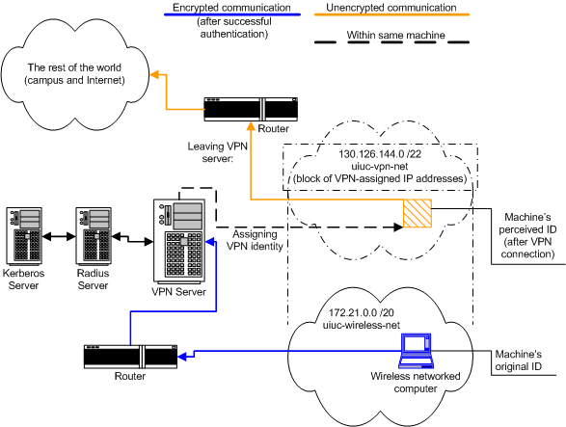
Virtual private networks (VPNs)‏
Diagram from https://www.cites.illinois.edu/vpn/vpnnetdiagram.html (go there for a detailed explanation)‏

Slide 42
Firewalls
Until the mid-90's most sites didn't bother filtering traffic
It became clear that exposing your internal network topology could cause problems
  E.g. If I know that router brand “X” has an open default configuration and I can see that you've got one of those, then my attack point is clear

Slide 43
Filtering routers
Initially people put in filtering rules in border routers
  E.g. “no packets with a destination on my inner network are allowed out”
But, IP spoofing attacks meant that this wasn't sufficient
  So firewall products developed
  Note: has been biggest security products market, I've not checked recently

Slide 44
Denial-of-Service (DoS)
Consume resources to make a service unavailable
  Has been known as a vulnerability for many years
  Began to be exploited in last decade on major Internet sites
    DDoS attacks against the DNS roots
DDoS = Distributed Denial of Service

Slide 45
TCP SYN flooding attack
SYN packets with spoofed IP addresses cause the server to maintain state
Flooding the server that way is your basic DoS attack
  CERT Advisory CA-96.21
https://mailman.apnic.net/mailing-lists/apple/archive/1996/09/msg00131.html
Client Server
------ ------
SYN-------------------->
<--------------------SYN-ACK
ACK-------------------->

Slide 46
Network access protocols
Issue is how to decide when to allow a node to join/use the network
  IEEE 802.1x networks (eduroam)
  Corporate networks
  Mobile operator networks
RADIUS protocol (or Diameter)
  RFC2865 (or RFC6733)

Slide 47
Search Engines
...to find vulnerable systems
Shodan HQ https://www.shodan.io/
  Est. 2013 - search for “camera”
Censys https://censys.io/
  Mainly IPv4 based surveying (zmap)
Ichidan ichidanv34wrx7m7.onion
  Didn’t work for me
There are more I guess...

Slide 48
Tor
Onion routing https://www.torproject.org/
Tor Browser (TBB) https://www.torproject.org/projects/torbrowser.html.en
Tor Hidden services: “<hash>.onion” DNS-like names
Search engine: https://ahmia.fi/
Be a bit careful though!

Slide 49
My browser setup
TBB: If searching for something sensitive (e.g. medical info)
Search default: DuckDuckGo (Where “!g” works too:-)
Default browser: FF + NoScript/Ghostery & disallowing cookies, with some white-listed sites
Some sites don’t work with the above; mostly: screw ‘em
If-need-be: chromium/incognito with a chmod of $HOME/.config/chromium to make almost all read-only (but not sure of effectiveness)
If-all-else-fails: Brave or Vivaldi
On phone: sailfish browser with no JS/no cookies and 2ndary open-kimono browsers if-need-be (Webcat/Web pirate)
Recommend you figure out some browser-hygiene you prefer and implement that – be willing to help others do the same!

Slide 50
Identification and Authentication
Establishing identity and
verifying credentials

Slide 51
Identification
Establish the identity of principals by means of:
  something known (password, PIN)
  something possessed (smart card, Java ring)
  something personal (fingerprint, retina scan)
  something to do (signature)
Combinations of above (smart card + PIN)

Slide 52
Passwords
Most systems rely exclusively on passwords
login: username
password: ********
Password scheme problems:
  users choose “bad” passwords (password, secret)
  compromised via sniffing
Good passwords won't be in a dictionary
There are better password protocols
  but first we need some more crypto

Slide 53
2008 Count of some of my passwords
Category | Count | Known | Examples
Logins | 10 | 6 | Laptops, host systems (incl. root accounts)
Devices | 5 | 0 | DSL router, home print/file servers, sensor nodes
Network access | 4 | 0 | Work n/w, WLAN, ISP, etc
Protocol | 14 | 1 | Outbound HTTP proxy, IMAP, Jabber, skype, etc.
Service | 21 | 4 | Mainly web sites with password stored outside browser
PINs | 7 | 4 | Bank cards, door access codes...
Total | 61 | 15

Slide 54
Kerberos Authentication
Project Athena at MIT (mid to late 1980s)
Hundreds of diskless workstations
  open terminal access, no physical security
  insecure network
Few servers (files, print, mail, …)
  physically secure

Slide 55
Simple Authentication
A password per service is infeasible
New authentication service (AS) introduced
Both users and services have passwords
AS identifies user by password
AS/TGS issues a “ticket” to the user
  ticket includes identity encrypted with the service’s password
  if the ticket decrypts properly, access to the service is granted
  TGS = ticket granting service

Slide 56
Insecure Workstations
What happens to tickets after a user has logged out?
  an opponent could log on to the workstation and use the tickets
  could be explicitly destroyed when user logs out
  sniffer could be used to capture tickets, hacker may then login to the same workstation and use the tickets (replay session)

Slide 57
Biometrics
Many people (apparently) think that replacing username & password with a biometric is a great idea.
It might be:
  If secure biometrics exist
  If the re-use implications are acceptable
  If the context supports the full life-cycle

Slide 58
Biometric methods
Fingerprint
Retina scan
Face recognition
Gait (walking)
Toe-smell

Slide 59
Fingerprint
Prof. Tsutomu Matsumota's well publicisied 2002 attack against most common fingerprint recognition engines
  https://cryptome.org/gummy.htm
  Information here is directly from his paper: “Impact of Artificial "Gummy" Fingers on Fingerprint Systems”

Slide 60
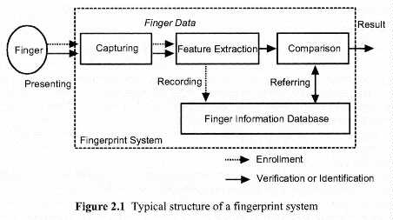
Fingerprint scanner

Slide 61
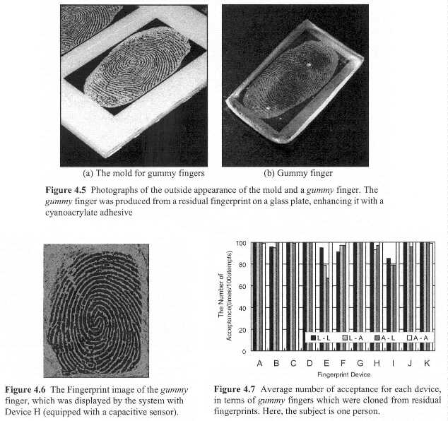
Make a gummy finger

Slide 62
Results
11 of 11 scanners tested were broken
  The list was extended a bit more since
That's enough of a result!

Slide 63
But there’s more! ...
CCC 2017: 55 minute video of breaking biometrics
https://www.youtube.com/watch?annotation_id=annotation_2684251971&feature=iv&src_vid=pIY6k4gvQsY&v=VVxL9ymiyAU
Fiebig, Tobias, Jan Krissler, and Ronny Hänsch. "Security Impact of High Resolution Smartphone Cameras." WOOT. 2014.
https://www.usenix.org/system/files/conference/woot14/woot14-fiebig.pdf

Slide 64
When are biometrics ok?
What applications?
  What type(s) of biometric?
  What benefits?
  What costs?
    Financial and other (e.g. Privacy)

Slide 65
Privacy
Rad RFC6973 - In addition to “normal” security threats we need to care about
  Correllation
  Identification
  Secondary use
  Disclosure
  Exclusion
  Re-identification
Actually, it's not entirely clear to me that the risk analysis methodology we follow for security works well for privacy
  There's scope for research there

Slide 66
Privacy Puzzle
Emails contain a Received header field which can contain the mail user agent IP address
  What consequences?
  Overall good or bad from a privacy perspective?

Slide 67
What is your #1 mitigation for all problems?

Slide 68
What is your #1 mitigation for all problems?
Yes, Backup.
Do that. Early and often.

Slide 69
Summary
Services vs. Mechanisms, CIA
~30 year history
Common Criteria
N/W security a bit different from system security
Firewalls etc.
Passwords (yuk)
Biometrics (also yuk)
Privacy (yay!)
Do backups

