Slide 1
Standard Security Protocols
Going up the stack:
PKI, DNS, TLS, IPsec and all that

Slide 2
Next hour(s)...
PKI model and protocols
SMIME formats and (a bit on) email
TLS protocol (TLS1.2 or TLS1.3)
IPsec
Kerberos
SSH
Wireguard
MLS
Knowing one of these
in detail is enough for
exam purposes – you
will need to read the
source materials

Slide 3
First bit...
Yawning :-)
Why standards?
Standards Development Organisations (aka alphabet soup)
Couple of examples
When to standardise?

Slide 4
Why standardise?
Generic reasons:
  Multi-Vendor Interoperability
  “Open”-ness
Security Reasons
  Remember: Crypto => Interop is hard!
  Review: Many (non-security) standards decrease security
NB: Not everything needs to be standardised!

Slide 5
A Possibly New Why?
Human Rights Protocol Considerations Research Group
  https://irtf.org/hrpc
“Rethinking Privacy Online and Human Rights: The Internet’s Standardisation Bodies as the Guardians of Privacy Online in the Face of Mass Surveillance”
  Adamantia Rachovitsa, Conference Paper No.5/2016 2016 ESIL Research Forum, Istanbul, 21-22 April 2016 (see materials page for copy and link to original)

Slide 6
Standards Devlopment Organisations (SDOs) and related
International organisations
  UN/ITU, ISO
"Open" Internet Standards Development Organisations
  IEEE, IETF, W3C
Commercial Enterprise Driven SDOs
  OASIS, FIDO Alliance
Company-specific pet projects
  FB Free basics/internet.org
Open-source projects
  Apache, WHATWG, OpenSSL, ...
Open-source commercial alliances
  OpenStack
Operational entities:
  ICANN, RIPE, ARIN,...
Topic specific alliances
  M3AAWG, Lora alliance, ...

Slide 7
Types of standards
SDOs produce different categories of output, not all standards, e.g. RFC1149
  Draft versions may be published or not, long-lived or not, rubbish or not
Almost all interesting standards in this space are openly available - some for a fee!
But note: All SDOs have some business model, even the best/most-open ones

Slide 8
ISO/ITU-T
National bodies are members (NIST, Enterprise-Ireland)
  https://www.iso.org
  https://www.itu.int
Security stuff:
  Child online protection (ITU?)
  Cryptographic mechanisms (ISO)
  Even more X.509 (PKI stuff ITU-T, mostly useless/irritating)
  Various ITU telephony specs
    Some inheriting from/profiling IETF

Slide 9
Internet Engineering Task Force (IETF)
No members: (in theory) a group of individuals developing the Internet
https://www.ietf.org https://www.irtf.org
Security:
  About 1-2 dozen of about 100 working groups usually doing interesting security stuff
Best of a bad lot really!
  But I would say that having been involved with this lot for >25 years;-)

Slide 10
World-Wide-Web Consortium (W3C)
Membership organisation ($5-50k per annum) plus “team” plus invited experts
https://www.w3.org
Some interesting old security groups
  XML Sig, Enc, XKMS
Currently:
  WebRTC
  Focus more on browser APIs and not protocols
  Privacy Interest group being more activehttps://www.w3.org/blog/2022/01/privacy-interest-group-ping-2021-year-in-review-and-thank-yous/
See also: WHATWG https://whatwg.org/

Slide 11
IEEE Standards Association
Individual memberships but meeting attendance counts
https://www.ieee.org/
Security:
  IEEE 802 – various security things, WPA etc.
  MAC address randomisation,
  MACsec (layer 2 crypto)

Slide 12
Examples of “standards”
Really good: RFC822/2822/5322 – Mail message format
Middling: RFC3185 “Re-use of CMS Content Encryption Keys”
    (Ahem!) Co-author present :-)
    Length: 10pp (-crud=3pp)
    Duration: ~18 months
    Purpose: Fix a problem for RADIUS/Diameter
    BUT: Zero implementations

Slide 13
“Bad” examples
Many to choose from
IETF: IKEv1 (see later)
IEEE: WEP (or was it?)
  https://www.ieee802.org/11/Documents/DocumentArchives/1994_docs/1194249_scan.pdfversion 1.0 November 1994

Slide 14

WEP Encapsulation
802.11 Hdr
Data
Encapsulate
Decapsulate
802.11 Hdr
IV
Data
ICV
WEP Encapsulation Summary:
Encryption Algorithm = RC4
Per-packet encryption key = 24-bit IV concatenated to a pre-shared key
WEP allows IV to be reused with any frame
Data integrity provided by CRC-32 of the plaintext data (the “ICV”)
Data and ICV are encrypted under the per-packet encryption key

Slide 15
Properties of Vernam Ciphers (1)
The WEP encryption algorithm RC4 is a Vernam Cipher:
Pseudo-random number generator
Encryption Key K
Random byte b
Plaintext data byte p
Ciphertext data byte c
⊕
Decryption works the same way: p = c ⊕ b

Slide 16
Properties of Vernam Ciphers (2)
Thought experiment 1: what happens when p₁ and p'₂ are encrypted under the same “random” byte b?
c'_{1'} = p'₁ ⊕ b
c₂ = p₂ ⊕ b
Then:
c'₁ ⊕ c₂ = (p'₁ ⊕ b) ⊕ (p₂ ⊕ b) = p'₁ ⊕ p₂
Conclusion: it is a very bad idea to encrypt any two bytes of data using the same byte output by a Vernam Cipher PRNG.
Ever.

Slide 17
How to Read WEP Encrypted Traffic (1)
802.11 Hdr
IV
Data
ICV
24 luxurious bits
Encrypted under Key +IV using a Vernam Cipher
By the Birthday Paradox, probability P_{n} two packets will share same IV after n packets is P₂ = 1/2²⁴ after two frames and
P_{n} = P_{n–1} + (n–1)(1–P_{n–1})/ 2²⁴ for n > 2.
50% chance of a collision exists already after only 4823 packets!!!
Pattern recognition can disentangle the XOR’d recovered plaintext.
Recovered ICV can tell you when you’ve disentangled plaintext correctly.
After only a few hours of observation, you can recover all 2²⁴ key streams.

Slide 18
How to Read WEP Encrypted Traffic (2)
Accelerate the process!
Send spam into the network: no pattern recognition required!
Get the victim to send e-mail to you
  The AP creates the plaintext for you!
Decrypt packets from one Station to another via an Access Point
  If you know the plaintext on one leg of the journey, you can recover the key stream immediately on the other
Etc., etc., etc.

Slide 19
Question
WEP was broken after being deployed, and then fixed. Same is true of SSL which became TLS.
Was that better or worse than IPsec/IKE that took 10 years to develop?

Slide 20
When to standardise
When many implementer’s codebases have to talk a protocol
  HTTP, SMTP,... (many, many examples)
When one implementer has to use another vendor's API
  WebRTC, PKCS#11
When serious review is required
  Routing (BGP) or TCP changes like RED, AQM
  Crypto algs, e.g. AES, PQ algs

Slide 21
When not to...
When you just want your name in “lights”
When your clever algorithm is the tenth way to do the job
When your scheme is patented
  Or secretly about to be patented!
When no-one cares
See RFC 6417 for guidance for researchers

Slide 22
More on when not to...
If you’re an open-source team and don’t have the cycles to engage with all the axe-grinders who’ll get involved when you engage in a really open process (and they will) – e.g. Tor
If you claim that implementation agility and speed is more important than multi-implementer interop - e.g. Signal, maybe wireguard

Slide 23
Standard Security Structures and Protocols
PKI, S/MIME, SSL, Kerberos, IPsec, SSH, Wireguard
Basically, things that do automated key management and secure application data transport

Slide 24
Materials
Lots of RFCs
https://datatracker.ietf.org/wg/
Bleichenbacher/"Avoiding the million-message attack” RFC 3218
  Good one for those who want to read ahead...

Slide 25
Next hour(s)...
PKI model and protocols
SMIME formats and (a bit on) email
TLS protocol (TLS1.2 or TLS1.3)
IPsec
Kerberos
SSH
Wireguard
MLS
Knowing one of these
in detail is enough for
exam purposes – you
will need to read the
source materials

Slide 26
Public Key Infrastructure (PKI)

Slide 27
Public Key Infrastructure (PKI)
Key management is a scaling problem
Possible to push “trust” (bad term!) up to a certification authority (CA)
“Trust” here is: CA is responsible for binding information about an entity (esp. names) with a public key
  Anyone who trusts that CA for that purpose can then check that entity's signature or encrypt to it

Slide 28
PKI History
Original concept: publishing public keys in newspapers
Electronic equivalent suggested in 1978 undergrad work:
  Kohnfelder, ”Toward a practical public key cryptosystem,” Bachelors Thesis, MIT Dept. of Electrical Engineering, May 1978
  https://dspace.mit.edu/handle/1721.1/15993
First standard was X.509 in 1988
IETF X.509 profile is in RFC 5280 from 2008, used by TLS, S/MIME and lots of other protocols

Slide 29
X.509-based PKI Problems
Everyone sensible has disliked X.509 since about the late 1990’s
  It's old, gnarly & horrible
Every now and then someone suggests replacing it with <foo>
  Sadly, so far, no <foo> has been sufficiently better to displace X.509 based PKI
Maybe in 5-10 years it'll be less important, but for now we have to suffer

Slide 30
Certificates (1)
Certificate ::= SEQUENCE {
tbsCertificate TBSCertificate,
signatureAlgorithm AlgorithmIdentifier,
signatureValue BIT STRING }
Who knows what ASN.1 is?
  An Abstract Syntax Notation
  With tag, length value encoding schemes (BER, DER, PER)
    SEQUENCE -> 0x30, INTEGER -> 0x02
  PITA, as are all marshalling schemes in the end

Slide 31
Certificates (2)
TBSCertificate ::= SEQUENCE {
version [0] EXPLICIT Version DEFAULT v1,
serialNumber CertificateSerialNumber,
signature AlgorithmIdentifier,
issuer Name,
validity Validity,
subject Name,
subjectPublicKeyInfo SubjectPublicKeyInfo,
issuerUniqueID [1]IMPLICIT UniqueIdentifier OPTIONAL,
subjectUniqueID[2]IMPLICIT UniqueIdentifier OPTIONAL,
-- If present, version MUST be v2 or v3
extensions [3] EXPLICIT Extensions OPTIONAL
-- If present, version MUST be v3
}

Slide 32
Certificate Revocation Lists
  A list of "bad" certificate serial numbers (plus list- and entry-extensions)
  Periodically issued by a CA
  Revocation = putting on block-list
  Revocation information can also be fetched via on-line certificate status protocol (OCSP)
  OCSP-responses can be stapled
  Reasons to revoke: Key compromise, Key loss, Change of function, Uninstall web server...

Slide 33
To check a certificate
Start with a (set of) locally trusted CA public keys
Progress down certification path:
  Is next-signature ok with previous public?
  Is certifcate revoked?
  Continue
Missing lots (see rfc5280)
  E.g. Policy mappings (yuk), but do ignore those!

Slide 34
PKI Entities
+---+
| C | +------------+
| e | <-------------------->| End entity |
| r | Operational +------------+
| t | transactions ^
| i | and management | Management
| f | transactions | transactions PKI
| i | | users
| c | v
| a | ======================= +--+------------+ ==============
| t | ^ ^
| e | | | PKI
| | v | management
| & | +------+ | entities
| | <---------------------| RA |<----+ |
| C | Publish certificate +------+ | |
| R | | |
| L | | |
| | v v
| R | +------------+
| e | <------------------------------| CA |
| p | Publish certificate +------------+
| o | Publish CRL ^ ^
| s | | | Management
| i | +------------+ | | transactions
| t | <--------------| CRL Issuer |<----+ |
| o | Publish CRL +------------+ v
| r | +------+
| y | | CA |
+---+ +------+

Slide 35
PKI Protocols
  Registration & renewal: PKCS#10, proprietary, CMP, CMC, EST and now ACME
    CMP (RFC 4210) still used by 3gpp, and for trains!
  Certificate retrieval: in-band, LDAP, DAP, HTTP, FTP, DPD
  Certificate status checking: OCSP, DPV, CRL processing, and now (maybe) application specifics like CRLite
    https://blog.mozilla.org/security/2020/01/21/crlite-part-3-speeding-up-secure-browsing/
    Browsers perhaps only caring about CA and popular-domain revocations these days, not sure
  Certificate Transparency (CT) for logging certificate issuance has been a success

Slide 36
Roots/Trust Points
Applications using PKI need to have a local set of (root) CA public keys they “trust”
Browsers and OSes have those – each with hundreds of CA organisations in the list
In/ex-clusion is highly political
  https://cabforum.org/ is a venue for some of that
  Mozilla operate a public discussion list (other tend to be less public) https://groups.google.com/a/mozilla.org/g/dev-security-policy
The WebPKI is a special case today – biggest and most important PKI but quite a few others do exist
  Other applications and OSes handle things similarly, often with some overlap with WebPKI

Slide 37
Some good news though...
https://letsencrypt.org/ operating a free CA since Dec 2015
ACME protocol for automated certificate management
  JSON based
  RFC 8555

Slide 38
ACME protocol
Automated Certificate Management Environment (ACME) is an HTTP-based protocol for managing certificates
  Works with LE and other CAs for acquiring Domain Validated (DV) certificates
Quite a few client implementations:
  certbot, ACME.sh, …
Typically: command line registration then (~weekly) cron job for renewal

Slide 39
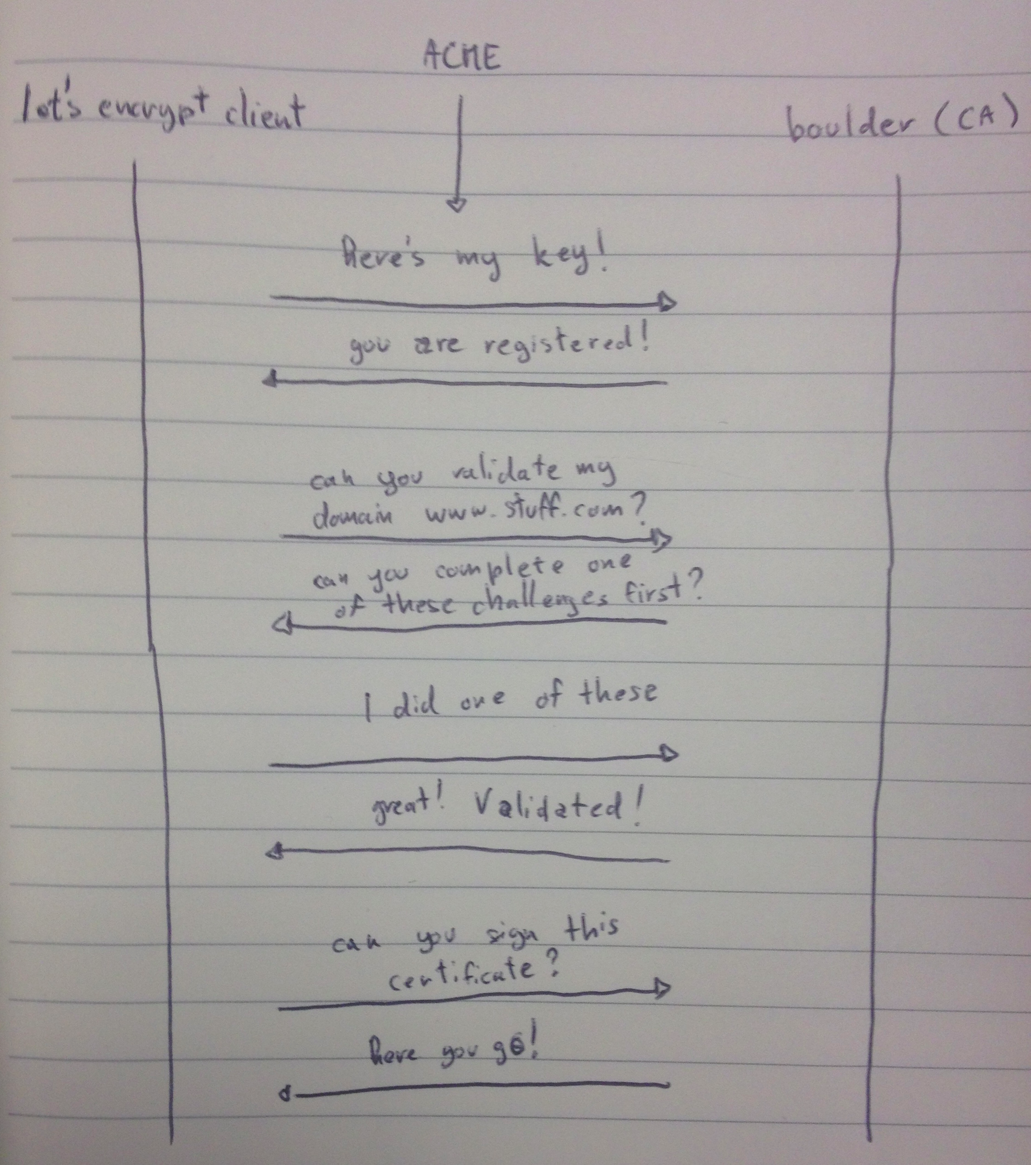
ACME protocol
https://cryptologie.net/article/274/lets-encrypt-overview/

Slide 40
ACME protocol
ACME challenges:
  Evidence for domain validation
  There’s a history of these turning out tricky in some deployment scenarios
Challenge types:
  http-01: random content at e.g. “/.well-known/acme-challenges/abcdef0123456”
  dns-01: As above but in DNS
  tls-sni-01/02: deprecated! Demonstrate ability to use random TLS SNI value

Slide 41
Certificate Transparency (CT)
There have been cases where CA’s have been hacked or misbehave (more later)
CT improves the WebPKI
  CT specified in (non-standard) RFC 6962 in 2013
  Standardisation process hugely sloooow…. Version 2.0 is defined in RFC 9162 (2021)
  I suspect everyone may stick with RFC 6962
Idea: append-only public logs of all certificates issued to allow detection of mis-issuance (not prevention, detection!)
Nice (if not quite reliable) search UI: https://crt.sh/
  Reminder to self: pop up this URL and show stuff: https://crt.sh/?q=tcd.ie

Slide 42
Attribute certificates
RFC5755 - Certificate-like thing with generic attributes (e.g. group membership) and no subjectPublicKey
Treat as experimental if you ever hear about them
Can be used for role-based access control etc.
BUT… when these seem useful there’s almost always a better way!

Slide 43
PQ certificates
New PQ algs will require public keys in certificates, which is fine (e.g. Dilithium, Kyber public keys)
Some people are proposing ways to embed two public keys in one certificate to support use of hybrid protocols
  That could end up a disaster, but we’ll see
A bunch of documents are visible at: https://datatracker.ietf.org/wg/lamps/documents/

Slide 44
X.509-based PKI Summary
Mix of mature and new(ish) technology
  Plenty of open-source, products and services and significant deployment experience
Deployment and application integration problems will always exist
  Can be overcome but expensive
Still technology-of-choice for scalable public key management
Improvement is possible: e.g. ACME/CT
Might be affected by post-quantum crypto
  Or, hopefully PQC will tip us into finally moving to something better

Slide 45
The Domain Name System (DNS)

Slide 46
Domain Name System (DNS)
Internet Assigned Numbers Authority (IANA, https://iana.org/) keeps lists of “top level domain names” (TLDS, e.g. .com, .ie), IP address allocations and protocol numbering registrations
  That’s a fantastic bit of bookkeeping but no more than that, policies are set elsewhere despite what some “Internet Governance” folks might say
  IANA is homed in ICANN which is one of the policy setting/operations entities
  The Regional Internet Regisgtries (RIRs) are another, and the IETF controls the protocols that create the space in which the policies operate
The DNS is structured as a tree with a single root, below which we have .com, .ie, etc. and below those we have example.com, tcd.ie etc. and within tcd.ie we have whatever e.g. TCD might want e.g. down.dsg.cs.tcd.ie
There are a set of (13 logical, physically: ~1000) DNS root servers on the Internet that serve as the DNS “root zone” and who can tell you set of IP addresses where you can find more authoritative information about .com or .ie. or any of the Top Level Domains (TLDs)
  Entities that do the bookkeeping for a TLD are called registries

Slide 47
Domain Name System (DNS)
There are 1464 TLDs, all recent ones being outrageously expensive, about 200 of those are country-code TLDs (ccTLDs), e.g. for “.ie” or “.de”
  https://www.iana.org/domains/root/db
DNS supports internationalised domain names (IDNs) because the world has many languages and writing systems (the Internet started out in ASCII)
  ουτοπία.δπθ.gr is a (no longer functioning) Greek IDN https://en.wikipedia.org/wiki/Internationalized_domain_name
    another representation for that is (in Punycode) is xn—kxae4bafwg.xn--pxaix.gr)
  You may see IDNs listed in punycode as XN--<<stuff>>
  IDNs create lots of confusion possibilities!
DNS authoritative servers store the canonical information for some “zone” (e.g. all the hosts in/below tcd.ie) but can also delegate to another server as happens in the case of cs.tcd.ie
When you want a new name (e.g. jell.ie) you have to go to a registrar who works with the relevant registry (e.g. Tolerant Networks Limited is me-as-a-registrar for .ie) and then pay to rent that for a few years (IEDR, rebranded as https://weare.ie/ is the name of the Irish ccTLD registry)
  Not all names are available – could be taken or a trade mark – some lawyers love this stuff!

Slide 48
Domain Name System (DNS)
You need a server machine with an IP address for a DNS name to be useful
  You often get from a hosting company or cloudy service provider like AWS or Azure or whomever
And then that machine’s name and IP address need to be published in the DNS of the parent zone
Then you can e.g. install nginx (a web server) and make your web site and interact with e.g. LetsEncrypt.org to get a public key certificate for your DNS name so TLS to your server will work
  Then browsers can nicely visit your web site
Web crawlers and attackers of all sorts will also constantly ping your server, all the time
At that point you may decide to be an advertiser or not, if you do, you’ll probably start to record things about people who visit you and maybe you’ll sign up to some advertising platform to make money for you and them
But you might also decide not to track anyone (what I do)
  Modulo normal web logs!

Slide 49
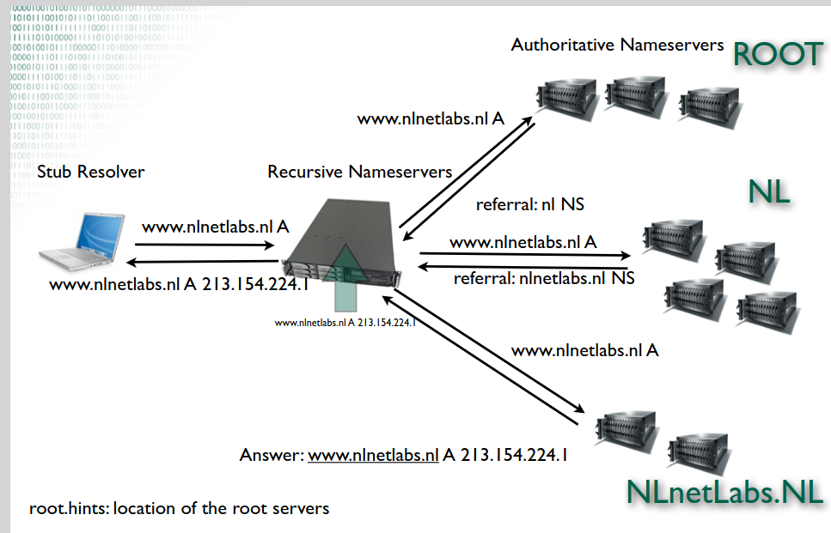
A DNS Query

Slide 50
Domain Name System (DNS)
We’ll return to the DNS later, esp for DNSSEC, and to discuss HTTPS, SVCB and (maybe) DELEG RRs
For now though, note that the webPKI depends on the DNS
  Most certificates provide “domain validation” and no more
  If I can bork the DNS, I can get a webPKI certificate for names I don’t really control

Slide 51
e-Mail, spam, S/MIME and PGP

Slide 52
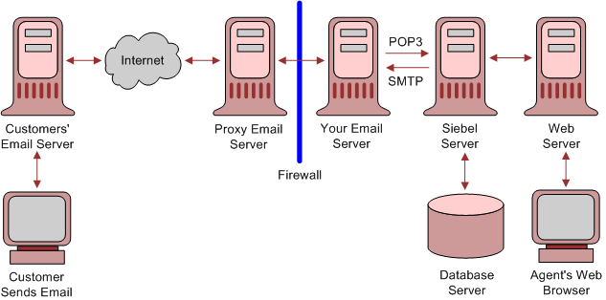
Email Architecture
See RFC 5598
https://docs.oracle.com/cd/E63029_01/books/SecurHarden/img/architecture_email_v.gif

Slide 53
Another architectural view
DNS
MX
Blocklists
Mail Transfer
Agent (MTA)
Mail Transfer
Agent (MTA)
Message
Store (MS)
Transfer (SMTP/25)
Submission (SMTP/587)
Reading (IMAP/143)
Mail User
Agent (MUA)
Mail User
Agent (MUA)

Slide 54
Mail Transport Security
DNS
MX
Blocklists
Mail Transfer
Agent (MTA)
Mail Transfer
Agent (MTA)
Mail Transfer
Agent (MTA)
Message
Store (MS)
Transfer (SMTP/25)
Submission (SMTP/587)
Reading (IMAP/143)
Mail User
Agent (MUA)
Mail User
Agent (MUA)
TLS
Mail Transport Security sometimes described as “hop-by-hop security”

Slide 55
Mail Transport Security Stats
Gmail publish “transparency report” stats
  https://transparencyreport.google.com/safer-email/overview
Other service providers see commensurate numbers
Recently: 97% of outbound and 98% of inbound are protected via some form of TLS
  Note: “Some form” == possibly opportunistic!
Variations remain

Slide 56
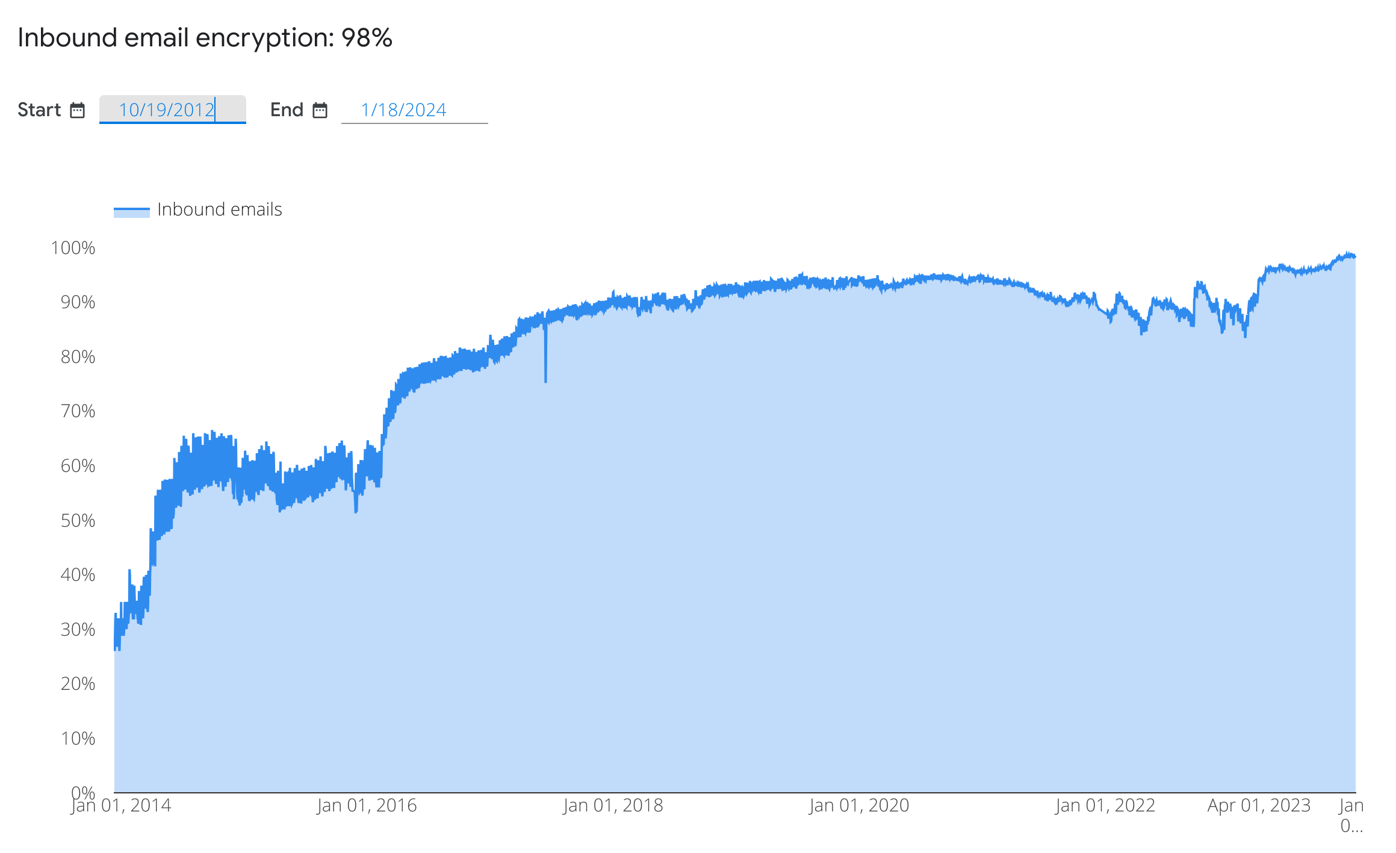
HBH over time (still @gmail)

Slide 57
Opportunistic SMTP/TLS (1)
Sending MTA looks up MX RR of recipient’s DNS domain
MX name might not be same as recipient’s domain, e.g., tcd.ie’s MX is msft/outlook
Sending MTA is TLS client, receiving MTA is TLS server
Question: which name to require in TLS server cert? MX name or recipient domain?
Answer: many receiving domains outsource MX to someone big and good at anti-spam meaning sending MTA has to deal with MX names and can’t insist MX be able to serve TLS certificate of recipient domain

Slide 58
Opportunistic SMTP/TLS (2)
Today many MX’s still serve self-signed certificates or expired certificates or certificates signed by some CA not trusted by sending MTA (e.g. a corporate CA)
For all the above reasons, SMTP/TLS is often still “opportunistic” in that MTAs enable it, but don’t impose the same level of checks as are done on the web
Note: on the web, there’s often a warm body who can see/react to errors or warnings – there is no human user present when a sending MTA tries to establish SMTP/TLS with a receiving MTA

Slide 59
MTA-STS
To improve on opportunistic SMTP/TLS we need receiving MTAs to publish a signal that it’s ok for sending MTAs to be more strict
MTA Strict Transport Security (RFC 8461) defines a way to publish that information in the DNS (so sending MTA can look for it before starting to connect)
  Modelled on HSTS and DKIM
Important: has a “testing” phase and defines how sending MTAs can report stats occasionally

Slide 60
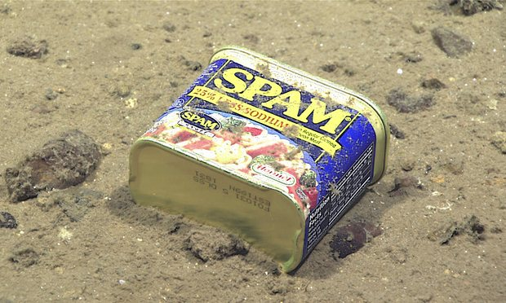
Mail and SPAM
…just can’t seem to get enough…
https://www.theguardian.com/environment/2017/feb/13/extraordinary-levels-of-toxic-pollution-found-in-10km-deep-mariana-trench#img-1

Slide 61
What is spam?
Various acronyms:
  Unsolicited bulk email (UBE)
  Unsolicited commercial email (UCE)
Spam is bad:
  Resource consumption
    Filters, scanners etc. cost time & money
  Malware
  Phishing attempts

Slide 62
Sometimes hard to know…
HILARY TERM GREETINGS FROM THE COLLEGE CHAPLAINS The College Chaplains send best wishes to all, and would like to bring the following upcoming events to your attention. They are open to any students or staff members who wish to join us. …

Slide 63
Original spam tricks
Just send email!
  Ahh…the naivety of it all!
Email to list
  Listservers got better, e.g. subscriber only with controlled subscription
Forge headers
Send via open relay
  Used to be a lot of these, very few now
    toad.com is (or was) an exception!

Slide 64
More spam tricks…
Confusion:
  accounts@paypa1.com
  support@eboy.com
  postmaster@boi-support.com
  About to get worse thanks to I18N
  security@bigbаnk.com
  ^ Unicode 0430 is cryllic small ‘a’
Throwaway domains/addresses
Zombie’d hosts
BGP spoofing
DKIM replay

Slide 65
Yet more
HTML messing
  Colour-related
  Relay sites
  Encoded URIs
  Font size 0: break words with zero width spaces

Slide 66
How much spam is there?
Lots
  Hard to get good figures, these are ones I’ve overheard
ISP backbones:
  70% + of email traffic
Delivered mail:
  40% + delivered
Increasing or not?
  Harder to tell if MTAs silently filter

Slide 67
How to solve spam…
Over to you…
But beware of FUSSP
  https://www.dmuth.org/fussp/

Slide 68
Recent Anti-spam techniques
Content filtering (Bayesian, etc.)
  Misc. AI magic
DNS Block Lists (SORBS, DNSBL)
Register of known spam operators (ROKSO)
Greylisting
  All in widespread use today
Sender Policy Framework (SPF)
Domain Keys Identified Mail (DKIM)
DMARC

Slide 69
SPF, DKIM, DMARC (v. briefly)
Sender Policy Framework (SPF): publish IP addresses of sending MTA in DNS; receiving MTA checks source IP of inbound connections – RFC 7208
Domain Keys Identified Mail (DKIM): sending MTA digitally signs outbound emails with private key associated to sending domain; receiving MTA looks up public key in DNS and checks signature; missing/bad signature treated as unsigned message - RFC 6376
Domain-based Message Authentication, Reporting, and Conformance (DMARC): sending MTA publishes “policy” in DNS stating how it would like receiving MTAs to treat messages, e.g. requiring SPF and DKIM to “pass” before accepting email, up to and including asking receivers to “reject” inbound mail that fails SPF or DKIM – RFC 7489

Slide 70
DMARC Downsides (1)
DMARC is great for transactional mail (e.g. receipts), but, there are valid and (to some) important uses of 3rd party sending: Mailing lists, alumni addresses
Mailing lists are the main tool for discussing how Internet standards (incl. Mail, incl. DKIM, incl. DMARC) should work, so breaking those seems dim
But some mail service providers will prefer to reduce their costs even so
  https://www.pcworld.com/article/2141120/yahoo-email-antispoofing-policy-breaks-mailing-lists.html
  https://wiki.asrg.sp.am/wiki/Mitigating_DMARC_damage_to_third_party_mail

Slide 71
DMARC Downsides (2)
When sender to mailing list is from a domain that publishes “p=reject” policy, other list-recipients may bounce the mail, leading to non-delivery, but also, after a few such bounces, leading the mailing list to unsubscribe the sender
  Result: <user>@yahoo.com can no longer participate in e.g. IETF
Risk: If gmail.com published “p=reject” that would likely cause havoc for organisations that depend on mailing lists
  Google said they won’t until the impact of that would be reduced sufficiently
Workarounds
  Use gmail or a vanity sending domain you control
  IETF mailing lists re-write sender’s address, e.g. to first.last=40example.com@dmarc.ietf.org
“Solution” for DMARC downsides (ARC) involves DKIM signing by sender’s MTA and a 2nd DKIM(-like) signature from list agent, but is complex, and interpreting ARC protections on a message is even more complex so not clear if ARC deployment will help
  Authenticated Received Chain (ARC) is RFC 8617

Slide 72
DKIM vs DNSSEC
We’re jumping miles ahead here, but will return to this: DKIM and DNSSEC involve publishing public keys in DNS
DNSSEC DS requires talking to parent domain, chains up to signed root zone
  ~1% deployment
DKIM publishes public key in DNS in TXT record with no additional DNS security
  Today DKIM is almost mandatory if you want your email delivered
  Partly, that’s due to the power of the major mail service providers
Think about the deployment pros and cons?

Slide 73
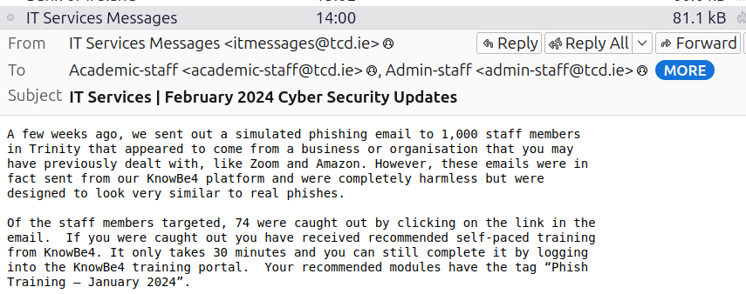
Simulated Phishing

Slide 74
SPAM summary
Email is historically and still currently a very important Internet application
Hop-by-hop/transport security for mail has significantly improved since 2013
SPF, DKIM and DMARC are deployable and very widely used
DMARC is good for some but not all
None of the above “solves” spam
Spam/Anti-spam is an arms-race, beware the FUSSP!
  http://www.circleid.com/posts/20131226_the_naive_arrogance_of_fussps/

Slide 75

End-to-end (E2E) Email Security
DNS
MX
Blocklists
Mail Transfer
Agent (MTA)
Mail Transfer
Agent (MTA)
Message
Store (MS)
Transfer (SMTP/25)
Submission (SMTP/587)
Reading (IMAP/143)
Mail User
Agent (MUA)
Mail User
Agent (MUA)
Encrypt and/or sign outbound mail
Decrypt and/or verify inbound mail

Slide 76
E2E mail security: S/MIME
There's a history here too!
  PGP, PEM and MOSS
  RSADSI's PKCS#7 based proposal
Cryptographic Message Syntax (CMS) is the basis for S/MIME and various other crypto applications using ASN.1
  So S/MIME = CMS
  + Message-Specification
  + Certificate-specification

Slide 77
CMS
How to MAC, sign and/or encrypt application data in an ASN.1 oriented way
  E.g. CMS defines: SignedData and EnvelopedData
  XML, JSON and CBOR equivalents started from here
Algorithms and options same as X.509
Latest CMS specification: RFC 5652
But first, to encrypt, we need a bit of glue between arithmetic (for RSA) and ASN.1 BIT STRINGs – often uses PKCS#1 v1.5 format...

Slide 78
PKCS#1 v1.5 Padding
(encryption) RFC 8017
RSA modulus: n=pq of length k bytes;
i.e. 256 ** (k-1)₁< n < 256 ** k
Padding octets are random but non-zero
most significant byte
least significant byte
00
02
Padding octets
00
message
at least 8 bytes
k bytes

Slide 79
CMS SignedData (1)
SignedData ::= SEQUENCE {
version CMSVersion,
digestAlgorithms DigestAlgorithmIdentifiers,
encapContentInfo EncapsulatedContentInfo,
certificates [0] IMPLICIT CertificateSet
OPTIONAL,
crls [1] IMPLICIT CertificateRevocationLists
OPTIONAL,
signerInfos SignerInfos }

Slide 80
CMS SignedData (2)
SignerInfo ::= SEQUENCE {
version CMSVersion,
sid SignerIdentifier,
digestAlgorithm DigestAlgorithmIdentifier,
signedAttrs [0] IMPLICIT SignedAttributes OPTIONAL,
signatureAlgorithm SignatureAlgorithmIdentifier,
signature SignatureValue,
unsignedAttrs [1] IMPLICIT UnsignedAttributes OPTIONAL }
SignerIdentifier ::= CHOICE {
issuerAndSerialNumber IssuerAndSerialNumber,
subjectKeyIdentifier [0] SubjectKeyIdentifier }
SignedAttributes ::= SET SIZE (1..MAX) OF Attribute
UnsignedAttributes ::= SET SIZE (1..MAX) OF Attribute
Attribute ::= SEQUENCE {
attrType OBJECT IDENTIFIER,
attrValues SET OF AttributeValue }
AttributeValue ::= ANY
SignatureValue ::= OCTET STRING

Slide 81
CMS Message Specification
Latest specification is RFC 8551
Tells you how to:
  Start with a MIME email message
  Treat that like plaintext the CMS way
  Then take the resulting bytes and make them into a MIME message
Note: LARGE messages exist
  Have to handle BER as well as DER

Slide 82
CMS Certificate Specification
Latest specification is RFC 8550
Tells you how to interface an s/mime mail user agent with a PKI
Tells you how to interpret RFC 5280 for s/mime purposes
  E.g. How to include email addresses in certificates

Slide 83
Wanna Try S/MIME?
It’s been a few years since I had a working s/mime setup (I use PGP mostly), but for your benefit...
In 2022, I tried this “free” service https://www.actalis.com/s-mime-certificates.aspx
Verification email was Italian-first:-)
Then they sent me a pkcs#12 file!
That means they know the private key!!
I didn’t install that in my mail user agent
I got Italian language emails last year reminding me that a certificate was going to expire (I think:-)
Doesn’t look good for ad-hoc use: https://kb.mozillazine.org/Thunderbird_:_FAQs:_Get_an_SMIME_certificate

Slide 84
Pretty Good Privacy (PGP)
PGP can do all that S/MIME does
PGPMime is RFC 3156
PGP’s basic formats in RFC 4880
  Not ASN.1 based (home-grown TLVs)
  Currently being updated (I help co-chair that)
    https://datatracker.ietf.org/doc/draft-ietf-openpgp-crypto-refresh/
Web-of-trust model != X.509 PKI
  But you don’t have to
Most important use-case? Maybe package signing
Now natively supported in Thunderbird

Slide 85
PGP Key Management
X.509-based PKIs are hierarchies
PGP web of trust (WoT) based on user’s signing one another’s keys, with possibly many signatures per public key
PGP Key IDs are (truncated) hashes
PGP key servers exist
Usability: sucks:-(
Details: lots of HOWTOs on the web

Slide 86
S/MIME and PGP Deployment
Most MUAs suport s/mime or PGP either built-in or as an option
  There are also “plug-in” products
And mostly then can work together
  I’ve used both, PGP currently seems more usable (with Thunderbird)
But e2e secure mail is not ubiquitous
  Why?

Slide 87
e2e email security barriers
Designs pre-date web user agent which changes trust model (where's the private key kept? Needs new infrastructure)
Needs all major mailbox providers (yahoo, hotmail, gmail) to deploy the same thing which also needs to be implemented by all major user agent developers (microsoft, mozilla, apple, google)
Public key retrieval needs to be fixed (doable if the above done, but a killer if not done), likely with some new PKI (doable but who's gonna pay?)
Mail headers need to be protected as users don't get that S/MIME and PGP only protect body and not e.g. Subject, From (new enveloping protocol needed, work-in-progress but kludgy)
We need to unify S/MIME and PGP or pick one or we'll lose interop (it's ok if the other soldiers on for some niches)
Users don't care much, so it has to be entirely transparent for them (needs significant UI work, co-ordinated across MUAs and significant web-UAs)

Slide 88
e2e email current attempts
(At least) two current projects have are trying to address general e2e mail security:
  Autocrypt: https://autocrypt.org/
  Sadly defunct: p≡p : https://pep.foundation/
Some service providers try make e.g. PGP easier:
  ProtonMail: https://protonmail.com/
All worthy, none (yet) with real MUA/mail-mega-provider traction
Most email security today depends on TLS for mail transport security which is hop-by-hop and not end-to-end
e2e email security doesn’t play so well with server-side anti-spam/malware/phishing techniques
BUT, without e2e email security, it’s all postcards!
  And there are people reading those: http://www.spiegel.de/international/europe/gchq-monitors-hotel-reservations-to-track-diplomats-a-933914.html

Slide 89
Transport Layer Security (TLS)

Slide 90
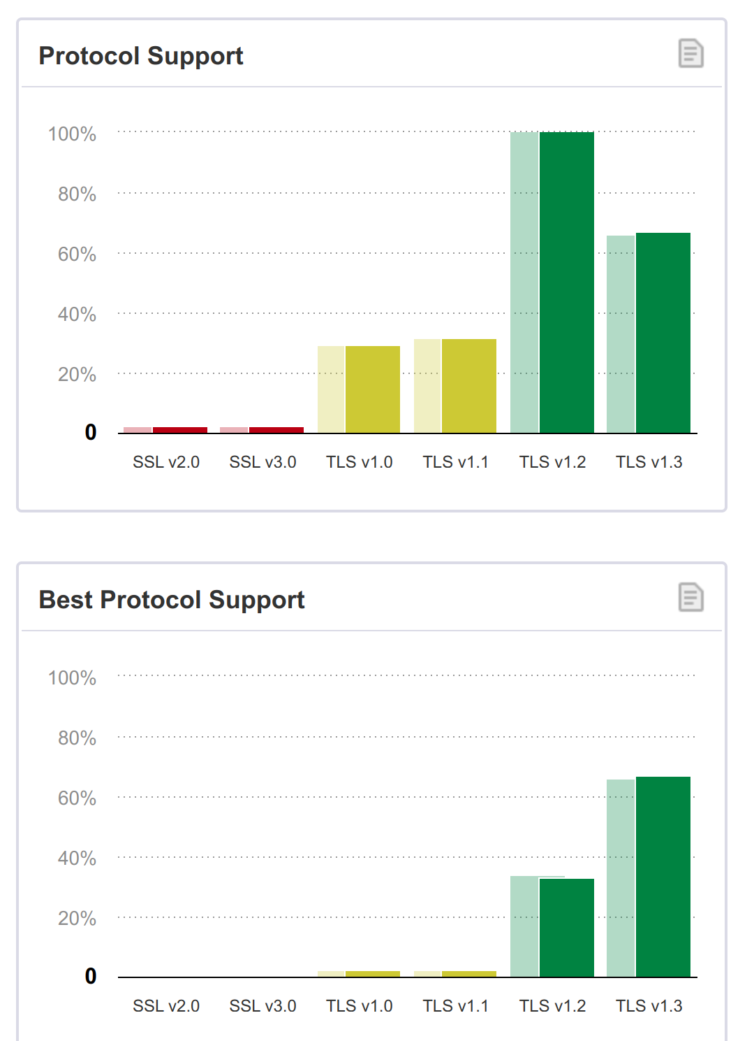
Transport Layer Security (TLS)
Secure Sockets Layer (SSL) proposed by
Netscape in 1994
Works with any application that uses sockets to communicate e.g., ftp, http, nntp, telnet...
Standardised as Transport Layer Security (TLS) in 1999
  Name was compromise with Microsoft (their version was called PCT)
    https://tim.dierks.org/2014/05/security-standards-and-name-changes-in.html
  Latest: TLS1.3, RFC 8446
  Most widely deployed:
  TLS1.2, RFC 5246 (just about?)
  Oddly: RFC6101 is SSL3.0!
https://www.ssllabs.com/ssl-pulse/

Slide 91
SSL original services
Server Authentication - “buyer” can believe they are dealing with a bona fide “merchant”
  (Optional) Client authentication
  Digital certificates (X.509)
Message Encryption - Buyer can send credit card details across the network without fear of interception
  Also message integrity and replay-detection
Relatively transparent to the user and application developer
  Hence the name “secure sockets layer”

Slide 92
Deployment of TLS
Mid '90's: Used in Netscape Commerce Server
  International “Step-up” encryption: Strong crypto for international banks, with special Verisign certificate
  Built into Communicator 4.0 and later
Now: everywhere, standard part of Web browsers, servers and all development platofrms (PHP, python, golang etc.)
  online trading, banking, commerce…
“foo”/TLS/TCP on port 443 is now de-facto baseline for Internet-scale interop

Slide 93
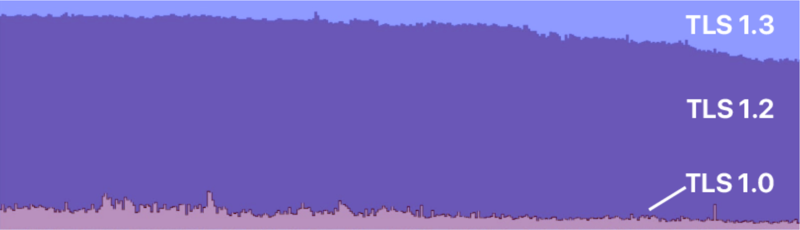
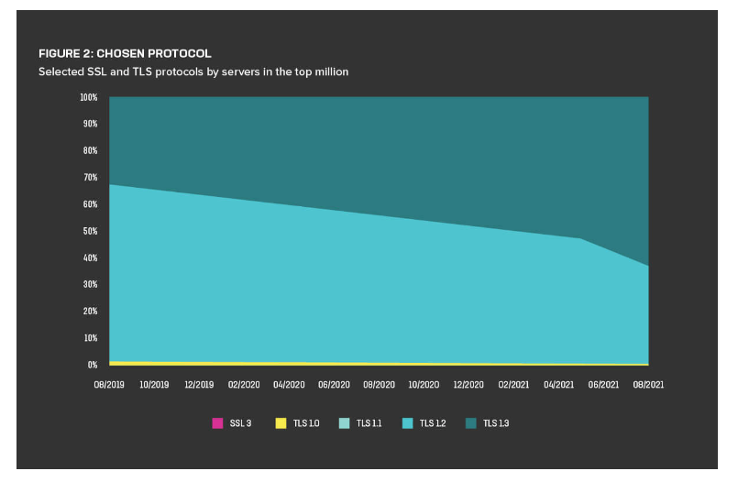
TLSv1.2 and TLSv1.3
We’ll look first at TLSv1.2, then lots more on TLSv1.3
TLSv1.3 is a major update despite the minor version number change
Older versions: next slide and RFC8996
Deployment snapshots:
  https://ietf.org/blog/tls13-adoption/
  ~27-30% v1.3 Nov 2019
  F5 2021 measurement: v1.3 chosen
  by 63% of top-1m servers in 2021
  https://www.ssllabs.com/ssl-pulse/
  Best protocol v1.3 for ~67% Dec 2023
  (was 60% in Feb 2023)
Cloudflare measurement from May 2018-May 2019
https://www.f5.com/labs/articles/threat-intelligence/the-2021-tls-telemetry-report

Slide 94
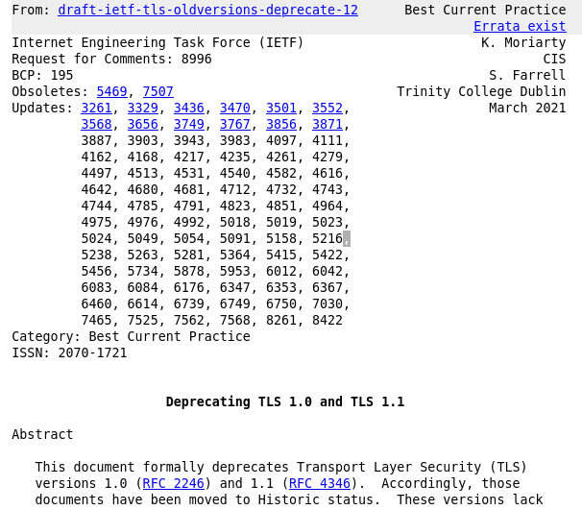

Slide 95
Components of the TLS Protocol
TLS broken into 4 interrelated sub-protocols
Application
Application
Secure Socket Layer
Alert
Handshake
Alert
Handshake
Dialogs
A_Data
Change
A_Data
Change
Cipher
Cipher
Normal TCP/IP Socket
Normal TCP/IP Socket

Slide 96
TLSv1.2 Handshake Protocol
Negotiate Compression Method and Cipher Suite
Swap random quantities
Client obtains server certificate path
Client invents PreMasterSecret (48 bytes) and securely sends it to the server
Keys Calculated by both
Finished message using new algorithms
Data send in A_Data Units
Client
Server
Client_Hello[Client_Random, SessionID,
CipherSuites, CompressionMethods]
Server_Hello[Server_Random, SessionID,
CipherSuites, CompressionMethod]
Certificate[Server_Cert]
Server_Hello_Done[]
Client_Key_Exchange[{PreMasterSecret}PKserver]
Change_Cipher_Spec[]
Finished[]
Change_Cipher_Spec[]
Finished[]
Application_Data[*]

Slide 97
TLSv1.2 Handshake Protocol
summary
client
server
ClientHello
ServerHello
Certificate*
CertificateRequest*
ServerKeyExchange*
Certificate*
ClientKeyExchange
CertificateVerify*
change cipher spec
Finished
change cipher spec
Finished
Application Data
Application Data
* Indicates optional or situation dependent messages that are not always sent

Slide 98
Computing Keys from the Pre-MasterSecret
First compute MasterSecret
MasterSecret = f(PreMasterSecret, Client.Random, Server.Random)
MasterSecret Used to prime key-generator
KeyBlock = f(MasterSecret, Client.Random, Server.Random)
Client_MAC_Secret
Partition key-stream
into individual
quantities
Server_MAC_Secret
Client_Key
KeyBlock
Server_Key
Client_Stream_Key
Server_Stream_Key

Slide 99
Applying the Keys to Application Data (TLSv1.2 Record Layer)
Fragment of User Data
Divide stream into blocks
<= 2₁₄ Bytes
Compress
Compressed Fragment
PAD
Compute MAC
Compressed Fragment
MAC
PAD
Length
Block Cipher (with padding) or Stream Cipher
Application Data Ind.
Protocol Version
Payload Length
Encrypted Payload

Slide 100
TLSv1.2 Ciphersuites
SSL/TLS supports various cryptographic options
  Digest algorithms, key transport, ...
Design decision was to represent all choices made in a single value
  Ciphersuite – a 16 bit number
  TLS_RSA_WITH_3DES_EDE_CBC_SHA
Interesting consequences...

Slide 101
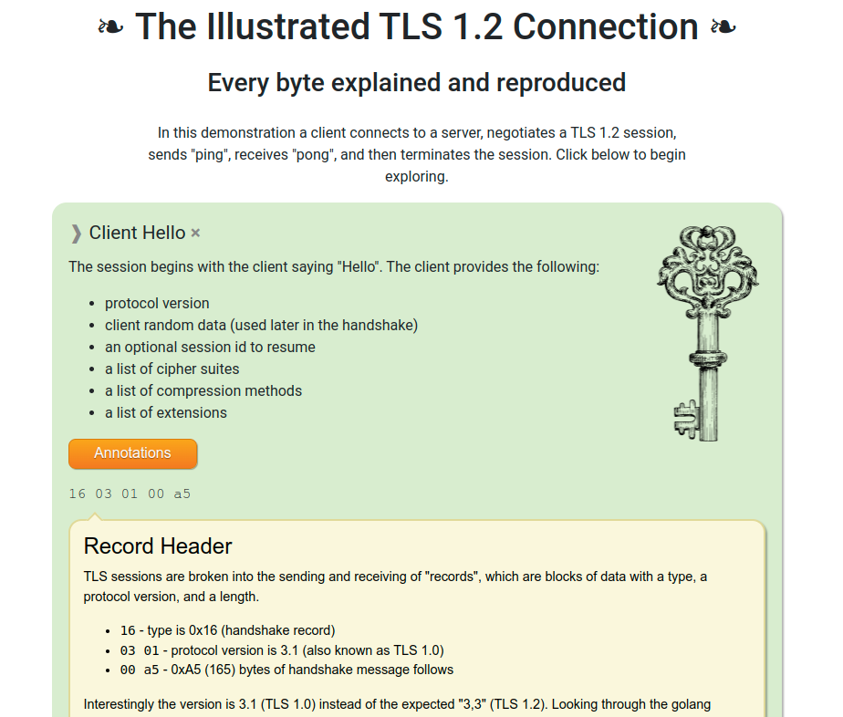
A TLSv1.2 Handshake Visualisation
https://tls12.xargs.org/
Shows a sample handshake with annotations
https://tls13.xargs.org/ similar for TLSv1.3

Slide 102
Bleichenbacher
“Materials” section has a full paper & ppt
  If you completely understand the attack, you're doing very well!
Basis
  PKCS#1 v1.5 padding adds formatting to the data
  If I have an “oracle” that'll attempt decryption and tell me when the recovered plaintext has the PKCS#1 v1.5 padding then I gain knowledge
This happened with TLS!
  “Million message” attack

Slide 103

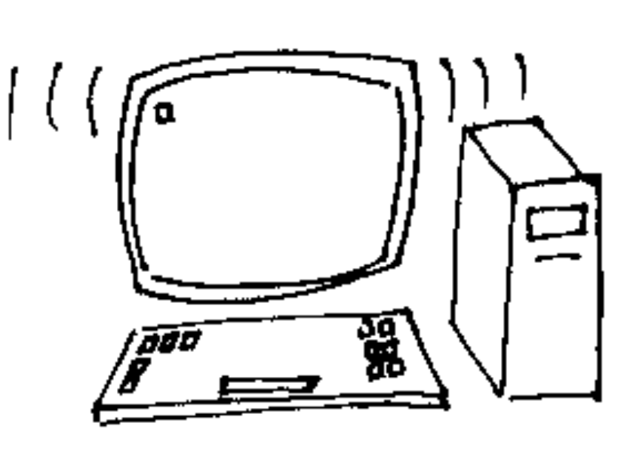
How the attack works: Overview
Eve
d
Bob
M=C ??
e
C =CS (mod n)
i
i
R
If a message C is PKCS conforming then
I
2*256**(k-2)_{k-2}-1 < MS < 3*256**(k-2)₋₂
This is an adaptive chosen-ciphertext attack
RFC3218 describes the attack and ways to avoid it.

Slide 104
Other TLS-relevant Stuff
Key-pinning in HTTP (HPKP): RFC 7469
HTTP Strict Transport Security (HSTS): RFC 6797
OSCP Stapling (RFC 6066)
MTA Strict Transport Security (RFC 8461)
Datagram TLS (DTLS) for connectionless applications (e.g. RTP): RFC 9147 for DTLS1.3, RFC 6437 for DTLS1.2
We’ll look at TLSv1.3 (RFC8446) in detail in a bit and Encrypted Client Hello (for TLSv1.3 only)
  https://tools.ietf.org/html/draft-ietf-tls-esni

Slide 105
IP Security (IPsec)

Slide 106
Ipsec overview
“Security Architecture” RFC 4301
  Key exchange, data encryption and data integrity mechanisms at the IP layer
Optional as part of an IPv4 stack
  (Used to be) Mandatory to implement as part of IPv6 stacks
  Note: Mandatory to implement (MTI) != “MUST use”
Tunnel/Transport modes
  VPNs using tunnel mode common
Security policy DB
  How to handle (un)protected packets

Slide 107
IP Security (IPsec)
Took sooooo looooong and produced such a complex outcome that they have a 2011 document roadmap (RFC 6071).
Start with RFC 4301, the architecture
Main moving parts: AH (RFC 4302), ESP (RFC 4303), and IKEv2 (RFC 7296)
  AH mostly deprecated
  IKE -> IKEv2 due to IKE/ISAKMP/... complexity, do NOT bother with IKEv1
So, we'll only look at ESP & IKEv2

Slide 108
ESP – Encapsulated Security Payload
0 1 2 3
0 1 2 3 4 5 6 7 8 9 0 1 2 3 4 5 6 7 8 9 0 1 2 3 4 5 6 7 8 9 0 1
+-+-+-+-+-+-+-+-+-+-+-+-+-+-+-+-+-+-+-+-+-+-+-+-+-+-+-+-+-+-+-+-+ ----
| Security Parameters Index (SPI) | ^Auth.
+-+-+-+-+-+-+-+-+-+-+-+-+-+-+-+-+-+-+-+-+-+-+-+-+-+-+-+-+-+-+-+-+ |Cov-
| Sequence Number | |erage
+-+-+-+-+-+-+-+-+-+-+-+-+-+-+-+-+-+-+-+-+-+-+-+-+-+-+-+-+-+-+-+-+ | ----
| Payload Data* (variable) | | ^
~ ~ | |
| | |Conf.
+ +-+-+-+-+-+-+-+-+-+-+-+-+-+-+-+-+-+-+-+-+-+-+-+-+ |Cov-
| | Padding (0-255 bytes) | |erage*
+-+-+-+-+-+-+-+-+ +-+-+-+-+-+-+-+-+-+-+-+-+-+-+-+-+ | |
| | Pad Length | Next Header | v v
+-+-+-+-+-+-+-+-+-+-+-+-+-+-+-+-+-+-+-+-+-+-+-+-+-+-+-+-+-+-+-+-+ ------
| Authentication Data (variable) |
~ ~
| |
+-+-+-+-+-+-+-+-+-+-+-+-+-+-+-+-+-+-+-+-+-+-+-+-+-+-+-+-+-+-+-+-+

Slide 109
ESP terms
Specification: RFC 4303
Security Parameters Index (SPI) selects amongst different
  Algorithms; Keys; etc.
  SPI (+ dest. IP) = Security Association (SA)
Seq# for anti-replay
  Never cycles (new SA needed)
Next header specifies payload protocol
SA's are directional
  So we use different keys between Alice and Bob as compared to between Bob and Alice

Slide 110
ESP – some features
ESP allows some basic level of traffic hiding
  Padding (up to 255 bytes) to disguise data length
  Tunnel mode between gateways
Data expansion
  About +19 bytes per packet, possibly worse
  Can be serious (telnet)

Slide 111
IKE - Internet Key Exchange
IKEv1 (RFC 2409) is a mess of:
  ISAKMP (rfc2408)
  OAKLEY (rfc2412) and SKEME (not an rfc)
  DOI (rfc2407)
IKEv2 (RFC 7296) is a single document that's much better
  But is 142 pages long;-(
Wasn't that simple!

Slide 112
IKEv2 (1)
Provides protocol to...
  Mutually authenticate
  Exchange keys
Based on:
  D-H and
  Pre-shared secrets or RSA

Slide 113
IKEv2 (2)
Establishes an IKE-SA and one (or more) CHILD-SA
Generally requires 4 or 6 messages
  IKE_SA_INIT (req/rep)
  IKE_AUTH (req/rep)
  CREATE_CHILD_SA (req/rep)

Slide 114
IKEv2 Phase1
IKE_SA_INIT & IKE_AUTH
Initiator Responder
----------- ---------
HDR, SAi1, KEi, Ni -->
<-- HDR, SAr1, KEr, Nr, [CERTREQ]
HDR, SK {IDi, [CERT,] [CERTREQ,] [IDr,] AUTH, SAi2, TSi, TSr} -->
<-- HDR, SK {IDr, [CERT,] AUTH,
SAr2, TSi, TSr}

Slide 115
IKEv2 Phase2
CREATE_CHILD_SA
Initiator Responder
----------- ---------
HDR, SK {SA, Ni,[Kei],[TSi,Tsr]} -->
<-- HDR, SK {SA, Nr,[Ker],[Tsi, TSr]}

Slide 116
Some IKEv2 Features
Not IKEv1!
Uses ESP to protect things
Misc:
  PFS, NAT-capable, Traffic Selectors, Liveness checks, Cookies
Still a bit clunky though!
  E.g. Compression (rfc2393), ESP and then AH nested SAs

Slide 117
IPsec summary
Tunnel mode widely used for VPNs and works just fine
  Transport mode hardly used at all
IKE interop today isn't perfect (with certs), but is ok
  Some vendor-specific stuff, e.g. For RADIUS/legacy auth
Deployment issues:
  Windows, NAT, Firewall, ECN, Opportunistic Keying, APIs
  IKEv2 work aims to address a bunch (but not all!) of these

Slide 118
Another IPsec overview
Good March 2022 presentation on IPsec by an expert (Paul Wouters)
  https://datatracker.ietf.org/meeting/113/materials/slides-113-saag-introduction-to-ipsec-00
If his content contradicts mine, believe him:-)

Slide 119
Other protocols: kerberos, SSH, wireguard
(MLS even later)

Slide 120
Kerberos
Originally developed as part of MIT project athena
  RFC4120 (but RFC1510 may be easier)
Designed for many users working with few(-ish) servers
  Largely symmetric key (shared secret) based
Based around clients interacting with a Key Distribution Centre (KDC) aka:
  Authentication server (AS)
  Ticket Granting Server (TGS)

Slide 121
Kerberos
Uses ASN.1 again! (sort-of)
Latest spec: RFC 4120
Typical use:
  Client sends AS_REQ to KDC gets AS_REP containing TGT
  Client sends TGS_REQ to KDC (includes TGT) and gets TGS_REP (including Ticket)
  Client sends KRB_SAFE to server including Ticket

Slide 122
A Ticket
Ticket ::= [APPLICATION 1] SEQUENCE {
tkt-vno [0] INTEGER (5),
realm [1] Realm,
sname [2] PrincipalName,
enc-part [3] EncryptedData -- EncTicketPart }
-- Encrypted part of ticket
EncTicketPart ::= [APPLICATION 3] SEQUENCE {
flags [0] TicketFlags,
key [1] EncryptionKey,
crealm [2] Realm,
cname [3] PrincipalName,
transited [4] TransitedEncoding,
authtime [5] KerberosTime,
starttime [6] KerberosTime OPTIONAL,
endtime [7] KerberosTime,
renew-till [8] KerberosTime OPTIONAL,
caddr [9] HostAddresses OPTIONAL,
authorization-data [10]
AuthorizationData OPTIONAL }

Slide 123
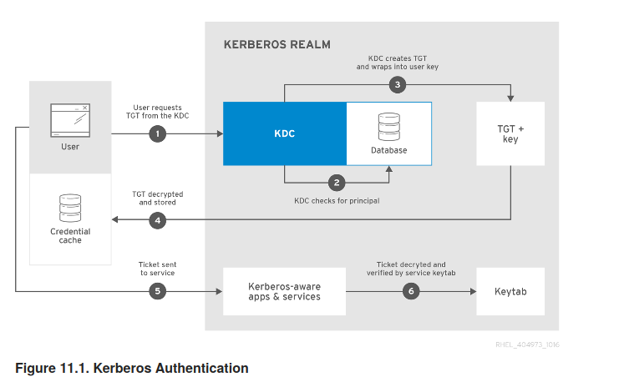
Kerberos Flows
https://access.redhat.com/documentation/en-us/red_hat_enterprise_linux/7/html/system-level_authentication_guide/using_kerberos

Slide 124
Kerberos Things to Note
Loose clock sync. Required
Kerberos realm is like but not the same as a DNS domain
Inter-realm and public key based operation defined but not used that often
Used in Windows security: KDC is part of ActiveDirectory server
Various authorization data extension have been done over the years
AS_REQ can contain dictionary attackable password or something better (usually the latter in modern implementations)

Slide 125
Secure Shell (SSH)
Architecture: RFC 4251
Details in RFCs 4252 (transport protocol), 4253 (user auth), 4254 (multiplexing)
Entirely typical flows – do D-H, authenticate in encrypted tunnel, application data in channel in encrypted tunnel
Tends to be more driven by widely-used implementations rather than the RFCs, so generally implementations are ahead of the RFCs, sometimes significantly so esp. for extensions and algorithms, e.g.: https://www.openssh.com/specs.html
Next 2 slides from: https://serverfault.com/questions/935666/ssh-authentication-sequence-and-key-files-explain

Slide 126
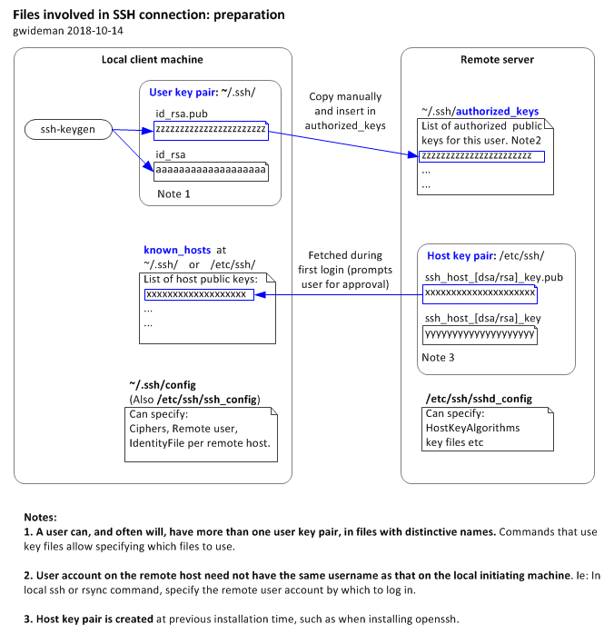

Slide 127
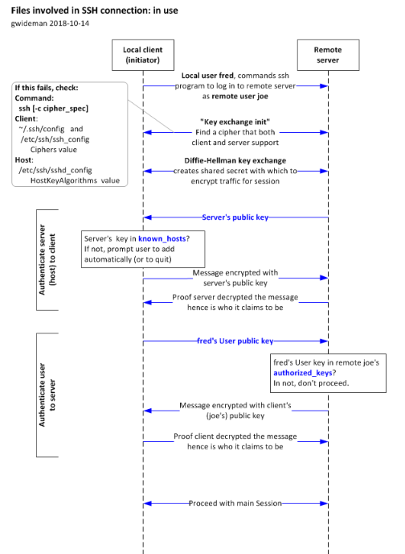

Slide 128
SSH Messages
Old style message descriptions, e.g. RFC 4252 describes the value of 'signature' as a signature by the corresponding private key over the following data, in the following order:
string session identifier
byte SSH_MSG_USERAUTH_REQUEST
string user name
string service name
string "publickey"
boolean TRUE
string public key algorithm name
string public key to be used for authentication

Slide 129
SSH things to note
SSH is the epitome of the Trust On First Use (TOFU) model in how it handles known host keys on the client
Be careful of VMs – easy to clone host key accidentally, e.g. if using puppet or similar
In almost all cases: turn off password authentication and only allow public key based auth for systems you manage
Be careful of user key pairs – it’s very easy to end up with lots of old keys (e.g. for ex-employees!) in authorized_keys files
SSH tunnelling is a fine thing – use a jump-off host to which you have a login to connect to others inside the LAN of the jump-off host – but as usual be careful in allowing this if you’re a sysadmin

Slide 130
Wireguard-1
Newish (2016), non-standard, work-in-progress VPN tunnelling protocol, but now (Jan 2020) accepted into upstream Linux kernel
Protocol description: https://www.wireguard.com/papers/wireguard.pdf and/or https://www.wireguard.com/protocol/
Design goals: simpler, quicker than IPsec or OpenVPN using only modern crypto, ~4K LOC in kernel
wg tool acts like iwconfig for managing interfaces, e.g. wg0,use normal OS tools (e.g. ip) to create i/f and handle addresses and routes
Local interfaces are associated with a static curve25519 key pair, remote peers with a public key, ephemeral curve25519 keys are generated in 1RTT handshake
Has a cookie mechanism for DoS mitigation, triggered if responder is “under load”
Optional PSK can be bound with key exchange for post-quantum future-proofing
Traffic is protected using Chacha20poly1305 and encapsulated in UDP

Slide 131
Wireguard-2
Public key distribution is out of scope – requires some other tooling, same as SSH
Wireguard doesn’t allocate IP addresses for clients – that’s also considered out of scope and needs other tooling (apparently, haven’t tried) – claimed to be problematic for some VPN operators who don’t want to configure/log anything per-client
  https://git.zx2c4.com/wg-dynamic was being developed in 2019, not sure of status
Various timers and optional keepalives built-in (for NAT)
If you want firewalling – just use a firewall (e.g. ufw) as if the traffic were in clear (no IPsec policy DB here:-)
Protocol (designer) is v. opinionated – deliberately no crypto agility at all within protocol versions (that’s also “modern”:-)
Performance and attack surface look good, will be interesting to see how this evolves

Slide 132
Mix'n'match
PKI vs. Shared-secret vs. Trusted public keys
TLS vs IPsec vs S/MIME vs CMS vs PGP vs Kerberos vs SSH vs Wireguard
When should you pick which?

Slide 133
Next hour(s)...
PKI model and protocols
SMIME formats and (a bit on) email
TLS protocol (TLS1.2 or TLS1.3)
IPsec
Kerberos
SSH
Wireguard
MLS
Knowing one of these
in detail is enough for
exam purposes – you
will need to read the
source materials

