Slide 1
Fuzzy Identity-Based Encryption
Privacy for the Unprepared
Amit Sahai
U.C.L.A.
Brent Waters
Stanford University
http://crypto.stanford.edu/~bwaters

Slide 2

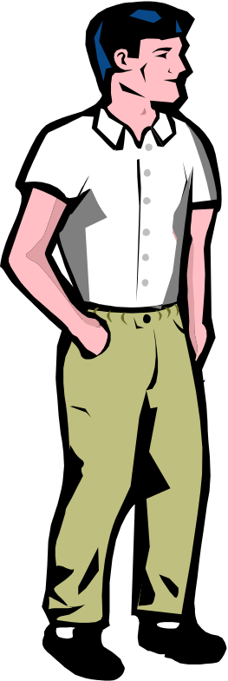

An Emergency Medical Visit

Slide 3

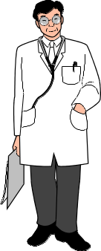

An Emergency Medical Visit
Blood tests, X-rays…
Encrypt data, but…
What key do we use?

Slide 4
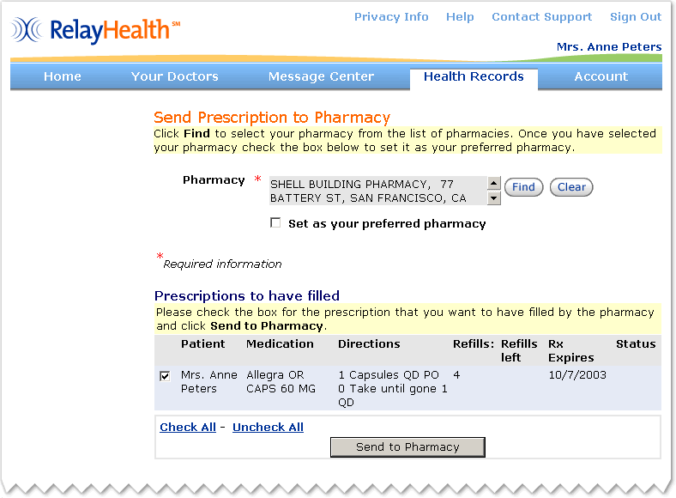
Real Life Example

Slide 5
Email password in clear
Email message from RelayHealth system
I've started a membership for you on RelayHealth so we can communicate online. Here's your temporary sign in name and password:
- Sign in name: Waters20
- Temporary password: the four-digit month and date of your birth, plus the characters: RTX5. (For example, if your birthday were July 4th, you would enter 0704RTX5).

Slide 6
Security Issues
Password is sent in the clear
Adversary could reset password back to mailed one
Prescriptions, appointments, lab results, on-line visits…

Slide 7

Identity-Based Encryption (IBE)
IBE: [BF’01] Public key encryption scheme where public key
is an arbitrary string (ID).
  Examples: user’s e-mail address, current-date, …
email encrypted using public key:
“bob@stanford.edu”
I am
“bob@stanford.edu”
Private key
CA/PKG
master-key

Slide 8
Problems with Standard IBE
What should the identities be?
    Names are not unique
  SS#, Driver’s License
First time users
Certifying to authority
  Documentation,…

Slide 9
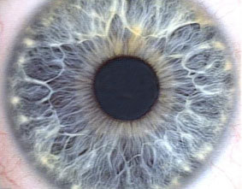


Biometric-based Identities
Iris Scan
Voiceprint
Fingerprint

Slide 10
Biometric-Based Identities
Stay with human
Are unique
No registration
Certification is natural

Slide 11
Biometric-Based Identities
Deviations
  Environment
  Difference in sensors
  Small change in trait
Can’t use previous IBE solutions!

Slide 12

Error-tolerance in Identity
k of n attributes must match
Toy example: 5 of 7
Public Key
Private Key
CA/PKG
5 matches
master-key

Slide 13
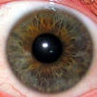

Error-tolerance in Identity
k of n attributes must match
Toy example: 5 of 7
Public Key
Private Key
CA/PKG
3 matches
master-key

Slide 14

Naive Method 1
“Correct” the error
  Fix measurement to “right” value
  What is right answer?
  Consider physical descriptions

Slide 15
Naive Method 2
IBE Key Per Trait
Shamir Secret share message
Degree 4 polynomial q(x), such that q(0)=M
Ciphertext
E₃(q(3))...
Private Key
2
5
7
8
11
13
16
q(x) at 5 points ) q(0)=M

Slide 16
Naive Method 2
Collusion attacks
Private Key
2
5
7
8
11
13
16
1
5
6
9
10
12
15
1
2
5
6
7
8
9
11
12
13
15
16

Slide 17
Our Approach
Make it hard to combine private key components
Shamir polynomial per user
Bilinear maps

Slide 18
Bilinear Maps
G , G₁ : finite cyclic groups of prime order p.
Def: An admissible bilinear map e: G×G → G₁ is:
  Bilinear: e(gª, g^{b}) = e(g,g)^{ab} ∀a,b∈Z, g∈G
  Non-degenerate:
  g generates G ⇒ e(g,g) generates G₁ .
  Efficiently computable.

Slide 19
Our Scheme
Public Parameters
e(g,g)^{y} 2 G1, g^{t1}, g^{t2},.... 2 G
Private Key
Random degree 4
polynomial q(x) s.t. q(0)=y
g^{q(5)/t5}
e(g,g)^{rq(5)}
g^{r¢ t5}
Ciphertext
Bilinear Map
Me(g,g)^{ry}
Interpolate in exponent to get e(g,g)^{rq(0)}=e(g,g)^{ry}

Slide 20
Intuition
Threshold
  Need k values of e(g,g)^{rq(x)}
Collusion resistance
  Can’t combine shares of q(x) and q’(x)

Slide 21
Performance/Implementation
Example: 60-bit identity match on 50 points
Supersingular curves
~7700 bytes
~2.5s decrypt
(50 B.M. applications, 50ms on 2.4GHz Pentium)
MNT curves
~1,200 byte ciphertext
~24 seconds decrypt
(50 B.M. applications, 500ms on 2.4GHz Pentium)

Slide 22


Biometrics for Secret Keys
Monrose et al.’99, Juels and Wattenberg’02,
Dodis et al. ‘04
Secret Key!
What happens if someone scans your biometric=secret key??
Has this happened?

Slide 23
Extensions
Non-interactive role based access control
  File systems
  Personal Ads?
Multiple Authorities
Forward Security
  Yao et al. CCS 2004

Slide 24
RelayHealth Epilogue
Contacted Relay Health
Very responsive and receptive

Slide 25


RelayHealth Epilogue
Cheaper Deployment
Mail based passwords
Physical Token
Traditional IBE
More Secure
Biometric-based IBE

Slide 27
Future Work
Multiple Authorities
Experimentation/Implementation
Other applications?

