Slide 1
Real Issues with TLS
(and Fixes)
Oh crap, the TLS ecosystem isn't near-perfect.
Some people work on fixes.
Others work on finding more problems.
That's life as a really popular security protocol.

Slide 2
TLS Issues
RFC 7457 - Summarizing Known Attacks on Transport Layer Security (TLS) and Datagram TLS (DTLS) – Feb 2015
  Good source of references to attacks/bugs as of that date
  More continues to happen of course...

Slide 3
Contents
Issues in rough age-order
  Weak key generation
  CA screw-ups
  Bleichenbacher
  Re-negotiation
  CA screw-ups
  Weak key generation
  Stuxnet/Flame
Issues in rough age-order
  CRIME
  Lucky-13
  DROWN
  Marvin
More to come no doubt
Some possible Futures for TLS

Slide 4
Don't panic!
Many issues have been found over the years with TLS implementations and a few issues with the protocol itself
It is still far far easier to properly use TLS and get security than it is to re-invent TLS
  So use it!
  But make sure you're using it properly

Slide 5
Ancient Crappy Key Generation
1996-era Netscape mucked up key generation
https://people.eecs.berkeley.edu/~daw/papers/ddj-netscape.html
  Problem: TLS pre-master secret could be guessed
  Only really 47 bits of entropy and not 128
Fix: More entropy and better code
  No protocol change needed

Slide 6
Ancient CA Screw-Ups
2001, social engineering works then and now
VeriSign issued code-signing certs to someone who was not microsoft.com
Fixes:
  VeriSign revoked certs
  MSFT issued a patch:
https://technet.microsoft.com/library/security/ms01-017
    Interesting sign of how bad revocation really was (and is!), user-agents need patching for serious revocations!

Slide 7
Bleichenbacher
1998 Adaptive chosen ciphertext attack
  First of those afaik that was near-practical
  Paper/ppt in course materials
Really an attack on PKCS#1 and not TLS, but impacts TLS implemtentations
Problem: responding to bad padding too early in handshake
Bleichenbacher just keeps on giving (to security researchers):
  Timing attacks on code, not just protocol
  Java exception handling to generate random PMK
  Cross-protocol attacks and fallback attacks – DROWN (later)
  ROBOT (later)
Fixes:
  Don't do that – RFC 3218
  Use OAEP – still not really done today because of “legacy” APIs

Slide 8
TLS Re-Negotiation Bug
Unlike others, this one was a protocol-design flaw
Re-negotiation - new session not bound to initial TLS session
  Attacker can force renego but URL from original session used with 2nd session's privileges
  Fix: RFC 5746, developed in 3 months start to finish, a breaking backwards incompatible protocol change
Traffic pattern:
Client Attacker Server
------ ------- ------
<--------- Handshake ------->
<===== Initial Traffic =====>
<------------------- Handshake =======================>
<================= Client Traffic =====================>

Slide 9
CA Screw-Ups (1 - diginotar)
2011, diginotar.nl were a public CA present in browser root stores
  https://en.wikipedia.org/wiki/DigiNotar
Someone hacks into diginotar servers, issues certificates for google.com, microsoft.com etc., abuses those certificates
Weeks later diginotar confess and are kicked from browser root stores and go bust
Problem: every CA can certify any DNS name in the web PKI
Fixes:
  diginotar liquidated
  CAA RR in DNS

Slide 10
CA Screw-Ups (2 - “comodogate”)
2011 again, good/bad year for this
Not Commodo's direct fault, but their responsibility
https://www.theregister.co.uk/2011/03/28/comodo_gate_hacker_breaks_cover
Comodo partner/RA hacked, certificate requests for google.com, microsoft.com etc., submitted from RA to CA and certificates issued
Certificates revoked quickly but lack of sanity checks within CA infrastructure damaging
Fixes:
  Commodo now do more sanity checking on requests from Ras
  CAA again

Slide 11
Internet-Scale Weak-Key Generation
2012 – Build DB of O(10^6) keys and look for problems...
  https://freedom-to-tinker.com/blog/nadiah/new-research-theres-no-need-panic-over-factorable-keys-just-mind-your-ps-and-qs/
Problem: many embedded devices generate keys before they have any real entropy on first boot; with RSA, 1st prime from pair likely to collide with someone else when there are millions of devices (TLS/SSH servers) visible on the Internet
  >1% of 15 million keys had common factors
  Common RSA modulus factors => easy to factor, GCD calculation is easy regardless of size
Fixes:
  More entropy (somehow;-)
  Better code (somehow:-)
Interesting thing:
  Building a DB of almost all public keys used on the public Internet is quite feasible
  Now there's a thought! More on that later.

Slide 12
Stuxnet/Flame – BIG Bad Actors
199x-201x: Stuxnet and Flame
Stuxnet: involved compromised code-signing private keys
Flame: Stuxnet + new MD5 prefix-collision attack for out of date Windows deployments + really really stupid conflation of different PKIs in MSFT ecosystem
https://arstechnica.com/information-technology/2012/06/flame-crypto-breakthrough/
  Above is a bit overstated maybe on the “breakthrough” part
Problems:
  Private key handling (stuxnet)
  Outmoded PKIs (MD5 – sheesh!)
  Major state actors have major resources and do not have the interests of the Internet at heart (at least for the parts of their organisations that create attacks)
Fixes:
  Do PKI better (we all wish;-)
  Don't stick with crap algorithms like MD5

Slide 13
BEAST – Back to TLS
2011 – BEAST
https://www.ietf.org/proceedings/85/slides/slides-85-saag-1.pdf
BEAST combines active content on page with a network MITM who can passively watch to allow for cookie recovery within TLS
  TLS with CBC, next block IV is last block's ciphertext; URLConnection class allows client code to split info into small chunks; allows messing with TLS application layer PDUs; allows client code that can't read cookie to emit data so that collaborating MITM can detect when client code guessed correct cookie
  Complicated – see the slides referenced above
Fix:
  Partly: Use TLS 1.2 and not earlier

Slide 14
CRIME – TLS Compression Not So Good in the end
2012 – CRIME
https://www.ietf.org/proceedings/85/slides/slides-85-saag-1.pdf
Easier to grok than BEAST – if you compress things then they get smaller; that allows you to guess and detect good guesses from ciphertext size
  Feed back HTML to client with guesses, each embedded in an img reference and see which gets smaller; smaller one is the one that's been seen before so you've learned a character of a cookie; repeat for next characters
Fixes:
  Turn off compression
  What to do for HTTP/2.0? HPACK for headers, application layer and no compression in TLS

Slide 15
Lucky-13 – CBC Problematic Again!
2013 – Lucky-13 CBC timing side-channel
https://en.wikipedia.org/wiki/Lucky_Thirteen_attack
CBC ciphersuites allow for a timing attack based on the size of HMAC-SHA1 input and timing on SHA1; millisecond differences bettwen good and bad padding expose plaintext
Attack more practical against DTLS (UDP/connectionless) than TLS (TCP/connection-oriented)
Fixes:
  Use TLS1.2 with AEAD ciphers
Of note:
  Researchers worked with vendors/standards community to get fixes out while resarch paper embargoed
  Everyone loved 'em for that

Slide 16
RC4 Problematic in TLS
2013, mid-March
https://www.isg.rhul.ac.uk/~sean/Mantin-RC4.pdf
Found position-based biases in RC4 ciphertext bytes, based on analysis of ~2^40 inputs; repeated encryption of same plaintext at same position (e.g. Cookie) vulnerable, more problematic if limited alphabet (e.g., base32); result is plaintext recovery with about 2^24 or 2^30 TLS sessions
Fixes:
  Don't use RC4
Of note:
  Same researchers as Lucky-13, same modus-operandi, same love

Slide 17
DROWN – SSLv2!!
March 2016
Old SSLv2 code that can still be accessed re-enables Bleichenbacher
If same RSA private key on >1 host, any of those willing to play SSLv2 could be attacked
Yes, they have a web site: https://drownattack.com/
Nice cross-protocol attack, similar to https://www.nds.rub.de/research/publications/ccs15/
Affected millions of sites on the Internet
Fix:
  Get rid of old, old code!
  Don't over-prioritize interop and ignore everything else

Slide 18
startcom/wosign - 2016
Startcom CA sold on the q.t.
Buyer a CA that had “interesting” practices
CA (WoSign) couldn’t justify those to browsers
Dropped from root stores, e.g.:
  https://threatpost.com/apple-to-block-wosign-intermediate-certificates/121044/
The good news: CT helped!

Slide 19
ROBOT - 2017
Return Of Bleichenbacher's Oracle Threat
  https://robotattack.org/
Mostly re-testing for Bleichenbacher on the Alexa top 1M
Main point: demonstrated real issues remaining in real deployments
To avoid: just don’t support RSA key transport at all

Slide 20
Trustico - 2018
CA re-seller (an RA) emailed 23k private keys to it’s CA
Apparently wanting those revoked due to business changes
And of course someone showed their web site was extremely borkable...
  https://arstechnica.com/information-technology/2018/03/trustico-website-goes-dark-after-someone-drops-critical-flaw-on-twitter/

Slide 21
Marvin - 2023
Bleichenbacher yet again, this time based on more accurate timing measurements and better statistical techniques
  https://people.redhat.com/~hkario/marvin/
Hubert Kario (pre-print) 28th European Symposium on Research in Computer Security, The Hague, Netherlands, September 25-29, 2023 https://eprint.iacr.org/2023/1442
Affected most then-current RSA/TLS implementations
  But not rusttls as that doesn’t support RSA key transport!
  Boringssl and BearSSL also not shown affected

Slide 22
eTLS or ETS or static D-H
As TLS1.3 was nearing completion, some folks (from BITS, a US financial services organisation) turned up who wanted to keep RSA key transport in TLS1.3, so they could eavesdrop “within their enterprises”
  The TLS WG said “no”; They then wanted to use static D-H TLS server shares so they could eavesdrop “within their enterprises”; The TLS WG said “no” again (or rather, did not have rough consensus to work on that, which likely involved attempts to pack rooms by both sides of the argument)
  See https://github.com/sftcd/tinfoil for my take on all that
So they went off to ETSI who speedily rubber-stamped their ideas and called that eTLS (later ETS or MSP when the IETF complained about abusing the name TLS)
  https://www.eff.org/deeplinks/2019/02/ets-isnt-tls-and-you-shouldnt-use-it
  https://www.etsi.org/deliver/etsi_ts/103500_103599/10352303/01.01.01_60/ts_10352303v010101p.pdf
  https://cve.mitre.org/cgi-bin/cvename.cgi?name=CVE-2019-9191 (slightly amusing:-)
Don’t implement, deploy or use that is my advice – disparage it instead

Slide 23
TLS MITM Products
20xx-date: Vendors sell TLS MITM products for “corporate policy enforcement”
https://directorblue.blogspot.ie/2006/07/think-your-ssl-traffic-is-secure-if.html
Reasons:
  Good: inbound malware scanning
  Bad: everything else
Some CA operators “collaborated” with this bad practice:
  https://bugzilla.mozilla.org/show_bug.cgi?id=724929
Getting more common, but IETF have refused numerous vendor requests to standardise this behaviour
Fixes:
  New PKI approaches/features that detect country-level misbehaviour will hit this
  End-to-end uise of TLS for sped and avoiding advertising will hit this

Slide 24
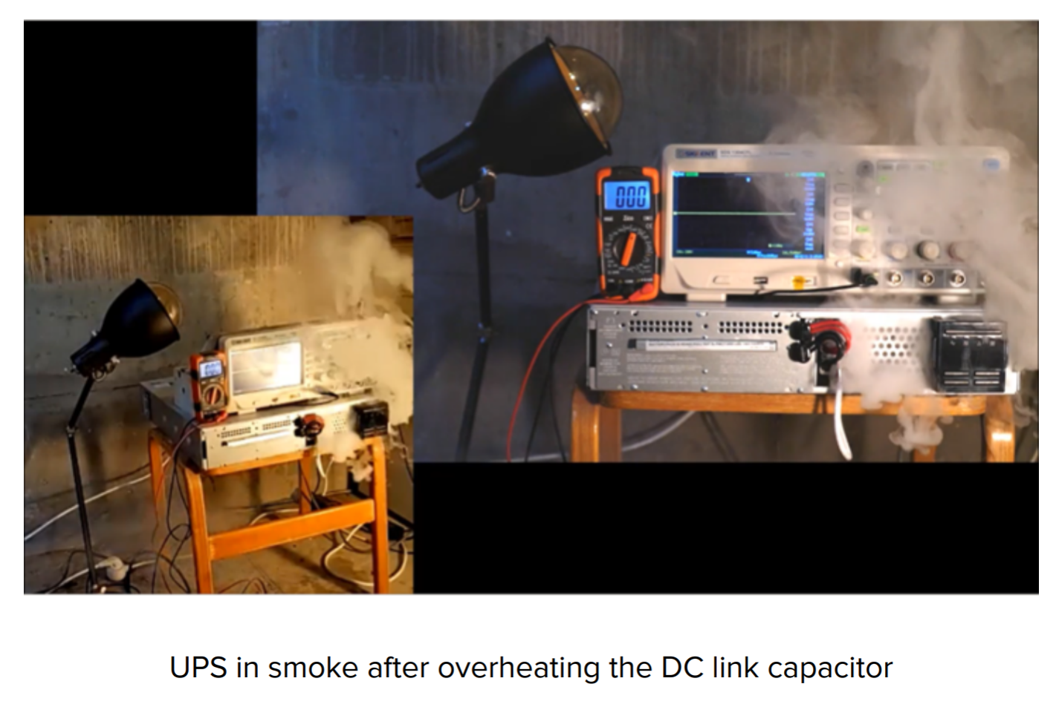
TLS API attack on UPS
2022: Security researcher deep-dive on UPS found various issues, including application-layer failure to react to TLS library errors.
Tech report:
  https://info.armis.com/rs/645-PDC-047/images/Armis-TLStorm-WP%20%281%29.pdf
Result (in the face of active attacking server) is re-use of partially populated TLS session
object that has a master
secret of all zeros – oops
Bonus: the tech report ends
with smoke emerging
from the UPS:-)

Slide 25
So where are we?
(D)TLS is imperfect in various ways
  PKI wrinkles and other imperfections
  Too many TLS ciphersuites (with weaknesses)
  Significant change takes years (before old bad code can be deleted)
(D)TLS is still the best bet for many things
  PKI is better than non-existent non-PKI (old-bad-but-existing-infrastructure often wins)
  Plenty of good TLS ciphersuites esp. TLS 1.3 AEAD
  Change only takes years because of success!

Slide 26
Aside: HTTP/2
HTTP is definitely one of the most important protocols on the Internet
HTTP/1.1 and earlier are not very efficient in various ways, e.g., header verbosity, head-of-line blocking
HTTP/2 recently finished (RFC7540), based on SPDY, to make improvements (without semantic change vs. HTTP/1.1)
Part of that work involved negotiating HTTP/2 usage and not HTTP/1.x usage
  Doing do without additional round-trips is a MUST
One important way to negotiate HTTP/2 is via TLS handshake
  Claim: HTTP/TLS gives better speed and connectivity than cleartext HTTP!
  Done via “Application Layer Protocol Negotiation” (ALPN) as TLS handshake extension (RFC7301)
Notes:
  This replaces TCP port numbers – architects faint!
  This makes TLS criticial for deployment of HTTP/2
  This annoys middlebox vendors/operators - Hmmmmmmmm
    QUIC (RFC9000) probably annoys them even more

Slide 27
Strict TLS
If a web site offers TLS then great, that's hard to spoof. If however, I spoof that same content but witout TLS, users won't notice.
  “Studies” show users don't notice lock-icon, green URL bar, etc.
However, browser can notice that a site I normally access over TLS is now in clear
  Browser can't by itself know that's bad for sure
But sites might be able to tell browser “once you've ever been here via TLS, you should never believe if you see this site in clear”
  For example, paypal.com are keen on this
  Creates potential new way to shoot oneself in the foot – turn on HSTS with the wrong key; sub-/parent-domain handling within same “administrative” domain
    Sidebar: public-suffix list is a pain
Result: HSTS HTTP header – HTTP Strict Transport Security (RFC 6797)
  Site says: TLS MUST be used to access this site (and optionally sub-domains) between now and now+timeout and browser MUST NOT allow cleartext access to the above
  Newer HSTS headers win over old (pushes duration out to future indefinitely)
  HSTS MUST be first seen over TLS of course

Slide 28
TLS Key Pinning
Subtly different idea...
Provide an HTTP header that allows browser to “pin” site TLS server certificate to one or two site public keys or CA public key (RFC 7469)
Allows a site to “brick” itself, so HPKP is mostly deprecated by sensible deployments
Note: HSTS is recommended, HPKP is not

Slide 29
CAA – Certification Authority Authorization
If a site publishes the list of CAs with which it wants to do business, then other (non-stupid) CAs can detect some badness that might currently pass unnoticed
  Some compromised RA asks company-CA to issue certificate for example.com but example.com has publicly said they get certs from Foo and Bar CAs only
  RFC 6844, is now being deployed due to CAB forum preferences, and it’s not hard (if you can write to DNS)

Slide 30
Conclusions
TLS and PKI are and will continue to be attacked
  The most commonly used end-to-end security mechanism is an attractive target for researchers and bad actors
20 years of experience seems to show:
  TLS is robust enough and can evolve slowly
  Evolution is too slow esp., for deprecation
  TLS is too hard to use properly for some application developers
  TLS1.3 (modulo 0rtt) will be a fine improvement
Don't panic:-)

