Slide 1
Encrypted Client Hello (ECH) a TLSv1.3 work-in-progress
(march 2022)

Slide 2
Overview
As well as knowing about today’s Internet it might be useful to know a bit about what’s coming and how some things evolve
So I’ll describe some work I’ve been helping with for the last couple of years, how that might go and how it might ultimately affect you
That’s a thing called “Encrypted ClientHello”

Slide 3
TLS and SNI
Transport Layer Security (TLS, RFC8446) is the security protocol that secures the web and many other applications – HTTP running over TLS is what makes HTTPS
One web server instance (e.g. an apache install using VirtualHost) can, and very frequently does, serve multiple web sites
Each of those may (and is v. likely to) use different TLS server key pairs/certificates, which are the things that allow a TLS client (like your browser) to authenticate the web site, i.e. to know that you’re really connecting to someone who (is related to someone who) controls “tcd.ie”

Slide 4
TLS for multiple web sites
Web Server
TLS session
TLS
Client
(browser)
TLS
server
Web
Site
Web
Site
Web
Sites
ClientHello->
(incl. SNI)
<-ServerHello
...

Slide 5
TLS and SNI
One of the first things an HTTPS server needs to do is pick a TLS server key/certificate to use for the TLS session
The client needs to verify that it’s talking to the correct server via the TLS server certificate, which (for the web) contains the domain name of the web site
Result: the first TLS message the client sends (the ClientHello) needs to specify the web site (DNS name) for which the TLS session is being established
That’s done using the Server Name Indication (SNI) extension to the ClientHello (RFC6066)

Slide 6
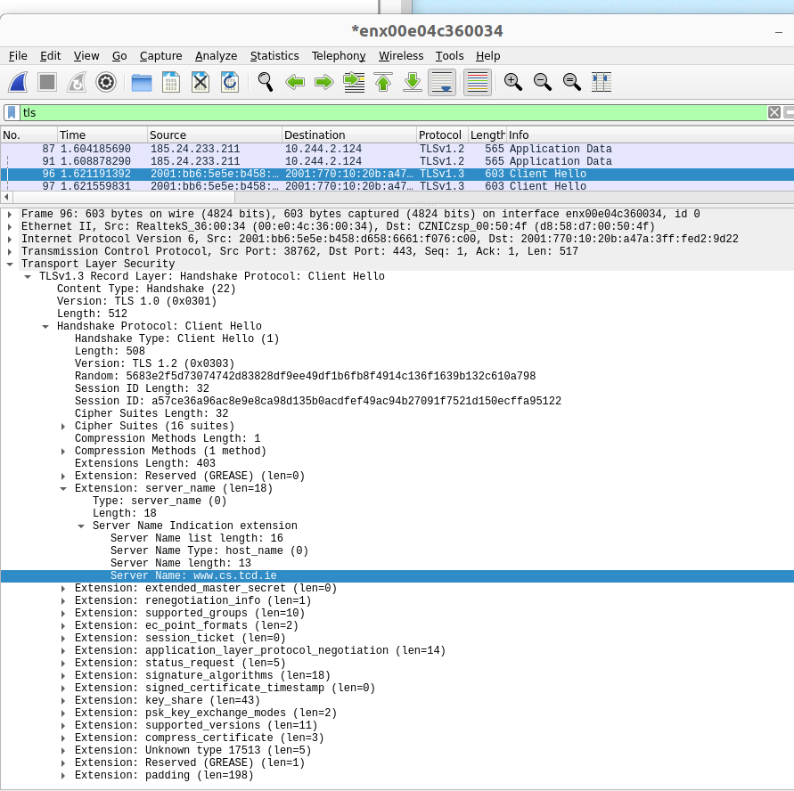
The SNI “Leak”
Wireshark knows how to decode this a ClientHello and we can see the cleartext SNI value on the right
That ClientHello message was sent from a browser when I accessed https://www.cs.tcd.ie

Slide 7
SNI as a leak
Since the SNI value is sent in the first message, neither party has a key with which to encrypt, so SNI is sent in clear in the first TLS handshake message (the ClientHello)
When accessing https://bank.example.com/getBalance the “getBalance” part will be encrypted (later, when the full HTTP request is sent) but the DNS name (“bank.example.com”) is sent in clear in the SNI extension
That’s a noticeable leak, especially as the SNI is visible to everyone on the path (my ISP, the site’s ISP, every intermediate router, hosters, governments)
SNI has also been used for censorship
  https://www.bleepingcomputer.com/news/security/south-korea-is-censoring-the-internet-by-snooping-on-sni-traffic/

Slide 8
SNI as a leak
Domain “fronting” (where the SNI has the hoster’s name but the HTTP request has the “real” DNS name) was brittle and got turned off by service providers
Previously, we weren’t motivated to try address this quite tricky problem because...
  TLS server certificate was sent in the clear prior to TLS1.3
  DNS name sent in clear using DNS protocol, but now we do have DNS privacy mechanisms (DoT/DoH)

Slide 9
What we’d like, and can do now
(“co-located” variant)
Web Server
TLS session
TLS
Client
(browser)
TLS
server
Cover
Site(s)
Cover
Site(s)
ClientHello->
(incl. “Cover”
or no SNI)
<-ServerHello
...
Hiddden
Site
Hiddden
Site(s)

Slide 10
Encrypted ClientHello (ECH)
Solution being developed in the IETF TLS WG: https://datatracker.ietf.org/doc/html/draft-ietf-tls-esni
Current draft is version -14, been in development since mid-2018
Latest version seems complete, now at the stage of testing
Multiple implementations exist, including mine
  https://github.com/sftcd/openssl/ is my “fork” of OpenSSL - a very widely used TLS/encryption library that can be used with apache, nginx, lighttpd (web server implementations) and haproxy versions I’ve modified to support ECH
  List: https://github.com/tlswg/draft-ietf-tls-esni/wiki/Implementations

Slide 11
How does ECH work?
Needs ability to create/consume new DNS resource records
Needs TLS1.3 (earlier versions send server cert in clear)
DNS privacy (DoT/DoH) not strictly needed but if you don’t use that maybe there’s less point in using ECH (Browsers will likely couple the two)
Web site publishes a new public key/value in the DNS (“SVCB” or “HTTPS”) with some additional keys (HPKE public values) for ECH
ECH-aware client (e.g. browser) can check if DNS record exists and has ECH keys
All going well, use those ECH keys with HPKE (RFC 9180 )to derive a new shared-secret and send the “real” ClientHello message encrypted in side an “outer” ClientHello message
The fact that ECH is being used is still visible

Slide 12
ECH Picture
DNS
Look up A/AAAA
and HTTPS
TLS
Client
(browser)
TLS session
Cover
Site
Hiddden
Site

Slide 13
GREASEing ECH
The fact that ECH is being used is still visible
That may be countered via “GREASEing” - having browsers that are not using ECH sometimes send a ClientHello that looks like it does use ECH
GREASEing is an anti-ossification TLS implementation trick – clients and servers include garbage values for optional things in order to decrease the probability that middleboxes fixate on currently deployed protocol options - RFC8701

Slide 14
The details….
Hybrid Public Key Encryption (HPKE – RFC9180)
HTTPS or SVCB RR in DNS
Inner/Outer ClientHellos
HelloRetryRequest gank
Code

Slide 15
HPKE – RFC 9180
A way to do ephemeral-static ECDH for a payload, i.e., to agree a symmetric key and use that to AEAD encrypt a payload that’s usually a symmetric key (used to encrypt the inner ClientHello)
Handles the various algorithm identifiers (KEM, KDF, AEAD), mixing the additional data as required and how to do multiple encryption operations (and decryptions too:-)
My (standalone) OpenSSL-based implementation https://github.com/sftcd/happykey
  hpke.c has 1971 lines of code (says cloc)
  Submitted PR to OpenSSL project: https://github.com/openssl/openssl/pull/17172 in November 2021, awaiting decision from OpenSSL management ctte still
Used for ECH, but also other new protocols: MLS, OHAI, an extension to QUIC, …
  https://datatracker.ietf.org/doc/rfc9180/referencedby/
A bit tedious to code, but not too hard and good test vectors exist and it seems to provide a useful abstraction
The public key values that enable ECH are the static HPKE values that are intended to be published in the DNS… as an ECHConflgList
  The relevant TLS server has to have the associated static private values

Slide 16
ECHConfigList
opaque HpkePublicKey<1..2^16-1>;
uint16 HpkeKemId; // Defined in RFC 9180
uint16 HpkeKdfId; // Defined in RFC 9180
uint16 HpkeAeadId; // Defined in RFC 9180
struct {
HpkeKdfId kdf_id;
HpkeAeadId aead_id;
} HpkeSymmetricCipherSuite;
struct {
uint8 config_id;
HpkeKemId kem_id;
HpkePublicKey public_key;
HpkeSymmetricCipherSuite cipher_suites<4..2^16-4>;
} HpkeKeyConfig;
struct {
HpkeKeyConfig key_config;
uint8 maximum_name_length;
opaque public_name<1..255>;
Extension extensions<0..2^16-1>;
} ECHConfigContents;
struct {
uint16 version;
uint16 length;
select (ECHConfig.version) {
case 0xfe0d: ECHConfigContents contents;
}
} ECHConfig;
ECHConfig ECHConfigList<1..2^16-1>;

Slide 17
A simple ECHConfigList
Base64 encoded:
AD7+DQA65wAgACA8wVN2BtscOl3vQheUzHeIkVmKIiydUhDCliA4iyQRCwAEAAEAAQALZXhhbXBsZS5jb20AAA==
Output of base64 -d | hd:
00000000 00 3e fe 0d 00 3a e7 00 20 00 20 3c c1 53 76 06 |.>...:.. . <.Sv.|
00000010 db 1c 3a 5d ef 42 17 94 cc 77 88 91 59 8a 22 2c |..:].B...w..Y.",|
00000020 9d 52 10 c2 96 20 38 8b 24 11 0b 00 04 00 01 00 |.R... 8.$.......|
00000030 01 00 0b 65 78 61 6d 70 6c 65 2e 63 6f 6d 00 00 |...example.com..|

Slide 18
HTTPS and SVCB RRs
Publishing ECHConfigList values in the DNS is fine but not enough to motivate deployment, we needed to try solve some other problems (for CDNs) to get there
In particular multiple-CDNs and “CNAME at apex” problems, but also other web issues (e.g. port!=443, HSTS, alt-svc, ALPN)
The result is new SVCB and HTTPS RR types
HTTPS is a simplified version of SVCB
  https://datatracker.ietf.org/doc/html/draft-ietf-dnsop-svcb-https
In addition to ECHConfigList values, an SVCB can also contain “hints” about IPv4 or IPv6 addresses, “alias” and ALPN information – the idea is to (ideally) get everything a browser might need in as few DNS queries/answers as possible
  The goal is to avoid additional round-trips – browsers care most about speed!
Situations requiring chasing SCVB RRs are envisaged (sort of like CNAME chasing)

Slide 19
A simple HTTPS RR value
QNAME is foo.example.com
Zone file fragment is
foo.example.com. 10 TYPE65 \# 71 ( 00010000050040003efe0d003ae7002000203cc1537606db1c3a5def421794cc778891598a222c9d5210c29620388b24110b000400010001000b6578616d706c652e636f6d0000 )

Slide 20
Rotating ECH Keys
While HPKE is ephemeral-static, servers may (and do) rotate the values
  Hourly for my servers and cloudflare’s
Servers need to keep “old” private values and be able to decrypt using those, as well as the freshest ones currently visible in DNS
  In my case, I keep the 3 most recent, and for twice the TTL
TLS servers (e.g. web server) therefore need to regularly reload keys and DNS infrastructure needs to be setup to handle regular re-publication of HTTPS/SVCB values
  A proposal for that: https://datatracker.ietf.org/doc/draft-farrell-tls-wkesni/ that caters for different administrators for web servers and DNS
  That proposal may be adopted or not, we’ll see

Slide 21
Browser Actions
A DoH- and ECH-enabled browser will likely send DNS queries for A, AAAA and HTTPS RRs (and maybe SVCB too) before initiating contact
  It may then chase SVCB RRs as indicated in the relevant values
  Likely that HTTPS/SVCB will only be used if browser knows queries sent via DoH
If there is an ECHConfigList in a relevant RR then the browser will supply that to some TLS client API, before connection is attempted
  nss for FF, boringssl for chrome etc.
When the TLS client library initiates the TLS handshake and has a (valid-looking) ECHConfigList then the library will trigger use of ECH

Slide 22
TLS Client Library Actions for ECH
Prepare the “inner” ClientHello (CH) as usual expressing the “real” intent
“Compress” the inner CH where the same values will also be present in the outer CH
Lots of complexity there for any value fed into the key derivation now we have to prepare for two outcomes (the client doesn’t know ECH will work out as planned)
More complexity due to e.g. “custom” CH extension handlers
Use an HPKE API to prepare and encrypt the inner CH, producing an ECH extension value to include in the outer CH
Prepare the outer CH so that it would also work (if ECH fails at the server for whatever reason)
Ready the state machine so that expected responses to either inner or outer CH can be handled
Send the CH (including an ECH extension) to the server...

Slide 23
Web Server Actions
Provide configuration settings for loading (and re-loading) ECH keys and ECHConfigList values
  Might be tied to specific VirtualHosts or similar
Don’t peek into the SNI in the ClientHello as it might be an outer CH when the real value to be used is in the inner CH
  Can require (fairly simple) server code changes

Slide 24
TLS Server Library Actions
If configured for ECH, check very early if there is an ECH extension in CH
If so try decrypt (using HPKE) and if successful replace state with content of inner CH
Handle error cases by falling back to processing outer CH
If ECH processing succeeded then signal that to client in the ServerHello random value using a “magic” value

Slide 25
Complications...
Handle GREASE so things don’t fail
HelloRetryRequest (HRR) where initial CH (inner or outer) has parameters (in particular chosen curves) incompatible with server, but that may be recoverable
Early-data used in 0RTT – will be encrypted with inner CH keys so can’t be handled if ECH decryption fails
Split-mode ECH where different servers handle front-end and back-end
  Note: split-mode + HRR can require major s/w architecture changes in front-end (at least for haproxy)
Clients like curl or wget will require significant re-engineering to handle the complexity of HTTPS/SVCB RRs and related caching – without ECH they can just use the OS’s DNS or a simple cache of A/AAAA values

Slide 26
Code
My OpenSSL fork with ECH is at https://github.com/sftcd/openssl
Last time I looked there were about 8k new lines of code, (incl. HPKE) but affecting lots of different parts of the TLS state machine
  Such widespread changes are not easy to evaluate
That’s likely a major work-item (and risk) for the upstream OpenSSL maintainers to incorporate
  And they’ll for sure disagree with some internal API detailed design changes I’ve made along the way
  My changes also had to deal with the evolution of the upstream code over the couple of years involved, which weren’t insignificant

Slide 27
Testing...
Basic interop tests
  On localhost, with other client/server implementations
Test harnesses
  OpenSSL make test target is complex
Fuzzing
  https://github.com/sftcd/echdnsfuzz
Internet-accessible servers (e.g. https://defo.ie/)

Slide 28
Personnel
It’d likely have been much harder to do any of this without contacts with other relevant developers
Some of the main contact points for ECH for other code-bases have changed over time too
Different folks’ timelines and priorities also change over time

Slide 29
Interesting thing #1
People who hate DNS privacy, probably hate ECH even more; for them, this is browsers and major web sites taking away information from which they’ve benefited
  They used to monitor DNS queries but now DoT/DoH make that much harder
  Switched to monitoring SNI from TLS ClientHello messages, and now ECH may kill that off
They may have been using that information for what you consider good or bad (they considered it “good”):
  Censorship, net-nanny, corporate policy enforcement, whitelisting TLS sessions to not MITM
That DNS or SNI information could also be used for profiling or sold to advertisers, but I’m not aware of reliable information that that has happened

Slide 30
Interesting thing #2
The people proposing/backing ECH are (I believe) doing so to try improve privacy (e.g. me, mozilla, aclu)
ECH may however further increase centralisation since hiding in larger crowds is more effective
It could be that the likes of cloudflare (test server deployed), apple (implemented client and server earlier) and google (implemented in boringssl library so far) are the main beneficiaries of ECH – how should we consider that result?

Slide 31
Interesting thing #3
ECH may make some kinds of Internet measurement harder, maybe a lot harder
How do we try get accountability for software and systems without leaving open gaping holes to be exploited by attackers or nation-states?
  Answer: we don’t know (or at least I don’t)

Slide 32
Interesting thing #4
My guess is that whether or not, and how well, Google chrome implement ECH GREASEing will be the key determinant of whether or not ECH gets long term deployment
As ECH sticks out, censors like the GFW can just block it
That’s easy if it’s not widely used and would kill deployment
If almost all ClientHello messages appear to contain ECH then such blocking gets harder
  Maybe not for the GFW but perhaps for most other censors

Slide 33
Last interesting thing
The processes for defining and implementing ECH are open to anyone with the skills and interest to get involved
  Consumes a lot of time, but getting the skills required isn’t really hard, all of you are certainly smart enough
So you could (if you choose) end up involved in key decisions about how the Internet affects us all that can reverberate up to fairly highly political levels
  (Don’t get a big head though:-)
  That’s part of the “permissionless innovation” I mentioned before
It’s also possible to be as involved with fewer technical skills, e.g. in civil society organisations or campaigning groups

Slide 34
Want to try it out?
As of 2022/03…
Install FF nightly
Enable DoH (settings/General/Network-settings and scroll down to “Enable DNS over HTTPS”) with your chosen provider
GOTO about:config
  Set network.dns.echconfig.enabled to True
Try it with some test sites:
  https://defo.ie/ech-check.php (mine)
  https://crypto.cloudflare.com/cdn-cgi/trace (cloudflare’s – not as nice IMO:-)
I hope, in future, it’ll be a standard thing you’ll never notice

Slide 35
Conclusion
ECH is an attempt to close off a remaining privacy leak in TLS
ECH is not that simple, but that’s because it’s a hard problem (to encrypt before 1st contact, at scale)
We’re now at a point where larger scale test deployments are possible
It’ll be interesting to see if this gets widely deployed or not in the next few years
  I hope it does!

