Slide 1
Improving TLSv1.3 privacy
a work-in-progress
Encrypted Server Name Indication
becomes
Encrypted ClientHello
Stephen Farrell
Trinity College Dublin
stephen.farrell@cs.tcd.ie
April 2020

Slide 2
TLS and SNI
Transport Layer Security (TLS, RFC8446) is the security protocol that secures the web and many other applications – HTTP running over TLS is what makes HTTPS
One web server instance (e.g. an apache install using more than one VirtualHost) can, and very frequently does, serve multiple web sites
Each of those may (and is very likely to) use different TLS server key pairs/certificates

Slide 3
TLS for multiple web sites
Web Server
TLS session
TLS
Client
(browser)
TLS
server
Web
Site
Web
Site
Web
Sites
ClientHello->
(incl. SNI)
<-ServerHello
...

Slide 4
TLS and SNI
One of the first things an HTTPS server needs to do is pick a TLS server key/certificate to use for the TLS session
The client needs to verify that it’s talking to the correct server via the TLS server certificate, which (for the web) contains the domain name of the web site
Result: the first TLS message the client sends (the ClientHello) needs to specify the web site (DNS name) for which the TLS session is being established
That’s done using the Server Name Indication (SNI) extension to the ClientHello (RFC6066)

Slide 5
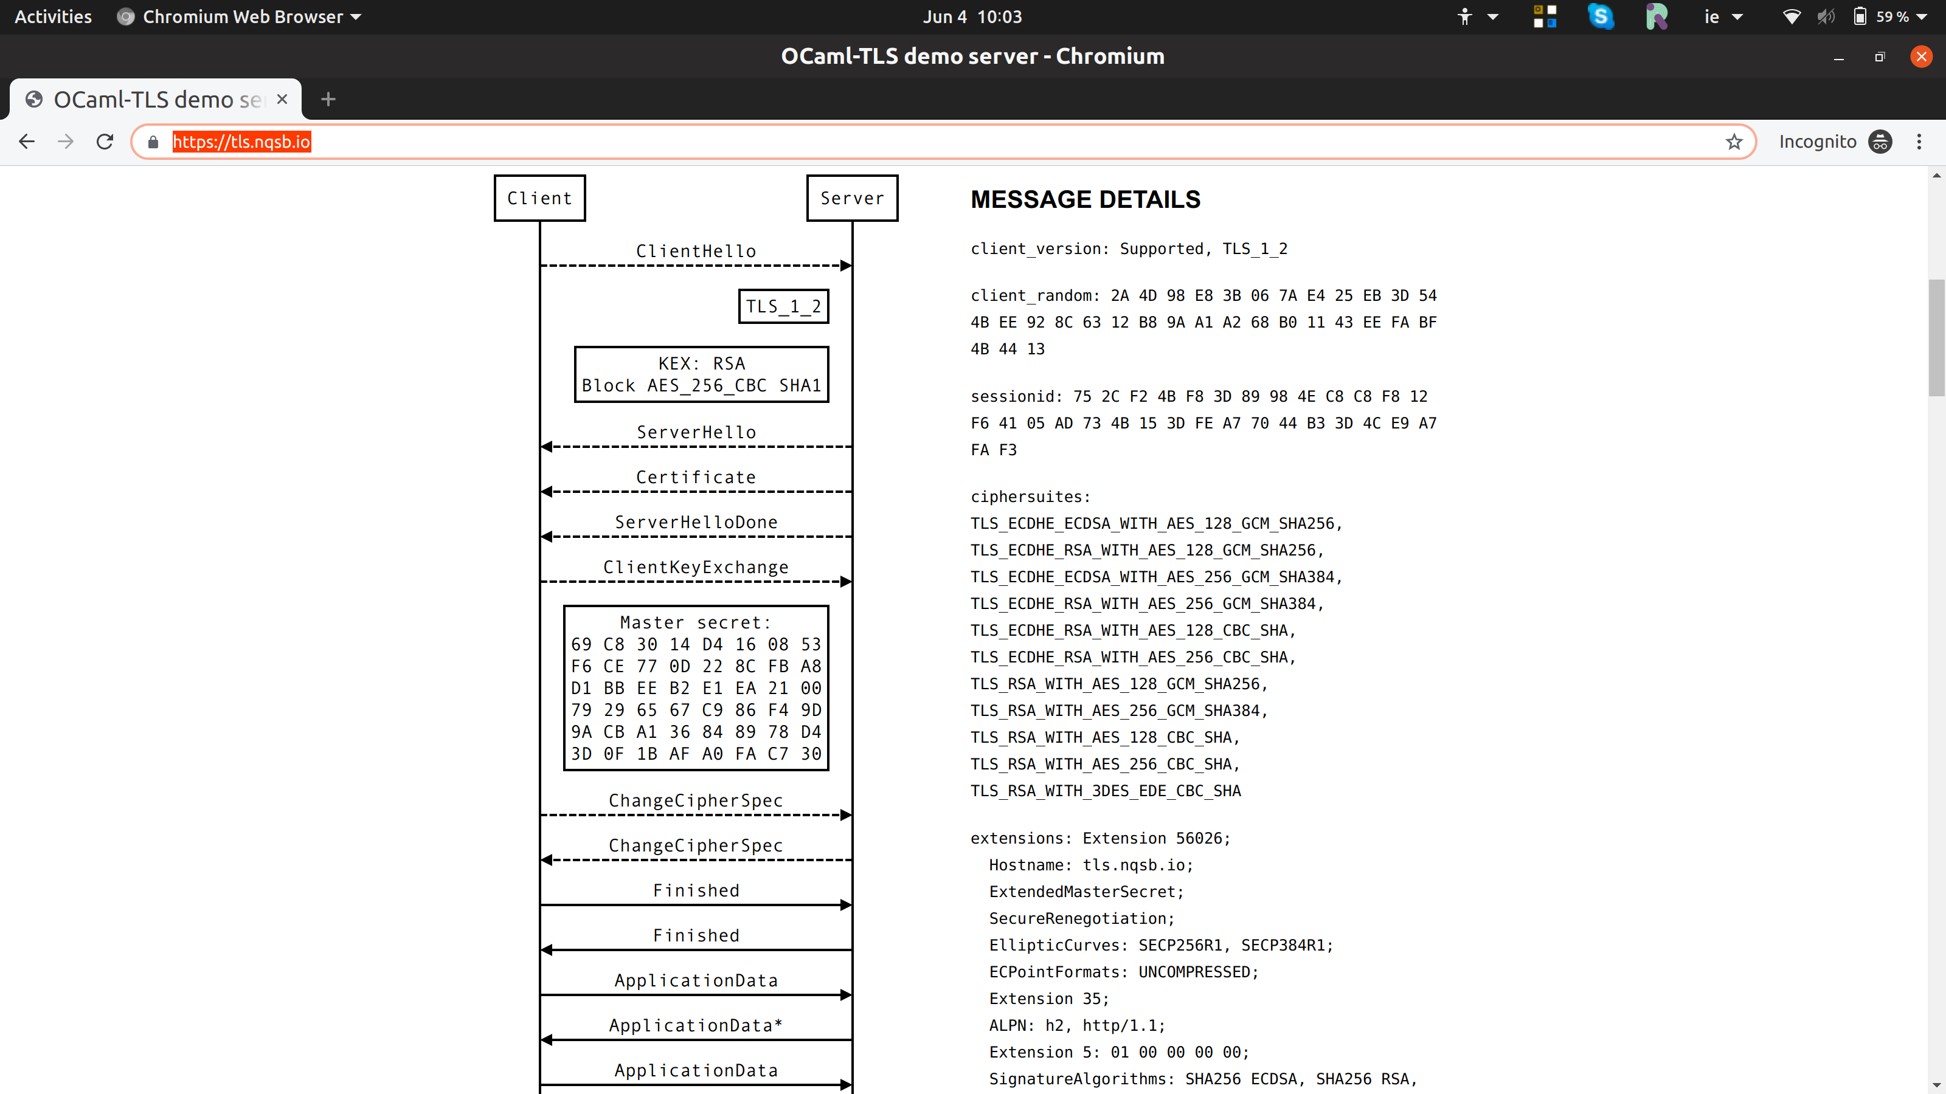
TLS Handshake
Nice TLS visualisation: https://tls.nqsb.io/
SNI

Slide 6
SNI as a leak
Since the SNI value is sent in the first message, neither party has a key with which to encrypt, so SNI is sent in clear in the first TLS handshake message (the ClientHello)
When accessing https://bank.example.com/getBalance the “getBalance” part will be encrypted (later, when the full HTTP request with the full URL is sent) but the DNS name (“bank.example.com”) is sent in clear in the SNI extension
That’s a noticeable leak, especially as the SNI is visible to everyone on the path (my ISP, the site’s ISP, every intermediate router, hosters, governments)
SNI has also been used for censorship
  https://www.bleepingcomputer.com/news/security/south-korea-is-censoring-the-internet-by-snooping-on-sni-traffic/

Slide 7
SNI as a leak
Domain “fronting” (where the SNI has the hoster’s name but the HTTP request has the “real” DNS name) worked, but was brittle and got turned off by service providers
Encrypting SNI might be attractive to enterprises that like the idea of hiding the fact that someone is accessing payroll.example.com vs. marketing.example.com
Previously, we weren’t motivated to try address this quite tricky problem because...
  TLS server certificate is in the clear prior to TLSv1.3
  DNS name in clear via Do53, but now we have DoT/DoH
  Reminder: Remember, we all love DoH:-)

Slide 8
Consensus on the problem
The IETF’s TLS working group has reached consensus on the problem to be addressed: https://tools.ietf.org/html/draft-ietf-tls-sni-encryption
Ideal solution likely not achievable, but would:
  Withstand TLS session message replay to expose SNI
  Not require a new key distribution infrastructure
  Make it hard to spoof “cover” server
  Not create new DoS vectors
  Not “stick out” (allow hiding in crowds)
  Provide forward secrecy for encrypted SNI
  Support co-located or separated “cover” and “hidden” services
  Work for more than the web (SMTP/TLS etc.)

Slide 9
What we’d like, and can do now
(“co-located” variant)
Web Server
TLS session
TLS
Client
(browser)
TLS
server
Cover
Site(s)
Cover
Site(s)
ClientHello->
(incl. “Cover”
or no SNI)
<-ServerHello
...
Hiddden
Site
Hiddden
Site(s)

Slide 10
“Split” variant
TLS
Client
(browser)
TLS session
Cover
Site
???
Hiddden
Site
Details of “cover” to “hidden” protocol are TBD
Protocol details likely fairly obvious
Correlation attack likely hard to mitigate
Terminolgy isn’t final:
  Cover vs. Front vs. public_name
  Hidden vs. Private name
  all used variously for the same things

Slide 11
Encrypted SNI (ESNI) or
Encrypted ClientHello (ECHO)
Solution being developed in the IETF TLS WG: https://tools.ietf.org/html/draft-ietf-tls-esni
  Current draft is version -06; most implementers currently seem to be on draft -02
  Earlier versions were called ESNI, name changed to ECHO in March 2020 (draft-06)
Maybe <12 months from being done
Plenty of interest, so may get fairly wide deployment
Deployments and Implementations:
  Cloudflare (https://encryptedsni.com)
  Firefox nightly
  Mine:-)
You can access any Cloudflare-hosted site using ESNI today, e.g. the IETF’s public web site (https://www.ietf.org/)

Slide 12
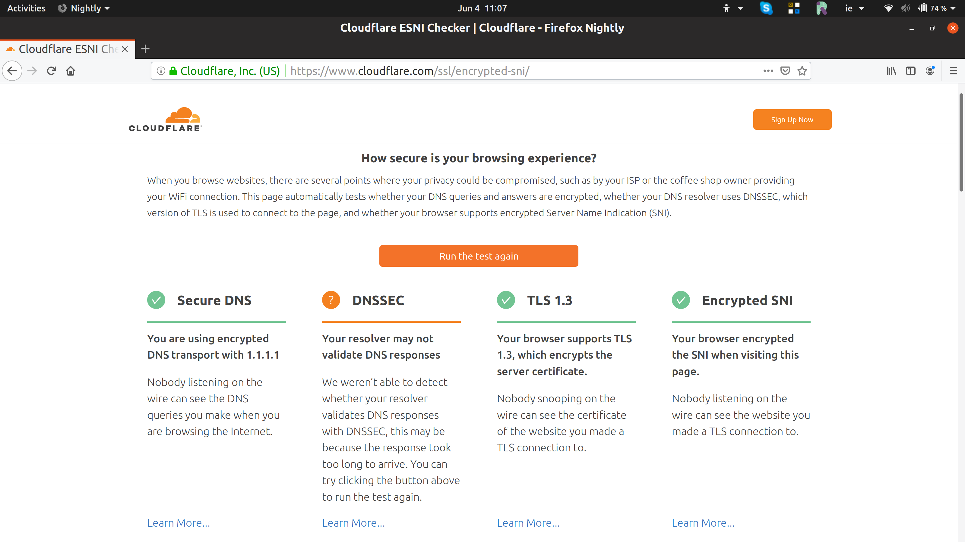
Encrypted SNI (ESNI)

Slide 13
My OpenSSL fork implementation
I’m working on an implementation of ESNI for the OpenSSL library: https://github.com/sftcd/openssl/tree/master/esnistuff
Code for versions -02 and -03 and -04 today (March 2020)
Not tested, no guarantees, early days, etc., etc.
Test server available at https://defo.ie/
  Has lighttpd, apache and nginx deployments all supporting ESNI using my OpenSSL fork and v. modest changes to the web server builds
  Updates ESNI keys hourly, with 3 hour ESNI key lifetime
  Zone is DNSSEC-signed too btw:-)
  If you wanna play, let me know, some people have already
Whether or not any of my code ends up in a standard release of the OpenSSL library is for later and will be determined via the OpenSSL project’s usual mechanisms for handling contributions
This project is funded by the OpenTech Fund (https://opentech.fund/) and is called “Developing ESNI for OpenSSL” or DEfO and details are also at https://defo.ie

Slide 14
How does ESNI/ECHO work?
Requires ability to create/consume new DNS resource records
MUST use TLSv1.3 (earlier versions send server cert in clear so no point)
DNS privacy (DoT/DoH) not strictly needed but if you don’t, what’s the point?
  Firefox implementation couples the DoH and ESNI/ECHO
Web site publishes a new public key/value in the DNS (in “ESNIKeys” or “HTTPSSVC” RR for ECHO)
TLS client (e.g. browser) checks if DNS record exists
If it does, all going well, use public value to derive a new shared-secret and send the true server name value in encrypted form in a new TLS ClientHello extension
The fact that this is being used is visible, but GREASE may help
TLS client may or may not send an outer/cleartext SNI (“cover” name) as well as the encrypted one
With ECHO, additional “inner” ClientHello fields can be encrypted, e.g. ALPN

Slide 15
ESNI/ECHO Picture
DNS
Look up A/AAAA
and ESNIKeys
or HTTPSSVC
TLS
Client
(browser)
TLS session
Cover
Site
Hiddden
Site

Slide 16
ESNIKeys (1)
ESNIKeys invented by TLS implementers, so defined
using TLS presentation syntax
Draft-02:
struct {
uint16 version;
uint8 checksum[4];
KeyShareEntry keys<4..2^16-1>;
CipherSuite cipher_suites<2..2^16-2>;
uint16 padded_length;
uint64 not_before;
uint64 not_after;
Extension extensions<0..2^16-1>;
} ESNIKeys;
Draft-03:
struct {
uint16 version;
uint8 checksum[4];
opaque public_name<1..2^16-1>;
KeyShareEntry keys<4..2^16-1>;
CipherSuite cipher_suites<2..2^16-2>;
uint16 padded_length;
uint64 not_before;
uint64 not_after;
Extension extensions<0..2^16-1>;
} ESNIKeys;

Slide 17
ESNIKeys (2)
Draft-02 used TXT RR with bas64 encoding of ESNIKeys
  published at _esni.hidden.example.com
  ESNIKeys.version 0xff01
Draft-03 uses a new (not yet officially assigned) RRTYPE
  Binary value published at apex of hidden.example.com
  ESNIKeys.version 0xff02
  Includes public_name (cover name) and address_set
Model is to frequently re-publish new values in DNS
  CF currently do it ~hourly, so do I with defo.ie
Changes to all this are ongoing

Slide 18
Key Derivation (up to draft-04)
Public key/value from DNS is an (EC)DH public value
TLS client invents it’s private/public value in same group
Z is the derived DH secret
Zx = HKDF-Extract(0, Z)
ESNIContents couples ESNIKeys, the new client key share and TLS session
key = HKDF-Expand-Label(Zx, "esni key", Hash(ESNIContents), key_length)
iv = HKDF-Expand-Label(Zx, "esni iv", Hash(ESNIContents), iv_length)
ClientESNIInner = nonce + padded version of “hidden” name
encrypted_sni = AEAD-Encrypt(key, iv, ClientHello.KeyShareClientHello, ClientESNIInner)
TLS server decrypts then demonstrates knowledge of nonce via an EncryptedExtension

Slide 19
GREASEing
The fact that ESNI/ECHO is being used is visible
That may be countered via “greasing” - having browsers that are not using ESNI/ECHO sometimes send a ClientHello that looks like it does use ESNI/ECHO
Greasing is an anti-ossification TLS implementation trick – clients and servers include garbage values for optional things in order to decrease the probability that middleboxes fixate on currently deployed protocol options – RFC 8701 describes how GREASE works in general for TLS

Slide 20
ESNI and multiple services (1)
Web sites use multiple CDNs and may switch between those (for price or availability reasons) frequently
DNS information is cached - all values from the DNS have a time-to-live (TTL) value, which can be small (e.g. 5 seconds) or large (e.g. 1 week)
When playing the ESNI game, client needs both the IP address of the site (A/AAAA) and the new public key (ESNIKeys)
Those could get out of whack for various reasons, perhaps especially if a web site is switching between CDNs
BUT – we don’t know how bad this problem may be – early evidence seems to show it’ll not be a big deal for clients, but could occasionally be for web sites
If problems were too common, browsers/CDNs might not deploy

Slide 21
ESNI and multiple services (2)
Two proposals have been made to address this problem:
  Include IP address information in the ESNIKeys value (in draft-03)
  Include IP address-range information in the ESNIKeys value
If draft-03 ends up as the final approach, it’ll cause some sysadmins to freak (again:-) as it’d duplicate address information in different places in the DNS, likely breaking tooling and network monitoring
Address-range proposal seems better to me, but is more complex and maybe has more cases where the A/AAAA and ESNIKeys values might not match - effect could be failed connections or falling back to cleartext SNI when ESNI ought be usable
Implementers are just starting to play with this so it’s not yet set off alarm bells... But it will if it stays as-is;-)

Slide 22
ESNI beomes ECHO
Problems:
  “Bespoke” ESNI key derivation was clunky
  Binding ESNI to outer handshake is a bit tricky (got to consider cut’n’paste attacks of various kinds)
  There are other things in the ClientHello we might like to hide
  ESNIKeys DNS RR is a little hard to justify and is very specific to this feature so might be less likely to be deployed
Solution (plan):
  Use a more generic/standard key wrapping/derivation that may be useful elsewhere (HPKE)
  Use an entire “inner” ClientHello as plaintext instead of just SNI, so we can hide more and be more future proof (e.g. hiding ALPN is good too)
  Work with browser/DNS people on a more generic HTTP alternative services DNS RR construction that also solves other problems (e.g. CNAME at zone apex) to increase liklihood of deployment

Slide 23
HPKE – Hybrid Public Key Encryption
HPKE aims to be a generic way to “encrypt application data using an AEAD, to a public key”
Not intended to be an application itself, but rather a tool that protocols and applications can use
Specification: https://tools.ietf.org/html/draft-irtf-cfrg-hpke
(My) code: https://github.com/sftcd/happykey
  OpenSSL based, intended for integration with my ESNI-enabled OpenSSL fork

Slide 24
HTTPSSVC Resource Record
Aims to enable a web site operator to publish various useful bits of information about that web site in the DNS
Specification: https://tools.ietf.org/html/draft-ietf-dnsop-svcb-httpssvc
Problems being addressed:
  Public key for ECHO
  What ALPN value(s) to use?
  Is the origin also at some alternative host:port as well?
  CNAME at zone apex problem for CDNs

Slide 25
Encrypted inner ClientHello
Model for ECHO becomes:
  Create an “inner” CH with the “real” settings, including the SNI that we want
  Encrypt that “inner” CH (using the public key from HTTPSSVC) and include the ciphertext as an extension in the “outer” CH
  Make up the “outer” CH to look “innocent” (probably by copying the non-sensitive bits of the “inner” CH to the “outer”)
Issues that creates:
  More complexity (sigh)
  Client has to guess (via trial decryption) if server’s answer relates to inner or outer CH (e.g. if wrong/old ESNI public key used)

Slide 26
ECHO Status
Latest ESNI draft (-06) sort of specifies ECHO
More work needed before we can do interop, so likely draft-07 needed soon
  I’m doing (some of) that work now:-)
A branch of my OpenSSL fork that had a guess of how that might end up (done before the draft-06 published)
  https://github.com/sftcd/openssl/blob/encch/esnistuff/echo.md
Padding discussion provides a good example of the kind of complexities involved
  https://github.com/tlswg/draft-ietf-tls-esni/pull/209

Slide 27
Conclusion
Encrypted SNI or ECHO is a fine continuation of our efforts to reduce cleartext meta-data exposing privacy-sensitive information
Spec definitely a work-in-progress but it also definitely works
Interest levels high so reasonable to expect stuff will happen in 2020
Feel free to get in touch if you’re interested
  stephen.farrell@cs.tcd.ie
  draft spec: https://tools.ietf.org/html/draft-ietf-tls-esni
  (my:-) code: https://github.com/sftcd/openssl/tree/master/esnistuff
  standalone HPKE code: https://gitbhub.com/sftcd/happykey
  DEfO project site: https://defo.ie/
Thanks!

