Slide 1
CS7053
Computer Security
Stephen Farrell & Michael Clear
stephen.farrell@cs.tcd.ie & clearm@tcd.ie
Course materials:
https://down.dsg.cs.tcd.ie/cs7053/
https://github.com/sftcd/cs7053
Slideware + some papers
Notes:
Who I am!
Who are you?

Slide 2
Administrivia
Lectures:
  Mon 1700-1800, LB04
  Wed 1500-1700, Salmon Theatre
Lecturers – we'll swap about:
  Weeks 1-3: Stephen
  Weeks 4-6: Michael
  Week 7: Reading Week?
  Week 8: Michael
  Weeks 9 & 10: Stephen
  Week 11: Michael
  Week 12: Stephen

Slide 3
Examination
80/20 exam/assignments marking split
  Old exam questions/solutions:
  https://down.dsg.cs.tcd.ie/old-exams/index.html
Assignment 1 (15%) “security considerations”
Assignment 2 (5%) “security incident” or PR
Dates:
  Due: any time up to the last day I'm marking exam papers, April 1st if you prefer a date
  Feel free to send versions for feed back
  Send PDF via email to Stephen
    Subject: cs7053 assignment
    File name: <<yourname>>.pdf

Slide 4
Assignments
Security Considerations:
  3-4 pages usually; use 'em in dissertation
  Discuss the security issues for your dissertation topic – see RFC 3552
    http://tools.ietf.org/html/rfc3552
Security Incident:
  1 page describing a significant incident that happens during the course saying why its significant
  Or, a github PR that's accepted

Slide 5
Course Outline
Introduction
Security Concepts
Cryptography
Core Internet Security Standards
Snowdonia and consequences
Some more advanced crypto
Some specific protocol stuff, may change, last year:
  Firewalls/IDS, Spam, DNSSEC etc.

Slide 6
Computer Security is...
...a good thing to study (“one born every minute”, and some of those are programmers!)‏
...something with more and more impact (scaling factor is about the same as the Internet)‏
...a part of risk management

Slide 7
Risk Management
Risks (bad things)‏
  Disclosure of trade secrets
  Sabotage (information or hardware)‏
  Denial of service
  Accidents (fire, flooding, earth quakes, …)‏
Solutions (not always good things)‏
  Security policies and mechanisms
  Physical security (locks, guards, CCTV, …)‏
  Formal specification/verification of software
  Halon, UPS, off-site backups

Slide 8
Vulnerabilities
Risks arise due to the existence of vulnerabilities in computer systems
All systems have vulnerabilities, our goal is not to remove absolutely all of them, but to control their impact
  Reducing numbers is good
  Can also isolate parts of the system (e.g. Firewalling)‏

Slide 9
Vulnerabilities
Most common:
  Scripting user agents
  Buffer overruns
  XSS & Injection (e.g. SQL injection)
  Insecure default settings
Uncommon, but interesting:
  Acoustic side-channel key extraction,
    Genkin, Shamir & Tromer
  http://eprint.iacr.org/2013/857.pdf

Slide 10
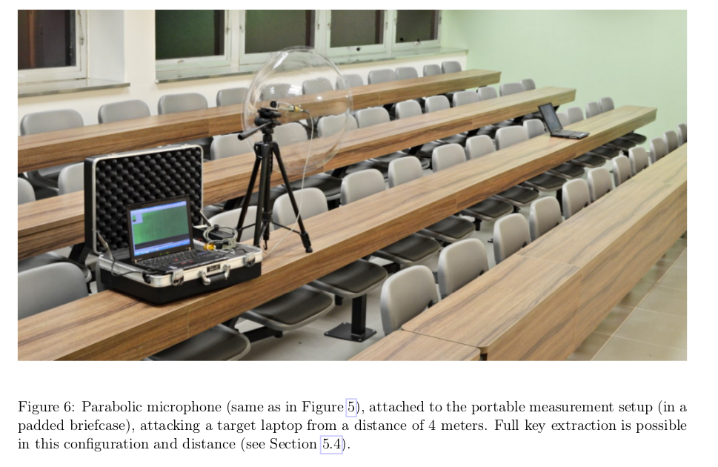
Sssshhhh....

Slide 11
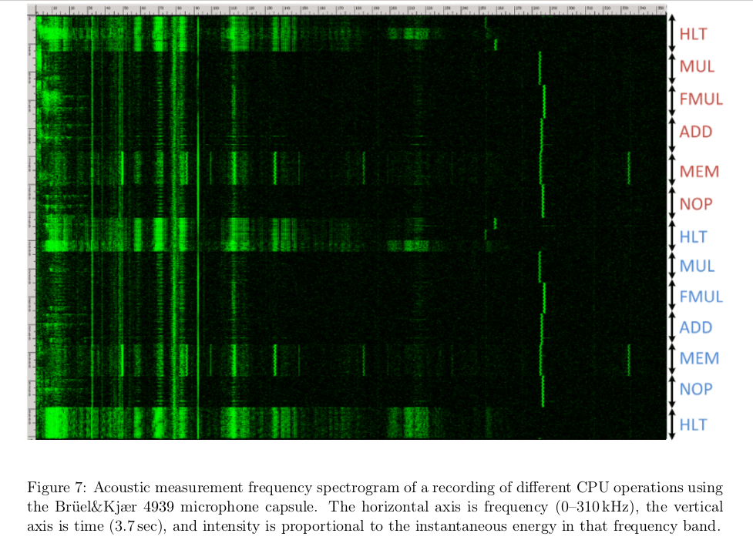

Slide 12
Good/Bad Actors
Systems have users
  Normal, administrative, “root”
Networks have nodes
  “Inside”, “outside”, trusted...
Attackers
  Can be one of the above
  Or not: a hijacked ISP router

Slide 13
Possible Bad Actors
Disgruntled employees (plenty)‏
Crackers (hackers)‏
Script-Kiddies (cracker wannabes)‏
Spies (industrial and military)‏
Criminals (thieves, organized crime)‏
Terrorists
Governments

Slide 14
Possible Exploits
Force legitimate user to reveal passwords
Social engineering
Recruit legitimate user
Sabotage (fire, electricity, …)‏
Sifting through garbage
Attacking the network (network threats)
Install malware‏

Slide 15
Active/Passive Attacks
Active attacks
  Fabrication, modification, deletion, replay of messages
Passive attacks
  eavesdropping/traffic analysis
  can be off-line (e.g. weak encryption)‏
Different protocol mechanisms are used to counter these

Slide 16
Summing up risk
Risk is a function of the cost of threats and their probability of occurrence
  Which function can be debated
  High/Medium/Low
    For both costs and probabilities
Threats occur when a vulnerability is exploited

Slide 17
Computer Security Goals
Traditional Security Goals: "CIA"
  Confidentiality
    Keeping secrets
  Integrity
    Preventing unauthorised modifications
    Keeping data consistent
  Authentication/Assurance/Availability
    The meaning of the “A” depends upon who you ask!

Slide 18
Services and mechanisms
From the old “OSI” world, we've inherited two (sometimes confusing) concepts:
  Security service: provides a security function to the system, based on the use of security mechanisms, e.g. confidentiality
  Security mechanism is a technique, or protocol etc. which can be used to provide a service, e.g. encryption, access control

Slide 19
Services/Mechanisms
Confidentiality
    Access control
    Cryptography
    Secure communication channels
Integrity
    Checksums
    Digital signatures
    Secure communication channels
Availability
    Designing secure software and communication protocols

Slide 20
Other buzzwords not yet mentioned
Privacy
Snowdonia
Trusted computing/ digital rights management
Usable Security

Slide 21
Puzzle
(If you know the answer already, please STFU/stay quiet!)
How do you send a secret message via courier (when you don't trust the courier)?

