Slide 1
CS7053/CS7453
Internet security & privacy
Stephen Farrell
stephen.farrell@cs.tcd.ie
Course materials:
https://down.dsg.cs.tcd.ie/cs7053/
https://github.com/sftcd/cs7053
Slideware + some papers
Notes:
Who I am!
Who are you?

Slide 2
Administrivia
Lectures:
  Mon 1700-1800, LB04
  Wed 1000-1100, LB08
  Wed 1700-1800, LB04
Dates:
  Term: Today -> April 7th
  Reading week: Feb 37th – Mar 3rd
  Me away: week of Mar 27th
    Will let you know what’s on closer to time

Slide 3
Examination
80%/20% exam/assignments marking split
  Old exam questions/solutions:
  https://down.dsg.cs.tcd.ie/old-exams/index.html
Assignment 1 (15%) “security considerations”
Assignment 2 (5%) “security incident” or PR
Dates:
  Due: any time up to the last day I'm marking exam papers, April 1st if you prefer a date
  Feel free to send versions for feedback
  Earlier emails get more feedback
  Send PDF to stephen.farrell@cs.tcd.ie
    Subject: cs7053 assignment
    File name: <<yourname>>.pdf

Slide 4
Assignment Tasks
Security Considerations:
  3-4 pages usually; use in dissertation/FYP
  Discuss the security issues for your dissertation topic – see RFC 3552
    https://tools.ietf.org/html/rfc3552
Security Incident:
  1 page describing a significant incident that happens during the course saying why its significant
  Or, a github PR that's accepted

Slide 5
Course Outline
Introduction
Security and privacy concepts
(Enough) cryptography (AES, RSA, ...)
(To grok) core security standards (TLS,...)
Stuff that's interesting for the last few weeks
  Ethics of disclosures
  Snowdonia and consequences
  More advanced crypto (ECC, FHE)
  Firewalls/IDS, Spam, DNSSEC etc.

Slide 6
Computer and Network Security is...
...a good thing to study (“one born every minute”, and some of those are programmers!)‏
...something with more and more impact (scaling factor is about the same as the Internet)‏
...a part of risk management

Slide 7
Privacy is...
...nowhere near as well understood
...an issue for people and not companies‏
...not clearly a part of risk management, but related

Slide 8
Risk Management
Risks (bad things)‏
  Disclosure of trade secrets
  Sabotage (information or hardware)‏
  Denial of service
  Accidents (fire, flooding, earth quakes, …)‏
Solutions (not always good things)‏
  Security policies and mechanisms
  Physical security (locks, guards, CCTV, …)‏
  Formal specification/verification of software
  Halon, UPS, off-site backups

Slide 9
Vulnerabilities
Risks arise due to the existence of vulnerabilities in computer systems
All systems have vulnerabilities, our goal is not to remove absolutely all of them, but to control their impact
  Reducing numbers is good
  Can also isolate parts of the system (e.g. Firewalling)‏

Slide 10
Vulnerabilities
Most common:
  Scripting user agents
  Buffer overruns
  XSS & Injection (e.g. SQL injection)
  Insecure default settings
Uncommon, but interesting:
  Acoustic side-channel key extraction,
    Genkin, Shamir & Tromer
  https://eprint.iacr.org/2013/857.pdf

Slide 11
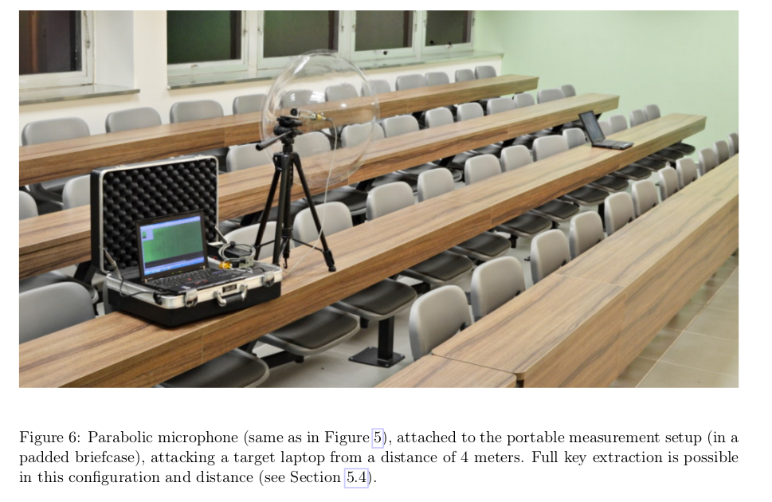
Sssshhhh....

Slide 12
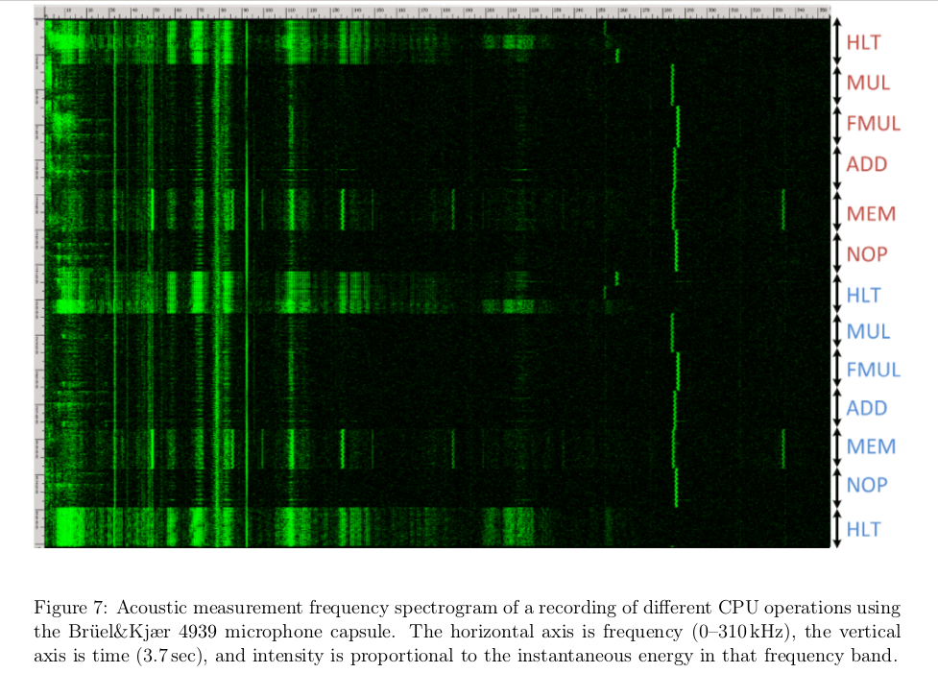

Slide 13
Good/Bad Actors
Systems have users
  Normal, administrative, “root”
Networks have nodes
  “Inside”, “outside”, trusted...
Attackers
  Can be one of the above
  Or not: a hijacked ISP router, a compromised SIM card factory, etc.

Slide 14
Possible Bad Actors
Disgruntled employees (plenty)‏
Crackers (hackers)‏
Script-Kiddies (cracker wannabes)‏
Spies (industrial and military)‏
Criminals (thieves, organized crime)‏
Terrorists
Governments

Slide 15
Possible Exploits
Force legitimate user to reveal passwords
Social engineering
Recruit legitimate user
Sabotage (fire, electricity, …)‏
Sifting through garbage
Attacking the network (network threats)
Install malware‏

Slide 16
Active/Passive Attacks
Active attacks
  Fabrication, modification, deletion, replay of messages
Passive attacks
  eavesdropping/traffic analysis
  can be off-line (e.g. weak encryption)‏
Different protocol mechanisms are used to counter these

Slide 17
Summing up risk
Risk is a function of the cost of threats and their probability of occurrence
  Which function can be debated
  High/Medium/Low
    For both costs and probabilities
Threats occur when a vulnerability is exploited

Slide 18
Privacy
Less well understood than security
Who cares? About what?
  Governments, marketers and large corporates do “care deeply” about your (lack of) privacy
How to protect that?
  Encrypt things in transit and storage
  Short-lived dynamic identifiers are better than long-lived static identifiers
  Just don't (require) identification

Slide 19
Other terms not yet mentioned
Snowdonia/pervasive monitoring
Usable Security
Trusted computing
Digital rights management

Slide 20
A cyber-warning
With very few exceptions people who say cyber-blah have little or no clue
  Or feel forced to succumb to “the market”
Cyber-foo is a marketing term for almost all foo
  Avoid using it
  When you hear it, be suspicious

Slide 21
Puzzle
(If you know the answer already, please STFU/stay quiet!)
How do you send a secret message via courier (when you don't trust the courier)?

