Slide 1
Oblivious Pseudo-Random Functions (OPRFs)
An example of newer crypto primitives
(sort-of extending the idea of hash functions)
https://datatracker.ietf.org/doc/html/draft-irtf-cfrg-voprf
CS7NS5/CSU44032
stephen.farrell@cs.tcd.ie
https://down.dsg.cs.tcd.ie/cs7053/
https://github.com/sftcd/cs7053

Slide 2
Introduction
This a new twist on some relatively old ideas but now with some possibly topical applications
Yay! Basing on old ideas (from 1992 in this case) is somewhat re-assuring WRT patents on the basic ideas
Yay! New topical applications – justify the (non-trivial) effort in mapping from a peer-reviewed cryptographic publication to an implementable API/protocol/application
But – don’t get carried away, not all new things end up important

Slide 3
Discrete Log Equivalence: DLEQ
Chaum, D., Pedersen, T.P. (1993). Wallet Databases with Observers. CRYPTO’ 92, section 3.2 (https://doi.org/10.1007/3-540-48071-4_7)
In a prime order group (order q), if we have secret scalar k and group elements such that B = A^{k} and D = C^{k}, a “prover” can prove this to a “verifier” without exposing k
Everyone knows q, A, B, C, D
Prover chooses random s, computes A^{s} and C^{s}; Prover sends A^{s} and C^{s} to verifier
Verifier chooses random challenge c and sends that to prover
Prover sends back “the proof”: r = s + c.k
Verifier accepts proof if A^{r} == a.B^{c} and C^{r} == b.D^{c}

Slide 4
Additive description of DLEQ
Changing description of original DLEQ to better match VOPRF spec...
  It’s really the same but just looks different:-)
In a prime order group (order p), if we have secret scalar k and group elements such that B = k.A and D = k.C, a “prover” can prove this to a “verifier” without exposing k
Everyone knows p, A, B, C, D
Prover chooses random s, computes a = s.A and b = s.C
Prover sends a and b to verifier
Verifier chooses random challenge c and sends that to prover
Prover sends back “the proof”: r = s + c.k
Verifier accepts proof if r.A == a + c.B and r.C == b + cD
Note: I think the above is correct but we’re at the limits of my crypto skills:-)

Slide 5
Pseudo Random Function (PRF)
A function F(k,_) is pseudorandom if the keyed function K(_) = F(k, _) is indistinguishable from a randomly sampled function acting on the same domain and range as K()
Cryptographers care about the above as it affects what can be proven, but for us, it’s just a matter of definition

Slide 6
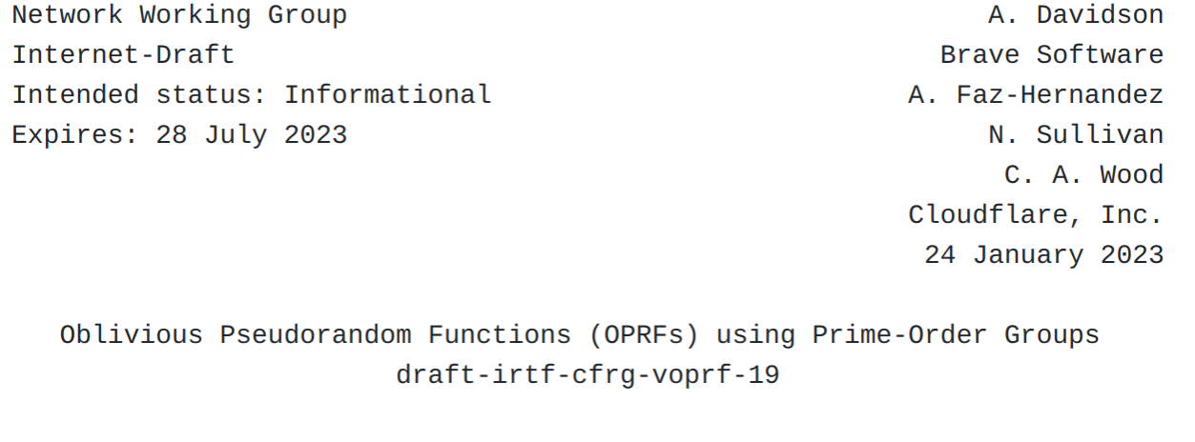

Slide 7
OPRF, VOPRF, POPRF
An Oblivious PRF (OPRF) is a two-party protocol between a server and a client, where the server holds a PRF key k and the client holds some input x. The protocol allows both parties to cooperate in computing F(k, x) such that the client learns F(k, x) without learning anything about k; and the server does not learn anything about x or F(k, x). A Verifiable OPRF (VOPRF) is an OPRF wherein the server also proves to the client that F(k, x) was produced by the key k corresponding to the server's public key the client knows. A partially oblivious PRF (POPRF) is a VOPRF with an additional public input y, based on F(k, x, y).

Slide 8
Proof/Verify Functions
The draft...https://datatracker.ietf.org/doc/html/draft-irtf-cfrg-voprf
... builds on DLEQ so that we can prove the equivalence for a set of m+1 values at once, not just two (without affecting the size of the proof)
... uses additive notation e.g. B = k.A rather than B = A^{k} but don’t let that bother you (they’re groups, and in practice elliptic curve groups)
... replaces exchange of random numbers with hashes/transcripts based on input values and context-distinguishing strings (e.g. the string “Challenge”) – the lengths of things are explicitly part of such transcripts – this makes the DLEQ scheme non-interactive (‘cause we don’t need a client to choose the challenge ‘c’)
Section 2.2 isn’t entirely obvious, but if you work it out, you’ll conclude that believing the DLEQ result means beliving this too
The draft is basically dealing with the usual elliptic curve groups (based on 25519, p256 etc)

Slide 9
Protocols
The spec defines OPRF, VOPRF and POPRF variant protocols, we’ll only look at the last (it does what the others do too)
In these protocols, the client is a verifier, the server is the prover, but there may be other verifiers later (recall the DLEQ scheme is non-interactive)
Basic idea is client “blinds” it’s input, sends blinded input to server which then uses the DLEQ trick (that’s the OPRF version) – blinding can be as simple as multiplying by a random scalar; the client can “unblind” (or “Finalize()”) results received from the server
The server’s secret (skS) in the VOPRF or POPRF setting is an asymmetric private value, such that the public value (pkS) allows the client to check the PRF output; the client of course needs to get to know the public value somehow
  VOPRF plays the DLEQ game with A = the group identity, B = pkS and C[0] = the blinded-input and with C being a 1-element list
The POPRF version additionally has a public input (“info”) known to both client and server that is also fed into the protocol (“tweaking” skS)

Slide 10
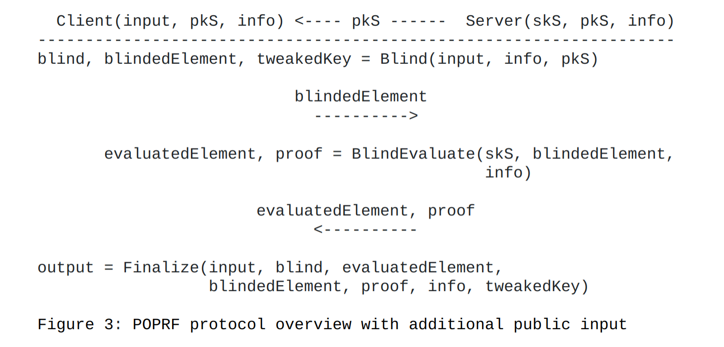
POPRF Protocol

Slide 11
An application
There are applications of such functions related to secret sharing and PAKEs but perhaps the main motivating one is...
... as an alternative to CAPTCHAs
PrivacyPass is such a technology: idea is to acquire a set of tokens from an issuing server (prover) that can be presented to a verifier, e.g. as evidence there’s a human behind the keyboard, without the verifier being able to correlate token usage and without the client being able to cheat
  https://datatracker.ietf.org/doc/html/draft-ietf-privacypass-protocol
  Oddly, the privacypass protocol makes use of VOPRFs in a context where the verifier knows the issuer’s secret (see section 5.4 of the above draft)

Slide 12
Conclusion
Relatively usable new(er) cryptographic primitives are being defined, often based on earlier more theoretic work
Those with broad applicability that get used for popular applications may become more important; not many will clear that hurdle (IMO)
Some of these are non-trivial to understand and use well – that’s a downside: it’s all very well to be super-clever, but (e.g. as engineers) we don’t want to deal with tons of new, less well-known, things constantly turning up, as they could increase risk (newer, buggy code; more attack surface; easily mis-understood; more centralising, ...)
But, our currently “core” cryptgraphic functions, (confidentiality, integrity, hashes, KDFs, PRNGs, etc.) might change or need to be expanded in future (or might not)

