Slide 1
CS7NS5/CSU44032
Security & privacy
Stephen Farrell
stephen.farrell@cs.tcd.ie
Course materials:
https://down.dsg.cs.tcd.ie/cs7053/
https://github.com/sftcd/cs7053
Slideware + some papers
Notes:
Who I am!
Who are you?

Slide 2
Computer and Network Security is...
...a good thing to study (“one born every minute”, and some of those are programmers!)‏
...something with more and more impact (scaling factor is about the same as the Internet)‏
...a part of risk management

Slide 3
Privacy is...
...nowhere near as well understood
...an issue for people and not companies‏
...not clearly a part of risk management, but related
  I’m unsure if risk analysis is a good approach to address privacy

Slide 4
So-called “consent”
Web sites/services/licensed things (like s/w) impose terms and conditions and require you “consent” to those (maybe via a “click-through”)
  Legal fiction, everyone knows people do not read T&C documents designed to obfuscate
  Apparently, that legal fiction is still considered non-fiction by courts
So-called “consent” is an awful model that only pretends to address privacy
Good presentation on the so-called “consent” problem, with IMO less good (but worth exploring) ideas on HOWTO fix https://datatracker.ietf.org/meeting/105/materials/slides-105-ietf-sesse-privacy-modern-concerns-steven-m-bellovin-00.pdf

Slide 5
Privacy
RFC 6973 - In addition to “normal” security threats we need to care about
  Correllation
  Identification
  Secondary use
  Disclosure
  Exclusion
  Re-identification

Slide 6
Privacy Puzzle
Emails can contain a Received header field which can contain the mail user agent IP address
  What consequences?
  Overall good or bad from a privacy perspective?
Redacted example:
Received: from localhost (ip-xxx-xxx-xxx-xxx.bb.vodafone.cz. [xxx.xxx.xxx.xxx])
by smtp.gmail.com with ESMTPSA id
h16-yyyyyyyyyyy.40.2023.01.30.05.40.25
(version=TLS1_3 cipher=TLS_AES_256_GCM_SHA384 bits=256/256);
Mon, 30 Jan 2023 05:40:25 -0800 (PST)

Slide 7
Sidebar: Internet RFCs
Last slide referred to RFC 6973
  https://datatracker.ietf.org/doc/html/rfc6973
The Request For Comment (RFC) series has been an important way to document Internet protocols and practices since 1969 when RFC1 was written
Most recent one I co-authored: RFC 9446, published July 2023
RFCs are freely available at many places but you can always get ‘em via the IETF (the main body producing RFCs), e.g. at
  https://datatracker.ietf.org/doc/rfc9446/
Not all RFCs specify protocols, some are process things, some are nerdy jokes (April 1st RFCs), and there’re other types too
There will be some RFCs that you will have to read to pass the exam
Anyway, I’ll usually not bother with URLs for RFCs as it should be obvious how to get ‘em

Slide 8
Privacy Processes
Various have been proposed or are in use, but this is not a mature space (IMO)
Privacy by design
    https://en.wikipedia.org/wiki/Privacy_by_design
Data protection by design and default
    https://ico.org.uk/for-organisations/guide-to-data-protection/guide-to-the-general-data-protection-regulation-gdpr/accountability-and-governance/data-protection-by-design-and-default/
Data protection impact assessments
    https://dataprotection.ie/en/organisations/know-your-obligations/data-protection-impact-assessments
A fairly good OWASP-person’s slide deck from 2018
    https://owasp.org/www-pdf-archive/TOREON_Adding_Privacy_by_Design_in_Secure_Application_Development_v20180412.pdf

Slide 9
Irish Covidtracker example
In 2020 the HSE (with developer Nearform) produced a GAEN covid tracking application
  https://www.hse.ie/eng/services/news/newsfeatures/covid19-updates/covid-tracker-app/
Way more information than you need on the Google/Apple Exposure Notification (GAEN) system:
  https://down.dsg.cs.tcd.ie/tact/
Original DPIA:
  https://github.com/HSEIreland/covidtracker-documentation/blob/master/documentation/privacy/Data%20Protection%20Impact%20Assessment%20for%20the%20COVID%20Tracker%20App%20-%2026.06.2020.pdf
While (I believe) they wanted to do all the right things, in a space that was very “foreign” for the HSE, the end result wasn’t wonderful from a privacy perspective:
  Dependency on Google Play Services (not HSE’s fault, inherent in GAEN)
  Super-cookie: JWT token required for TEK download – most other GAEN apps have no such token
Note: the above is only about privacy, the efficacy of these apps is another question entirely (spoiler: I don’t think they were useful), but that wasn’t known (for sure) at that time

Slide 10
Privacy by design (PbD) Principles
7 "foundational principles":
Proactive not reactive; preventive not remedial
Privacy as the default setting
Privacy embedded into design
Full functionality – positive-sum, not zero-sum
End-to-end security – full lifecycle protection
Visibility and transparency – keep it open
Respect for user privacy – keep it user-centric
Not clear (to me) that incentives align here such that result will be a privacy “win.”

Slide 11
A few more thoughts on privacy
Who cares? About what?
  Many governments, marketeers and large corporates do “care deeply” about your (lack of) privacy
How can designers/implementers improve/protect privacy?
  Behave as if your entire family will all be users – minimise!
  Encrypt things in transit and storage
  Short-lived dynamic identifiers are better than long-lived static identifiers
  Just don't require identification
  Your idea here...
How can you help yourself as a user?
  Don’t create more accounts
  Target diversity
  Your idea here...
  Also see https://down.dsg.cs.tcd.ie/witidtm/

Slide 12
Risk Management
Risks (bad things)‏
  Disclosure of trade secrets
  Sabotage (information or hardware)‏
  Denial of service
  Accidents (fire, flooding, earth quakes, …)‏
Solutions (not always good things)‏
  Security policies and mechanisms
  Physical security (locks, guards, CCTV, …)‏
  Formal specification/verification of software
  Halon, UPS, off-site backups

Slide 13
Vulnerabilities
Many risks arise due to the existence of vulnerabilities in computer systems
All systems have vulnerabilities, our goal is not to remove absolutely all of them, but to control their impact
  Reducing numbers is good
  Can also isolate parts of the system (e.g. Firewalling)‏

Slide 14
Vulnerabilities
Very common:
  Scripting user agents
  Buffer overruns
  XSS & Injection (e.g. SQL injection)
    https://owasp.org/www-community/attacks/xss/
  Insecure default settings
Uncommon, but interesting:
  Acoustic side-channel key extraction,
    Genkin, Shamir & Tromer
  https://eprint.iacr.org/2013/857.pdf

Slide 15
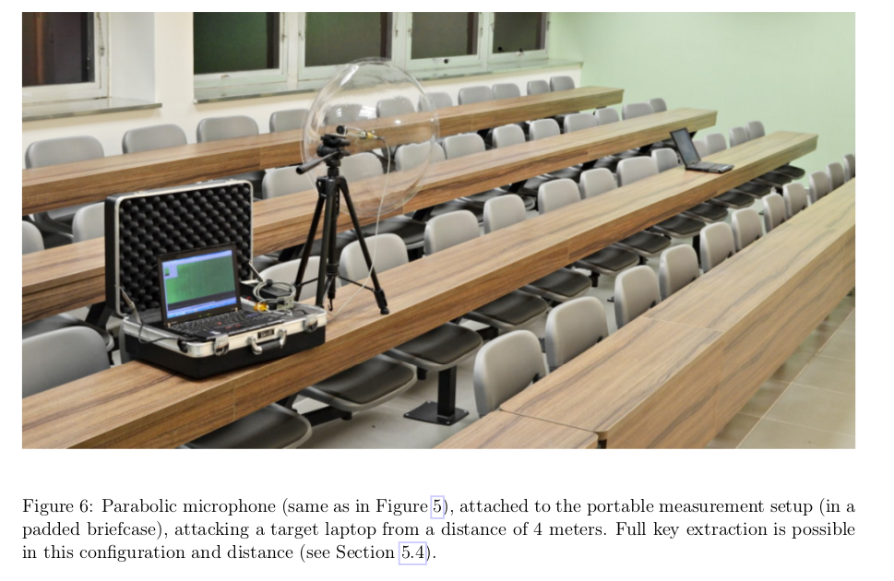
Sssshhhh....

Slide 16
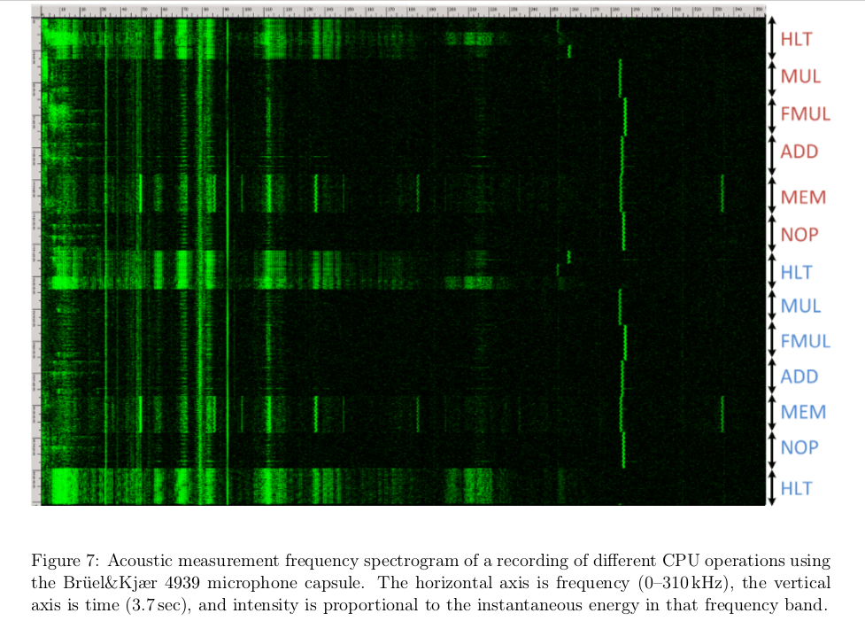

Slide 17
Good/Bad Actors
Systems have users
  Normal, administrative, “root”
Networks have nodes
  “Inside”, “outside”, trusted...
Attackers
  Can be one of the above, or not...
  Hijacked ISP router, compromised SIM card factory, bot etc.

Slide 18
Possible Bad Actors
Disgruntled employees (plenty)‏
Crackers (hackers)‏
Script-Kiddies (cracker wannabes)‏
Spies (industrial and military)‏
Criminals (thieves, organized crime)‏
Terrorists
Governments
Bait’n’switchers (service providers who change business model)

Slide 19
Possible Exploits
Force legitimate user to reveal passwords
Social engineering
Recruit legitimate user
Sabotage (fire, electricity, …)‏
Sifting through garbage
Attacking the network (network threats)
Install malware‏

Slide 20
Active/Passive Attacks
Active attacks
  Fabrication, modification, deletion, replay of messages
Passive attacks
  Eavesdropping/traffic analysis
  Can be off-line (e.g. if weak encryption)‏
Different protocol mechanisms are used to counter these

Slide 21
Risk Analysis Process
Many variations exist, mostly they resemble:
  Identify assets
  Identify risks and vulnerabilities
  Consider probabilities
  Consider consequent costs/losses
  Rank risks
  Develop mitigation(s) for highest ranked risk(s)
  Iterate, until effort exhausted or time up
    All the time recording what you’ve done

Slide 22
Summing up risk
Risk is a function of the cost of threats and their probability of occurrence
  Which function can be debated
  High/Medium/Low
    For both costs and probabilities
Threats occur when a vulnerability is exploited

