Slide 1
WebRTC
How we’ve been doing lectures
this last few weeks...
Various bits of this follow:
https://github.com/webrtc-security/webrtc-security.github.io/blob/master/index.md

Slide 2
WebRTC Functions
WebRTC is a way to make encrypted voice/video calls directly between two web browsers
  Ideal flow is direct ciphertext packets from one browser to the other and that works just fine e.g. with IPv6 at home, that is; in a peer-to-peer mode
A web site mediates call setup using Javascript and standard interfaces implemented in web browsers, and calls use standard protocols for data, voice and video
  This sort of means that the signalling protocol is non-standard (up to whatever the JS developer wants) but the media path uses standard protocols (v. different from POTS!)
Uses: sales and support for web sites, conference calling for enterprises, calling between random people

Slide 3
WebRTC Standardisation
Co-operation between IETF (protocols) and W3C (browser APIs), largely driven by browser-makers but with lots of input from more traditional telcos
  https://datatracker.ietf.org/wg/rtcweb/
  https://www.w3.org/2018/07/webrtc-charter.html
Mostly smooth but took way longer than expected due to inherent complexity and a major bun-fight (>2 years) about which audio/video codecs to make mandatory-to-implement
  Such codecs have historically been patented – the telco industry was fine with that but with WebRTC open-source browsers replace handsets so patents and odd IPR licenses become much more of an issue
Standardisation-nerd lesson: don’t create a huge web of interdependencies in specifications – approx 100 almost-finished RFCs have been queued up waiting on one another for up to 5 years!
  https://www.rfc-editor.org/cluster_info.php?cid=C238

Slide 4
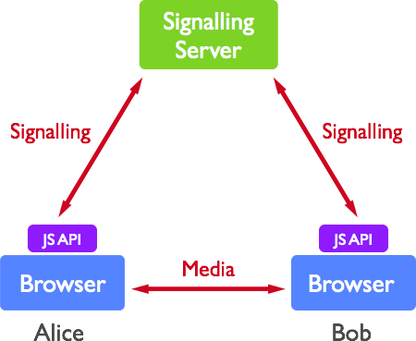
WebRTC Basic Flow

Slide 5
WebRTC – the bad side
Web site that sets up call can eavesdrop, maybe beyond life of call
  Can be detected in many cases, so less likely to be done commonly, but there are many bad actors in the world
“Consent” model is as broken as ever, but WebRTC extends SOP security model and “consent” model (for camera/mic) so is therefore making a bad situation worse
Peer-to-peer connections (a good thing) require exposing information about the peers’ IP addresses to work – sometimes those addresses can be sensitive
  OTOH WebRTC probably exposes many new correlators/identifiers despite the designers’ best intentions
  And they have tried to eliminate new privacy leaks where possible

Slide 6
WebRTC – the good side!
You can be your own phone company, https://jell.ie/webrtc/ is mine
  That’s all built from open-source, I didn’t write any WebRTC code at all, all I did was download, build and configure stuff, and I didn’t have to ask anyone for permission (figuring out how is time consuming but doable)
https://meet.jit.si/somerandomname is a slightly more scaleable WebRTC deployment and various others exists at that scale
Highly scalable tools like Cisco’s Webex use WebRTC without needing special client s/w; I’ve been on “calls” with >200 people that replaced a cancelled f2f conference session
Blackboard’s “collaborate ultra” feature is also a WebRTC instance
In COVID19 lockdowns, WebRTC has allowed many, many people to continue to work from home without having to install weird conference calling clients (not all video calling tools use WebRTC)

Slide 7
Try it and see
You can try a concall at:
  https://meet.jit.si/playingwithwebrtc
    The pathname in the URL can be whatever you want, a couple of other services do the same kind of thing
  I like Jitsi for calls with maybe up to 6 people
  Can see problems depending on mix of network configurations (anecdotally)
You can do that now or later
  But don’t stop paying attention to the lecture:-)

Slide 8
WebRTC Protocol Stack
The WebRTC protocol stack is incredibly baroque and complex
  All the usual HTTPS stuff, plus...
  Weird mixture of DTLS, SCTP, UDP, SRTP
  With added ICE, STUN and TURN for NAT fun
  And SDP for offer/answer fun
Reasons for WebRTC complexity:
  Browsers don’t normally talk to one another
  TCP isn’t great for real-time media
  Negotiating media parameters (codecs, bit rates, screen details) is complex
  Complicated corner-case use-cases: legacy interop, conference calls

Slide 9
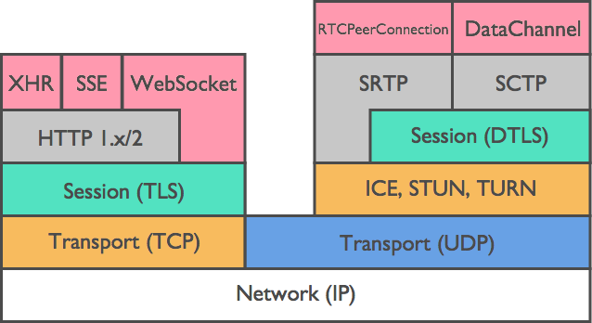
WebRTC Stack

Slide 10
WebRTC API Terms
XHR – XMLHttpRequest is a (now outdated by fetch()?) way to write asynchronous JS code
SSE – Server Sent Events API (uncommon?)
WebSockets – provide a way to send arbitrary data from a browser to a peer
RTCPeerConnection – is a new WebRTC API that allows a browser tx/rx real-time data with a peer browser in a WebRTC session
DataChannel is another WebRTC API, but for non-realtime data, e.g. the chat session in a call

Slide 11
SDP for media
Session Description Protocol (SDP, RFC 4566) was designed before WebRTC for VoIP
Offer/answer model where one peer says e.g. “I can do AV8, screen: 1024x768” etc. and other peer answers – kind of like TLS ciphersuite negotiation but with many more degrees of freedom
  Developers generally hate SDP as it’s exposed to the JS coder

Slide 12
WebRTC Protocol Terms
SRTP – is the Secure Real Time Protocol, RFC 3711 defines a way to secure real-time media traffic
DTLS – is the Datagram Transport Layer Security protocol, RFC 6347
DTLS-SRTP, RFC 5764 – defines how to use DTLS session keys for SRTP
SCTP – is the Stream Control Transmission Protocol, RFC 4960 – basically provides a mix of TCP-like and UDP-like features

Slide 13
WebRTC and NATs
Many browser instances will be behind a NAT
ICE – Interactive Connectivity Establishment (RFC 8445) is an algorithm for picking/agreeing whether to communicate directly or not, and if not, how – may use STUN and/or TURN
  Also handles IPv4 and IPv6 and multiple interfaces (e.g. WiFi and GSM)
STUN – Session Traversal Utilities for NAT (RFC 5389) – a STUN server on the public Internet enables a browser to figure out it’s public IP address
TURN – Traversal Using Relays around NAT (RFC 5766) provides a way to relay packets if there’s no other way to get them inside the NAT
Mostly: TURN servers are also STUN servers, but STUN servers are cheap (no media) whereas TURN servers can be expensive (media traffic goes via TURN server), so many STUN servers might not (willing to) offer TURN service
STUN and TURN servers are capable of collecting call meta-data

Slide 14
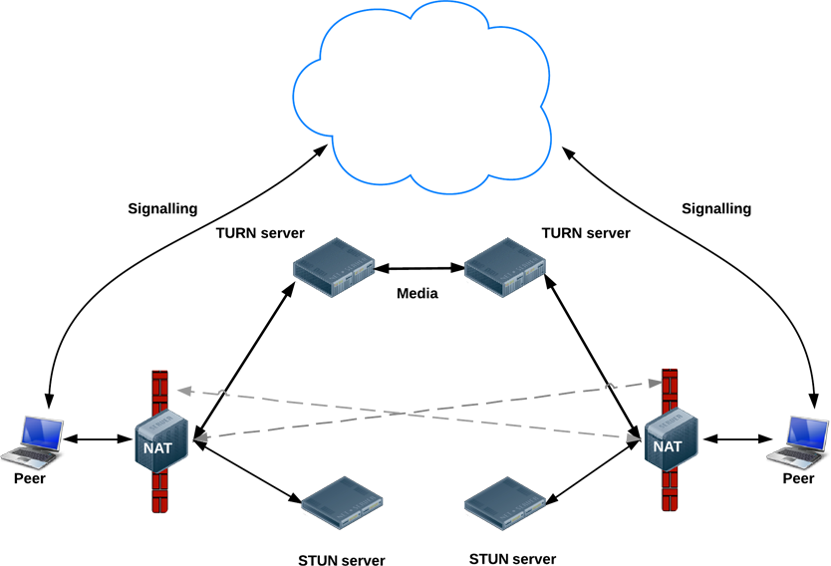
WebRTC and NAT
From https://www.html5rocks.com/en/tutorials/webrtc/infrastructure/

Slide 15
IP Location Privacy
ICE tries all the options (local addresses) it can to find the best path, ideally direct browser to browser without TURN
If a user is using a VPN, that can be considered sensitive – ICE might publish that fact to the network, and the network is sometimes the adversary
Took a couple of years to find a fix, eventually FF did
Problem was raised by privacy advocates who work in places with repressive regimes
Technical solution multicast DNS! (mDNS)
  For any sensitive addresses, invent a “<random>.local” DNS name
  If two browser both in same scope (e.g. on same LAN) then could resolve mDNS name
  If not, then sensitive address not exposed!
  Loosely based on how Apple do discovery in LANs (bonjour)
  https://tools.ietf.org/html/draft-ietf-rtcweb-mdns-ice-candidates

Slide 16
WebRTC Security Overview
Documented in:
  https://tools.ietf.org/html/draft-ietf-rtcweb-security

Slide 17
Permission Model
Browser Same Origin Policy (SOP) extended – user prompted to allow access for site to microphone/camera and that permission is sticky if the site uses HTTPS
  When WebRTC started, HTTPS was not as ubiquitous as today, likely plaintext HTTP will be blocked or already is
Use of microphone/camera likely indicated via icon on browser URL bar, and that’s also how a user can revoke permission (if they remember – would they?)
People on phones/tablets have less control (as always)
Overall effect: web sites get permission is my bet – not sure if anyone has tried to measure how many people say “no” (and keep saying “no”)

Slide 18
Transport Security
DTLS used for DataChannel
DTLS-SRTP used for media
  DTLS-SRTP uses the (D)TLS handshake and then exports sessions keys for use with SRTP and is run between browsers (after ICE is done)
  So web site doesn’t see the keys (but it could cheat if it wanted)
But… this is between browsers neither of which has a public key certificate, so how’s that gonna work?
  Leap of faith, mostly (so ToFU) – exchange digests of public keys in signalling and then treat those public keys as trusted (for that call) in TLS handshake
  Theoretically, one can link to an identity provider (IdP) but not clear how common or realistic that may be
  One use-case can provide authentication: if a person clicks on the “talk to an agent” button on a web-site then the web-site end of the call will be a server in a call centre that can have a good TLS server certificate

Slide 19
Browser debug info
Browsers have debug interfaces for WebRTC:
  Firefox: about:webrtc
  Chromium: chrome://webrtc-internals
  Opera: opera://webrtc-internals
You can see what ICE did and the full horror of SDP:-)

Slide 20
Conference calls
Zoom doesn’t do WebRTC but something similar but proprietary
  https://theintercept.com/2020/04/03/zooms-encryption-is-not-suited-for-secrets-and-has-surprising-links-to-china-researchers-discover/

