Slide 1
Some Security and Privacy issues
in the 21st Century Internet
stephen.farrell@cs.tcd.ie
2020201
(based on HEANET Conference talk from 2016)

Slide 2
TL;DR
  The talk will describe some of the ways in which Internet security and privacy have evolved over the past couple of decades. In brief, we have seen improved deployment of security technologies in an increasingly hostile environment, yet we also continue to see the same mistakes being made e.g. the absence of small-device software update. The conclusion can be optimistic or pessimistic, depending on one's point of view. However, it is clear that Internet security and privacy issues will continue to create employment opportunities for defenders and attackers.

Slide 3
Summary
Same mistakes get made over and over
But we are finally starting to gain real experience in deploying deployable security technologies
Same mistakes get made over and over
Privacy is the real next challenge
Same mistakes get made over and over
But there are things you can do to help...

Slide 4
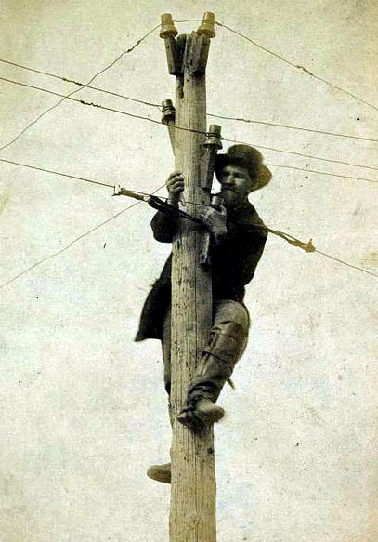
Let’s start in the 19th Century
A little before the Internet but…wires were tapped
  http://bugsweeps.com/info/wiretap_short_history.html
  https://www.counterpunch.org/2013/08/09/a-social-history-of-wiretaps-2/
Basic law enforcement requirement:
  Everything needs to be tappable
Same as current lawful intercept
  Not clearly a great plan

Slide 5
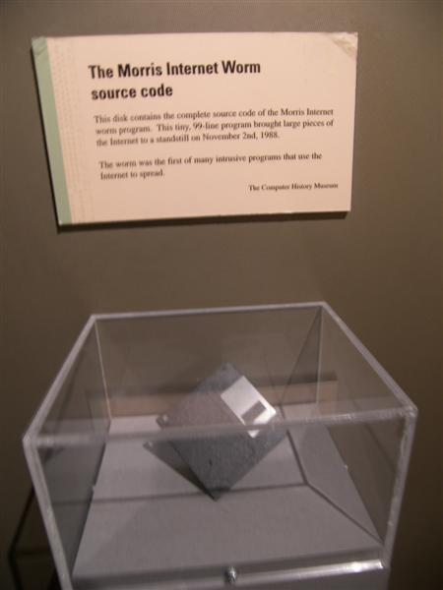
1988 – Morris worm
First widespread worm in the wild
Partitioned the Internet for days
Sendmail debug mode, fingerd buffer overrun, password guessing
  Buggy password guessing CPU consumption caused the DoS
Worth reading the initial report as it describes things from first principles
  https://spaf.cerias.purdue.edu/tech-reps/823.pdf
https://en.wikipedia.org/wiki/File:Morris_Worm.jpg

Slide 6

1993-today Name fun: digital.com
Owned by: DEC, Compaq, HP, and now “Quality Nonsense Ltd.” of London, UK
  https://digital.com is now some kind of review site
    Even has a bit of history of the name https://digital.com/about/#section-7
  https://betanews.com/2015/03/17/30-years-of-dotcom-what-became-of-the-first-100-domains/
In 2015, of 1st 100 .com domains:
  52% still same
  24% dead
  18% redirect new company
  6% redirect same company
One might speculate that in the long term less than 50% of DNS names will remain “good”
  but almost all Internet security mechanisms depend on DNS names!
https://en.wikipedia.org/wiki/File:Digital_556-flattened4.svg

Slide 7
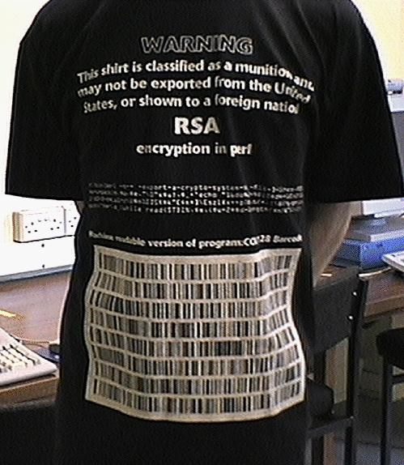
1999, 2016 – Crypto product survey
Surveys done in 1999 and 2016 identifying cryptographic products (incl. OSS) available worldwide
  Fewer in 2016, 546 vs. 805 “foreign,” but crypto is now a mainstream feature more than a product category
Not clear surveys are commensurate, except for the intended affect on US policy related to cryptography
  Any such laws are ultimately not a problem as mathematics is not nationalist!
  They can be a PITA though
https://cryptome.org/cpi-survey.htm
https://www.schneier.com/academic/paperfiles/worldwide-survey-of-encryption-products.pdf

Slide 8
2003-date – DDoS Galore
2003: SCO case...
  https://news.netcraft.com/archives/2003/12/10/ddos_takes_sco_site_down.html
  Web site “down for 3 days” after ~64Mb/s (50,000 packets/s) SYN flooding
  Our sympathies are where?
2016: Brian Krebs case…
  https://krebsonsecurity.com/2016/09/krebsonsecurity-hit-with-record-ddos/
  Journalist attacked by subject of article (who is in the business of DDoSing folks:-)
  620Gb/s attack, reportedly later 1Tb/s vs. Dyn
  Botnet of crap devices, not a reflection attack
DDoS is a cause of Internet centralisation forcing sites to use CDNs and similar, not really such a desirable thing

Slide 9
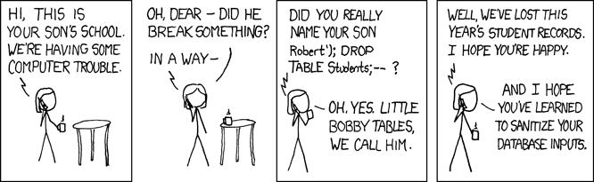
2003, 2013 – SQL Injection
  US FTC threatens petco.com with sanctions for leaking 500,000 user credit card details
    https://news.netcraft.com/archives/2003/12/10/us_regulators_probe_security_lapses_at_retailers.html
    In 2016, https://www.petco.com re-directed tohttp://www.petco.com even though they had TLS in place since at least 2013 (https://crt.sh/?q=petco.com)
      They’ve since fixed at least that
  2017: OWASP top-10? Still there @ #1!
https://www.xkcd.com/327/

Slide 10
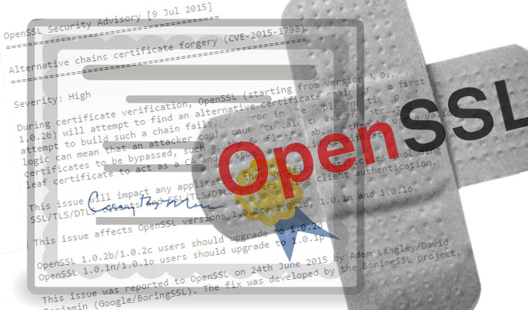
2003,2016 – openssl vulns/updates
2003: Various CVEs (bugs) in openssl reported, openssl updated, 50k web sites still using vulnerable old versions ~1 year after CVE
  https://news.netcraft.com/archives/2003/11/03/vulnerable_versions_of_openssl_apparently_still_widely_deployed_on_commerce_sites.html
Same old, same old in 2016
  https://news.softpedia.com/news/big-surprise-companies-are-slow-to-patch-latest-openssl-flaw-504579.shtml
OpenSSL team now much better
supported
  And… I might make that worse:-)
    https://github.com/sftcd/openssl
    Though I’ll try to make it better.
Not just OpenSSL though:
  This one is from Jan 29 2021:
  https://www.theregister.com/2021/01/29/severe_libgcrypt_bug/
https://threatpost.com/openssl-fixes-critical-bug-introduced-by-latest-update/120851/

Slide 11

2003 – Weird CA Business Model
A hoster offering “cheap” US$25/yr certs as a way to attract the kind of web site that uses SSL
  https://news.netcraft.com/archives/2003/09/09/do_ssl_certificate_authorities_still_have_a_margin_generating_business_model.html
The CA business model was always weird and still is
Things like LetsEncrypt (2015) and acme do however look promising
https://letsencrypt.org/

Slide 12
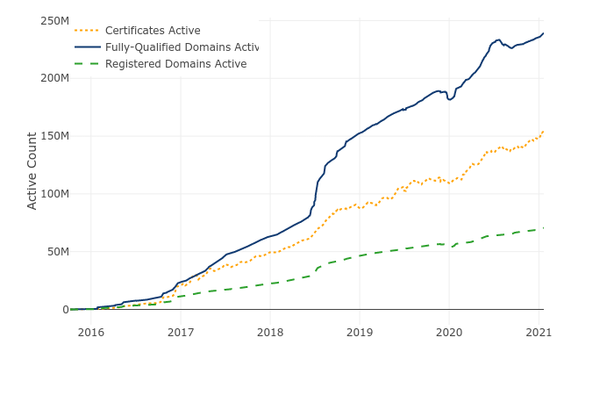
Letsencrypt Growth
https://letsencrypt.org/stats/

Slide 13
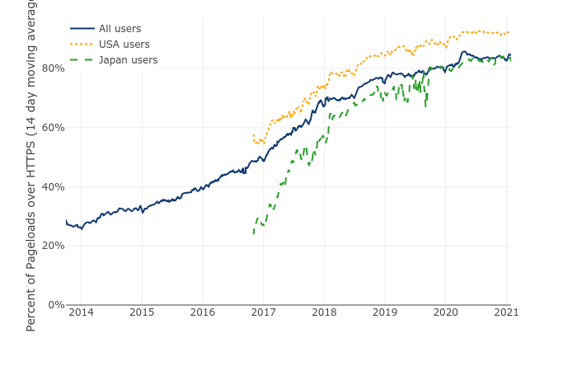
HTTPS Growth
https://letsencrypt.org/stats/ based on FF telemetry https://docs.telemetry.mozilla.org/datasets/other/ssl/reference.html

Slide 14

2003 – SSO around the corner (still)
Large consortium of vendors establish a single-sign-on system and start to deploy that
  https://news.netcraft.com/archives/2003/01/22/liberty_alliance_identity_server_launched.html
This still happens, (Fido, WebAuthn) there’ll always be another fashionable “federated” thing, maybe someday one will work out as planned
  https://en.wikipedia.org/wiki/WebAuthn is I think the most recent
To be fair, some stuff works: Eduroam, login based on ${megacompany} credentials (FB, Google etc)
https://web.archive.org/web/19980529171444/http://www.sse.ie/prodserv.html

Slide 15
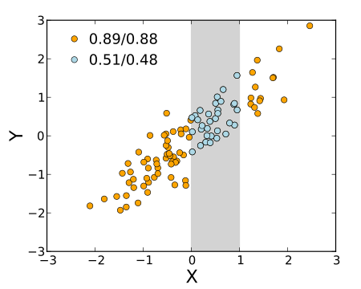
2007 - Netflix Competition
Anonymised data sets published to allow researchers to improve delivery algorithms
Correlation of review times with IMDB allow identification (with some embarrassment)
  https://en.wikipedia.org/wiki/Netflix_prize#Privacy_concerns
  https://arxiv.org/abs/cs/0610105
Fine example of unexpected nature of some privacy issues. Many privacy issues however are utterly predictable if one spends a very short amount of time thinking about the topic.
https://en.wikipedia.org/wiki/File:Correlation_range_dependence.svg

Slide 16
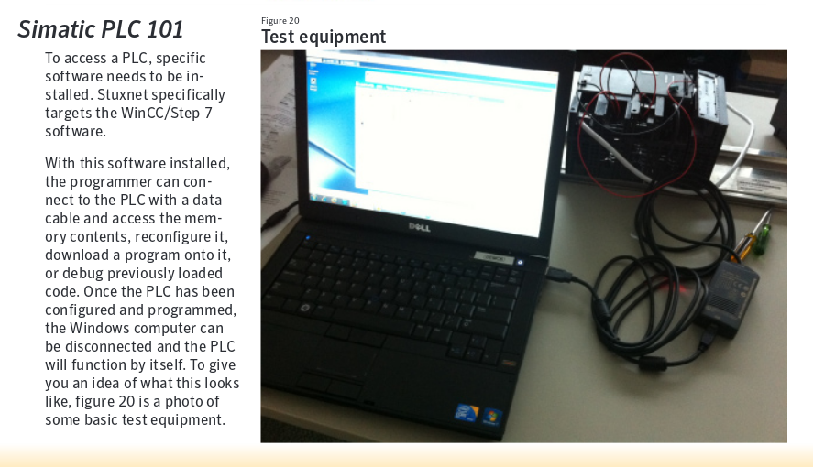
2010-ish - Stuxnet
Targeted controllers for (off-line) Iranian centrifuges involved in Uranium purification, so had to span air-gap
  https://en.wikipedia.org/wiki/Stuxnet
  https://www.wired.com/images_blogs/threatlevel/2010/11/w32_stuxnet_dossier.pdf
Interesting part of Stuxnet is that the US essentially admitted it! That’s pretty stupid really but also set an awful precedent for which we’ll continue to pay for some time to come
Malware attribution is almost never believable, even genetic linkage could/should be faked by those skilled in the art

Slide 17
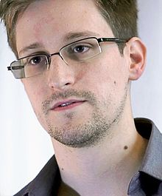
2013 - Snowdonia
Partial timelines:
  https://en.wikipedia.org/wiki/Global_surveillance_disclosure
  https://www.theguardian.com/us-news/nsa
My favourite:
  https://www.theguardian.com/world/2014/feb/27/gchq-nsa-webcam-images-internet-yahoo
My most interesting (politically):
  https://theintercept.com/2018/02/17/gchq-belgacom-investigation-europe-hack/
My most interesting (technically):
  The short-range radar thing
  https://en.wikipedia.org/wiki/NSA_ANT_catalog
https://en.wikipedia.org/wiki/Edward_Snowden

Slide 18
2016 – DNC spearphish
Report on spearphising attempts aimed at US Democratic political party’s 2016 presidential election campaign
  https://www.secureworks.com/research/threat-group-4127-targets-hillary-clinton-presidential-campaign
10% of links clicked according to report
Again, attribution is not convincing
Role of DKIM signatures is interesting and not considered during development of DKIM

Slide 19
2018 – DNA Databases
Law enforcement using stored DNA data to identify suspects’ relatives
  https://yro.slashdot.org/story/18/08/02/0253250/top-genetic-testing-firms-promise-not-to-share-data-without-consent?utm_source=rss1.0mainlinkanon&utm_medium=feed
Genomic data (and similar) is sensitive now and may still be sensitive in >100 years
  Very hard challenge for security mechanisms!

Slide 20
2018 - “Smart” speaker snooping
Alexa “bug” causes bad stuff:
  https://yro.slashdot.org/story/18/05/24/1633218/woman-says-alexa-device-recorded-her-private-conversation-and-sent-it-to-random-contact-amazon-confirms-the-incident?utm_source=rss1.0mainlinkanon&utm_medium=feed
Religious practice via Alexa
  https://www.theregister.co.uk/2018/05/24/pray_for_me_alexa/
  What could possibly go wrong there? ;-)

Slide 21
2018 – Service provider “sharing”
Cambridge Analytica
  https://en.wikipedia.org/wiki/Cambridge_Analytica
FB and tech “partners”
  https://www.nytimes.com/2018/12/18/technology/facebook-privacy.html
Android apps
  https://privacyinternational.org/report/2647/how-apps-android-share-data-facebook-report
US Telcos selling location data
  https://arstechnica.com/?p=1438339

Slide 22
2018 leaks galore
Marriott hotel group, losing up to 500M customer records, incl. passport data
  https://www.theregister.co.uk/2018/11/30/marriott_starwood_hotels_500m_customer_records_hacked/
Under armour: 150M records
  https://www.reuters.com/article/us-under-armour-databreach/under-armour-says-150-million-myfitnesspal-accounts-breached-idUSKBN1H532W
Too many to list really

Slide 23
2018 mega-scalers maybe not as secure as thought
One natural reaction to security problems for smaller sites is to offload the problem to mega-scalers like Google or FB using their “login via” schemes
Maybe they’re not so much better than others as we thought:
  Google+ 500k user data leak
    https://arstechnica.com/tech-policy/2018/10/google-exposed-non-public-data-for-500k-users-then-kept-it-quiet/
  FB/Cambridge analytica again:
    https://www.thesslstore.com/blog/facebook-data-leak-cambridge-analytica/

Slide 24
2020/2021 supply-chain again
Solarwinds attack
  https://www.csoonline.com/article/3601508/solarwinds-supply-chain-attack-explained-why-organizations-were-not-prepared.html
Again – don’t get hung up on attribution
IMO the main fail was putting such a privileged device onto many networks
  Did it need all those privs? Least-privilege is a very old security concept
The build issue is secondary

Slide 25
Moving on to the Future...
Some people talk about the Internet of things but the Internet has always been made up of things
Though maybe we can re-use the IoT marketing term…

Slide 26
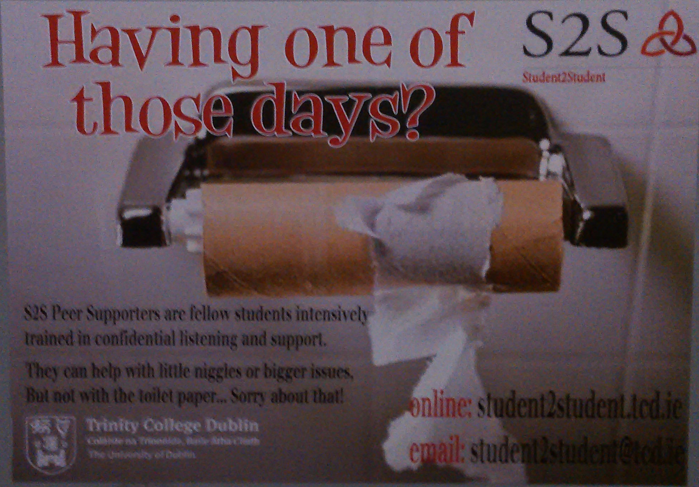
Seen in a TCD cubicle...

Slide 27
The Other IoT
The Internet-of-Toilets will use the 5G network. In this IoT, each time a toilet is used, chemical (and perhaps DNA) analysis of the flushed content is done by the device and packets are sent to the network containing the results. IoT devices may be in the home, in businesses or provided by municipalities.
The data may be used for personalised healthcare services, for public health or, of course, advertising (imagine a pop up add over a pub urinal for just that medical condition you have;-). Insurance companies and lots of other businesses would likely be interested in the data. Service-selection and long term storage of the data present challenges.
These IoT devices are multi-user with no sophisticated user interfaces (except in Japan:-) and issues of identity, privacy, confidentiality and consent abound. Lawful intercept considerations would also arise - while societies may consider it ok for law enforcement to be able to listen to audio calls, it is not clear that the same is true for the packets emitted here, yet those are all bytes for the network."
Text is from about 2014 or so.

Slide 28
Some Security and Privacy Issues...
Who controls the data generated?
User interfaces and the lack thereof...
Who is authorised to update devices, and how?
Random numbers and crypto processing

Slide 29
Data Transport
Devices generate data & send (secured via TLS?) to some host
Today, there’s no great way to get a (D)TLS server cert to use for that host unless the host has a DNS name
  Leads to device→cloudy-server lock-in
Challenge: find ways to authenticate and securely exchange keys between a small device and a host that the device-owner chooses
Challenge: sometimes emitting a packet (encrypted or not) leaks privacy sensitive information
  E.g. query sent to NTP server => person arrived home and stuff woke from suspend

Slide 30
Pervasive Monitoring
From RFC7258/BCP188: “Pervasive Monitoring is an Attack”
Pervasive Monitoring (PM) is widespread (and often covert) surveillance through intrusive gathering of protocol artefacts, including application content, or protocol meta-data such as headers. Active or passive wiretaps and traffic analysis, (e.g., correlation, timing or measuring packet sizes), or subverting the cryptographic keys used to secure protocols can also be used as part of pervasive monitoring. PM is distinguished by being indiscriminate and very large-scale, rather than by introducing new types of technical compromise.

Slide 31
PM is not everything
PM is far from the only security or privacy issue on which we need to work
  Spam, malware, DDoS, …
  But mitigations for PM can also help a lot with other problems
Hypothesis: If we work to address PM, and prioritise services and mechanisms that mitigate PM and that are also effective against other attacks then we will be doing the “right thing”
And the “we” there means us all, not just IETF

Slide 32
Data Storage
So my devices produce a trickle/ton of data every day, what happens to that?
  Helps some vendors monetize me?
  Leaks to some bad actors eventually?
  Gets deleted when vendors end-of-life service?
Challenges:
  Minimise the data that is ever sent/stored
  Scrub stored data regularly (with what guarantee?)
  Data portability?

Slide 33
(Lack of) User Interfaces
Device discovery and provisioning are just hard unless you also have the device call-home to a vendor-selected site
  Device offering web server? See “data transport”
Challenge: we need ways to introduce devices to our networks that are acceptable to the owners/operators of those networks
  While we can all develop some of these, it’s not clear what’s really going to work well enough at big enough scale for the range of devices that will be developed

Slide 34
Opportunistic Security RFC 7435
Security mafia modus operandi has (in practice) been to define and implement security that works for higher security environments
  => often hard/expensive to deploy => often not used => cleartext often sent even when better options exist
Opportunistic Security (OS) aims to evaluate these trade-offs on a connection-by-connection basis, explicitly allowing for e.g. unauthenticated endpoints for confidentiality (open-channel key exchange) as an option that is better than cleartext
I (personally) hope that this concept is followed very often and is fleshed out to the point where we end up with a new security development approach that is based around OS
  Not there yet: TLS deprecation of RC4 was interesting because of differing perspectives from web and mail folks about what conclusion to draw when following the OS approach

Slide 35
OS example: Deprecating RC4
RC4 past sell-by date: agreed by all
For the web ~15% of https sites were using TLS/RC4 (FF 2014 measurement)
  When RC4 zapped 99% of those just picked a better option (AES, 3DES)
SMTP+STARTTLS between MTAs
  There is a widely deployed MTA that only does RC4, 3DES is buggy and won't work (so I'm told)
  Zapping RC4 means emails will be sent in clear between MTAs when one is the buggy one
So – which is better: deprecate RC4 entirely or add this and possibly other caveats?
  IETF rough consensus was to deprecate entirely, but some mail folks were in the rough
Interesting example implying conclusion from following OS protocol design pattern will depend on scope
  OS requires us each to figure out some kind of utility or objective function and where those differ enough, different well meaning folks will reach different conclusions
It is OK that it is harder to figure out what to do when following the OS approach

Slide 36
Updates...
Non-updatable devices are a recipe for disaster
  cf. Mirai – plenty of badly engineered devices will continue to be added to (and found on) the public Internet every day
Challenge(s): Many issues with s/w update in this context, we hosted a workshop on this in TCD in June 2016, see RFC 8240 for details:
    https://tools.ietf.org/html/rfc8240
    Some progress since then – vendors now mostly seem to accept updates are needed at least
Interesting “conclusion”: device update seems to call for all devices to support a way to “root” the device – both dangerous and seemingly necessary!

Slide 37
Crypto for small devices
Some very small devices can’t play (D)TLS with the Internet, what then? Roll-your-own crypto? Urgh
Issue with assurance that the crypto is “good”
  Dual-ec fiasco http://dualec.org/
    Bit sad that https doesn’t work for that!
Challenge: initiatives like https://cryptech.is/ needed for smaller platforms
  More generally: We may need larger players to help fund OSS that makes life easier for small developers of small devices
  Key part of this: good (P/T)RNGs

Slide 38
What to do? (1)
Consider privacy issues in your systems and networks and the data you make available
  Avoid logging potentially sensitive data if you can
  Find and delete old crap you no longer need
  That means more work! But you should do it
Encourage target diversity - Don't all use the same services all the time
  Even if you're not a huge population, you can start trends

Slide 39
What to do? (2)
Turn on crypto – ciphertext should be base assumption for new things
    Consider the OS approach to make that easier
Don't use new stuff without considering privacy implications
  Data minimisation will save you some later leaks
Help with better implementations
  https://cryptech.is/ and similar

Slide 40
What to do? (3)
Don't demand the impossible (and do nothing in the meantime)!
  Encourage clean-slate work, but don't imagine it can all be deployed now – and only deployed things help
Agitate (if that's your kind of thing:-)
Consider privacy trade-offs when deploying e.g. IDS, anti-spam or malware detection technologies
Be responsible and take the broader implications of your work into account before, while and after doing it
  That includes research!

Slide 41
Summary
There’s a bit of history, mostly bad:-)
But there has been progress too, and we are getting better in some important respects
IETF and others have consensus PM is an attack (RFC7258) and are working that problem, as a way to help get more and better deployment of security and privacy technologies
When/if societies do decide that PM is as bad as it is, then the technical community should have in place the tools to effect that decision – you can help put those in place!

Slide 42
Thanks
Offline questions welcome too
stephen.farrell@cs.tcd.ie
2016 version:
https://down.dsg.cs.tcd.ie/heanet/
2021 version:
https://down.dsg.cs.tcd.ie/cs7053/lectures/heanet-farrell.pdf

Slide 43
Backup Stuff
Note: backup slides weren’t updated so may be out of date

Slide 44
IETF (Re)Action
Overall: snowdonia has re-energised folks to do better on security and privacy in general (and not solely in response to PM)
  Side meeting in Berlin @ IETF-87 (July 2013)
  Tech plenary, major discussion @ IETF-88 (Nov 2013)
  STRINT workshop before IETF-89 (Feb 2014) [RFC7687]
  Topic at many meetings/BoFs @ IETF-89 (July 2014)
  Seeing results from IETF-90 (Nov 2014) onwards...
Unsurprisingly this is similar to the more broad technical community reaction

Slide 45
IETF work related to PM
RFC 7258/BCP188 published after major IETF LC debate – sets the basis for further actions
RFC 7435 defines “Opportunistic Security” - less gold-plating, more deployment
IAB Statement on Internet Confidentiality: basically: encrypt everything!
New working groups established:
  UTA: update BCPs on how to “Use TLS in Applications” - RFC7525
  DPRIVE: “DNS Privacy”- unthinkable before snowdonia RFC7626
  TCPINC: “TCP INCreased security”: tcpcrypt proposed two years earlier but rejected
    Mistakenly, including by me, as ack'd at mic @ IETF-88, bummer
IAB re-factored security and privacy programme
  Developed PM threat model document (RFC7624)
Stuff not going so well
  Old-RFC privacy/PM review team – go back and see what needs fixing: moribund
  Endymail email list for discussion of ways IETF can help those working on new e2e interpersonal messaging solutions: hard problem

Slide 46
PM is an Attack RFC 7258
RFC7258/BCP188 says that all IETF work will consider PM as an attack to be mitigated as part of our normal design processes for all protocol development
  Note: this does not mean PM is always relevant nor that it's always practical to mitigate PM via protocol mechanisms, but if you can't, you need to be able to say why
Took ~1000 emails to get rough consensus on that since countering PM is not free
    Impacts on network management
    Some folks scared of unreasonable security/privacy nerd dominance

Slide 47
DNS Privacy
DNSSEC provides integrity and origin authentication but confidentiality/privacy was never considered a requirement
Since 2013 that has changed, IETF DPRIVE working group was formed to tackle this issue
Problem statement set out in RFC 7626
QNAME minimisation RFC 7816
TLS/TCP on port 853 between stub and recursive almost done, DTLS/UDP equivalent in the works
Work on recursive to authoritative starting
Discussion on DNS/HTTP at IETF97 (Nov2016) will certainly include DNS/HTTPS (way too early to say where that might go)

Slide 48
QUIC
QUIC is a proposed new transport protocol that runs over UDP and that encrypts a lot
  https://datatracker.ietf.org/doc/charter-ietf-quic/
  Goal is the same security properties as TLS1.3/TCP
QUIC is already deployed to some extent
Privacy is not the only reason things like QUIC use encryption
  Cleartext allows middleboxes to see and mess with traffic, which has good and bad aspects
Will likely provide examples of the tension between privacy and the ability to manage a network mentioned in RFC 7258

Slide 49
Other relevant IETF Things
TLS 1.3 aiming for better handshake encryption properties and learning from previous TLS problems in various ways
HTTP/2.0, [RFC7540] the major deployment model for which seems to be to run much much more HTTP traffic over TLS
Extension to HTTP/2.0 defining opportunistic security way of sending http URI schemed content over TLS
Negatively: deprecate RC4 [RFC7465] in TLS, SSL3 [RFC7568]
And since all this is IETF stuff, you can (and please do) join in and help if you're willing and able – that's how to make it better!
  Even a small amount of good researcher input is hugely valuable (but you need to be able to deal with a noisy environment;-)
New Curves and deprecating old crypto (CURDLE WG)
OPENPGP WG updating crypto

Slide 50
Non-IETF Things Relevant to IETF
Crypto Forum Research Group (CFRG) in Internet Research Task Force (IRTF)
  Goal: provide venue bridging academic crypto and Internet technical community
  Curve25519, Curve448 [RFC7748]
  Chacha20/Poliy1305 AEAD construct [RFC7664]
IEEE 802 have started work on privacy and are considering e.g. MAC address randomisation
  Collaborating with IETF
W3C TAG statement on “Securing the Web”
  Builds on RFC7258 and IAB statement
  https://www.w3.org/2001/tag/doc/web-https
… there are loads more

Slide 51
Longer Term Factors at Play
Spooks will be spooks (whether govt. or private sector)
Privacy invasive commerce (legitimate and not)
Legal accountability mechanisms (courts of various kinds)
Small+good things can transition to (big+bad, dead or living-dead)
Badly-informed decision makers/commentators/twits
Government regulation of business (e.g. Data Protection Agencies)
Commercial reaction to user privacy requirements (even evil corporate behemoths have many good folks working for 'em)
NGOs working to enhance privacy (and get attention)
Constantly refreshed naivety of yet another generation of clean-slaters (producing occasional good ideas)
Guilt-by-association is a fallacy no matter who makes the error
Technical privacy enhancing/enforcement mechanisms (when those work)

Slide 52
IAB Statement
“We recommend that encryption be deployed throughout the protocol stack since there is not a single place within the stack where all kinds of communication can be protected.
The IAB urges protocol designers to design for confidential operation by default. We strongly encourage developers to include encryption in their implementations, and to make them encrypted by default. We similarly encourage network and service operators to deploy encryption where it is not yet deployed, and we urge firewall policy administrators to permit encrypted traffic.”
  https://www.iab.org/2014/11/14/iab-statement-on-internet-confidentiality/

Slide 53
So what else?
We've outlined the problem
We've seen there's work ongoing
  Most addressing relatively low-hanging fruit in a sense
Still hard to get agreed/done/finished/deployed
  Esp. deployed, which is REQUIRED for this to be at all useful – Fantasy is of no use here
But almost are fairly obvious things to do
  Encrypt more, do more/better security, yay!
So how about a hard problem or two?

Slide 54
More References (1)
General IETF stuff:
https://www.ietf.org/
https://www.ietf.org/newcomers.html
Working group details for WG <foo>:
  https://tools.ietf.org/wg/<foo> - links to charter, docs, mail archive etc
  Suggested <foo> values:
    tls, dprive, tcpinc, httpbis, uta

Slide 55
References (2)
Relevant IETF non-wg lists:
  All of them (loads): https://www.ietf.org/list/nonwg.html
  Perpass – triage list for PM related stuff:
    https://www.ietf.org/mailman/listinfo/perpass
  Security area list (saag)
    https://www.ietf.org/mailman/listinfo/perpass
  Possible e2e interpersonal messaging discussion
    https://www.ietf.org/mailman/listinfo/endymail
  General privacy discussion
    https://www.ietf.org/mailman/listinfo/ietf-privacy
IRTF:
  https://www.irtf.org/
  IRTF Crypto Research Forum Goup: https://irtf.org/cfrg

Slide 56
References (3)
Videos (ISOC hint:-)
  IETF youtube stuff in general
  https://www.youtube.com/user/ietf/videos?sort=p&view=0&flow=grid
Nov'13 IETF technical plenary video
  https://www.youtube.com/watch?v=oV71hhEpQ20
Dan york videos 5 minute summaries of IETF meetings
  There are loads but these are about PM
  https://www.youtube.com/watch?v=HG54EsHYKr0
  https://www.youtube.com/watch?v=fbjs_6Mz-6s
STRINT workshop (RFC7687)
  Has all 66 position papers
  https://www.w3.org/2014/strint/

Slide 57
References (4)
IEEE Internet Computing “soapbox” column on why PM is bad:
  http://www.computer.org/csdl/mags/ic/2014/04/mic2014040004.pdf
Some Internet drafts not referenced above:
  PM Threat model
    https://tools.ietf.org/html/draft-iab-privsec-confidentiality-threat
  DNS Privacy problem statement`
    RFC7626
  “Modern” TLS best current practices
    RFC7525

