Slide 1
Reflections on Ten+ Years Past the Snowden Revelations
Background and RFC9446
Stephen Farrell
stephen.farrell@cs.tcd.ie
Feb 2024

Slide 2
Reflections on Ten Years Past the Snowden Revelations
RFC9446
Stephen Farrell, Farzaneh Badii,
Bruce Schneier, Steven M. Bellovin
IETF 117
July 2023
Presenter: stephen.farrell@cs.tcd.ie

Slide 3
What happened?
In 2013, an NSA contractor (Edward Snowden) released a large set of internal, classified documents to reporters who (carefully) published stories based on those
Overall, those showed that 5-eyes signals intelligence agencies were far more intrusive than had been appreciated
If you’re not familiar with this stuff or have forgotten, there’s a pretty good timeline at:
  https://en.wikipedia.org/wiki/Global_surveillance_disclosures_(2013%E2%80%93present)

Slide 4
Upstream Collection
Examine loads of traffic at Internet backbone devices
Sometimes related to trans-oceanic fibre
Often with operator co-operation
Likely involving some filtering and buffering before being sent back to “base”
Subtle definitions for what “collected” means
  https://en.wikipedia.org/wiki/Upstream_collection

Slide 5
BULLRUN
One of the programmes disclosed was BULLRUN, an ~US$250m/yr fund to break or work around the kind of security mechanisms we use on the Internet
  https://en.wikipedia.org/wiki/Bullrun_(decryption_program)
The DUAL_EC_DRBG fiasco is the kind of thing that may have been a part of that
  https://projectbullrun.org/dual-ec/documents/dual-ec-20150731.pdf

Slide 6
ROYAL CONCIERGE
GCHQ (UK signals intelligence agency) monitored ~350 hotels to see who’s booking a room, presumably so they could have fun later
  https://www.spiegel.de/international/europe/gchq-monitors-hotel-reservations-to-track-diplomats-a-933914.html
Apparently done by monitoring cleartext emails to see when a reservation confirmation is sent from somewhere interesting to somewhere interesting

Slide 7
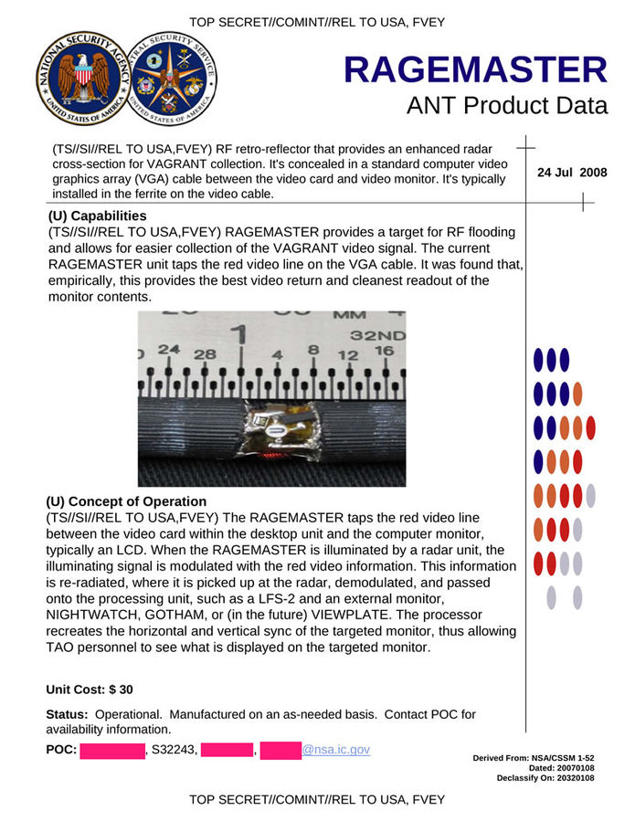
ANT Catalog
Tap the video signal between computer and monitor
Retrieve data when illuminated via radar unit (PHOTOANGLO)
Loads more fun devices and s/w at:
  https://en.wikipedia.org/wiki/ANT_catalog

Slide 8
IETF
The Internet Engineering Task Force (IETF) is the main body that defines Internet protocol standards – https://ietf.org/
Those include specifications for ways to encrypt and otherwise cryptographically protect Internet traffic, e.g. TLS, IPsec, S/MIME, PGP
IETF participants were not happy about the Snowden revelations

Slide 9
IETF 88 Links
IETF started to react in 2013, esp. at the November 2013 meeting, a 2014 workshop and subsequently (and it continues today)
IETF-88 Plenary slides: https://www.ietf.org/proceedings/88/technical-plenary.html
Video: https://www.youtube.com/watch?v=oV71hhEpQ20&pp=ygUQaWV0ZiA4OCBwbGVuYXJ5IA%3D%3D
STRINT workshop: https://www.w3.org/2014/strint/

Slide 10
Being Annoyed Helps
Result was quite a bit of energy directed towards improving deployments, Internet protocols and even IETF processes, including...
  RFC7258/BCP188
  The letsencrypt CA, leading to ACME protocol
  Email transport layer encryption (SMTP/TLS deployment, MTA-STS)
  Encryption of as much as possible with forward secrecy as a new baseline for transport layer and above (e.g., TLSv1.3, QUIC etc.)
  DNS privacy (DoT/DoH/ODoH)
  Caring more about long term identifiers (e.g., randomised MAC addresses, MADINAS WG)

Slide 11
Pervasive Monitoring
From RFC7258/BCP188: “Pervasive Monitoring is an Attack”
Pervasive Monitoring (PM) is widespread (and often covert) surveillance through intrusive gathering of protocol artefacts, including application content, or protocol meta-data such as headers. Active or passive wiretaps and traffic analysis, (e.g., correlation, timing or measuring packet sizes), or subverting the cryptographic keys used to secure protocols can also be used as part of pervasive monitoring. PM is distinguished by being indiscriminate and very large-scale, rather than by introducing new types of technical compromise.

Slide 12
PM is/was not everything
PM is far from the only security or privacy issue on which we need to work
  Spam, malware, DDoS, …
  But mitigations for PM also help a lot with other problems
Hypothesis: Working to address PM, and prioritising services and mechanisms that mitigate PM and that are also effective against other attacks is doing the “right thing”

Slide 13
Security & Privacy vs. “Management”
There’s a tension (ack’d in RFC7258) that the better we protect security/privacy, the less well (some) network management tools work
  There are also elements of mis-trust between some stakeholders that make this harder
This recurs over and over, and generates angst:
  Via efforts to break TLS (“Pretty please standardise my MitM technique”)
  Via efforts to encrypt protocol data units that are relevant for network management causing heartache for network management folks
Hard to know to what extent this is due to lazy/legacy n/w management techniques and how much it’ll be a lasting problem, but the increasing prevalence of ciphertext and end-to-end encryption will not change
  In other words: we need to develop new n/w management tools that still work well when networks carry much more ciphertext
And of course various governments usually have a plan in the drawer for “defeating” encryption that they pull out from time to time as events transpire
  I think that ship has sailed myself

Slide 14
RFC9446 Overview
The Snowden documents were released starting in June 2013 so in 2023 it seemed timely to reflect on what happened and what’s changed?
RFC9446 is a collection of the authors’ separate reflections and some conclusions
We hope it spurs others to similarly reflect, reach conclusions, and maybe take action
Eliot Lear (our esteemed ISE) instigated this, recruited the authors and cat-herded variously

Slide 15
It’s Four Essays (mostly)
Bruce provides a contemporaneous account of some of his involvement with the Snowden documents, not previously published
Stephen recalls what happened within and around the IETF as a result
Farzaneh considers impacts from a human-rights perspective
Steve recounts the evolution of crypto-wars from pre-history, via Clipper, through Snowden and up to today
Each include opinions as to what’s important to consider in all this
  This talk is mostly about those opinion bits

Slide 16
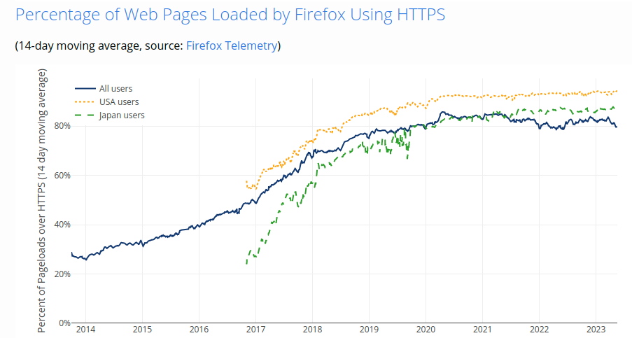
Some Good News
https://letsencrypt.org/stats/

Slide 17
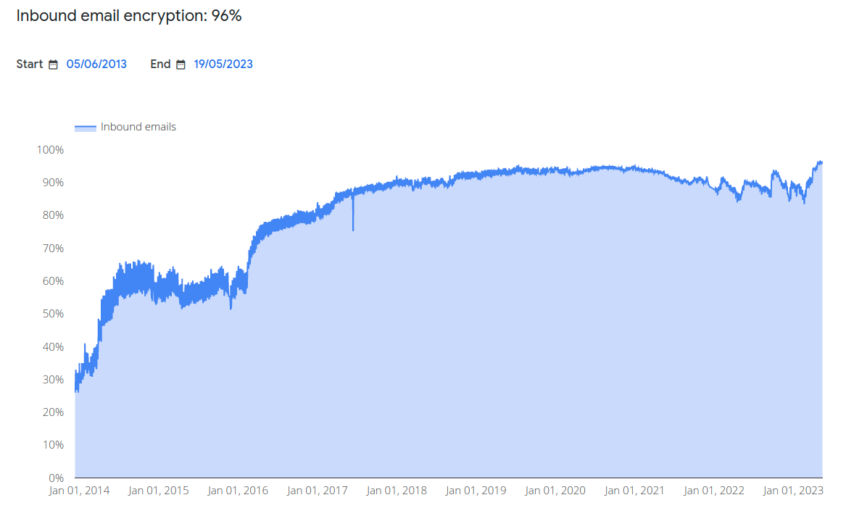
Some Good News
https://transparencyreport.google.com/safer-email/overview

Slide 18
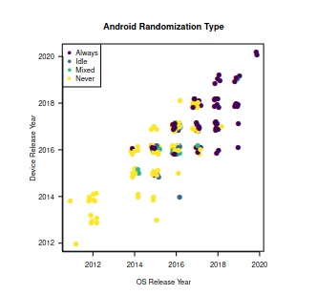
Some Good News
https://www.petsymposium.org/2021/files/papers/issue3/popets-2021-0042.pdf
MAC address randomisation being deployed and getting (slowly?) better

Slide 19
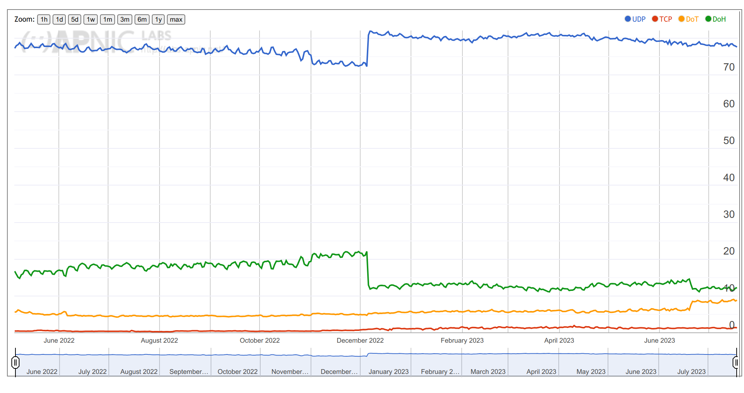
Middling News
https://stats.labs.apnic.net/edns/XA
Cloudflare Open Recursive Resolver DNS Query Profile for World (XZ)

Slide 20
4 points from Bruce’s essay
Maybe the implant catalog wasn’t a Snowden document?
All we learned then is well out of date, we don’t know what’s been done since
IETF 88 participants were indignant
Despite the outcry, not much changed (visibly) in terms of US govt approach

Slide 21
4 points from Stephen’s essay
Pushback against more encryption comes from those affected (but who get over it) and from those who just don't want it
We didn't try tackle commercial surveillance near as much (RFC7258 does apply!)
Regulators may stymie permissionless innovation
We should think more about the ethics of what we do

Slide 22
4 points from Farzaneh’s essay
Hard to empirically measure Snowden's effect
We've never considered human rights that much, not clear that's changed
Maybe not Snowden, but WHOIS -> RDAP took a long time
Impact assessment may reveal how protocols have an impact on which and whose human rights

Slide 23
4 points from Steve’s essay
Governments have long used encryption—and tried to break other folks’ encryption
“Spies gonna spy”—if encryption is in the way, they’ll (somehow) try to work around it
Even if our protocols are great, implementations, overall systems & s/w are not (c.f. ransomware)
We should worry more about metadata

Slide 24
Current Work
IETF work to improve comsec continues, e.g.:
  TLS Encrypted Client Hello (ECH)
  Hybrid post-quantum crypto schemes
  Oblivious HTTP/DoH and similar
  Privacy preserving metrics
  Eventually, we’ll get a lot more interested in countering traffic analysis
But… annoyance also dissipates...

Slide 25
Surveillance Capitalism
Internet engineers found it quite possible to act based on their annoyance with signals intelligence agencies
It seems harder to get them to do something about the legal but hugely privacy-invasive systems their employers deploy
Advertising business model is basically pervasive monitoring
  Pretty similar to the effect of breaches and data leaks (other than seemingly legal)
Result: IMO the Internet is “worse” now than it was in 2013
  Government regulators seem keen to step in, maybe correctly
  That risks the permissionless innovation that lead to success for the earlier Internet
Maybe: we should stop considering that we somehow “own” data we collect just because we control a copy

Slide 26
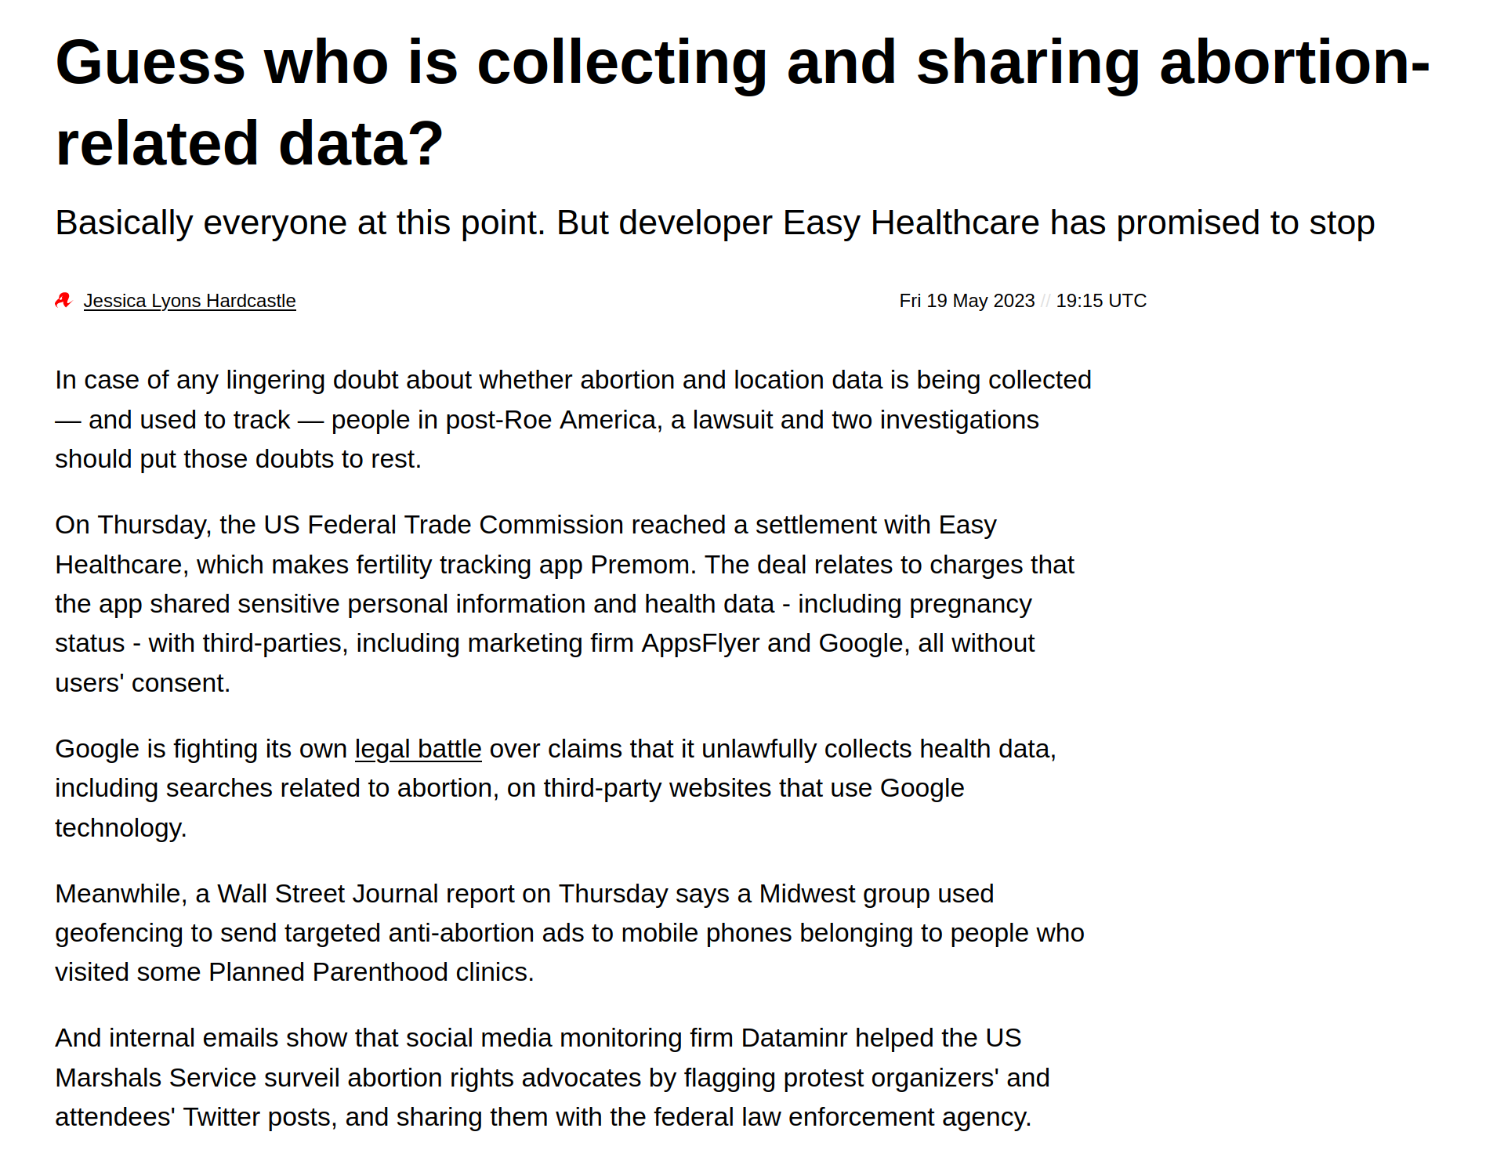
How bad does this get? https://www.theregister.com/2023/05/19/abortion_data_tracking_cases/
Regardless of what one thinks about abortion, we can probably all agree that it’s related data needs to be handled cautiously, ethically and with care for people in difficult situations.
The web and mobile app ecosystem clearly leads developers and deployers to utterly lose sight of that.
The answer here isn’t better network protocols, but ethical behaviour (that then requires good network protocols).

Slide 27
Conclusions
Snowden’s revelations were a big deal and did lead to significant change in Internet protocols and deployments
  We’re not done with that work
We know that things in many ways are worse now for people using the Internet
Probably good if we reflect on all that and see what else needs doing and what needs changing
My main take away: we should apply RFC7258 to protocols usable by commercial snoops just as much as we did government snoops

Slide 28
Thanks
Offline questions welcome too
stephen.farrell@cs.tcd.ie
These slides also at:
https://down.dsg.cs.tcd.ie/rfc9446-pressie-tcd.pdf

