Slide 1
CS7NS5/CSU44032
Security & privacy
Stephen Farrell
stephen.farrell@cs.tcd.ie
What happens when you hit “send”?
(Things about how email works.)
https://down.dsg.cs.tcd.ie/cs7053/
https://github.com/sftcd/cs7053

Slide 2
There are many slides in this deck
I will be skipping over many of them very quickly but happy to go back as needed (just yell at me or send email later)

Slide 3
Let’s see what happened so these mails could traverse the Internet
Both emails are from stephen.farrell@cs.tcd.ie to stephen@jell.ie
The “from” address is my main TCD email
The “to” address is (also me:-) at another mail server I operate myself
The full content of the 1st mail is at: https://down.dsg.cs.tcd.ie/cs7053/lectures/mail1.html

Slide 4
How did that mail get to its destination?
Sent from my cs.tcd.ie account on my laptop on the TCD SCSS WiFi n/w using Thunderbird
... to outlook.office365.com
    That could be in Paris: https://www.lookip.net/ip/52.97.233.18 but probably not (26ms vs. 37ms average ping time for inria.fr)
... then it bounced around some internal Microsoft servers:
  DB6PR07CA0182.eurprd07.prod.outlook.com
  DB7PR02MB5113.eurprd02.prod.outlook.com
  HE1PR0202MB2746.eurprd02.prod.outlook.com
... ‘till it reached a Microsoft egress server: EUR02-VE1-obe.outbound.protection.outlook.com
    That could be in Vienna https://www.lookip.net/ip/213.199.154.47 but probably not
... which sent it to jell.ie’s mail exchange server vps.jell.ie
    That is in CityWest https://www.lookip.net/ip/185.24.234.243
... where I read it from my laptop also via Thunderbird back in TCD

Slide 5
My mail got to routed to it’s destination via the Internet, so let’s talk about that a bit...
First though...
Is the Internet a network?

Slide 6
Is the Internet a network?
(hint: the answer is “no”:-)

Slide 7
A network of networks
The Internet is made up of tens of thousands of Autonomous Systems (ASes)
  https://en.wikipedia.org/wiki/Autonomous_system_%28Internet%29
  72951 ASes as of 2022-02-02, (https://www.cidr-report.org/as2.0/)
    Was: 65,428 in Aug 2019
Think of these as the set of Internet Service Providers (ISPs, like Eircom, Vodafone, Virgin), other networks (e.g. HEANET which is TCD’s “ISP”), big companies (e.g. Microsoft, Google, IBM) and oddities like Internet eXchange Points (IXPs, like INEX)
Each is (in principle and often in practice) an independent network (or set of networks) and their operators can do whatever they want
  They’re essentially defined by sets of numbers: Static: AS number (ASN); Dynamic: sets of IP address prefixes
They interact using Internet protocols (like IP, TCP, BGP) and peering arrangements
  IP: Internet Protocol; TCP: Transmission Control Protocol; BGP: Border Gateway Protocol
  Peering: agreeing to transit/handle traffic (and for how many €€€)

Slide 8

CAIDA Map of ASes
CAIDA (Center for Applied Internet Data Analysis) is a UC San Diego Internet measurement organisation
  You can measure a lot of what happens on the Internet as it happens!
This is a 2020 map of the ASes as they were then
  https://www.caida.org/projects/cartography/as-core/2020/
More central => more connected, serving more people
  In the middle, are the highly connected ASes such as level3

Slide 9
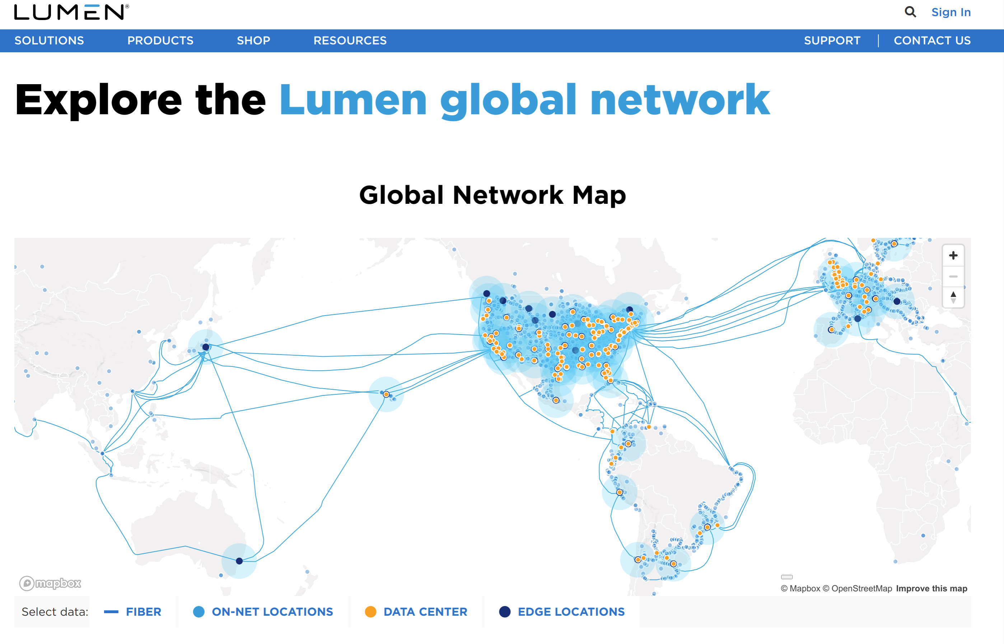
Lumen (was Level3 etc.) is one of those (a BIG one)
https://www.lumen.com/en-us/resources/network-maps.html

Slide 10
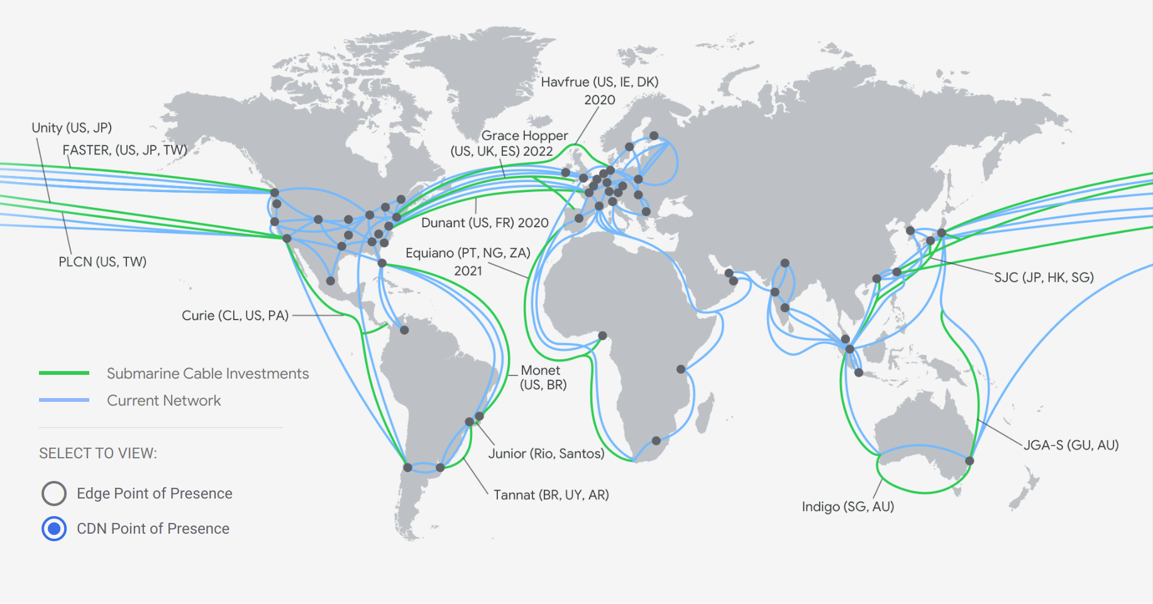
Google cloud
https://cloud.google.com/about/locations/#network note this is just google cloud, not all their stuff

Slide 11
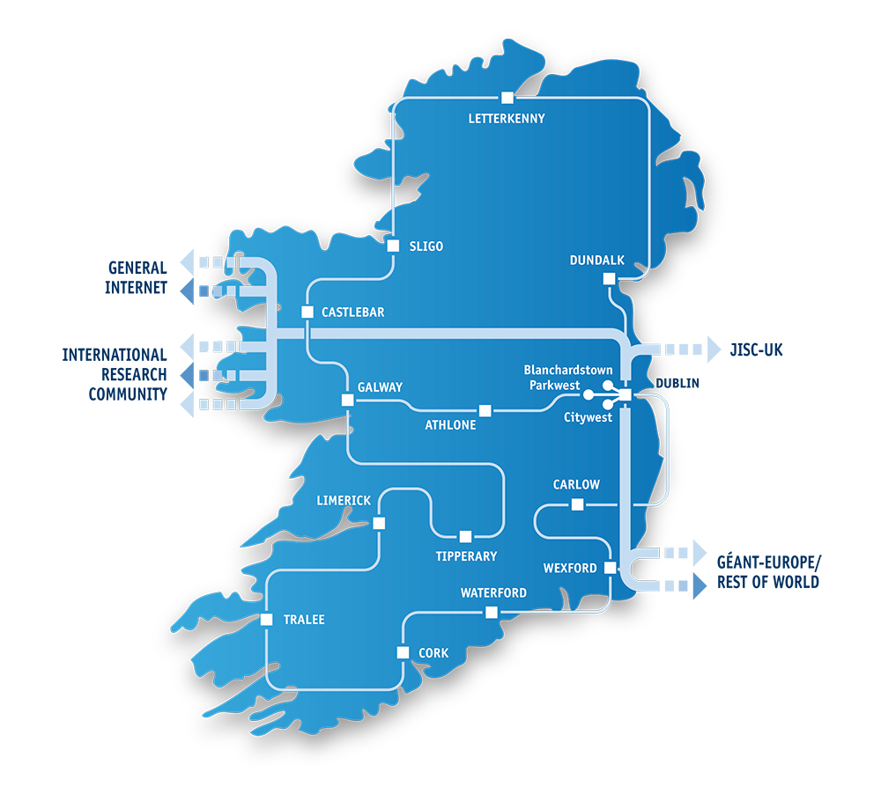
Heanet national n/w
https://www.heanet.ie/network-maps

Slide 12

The TCD network (circa 2019)
- Network Core - Routers (High-availability pair)
- Distribution Layer - routed Layer 3 switches serving x7 campus zones
- Access Layer - Layer 2 Ethernet switches in building comms rooms and wireless Access Points
- External internet connectivity via L3 WAN block to ISP - Border Routers and Firewalls, DMZ hosting web services
- Data Centre network connectivity - central server and application hosting
Thanks to TCD IT for providing this anonymised diagram – doing that’s not a no-brainer btw!

Slide 13

My home network
That’s from a few years ago – so is somewhat out of date:-)
Biggest change since: there’s now >12TB storage capacity!

Slide 14
Interoperability
To make the Internet work, with all those networks at different scales, we need to agree on how to interoperate for some basic/minimal set of things
  That means defining/agreeing on Internet Protocols
  Where we need to agree on how to interoperate, a lot of that is done by the Internet Engineering Task Force (IETF) and other Internet standards bodies (IEEE SA, W3C)
But we do not aim to agree about everything in everyone’s network
  An awful lot happens at the “application layer” in code written by people and organisations, e.g. FB, Google, banks, Netflix, ...
  Those services are not the Internet – they depend on the Internet!
And yet more happens when people configure services that use generic code

Slide 15

What’s a network protocol?
https://en.wikipedia.org/wiki/File:IP_stack_connections.svg

Slide 16
“Permissionless innovation”
One important point is: in principle each network operator can do whatever it wants so long as it interoperates “nicely” with others (and even when it doesn’t act particularly nicely;-)
  That also applies to your home network (if you want and are able)
  There are no protocol police (yet!)
This is one of the main reasons why the Internet has been so successful

Slide 17
“Tussles”
Repeating: we do not aim to agree about everything in everyone’s network...
When the “policies” reflected in those collide then “fun” follows;-)
  If protocols or application code constrains what operators can do then people complain
  If what n/w operators are doing breaks (esp changes to) applications then people complain
  In both cases people often complain at the wrong place;-)

Slide 18
The Internet is not the web
The web is (roughly) the set of computers that speak the HTTP protocol
  HTTP == HyperText Transfer Protocol (http://example.com)
  HTTPS == HTTP/Transport Layer Security (https://example.com)
Email doesn’t use HTTP, but rather (mostly) the Simple Mail Transfer Protocol (SMTP) which is a couple of decades older than HTTP
Mobile network internals (3G, 4G, 5G...) mostly run over IP using a bunch of protocols you’d prefer to never have to know about

Slide 19
Back to my mail...
From my laptop the packets making up the mail (submission) probably went via 134.226.254.93 (a TCD router) to the destination address of 52.97.214.146 (Outlook ingress server)
TCD (who “are” 134.226/16) know how to route to the outside world via Heanet
Heanet know how to route to 52.96/12 (Msft), via INEX, our local Internet Exchange Point (IXP)
There are about 12 routers on that path
A (possibly different) reverse path also needs to work, for acknowledgements, to handle errors and to prevent denial-of-service and reduce spam (so packets from 52.97.214.146 need to find their way back to 134.226/16 as needed).
But how did anything know that outlook.office365.com is at 52.97.214.146?

Slide 20
Domain Name System (DNS)

Slide 21
How do we find the destination?
All those names we saw earlier are DNS names:
  cs.tcd.ie
  outlook.office365.com
  DB6PR07CA0182.eurprd07.prod.outlook.com
  DB7PR02MB5113.eurprd02.prod.outlook.com
  HE1PR0202MB2746.eurprd02.prod.outlook.com
  EUR02-VE1-obe.outbound.protection.outlook.com
  jell.ie
  vps.jell.ie

Slide 22
What’s the DNS?
The single world-wide distributed naming system (that’s worked so far)
Main purpose: map names to IP addresses so applications and humans can deal with names rather than addresses
  tcd.ie is easier to type/remember than something within 134.226/16 or 2001:770:10::/48
  IPv4 addresses use A resource record (RR) type; IPv6 addresses use AAAA resource record (RR) type
The DNS is also used for many other purposes
  Mail address right-hand-side to mail server name(s) via MX RR
  DNS block lists of spam sources (and other block lists)
  “Passive DNS” monitoring for various security purposes
  Telling lies (RPZ) to help people avoid “bad” domains
  State- or enterprise-level censorship
  ...

Slide 23
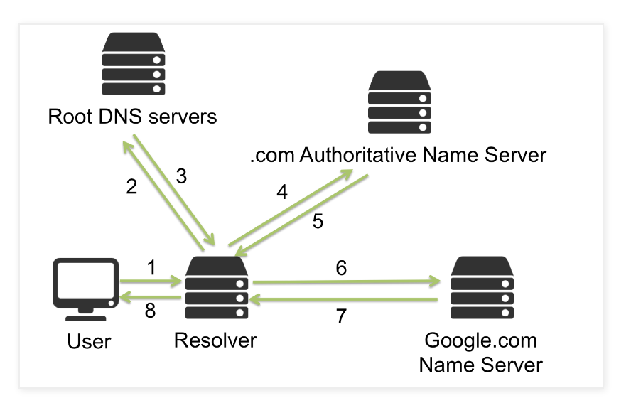
Traditional DNS recursive diagram
(resolving google.com)

Slide 24
DNS Ecosystem
Top Level Domains (TLDs)
  Country-code TLDs (ccTLDs): .ie, .uk, .is,...
    Each more or less do what they want
    IEDR manage .ie zone, CZ.nic manage .cz, ...
  Generic TLDs (gTLDs): .com, .org, .net,...
    Run under ICANN’s oversight (https://icann.org)
    There are ~1000 of those now (because $$$)
Second level domains (2LDs), or effective Top Level Domains (eTLD)
  Comply with parental controls (to some extent)
  Examples: example.com, tcd.ie, amazon.co.uk
  .com TLD has ~158M names, .ie has ~300k, .org has ~10M, Total: ~365M (as of Q3 2021)
  https://www.verisign.com/en_US/domain-names/dnib/index.xhtml
Third level and below: controlled by parent/2LD/eTLD, e.g. down.dsg.cs.tcd.ie

Slide 25
The root zone
The root zone “.” is special – it’s content is (carefully) managed by IANA and handed over to the root server operators…
  https://www.iana.org/domains/root/servers
The root server operators serve the root zone – about 1000 instances worldwide in about 130 countries, with subsets of those managed each of by 12 organisations via13 named root servers (there was one merge in the last couple of decades)
Most root zone instances are accessed using anycast IP routing
  Other public authoritative and even recursive servers (e.g. QuadN’s such as 8.8.8.8 or 1.1.1.1 or 9.9.9.9) also use anycast for better performance
The root zone is pretty stable – and the Internet really needs that to be the case
Every Recursive needs at least one root server IP to start

Slide 26
Registry/Registrar/Registrant
Top Level Domains (TLDs) are operated by registries,
  IEDR manage .ie; Affilias operate a bunch of ccTLDs and gTLDs https://afilias.info/global-registry-services
  Public Interest Registry (PIR) operate .org (and feed $$$ to Internet Society, which feeds $$ to IETF and RFC editor)
Registrars accredited by registries and deal with registration of names (and transfer and de-registration); registry-specific rules may apply, e.g. “connection to Ireland” for .ie
Registrant is the entity that wants/has a name registered
Registries handle name conflicts, e.g. when trademark issues arise via some dispute resolution process (can involve $$$)
Registration costs to registrants from registrars vary from “free” to ~$1000, but mostly ~$10 per year
  Some money flows up from registrar to registry (ccTLD or gTLD) and to ICANN (for gTLDs)
ICANN auction new gTLDs now and then :-(
  Costs ~$1M+ to play that game, ICANN have ~$150M resting in an account as a result

Slide 27
DNS Servers/Protocol
A (logical) zone file for a domain is served by an Authoritative DNS server
Recursive DNS servers query the Authoritatives to resolve names, e.g. starting at “.” ask “where is .ie”; get answer; at “.ie” ask “where is tcd.ie”; at “tcd.ie” ask “what is the IP for www.tcd.ie”
Clients (your laptop/phone) ask Recursive servers to resolve names e.g. “what is the IP for tcd.ie” and if it doesn’t already know the answer the Recursive will do as much of the dance above as needs (re-)doing
The protocol spoken between clients, Recursives and Authoritatives is the DNS protocol

Slide 28
Changing DNS...
“Public” recursives such as 8.8.8.8 (google), 9.9.9.9 (quad9) or 1.1.1.1 (cloudflare) are moving a control point (n/w location of recursive)
Stub <-> recursie DNS encryption mechanisms (DoT/DoH) are moving another control point (visibility of queries/answers *and* the placement of the stub on the host)
We’re starting to figure out how to encrypt recursive <-> authoritative
Affected people get very cranky when such changes happen:-)
These are real changes – recent EU proposal for funding a “Euro” public recursive (quad9 is in .ch btw)

Slide 29
Back to my mail...
I don’t have logs for these but the following is likely/possible...
My laptop maybe used 89.234.186.112 as a name server to resolve outlook.office365.com
  That may be in Brittany, France https://ipinfo.io/89.234.186.112
Microsoft maybe accessed a.iedr.ie/77.72.78.91 to find the name server for jell.ie
  That is in Dublin, Ireland https://ipinfo.io/77.72.78.91 but has “mirrors” in Holland, US etc.
Microsoft accessed one of the jell.ie name servers (maybe ns1.frobbit.se/45.56.92.19) to resolve jell.ie
  That may be in Freemont, CA, USA https://ipinfo.io/45.56.92.19
The authoritative zone file for jell.ie is “homed” in my home:-)
  DNSSEC re-signed daily on a server in my home and uploaded to various places including ns1.frobbit.se
vps.jell.ie used it’s own (local) recursive DNS server to get Microsoft’s DKIM public key so may have done the full “DNS dance” shown earlier, that may have accessed ns1-208.azure-dns.com/40.90.4.208
  That may be in Redmond, WA, USA https://ipinfo.io/40.90.4.208

Slide 30
Email Protocols

Slide 31
Mail Transport Security
DNS
MX
Blocklists
Mail Transfer
Agent (MTA)
Mail Transfer
Agent (MTA)
Mail Transfer
Agent (MTA)
Message
Store (MS)
Transfer (SMTP/25)
Submission (SMTP/587)
Reading (IMAP/143)
Mail User
Agent (MUA)
Mail User
Agent (MUA)
TLS
Mail Transport Security sometimes described as “hop-by-hop security”

Slide 32
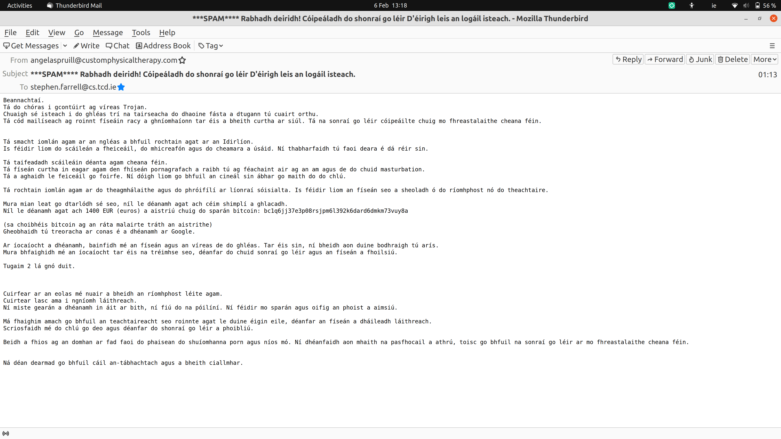
Skipping over Spam...

Slide 33
Mail Transport Security Stats
Gmail publish “transparency report” stats
https://transparencyreport.google.com/safer-email/overview
Other service providers see commensurate numbers
Recently: 89% of outbound and inbound are protected via some form of transport layer security
  TLS: same security protocol that makes https from http!
  Note: “Some form” == possibly less well configured
Regional variations remain

Slide 34
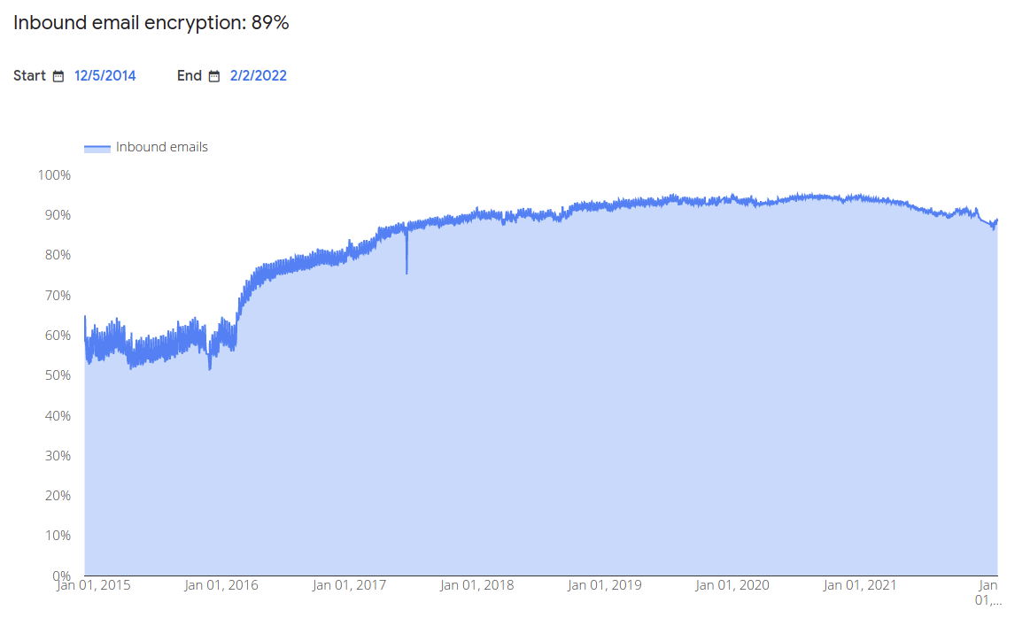
HBH over time (still @gmail)

Slide 35
End-to-End email security
We’d like to encrypt mail content from sender to recipient and not just hop-by-hop
There are two ways to do that:
  S/MIME and PGP
S/MIME is much more “commercial”
PGP is much more “roll-your-own”
Neither is in widespread use (sadly)

Slide 36
Wanna Try S/MIME?
It’s been a few years since I had a working s/mime setup (I use PGP mostly), but for your benefit...
For this year, I tried this “free” service https://www.actalis.com/s-mime-certificates.aspx
Verification email was Italian-first:-)
Then they sent me a pkcs#12 file!
That means they know the private key!!
I didn’t install that in my mail user agent
Doesn’t look good for such ad-hoc use: https://kb.mozillazine.org/Thunderbird_:_FAQs:_Get_an_SMIME_certificate

Slide 37
Pretty Good Privacy (PGP)
PGP can do all that S/MIME does
PGPMime is RFC 3156
PGP’s basic formats in RFC 4880
  Currently being updated (I help co-chair that)
    https://datatracker.ietf.org/doc/draft-ietf-openpgp-crypto-refresh/
Web-of-trust model != X.509 PKI
  But you don’t have to
Most important use-case? Maybe package signing
Now natively supported in Thunderbird

Slide 38
S/MIME and PGP Deployment
Most mail clients suport S/MIME or PGP either built-in or as an option
  There are also “plug-in” products
And mostly then can work together
  I’ve used both, PGP more usable (with Thunderbird)
But e2e secure mail is not ubiquitous

Slide 39
E2E email security barriers
Designs pre-date web user agent which changes trust model (where's the private key kept? Needs new infrastructure)
Needs major mailbox providers (yahoo, hotmail, gmail) to deploy the same thing which also needs to be implemented by all major MUA developers (microsoft, mozilla, apple, google)
Public key retrieval needed (doable if the above done, but a killer if not), but who's gonna pay?)
We need to unify S/MIME and PGP or pick one or we'll lose interop (it's ok if the other soldiers on for some niches)
Users don't care, so it has to be entirely transparent for them (needs significant UI work, co-ordinated across MUAs and significant web-UAs)
New anti-spam deployments needed
Note: this list used have one more entry, but header-encryption is on the way to being sorted!

Slide 40
Back to my mail...
Just for that mail packets flew about to places that likely include:
  TCD
  Paris
  Vienna
  CityWest
  Brittany, France
  Dublin, Ireland and/or Holland, US (mirrors)
  Freemont, CA, USA and/or CityWest/Sweden
  My home:-)
  Redmond, WA, USA

Slide 41
Back to my mail...
Organisations involved include...
  TCD
  Microsoft
  Heanet
  INEX
  Servebyte
  Google
  Frobbit
  IEDR
...and less obviously...
  IETF
  ICANN
  LetsEncrypt
  Mozilla
  Canonical
  Linux Kernel maintainers
  Postfix maintainers
  ...and many more...

Slide 42
Conclusion
It’s not that complex but it is complicated
  Billions of emails are sent every day, not all of which are spam:-)
Almost all of the issues above apply also to the web
  But the Internet is (still:-) not the web
There are many “players” in the Internet game
  Tussles abound and that will continue
There may be some legal consequences...
  Hands over gratefully to Maria Grazia :-)

