Slide 1
Introduction to OAuth2
Phil Hunt
Oracle Corporation
March 2016
@independentid
phil.hunt@oracle.com

Slide 2
Agenda
Introduction
Protocol Flow
Profiles
Security as a Balance
References
17-04-03
Oracle IDM Standards – OAuth2 Introduction

Slide 3
Introduction

Slide 4
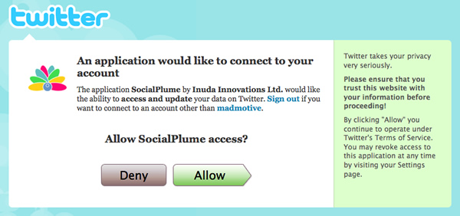
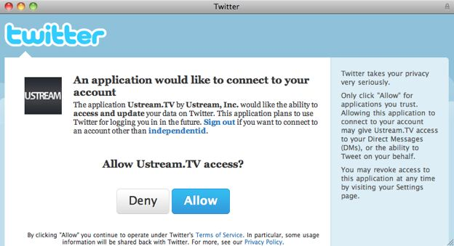
What is OAuth?
Emerging IETF standard
Allow web site X (client) to access your protected data through a web API Y.
17-04-03
Oracle IDM Standards – OAuth2 Introduction

Slide 5
Glossary
Client
  An application obtaining authorization for some protected resources
End-User
  Resource Owner (or one who controls access)
Authorization Server
  Entity that can obtain authorization from the end-user and issue security tokens (aka access tokens)
Resource Server
  Server that can validate security tokens and provide the protected resource
Access Code, Access Token, Access Grant, Refresh Token
  Security Tokens
17-04-03
Oracle IDM Standards – OAuth2 Introduction

Slide 6
What it does?
Avoids re-use of user-id & password by clients
  E.g. Mint.com & CashEdge.com
  Builds on existing web SSO and Federation (e.g. SAML)
Delegation or Tokenization
  Authorizes a client to act on behalf of user by issuing a "token"
Separation of Role & Rights
  SPs can distinguish between user and client app
17-04-03
Oracle IDM Standards – OAuth2 Introduction

Slide 7
Why?
Propagation of passwords
Emergence of Mobile and Web Applications
  Mobile – is there security value in constantly signing on for a mobile app?
  Web – Let Mint.com access records from all your banks to product aggregated reports
  Probably not a good idea to give them your bank password!
Multi-factor Authentication is not easy for client apps without *tight*-coupling
17-04-03
Oracle IDM Standards – OAuth2 Introduction

Slide 8
Early Assumptions
Potentially millions of clients compared to single (or few) service providers
Client developers have less security skill
  Protocol must be simple for clients!
Dis-entangle clients from user authentication issues
Clients, often by way of their developers have a prior relationship with the service provider.
  e.g. developer registers with Facebook
Endpoints are known and fixed
Clients talk to one service provider
17-04-03
Oracle IDM Standards – OAuth2 Introduction

Slide 9
Protocol Flow
17-04-03
Oracle IDM Standards – OAuth2 Introduction

Slide 10
Protocol Flow
The following is a sample flow
OAuth provides many variations
Detailed slides & cases to follow
17-04-03
Oracle IDM Standards – OAuth2 Introduction

Slide 11

Protocol Flow
Authentication Service
AM triggers user authentication
Client App
Client redirects user/browser
to auth mgr with client_id, scope and
a redirect_uri
Authorization Manager
Resource Server
Anonymous
Authenticated
Token
See section 4.0
17-04-03
Oracle IDM Standards – OAuth2 Introduction

Slide 12
Protocol Flow
Authentication Service
AM asks user for consent
Client App
Authorization Manager
Resource Server
Anonymous
Authenticated
Token
17-04-03
Oracle IDM Standards – OAuth2 Introduction

Slide 13
Protocol Flow
Authentication Service
Client App
Authorization Manager
Response is returned with grant code to redirect_uri
Resource Server
Anonymous
Authenticated
Token
17-04-03
Oracle IDM Standards – OAuth2 Introduction

Slide 14
Protocol Flow
Authentication Service
Client App
Authorization Manager
In background (non-browser) using the authentication cred of the client app, the code, and client_id are exchanged for an access token via HTTP POST*
Resource Server
Anonymous
Authenticated
Token
See section 5.0
Note: There are 5 variations!
17-04-03
Oracle IDM Standards – OAuth2 Introduction

Slide 15
Protocol Flow
Authentication Service
Client App
Authorization Manager
Client accesses resource using OAuth token in Authorization header
Resource Server
Anonymous
Authenticated
Token
See section 6.0
17-04-03
Oracle IDM Standards – OAuth2 Introduction

Slide 16
Protocol Flow
Authentication Service
Client App
Authorization Manager
Client may periodically use refresh token to get a new access token
Hint: Refresh is an OOB/implicit "proof of possession"
Allows access tokens to be short lived – reduces revocation risks
Resource Server
Anonymous
Authenticated
Token
See section 5.1.4
17-04-03
Oracle IDM Standards – OAuth2 Introduction

Slide 17
Profiles / Use Cases

Slide 18
Profiles – Web Server
Clients that can interact with end-user’s agent (typically a browser) and capable of handling redirection from authorization server
End-User at Browser
A. Client Id & Redirect URI
Authorization Server
B. User Authenticates
C. Authorization Code
A.
C.
Web Client
App
D. Client Creds, Authz Code & Redirect URI
E. Access Token w/opt refresh token
17-04-03
Oracle IDM Standards – OAuth2 Introduction

Slide 19
Profiles – User Agent
Client applications inside a user-agent/browser.
Typically using scripting language
Client
App in
Browser
F. Access
Token (via fragment)
A. Client_ID & Redirection_URI
Authorization Server
B. End-User Authenticates
C. Redirect URI with Access Token in Fragment
D. Redirect URI without Fragment
Web Server with Client Resource
E. Web Page with Script
17-04-03
Oracle IDM Standards – OAuth2 Introduction
Notes:
Use Cases:
4. Device. Access grant obtained via separate browser access
5. Client Password Creds
6. Assertion based
8. Access token exchange? / 9. Multi-token
11. Signature with asym secret
Oracle Confidential

Slide 20
Profiles – Native Application
This has been evolving for some time
  See: draft-ietf-oauth-native-apps
A few years ago, apps called embedded browser creating a "silo". Effect was loss of SSO state.
  Users angry at having to login for each new app
  This was done to keep apps from stealing browser data (e.g. cookies) from other applications.
Lobbying for changes to iOS and Android has lead to recent ability to allow use of a secure browser that shares cookie state and not readable by client app.
17-04-03
Oracle IDM Standards – OAuth2 Introduction

Slide 21
Client Access – Autonomous
Client is acting based on its own rights previously granted by the authorization server service provider.
Client
App
C. Client Creds & <User Description>
Authorization Server
D. Access Token (w/opt Refresh Token)
E. Access Token
Resource Server
F. Protected Resource
17-04-03
Oracle IDM Standards – OAuth2 Introduction
Notes:
Use Cases:
4. Device. Access grant obtained via separate browser access
5. Client Password Creds
6. Assertion based
8. Access token exchange? / 9. Multi-token
11. Signature with asym secret
Oracle Confidential

Slide 22
Profiles – Autonomous
Utilize an existing trust relationship or framework to establish authorization
Possibilities
  Obtain access token by authenticating with the server using client credentials. Scope limited to
    Those granted by Client Creds alone
    Some other prior arrangement with resource owner
  Use an existing access grant expressed as an assertion format (e.g. SAML Assertion)
17-04-03
Oracle IDM Standards – OAuth2 Introduction

Slide 23
Security Is a Balance

Slide 24
Lessons
Difficult to secure many moving pieces
  OAuth has both a large security considerations section AND and a Threat Model Document
  HTTP Redirect provides functional isolation of authentication from clients – Good!
    Opens the door to more cross-site, and mix-up attacks
TLS Solves a Lot of Problems and Comparatively Easy for Apps
  If clients don't get this correct, they won't get other security aspects!
HTTP Redirect while powerful is VERY hard to secure
  Good functional isolation of authentication from clients
  See: draft-ietf-oauth-closing-redirectors
Making life easy for clients has made OAuth2 successful
  E.g. simple requests, no app layer crypto (only TLS)
Too much documentation is as bad as too little!
17-04-03
Oracle IDM Standards – OAuth2 Introduction

Slide 25
Lessons…
Use of popular protocols changes over time
  New threats will emerge – e.g. dynamic use
  OAuth now being used for new configure or discovery on-the-fly cases to access multiple service providers
    New Mix-up Issue (a mobile app has one redirector)
    Depending on how a client is configured could a phisher take advantage and insert a MITM by mis-informing a client application or browser application?
17-04-03
Oracle IDM Standards – OAuth2 Introduction

Slide 26
OAuth is Authorization
OAuth depends on other methods to authenticate users, clients and endpoints
  OAuth enables a client to access a resource
The audience (of an authorization) is the resource and NOT the client
  All information is "opaque" to client
  Clients should NOT assume obtaining token means a user was authenticated. It just means access is granted.
Use OpenID Connect if a client needs to authenticate users.
17-04-03
Oracle IDM Standards – OAuth2 Introduction

Slide 27
References

Slide 28
Key Specifications
RFC6749 – OAuth 2
RFC6750 – Bearer Tokens
RFC6819 – OAuth 2 Threat Model
RFC7519 – Json Web Token
RFC7523 – JWT Bearer Tokens
OpenID.net – OpenID Connect
  To authenticate users to clients
17-04-03
Oracle IDM Standards – OAuth2 Introduction

Slide 29
Related Specifications
RFC7009 – Token Revocation
RFC7521 – Assertions
RFC7522 – SAML Bearer
RFC7591 – Dynamic Registration
RFC7592 – Dynamic Registration Mgmt
RFC7628 – SASL OAuth (e.g. EMail)
RFC7662 – Introspection (token lookup)
RFC7636 – PKCE (mobile app security)
17-04-03
Oracle IDM Standards – OAuth2 Introduction

Slide 30
Drafts in Progress
draft-ietf-oauth-closing-redirectors
  Issues around open redirectors
draft-ietf-oauth-discovery
  How to discovery correct OAuth config data
draft-ietf-oauth-mix-up-mitigation
  Prevent an AS from attacking another
draft-ietf-oauth-device-flow
  OAuth for limited input devices
draft-ietf-oauth-native-apps
  How to do OAuth in modern mobile phones
17-04-03
Oracle IDM Standards – OAuth2 Introduction

