Slide 1
Scaleable Computing
What about some failures?
CS7NS1/CS4400
Stephen Farrell
stephen.farrell@cs.tcd.ie
https://github.com/sftcd/cs7ns1/
Note: PRs for repo are welcome!

Slide 2
Contents
1965 NE US/Canada power outage
2012 Hurricane Sandy
Facebook’s 2015 approach to failures
General survey of Internet outages (Mar. 2018)
Oct 2018 Github.com outage
I broke my TV! (Oct 2018)
Some effects of the root KSK roll (Nov 2018)
Nov 13th Google BGP leak/hijack
...Your outages/failure war-stories here.

Slide 3
1965 NE US/Canada Power Outage
Cascading relay trips caused major outage
  Relay tripped => power re-routed elsewhere => another relay trip
  https://en.wikipedia.org/wiki/Northeast_blackout_of_1965
“ANATOMY OF POWER SYSTEM BLACKOUTS: PREVENTIVE RELAYING STRATEGIES” from 1996 considers “hidden failures” and “regions of vulnerability,” IEEE Transactions on Power Delivery, Vol. 11, No. 2, April 1996, Tamronglak et al.
  https://ieeexplore.ieee.org/stamp/stamp.jsp?arnumber=489327
Protection systems can cause failure!

Slide 4
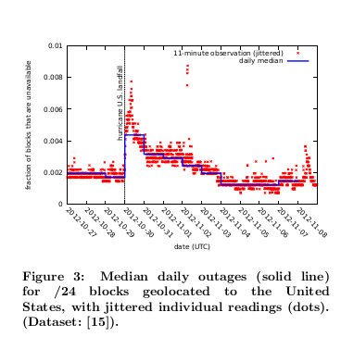
2012 Hurricane Sandy
Hurricane caused Internet outages
  Active measurement – pings of IPv4 /24 ranges and MaxMind geo-location
  Post-facto analysis of outages, but near real-time is possible
“A Preliminary Analysis of Network Outages During Hurricane Sandy”, USC/ISI Technical Report ISI-TR-685, November 2012, Heidemann et al.

Slide 5
Facebook’s approach in 2015
"Move Fast and Break Things" – dunno if they still say that:-)
Causes: hard disk failures, workload changes, human error, fast configuration propogation
Mitigations: A/B testing, controlled config propogation/canaries, strict validation of configs, simplify reverting, fire-drills, post-mortems, clever queues and good dashboards (that scale)
More SLA violations when people are working on the system than when they’re not (at home, vacating, doing bureaucracy!)
“Fail at Scale, Reliability in the face of rapid change”, ACM Queue, Oct 2015, Maurer
  https://queue.acm.org/detail.cfm?id=2839461

Slide 6
Internet Outages Survey
“A comprehensive survey on internet outages,” Journal of Network and Computer Applications, v 113, 1 July 2018, Pages 36-63, Aceto et al.
Causes: mixed; nature (weather, earthquakes), submarine cable cuts, censorship, DDoS, BGP fun, buggy kit
Detection Methods: passive/active/hybrid measurements
Impacts: numbers affected, costs (to whom?), (censorship?)
Methods for Resilience: of n/w or AS, of applications?
Lots of good references there... graphic on next slide...

Slide 7
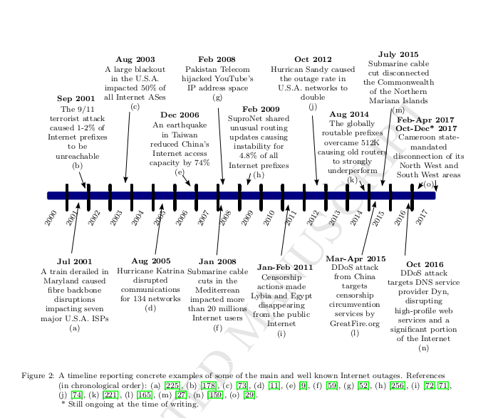

Slide 8
“Internet outage”
Aceto et al’s, definition of “Internet outage” doesn’t seem so good to me:
  “...the particular condition in which the network lies when one or multiple network elements located in a specific geographic area either do not work properly or are not reachable due to intentional or accidental events.”
What’d be a better definition?

Slide 9
Github.com outage
Oct 21 2018 outage
Cause: 43 seconds n/w partition
Result: ~24 hours of downtime for github.com web site features
  US coast-coast latency (60ms) and DB failover/recovery problems
Notable: git CLI kept working; lack of OOB status reporting; growth => complexity, lack of history
Write up: https://blog.github.com/2018-10-30-oct21-post-incident-analysis/

Slide 10
I broke my TV!
<Draws on the blackboard>
In turning on DNS/TLS (DoT) at my main home router, I got too enthusiastic and set set top boxes (STB) to use that recursive, which won’t work (STB’s on WAN side of DoT recursive).
~72 hours later STB’s needed new DHCP leases, and they somehow also needed DNS at that time (WTF? but whatever, some multicast IPTV stuff I guess) which didn’t work of course
  Confusion abounded given the latency between the bad action and the breakage

Slide 11
DNS Root KSK Roll
October 13 2018: Eir had a problem:
  https://www.rte.ie/news/2018/1013/1002966-eir-outage/
  Ultimate (speculated) cause: new 2017 key signing key for DNS roots!
<Draws on blackboard again>
then
Re-uses Geoff Huston’s slides from last week
  https://iepg.org/2018-11-04-ietf103/2018-11-04-kskroll-iepg.pdf
Background on what/how they measure:
    https://www.potaroo.net/presentations/2017-09-13-how-labs-measures.pdf

Slide 12
Google BGP hijack/leak
Tuesday Nov 13th:-)
  https://www.theregister.co.uk/2018/11/13/google_russia_routing/
Nigerian ISP advertises google ranges via BGP
  Apparently accidentally, though not all BGP hijacks are accidents
Result: for 74 minutes, routes to google were via TransTelekom (RU) and China Telecom, who blackholed the trafffic
Lesson: BGP is fragile, RPKI may help

Slide 13
Interesting failures you’ve seen?
Yes, Rosettahub:-) But how specifically?
What else...

Slide 14
Contents - revisited
Cascading protection system fail: 1965 NE US/Canada power outage
Nature: 2012 Hurricane Sandy
Processes: Facebook’s 2015 approach to failures
Surveys: General survey of Internet outages (Mar. 2018)
Backend orchestration flaws: Oct 2018 Github.com outage
Too smart by half: I broke my TV! (Oct 2018)
Complex systemic effects: Some effects of the root KSK roll (Nov 2018)
Legacy Infrastructure: Nov 13th Google BGP leak/hijack
Various:-) : ...Your outages/failure war-stories here.

Slide 15
Conclusion
Failure is real and inevitable
  Fail to plan to fail => fail :-)
We learn a lot from considering failures
  Especially our own
Lots of code is concerned with handling failures
  If that’s not true for your system, then you likely have trouble ahead!

