Slide 1
TEU00311
What is the Internet doing to me?
(witidtm)
Stephen Farrell
stephen.farrell@cs.tcd.ie
https://github.com/sftcd/witidtm
https://down.dsg.cs.tcd.ie/witidtm
URLs accessed 2026-10-12

Slide 2
Computers, Operating Systems
and some example risks

Slide 3
Overall landscape
Desktops, laptops, tablets, phones, “smart” speakers, home routers, raspberry-Pis, “fitness” devices…are all computers running some operating system
Differently popular, open, reliable, invasive and general purpose or not
Your choices should not only be driven by money and ease-of-use, though those factors tend to dominate

Slide 4
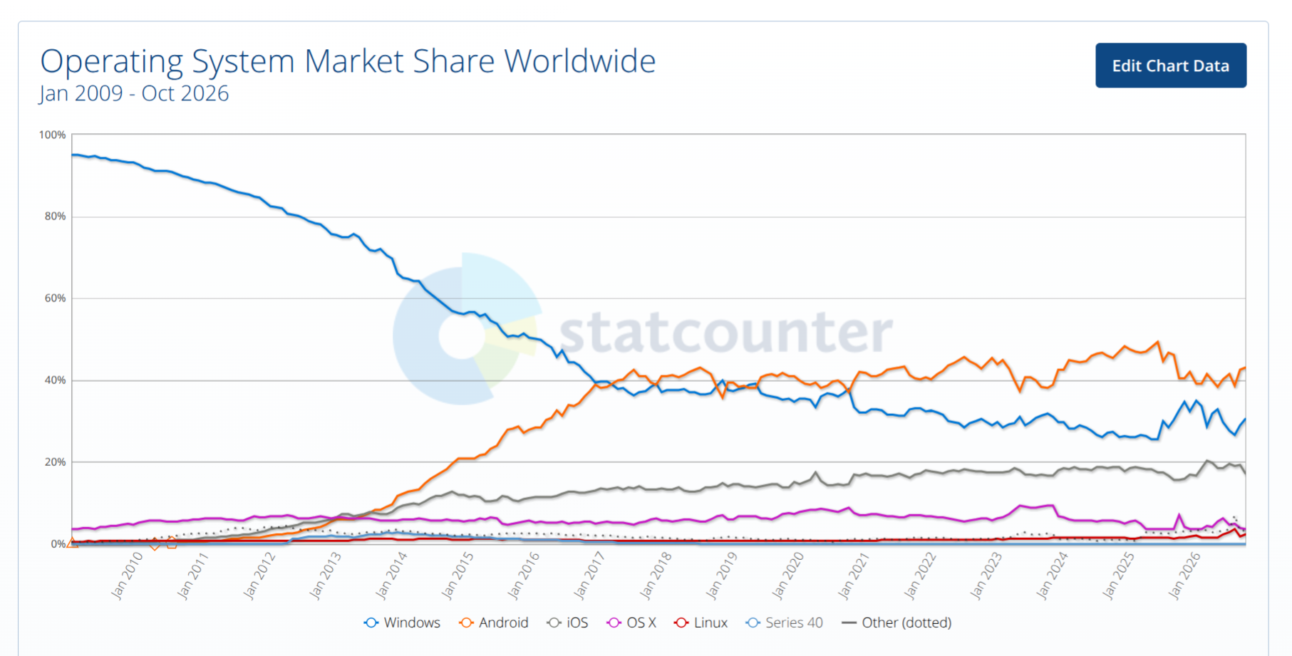
Operating Systems Market Shares
Graph: since 2009
Android
Windoze
iOS
OS X
Chrome-OS
...
Desktop Linuxes
e.g Ubuntu
https://gs.statcounter.com/os-market-share#monthly-200901-202610
Linux (laptop/desktop) now approx 4.5%, Chrome-OS 2.3%

Slide 5
Machine/OS issues to consider (1)
Price, ease of use, updates/support, backup
  Insurance? Meh;-(
Security: probability of attack, probability of success, cost (impact) of successful attack
  Probability of attack relates to market share
Privacy: hiding in crowds vs. standing out by being more privacy-aware
  Tension vs. Probability of attack?
Having backups is your #1 protection – if you do nothing else set that up!
  But only valuable if you sometimes test restore!
Automated updates should be considered mandatory, or else you’ll eventually suffer
  Consider how well update system works, some OSes take ages to update
  Some devices (still!) get no updates – avoid!

Slide 6
Machine/OS issues to consider (2)
Openness – to what extent can someone find out what’s going on under the hood?
Even if you can’t/don’t do that, whether or not others can makes a difference
It’s a big world and many of the tech issues you face will have been overcome by someone else sometime
  And likely being nerdy, they won’t have been able to resist telling the world how they fixed stuff:-)
But: “open” tends to be correlated with “hard to use” or “for nerds”

Slide 7
Machine/OS issues to consider (3)
To be fair, there are also some benefits in a more complete but closed ecosystem, like Apple’s
  https://help.apple.com/pdf/security/en_GB/apple-platform-security-guide-b.pdf
  Note: the above document is written for someone like me, it may be a tough read;-) But it is very thorough – Dec 2024 version is 250 pages
Apple’s “Personal Safety User Guide” (2026) may be more relevant for you:
  https://help.apple.com/pdf/personal-safety/en_GB/personal-safety-user-guide-en_GB.pdf
  That’s only 141 pages:-)
Interesting to compare/contrast today’s “major” OSes – Windows, Android, Apple with what the FOSS movement would like
  FOSS: https://en.wikipedia.org/wiki/Free_and_open-source_software

Slide 8
End of Life
Devices do not last forever – batteries have a limited number of charge cycles
When (when, not if!) a device fails or is lost/stolen, what will you lose?
  See “backup” point earlier
When (when, not if!) a vendor turns off support, or a service (e.g. OS updates, some photo-sharing feature), what will happen to your stuff?
When you’re done with the hardware, what do you do?
  “Two-thirds of used disc drives on Craigslist and eBay contain sensitive data” is a 2016 article, no reason to expect that’ll change v. soon
  https://www.itpro.co.uk/security/26814/two-thirds-of-used-disc-drives-on-craigslist-and-ebay-contain-sensitive-data

Slide 9
Device-based tracking/surveillance
Anything with “location services” can be unexpectedly dodgy
  Image metadata inside the image file can include location
  “Fitness” trackers
Cell-tower history within mobile operators
List of Wi-Fi networks to which you’ve attached sometime
Bluetooth Tracking
“Smart” speakers
“Security” cameras
Telemetry from applications or OS
Software update!
  But didn’t we want that? Yes. But can’t it help tracking? Yes. Hmm...

Slide 10
MAC Addresses
Device-tracking often (ab)uses long-term hard-coded identifiers such as MAC addresses (or IMEI/IMSI in mobile n/w)
MAC address: link layer address (mostly) hardcoded to radio or other network chip
  Same form of address used in WiFi and most other network protocols at link layer, e.g. Bluetooth
  Roughly: how two devices on the same local area network (LAN) identify one another
Looks like “6C:9C:ED:87:27:60” (48 bits) - 1st half is manufacturer ID (Cisco), 2nd half device-ID (a WiFi router that is/was in TCD SCSS)
  You can look up manuf IDs from the registry: https://www.macvendorlookup.com/
MAC address is often fixed for the lifetime of the device; There is now a 64-bit version, not sure how widely used yet
  You can probably see these in your “about device” tab or similar

Slide 11
Randomised MACs
MAC address randomisation is a good idea and now fairly well deployed
  Often, the MAC address only really needs to be stable for a session, so can be randomised
  But – if you paid for the hotel WiFi that might be based on your MAC address, or an enterprise network might use MAC addresses to decide which machines are allowed on the local network, or the machine may be a switch/router/server where changing MAC address would break stuff or be inefficient
So you can’t always randomise, and doing so well needs higher-layer controls
HOWTO turn on varies by OS and version
On an android 10 phone I used have:
  Developer options/Enhanced Wi-Fi MAC randomisation
  You may need to turn on developer options first (search for HOWTO)

Slide 12
Bluetooth
Early BT devices regularly broadcast their MAC addresses
Later BT specs try to fix this, allowing support for randomised MAC addresses
All good so? Nope!
  Even if MAC addresses and payload identifiers change randomly, doing so out of sync enables tracking, sometimes indefinitely (read paper, and see next slide)
  Becker, J., Li, D., & Starobinski, D. (2019). “Tracking Anonymized Bluetooth Devices,” Proceedings on Privacy Enhancing Technologies, 2019(3), 50-65. doi: https://doi.org/10.2478/popets-2019-0036
Generalising: identifier correlation over time, devices and networks, is a very hard problem to mitigate – similar issues with DHCP leases, IP and email addresses, account names and web artefacts (cookies etc.)

Slide 13


Slide 14
Interesting MAC Address Leak
Sep 2023 DefCon talk:
  https://www.youtube.com/watch?v=cO1JSzAdPM8
Top half of Bluetooth Low Energy (BLE) MAC address in beacons is often the manufacturer ID (OUI)
Not many manufacturers make e.g. tasers, stun guns or holsters for police guns
Manufacturers do Bluetooth-enable those, e.g. to log extraction of gun from holster, to trigger body-cam recording if taser fired
If you see BLE beacons for those OUIs, then chances are someone using those devices is nearby
Wardriving databases (e.g. https://wigle.net/) contain historic geo-located scans
The same issues may arise for other BLE enabled things you carry!

Slide 15
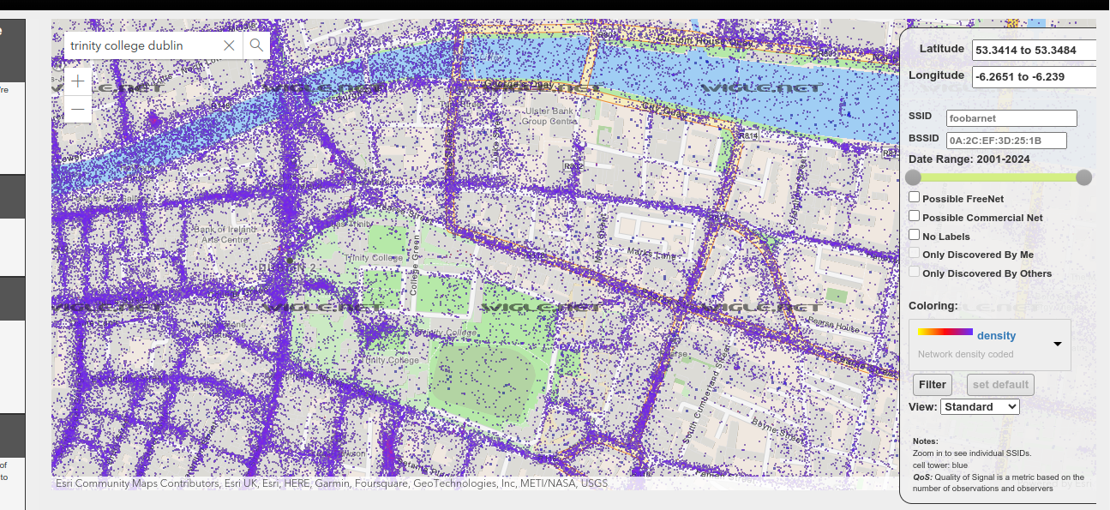
wigle.net

Slide 16
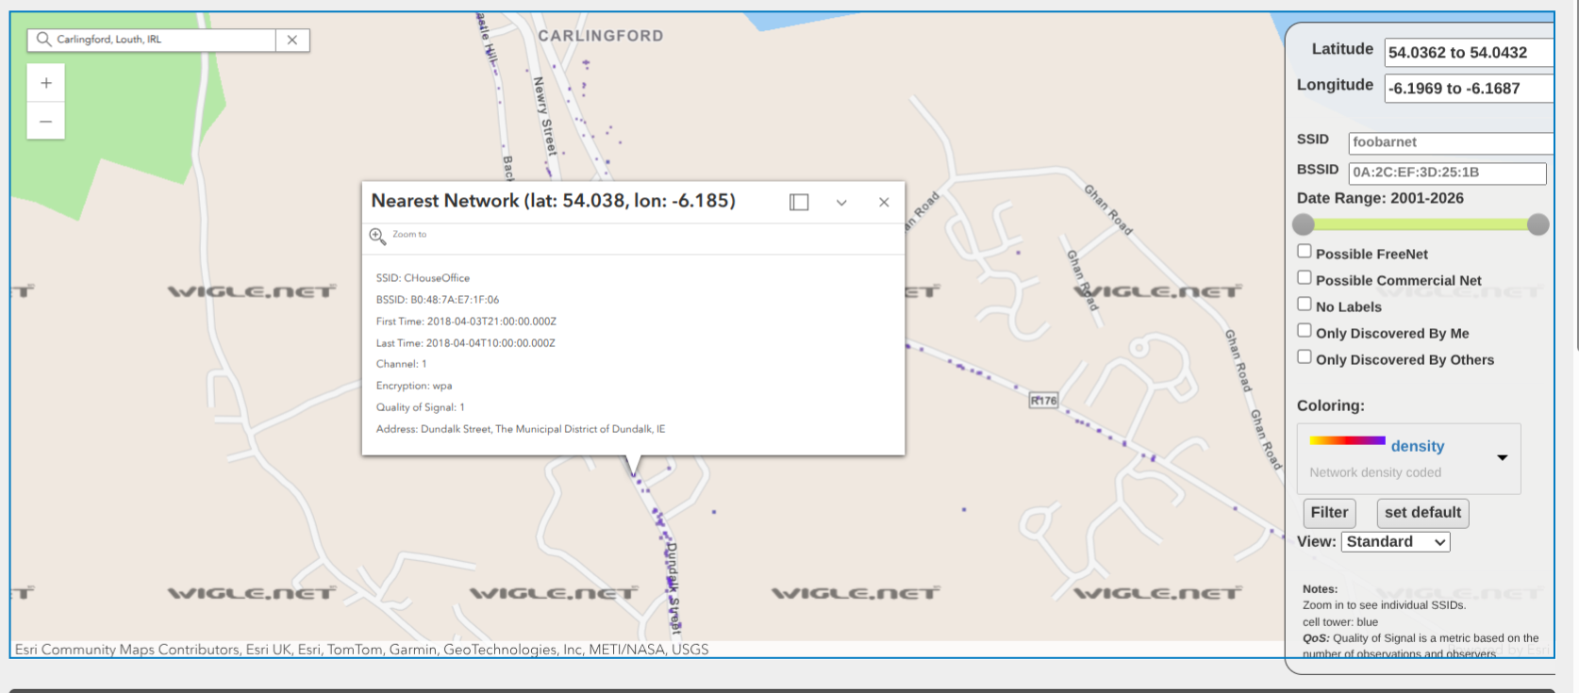
Wiggle.net/Carlingford Co. Louth

Slide 17
Unwanted Trackers
Apple AirTags and similar BLE-based systems have been abused to track e.g. intimate partners
How they work (briefly):
  Tag emits BLE beacon with encrypted ID
  Nearby participating devices encrypt their location “with” BLE beacon and send to service provider
  When device “lost” query service provider for records encrypted for your device to get location(s)
  A good crypto scheme for this can be derived so service provider doesn’t learn too much
Unwanted tracker detection: When device is “lost” and seen frequently by one other device (the one possibly being tracked), device may be “uncloaked” e.g. by causing it to emit sound
The companies involved are currently trying to standarise ways in which such unwanted tracking could be detected
  https://datatracker.ietf.org/wg/dult/about/
  https://github.com/bdetwiler/draft-detecting-unwanted-location-trackers/
  A proposal that group considered: https://eprint.iacr.org/2023/1332.pdf - has a nice description of the problem and proposal for those used to ready crypographic specifications
What do we think about that?

Slide 18
Malicious Software (Malware)
Malware on your devices could:
  Exfiltrate your data (keyboard sniffers, ID theft, “wallet” attacks, mobile app “SDKs”)
  Work for someone else (cryptominers, clickfraud/adware)
  Be part of a botnet (DDoS)
  Encrypt your files (ransomware)
  (Sometimes) survive factory-reset (though less commonly)
Technical types: viruses, worms, trojans, ...
  We’re less concerned here with how malware works or details of how to detect/prevent malware doing bad things
  More interesting is: How can you avoid or recover?
Note that anti-malware tools (e.g. anti-virus) can look similar to malware - they both want access the “innards” of the OS/network-interactions – that can make such tools attractive as a target

Slide 19
How malware may arrive...
Pre-installed (accidentally or deliberately, bloatware/crapware)
Supply chain attacks (e.g., buy a popular npm library, infect that, or generate a new library with a typosquatted name)
Appear to be an application or browser extension that someone may want (e.g., phone torch app)
Mail attachment (pdf, zip, tar, ...) in spam or spear-phish – be careful of how email addresses and file names are displayed in your mail user agent!
Drive-by exploitation via web-site/browser vulnerability
Fake QR code leading to site encouraging download/install
USB stick (watering hole attack)
USB charger (how much do you trust Dublin Bus? :-)

Slide 20
Actors in the “AppStore” model
The interested parties include the OS vendors, device manufacturers, mobile network operators, app developers and the services those apps use/enable
  Your interests likely come last in that list, despite what most of the others may say, and even if they really mean what they say!
  Their interests won’t always be aligned either (e.g. mobile network operator vs. over-the-top service provider)
  And there are non-stupid bad actors in the game, esp. in the app developer and services-those-use/enable cohorts
So what do you think are their interests?
  OS makers: Google (android), Apple (IOS), Canonical (Ubuntu)
  Device manufacturers: Samsung, Apple, Huawei, Sony, …
  Mobile network operators: China Mobile, … Vodafone, … Telefonica, … Eir, Three
  App developers: Google, Apple, device makers plus many others I’ve never heard of
  Service providers: Google, Facebook, Twitter, … Netflix, Sky, ...

Slide 21
“AppStore” Permissions model
Both iOS and android “app” install processes use a “permissions” model, windoze, chromebooks and MAC OS are heading that way more
  As is Ubuntu, but only sort-of, it being a much more open OS
Android used (before 2015) present “permissions needed” only at install time, now both it and iOS pop up permission requests when the app first tries to make use of something “sensitive”
  But are those permission classes really meaningful? And do they protect you? TBH: I find it hard to tell
Research in this space also seems less concentrated on how well all this protects users and more on how “well accepted” it is by users, e.g.:
  Reinfelder, Lena, et al. "An Inquiry into Perception and Usage of Smartphone Permission Models." International Conference on Trust and Privacy in Digital Business. Springer, Cham, 2018.
    https://www.researchgate.net/profile/Lena_Reinfelder/publication/326630389_An_Inquiry_into_Perception_and_Usage_of_Smartphone_Permission_Models_15th_International_Conference_TrustBus_2018_Regensburg_Germany_September_5-6_2018_Proceedings/links/5c0e58564585157ac1b73e03/An-Inquiry-into-Perception-and-Usage-of-Smartphone-Permission-Models-15th-International-Conference-TrustBus-2018-Regensburg-Germany-September-5-6-2018-Proceedings.pdf
  Rajivan, Prashanth, and Jean Camp. "Influence of privacy attitude and privacy cue framing on android app choices." Twelfth Symposium on Usable Privacy and Security ({SOUPS} 2016). 2016.
    https://www.usenix.org/system/files/conference/soups2016/wpi16_paper-rajivan.pdf
  Could be I didn’t spend enough time looking though (I did look around in 2019 but didn’t repeat since:-)

Slide 22
Some ISPs also track
US Federal Trade Commission Oct 2021 report
  https://www.ftc.gov/system/files/documents/reports/look-what-isps-know-about-you-examining-privacy-practices-six-major-internet-service-providers/p195402_isp_6b_staff_report.pdf
Major US ISPs sneakily “sharing” info about their customers
Not that surprising

Slide 23
What do I use?
Main devices:
  Home router: OpenWRT (Turris Omnia)
  Laptop: Ubuntu (Framework 13)
  Phone: Murena teracube 2e de-Googled Android
  A cardboard box: with a pile of old phones and laptop hard-drives:-)
The above is not a recommendation for you, just what I use
Various others @ home and for work, mostly Ubuntu servers on hosted virtual machines (VMs), some real (“bare-metal”) servers and some old laptops
Other people on my home network use android, iphone, mac, (currently no windoze)
Main living room laptop also runs Ubuntu and is entirely usable for non-nerds

Slide 24
If you wanna try Ubuntu...
Ideally try with old laptop
  Drivers for newer models can take a while to catch up with proprietary versions, esp for WiFi
You can try before installing to hard drive by running from a “live” USB stick
You can make system dual-boot if you wanna try some more but still keep your earlier OS

Slide 25
What do you use?
What would you like to use?
What do you dislike that you use?

