Slide 1
TEU00311
What is the Internet doing to me?
(witidtm)
Stephen Farrell
stephen.farrell@cs.tcd.ie
https://github.com/sftcd/witidtm
https://down.dsg.cs.tcd.ie/witidtm

Slide 2
Reading news
We probably all have preferred sources of news
What are yours?
Why do you choose them?
Do you treat all sources equally? (as a reader)
What kind of media do you prefer (text, audio, video), for what and why?
What kinds of publishers/aggregators are there?

Slide 3

How I once read tech news
Back in pre-history (from 1980) there was usenet/netnews
  https://en.wikipedia.org/wiki/Usenet
That was (and still is!) a federated set of servers that distribute messages from named newsgroups to one another using the Network News Transfer Protocol (NNTP)
Anyone could write a message to most groups, some were moderated
comp.risks or “The Risks Digest” was one such newsgroup
AFAIK, that’s where you can still see the oldest text I wrote (from 1989) that’s still online:
  https://catless.ncl.ac.uk/Risks/8.38.html
  That’s over there ------------------------------------------------>
  Obviously, a number of posters said I was stupid in followups:-)
Amazingly the risks digest is still on the go!
  https://catless.ncl.ac.uk/Risks/
  You can view it via Usenet or as an RSS feed...
The catless.ncl.ac.uk web page currently generates certificate warnings (sadly)

Slide 4
How I read news a decade ago
From ~early 2000’s I had a small, slowly changing, collection of browser bookmarks for ~7-8 news sites that I’d regularly visit
I organised those into a folder of bookmarks
At some stage Firefox added a feature to “open all in tabs” so you could load all those pages, each on its own tab, with one click
  That feature is still there but a bit more hidden in latest FF

Slide 5
FF news bookmarks circa. 2015
I bookmarked these news sites:
  Irish Times
  RTE
  /.
  Washington post
  BBC
  The Intercept
  The Guardian
  Breakingnews.ie
All was good but that didn’t work on my phone
  That was an issue from say ~2008 once I had a well-connected phone
  An RSS reader did work there though

Slide 6

RSS Readers
RSS = Real Simple Syndication
  https://en.wikipedia.org/wiki/RSS seems accurate enough
Designed (in 1999) to provide a simple overview of a web page (plus a link) and to be used in a “feed” so that an RSS reader can track updates as web pages change and new pages are added
RSS is (I think) Ideal for readers of news web sites and aggregators
Not ideal for publishers: No advertising. No analytics.
RSS support now removed from current desktop browsers
  e.g. firefox https://support.mozilla.org/en-US/kb/feed-reader-replacements-firefox
Some mail user agents (e.g. Thunderbird) still support RSS
  chrome 94 re-enabled some RSS features in 2021
    https://www.androidheadlines.com/2021/10/follow-sites-on-chrome-rss-powered-feed.html

Slide 7
RSS “item” example
From: https://www.rte.ie/news/rss/news-headlines.xml (on the day I first made this slide:-)
<item>
<title>Taoiseach awaits outcome of 'volatile' week in UK</title>
<link>http://www.rte.ie/news/brexit/2019/0902/1073287-brexit-eu/</link>
<description>
Taoiseach Leo Varadkar has said he may meet British Prime Minister Boris Johnson next week and says he will of course listen to alternatives to the backstop.
</description>
<pubDate>Mon, 02 Sep 2019 11:50:21 +0000</pubDate>
<guid>http://www.rte.ie/news/brexit/2019/0902/1073287-brexit-eu/</guid>
<category>Brexit</category>
<media:content url="https://img.rasset.ie/00129ec1-800.jpg" width="800" type="image/jpeg" height="450"/>
</item>
The syntax used there is XML (eXtensible Markup Language)
XML is (sort-of) a superset of HTML
An RSS “feed” is just a set of items plus some wrapping stuff
An RSS reader has URLs like the above configured and then renders the items

Slide 8
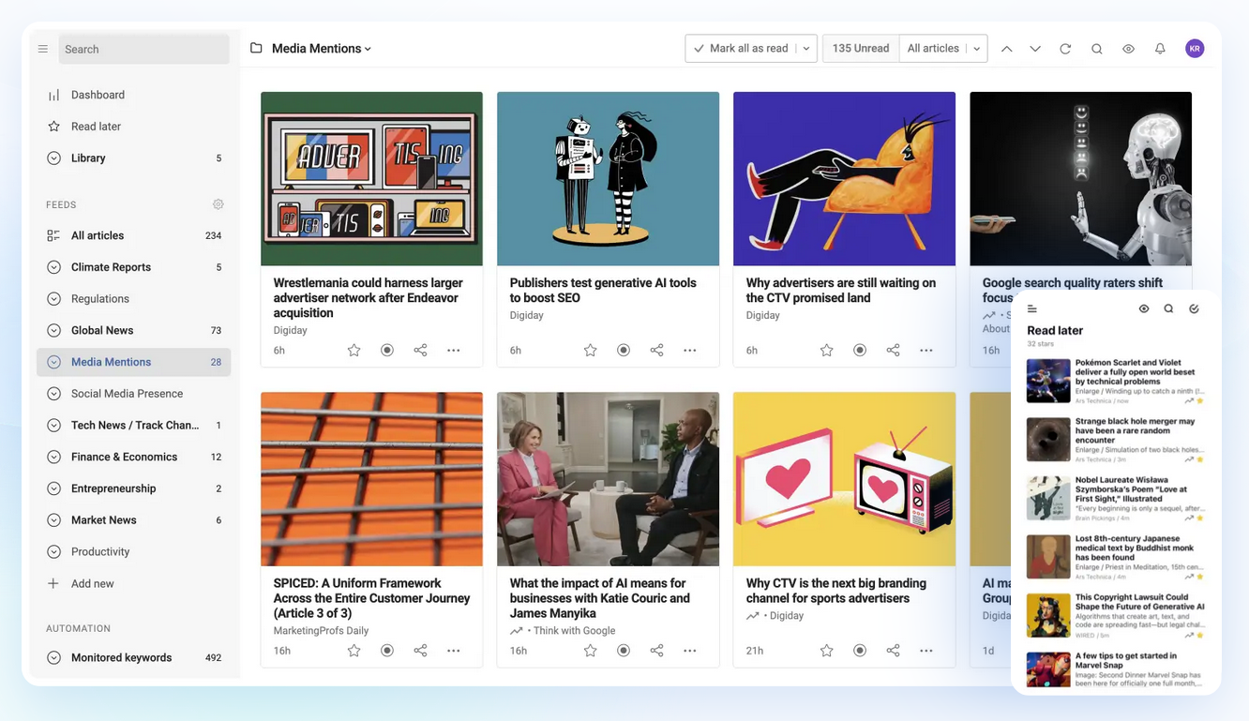
How an RSS reader looks/looked
Image from https://www.inoreader.com/ (accessed 2025-09-03)
Note: I don’t use ‘em but they may be ok (or not)

Slide 9
Next step was dissatisfaction;-)
For quite a while, (maybe 2010-2016), I was fine with browser bookmarks and an RSS reader on my phone
  More-or-less the same sources though not identical
Eventually though, the amount of web crap (ads, JS, “accept cookie”) got annoying
  And Snowden’s news told us lots more was being surveilled that we had thought
In 2015 I setup jell.ie as my own server
  jell.ie runs on a virtual private server (VPS) in a hosting site operated by a small hoster based in Amsterdam (used to be on a VPS run by a chap in Sligo, but I moved it)
  Sometimes people call VPS’ virtual machines (VM) – kinda the same thing mostly but not always
  One server (basically a rack-mounted PC) can run multiple VMs for different customers
Having jell.ie meant I could control more things, but what to do?
  First: measure, then see what I want to control

Slide 10

2017 Measurements (1)
8 web sites measured that had corresponding RSS feeds
Re-checked those URLs on 20190908:

Slide 11
2017 Measurements (2)
As we saw already ‘shift-ctrl-I’: let’s you see what’s up as a page loads
Another thing you can do in developer-mode is save a “har” file – an HTTP archive file that stores details of most of the interactions you can see in a browser’s developer-mode
  HOWTO: in browser, shift-ctrl-I; choose network tab; reload page; right-click, select “save as har” (FF) or “save as har with content” (chromium/opera)
  HAR files are large JSON things
    JSON is JavaScript Obect Notation - a way to represent structured data that’s currently fashionable
  Be careful to clear browser cache before measuring!
(With a bit of scripting) that allowed me to count attempts to set cookies and how many hosts were being contacted for each page load
One could automate all that, but I didn’t, I tested 2 configurations:
  Out-of-the-box chromium
  FF+NoScript+Ghostery+cookies-off

Slide 12

2017 Measurements (3)

Slide 13
2017 Firefox setup
Turn off cookies in preferences, except for an allowlist of sites I want to let use cookies (about 10)
  That means only those 10 sites can set cookies that FF will re-send to the site
NoScript is an add-on that turns off Javascript for all but a set of allowlisted web sites
  FF won’t execute Javascript code embedded into a non-allowlisted web page
  Default config allows “well known” things like gmail (maybe 100 sites) but I turn all those off and only allow those I want/need (also about 14, about 8 of which are also allowed cookies)
Ghostery is an ad/tracker blocker add-on
  Has a blocklist of sites that are trackers (about 3000! and growing!), default is to allow a bunch of things (same as NoScript) but I turn ‘em all off
  HTTP requests to those trackers that would otherwise happen automatically (e.g. 1x1 pixel images) are intercepted and not sent
“HTTPS Everywhere” add-on
  Has an allow-list of domains so that whenever the domain in an HTTP schemed request is on the allowlist the URL is automatically changed to an HTTPS schemed URL (i.e. it automates turning on encryption); Uninstalled when broke at some stage;
  Modern browsers have that as a built-in setting now, and it is, or will become, the default
  I’m currently still running this but EFF (the authors) have declared victory and will deprecate it sometime
    https://www.eff.org/deeplinks/2021/09/https-actually-everywhere

Slide 14

2017 Measurements (4)

Slide 15
Frequently leaving breadcrumbs at 245 hosts, many of whom are purely there for tracking, would be horrendous, and even 34 hosts seems ickky...
...so I made https://jell.ie/news/

Slide 16


Slide 17
Example of what control means
I got fed up seeing headlines featuring the name of a certain former US president
Each time I generate a page, a bit of PHP code I added to my web page replaces that string with a randomly selected Dutch name:-)
  https://randomuser.me/api/?nat=nl is a site that gives random user information (names, d-o-b, logins, emails) designed to look credible – it’s used for evasion (creating phoney accounts) but more legitimately for software testing
  It supports about 16 nationalities but Dutch names were funnier somehow
I don’t actually call the API each time any more (that’d be another breadcrumb!) but have downloaded a snapshot of their Dutch names and randomly pick first and last names from that locally
    https://github.com/RandomAPI/Randomuser.me-Node

Slide 18


Slide 19
The jell.ie news
Service is https://jell.ie/news and you’re welcome to read it if you want
  Even better if you (someday) make your own service based on your own choices!
Text description of why and what:
  https://down.dsg.cs.tcd.ie/witidtm/refs/jell.ie-news.html
  https://github.com/sftcd/witidtm/blob/master/refs/jell.ie-news.md
    Includes measurement details given above
Does what I want, on laptops, tablets and phones
  We’ll walk through it...

Slide 20
Jell.ie news == VPS+Apache2+simplepie
Jell.ie is a VM/VPS I rent from a hoster running Ubuntu 22.04.4 LTS, with Apache2
  Totally run of the mill, cost is <1 coffee/week
  Learning HOWTO cost is not too high, mostly reading
Given I have a web server and a set of news sources I’d like to read, why not have my web server contact the various news sources, cache the content and then display that to me without me leaving breadcrumbs all over?
Checked who’d done what before and found simplepie, a PHP script for just that
  The VPS (not my browser) updates the RSS feeds and caches them
  https://github.com/simplepie/simplepie/
  Tweaked that to better do what I want, mostly forget what I changed

Slide 21
LAMP Server
LAMP server is usually a VM/VPS with Linux Apache MySql and PHP
  https://en.wikipedia.org/wiki/LAMP_%28software_bundle%29
  That or similar are commonly setup with nearly one click at a hoster
PHP is a recursive acronym for PHP: Hypertext Preprocessor (geeks, eh;-)
  https://www.php.net/
  PHP is a simple scripting language that runs inside the web server in order to generate tailored HTML pages
Javascript (in contrast) is a scripting language such that the web server gives the browser the (possibly complex) script which is then run by the browser
Many purist programmers hate bits or all of both PHP and Javascript
  Others don’t:-)

Slide 22
Jell.ie news == VPS+Apache2+simplepie
Instead of my browser talking to many web sites and trackers, it talks to my VPS – jell.ie
Simplepie PHP code, running inside the https://jell.ie web server acts as an RSS client pulling the RSS feeds and turning those into ok-to-nice HTML
So my browser doesn’t interact with the source web sites, nor trackers
Default for simplepie includes links to feed-item images on the source site, but that’d mean my IP connecting to the image source, so I turned on caching of images and mapping of img URLs as well
But then I turned off images entirely as they don’t add much

Slide 23
Jell.ie news == VPS+Apache2+simplepie
Simplepie has a cache, (I set it to 1 hour) so that each load of the page does not result in a new fetch from the source sites – use that so I don’t expose timing/presence information to the web sites
I have a “cron” job that also runs on the jell.ie VPS that refreshes that cache every 30 mins
  Last I looked (2019), bingbot was reading the jell.ie news about every 30 mins
So the source sites just see the VPS once per 30m and never see timing related to my browser accessing the news (nor yours!)
Until I click through to read the detail of a story when it’s back to “normal” web access
One recent (~Aug 2022) change: the US NPR web site publish nice text-only versions of articles (https://text.npr.org/) that don’t require cookie click-throughs, so I now munge npr.org URLs to link direct to the text-only version of the article

Slide 24

2017/2019 Measurements

Slide 25
Reading news
We probably all have preferred sources of news
What are yours?
Why do you choose them?
Do you treat all sources equally? (as a reader)
What kind of media do you prefer (text, audio, video), for what and why?
What kinds of publishers/aggregators are there?

