Slide 1
TEU00311
What is the Internet doing to me?
(witidtm)
Stephen Farrell
stephen.farrell@cs.tcd.ie
https://github.com/sftcd/witidtm
https://down.dsg.cs.tcd.ie/witidtm
URLs accessed 20200925 (not all content from URLs updated)

Slide 2
What’re we here for?
We all use the Internet all the time
You may or may not know what’s happening under the hood, and shouldn’t need to know all the nitty-gritty detail
But, to make better decisions as to what you do, it’s good to know something about some of those details
This module aims to help you learn enough to make better decisions about what you want, and how to get it, as you interact with the Internet
I hope: you’ll apply those lessons, tell others about it all and maybe agitate for a better Internet for a better society (but you won’t fail the module if you don’t agitate:-)

Slide 3
Administrivia

Slide 4
TCD Personnel/Contacts
Lectures:
  Dr. Stephen Farrell, stephen.farrell@cs.tcd.ie
  Dr. Dave Lewis, dave.lewis@cs.tcd.ie
    You’ll see Dave after Reading week
  Dr. Eoin O’Dell, eoin.odell@tcd.ie
    You’ll see Eoin in next week
For generic stuff, I guess you email me – try include “witidtm” in the subject line

Slide 5
Who are we? (SITS as of Sep 25th)
8 Computer Engineering
7 Global Business
4 Political Sci and Geography PDE Joint Pathway
4 Law Single Pathway
4 Engineering with Management Single Pathway
4 Business and Economics
3 Theoretical Physics Single Pathway
3 Environmental Sciences
2 Sociology and Social Policy Single Pathway
2 Psychology Single Pathway
2 Mechanical and Manufacturing Engineering
2 Biochemistry
1 TSM Geography and Sociology (Freshman)
1 TSM French and Spanish (Freshman)
1 TSM English Literature and German (Freshman)
1 TSM Economics and Mathematics (Freshman)
1 TSM Ancient History and Archaeology and Jewish and Islamic Civilisations (Freshman)
1 Sociology and Drama Studies
1 Religion Single Pathway
1 Physics and Astrophysics Single Pathway
1 Molecular Medicine
1 Middle Eastern Jewish and Islamic Civilisations and Classical Civilisation Joint Honors
1 Microbiology
1 Law and Political Sci Joint Pathway
1 Irish and French Joint Honors
1 Human Genetics
1 History of Art & Architecture and Italian Joint Honors
1 History of Art and Architecture Single Honors
1 History and Political Science Joint Honors
1 Geoscience Single Pathway
1 Geography and Sociology Joint Honors
1 Film Studies and History Joint Honors
1 Electronic and Computer Engineering
1 Course Name
1 Chemistry
1 Business Economics and Social Studies
1 Business and Political Science
1 Bioengineering
1 Dunno
1 Me
1 Eoin
1 Dave

Slide 6
about:me
SCSS research fellow
Research topics: security, privacy & delay-tolerant networking
Currently a member of Internet Architecture Board
  https://iab.org
    Note: definitely not the other (IMO less nice;-) IAB - https://www.iab.com/
Other courses taught, pubs, CVish stuff etc:
  https://www.scss.tcd.ie/Stephen.Farrell/

Slide 7
Schedule
All online for now (sigh;-)
Lecture slots, all BB collaborate “ultra”, so “live-with-recording”:
  Tuesday 1000-1050
  Thursday 1600-1750
“Office hours”:
  Monday 1100-1130+ also via BB collaborate “ultra”
  Lecturer(s) will hang out there/then, any of you welcome to join & chat
  Might swap that time some weeks depending on conflicts with other schedules
Reading week: Week 11, November 9th

Slide 8
Assessment
3 Assignments, submit via BB
GDPR request and anonymised report – 30 %
“Ethics canvas” – 30 %
Individual report on device & app tracking – 40 %
No exam unless you flunk, then … eh, not sure yet;-)

Slide 9
Module Materials
There is no book – feel free to recommend some if you like
Materials will be linked to from, or on, the module web page:
  https://down.dsg.cs.tcd.ie/witidtm
Content of module web page is also in Github at:
  https://github.com/sftcd/witidtm
Clone that repo and/or visit that page often, as it will change during the runtime of the module!
  Who knows what “clone that repo” means?
  I’ll be happy to take PRs, if offered – if very good I might even give some marks

Slide 10
Style
Unless otherwise stated, all lecture slots will be recorded
  If you don’t consent to that, let us know!
Would love to see active participation via chat and audio
  Happy to take suggestions to improve things (probably won’t accept all suggestions though;-)
For some lecture slots, we’ll minimise the presentation to encourage interaction
Please don’t sit there and say nothing!
It is entirely ok to ask what might appear to be less-than-clever questions, e.g. “Who makes money from YouTube?” - supposedly naive questions can be good and the answers might be quite subtle
It is entirely ok to comment on what we tell you, e.g. “That’s nonsense – I use <foo> all the time and it’s fine afaics” - this is about you after all, so (dis)agreeing with us and one another is desirable (but don’t be an ass, and do listen)
If you don’t comment or ask questions, we’ll all be more bored and I’ll get cranky!

Slide 11
Butting in...(a good thing!)
If I’m waffling on and you have a question or comment then we can try a virtual “mic line”:
  Type “+q” in the chat room to join the line (easier to spot and order than “raised hands”)
  It’s ok to e.g. “+q to ask if tcd.ie is a DNS domain?” or “+q to follow up on that point about FB” or “+q to say that I didn’t get that last bit”
I’ll go to the “mic line” either then or in a bit, we can do the umute dance and chat about the questions one at a time
If there’s a bunch of people in the “mic line” and your point has been covered already then it’s good to type “-q ...” to get out of the mic line
It is entirely fine to chat in the chat room all the time – just keep it relevant and considerate
If (subsets of) the class have their own external chat room(s)... I don’t care:-)

Slide 12
So, with administrivia out of the way,
let’s start...

Slide 13
Here’re some questions we’ll come back to at the end of the slide-deck (today or next day, whenever) but please start to ponder them...

Slide 14
I think the Internet is great
(and have for 30+ years)
but
are the 3-4 billion people connected
all your friend?

Slide 15
How do you interact with the Internet?

Slide 16
Do you care about your, my, or all of our,
security on the Internet?
If so, what do you care about most?

Slide 17
Do you care about your, my, or all of our
privacy?

Slide 18
That’s all for now, we’ll be returning to those questions as we go.
But… what other questions should we be considering?

Slide 19
What else?
Your topic here... what’d you like to cover?
(we can revisit this multiple times)

Slide 20
Meanwhile… let’s start with…
Is the Internet a network?

Slide 21
Is the Internet a network?
(hint: the answer is “no”:-)

Slide 22
A network of networks
The Internet is made up of about 65,428 Autonomous Systems (ASes)
  https://en.wikipedia.org/wiki/Autonomous_system_%28Internet%29
  69762 ASes as of 2020-09-25, (https://www.cidr-report.org/as2.0/)
    Was: 65,428 in Aug 19
Think of these as the set of Internet Service Providers (ISPs, like Eircom, Vodafone, Virgin), other networks (e.g. HEANET which is TCD’s “ISP”), big companies (e.g. Google, FB) and oddities like Internet eXchange Points (IXPs, like INEX)
Each is (in principle and often in practice) an independent network (or set of networks) and their operators can do whatever they want
  They’re essentially defined by sets of numbers: Static: AS number (ASN); Dynamic: sets of IP address prefixes
They interact using Internet protocols (like IP, TCP, BGP)
  IP: Internet Protocol; TCP: Transmission Control Protocol; BGP: Border Gateway Protocol
We’ll delve more into all that later, but first… some pretty pictures

Slide 23
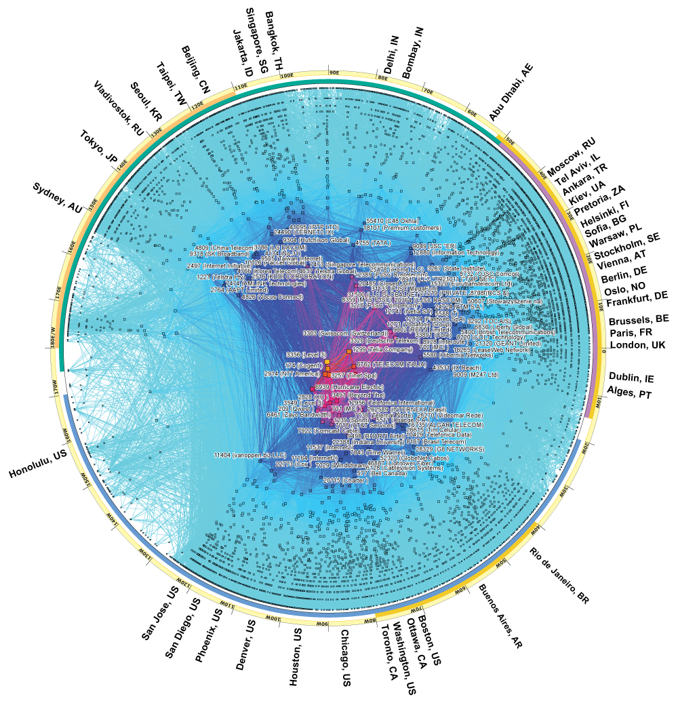
CAIDA Map of ASes
CAIDA (Center for Applied Internet Data Analysis) is a UC San Diego Internet measurement organisation
  You can measure a lot of what happens on the Internet as it happens!
This is a 2017 map of the ASes as they were then
  https://www.caida.org/research/topology/as_core_network/2017/
More central => more connected, serving more people
  You can see Dublin at about 3 o’clock
  In the middle (if you zoom) you could see level3 and cogent which are large ASes

Slide 24
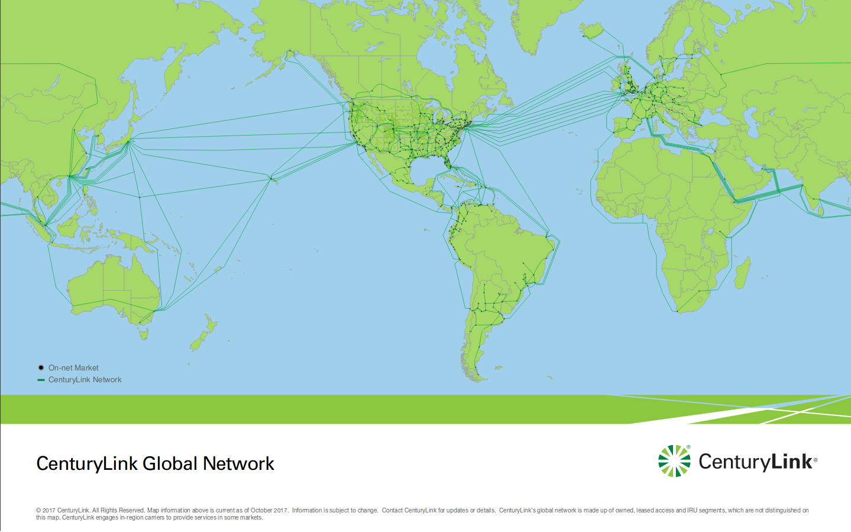
Level3 is one of those (a BIG one)
https://www.level3.com/~/media/files/maps/en-network-services-level-3-network-map.ashx

Slide 25
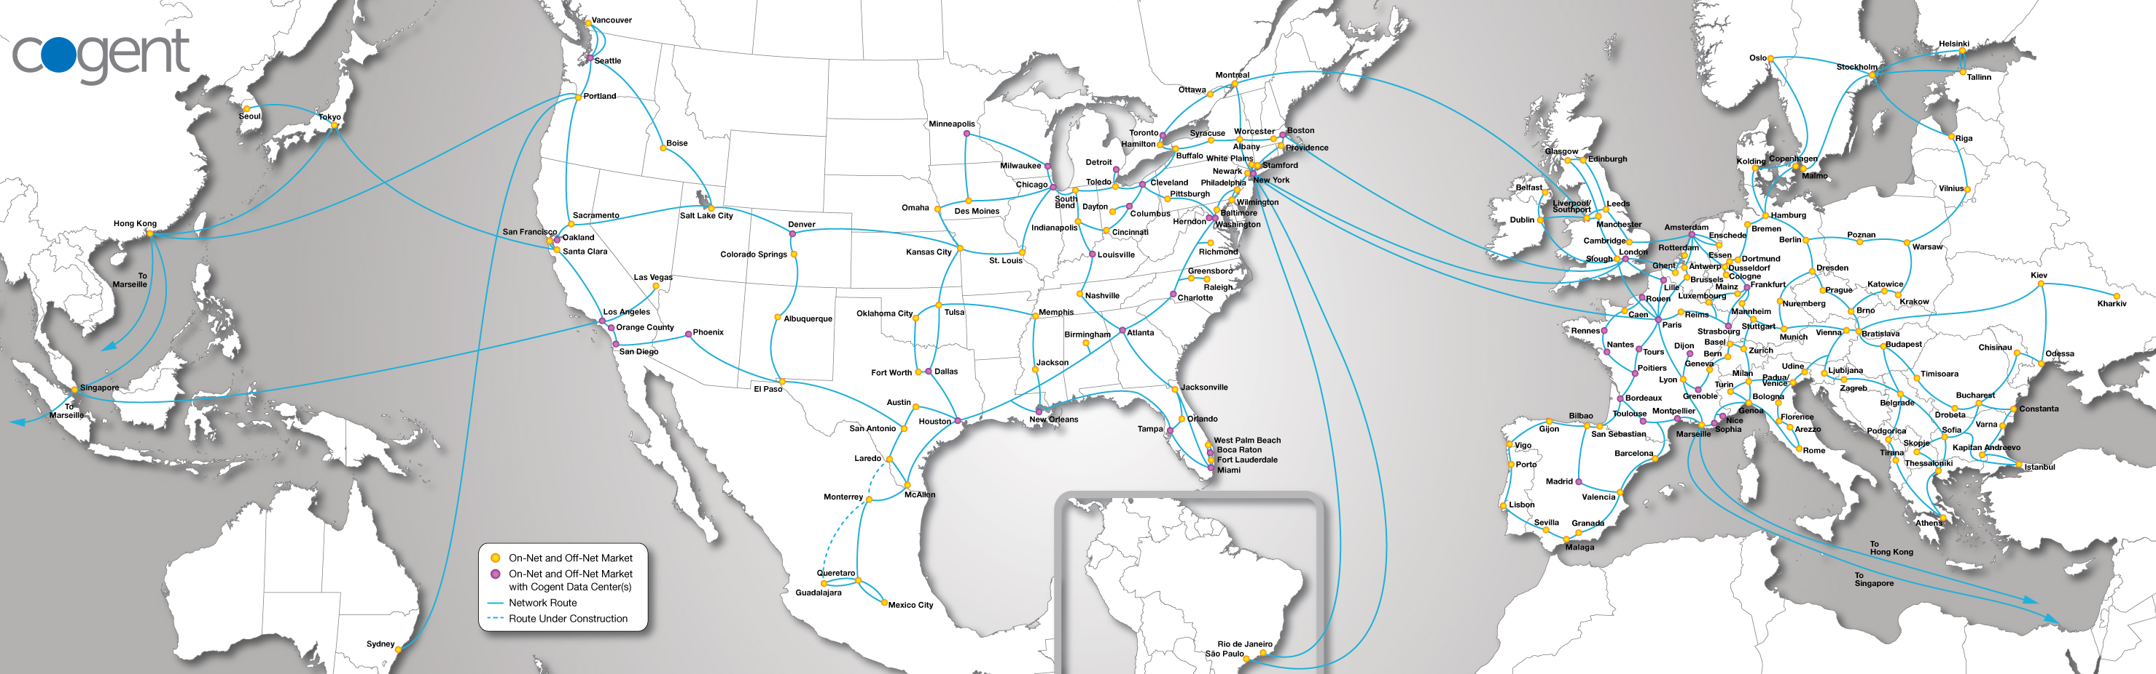
Cogent similarly
Cogent's network stretches over 204 markets throughout 43 countries in North America, Europe and Asia, with over 57,400 route miles of long-haul fiber and more
than 34,100 miles of metropolitan fiber serving over 840 metropolitan rings. Our end-to-end optical transport network consists of IP-over-WDM fiber links running up
to 2,120 Gbps intercity capacity and 2,000 Gbps on metropolitan rings, located in Cogent's major markets throughout North America, Europe and Asia. On the IP layer, Cogent's Tier 1, IPv6 and MPLS enabled network has direct IP connectivity to more than 6,760 AS (Autonomous System) networks around the world with over
185 Tbps internetworking capacity.
https://www.cogentco.com/en/network/network-map

Slide 26
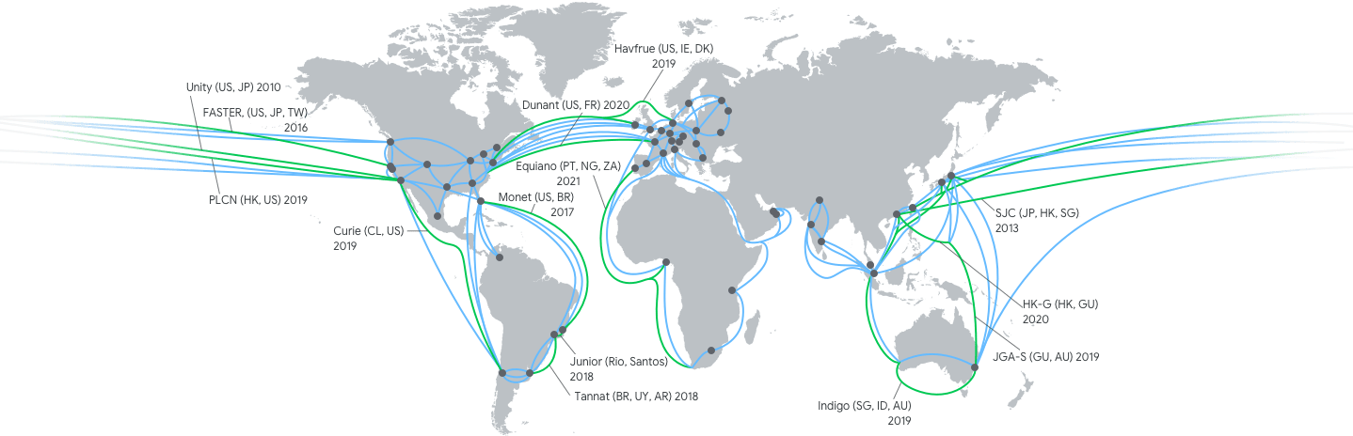
Google cloud
https://cloud.google.com/about/locations/#network-tab note this is just google cloud, not all their stuff

Slide 27
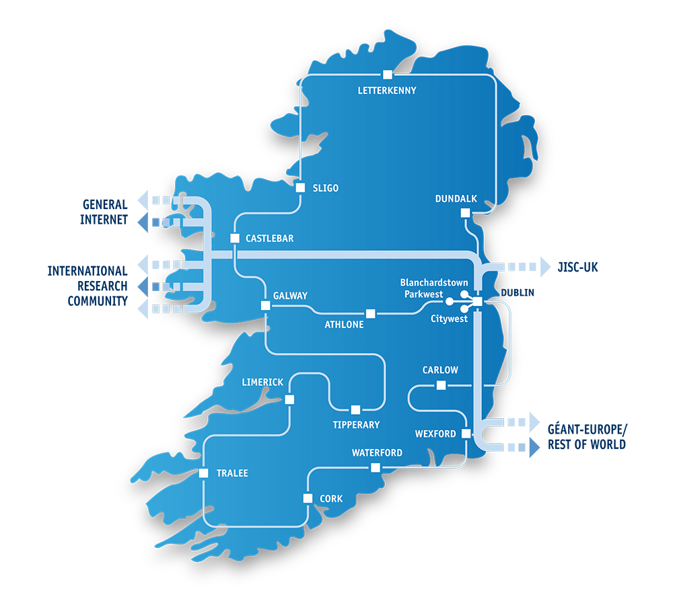
Heanet national n/w
https://www.heanet.ie/network-maps

Slide 28

The TCD network
- Network Core - Routers (High-availability pair)
- Distribution Layer - routed Layer 3 switches serving x7 campus zones
- Access Layer - Layer 2 Ethernet switches in building comms rooms and wireless Access Points
- External internet connectivity via L3 WAN block to ISP - Border Routers and Firewalls, DMZ hosting web services
- Data Centre network connectivity - central server and application hosting
Thanks to TCD IT for providing this anonymised diagram – doing that’s not a no-brainer btw!

Slide 29
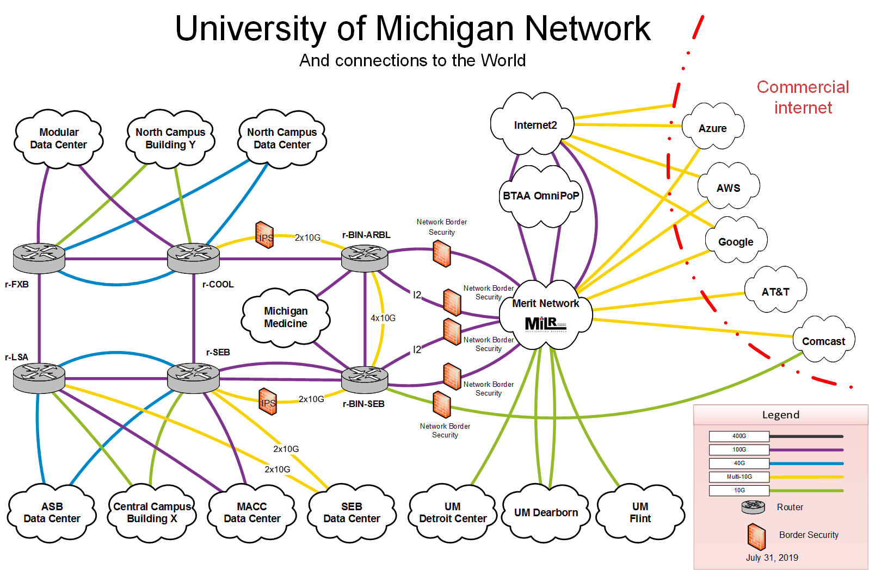
A 2nd campus example
https://its.umich.edu/enterprise/wifi-networks/campus-network-diagram-description

Slide 30

My home network
That’s from a few years ago – numbers are out of date:-)

Slide 31
Interoperability
To make the Internet work we need to agree on how to interoperate for some basic/minimal set of things
  That means defining/agreeing on Internet Protocols
  Where we need to agree on how to interoperate, a lot of that is done by the Internet Engineering Task Force (IETF) and other Internet standards bodies (IEEE SA, W3C)
    I’m quite involved with IETF stuff, so consider me biased there:-)
But we do not aim to agree about everything in everyone’s network
  So an awful lot happens at the “application layer” in code written by people and organisations, e.g. FB, Google, banks, Netflix, ...
  Those services are not the Internet – they depend on the Internet!
And yet more happens when people configure services that use generic code

Slide 32

What’s a network protocol?
https://en.wikipedia.org/wiki/File:IP_stack_connections.svg

Slide 33
“Permissionless innovation”
One important point is: in principle each network operator can do whatever it wants so long as it interoperates “nicely” with others (and even when it doesn’t act particularly nicely;-)
  That also applies to your home network (if you want and are able)
  There are no protocol police (yet!)
This is one of the main reasons why the Internet has been so successful
Related: the classic “End-to-end argument” paper
  Salzer, Reed. Clark,“End-to-end arguments in system design” ACM ToCS (1984).
    https://web.mit.edu/Saltzer/www/publications/endtoend/endtoend.pdf
  I recommend a read of that!
  Don’t consider it as gospel though – it’s the end-to-end argument and not really the end-to-end principle even though it gets called the latter a lot

Slide 34
“Tussles”
Repeating: we do not aim to agree about everything in everyone’s network...
  So an awful lot happens at the “application layer” in code written by people and organisations
  And yet more happens when people configure services that use that code
When the “policies” reflected in those collide then “fun” follows;-)
  If protocols or application code constrains what operators can do then people complain
  If what n/w operators are doing breaks (esp changes to) applications then people complain
  In both cases people often complain at the wrong place;-)
Another paper:
  Clark, David D., et al. "Tussle in cyberspace: defining tomorrow's Internet." ACM SIGCOMM Computer Communication Review. Vol. 32. No. 4. ACM, 2002.
    https://www2.cs.duke.edu/courses/compsci514/cps214/spring09/papers/p347-clark.pdf
  Same “Clark”, but older:-) Interestingly, the 2002 paper is IMO far more dated (and wrong!) than the 1984 paper!
We’ll consider a “topical” example later (Search for “DNS over HTTPS” if you want to check it out); don’t worry if this issue seems a bit too hard to grok at this point

Slide 35
Aside: Cyber<blah>
Be wary of anyone who uses a term like “Cyber<blah>”
~90% of the time, that’s a strong indicator that they don’t really know what they’re talking about (if they did, they’d use a more precise and well-defined term)
Sadly, about 10% of the time (and increasing) such terms are used because “industry” keeps on doing it and people just repeat stuff thoughtlessly
Don’t be afraid to ask someone to define “Cyber<blah>” if they use such a term, and don’t be surprised if they find that hard!
  E.g. “Does cyberspace include a person driving a car that’s had it’s license plate automatically scanned?” or “What’s not included in cybersecurity?”

Slide 36
The Internet is not the web
Another important point!
The web is (roughly) the set of computers that speak the HTTP protocol
  HTTP == HyperText Transfer Protocol (http://example.com)
  HTTPS == HTTP/Transport Layer Security (https://example.com)
Email doesn’t use HTTP, but rather (mostly) the Simple Mail Transfer Protocol (SMTP) which is a couple of decades older than HTTP
Mobile network internals (3G, 4G, 5G...) mostly run over IP using a bunch of protocols you’d prefer to never have to know about
But lots of our interactions with the Internet are via the web

Slide 37
Some of the things we’ll do later...
Understand what happens under the hood when your browser loads a web site
Get an overview of advertising networks
Talk a bit about spam and phishing (email badness)
Learn how to watch network traffic
We’ll look more at the web soon, meanwhile back to you...

Slide 38
How do you interact with the Internet?

Slide 39
Do you care about your, my, or all of our,
security on the Internet?
If so, what do you care about most?

Slide 40
Do you care about your, my, or all of our
privacy?

Slide 41
That’s all for now, we’ll be returning to those questions as we go.
But… what other questions should we be considering?

Slide 42
What else?
List from 20190912 lecture:
  Use of personal data in politics
  Banking
  HOWTO do coding
  Encryption
  U18 and their rights
  Cryptocurrency BTC
  Spyware
(we can revisit this multiple times)

Slide 43
What else?
List from 20200929 lecture:
(we can revisit this multiple times)

