Slide 1
TEU00311
What is the Internet doing to me?
(witidtm 2026/2027)
Stephen Farrell
stephen.farrell@cs.tcd.ie
https://github.com/sftcd/witidtm
https://down.dsg.cs.tcd.ie/witidtm
URLs accessed TBD (not all content from URLs updated)

Slide 2
What’re we here for?
We all use the Internet all the time
You may or may not know what’s happening under the hood, and shouldn’t need to know all the nitty-gritty detail
But, to make better decisions as to what you do, it’s good to know something about some of those details
This module aims to help you learn enough to make better decisions about what you want, and how to get it, as you interact with the Internet
I hope: you’ll apply those lessons, tell others about it all and maybe agitate for a better Internet for a better society (but you won’t fail the module if you don’t agitate:-)

Slide 3
Administrivia

Slide 4
TCD Personnel/Contacts
Lecturers:
  Dr. Stephen Farrell, stephen.farrell@cs.tcd.ie
  Dr. Abeba Birhane, birhanea@tcd.ie
    You’ll see Abeba next week
  Dr. Eoin O’Dell, eoin.odell@tcd.ie
    You’ll see Eoin in October
  A couple of guest lectures along the way (more as we go)
For generic stuff, email Stephen – try include “witidtm” in the subject line

Slide 5
about:me
SCSS research fellow
Research topics: Internet security & privacy and delay-tolerant networking
Pronouns: he/him
  Feel free to let us know if/when we get yours wrong
Other courses taught, pubs, CVish stuff etc:
  https://www.scss.tcd.ie/Stephen.Farrell/

Slide 6
about:us
28 Computer Science Single Pathway
10 Theoretical Physics Single Pathway
7 Business and Economics
4 Human Genetics
3 Neuroscience
3 Geoscience Single Pathway
3 Electronic and Computer Engineering
3 Computer Engineering
2 Semester Start Up AHSS Michaelmas Term
2 Psychology Single Pathway
2 Pharmacy (Integrated) Single Pathway
2 Music Single Pathway
2 Microbiology
2 Management Science and Information Systems
2 Human Health and Disease Single Pathway
2 History Single Pathway
1 UG Visiting EMS + HS Michaelmas Term
1 UG Visiting AHSS, EMS + HS Michaelmas Term
1 Sociology and Social Policy Joint Honours
1 Sociology and Business
1 Political Science and Social Policy Joint Honours
1 Pol Sci PPES and Economics PPES Joint Pathway
1 Philosophy Single Pathway
1 Music and Philosophy Joint Honours
1 Molecular Medicine
1 Medicinal Chemistry
1 Global Business
1 Geography and Sociology Joint Honours
1 Geography and Geoscience Single Pathway
1 Environmental Sciences
1 English Studies Single Pathway
1 Economics and Sociology
1 Economics and Political Science
1 Economics and Computer Science Joint Honors
1 Economics
1 Computer Science and Business Joint Honours
1 Chemical Sciences Single Pathway
1 Biological and Biomedical Sciences
1 Biochemistry
SITS as of 2025-09-02

Slide 7
Schedule
Two lab sessions on Thursday Sep 24th and October 1st (location: next slide +1)
Otherwise, lecture slots are:
  Tuesday 1000-1050, Lloyd basement, LB08
  Thursday 1600-1750, Lloyd basement LB01
Reading week: October 26th

Slide 8
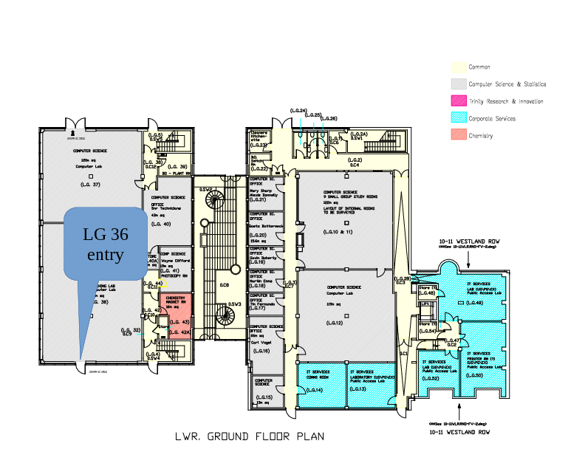
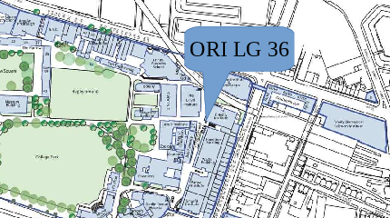
Labs Location
Labs in ORI LG36 from 1600-1750
Bring a laptop and phone if you can
You should be able to use lab PCs anyway (if necessary, you should have gotten a mail wrt scss account this week, if not, don’t worry)

Slide 9
Assessment
3 Assignments, submit via Blackboard
AS1: LLM Bias in CVs (lab exercise) – 25 %
  Deadlines for all: we’ll talk about those in a week or two
AS2: GDPR request and anonymised report – 25 %
AS3: Individual report on device & app tracking – 25 %
In-person attendance over full semester – 25%
  Because: attendance is good:-)
  If you have a valid reason for absence then send mail to Stephen and we’ll factor that in
  We’ll have sign-in sheets at the front of the room, make sure you fill that in every time
Re-assessment (if needed) will be an in-person, sit-down, exam
  Old ones at https://down.dsg.cs.tcd.ie/old-exams/witidtm.html

Slide 10
Background Survey
There’s a quick 5 question survey on blackboard
Please complete that before the end of Wednesday 16th
I may modify the topics-covered based on the answers
I will use the answers to level-set
So please fill that in

Slide 11
Module Materials
There is no book – feel free to recommend some if you like
Materials will be linked to from, or on, the module web page:
  https://down.dsg.cs.tcd.ie/witidtm
Content of module web page is also in Github at:
  https://github.com/sftcd/witidtm
Clone that repo and/or visit that page often, as it will change during the runtime of the module!
  Who knows what “clone that repo” means?
  I’ll be happy to take PRs, if offered – if very good I might even give some marks

Slide 12
Style
This module is fully in-person with no recording and no streaming
Don’t sit there and say nothing!
It is entirely ok to ask what might appear to be less-than-clever questions, e.g. “Who makes money from YouTube?” - supposedly naive questions can be good and the answers might be quite subtle
It is entirely ok to comment on what we tell you, e.g. “That’s nonsense – I use <foo> all the time and it’s fine for me” - this is about you after all, so (dis)agreeing with us and one another is desirable (but don’t be an ass, and do listen)
If you don’t comment or ask questions, we’ll all be more bored and I’ll get cranky!

Slide 13
Do self-organise a chat medium
If (subsets of) the class have their own external chat room(s)... I don’t care:-)
Actually, I’d prefer you do, so who’ll organise that?
If you’d like me to broadcast the co-ordinates for that (an invite, a web page or whatever) please let me know and I’ll send mail to the group
I won’t be spying on whatever you get up to there:-)

Slide 14
So, with administrivia out of the way,
let’s start with…
Is the Internet a network?

Slide 15
Is the Internet a network?
(hint: the answer is “no”:-)

Slide 16
A network of networks
The Internet is made up of tens of thousands of Autonomous Systems (ASes)
  https://en.wikipedia.org/wiki/Autonomous_system_%28Internet%29
  77535 ASes as of 20250831, (https://www.cidr-report.org/as2.0/)
    Was: 76324 on 20240901, 74903 on 20230829, 73797 on 20220817, 72173 on 20210907, 65,428 in Aug 2019
Think of these as the set of Internet Service Providers (ISPs, like Eircom, Vodafone, Virgin), other networks (e.g. HEANET which is TCD’s “ISP”), big companies (e.g. Alphabet/Google, Meta/FB) and oddities like Internet eXchange Points (IXPs, like INEX)
Each is (in principle and often in practice) an independent network (or set of networks) and their operators can do whatever they want
  They’re essentially defined by sets of numbers: Static: AS number (ASN); Dynamic: sets of IP address prefixes
They interact using Internet protocols (like IP, TCP, BGP)
  IP: Internet Protocol; TCP: Transmission Control Protocol; BGP: Border Gateway Protocol
We’ll delve more into all that later, but first… some pretty pictures

Slide 17
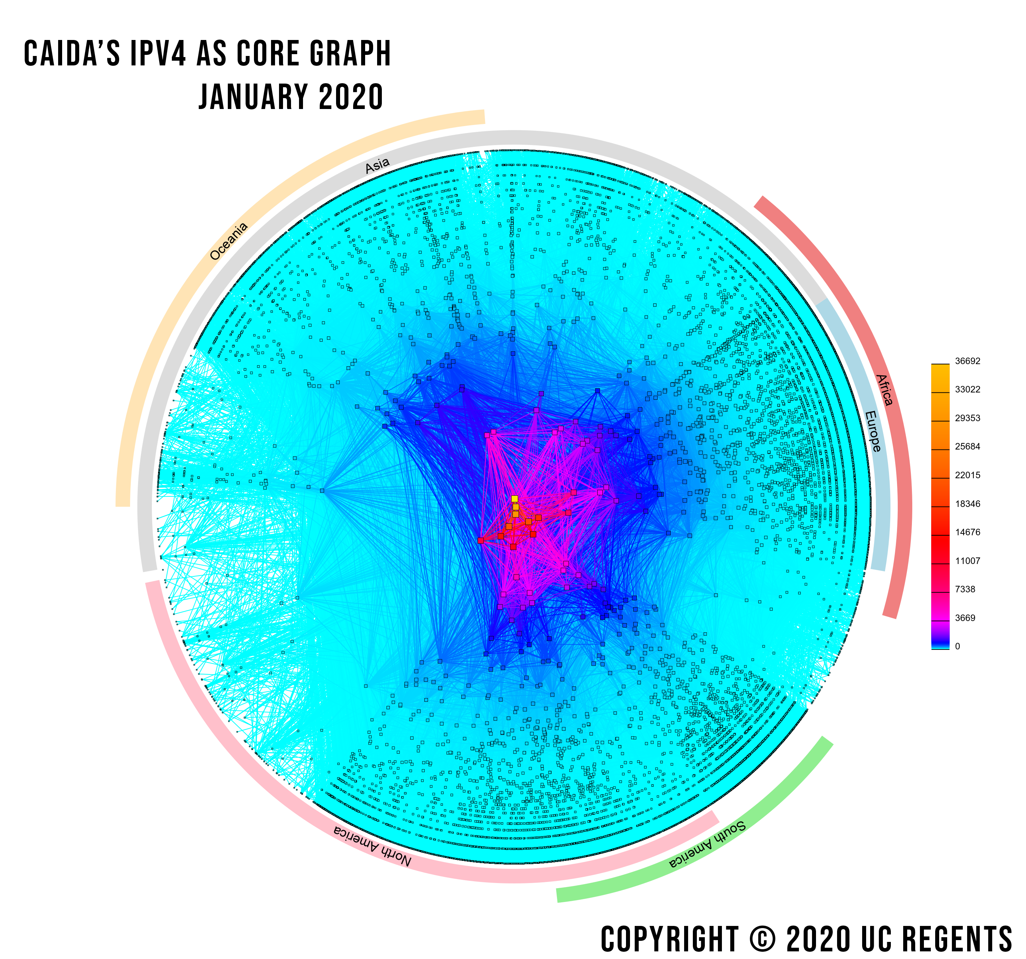
CAIDA Map of ASes
CAIDA (Center for Applied Internet Data Analysis) is a UC San Diego Internet measurement organisation
  You can measure a lot of what happens on the Internet as it happens!
This is a 2020 map of the ASes as they were then
  https://www.caida.org/projects/cartography/as-core/2020/
More central => more connected, serving more people
  In the middle, are the highly connected ASes such as level3 and cogent

Slide 18
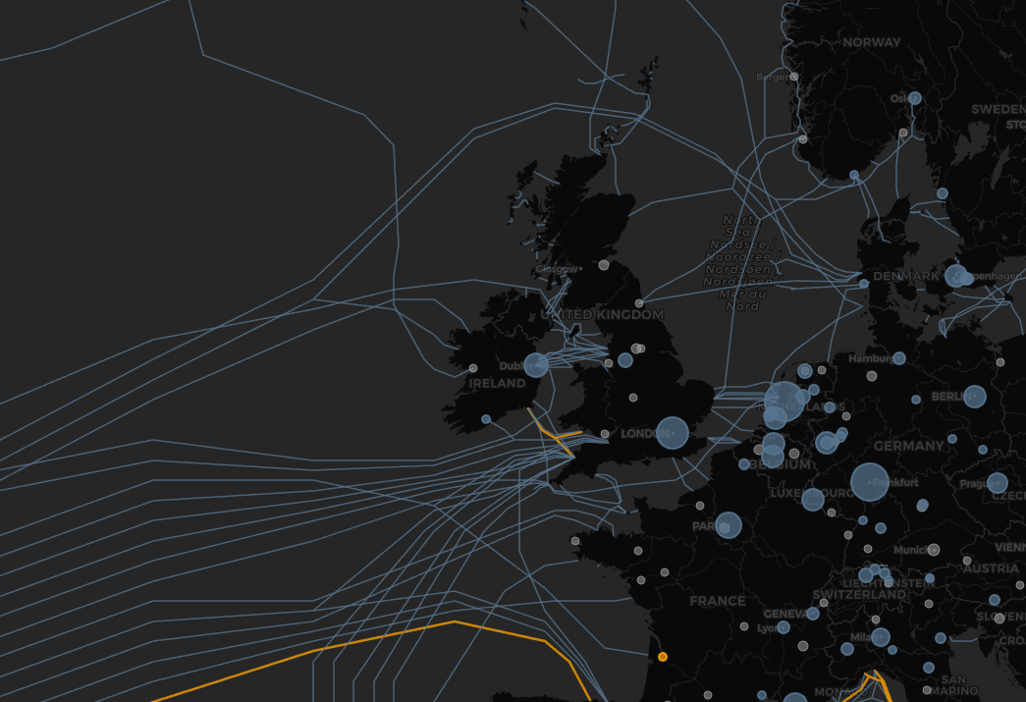
Submarine Cables
Interactive map at:
https://map.kmcd.dev/

Slide 19
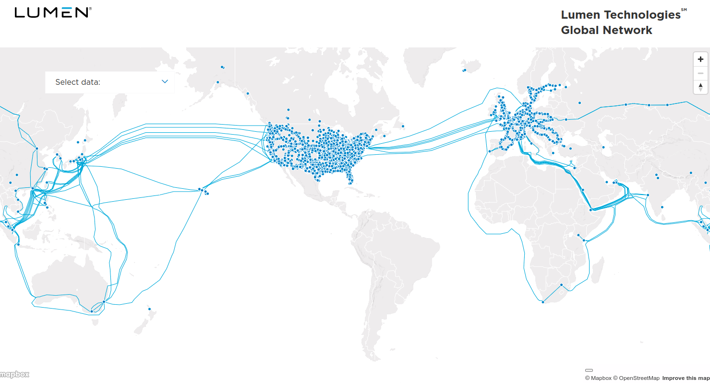
Lumen (was Level3 etc.) is one of those (a BIG one)
https://www.lumen.com/en-us/resources/network-maps.html
Map borked on 2025-09-01

Slide 20
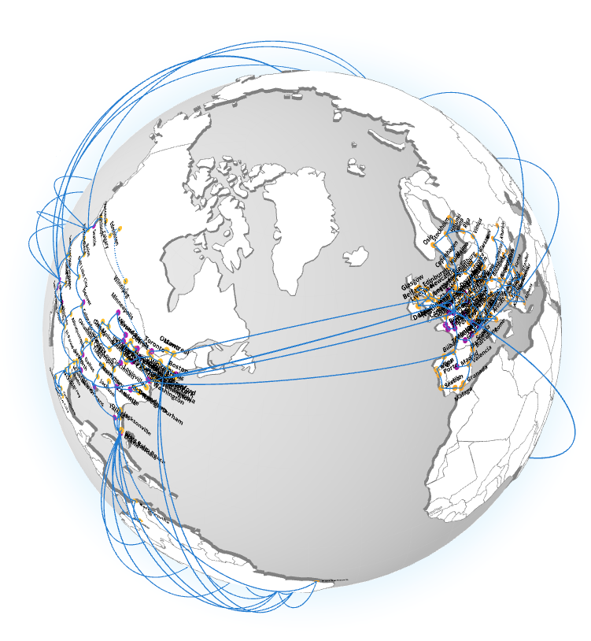
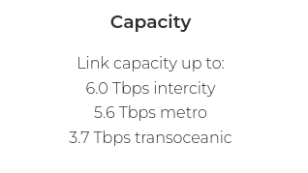
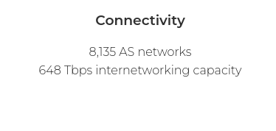
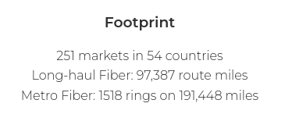
Cogent similarly
https://www.cogentco.com/en/network/network-map
Numbers above are 2024

Slide 21
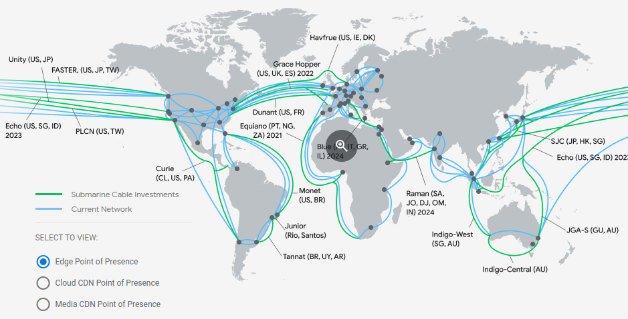
Google cloud
https://cloud.google.com/about/locations/#network note this is just google cloud, not all their stuff

Slide 22
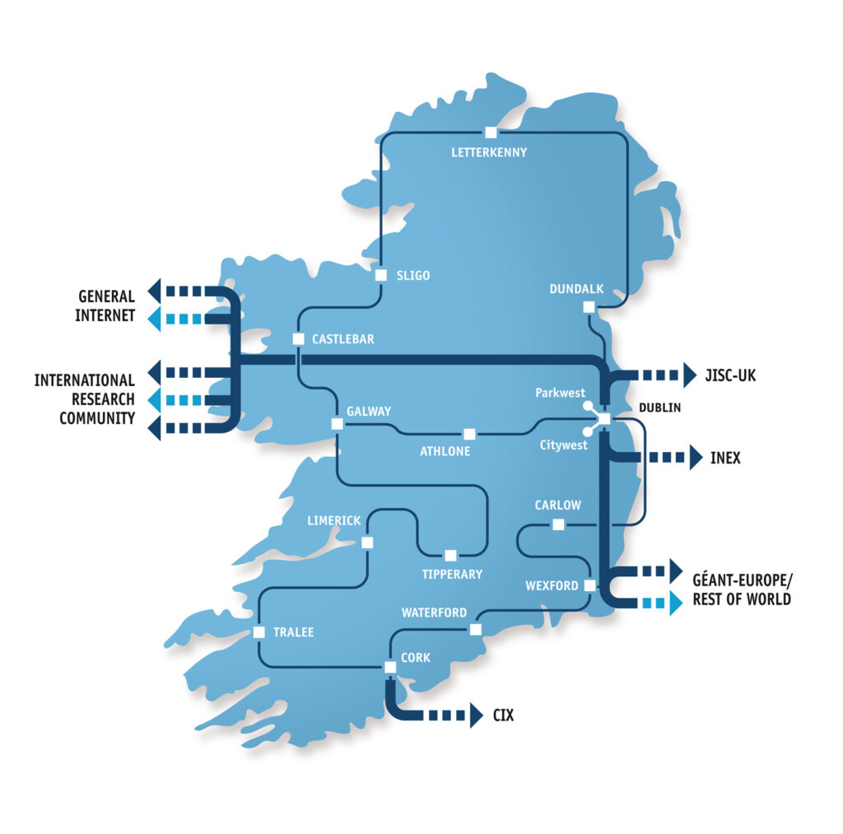
Heanet national n/w
https://www.heanet.ie/network-maps

Slide 23
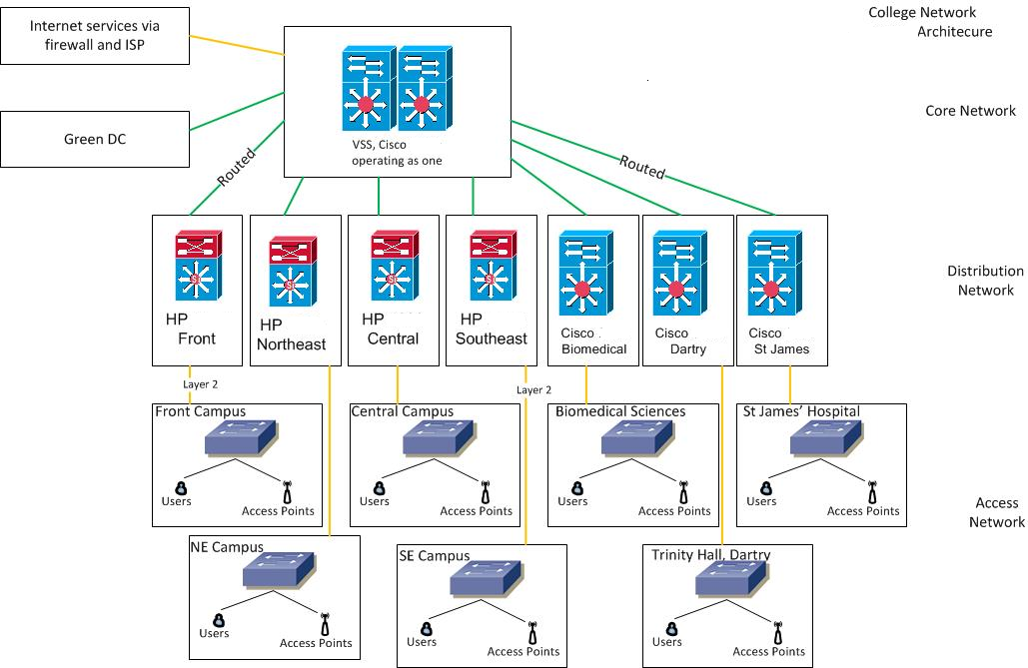
The TCD network (circa 2019)
- Network Core - Routers (High-availability pair)
- Distribution Layer - routed Layer 3 switches serving x7 campus zones
- Access Layer - Layer 2 Ethernet switches in building comms rooms and wireless Access Points
- External internet connectivity via L3 WAN block to ISP - Border Routers and Firewalls, DMZ hosting web services
- Data Centre network connectivity - central server and application hosting
Thanks to TCD IT for providing this anonymised diagram – doing that’s not a no-brainer btw!

Slide 24
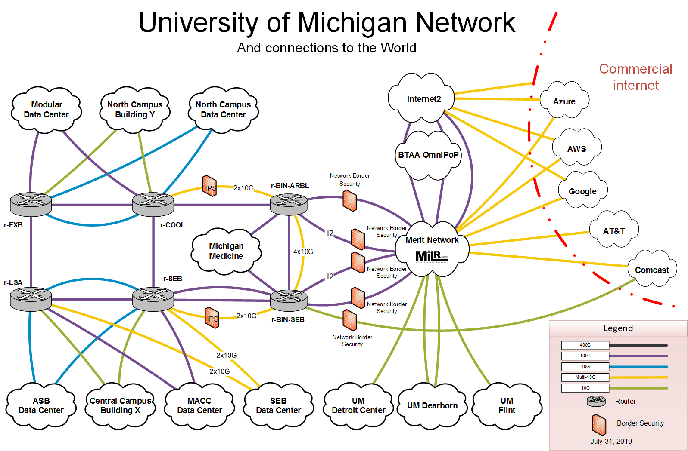
A 2nd campus example
https://ds.cs.luc.edu/_images/umich-network.png

Slide 25
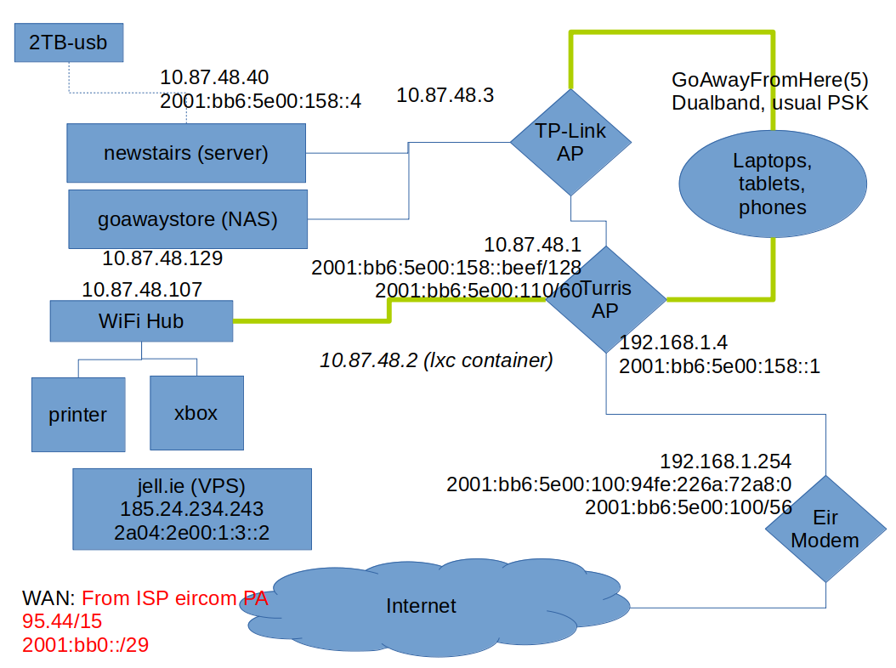
My home network
That’s from a few years ago – so is somewhat out of date:-)

Slide 26
Interoperability
To make the Internet work, with all those networks at different scales, we need to agree on how to interoperate for some basic/minimal set of things
  That means defining/agreeing on Internet Protocols
  Where we need to agree on how to interoperate, a lot of that is done by the Internet Engineering Task Force (IETF) and other Internet standards bodies (IEEE SA, W3C)
    I’m quite involved with IETF stuff, so consider me biased there:-)
But we do not aim to agree about everything in everyone’s network
  So an awful lot happens at the “application layer” in code written by people and organisations, e.g. FB, Google, banks, Netflix, ...
  Those services are not the Internet – they depend on the Internet!
And yet more happens when people configure services that use generic code

Slide 27
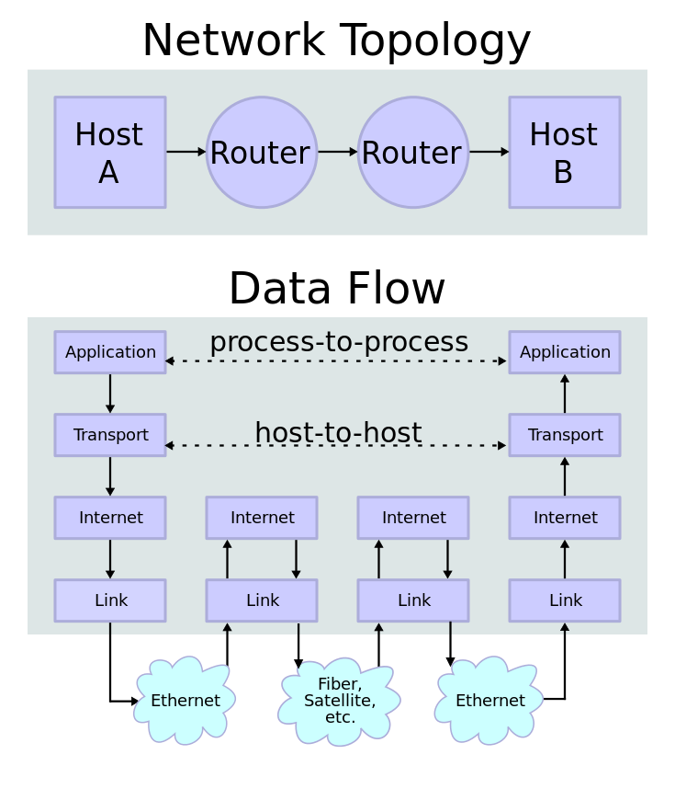
What’s a network protocol?
https://en.wikipedia.org/wiki/File:IP_stack_connections.svg

Slide 28
“Permissionless innovation”
One important point is: in principle each network operator can do whatever it wants so long as it interoperates “nicely” with others (and even when it doesn’t act particularly nicely;-)
  That also applies to your home network (if you want and are able)
  There are no protocol police (yet!)
This is one of the main reasons why the Internet has been so successful
Related: the classic “End-to-end argument” paper
  Salzer, Reed. Clark,“End-to-end arguments in system design” ACM ToCS (1984).
    https://web.mit.edu/Saltzer/www/publications/endtoend/endtoend.pdf
  I recommend a read of that! (Esp. for Comp. Sci./Engineering types)
  Don’t consider it as gospel though – it’s the end-to-end argument and not really the end-to-end principle even though it gets called the latter a lot

Slide 29
“Tussles”
Repeating: we do not aim to agree about everything in everyone’s network...
  So an awful lot happens at the “application layer” in code written by people and organisations
  And yet more happens when people configure services that use that code
When the “policies” reflected in those collide then “fun” follows;-)
  If protocols or application code constrains what operators can do then people complain
  If what n/w operators are doing breaks (esp changes to) applications then people complain
  In both cases people often complain at the wrong place;-)
Another paper:
  Clark, David D., et al. "Tussle in cyberspace: defining tomorrow's Internet." ACM SIGCOMM Computer Communication Review. Vol. 32. No. 4. ACM, 2002.
    https://groups.csail.mit.edu/ana/Publications/PubPDFs/Tussle%20in%20Cyberspace%20Defining%20Tomorrows%20Internet%202005's%20Internet.pdf
  Same “Clark”, but older:-) Interestingly, the 2002 paper is IMO far more dated (and wrong!) than the 1984 paper!

Slide 30
Aside: Cyber<blah>
Be wary of anyone who uses a term like “Cyber<blah>”
~90% of the time, that’s a strong indicator that they don’t really know what they’re talking about (if they did, they’d use a more precise and well-defined term)
Sadly, about 10% of the time (and increasing) such terms are used because “industry” keeps on doing it and people just repeat stuff thoughtlessly
Don’t be afraid to ask someone to define “Cyber<blah>” if they use such a term, and don’t be surprised if they find that hard!
  E.g. “Does cyberspace include a person driving a car that’s had it’s license plate automatically scanned?” or “What’s not included in cybersecurity?”

Slide 31
The Internet is not the web
Another important point!
The web is (roughly) the set of computers that speak the HTTP protocol
  HTTP == HyperText Transfer Protocol (http://example.com)
  HTTPS == HTTP/Transport Layer Security (https://example.com)
Email doesn’t use HTTP, but rather (mostly) the Simple Mail Transfer Protocol (SMTP) which is a couple of decades older than HTTP
Mobile network internals (3G, 4G, 5G...) mostly run over IP using a bunch of protocols you’d prefer to never have to know about
But lots of our interactions with the Internet are via the web

Slide 32
The Internet is not AI
Artificial Intelligence (AI) used to be a field of study, today it’s mostly a marketing buzzword
Large Language Models (LLMs) are what powers most things called “AI”
Those are very very complicated autocomplete tools and nothing more
We’ll talk a bit more about them later

Slide 33
Some of the things we’ll do later...
Understand what happens under the hood when your browser loads a web site
Learn how to watch network traffic
Get an overview of advertising networks
Talk a bit about spam and phishing (email badness)
We’ll look more at the web soon, meanwhile back to you...

Slide 34
How do you interact with the Internet?

Slide 35
Do you care about your, my, or all of our,
security on the Internet?
If so, what do you care about most?

Slide 36
Do you care about your, my, or all of our
privacy?

Slide 37
That’s all for now, we’ll be returning to those questions as we go.
But… what other questions should we be considering?

Slide 38
What else interests you?
List:
  ...
(we can revisit this multiple times)

