Slide 1
TEU00311
What is the Internet doing to me?
(witidtm)
Stephen Layperson
&
Eoin Lawyer
https://github.com/sftcd/witidtm
https://down.dsg.cs.tcd.ie/witidtm

Slide 2
Legal Stuff
Stephen says: IANAL (I am not a lawyer)
  And even if I were, you’d not be getting “legal advice” unless you’re paying for it!
Luckily, we have a real laywer (Eoin) on hand
  Who’ll also not be giving us “legal advice” :-)
I’ll present a layperson-view slide (or two), then Eoin can correct what I’ve messed up, and then we’ll chat about what you think...

Slide 3
Legal Stuff
Again: IANAL, but I have stumbled over some legal issues that are relevant to our topic over the years:
  Copyright
  Terms and conditions
  Export controls
  Privacy regulations

Slide 4
(so-called) “Intellectual Property”
My fundamental problem is a lack of belief in so-called “intellectual property”
  For me IP == Internet Protocol :-)
Authors do have a right to be acknowledged, and people should be fairly paid for their labour
  But that doesn’t require (so-called) Intellectual Property Rights (IPR)
Argument by induction:
  Before the document containing my patent filing or carefully crafted poetry was finished, I had to make the last change...
  Before that I made the 2nd last change...
  ...my document started out as an empty open-office document, which is the same as every else’s empty document
    modulo device based tracking:-)
  When did my document become imbued with some intellectual property?
There are legal answers to the above, but they all seem to reduce to “when the overall content became novel”
  Does that mean autogenerated random language is also (so-called) “intellectual property”?

Slide 5
(so-called) “Intellectual Property”
However, despite my doubts, the rest of the world treats information as if it can be owned...
  I’m an outlier and there are people I respect who disagree with me on this
There are many €€€ involved in all this, which seems (in my experience) to be correlated with people being willing to suspend disbelief
I’d encourage you to ponder what you think about this topic
  While (IMO) so-called “intellectual property” is a not real thing, I don’t do pirate video/audio
  Pick your battles wisely!
If you form an opinion and are consistent in following that, you may change your behaviour
  For example, you might be less likely to work for a company that values patents highly
    Like a patent troll – and they do exist
@Eoin: I know I’m legally wrong but why?
@All: whatcha think about all that?

Slide 6
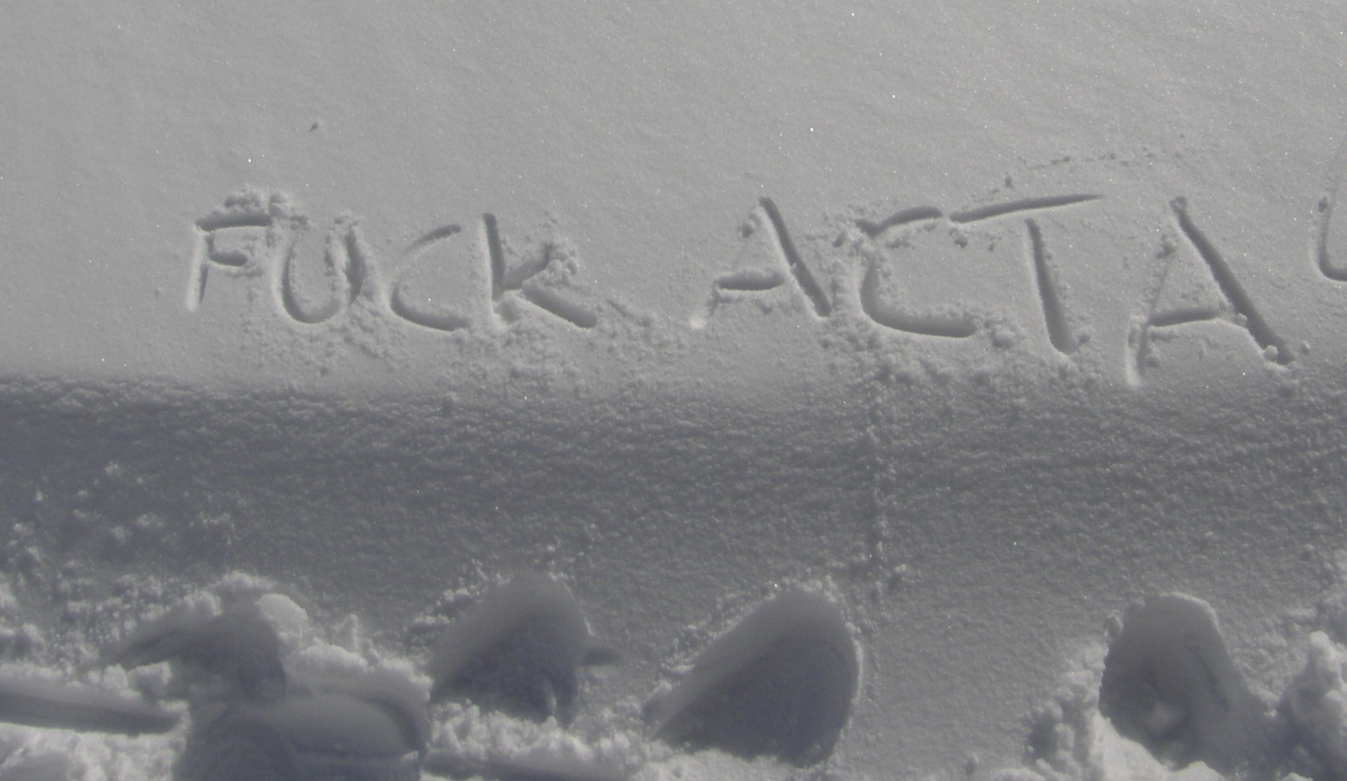
2012 – ACTA was a bad thing
Snow graffiti, photographed (by me) at about 2000m in the Alps near Grindlewald
ACTA was a proposed international treaty on “anti-counterfeiting” that overreached a lot
  https://en.wikipedia.org/wiki/Anti-Counterfeiting_Trade_Agreement - killed eventually by Eorupean parliament
Over-reach is a common side-effect of trying to protect (IMO non-existent) IPR

Slide 7
Copyright
Copyright != patents != trademarks != trade secrets
The rules vary by jurisdiction
  https://www.copyright.gov/help/faq/faq-general.html
  https://en.wikipedia.org/wiki/Copyright_law_of_the_European_Union
You can assert your copyright over almost anything you author
  I do that for code I write, according to whatever is right for the upstream project
Copyleft – Gnu Public License (GPL)
  https://www.gnu.org/licenses/gpl-3.0.en.html
  Idea is: license code and make available for free, but anyone using that has to also adhere to the GPL
  “Viral” spread – if you use GPL code in your stuff, your stuff (probably) becomes GPL

Slide 8
Distributed Rights Management
DRM refers to technologies that seek to preserve the rights of copyright owners
  https://en.m.wikipedia.org/wiki/Digital_rights_management
Fact is though, that equipment owners have the upper hand
DRM attempts to prevent the equipment owner from fully controlling access to content (e.g. movies, audio) on their own devices
Technologies: secure boot, s/w licenses, HDMI, DVD protection etc.
Often: backed up by laws, regulation, e.g. DMCA
  https://en.wikipedia.org/wiki/Digital_Millennium_Copyright_Act
Fairly long history of ineffectiveness of DRM
But... from the copyright owner’s perspective, speed bumps that convince people to pay via some service provider may be sufficient

Slide 9
Creative Commons
Extends ideas arising from GPL to other kinds of content (video, images, music, essays, whatever...)
  https://creativecommons.org/
Defines a range of licenses, not all of which are “nice,” (but most are)
Example license: CC-BY-SA is similar to GPL
  https://creativecommons.org/licenses/by-sa/2.0/
@Eoin, what’d I get wrong this time?
@All: what do we all think about that?

Slide 10
Terms and Conditions
I don’t feel morally compelled to pay any attention to things that are deliberately obfuscatory, such as tens of pages of terms and conditions
  But a court would likely disagree
  I’m hoping someday one will call a halt to the nonsense
A paper arguing that these agreements are beyond the reading ability of the “average American” and hence unfair for that reason
  Benoliel, Uri, and Shmuel I. Becher. "The Duty to Read the Unreadable." (2019).
  https://papers.ssrn.com/sol3/papers.cfm?abstract_id=3313837
End-user license agreements (EULA) for software and services are similar
@Eoin: what is the Irish situation?
@All: what do we think about T&C’s?

Slide 11
Export controls
Governments do control the export of certain technologies, mostly related to military or dual-use goods or technologies – for example centrifuges for enriching Uranium
  1990’s crypto-wars – strong cryptography was treated the same as munitions, in terms of export controls
Wassenar arrangement – occasional but ongoing fears that that might impact on security research and the communicating results
  https://www.wassenaar.org/
Some goverments may try this route to control (use of) technologies like cryptography and algorithms used in artificial intelligence applications
  There are understandable reasons why people (voters) may “like” to see regulation of technologies
Current trend in Govt approaches: “Observability” – “we don’t want to break the crtypto, we only want to see what’s being said (when that’s ‘bad’)”
@Eoin: ... the usual... :-)
@All: what do we think of that?

Slide 12
Thought Experiment on Regulation
I don’t like the idea of regulating development, use or export of Internet technologies
  Those are really just ideas, regulating them is as silly as patenting them
My silly thought experiment:
  What if jurisdictions regulated any entity that has a database of more than N users?
  Say where N==150M in the US, and N==2M in Ireland
@Eoin: What’s a good set of regulations for TOO-BIG entities?
@All: Any chance you’d go for target diversity?

Slide 13
General Data Protection Regulation
The GDPR entered into force in May 2018
It’s an EU framework that gives data subjects (people:-) rights and imposes responsibilities on data controllers and data processors (companies, basically)
GDPR imposes responsibilities any time data can be personally identifying
  It is consistent with the GPDR that IP addresses, as used in the Internet protocol, can sometimes be personally identifying, and hence data controllers may be required to handle them specially
https://en.wikipedia.org/wiki/General_Data_Protection_Regulation
https://eur-lex.europa.eu/legal-content/EN/TXT/HTML/?uri=CELEX:32016R0679&from=EN
https://ec.europa.eu/info/law/law-topic/data-protection_en

Slide 14
GDPR principles, roughly
Your consent is needed
Data must be collected for a stated reason, if new uses are developed, consent may need to be re-acquired
Consent can be withdrawn any time
Data subjects have a right to request a copy of the information held about them by a data controller
@Eoin: I kinda like the GDPR so this time I hope I wasn’t so wrong:-)
@All: Excercise your rights or they’ll disappear!

Slide 15
Right to be forgotten
That is the law, and I understand the “copy()” operation on computers, but...
I don’t know of any way to “uncopy()”
  That’s not the same as “delete()” !
  Mainly because of redundancy and backups, but also networked filesystems, de-duplication, and the distributed nature of the Internet
@Eoin: what’s the semantics of RTBF?
@All: what do you think ought (not) be forgettable?

Slide 16
Summary
We discussed:
  Copyright
  Terms and conditions
  Export controls
  Privacy regulations
What else should we have covered?

