Slide 1
TEU00311
What is the Internet doing to me?
(witidtm)
Stephen Farrell
stephen.farrell@cs.tcd.ie
https://github.com/sftcd/witidtm
https://down.dsg.cs.tcd.ie/witidtm
URLs accessed 20201019

Slide 2
Computers, Operating Systems
and some example risks

Slide 3
Overall landscape
Desktops, laptops, tablets, phones, “smart” speakers, home routers, raspberry-Pis, “fitness” devices…are all computers running some operating system
Differently popular, open, reliable, invasive and general purpose or not
Your choices should not only be driven by money and ease-of-use, though those factors tend to dominate

Slide 4
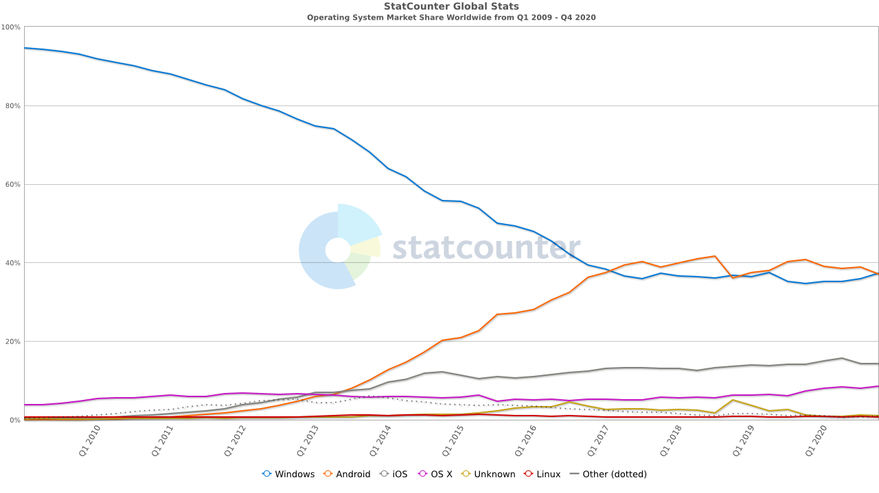
Operating Systems Market Shares
Graph: last 10 years
Android
Windoze
iOS
OS X
...
Desktop Linuxes
e.g Ubuntu
https://gs.statcounter.com/os-market-share#quarterly-200901-202004
Linux (laptop/desktop) now <1%

Slide 5
Machine/OS issues to consider (1)
Price, ease of use, updates/support, backup
  Insurance? Meh;-(
Security: probability of attack, probability of success, cost (impact) of successful attack
  Probability of attack relates to market share
Privacy: hiding in crowds vs. standing out by being more privacy-aware
  Tension vs. Probability of attack?
Having backups is your #1 protection – if you do nothing else set that up!
  But only if you sometimes test restore!
Automated updates should be considered mandatory, or else you’ll eventually suffer
  Consider how well update system works, some OSes take ages to update
  Some devices (still!) get no updates – avoid!

Slide 6
Machine/OS issues to consider (2)
Openness – to what extent can someone find out what’s going on under the hood?
Even if you can’t/don’t do that, whether or not others can makes a difference
It’s a big world and many of the tech issues you face will have been overcome by someone else sometime
  And likely being nerdy, they won’t have been able to resist telling the world how they fixed stuff:-)
But: “open” tends to be correlated with “hard to use” or “for nerds”

Slide 7
Machine/OS issues to consider (3)
To be fair, there are also some benefits in a more complete but closed ecosystem, like Apple’s
  https://manuals.info.apple.com/MANUALS/1000/MA1902/en_US/apple-platform-security-guide.pdf
  Note1: the above document is written for someone like me, it may be a tough read;-) But it is very thorough.
  Note2: the link above may be subject to bit-rot – the 2019 version no longer worked in 2020 but did sort-of land me on the right bit of Apple web page
Interesting to compare/contrast today’s “major” OSes – Windows, Android, Apple with what the FOSS movement would like
  FOSS: https://en.wikipedia.org/wiki/Free_and_open-source_software

Slide 8
End of Life
Devices do not last forever
  Ultimately the battery has a limited lifetime in terms of charge cycles
When (when, not if!) a device fails or is lost/stolen, what will you lose?
  See “backup” point earlier
When (when, not if!) a vendor turns off support, or a service (e.g. OS updates, some photo-sharing feature), what will happen to your stuff?
When you’re done with the hardware, what do you do?
  “Two-thirds of used disc drives on Craigslist and eBay contain sensitive data” is a 2016 article, no reason to expect that’ll change v. soon
  https://www.itpro.co.uk/security/26814/two-thirds-of-used-disc-drives-on-craigslist-and-ebay-contain-sensitive-data

Slide 9
Device-based tracking/surveillance
Anything with “location services” can be unexpectedly dodgy
  Image metadata inside the image file can include location
  “Fitness” trackers
Cell-tower history within mobile operators
List of Wi-Fi networks to which you’ve attached sometime
Bluetooth Tracking
“Smart” speakers
“Security” cameras
Telemetry from applications or OS
Software update!
  But didn’t we want that? Yes. But can’t it help tracking? Yes. Hmm...

Slide 10
Blackboard Assignment Heads-Up
Research and report on:
  1) the ways in which a real device/OS you possess or use exposes you to potential device-based tracking, as you normally use the device/OS
  2) how the browser(s) you use accumulate cookies and other state and how you could reduce or avoid that
Report: ~4-5 pages, more if needed but try keep it short, use URLs/references/appendices for tech detail or screen shots
Content:
  For (1): say how that tracking could work, describe your exposure, say what you think about that and what you will or will not do about it - justify that last part, esp. If you conclude you’ll do nothing
  For (2): we’ll chat after we learn a bit more about Advertising
Deadline: Before reading week (ish, meh, deadlines;-)
Marks: 40%,higher marks for the unexpected and for thorough research!
We’ll talk about two tracking examples, you can’t use those for the assignment
More on this later, feel free to ask questions.... esp. In Monday “office-hour”

Slide 11

Image Metadata: EXIF
https://photographylife.com/what-is-exif-data
https://helpdeskgeek.com/how-to/how-to-remove-exif-data-from-your-photos/
exif DSCN0010.jpg
EXIF tags in 'DSCN0010.jpg' ('Intel' byte order):
--------------------+----------------------------------------------------------
Tag |Value
--------------------+----------------------------------------------------------
Image Description |
Manufacturer |NIKON
Model |COOLPIX P6000
Orientation |Top-left
X-Resolution |300
Y-Resolution |300
Resolution Unit |Inch
Software |Nikon Transfer 1.1 W
Date and Time |2008:11:01 21:15:07
YCbCr Positioning |Centered
Compression |JPEG compression
X-Resolution |72
Y-Resolution |72
Resolution Unit |Inch
Exposure Time |1/75 sec.
F-Number |f/5.9
Exposure Program |Normal program
ISO Speed Ratings |64
Exif Version |Exif Version 2.2
Date and Time (Origi|2008:10:22 16:28:39
Date and Time (Digit|2008:10:22 16:28:39
Components Configura|Y Cb Cr -
Exposure Bias |0.00 EV
Maximum Aperture Val|2.90 EV (f/2.7)
Metering Mode |Pattern
Light Source |Unknown
Flash |Flash did not fire, compulsory flash mode
Focal Length |24.0 mm
Maker Note |3298 bytes undefined data
User Comment |
FlashPixVersion |FlashPix Version 1.0
Color Space |sRGB
Pixel X Dimension |640
Pixel Y Dimension |480
File Source |DSC
Scene Type |Directly photographed
Custom Rendered |Normal process
Exposure Mode |Auto exposure
White Balance |Auto white balance
Digital Zoom Ratio |0.00
Focal Length in 35mm|112
Scene Capture Type |Standard
Gain Control |Normal
Contrast |Normal
Saturation |Normal
Sharpness |Normal
Subject Distance Ran|Unknown
North or South Latit|N
Latitude |43, 28, 2.81400000
East or West Longitu|E
Longitude |11, 53, 6.45599999
Altitude Reference |Sea level
GPS Time (Atomic Clo|14:27:07.24
GPS Satellites |06
GPS Image Direction |
Geodetic Survey Data|WGS-84
GPS Date |2008:10:23
Interoperability Ind|R98
Interoperability Ver|0100
--------------------+----------------------------------------------------------
EXIF data contains a thumbnail (6702 bytes).
https://raw.githubusercontent.com/ianare/exif-samples/master/jpg/gps/DSCN0010.jpg

Slide 12

52100 Arezzo, Province of Arezzo, Italy
Took about 5 minutes to find this in Google street view
Most of that was finding a way to map degree, minutes, seconds to fractional Lat,Long
All automatable, could easily produce location history from a set of images
How could such a “leak” be damaging to you or to someone else in your images?
https://www.google.ie/maps/@43.4673702,11.8852196,3a,75y,23.31h,83.05t/data=!3m6!1e1!3m4!1sFBuQ4s_rnPpfgkeoZ3uQhw!2e0!7i13312!8i6656

Slide 13
Assignment Part-1 Outline (1)
If you were to use location-in-EXIF for the assignment (which you can’t:-) then your assignment might look like:
  Intro para: summarise all below like a paper abstract
  Para describing the general vulnerability: device tracking as a risk to device-owner
  Para describing EXIF, GPS, how your camera uses that (or used to, if that’s the case)
  Describe potential for tracking: uploaded images giving a location history
  What’d you do about it?
    Default to location-services off, scrub images before upload (say how), check earlier uploaded images (and do what with ‘em?), get a new device/camera
    Or, if your response is “do-nothing,” then justify that, e.g. I don’t upload images but get lost a lot so need location-services:-) Or maybe argue that image locations aren’t a big deal except in unrealistic movie-plot scenarios
  References – if reference is to peer-reviewed paper, good; if reference is URL then include “accessed-at date”

Slide 14
Assignment Part-1 Outline (2)
Try make it something you’d not be embarassed to show your buddies in a year’s time
It’s ok if the tracking you describe is low-risk, i.e., you do not have to find some mega-concerning risk to write about
It’s ok if you reference something where you don’t fully grok all the details but if so, say so and we can chat about that in class if you want
PLEASE submit a PDF
It’s ok to work together on this one, but do say with whom you’ve worked but the conclusions must be your own
Effort:
  4-5 pages is fine, as is more
  Maybe spend an hour researching (20 mins searching, 40 reading) and another hour writing for Part-1
Possible starting point: Google scholar (want a bit of a demo?)
  https://scholar.google.com/scholar?hl=en&as_sdt=0%2C5&q=device+tracking+image+exif+location+data&btnG

Slide 15
MAC Addresses
Device-tracking often (ab)uses long-term hard-coded identifiers such as MAC addresses (or IMEI/IMSI in mobile n/w)
MAC address: layer 2 address (mostly) hardcoded to radio or other network chip
  Same form of address used in WiFi and most other network protocols at layer 2, e.g. Bluetooth
  Roughly how two devices on the same local area network (LAN) identify one another
Looks like “6C:9C:ED:87:27:60” (48 bits) - 1st half is manufacturer ID (Cisco), 2nd half device-ID (a WiFi router in TCD SCSS)
  You can look up the manuf ID in the registry: https://www.adminsub.net/mac-address-finder/84:C7 gives a list that includes Sony
MAC address is often fixed for the lifetime of the device; There is now a 64-bit version, not sure how widely used yet
  You can probably see these in the “about device” tab or similar
MAC address randomisation is a good idea and starting to be deployed
  Often, the MAC address only really needs to be stable for a session, so can be randomised
  But – if you paid for the hotel WiFi that might be based on your MAC address, or an enterprise network might use MAC addresses to decide which machines are allowed on the local network, or the machine may be a switch/router/server where changing MAC address would break stuff or be inefficient
  So you can’t always randomise, and doing so well needs higher-layer controls

Slide 16
Bluetooth
Early BT devices regularly broadcast their MAC addresses
Later BT specs try to fix this, allowing support for randomised MAC addresses
All good so? Nope!
  Even if MAC addresses and payload identifiers change randomly, doing so out of sync enables tracking, sometimes indefinitely (read paper, and see next slide)
  Becker, J., Li, D., & Starobinski, D. (2019). “Tracking Anonymized Bluetooth Devices,” Proceedings on Privacy Enhancing Technologies, 2019(3), 50-65. doi: https://doi.org/10.2478/popets-2019-0036
Generalising: identifier correlation over time, devices and networks, is a very hard problem to mitigate – similar issues with DHCP leases, IP and email addresses, account names and web artefacts (cookies etc.)

Slide 17


Slide 18
Malicious Software (Malware)
Malware on your devices could:
  Exfiltrate your data (keyboard sniffers, ID theft, “wallet” attacks, mobile app “SDKs”)
  Work for someone else (cryptominers, clickfraud/adware)
  Be part of a botnet (DDoS)
  Encrypt your files (ransomware)
  (Sometimes) survive factory-reset (though less commonly)
Technical types: viruses, worms, trojans, ...
  We’re less concerned here with how malware works or details of how to detect/prevent malware doing bad things
  More interesting is: How can you avoid or recover?
Note that anti-malware tools (e.g. anti-virus) can look similar to malware - they both want access the “innards” of the OS/network-interactions – that can make such tools attractive as a target

Slide 19
How malware may arrive...
Pre-installed (accidentally or deliberately, bloatware/crapware)
Supply chain attacks (e.g., buy a popular npm library, infect that, or generate a new library with a typosquatted name)
Appear to be an application or browser extension that someone may want (e.g., phone torch app)
Mail attachment (pdf, zip, tar, ...) in spam or spear-phish – be careful of how email addresses and file names are displayed in your mail user agent!
Drive-by exploitation via web-site/browser vulnerability
USB stick (watering hole attack)
USB charger (how much do you trust Dublin Bus? :-)

Slide 20
Actors in the “AppStore” model
The interested parties include the OS vendors, device manufacturers, mobile network operators, app developers and the services those apps use/enable
  Your interests likely come last in that list, despite what most of the others may say, and even if they really mean what they say!
  Their interests won’t always be aligned either (e.g. mobile network operator vs. over-the-top service provider)
  And there are non-stupid bad actors in the game, esp. in the app developer and services-those-use/enable cohorts
So what do you think are their interests?
  OS makers: Google (android), Apple (IOS), Canonical (Ubuntu)
  Device manufacturers: Samsung, Apple, Huawei, Sony, …
  Mobile network operators: China Mobile, … Vodafone, … Telefonica, … Eir, Three
  App developers: Google, Apple, device makers plus many others I’ve never heard of
  Service providers: Google, Facebook, Twitter, … Netflix, Sky, ...

Slide 21
“AppStore” Permissions model
Both iOS and android “app” install processes use a “permissions” model, windoze, chromebooks and MAC OS are heading that way more
  As is Ubuntu, but only sort-of, it being a much more open OS
Android used (before 2015) present “permissions needed” only at install time, now both it and iOS pop up permission requests when the app first tries to make use of something “sensitive”
  But are those permission classes really meaningful? And do they protect you? TBH: I find it hard to tell
Research in this space also seems less concentrated on how well all this protects users and more on how “well accepted” it is by users, e.g.:
  Reinfelder, Lena, et al. "An Inquiry into Perception and Usage of Smartphone Permission Models." International Conference on Trust and Privacy in Digital Business. Springer, Cham, 2018.
    https://www.researchgate.net/profile/Lena_Reinfelder/publication/326630389_An_Inquiry_into_Perception_and_Usage_of_Smartphone_Permission_Models_15th_International_Conference_TrustBus_2018_Regensburg_Germany_September_5-6_2018_Proceedings/links/5c0e58564585157ac1b73e03/An-Inquiry-into-Perception-and-Usage-of-Smartphone-Permission-Models-15th-International-Conference-TrustBus-2018-Regensburg-Germany-September-5-6-2018-Proceedings.pdf
  Rajivan, Prashanth, and Jean Camp. "Influence of privacy attitude and privacy cue framing on android app choices." Twelfth Symposium on Usable Privacy and Security ({SOUPS} 2016). 2016.
    https://www.usenix.org/system/files/conference/soups2016/wpi16_paper-rajivan.pdf
  Could be I didn’t spend enough time looking though (I did look around in 2019 but didn’t repeat in 2020 so far:-)

Slide 22
What do I use?
Main devices:
  Home router: OpenWRT (Turris Omnia)
  Laptop: Ubuntu (Dell XPS)
  Phone: Sailfish (Sony Xperia)
  A cardboard box: with a pile of old phones and laptop hard-drives:-)
Various others @ home and for work, mostly Ubuntu servers on hosted virtual machines (VMs), some real (“bare-metal”) servers and some old laptops
Other people on my home network use android, iphone, mac, windoze
Main living room laptop also runs Ubuntu and is entirely usable for non-nerds

Slide 23
If you wanna try Ubuntu...
Ideally try with old laptop
  Drivers for newer models can take a while to catch up with proprietary versions, esp for WiFi
You can try before installing to hard drive by running from a “live” USB stick
You can make system dual-boot if you wanna try some more but still keep your earlier OS
I wish we had some face-to-face sessions where you can try stuff like that out… but we don’t. If the situation improves in the new year, and a bunch of you wanted to, I’d be happy to organise a bit of a hackathon like that.
  If so: mail me after you’ve gotten your module results

Slide 24
What do you use?
What would you like to use?
What do you dislike that you use?

