Slide 1
What is the Internet doing to me?
(witidtm 2026/2027 - TEU00311)
Lab Sessions
Stephen Farrell
stephen.farrell@cs.tcd.ie
https://github.com/sftcd/witidtm
https://down.dsg.cs.tcd.ie/witidtm

Slide 2
People
We’ve some helpers today, feel free to grab any of us and ask stuff
As well as me and Abeba, there’s:
  Matias Duran
  Riccardo Angius

Slide 3
Lab#1

Slide 4
Things for today...
Login to SCSS account on lab machine and/or get your laptop online
GOTO: https://duck.ai/chat and play about a bit
Do Abeba’s assignment whilst here...

Slide 5
Login/get-online
Desktop logins: no “domain”, use SCSS password, not your TCD password (if those differ), so e.g. if your TCD email is bloggsj14@tcd.ie then you enter “bloggsj14” as the username
Get online: we’ll deal with things as they arise
After you’re done: see if anyone else needs help

Slide 6
I did check that username... :-)
“Your message to bloggsj14@tcd.ie couldn't be delivered.
A custom mail flow rule created by an admin at tcdud.onmicrosoft.com has blocked your message.
5.1.1 The e-mail service at tcd.ie does not know this email address.”

Slide 7
Large Language Models (LLMs)
ChatGPT and pals are quite popular but interestingly unreliable, so let’s play with that
DuckDuckGo provide an interface to interact with various LLMs that doesn’t reuqire an account:
  https://duckduckgo.com/aichat
We do not know if all of us using that at once might hit some rate limiting (hopefully not, but we’ll see...)

Slide 8
Differences in size / energy consumption
Models show with a "B" how many billion parameters they have.
Generally, +parameters, more capable, higher cost
Easy tasks do not need the biggest models and using them would be a waste, bigger models generally consume more energy.
This is what ChatGPT-5 changed, making the decision for each prompt on what style of model to use.
Quantization reduces energy usage while maintaining number of parameters by reducing resolution of each parameter.
Ref: https://ieeexplore.ieee.org/document/10549890/
https://arxiv.org/pdf/2507.11417

Slide 9
Go to: https://duckduckgo.com/aichat
Pick a model that doesn’t “hit limits sooner”
Read the T&C’s
Play...

Slide 10
Some prompts to try/modify
How many r’s in raspberry?
  You may need to try different models to get the wrong answer:-)
...more TBD...

Slide 11
Lab#2

Slide 12
Browsers and the Web
Sort yourselves into groups of ~2-3
Fire up a “new”/“clean” browser
Explore settings, esp security/privacy related
Watch HTTP traffic (shift-ctrl-I)
Find the “worst” site you can
  NSFW disallowed!!!
  You define/justify “worst”
  Report back from group

Slide 13
Stretch goal
If we get the above done great, if not, that’s ok
Could be some people get to the stretch goal today or we look at it in future...
Stretch goal: HTTP archive (.har) file generation and a bit of analysis

Slide 14
Play with “new” browser
Don’t use one that has e.g. stored credentials for some account you care about – basically don’t muck up your daily-driver setup
Lab machine browsers can probably be reset easily enough (TBC)
On own device: maybe install one you’ve not used before
  Possibles: Brave, Firefox, chromium, vivaldi, opera...
  Tor Browser and/or Brave supports opening a window via Tor
  More exist, but start being careful if you go for something less widely used: browser downloads have been known to contain malware from time to time (but mostly on phones)
On mobile devices you might also try the DuckDuckGo Browser:
  https://duckduckgo.com/duckduckgo-help-pages/mobile/ios

Slide 15
Browser settings
Defaults are important and not always what you would want!
Play about in settings and see what you find – ask if not sure or comment if you think you should tweak
As they differ a bit, and change over time, you might want do this now and then for all browsers you use: e.g. lab machine, laptop, phone
Things to check/set:
Telemetry/sending usage info
Search engine
Search/URL bar suggestions
AI controls
Locations/Camera/Microphone/Notification permissions
App launching
Private DNS/DNS over HTTPS (DoH)
Home/new page settings
Cookies
Blockers/Tracking protection
Logins/passwords/Payment methods
Javascript
“HTTPS-only” mode
Clear things on exit
Stored site permissions

Slide 16
Watch web traffic
Open browser
Type shift-ctrl-I (or equivalent) to open developer interface
Re-size screens to taste
Choose “network” tab in developer pane
Try loading a few sites and watch what happens
  DO NOT load NSFW sites!
Look about on the web and decide which site is the “worst” from your POV and why
  Just yell/put up hand when you have a “worst” to nominate
  We’ll pick a winner if we’ve time – Prize == applause:-)

Slide 17
Shift-ctrl-I for macs...
Macs differ:
  Firefox: Option + Command + I
  Safari: Option + Command + C
  Chrome: Option + Command + C
Access to developer tools in Safari has to be activated in the settings first. If anyone has problems with that they can find detailed information on how to do this here: https://support.apple.com/en-ie/guide/safari/sfri20948/mac
Thanks to Luca Schäfer (2021 student) for the above

Slide 18
Browser Extensions
Most browsers have a library of add-ons or extensions that you can download and install
Some are quite useful:
  Firefox: NoScript – compare page load times with/without
  Others?
Note: be a bit careful – extensions are powerful things and can see your browsing!

Slide 19
Stretch goal
Figure out how to save an HTTP archive file (.har)
Figure out how to view .har files
Figure out how to diff .har files
See what changes between seemingly identical browser sessions
  ...any tracking?

Slide 20
Go do stuff!

Slide 21
Images
EXIF data in image files
DO NOT use any image that has a reasonable probability of upsetting anyone

Slide 22
Why are details of images relevant to this module?
We upload lots of images
Automated image capture is near ubiquituous
  CCTV, ANPR, ...
Other people upload images of us
Organisations with image databases analyse those

Slide 23
Data vs. Metadata
Typically we talk about the “data” as being the main thing being processed or communicated or stored...
  E.g: the bits rendered for an image or video, the content of an email, the messages in a text chat or the audio packets in a voice call
So-called “metadata” is also data but is “about” the above rather than part of the above
  E.g. timing of a communication, sender/receiver IP addresses, the size of data fields, etc
Even if data is well-protected (e.g. encrypted), metadata can leak separately (or be deliberately stored/exposed) so meta-data creates risk
For someone surveilling, metadata can be more attractive than data, e.g. law enforcement may benefit more from building a social graph of criminals compared to seeing the content of a few messages, or, facebook might learn enough from whatsapp metadata that they no longer need to see the content to sell advertising
Metadata is also often more structured and hence easier to process for those who want to see what people are doing
Metadata can also be a little unexpected to end-users, e.g. author information in documents, or, in images...

Slide 24

Image Metadata: EXIF
https://photographylife.com/what-is-exif-data
https://helpdeskgeek.com/how-to/how-to-remove-exif-data-from-your-photos/
exif DSCN0010.jpg
EXIF tags in 'DSCN0010.jpg' ('Intel' byte order):
--------------------+----------------------------------------------------------
Tag |Value
--------------------+----------------------------------------------------------
Image Description |
Manufacturer |NIKON
Model |COOLPIX P6000
Orientation |Top-left
X-Resolution |300
Y-Resolution |300
Resolution Unit |Inch
Software |Nikon Transfer 1.1 W
Date and Time |2008:11:01 21:15:07
YCbCr Positioning |Centered
Compression |JPEG compression
X-Resolution |72
Y-Resolution |72
Resolution Unit |Inch
Exposure Time |1/75 sec.
F-Number |f/5.9
Exposure Program |Normal program
ISO Speed Ratings |64
Exif Version |Exif Version 2.2
Date and Time (Origi|2008:10:22 16:28:39
Date and Time (Digit|2008:10:22 16:28:39
Components Configura|Y Cb Cr -
Exposure Bias |0.00 EV
Maximum Aperture Val|2.90 EV (f/2.7)
Metering Mode |Pattern
Light Source |Unknown
Flash |Flash did not fire, compulsory flash mode
Focal Length |24.0 mm
Maker Note |3298 bytes undefined data
User Comment |
FlashPixVersion |FlashPix Version 1.0
Color Space |sRGB
Pixel X Dimension |640
Pixel Y Dimension |480
File Source |DSC
Scene Type |Directly photographed
Custom Rendered |Normal process
Exposure Mode |Auto exposure
White Balance |Auto white balance
Digital Zoom Ratio |0.00
Focal Length in 35mm|112
Scene Capture Type |Standard
Gain Control |Normal
Contrast |Normal
Saturation |Normal
Sharpness |Normal
Subject Distance Ran|Unknown
North or South Latit|N
Latitude |43, 28, 2.81400000
East or West Longitu|E
Longitude |11, 53, 6.45599999
Altitude Reference |Sea level
GPS Time (Atomic Clo|14:27:07.24
GPS Satellites |06
GPS Image Direction |
Geodetic Survey Data|WGS-84
GPS Date |2008:10:23
Interoperability Ind|R98
Interoperability Ver|0100
--------------------+----------------------------------------------------------
EXIF data contains a thumbnail (6702 bytes).
https://raw.githubusercontent.com/ianare/exif-samples/master/jpg/gps/DSCN0010.jpg

Slide 25

52100 Arezzo, Province of Arezzo, Italy
Took about 5 minutes to find this in Google street view
Most of that was finding a way to map degree, minutes, seconds to fractional Lat,Long
All automatable, could easily produce location history from a set of images
How could such a “leak” be damaging to you or to someone else in your images?
https://www.google.ie/maps/@43.4673702,11.8852196,3a,75y,23.31h,83.05t/data=!3m6!1e1!3m4!1sFBuQ4s_rnPpfgkeoZ3uQhw!2e0!7i13312!8i6656

Slide 26
Viewing EXIF Data
Local: Right-click and “properties”
Better local: install something allowing you to scan multiple images
  E.g. “sudo apt install libimage-exiftool-perl” on Ubuntu
On web: save image to local then GOTO above

Slide 27
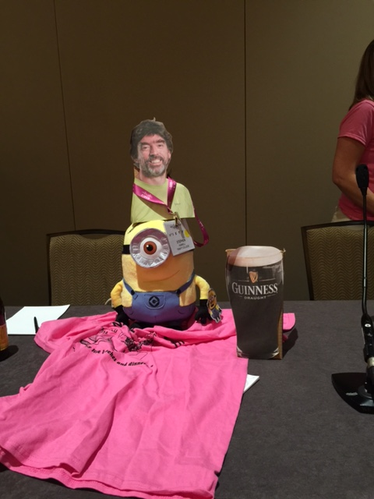
My Pictures
A couple of years back, I scanned the 35,429 files in my Pictures directory and found ~493 of those (excl. dups) contained EXIF GPS lat/long values
  Earliest was from 2009, most recent from 2022
  Latitidue ranged from 67° N, to 3° S
  Longitude ranged from 157° W, to 67° E
    The 157° W pic: a conference in Hawaii I attended remotely;-(
On the linux command line that looked like:
$ exiftool -gpslatitude -gpslongitude -createdate -csv -r ~/Pictures

Slide 28
Photo Sharing (1)
What happens when you share photos?
  Worth noting that some people, esp. photo enthuiasts, do want all the EXIF data preserved/shared
“Approximately 69% of services under study were found to actively sanitize EXIF metadata, which mitigates privacy risks for the users.”
The quote above and the table on the next slide are from:
  Gouert, Charles, and Nektarios Georgios Tsoutsos. "Dirty Metadata: Understanding A Threat to Online Privacy." IEEE Security & Privacy 20.6 (2022): 27-34.
  https://udspace.udel.edu/server/api/core/bitstreams/f2a04ac2-e998-49a4-b943-c26659c74fe4/content accessed 20250916
If “scrubbing” happens on the server, the server still gets metadata even if service users don’t, not clear when that might apply
A recent (April 2026) blog on that (not sure how accurate):
  https://fast.io/resources/social-media-photo-metadata-platforms-strip/

Slide 29
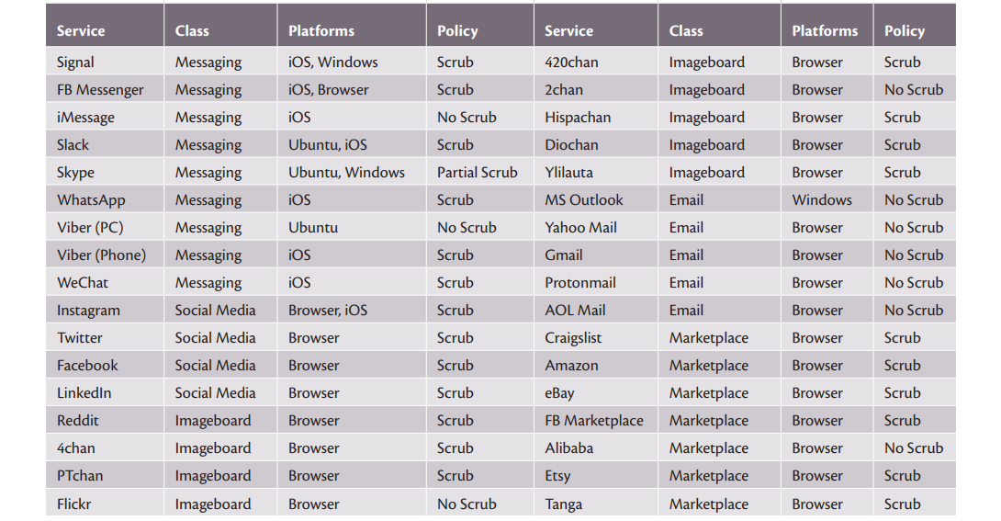
Photo Sharing (2)

Slide 30
Your EXIF task...
Select some image(s) online or locally
Determine if they contain EXIF location data, and how identifying that may be
Upload/send such images variously and check what, if any, scrubbing has happened
What can you infer from the above?
What could you infer if you did the above for a number of images of related subjects?

Slide 31
Go do stuff!

Slide 32
Facial recognition
A kind of “biometric” (more later on the imperfections of biometrics:-)
Nice overview, including tricky issues at: https://en.wikipedia.org/wiki/Facial_recognition_system (accessed 20250916)
Basic idea: program analyses image bits, search for pattern that looks like a face (eyes, nose, mouth, ...), classifies that (based on machine learning using image collections), compare results from two images – if close enough, declare match
  False positives and negatives will happen
Note: this is not my area of expertise!

Slide 33
Facial recognition (ab)uses
Find a photo of “this person”
  Find local pics of your mum, organise your image gallery
Find people with outstanding arrest warrants in a crowd
  Recognition of faces in moving crowd is harder than individually, but likely, not that much harder
Determine ethnicity of people using public transport
  Critics may say things like the above - proponents might talk about improving efficiency but build systems that have this effect

Slide 34
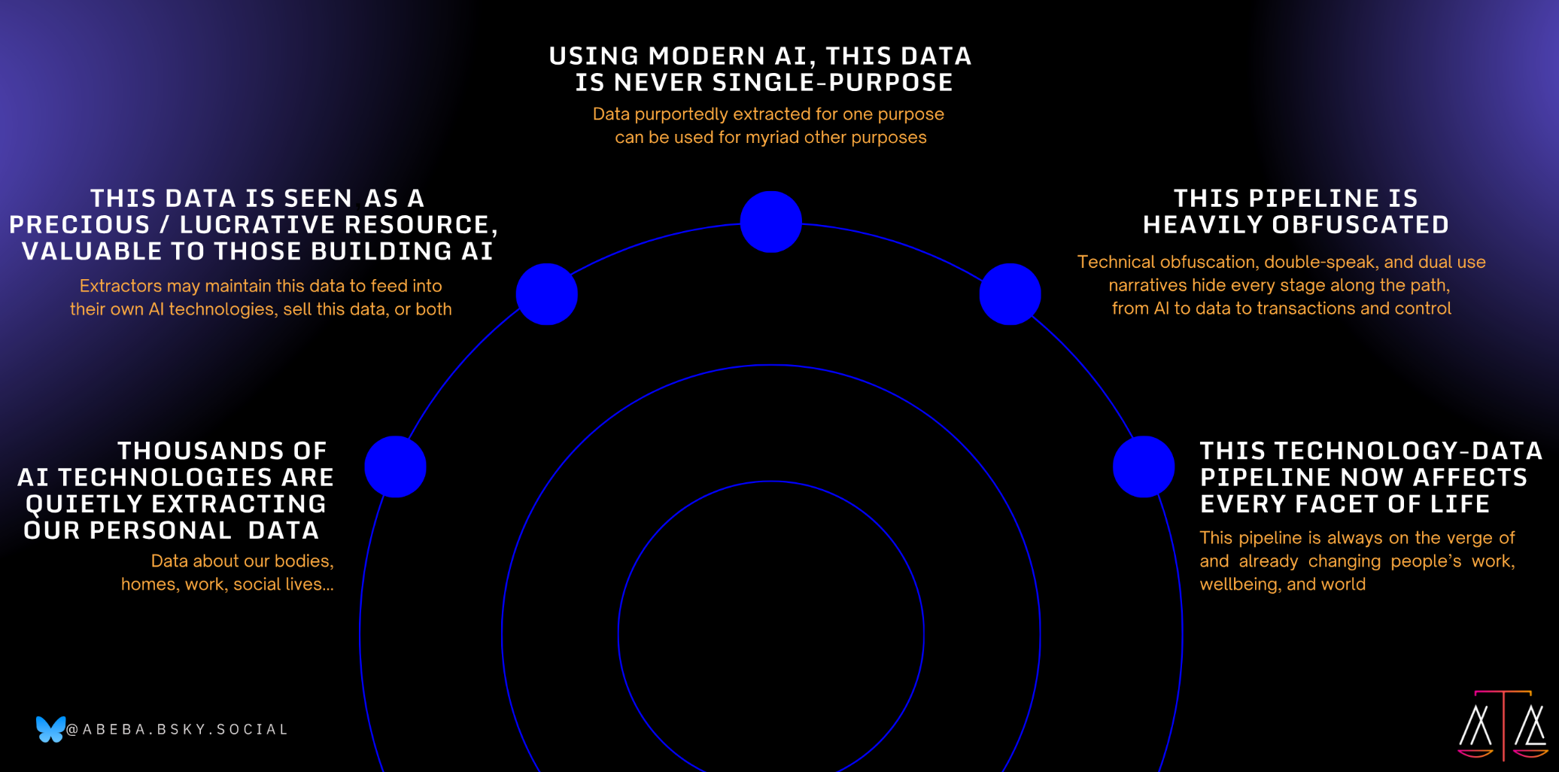
Surveillance AI Pipeline
Paper by Abeba: https://www.nature.com/articles/s41586-025-08972-6

Slide 35
Image Search
Google “reverse” image search
  GOTO https://images.google.com/
  Click the “camera” icon
  Paste/upload an image
  Google will search for info and other images

Slide 36
Image Search Task
Your task: play with that image search to try find images that produce bad search results
  The goal is to get a feel for what does/doesn’t work well with that
Don’t use any NSFW images
Don’t use images of people who might not want you to use their image (including yourself if that’s the case!)

Slide 37
Stretch goal – Try break that
Find an image that produces good search results (easy:-)
Pick an image editor
  My suggestion: gimp, https://www.gimp.org/
  But there may be simpler options
Try find the “smallest” change that causes the search results to be noticeably worse
General topic: adversarial images
  https://christophm.github.io/interpretable-ml-book/adversarial.html accessed 20250916
  Same concepts apply to other machine learning settings, e.g. text, audio, ...

Slide 38
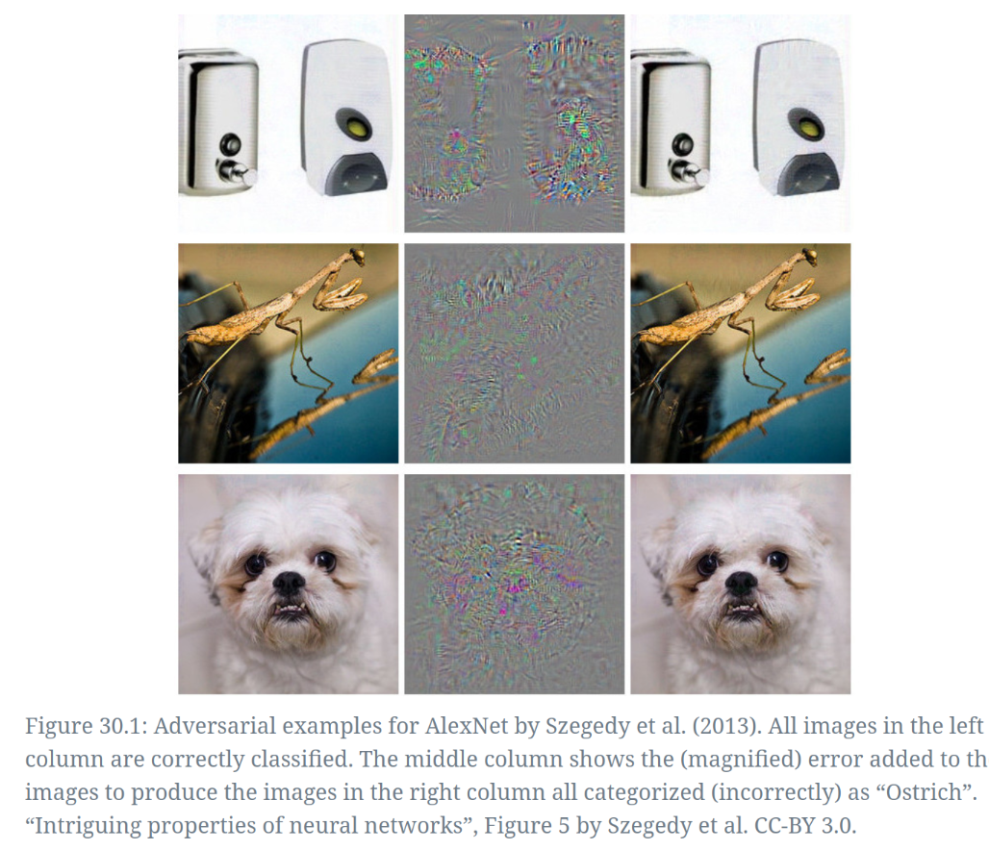
Adversarial Example
Image is shown at https://christophm.github.io/interpretable-ml-book/adversarial.html and originally from:
Szegedy, Christian, Wojciech Zaremba, Ilya Sutskever, Joan Bruna, Dumitru Erhan, Ian Goodfellow, and Rob Fergus. 2014. “Intriguing Properties of Neural Networks.” arXiv. https://doi.org/10.48550/arXiv.1312.6199.

Slide 39
Go do stuff!

Slide 40
Network Obsevers
I have a local hotspot running to show network traffic
You can join that with a local device (details shortly) if you want
If you do that from a laptop you might want to install wireshark

Slide 41
Wireshark
Fine tool to observe network traffic
  https://www.wireshark.org/
The network-layer equivalent of what you saw in a browser with shift-ctrl-I
But not limited to web traffic, you see it all as it is “on the wire”

Slide 42
Network Obsevers
Join my hotspot
  SSID: witidtm-lab
  WPA Password: bal-mtditiw
We’ll watch some traffic using wireshark, and chat about that
Stretch goal: do it yourself at home if interested

Slide 43


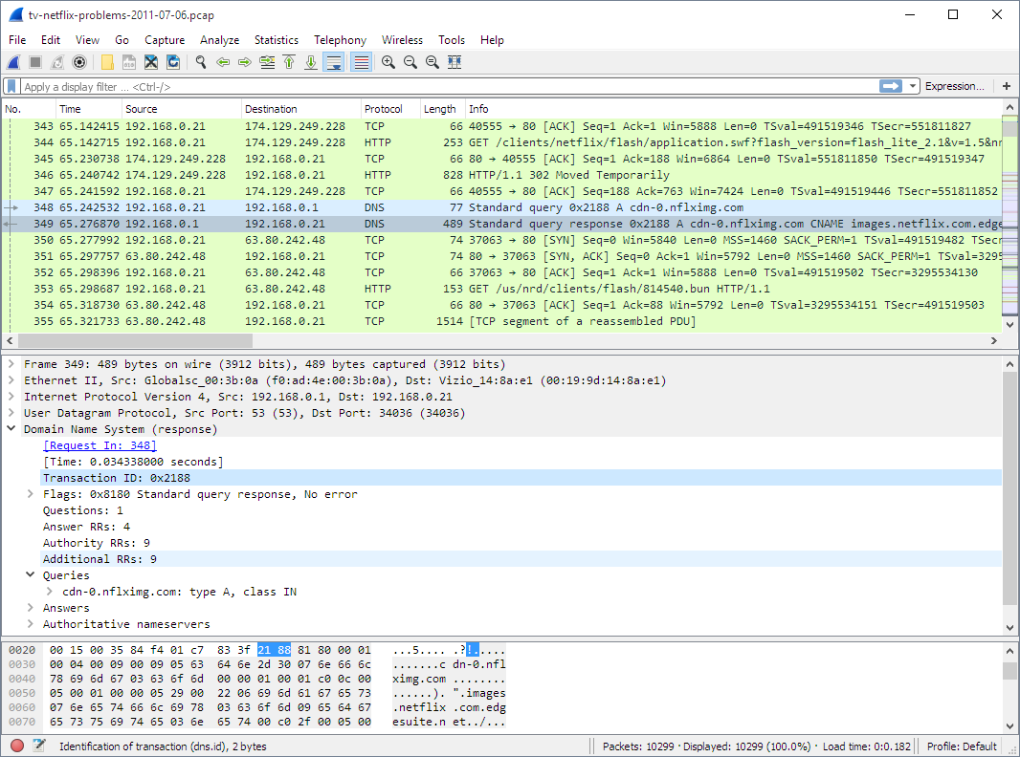
Hotspot setup
WiFi
SSID: witidtm-lab WPA Password: bal-mtditiw
Turris Home Router
Doing (lab) WiFi, DHCP, DNS,
NAT and forwarding
Conncected upstream to my laptop
TCD network
My laptop
Forwarding, DHCP for Turris
DNS for hotspot WiFi clients
Running Wireshark
Conncected upstream to college
(via college WiFi)

Slide 44
Hotspot setup
WiFi
SSID: witidtm-lab WPA Password: bal-mtditiw
Turris Home Router
Doing (lab) WiFi, DHCP, DNS,
NAT and forwarding
Conncected upstream to my laptop
All your traffic are belong to us!
TCD network
My laptop
Forwarding, DHCP for Turris
DNS for hotspot WiFi clients
Running Wireshark
Conncected upstream to college
(via college WiFi)

Slide 45
DHCP (1)
Dynamic Host Configuration Protocol (DHCP) is (almost always) how your device gets an IPv4 address after joining a network
  Spec is RFC2131 from 1997
DHCP has a “hostname” option that client’s send and that has often been the same as a long-term device name, e.g. “Stephen’s iPhone”
  That can be used for a loooong time
  Recent phone OSes tend to send something more random looking but often don’t vary the value
  If you migrate from an old to a new device, that setting might carry over even if your current OS would otherwise use a random value
  Changing hostname could break stuff though so be a bit careful
Other DHCP options clients send can also be identifying e.g. OS version

Slide 46
DHCP (2)
As well as returning an IP address, the DHCP server can send many other options
  Most aren’t widely deployed
The DNS server IP address option is though
  Tells clients what server to use for DNS in this network
OSes can override that but mostly (so far) don’t
  Unless you have DoT configured or some Apple stuff

Slide 47
Router Admin
Demo OpenWRT/Foris/Luci

Slide 48
MAC Addresses
Device-tracking often (ab)uses long-term hard-coded identifiers such as MAC addresses (or IMEI/IMSI in mobile n/w)
MAC address: link layer address (mostly) hardcoded to radio or other network chip
  Same form of address used in WiFi and most other network protocols at link layer, e.g. Bluetooth
  Roughly: how two devices on the same local area network (LAN) identify one another
Looks like “6C:9C:ED:87:27:60” (48 bits) - 1st half is manufacturer ID (Cisco), 2nd half device-ID (a WiFi router that is/was in TCD SCSS)
  You can look up manuf IDs from the registry, e.g. https://www.macvendorlookup.com/ accessed 20250916
MAC address is often fixed for the lifetime of the device; There is now a 64-bit version, not sure how widely used yet
  You can probably see these in your “about device” tab or similar

Slide 49
Randomised MACs
MAC address randomisation is a good idea and now fairly well deployed
  Often, the MAC address only really needs to be stable for a session, so can be randomised
  But – if you paid for the hotel WiFi that might be based on your MAC address, or an enterprise network might use MAC addresses to decide which machines are allowed on the local network, or the machine may be a switch/router/server where changing MAC address would break stuff or be inefficient
So you can’t always randomise, and doing so well needs higher-layer controls
HOWTO turn on varies by OS and version
On an android 10 phone I used have:
  Developer options/Enhanced Wi-Fi MAC randomisation
  You may need to turn on developer options first (search for HOWTO)

Slide 50
Some traffic
Display wireshark and see what’s visible

Slide 51
DNS names
Today, we can mostly see the DNS names being queried as that’s cleartext
Starting to see more use of encrypted DNS traffic
Two flavours: DoT and DoH
We’ll look quickly at that but chat more about it later
On that old crappy android device enabling DoT used be:
  Settings/Connections/More Connection Settings/Private DNS
  BUT that won’t work with college as upstream as DoT uses port 853 and college block that port – it should work fine at home and with your mobile data provider

Slide 52
Do53 vs DoT vs DoH
Do53 == old style cleartext DNS
Who do you want to/care about seeing your DNS traffic?
  Your ISP, TCD, coffee-shop and their ISP, Cloudflare, Google ?
Pros and cons to each of these

Slide 53
Brave Browser
Not a bad browser on mobiles
Has various “shields up/down” settings
  Settings/Brave Sheilds and Privacy/Use Secure DNS
  DoH – that does work in college
    There may be a set of known services from which to choose
    Or you can add a custom one:
      For cloudflare try: https://1.1.1.1/dns-query
  DoH can also be set in most other browsers these days too

Slide 54
Stretch Goal
Repeat this at home if interested
  Can help with, but not mandatory for, my assignment
Setup hotspot using laptop
Install wireshark
Inspect traffic and learn

Slide 55
http:// vs. https://
https:// URLs turn on encryption and web-site authentication between your browser and the web site
  Far from a perfect system, but good enough 90%+ of the time
  99.2% of web traffic as seen by cloudflare uses https:// URLs
  https://radar.cloudflare.com/adoption-and-usage
Some people haven’t gotten the message, or slip up, allowing local networks to mess about; https://whynohttps.com/ has lists, including by country
  The 8th most loaded listed there is...
One way to mess up: replace an old service that used http:// URLs with one that uses https:// URLs but leave references to the old thing in place and the old service running (even with a mandatory re-direct to the new one)
  https://www.irishimmigration.ie/wp-content/uploads/2021/04/INIS-online-portal-guidance.pdf contains a link to the “old” thing here which was http://www.inis.gov.ie (accessed 2026-09-29)
Browser warnings (interstitial pages) may save you, but not if you click-through those
  If you used the old service URL a lot, you might get used to doing that click-through

Slide 56
Fake a real web site
A legacy Irish government web site: inis.gov.ie
Inside my laptop I’m running a web server
I can “easily” re-direct the traffic for the insecure URL to that
  This might not work for you, depends if their IP addresses have changed and what DNS you use, and if I mucked up, but we’ll see...
# start lighttpd
$ ./testlighttpd.sh
$ sudo sysctl -w net.ipv4.conf.all.route_localnet=1
$ sudo iptables -t nat -A PREROUTING -i enx38c986f09157 \
-p tcp -d 146.0.55.149 --dport 80 \
-j DNAT --to-destination 127.0.0.1:8099

