Slide 1
TEU00311
What is the Internet doing to me?
(witidtm)
Stephen Farrell
stephen.farrell@cs.tcd.ie
https://github.com/sftcd/witidtm
https://down.dsg.cs.tcd.ie/witidtm

Slide 2
Online Advertising
(what I want you to ponder...)
What’s your attitude to online advertising?
What do you know about how it works?
  What do you want to know?
What concerns do you have about online ads?
Are you ok with being the product when using “free” services?
  Always or just sometimes?
  What would you do to avoid being the product?

Slide 3
Overview
A bit of cookie background
A very quick overview of web ads
Real-Time Bidding for your eyeballs
Cui Bono?

Slide 4
Watching Cookies
How might you do it? Up to you! One option:
  Install a browser (e.g. chromium, opera) that’s new for you
  Explore it’s settings (advanced/privacy), zap all it’s cookies etc.
  Visit site(s) of interest, in various states (e.g. logged into to FB/Gmail first or not different browser privacy settings...)
  Record state of cookies at various stages and with various options
  Analyse cookie origins, names and content (some extensions/plugins may make that easier)
Another option: use dev-mode and HAR files
Caution: Be careful if you zap cookies in a browser you use day-to-day – you might break some login for which you’ve forgotten the password!
  If you do install some new addon/extension, check it out first, and consider keeping or deleting it later

Slide 5
Cookie Resources
Fairly simple overview
  https://www.gohacking.com/how-browser-cookies-work/
Wikipedia: lots of (probably too much) detail
  https://en.wikipedia.org/wiki/HTTP_cookie
Dabrowski, Adrian, et al. "Measuring Cookies and Web Privacy in a Post-GDPR World." International Conference on Passive and Active Network Measurement. Springer, Cham, 2019.
    https://www.johannaullrich.eu/assets/papers/dabrowski2019_pam.pdf

Slide 6
Facebook Advertising
Fairly reasonable description: Andreou, Athanasios, et al. "Measuring the facebook advertising ecosystem." 2019.
  https://hal.archives-ouvertes.fr/hal-01959145/file/Andreou-etal_FacebookAds_NDSS2019.pdf
Points:
  Anyone can be an advertiser there (5 clicks), so it’s not the same game as on the web
  FB’s walled garden allows them to be less visible
  Targeting based on PII and interests seems creepy to me

Slide 7
Two Documents
Estrada-Jiménez, José, et al. "Online advertising: Analysis of privacy threats and protection approaches." Computer Communications 100 (2017): 32-51.
  https://upcommons.upc.edu/bitstream/handle/2117/99742/Online%2Badvertising%2Bprivacy%2Bthreats%2Band%2Bsolutions.pdf
Some of the slides here are based on that (tables or diagrams without a reference are from there)
That’s based on work done in or before 2016
UK Information Commissioner’s Office report from June 2019
  https://ico.org.uk/media/about-the-ico/documents/2615156/adtech-real-time-bidding-report-201906-dl191220.pdf

Slide 8
Who wins?
“Real-time bidding creates a rare win-win-win situation.
Advertisers have the ability to serve ads based on real-time user data. They can “target users based on their demographic, psychographic, or behavioral attributes”.
Users/readers are served with relevant ads rather than a vague one. This, in turn, improves the ad experience.
Publishers or website owners can earn better ad revenue with the help of RTB.”
https://headerbidding.co/real-time-bidding/

Slide 9

What I imagine advertisers want...
https://www.theregister.co.uk/2019/09/23/microsofts_connected_store_dynamics_365_announcement_connects_online_and_physical_retail/
From an el Reg article about a Microsoft product to support retailers, so not quite the same, but a nice/ickky illustration.
And it’s not clear to me how that’d scale (but maybe they don’t care?).

Slide 10

Some Actors
User: you and your browser(s)
Publisher: gets paid for display of ad - web site (e.g. google search, CNN, rte.ie)
Ad platform: intermediaries who help advertiser target ads - Google, FB, ...
Advertiser: pay for display of ads - company selling widgets, travel, ...

Slide 11

Moar Actors
Real time bidding (RTB):
Publisher -> Ad platform: “I have <this> inventory (of display space)”
Ad platform -> Advertisers: “how much will you pay for <this>?”

Slide 12

Another view
Yuan, Shuai, Jun Wang, and Xiaoxue Zhao. "Real-time bidding for online advertising: measurement and analysis." Proceedings of the Seventh International Workshop on Data Mining for Online Advertising. ACM, 2013. https://arxiv.org/pdf/1306.6542.pdf

Slide 13
Brave’s view...
Brave is a browser competing with others (chrome, FF, safari...)
  AFAIK, they have negligible market share at the moment
As a company, Brave describe themselves as being privacy focused
  They are trying to promote an alternative to current advertising models
In 2018-2019, Brave (the company) lodged compaints against real-time-bidding (RTB) in general and e.g., Google’s advertising behaviour with various European data protection agencies
  https://brave.com/wp-content/uploads/2018/09/Behavioural-advertising-and-personal-data.pdf
  https://brave.com/rtb-updates/ - Jan 2020: No action
Bid request examples:
  https://brave.com/wp-content/uploads/2019/02/3-bid-request-examples.pdf
  Note: These are from Google API samples, not clear to me what’s deployed in the wild

Slide 14

Brave’s view of RTB...
https://brave.com/wp-content/uploads/2018/09/Behavioural-advertising-and-personal-data.pdf

Slide 15

Sample request
https://brave.com/wp-content/uploads/2019/02/3-bid-request-examples.pdf

Slide 16
RTB Waterfall vs. Header Bidding
Waterfall model is (apparently) where SSP tries 1st DSP:
  If auction won, then render Ad
  If not, move to next DSP
  Repeat until done (with possible fallbacks to non DSP Ad sources)
Header bidding model has some of the action happen in the user’s browser, but is newer and still in flux (also apparently)
One claim I’ve seen: in 2019, 14% of top 50k sites using header bidding, 70+% (presumably) using waterfall RTB

Slide 17
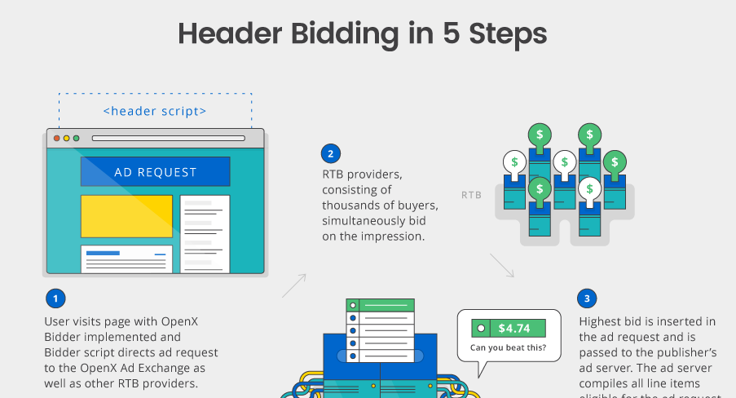
OpenX (an Ad exchange)
http://welcome.openx.com/rs/745-BUQ-779/images/Header%20Bidding%20Infographic.png

Slide 18


Header bidding
https://arxiv.org/pdf/1907.12649.pdf

Slide 19
Twitter Backend Sharing (1)
Companies engaged in advertising may say that they do or do not share/sell data but humans are very good at apparently not recognising when they breach/avoid such policies in an entirely self-serving manner
Twitter advertising example from Oct 2019
  https://help.twitter.com/en/information-and-ads
  Still there in Nov 2021
Advertising partner uploads database incl. Identifiers
Twitter match that with their user database, sometimes based on phone numbers supplied to twitter for 2-factor authentication
  Presumably: someone then sends targetted ads to twitter users

Slide 20
Twitter Backend Sharing (2)
Are twitter correct in saying “No personal data was ever shared externally with our partners or any other third parties.” ?
IMO no. Ads may have contained web bugs (1x1 pixel images) allowing “partners or other third parties” to track matching twitter users.
I’d characterise the above as twitter selling trackable access to their user database.
I would be extremely surprised if twitter were alone in acting like this. It makes money. Seemingly without harming anyone.
All of the above is extremely non-transparent.

Slide 21
Who gets to see what?
In principle: anyone who signs up to an Ad exchange gets request data
  Could be nation state actors as well as real commercial entities
  Researchers use these advertising platforms to do experiments
“Cookie matching” correlates over time and multiple properties
  Kind of a collusion between Ad platform and advertisers
  https://developers.google.com/authorized-buyers/rtb/cookie-guide#examples
    Includes explanation of how they recover if user clears cookies! (Thanks, google_user_id!)
Same kind of thing happens with Google user ID and Apple advertising ID
And location, device identifiers, user agent string/application IDs...
Independent data brokers also exist (more in the US perhaps) that may be able to match non-web data items, e.g. if SSN in both data sets somehow

Slide 22
Some More Papers
Olejnik, Lukasz, and Claude Castelluccia. "To bid or not to bid? Measuring the value of privacy in RTB." (2015).
  https://www.inrialpes.fr/planete/people/lukasz/rtb2.pdf
Pachilakis, Michalis, et al. "No More Chasing Waterfalls: A Measurement Study of the Header Bidding Ad-Ecosystem." arXiv preprint arXiv:1907.12649 (2019).
  https://arxiv.org/pdf/1907.12649.pdf

Slide 23
Scale (again)
To render the Ad, the auction must be speedy
Speed of light means needing a presence near the auctioneer, e.g. within 120ms => (nearly) the same city as wherever the auctioneer’s data centre
  120ms is a Google number, and hey, they’ll also sell you cloudiness so you can meet that number;-)
Implication:
  To deal with big Ad platforms, SSP’s and DSP’s need to be big
  => centralisation++

Slide 24
Who benefits?
User: Sees “relevant” Ads, fewer repeat Ads
  Cost: privacy, tracking, bandwidth, latency, creepiness
Publisher: gets revenue
    +4% for cookies? https://www.eff.org/fa/deeplinks/2019/06/research-shows-publishers-benefit-little-tracking-ads
  Cost: control -> others (AdX, SSP...), dependency , GDPR costs, technology costs
  New control issue: Web packaging (AMP etc.)
Advertiser: presumably gets more sales (or just clicks?)
  Cost: revenue share with exchanges, technology costs
Ad platform: YES YES YES
  Cost: technology costs, so far as I know, little cost due to privacy
That said, I have not (and have no interest in) chasing the money flows, I’d prefer it just didn’t!
  There is a LOT of money flowing though

Slide 25
Online Advertising
What’s your attitude to online advertising?
What do you know about how it works?
  What do you want to know?
What concerns do you have about online ads?
Are you ok with being the product when using “free” services?
  Always or just sometimes?
  What would you do to avoid being the product?

