Slide 1
TEU00311
What is the Internet doing to me?
(witidtm)
Stephen Farrell
stephen.farrell@cs.tcd.ie
https://github.com/sftcd/witidtm
https://down.dsg.cs.tcd.ie/witidtm

Slide 2
Testing Apps for COVID-19
Tracking (TACT) Project
Joint project since April 2020 with Dr. Doug Leith, also from TCD comp sci (Doug did most of the clever bits)
  https://down.dsg.cs.tcd.ie/tact/
This talk mostly based on one from July 2020
  https://down.dsg.cs.tcd.ie/tact/tact-pearg-pressie.pdf
There’s even a video of that
  https://www.youtube.com/watch?v=Yva3py95H98&list=PLC86T-6ZTP5hG1r1T0vHX9uIm-CYjYcbA&index=14&t=344s
More background added here

Slide 3
Background
So far during the COVID-19 pandemic, the Irish Government and Health Services Executive (HSE) are locally perceived to have done a pretty good job managing the pandemic and already-stressed health care services
A March 2020 paper (*) asserted that: “A mobile phone App can make contact tracing and notification instantaneous upon case confirmation.”
Most people would like that to be true
We were unsure if that was true or not, nor what privacy/security consequences might flow from population-scale uses of such Apps
Trinity College Dublin (our employer) announced quick-turnaround funding for projects related to the pandemic (mostly aimed at medics)
We applied for, and got funding for, Testing Apps for COVID-19 Tracing (TACT)
(*) Ferretti, Luca, et al. "Quantifying SARS-CoV-2 transmission suggests epidemic control with digital contact tracing." Science 368.6491 (2020).

Slide 4
Caveats
Many decisions, esp. earlier ones, had to be made quickly in the face of significant uncertainty
Lots has changed since March 2020, and more change seems likely
I believe everyone with whom we’ve interacted on this so far is trying to do good
But: it’s also important to discover and then improve/fix things that need fixing

Slide 5
Overview
Non-Bluetooth Methods
Bluetooth proximity concept
The Google/Apple Exposure Notification (GAEN) system
A replay attack
Is BLE proximity detection effective?
What traffic do GAEN Apps send? (on Android)
Measuring deployments
Conclusion

Slide 6
Non-Bluetooth Contact Tracing Methods
“Traditional” phone/interview based methods
GPS location based
  Accuracy is an issue but no signal indoors is a killer
  Severe privacy issues as Public Health Authority (PHA) gets to track all
Location QR-code scanning
  Scan QR code on wall, PHA tells everyone time/location of potential close contacts
  Tried in New Zealand and also in UK (alongside Bluetooth)
S. Korea: use CCTV & payment transaction details to determine who was a close contract to known cases
Note that Chinese-style “apps displays green-tick or you’re not getting in” isn’t really contact tracing

Slide 7
Bluetooth Proximity
Ferretti’s paper wasn’t the 1st to suggest using Bluetooth (BT) for contact tracing:
  Yoneki, Eiko. "Fluphone study: Virtual disease spread using haggle." Proceedings of the 6th ACM Workshop on Challenged Networks. 2011.
Basic idea: Radio signals weaken with distance from transmitter so might be usable to detect proximity
BT is a short-range radio technology that’s supported in almost all phones, in particular Bluetooth Low Energy (BLE) is supported in many modern phones
BLE has a “beacon” feature where a phone can regularly transmit a beacon value, and all others in range can receive that value
When a phone receives a BLE beacon, it also records the “Received Signal Strength Indicator” (RSSI) value, measured in decibels (dB)
  -100 dB will represent “far”, -50 would be “near” – decibel scale is logarithmic
NB: BT is designed for data transfer (e.g. with headset) and not for distance estimation

Slide 8
BLE for Contact Tracing Concept
Try get everyone in a region with a BLE capable phone to install the relevant app
Phones regularly (say 4/second) transmit beacons that have privacy-friendly values
Phones listen for and record time, beacon and RSSI values for 14 days – typically for 4 seconds every 4 minutes to conserve power (listening all the time consumes more power than briefly turning on transmitter to send a beacon)
If someone tests positive for COVID-19, they trigger a public-health-authority (PHA) server to publish a set of “keys” (usually one “key” for each of the last 14 days) so that...
Each “key” can be matched with stored beacon values if the two phones were nearby on that day
Phones therefore also regularly download all the “keys” related infected folks
If there’s a match between a “key” and a beacon value, and if the RSSI indicates the phones were “close enough for long enough” then the app alerts the user that they were a “close contact”
Device owner should then go get tested, isolate etc.

Slide 9
Initial Issues
How much trust are device owners putting in PHA?Mostly comes down to how to generate keys – centrally or on-device
  Centrally generated keys are sent (in batches) to device and beacon values generated from those – Bluetrace scheme in Singapore & Australia does this – Allows PHA who to map from beacons to e.g. user so less good for privacy
    - We did an analysis of the open-source version of the Singapore app in April https://www.scss.tcd.ie/Doug.Leith/pubs/opentrace_privacy.pdf
  Distributed key generation happens on the phone, keys are only uploaded after a positive test, so PHA can’t abuse beacon values as in central case
  This was the main controversy in the Mar/Apr timeframe
Apps using BLE can exhaust battery quickly so mobile OSes (android & esp. apple) don’t allow apps free use of BLE while the app is in the background
  It becomes impractical to do any of this without co-operation from Google/Apple – UK, France and others tried but it fails as proximity detection fails too often when app in background

Slide 10
Google & Apple Co-operate
In April Google and Apple announced that they would co-operate on a BLE based decentralised scheme
  Their scheme is very like other decentralised schemes that were proposed by academics around that time (a good thing)
Google/Apple Exposure Notification (GAEN) scheme
  https://www.google.com/covid19/exposurenotifications/
  https://covid19.apple.com/contacttracing
Most PHAs (in EU anyway) seem to have adopted the GAEN approach
  We’ve more or less focused TACT work on that since April
Ireland, via the Health Services Executive (HSE) and Nearform (a Waterford based mobile app company), were initially developing their own (centralised?) scheme, but adopted the GAEN approach in May 2020

Slide 11
The GAEN System (1)
GAEN App uses GAEN API implementation
App handles interaction between handset and Public Health Authority servers
API implementation handles key storage, BLE beacons and beacon/key (TEK) matching
Handsets generate a Temporary Exposure Key (TEK) every day
BLE beacons are sent @~4Hz and contain a Rolling Proximity Identifier (RPI) value that changes whenever BLE MAC address changes (about every 10 minutes)
  RPIKi := HKDF(TEKi,NULL,UTF8("EN-RPIK"),16)
  RPIi,j := AES128(RPIKi,time-in-10-min-chunks)
  Beacons also include encrypted TxPower value (unauthenticated encryption but not that bad here)
Handsets listen for beacons for about 4s every 4 mins and record the time, the beacon value (RPI) and Received Signal Strength Indicator (RSSI) for 14 days
If Alice tests positive, she causes her App to upload the set of TEKs she used for the last (up to) 14 days to her Public Health Authority server
Bob’s handset downloads TEKs from his Public Health Authority server, perhaps every 2 hours, and checks if any TEK matches any stored RPI

Slide 12
The GAEN System (2)
Stated goal of these Apps is to detect if two handsets were within 2m for more than 15 minutes, based essentially on matching RPIs to TEKs and the associated RSSI and TxPower values
  Spoiler: I don’t believe that can be reliably achieved
“Attenuation” is the measurement used, defined as TxPower-RSSI
  TxPower might be -27dB, RSSI might be -80dB so attenuation then would be 53dB
  Measurements also need to be amortised over matching beacons seen and maybe (not specified) with some outliers thrown away
GAEN API implementation accepts thresholds from App code and returns attenuationDuration values for the “above”, “between” and “below” ranges
  E.g. App might input “[55,62]” and, if there’s an RPI/TEK match, get back “[10,3,11]” meaning handsets were “closer” than “55dB attenuation” for 10 minutes, in between 55db and 62dB for 3 minutes and “further away than” 62dB for 11 minutes
App then decides if that output implies a notification is needed
  If notified, user is usually guided to isolate, go get tested, etc.

Slide 13
The GAEN System (3)
Governance: Google and Apple are in control
(IMO) Reasonable justifications for that:
  There are ~200 countries, don’t want 200 schemes
  Google/Apple mobile OS duopoly, and their knowledge of handset internals, means you couldn’t credibly tackle this problem without them
  Don’t want: fake tracing Apps, Apps draining battery messing with BLE or Apps using worse crypto than GAEN spec
Upshot however is that OS updates can directly affect notifications without any visibility to Public Health Authorities (e.g. calibration adjustments)
  Spoiler: revisiting governance may be a good idea

Slide 14
The GAEN System (4)
Some interesting questions for these Apps might be:
  How many people who would not have been found via manual contract tracing get notified?
  How many people are notified sooner than would be the case with manual contact tracing?
  How many notified people turn out to test positive for COVID-19, vs. the averages for testing at that time/in that locale?
  What are the true/false positive/negative rates for notifications (where “true” == “within 2m for >15 mins” or whatever is the goal)
So far, we’ve not seen the overall contact tracing systems (manual+App-based, together) being setup so as to be able to answer questions like those above. It’d be good if they were.
How many downloads or the proportion of the population who’ve installed isn’t really a good metric
  “You need 60% of the population” is not true – that refers to an unrealistic model in Ferretti et al where the only contact tracing is via such Apps

Slide 15
Replay Attack
There’s an obvious replay attack: collect beacons (likely from someone who’s positive) and re-transmit/spread those to others elsewhere
  E.g. use raspberry Pi computers at two collector and spreader locations, connected via the Internet – collector listens for BLE beacons, then sends to spreader which can re-broadcast those values in distant location – other phones near the spreader may be treated as close contacts if someone near the collector later tests positive
  Locate the collector near a COVID-19 testing station
  Locate the spreader near potential victims e.g. in hospital Emergency Dept
  https://down.dsg.cs.tcd.ie/tact/replay.pdf
We calculate an (under)estimate for the amplification factor for such an attack
  With conservative early-May Irish figures, “collector” at COVID testing station and “spreader” at hospital emergency department, each true-positive case could produce 4 or more false positive notifications
Attack is obvious, hasn’t been mitigated and hasn’t (yet) happened (AFAIK)
A variation of this attack also affects centralised systems e.g. Singapore’s
As beacons are unauthenticated, attacks like this are very very hard to mitigate

Slide 16
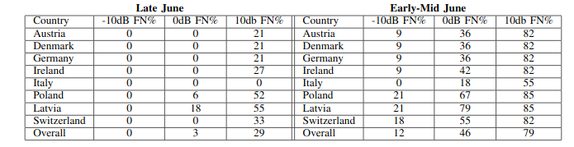
Does BLE Proximity Work?
Pairwise tests with different handset types at 1m for 30+ minutes still produce false negatives if you assume some “noise” due to orientation that affects attenuation
  https://down.dsg.cs.tcd.ie/tact/posorient.pdf
On June 13th Google shipped an update that added new calibration adjustments to attenuation calculations. We had tested before that, so we re-did the same tests.
Percentage false negative seen for various Country configurations:

Slide 17
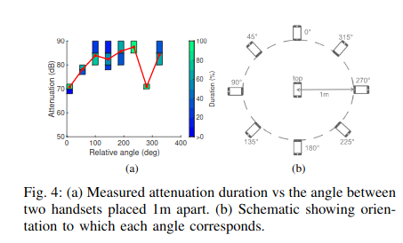
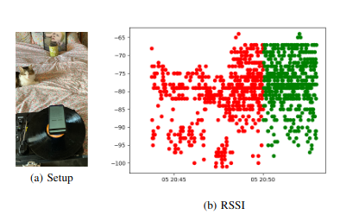
“Noise”
Handsets package antennae in different ways and so orientation can change attenuation by itself (as can other things)
We’re not sure how to model this but it seems to be able to affect RSSI (and hence attenuation) by 10-20dB
Cat video! https://down.dsg.cs.tcd.ie/tact/changes.mov

Slide 18
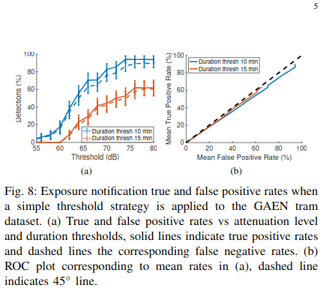
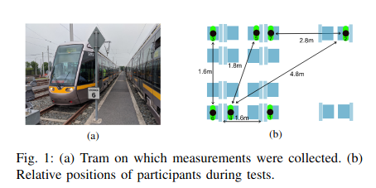
Real-World Scenario Testing
We did tests of real-world scenarios to see how those affect RSSI, attenuation etc.
  Walking, cycling, sitting around a table, on a park bench, between cars in parallel
Two are noteworthy:
  On a commuter bus https://www.scss.tcd.ie/Doug.Leith/pubs/bus.pdf
  On a tram https://www.scss.tcd.ie/Doug.Leith/pubs/luas.pdf
Those seem like scenarios where these Apps, if they work, could help with contacts that would otherwise be missed but the metallic surrounds affected BLE distance estimation badly

Slide 19
What traffic is sent? (on Android)
The Android implementation of the GAEN API is a part of Google Play Services. If you disable Google Play Services these Apps won’t work.
We mitm’d and unpinned a set of GAEN Apps and captured traffic traces of App traffic and traffic from Google Play Services
  https://www.scss.tcd.ie/Doug.Leith/pubs/contact_tracing_app_traffic.pdf
Overall the Apps seem well-behaved but Google Play Services shares long term identifiers with Google and also frequently connects in a way that would allow IP-based location tracking

Slide 20
Example: Irish CovidTracker App
For all apps, we only tested onboarding and TEK downloads – we didn’t touch anything that the client might e.g. do after a positive test as that could interfere with a running service
Irish App has some issues:
  An unnecessary “supercookie” – A JWT authToken used as a bearer token to download TEKs (no other services had such an individual cookie) – the HSE’s Data Protection Impact Assessment (DPIA) states that they don’t log that kind of information but it’d be better to not have it in the protocol
  The App allows users to opt-in to sending “metrics” that mix devops (whether App opened that day) and medical information (how many times notified) – we recommend separating those into different security contexts
  There’s some path-not-taken code that makes a call to Google Firebase
Most apps were open-source, had DPIAs, did certificate pinning and were pretty clean in terms of data-sent, Irish App would be “mid-table” if this were a league

Slide 21
Google Play Services
We turned off everything we could, including Google Play Services “Usage & Diagnostics” and tried to get to a minimal configuration where a GAEN App can run (reminder: that requires Google Play Services to be running)
Roughly every 6 hours, Google Play Services connects to a “/checkin” API and sends back information including the handset IMEI, phone number, SIM serial number, WiFi MAC address and the email address associated with the handset
Roughly every 20 minutes, Google Play Services connects to a “/p/log/batch” API including a cookie that is present in the “/checkin” HTTP request, thereby linking many long-term persistent hard-to-change identifiers with the IP address that can be geo-located
The above messages contain additional telemetry – how much depends on settings and what other Apps are running (but is opaque); there was some variation in the frequency of connecting to the “/p/log/batch” endpoint, depending on settings.
There is no published DPIA for the Android GAEN API implementation nor of Google Play Services (that we know about).
Google Play Services is closed-source.
That all seems hugely invasive to us and is required if you want to use a GAEN App on Android.

Slide 22
Measuring Deployments
The set of TEKs that Bob’s phone downloads are public, so we can count those
We’re currently measuring those for 33 different regions around the world – hourly download of TEKs to our measurement server
  Started in June, added regions as they deployed or when we got around to them
  https://down.dsg.cs.tcd.ie/tact/tek-counts/ shows counts, updated a couple of times a day
Recall that you upload 14 TEKs, and the health authority might publish some or all of those, so if we see 1 new TEK for Ireland today, there’ll (maybe) be 1 new TEK added to the count for each of the last 14 days – we do have hourly snapshots so can estimate how many TEKs are being uploaded each day
Note: these measurements can’t tell us if these Apps “work” but might tell us they don’t work (in some places)

Slide 23
Measurement Campaign
For each deployment (of 33), we needed for figure out the TEK download URLs used
  Doug Leith did all the smart stuff here!
Sometimes URL is clear from open-source code and documentation (maybe with some guessing)
Mostly though, we had to install App on rooted handset and run a man-in-the-middle attack to decrypt the HTTPS traffic
In a bunch of cases we also had to “unpin” the CA certs with which the App was shipped
There are lots of server-side oddities:
  Ireland and other Nearform apps require an unnecessary and privacy unfriendly refreshToken to “authorise” the TEK download (it doesn’t need to be authorised as everyone does it!)
  Canadian server uses a hard-coded secret key to obfuscate URL
  Many servers include timestamps in URLs
  Many servers require download of an index or manifest before getting TEKs
We then script up the hourly downloads, lots of scripts at:
  https://github.com/sftcd/tek_transparency

Slide 24
Measurement Difficulties
The GAEN design did not include anything that would allow anyone to measure it’s efficacy, and health authorities don’t publish much detail
  Oops! Would we do that with a drug? Is a population-scale deployment of an app that different?
That meant we needed the measurement tooling from the previous slide
Server implementations have also done other odd things, mainly adding fake TEKs
  We can often work around those fakes in our estimates but it’s another complexity esp as they turn that kind of thing on and off over time
In early July Ireland and Northern Ireland started to share TEKs (which makes sense but also makes estimating harder)
  In late October, additional EU countries started sharing and a common server in the US now supports (I think) 12 states
Ireland, Germany and Switzerland do now emit some (different) statistics in different ways so we started screen-scaping those

Slide 25

Shortfalls (1)
If we know:
  Number of cases per day and population in the region
  Percent of population running app
  Number of TEKs uploaded per day
Then we can calculate whether or not there’s a shortfall in the number of TEK uploads we should expect
We express that as a percentage, ideally, close to zero
We did that in October
  https://down.dsg.cs.tcd.ie/tact/survey10.pdf
Result: not great, esp Italy and Poland (both with shortfalls of >90%)

Slide 26
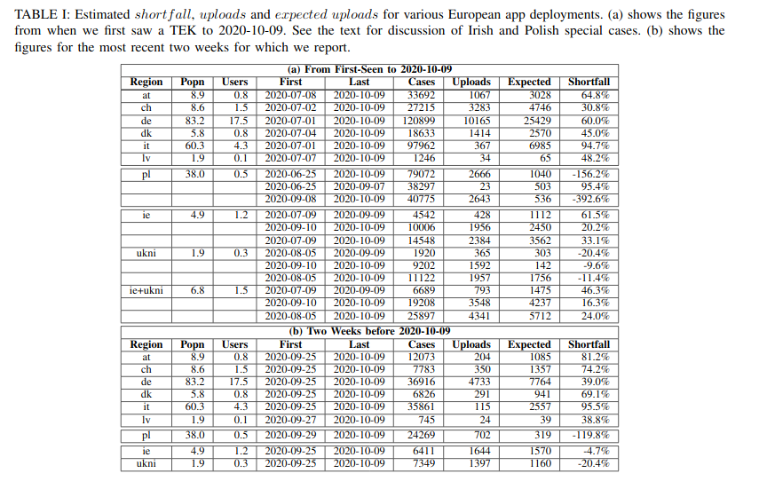
Shortfalls (2)

Slide 27
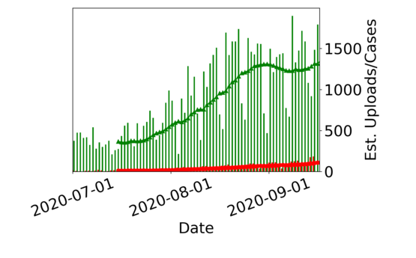
Shortfalls (3)
German Cases vs. Uploads with ~21% using their app
Plan is to look again at the data around year-end

Slide 28
Actual Irish Shortfall
HSE App now includes some in-App statistics
  Not sure when introduced
Since early Oct we’ve been downloading those hourly as part of our measurement campaign
These numbers show a similar shortfall but are no longer estimates – they’re the HSE’s own figures

Slide 29
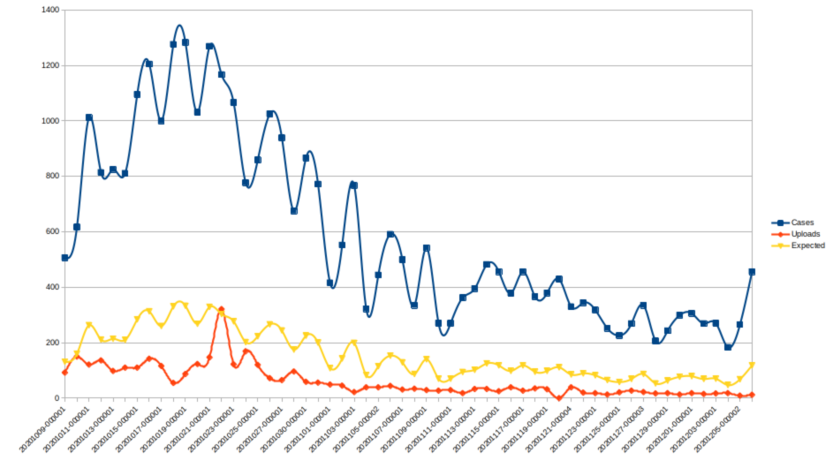
Actual Irish Shortfall
2020-10-09 to 2020-12-05
1.3M active users, 4.9M population
Cases: 34,172
Uploads: 3,494, Expected: 8,857 Shortfall: 60%

Slide 30
Reasons for shortfalls?
Really unclear as of now, could be some mixture of:
  Uploads need anti-spam protection via a “code” that only allows those really testing positive to upload, and maybe that’s too hard for a person to handle when they’ve just been told their test is positive
  People actually just don’t trust these systems despite the design and all the advertising
  Demographic factors: maybe active users are more likely young and asymptomatic, or maybe active users are more likely older, more careful and less likely to test positive
  Geography: maybe some regions have lots of cases but other regions have lots of active users
  Uncounted uninstalls: maybe people are turning this stuff off for some reason
In any case with substantial shortfalls such as in Italy or Poland you would really have to wonder if there’s any utility in those apps (so far)
  Even Ireland and Switzerland seem to have maybe ~33% shortfalls which (IIUC) was not expected back in March

Slide 31
Conclusions
These Apps are being deployed, governments are encouraging adoption for entire populations
Replay attacks (and perhaps others) exist and have yet to be mitigated
BLE-based proximity detection may not work as well as claimed
  We do expect that to improve over time, but are unsure if it will ever be reliable
  The “<2m && >15 mins” criterion may be asking the wrong question – we find it hard to see that that can be reliably determined, we don’t know if some other (epidemiologically) useful criterion could be reliably determined
The Android implementation of the GAEN API comes with serious privacy problems
  If you don’t care about Google tracking you, then you have no problem
  If you don’t want to install a GAEN App, then you have no new problem
  If you care about Google tracking you and want to run a GAEN App, you have a new problem
We have no information about the internals of the Apple implementation
Measurements show shortfalls that may indicate that these overall systems don’t seem to work as well as envisaged
The GAEN system still requires more public documentation, perhaps needs a new “quiet mode” to justify population-wide acceptability and it may be wise to revisit the governance setup for the overall GAEN system
We also need to start planning to get these systems turned off

Slide 32
Resources
All details are available at: https://down.dsg.cs.tcd.ie/tact/
Seven of the 10 documents there are tech-reports, not (yet) peer-reviewed, 3 have been peer-reviewed
We have published data sets for the bus, tram and pairwise data sets and publish the daily TEK counts
We have published code for the TEK survey and a modified version of the Google exemplar GAEN App that was used in tests
We have an (unpublished, it’d help with the replay attack) App that supports other tests by doing the transmitting GAEN functions without using the GAEN API but that interops with the Android and Apple implementations – happy to make available to other researchers

Slide 33
Thanks
Offline questions welcome too
stephen.farrell@cs.tcd.ie
These slides:
https://down.dsg.cs.tcd.ie/tact/

