Slide 1
TEU00311
What is the Internet doing to me?
(witidtm)
Stephen Farrell
stephen.farrell@cs.tcd.ie
https://github.com/sftcd/witidtm
https://down.dsg.cs.tcd.ie/witidtm

Slide 2
The Internet is not the web
Still an important point!
The web is (roughly) the set of computers that speak the HTTP protocol
  HTTP == HyperText Transfer Protocol
Email doesn’t use HTTP, but rather (mostly) the Simple Mail Transfer Protocol (SMTP) which is a couple of decades older than HTTP
Mobile networks (3G, 4G, 5G...) mostly run over IP using a bunch of protocols you’d prefer to never have to know about
Many “triple-play” television services run over multicast IP
But lots of our interactions with the Internet are via the web
We’ll look more at the web now...

Slide 3
Mechanics of the Web
(Plumbing:-)

Slide 4
So you click a link...
What do you think happens?

Slide 5
So you click a link...
10 minute video that’s a bit simplified and out of date, but that might be a good thing:-
  https://gizmodo.com/what-actually-happens-when-you-click-on-a-link-1665573786
Domain Name System (DNS) resolution
This is a recursive protocol that uses a world-wide piece of infrastructure (the DNS) that depends on a complex name registration system (next slides)
Transport Connection Established (TCP)
Transport Layer Security (TLS or SSL) session established
  Not mentioned in video but now happens >70% of the time when HTTPS used
HTTP request sent
HTTP response received
Probably contains HTML with links so GOTO step 1 for each one

Slide 6
What’s a URL?
A web “link” is really a Uniform Resource Locator
  Generalisation: Uniform Resource Indicator (URI) which can be a name instead of a locator
  Name/Locator or Identifier/Locator concepts are common in networking and often boringly controversial (so we’ll skip that:-)
URI/URL definitions are in RFC3986
  https://tools.ietf.org/html/rfc3986
  But that’s also been “forked” by browser makers (a fine example of boring controversy;-)
    https://url.spec.whatwg.org/
URIs are used as web links but also for many other things, e.g. voice over IP signalling, e.g. SIP URIs can represent phone numbers
  sip:1-999-123-4567@voip-provider.example.net
  https://en.wikipedia.org/wiki/SIP_URI_scheme

Slide 7
Parts of a URI/URL
foo://example.com:8042/over/there?name=ferret#nose
\_/ \______________/\_________/ \_________/ \__/
| | | | |
scheme authority path query fragment
“Real” example:
https://down.dsg.cs.tcd.ie/teu00311/stuff#middle
Mostly, the URL schemes you’ll see will be “https” or “http” but there are many more
The “authority” part is essentially the DNS name of the host (with an optional port number)
The “path” can be thought of as a directory/folder name on that host
The “query” part provides a way to parameterise URLs sent to programs
The “fragment” provides a way to “land” your browser at some place in a presumably long page

Slide 8
The Domain Name System (DNS)
Internet Assigned Numbers Authority (IANA, https://iana.org/) keeps lists of “top” level names (e.g. .com, .ie), IP address allocations and protocol numbering registrations
  That’s a fantastic bit of bookkeeping but no more than that, policies are set elsewhere despite what many “Internet Governance” folks might say
  IANA is homed in ICANN which is one of the policy setting/operations entities
  The RIRs are another, and the IETF controls the protocols that create the space in which the policies operate
DNS has a single root, below which we have .com, .ie, etc. and below those we have example.com, tcd.ie etc. and below which you have whatever e.g. TCD might want e.g. down.dsg.cs.tcd.ie
There are a set of (13 logical, physically hundreds of) servers in the network that serve the “root zone” and who can tell you set of IP addresses where you can find more authoritative information about .com or .ie. or any of the Top Level Domains (TLDs)
  Entities that do the bookkeeping for a TLD are called registries

Slide 9
The Domain Name System (DNS)
Each of those servers will be authoritative for some zone (e.g. all the hosts in *.tcd.ie) but can also delegate as happens in the case of cs.tcd.ie
When you want a new name (e.g. jell.ie) you have to go to a registrar who works with the relevant registry (e.g. Tolerant Networks Limited is me-as-a-registrar for .ie) and then pay to rent that for a few years
  Not all names are available – could be taken or a trade mark – some lawyers love this stuff!
You need a server machine with an IP address for that to be useful
  You often get from a hosting company or cloudy service provider like AWS or Azure or whomever
And then your machine’s name and IP address need to be published in the DNS
Then you can e.g. install apache (a web server) and make your web site and interact with e.g. LetsEncrypt.org to get a public key certificate so TLS will work
  Then browsers can nicely visit your web site
  Web crawlers and attackers of all sorts will also constantly ping your machine, all the time
At that point you may decide to be an advertiser or not, if you do, you’ll probably start to record things about people who visit you and maybe you’ll sign up to some advertising platform to make money for you and them
But you might also decide not to track anyone (what I do)
  Modulo normal web logs!

Slide 10
IP Addressing and Routing
How does a browser make that TCP connection to a web site after it gets the IP address?
Regional Internet Registries (RIRs) such as RIPE allocate Autonomous System (AS) numbers and blocks of IP addresses to network operators (e.g. ISPs, enterprises, hosting companies)
Addresses are further allocated downstream, eventually to e.g. your laptop via DHCP, or (semi-)manually to a server hosting a web site in a data centre
ASes tell one another about who has what blocks of addresses and how to route packets to one another via the Border Gateway Protocol (BGP) – remember there are tens of thousands of ASes
There are “private” address ranges as well as public IPv4 and IPv6 addresses. Often private IPv4 addresses (e.g. 10.0.0.1 or 192.168.1.1) are used within home networks and Network Address Translation (NAT) is used to map those to shared public IP addresses - mainly to get around the fact that all 4 billion IPv4 addresses have been allocated by IANA already
Once your browser has a source IP address and knows the web site (destination) IP address then they can establish the TCP connection, assuming the relevant ISPs have done a good job with BGP, which mostly happens
  The source address is needed to get the answer from the web site

Slide 11
HyperText Markup Language (HTML)
Simplistically, the web pages that you download via HTTPS are HTML files
  There’s also lots of non-HTML content: video, Javascript, images
  Reality is nowhere near this simple… but it can be!
HTML describes the structure of the web page
Browser renders that
Key concept: hypertext links

Slide 12
HTML for a trivial web page
https://down.dsg.cs.tcd.ie/witidtm/examples/trivial.html
<!DOCTYPE html PUBLIC "-//W3C//DTD XHTML 1.0 Transitional//EN"
"http://www.w3.org/TR/xhtml1/DTD/xhtml1-transitional.dtd">
<html xmlns="http://www.w3.org/1999/xhtml">
<head>
<title>A trivial web page</title>
</head>
<!-- Background white, links blue (unvisited), navy (visited), red (active) -->
<body bgcolor="#FFFFFF" text="#000000" link="#0000FF" vlink="#000080" alink="#FF0000">
<p>The trivial content is just a link to the
<a href="https://jell.ie/news/">jell.ie news</a>
</p>
</body>
</html>

Slide 13
A link on our trivial web page
https://down.dsg.cs.tcd.ie/witidtm/examples/trivial.html
<!DOCTYPE html PUBLIC "-//W3C//DTD XHTML 1.0 Transitional//EN"
"http://www.w3.org/TR/xhtml1/DTD/xhtml1-transitional.dtd">
<html xmlns="http://www.w3.org/1999/xhtml">
<head>
<title>A trivial web page</title>
</head>
<!-- Background white, links blue (unvisited), navy (visited), red (active) -->
<body bgcolor="#FFFFFF" text="#000000" link="#0000FF" vlink="#000080" alink="#FF0000">
<p>The trivial content is just a link to the
<a href="https://jell.ie/news/">jell.ie news</a>
</p>
</body>
</html>

Slide 14
HyperText Transfer Protocol
Me: GOTO white/black-board
You: draw your own diagram or take a pic:-)
HTTP/1 is a text-based protocol and still widely used
HTTP/2 is semantically the same but binary and with a few other efficiency improvements – go-faster-stripes basically
h3 is in-development now, and may turn out to be HTTP/2 over QUIC
HTTP/TLS = HTTPS – back to the drawing

Slide 15
TLS Sessions per “front page”
I recently (2019Q1) did some tests, loading the “front page” of these sites and recording the network traffic. The numbers below are the number of separate TLS sessions that were created when the initial page HTML is rendered, to display content and (mostly) ADs
N = count of tests done
Min,max,stdev,avg refer to
the number of TLS sessions
for each test
Automation tool used was
Selenium on Ubuntu which
mostly used FF, but also
chrome/opera for some tests
Browsers/selenium drivers
are “out of the box” with no
special config, nor plug-ins,
extensions etc.

Slide 16
Why did the Irish Times front page have an average of 120+ TLS sessions?
Why did tcd.ie have an average > 92?

Slide 17
Why did the Irish Times front page have an average of 120+ TLS sessions?
Why did tcd.ie have an average > 92?
With a desktop browser... you can
see what’s happening: “shift-ctrl-I”
(but we’re getting a bit ahead with that)

Slide 18
Scaling and Content Delivery Networks

Slide 19
Big web sites aren’t trivial
Caveat: I don’t run a big web site! So I don’t really know this stuff in full detail.
There’s a web called “high scalability” that publishes “war stories” for people who manage large systems
One article gives a nice perspective from a sys admin point-of-view – probably too much detail for us, but good as a description of how a “middle-sized” web site has developed in the back-end over the last decade
  https://www.betabrand.com/ “Best. Pants. Ever.” (sigh;-)
  https://boxunix.com/2018/12/10/from-bare-metal-to-kubernetes/
  If you do read that, I’d say the take-away is that there’s enough complexity in even a middle-sized merchant web site that many things can go wrong on their end, including some that could affect you (e.g. data leaks, which we’ll look at later)
Another article talks about how Netflix do stuff...

Slide 20
“Netflix: What Happens When You Press Play?”
We’ll look at some quotes from this Dec. 2017 article about Netflix (author: Todd Hoff)
  https://highscalability.com/blog/2017/12/11/netflix-what-happens-when-you-press-play.html
Some 2017 Netflix statistics:
Netflix has more than 110 million subscribers.
Netflix operates in more than 200 countries.
Netflix has nearly $3 billion in revenue per quarter.
Netflix adds more than 5 million new subscribers per quarter.
Netflix plays more than 1 billion hours of video each week. As a comparison, YouTube streams 1 billion hours of video every day while Facebook streams 110 million hours of video every day.
Netflix played 250 million hours of video on a single day in 2017.
Netflix accounts for over 37% of peak internet traffic in the United States.
Netflix plans to spend $7 billion on new content in 2018.

Slide 21
The quotes...
“Netflix collects a lot of information. Netflix knows what everyone has watched when they watched it and where they were when they watched. Netflix knows which videos members have looked at but decided not to watch. Netflix knows how many times each video has been watched…and a lot more.”
“When browsing around looking for something to watch on Netflix, have you noticed there’s always an image displayed for each video? That’s called the header image. The header image is meant to intrigue you, to draw you into selecting a video. The idea is the more compelling the header image, the more likely you are to watch a video. And the more videos you watch, the less likely you are to unsubscribe from Netflix.”
“Everyone used to see the same header image. Here’s how it worked. Members were shown at a random one picture from a group of options, like the pictures in the above Stranger Things collage. Netflix counted every time the video was watched, recording which picture was displayed when the video was selected.For our Stranger Things example, let’s say when the group picture in the center was shown, Stranger Things was watched 1,000 times. For all the other pictures, it was watched only once each. Since the group picture was the best at getting members to watch, Netflix would make it the header image for Stranger Things forever. ”
“That’s why Netflix now personalizes all the images they show you. Netflix tries to select the artwork highlighting the most relevant aspect of a video to you. How do they do that? Remember, Netflix records and counts everything you do on their site. They know which kind of movies you like best, which actors you like the most, and so on. Let’s say one of your recommendations is the movie Good Will Hunting. Netflix must choose a header image to show you. The goal is to show an image that lets you know about a movie you’ll probably be interested in. Which image should Netflix show you?”

Slide 22
Content Deliery Network
Netflix use “hundreds of thousands” of Amazon EC2 instances for their application logic – stuff that happens before video is streaming
  Anyone know what “Amazon EC2” is? If not, you wanna?
For video, Netflix built their own Content Delivery Network (CDN) – most web sites use 3rd party CDNs like Akamai, Cloudflare etc.
  CDNs represent a kind of Internet centralisation that you may not have known about?
Basic idea is to put large data files near where the customer is so data (video) gets there faster, and to be more reliable when failures happen
So where are Neflix CDN points-of-presence (PoPs)?

Slide 23

Netflix PoPs (2017)
PoPs are mostly hosted by ISPs or IXPs
Because Netflix send lots of data (37% of the internet traffic in the US) and otherwise the ISPs would have to pay interconnect charges to the ISPs between them and the content
That’s done with Neflix-designed hardware physically located in the ISP’s network – called an Open Connect Appliacnce (OCA)

Slide 24



So what happens when you press Play?

Slide 25

More up to date pic
I have no idea if the differences in these diagrams are significant:-)
https://openconnect.netflix.com/Open-Connect-Overview.pdf

Slide 26
Browser Hygiene

Slide 27
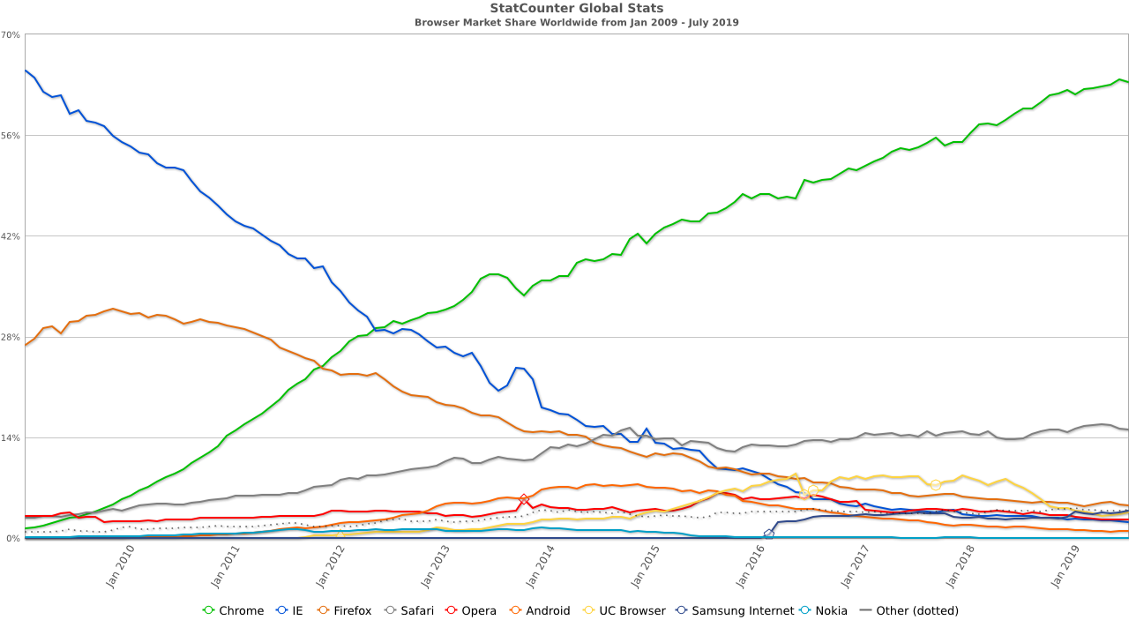
Browser worldwide market share
2009-2019
Chrome
Safari
Firefox
Opera
Android
UC browser
...
Brave
Vivaldi
https://gs.statcounter.com/browser-market-share#monthly-200901-201907

Slide 28
Overall browser landscape
Browser defaults are chosen by browser implementers (Google, Mozilla, Apple,...)
  Allow Javascript and cookies, do telemetry, try get you to login, keep state ...
Historically, browser-makers seemed to care most about market share
  Performance and rendering were their main concerns as they lose market share if they’re slower or sites don’t render sites (well)
They started getting significantly better at security a while back (2013+)
Some browser-makers are starting to get a bit better at privacy
IMO they don’t behave as if they think you should be the one in control

Slide 29
My browser setup
Default browser: FF “nightly” + NoScript/Ghostery & disallowing cookies, with some white-listed sites with search via DuckDuckGo (“!g” works too, if needed:-)
    This is the only browser that saves logins, but not for sensitive things (we’ll consider passwords later)
    Some sites don’t work with the above; mostly: screw ‘em
Tor Browser: If searching for anything sensitive (e.g. medical info)
If-need-be: chromium/incognito with no write-access to disk and so that it shoots it’s own brain out on exit (at least I hope so;-)
    Use that e.g. for airline/hotel bookings
If-all-else-fails: Brave or Vivaldi
On phone: sailfish browser with no JS/no cookies and 2ndary open-kimono browsers if-need-be (Webcat/Web pirate)
Recommend you figure out some browser-hygiene you consider ok and follow that
    Requires some self-discipline!
    Be willing to help others do the same!

Slide 30
Your browser setup?
What browser(s) do you use? What extensions/plugins?
  (your stuff here)
We’ll return to cookies etc shortly

