Slide 1
TEU00311
What is the Internet doing to me?
(witidtm)
Stephen Farrell
stephen.farrell@cs.tcd.ie
https://github.com/sftcd/witidtm
https://down.dsg.cs.tcd.ie/witidtm
URLs accessed 20190907

Slide 2
What’re we here for?
We all use the Internet all the time
You may or may not know what’s happening under the hood, and shouldn’t need to know all the nitty-gritty detail
But, to make better decisions as to what you do, it’s good to know something about some of those details
This module aims to help you learn enough to make better decisions about what you want, and how to get it, as you interact with the Internet
I hope: you’ll apply those lessons, tell others about it all and maybe agitate for a better Internet for a better society (but you won’t fail the module if you don’t agitate:-)

Slide 3
Administrivia

Slide 4
TCD Personnel/Contacts
Lectures:
  Dr. Stephen Farrell, stephen.farrell@cs.tcd.ie, WR3.4, x2354
  Dr. Dave Lewis TBD
Teaching Assistant:
  Christian Cabrera,cabrerac@scss.tcd.ie
Demonstrators: TBD

Slide 5
Schedule
Tuesday 1000-1050, Synge 2, Hamilton building
Thursday 1600-1750, M17, Museum building
Weeks 3-7: Just lectures
Weeks 8,10-14:
  Themed lecture (Tue, 1000-1050)
  Hackathon/lab (Thu, 1600-1750) – venue moves to Regent’s House
Reading week: Week 9, October 21
September 10th is in week 3 - Why do week numbers start at 3? I’ve no idea;-)
Details of labs are being worked out, stay tuned

Slide 6
External Experts
Most labs/hackathons will be lead by an external expert, most will be remote
Getting busy people to help (for nothing:-) means being flexible so changes are likely as we go
Will let you know as dates/topics are firmed up

Slide 7
Assessment
Blackboard tests – 45% (see next slide)
  https://tcd.blackboard.com/webapps/blackboard/execute/courseMain?course_id=_56807_1
  I’m not a huge fan of blackboard but we’ll try...
GDPR request and anonymised report – 25 %
Group project (report) – 15%
Individual project (report) – 15%
No exam unless you flunk, then a supplemental for 100%, but don’t flunk!

Slide 8
Blackboard tests
Initial survey (not marked)
Week 2 - Small essay (5%)
Week 3 - Multiple Choice Questions (MCQ) on content to date (5%)
Week 4 - As with week 3:-) (5%)
Hackathons: MCQ before each so you have enough background to (3 x 10%)
For all BB tests – deadlines apply, late submission means high penalties, details will be posted for each
I may change some of that depending how well the quiz thing works (or not!)

Slide 9
Module Materials
There is no book – feel free to recommend some if you like
Materials will be linked to from, or on, the module web page:
  https://down.dsg.cs.tcd.ie/witidtm
Content of module web page is also in Github at:
  https://github.com/sftcd/witidtm
Clone that repo and/or visit that page often, as it will change during the runtime of the module!
  Who knows what “clone that repo” means?
  I’ll be happy to take PRs, if offered – if very good I might even give some marks of let someone off an assignment

Slide 10
Style
The module is designed to be interactive, so don’t sit there and say nothing!
It is entirely ok to ask what might appear to be dumb questions, e.g. “Who makes money from YouTube?” - supposedly naive questions can be good and the answers might be quite subtle
It is entirely ok to comment on what we tell you, e.g. “That’s nonsense – I use <foo> all the time and it’s fine” - this is about you after all, so (dis)agreeing with us and one another is desirable (but don’t be an ass, and do listen)
If you don’t comment or ask questions, we’ll all be more bored and I’ll get cranky!
So, let’s start...

Slide 11
Is the Internet a network?

Slide 12
Is the Internet a network?
(hint: the answer is “no”:-)

Slide 13
A network of networks
The Internet is made up of about 65,428 Autonomous Systems (ASes)
  https://en.wikipedia.org/wiki/Autonomous_system_%28Internet%29
  65,428 number as of Aug 19 (https://www.cidr-report.org/as2.0/)
Think of these as the set of Internet Service Providers (ISPs, like Eircom), other networks (e.g. HEANET which is TCD’s ISP), big companies (e.g. Google, FB) and oddities like Internet eXchange Points (IXPs, like INEX)
Each is (in principle and often in practice) an independent network (or set of networks) and their operators can do whatever they want
  They’re essentially defined by sets of numbers: Static: AS number (ASN); Dynamic: sets of IP address prefixes
They interact using Internet protocols (like IP, TCP, BGP)
  IP: Internet Protocol; TCP: Transmission Control Protocol; BGP: Border Gateway Protocol
We’ll delve more into all that later, but first… some pretty pictures

Slide 14
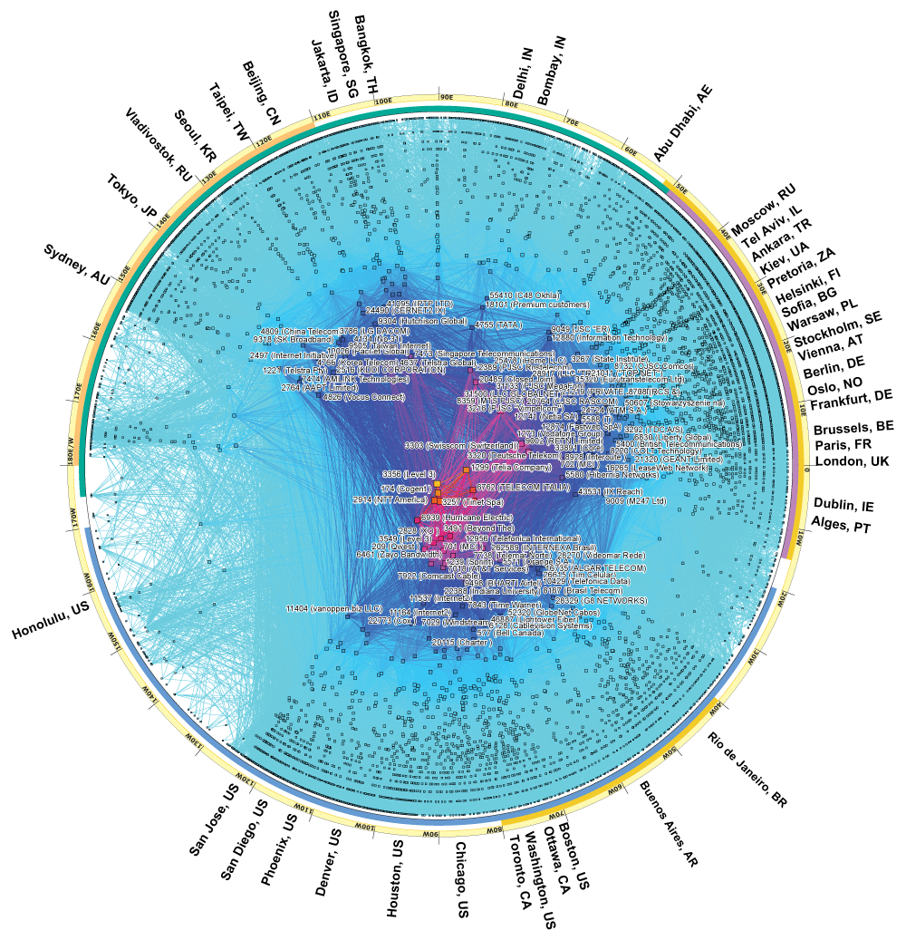
CAIDA Map of ASes
CAIDA (Center for Applied Internet Data Analysis) is a UC San Diego Internet measurement organisation
  You can measure a lot of what happens on the Internet as it happens!
This is a 2017 map of the ASes as they were then
  https://www.caida.org/research/topology/as_core_network/2017/
More central => more connected, serving more people
  You can see Dublin at about 3 o’clock
  In the middle (if you zoom) you could see level3 and cogent which are large ASes

Slide 15
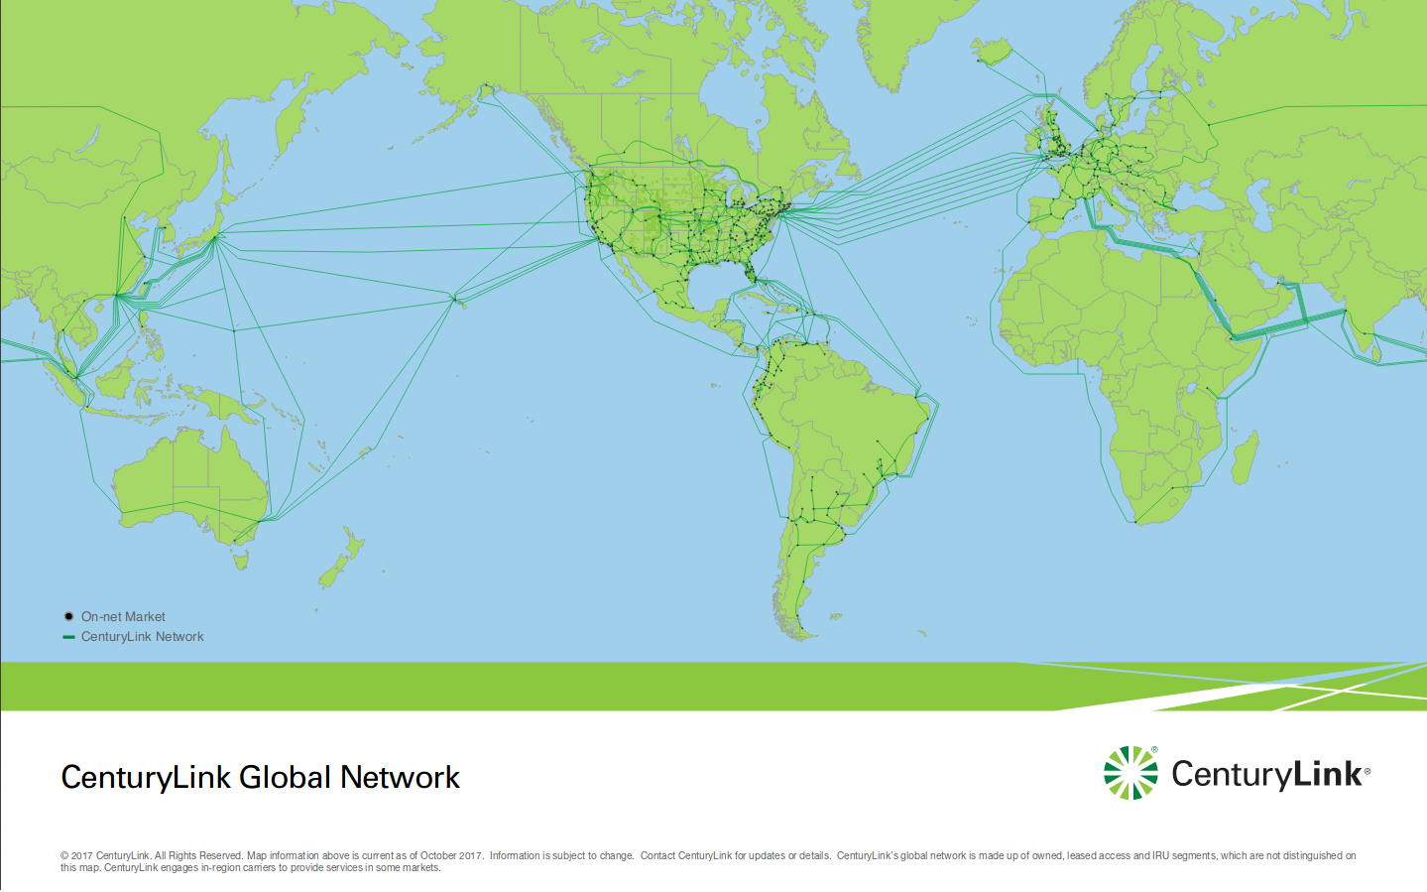
Level3 is one of those (a BIG one)
https://www.level3.com/~/media/files/maps/en-network-services-level-3-network-map.ashx

Slide 16
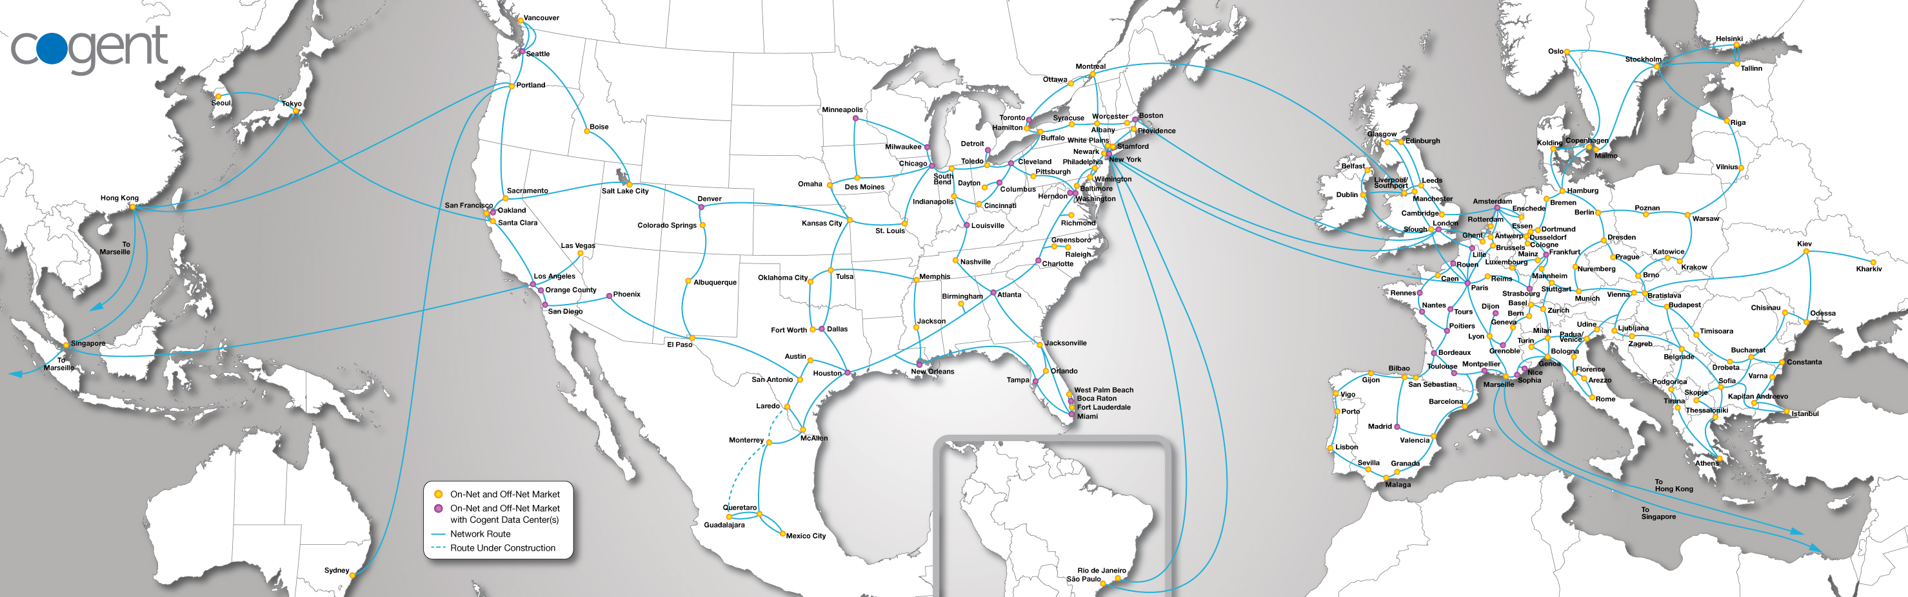
Cogent similarly
Cogent's network stretches over 204 markets throughout 43 countries in North America, Europe and Asia, with over 57,400 route miles of long-haul fiber and more
than 34,100 miles of metropolitan fiber serving over 840 metropolitan rings. Our end-to-end optical transport network consists of IP-over-WDM fiber links running up
to 2,120 Gbps intercity capacity and 2,000 Gbps on metropolitan rings, located in Cogent's major markets throughout North America, Europe and Asia. On the IP layer, Cogent's Tier 1, IPv6 and MPLS enabled network has direct IP connectivity to more than 6,760 AS (Autonomous System) networks around the world with over
185 Tbps internetworking capacity.
https://www.cogentco.com/en/network/network-map

Slide 17
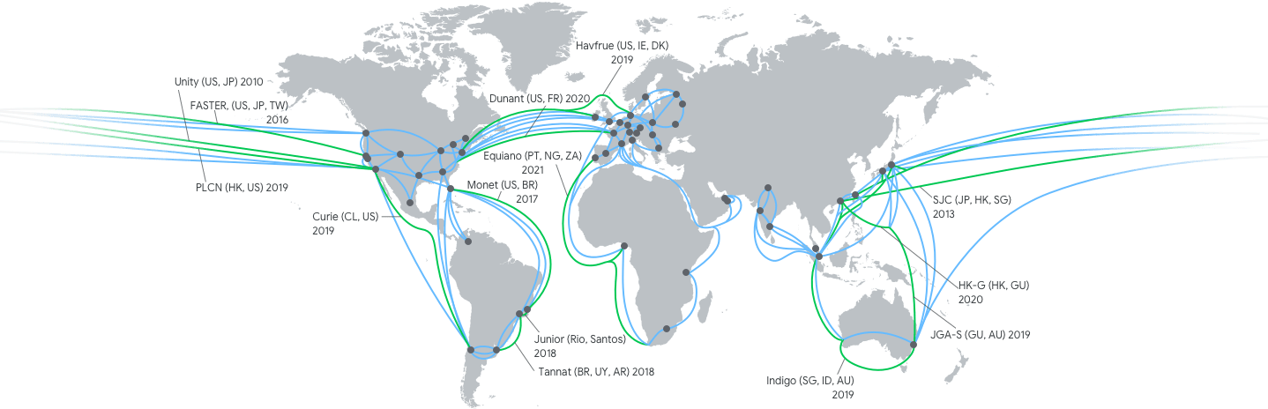
Google cloud
https://cloud.google.com/about/locations/#network-tab note this is just google cloud, not all their stuff

Slide 18
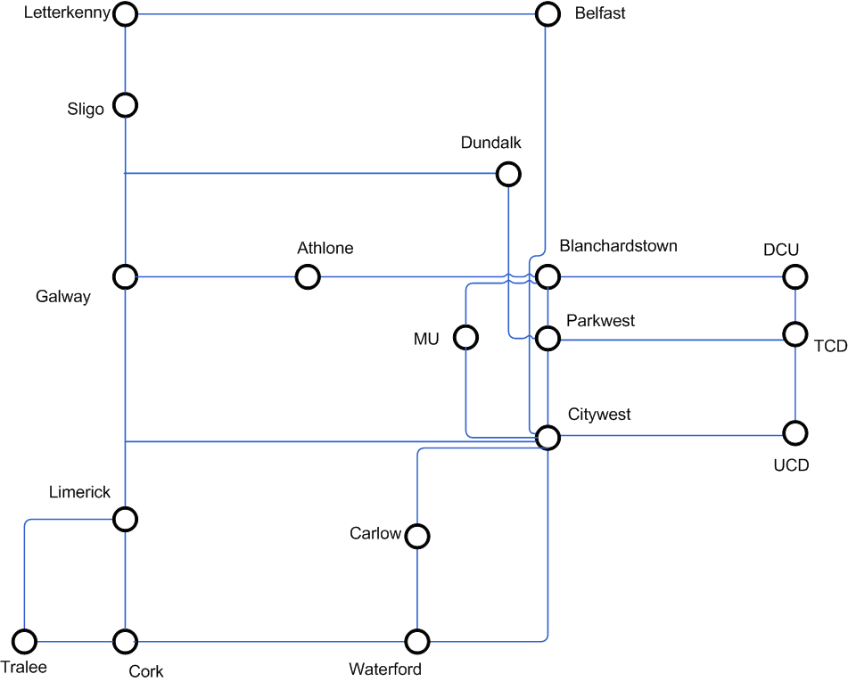
Heanet national n/w
https://www.heanet.ie/the-network/network-maps

Slide 19
The TCD network
Me: Could you send me a n/w diagram to give students an indication of the complexity of a campus n/w?
Them: No.... <mumble> ... security ;-(
Ah well, they’re mostly similar so...

Slide 20
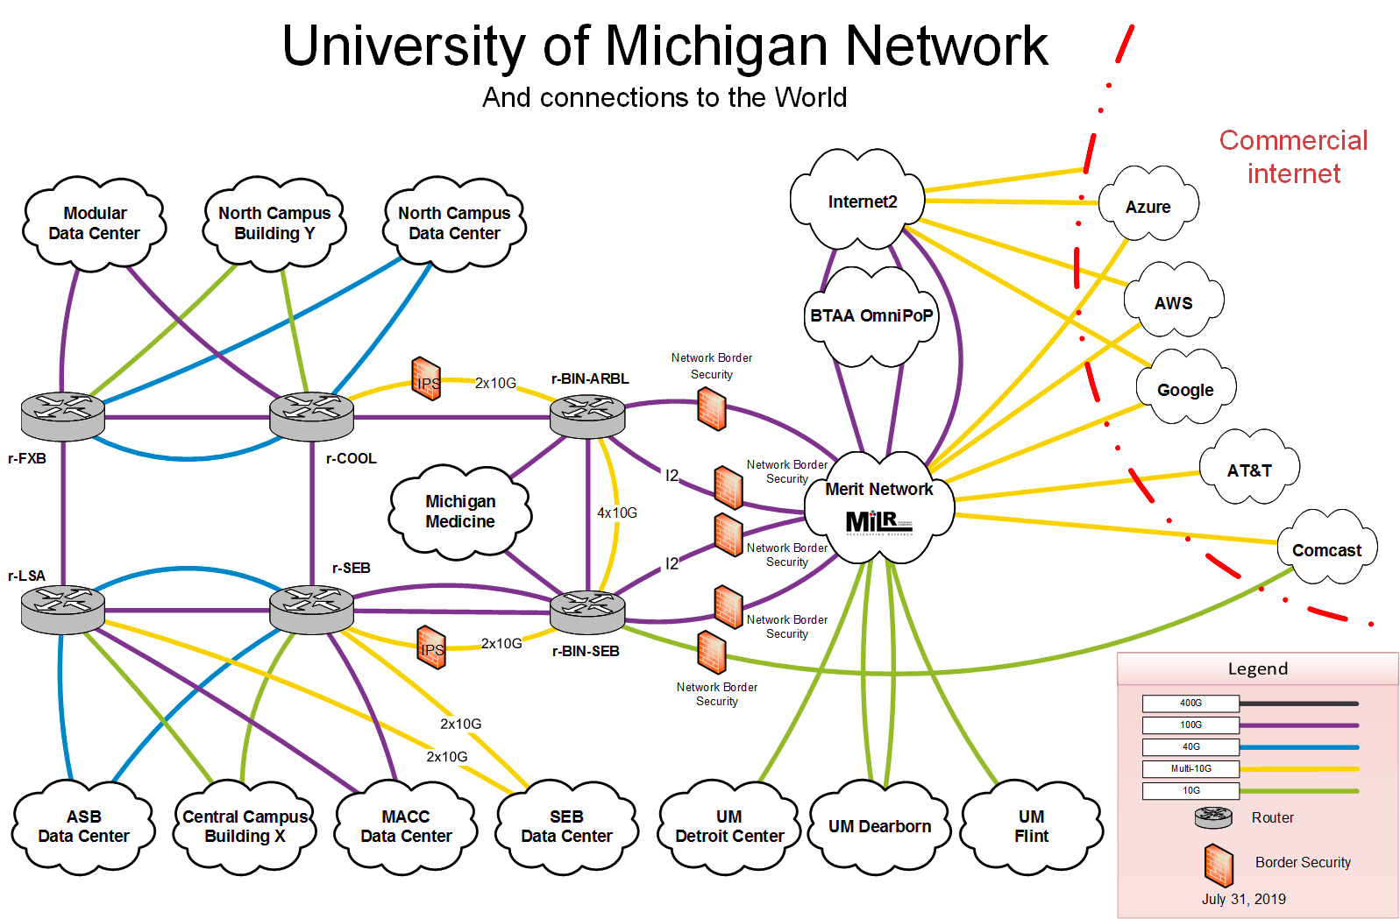
Umich n/w diagram
https://its.umich.edu/enterprise/wifi-networks/campus-network-diagram-description

Slide 21
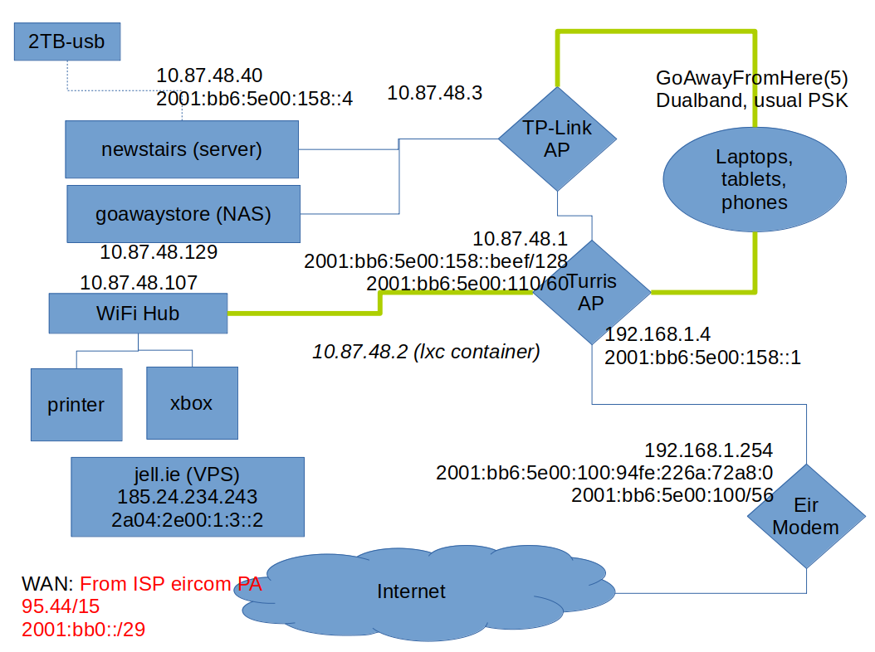
My home network
That’s from a few years ago – numbers are out of date:-)

Slide 22
Interoperability
To make the Internet work we need to agree on how to interoperate for some basic/minimal set of things
  That means defining/agreeing on Internet Protocols
  Where we need to agree on how to interoperate, a lot of that is done by the Internet Engineering Task Force (IETF) and other Internet standards bodies (IEEE SA, W3C)
    I’m quite involved with IETF stuff, so consider me biased there:-)
But we do not aim to agree about everything in everyone’s network
  So an awful lot happens at the “application layer” in code written by people and organisations
  And yet more happens when people configure services that use that code

Slide 23
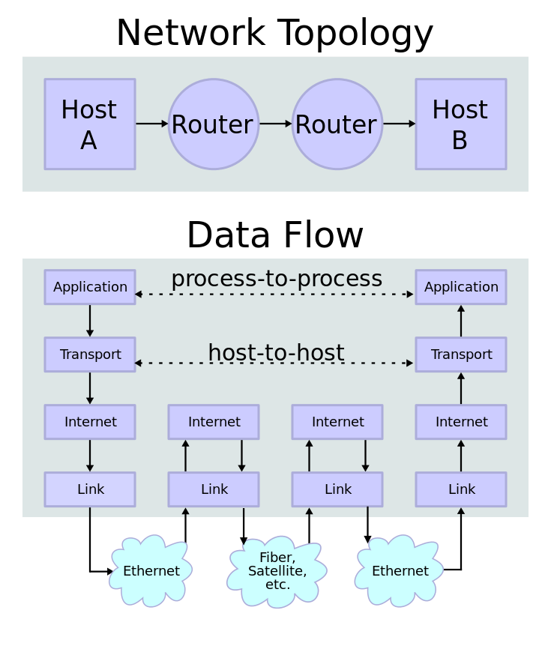
What’s a network protocol?
https://en.wikipedia.org/wiki/File:IP_stack_connections.svg

Slide 24
“Permissionless innovation”
One important point is: in principle each network operator can do whatever it wants so long as it interoperates “nicely” with others (and even when it doesn’t act particularly nicely;-)
  That also applies to your home network (if you want and are able)
  There are no protocol police
This is one of the main reasons why the Internet has been so successful
Related: the classic “End-to-end argument” paper
  Salzer, Reed. Clark,“End-to-end arguments in system design” ACM ToCS (1984).
    https://web.mit.edu/Saltzer/www/publications/endtoend/endtoend.pdf
  I recommend a read of that!
  Don’t consider it as gospel though – it’s the end-to-end argument and not really the end-to-end principle even though it gets called the latter a lot

Slide 25
“Tussles”
Repeating: we do not aim to agree about everything in everyone’s network...
  So an awful lot happens at the “application layer” in code written by people and organisations
  And yet more happens when people configure services that use that code
When the “policies” reflected in those collide then “fun” follows;-)
  If protocols or application code constrains what operators can do then people complain
  If what n/w operators are doing breaks (esp changes to) applications then people complain
  In both cases people often complain at the wrong place;-)
Another paper:
  Clark, David D., et al. "Tussle in cyberspace: defining tomorrow's Internet." ACM SIGCOMM Computer Communication Review. Vol. 32. No. 4. ACM, 2002.
    https://www2.cs.duke.edu/courses/compsci514/cps214/spring09/papers/p347-clark.pdf
  Same “Clark”, but older:-) Interestingly, the 2002 paper is IMO far more dated (and wrong!) than the 1984 paper!
We’ll consider a “live” example later (Search for “DNS over HTTPS” if you want to check it out); don’t worry if this issue seems a bit too hard to grok at this point

Slide 26
Aside: Cyber<blah>
Be wary of anyone who uses a term like “Cyber<blah>”
~90% of the time, that’s a strong indicator that they don’t really know what they’re talking about (if they did, they’d use a more precise and well-defined term)
Sadly, about 10% of the time (and increasing) such terms are used because “the industry” keeps on doing it and people just repeat stuff thoughtlessly
Don’t be afraid to ask someone to define “Cyber<blah>” if they use such a term, and don’t be surprised if they find that hard!
  E.g. “Does cyberspace include a person driving a car that’s had it’s license plate automatically scanned?” or “What’s not included in cybersecurity?”

Slide 27
The Internet is not the web
Another important point!
The web is (roughly) the set of computers that speak the HTTP protocol
  HTTP == HyperText Transfer Protocol
Email doesn’t use HTTP, but rather (mostly) the Simple Mail Transfer Protocol (SMTP) which is a couple of decades older than HTTP
Mobile network internals (3G, 4G, 5G...) mostly run over IP using a bunch of protocols you’d prefer to never have to know about
But lots of our interactions with the Internet are via the web
We’ll look more at the web later, meanwhile back to you...

Slide 28
How do you interact with the Internet?

Slide 29
Do you care about your, my, or all of our,
security on the Internet?
If so, what do you care about most?

Slide 30
Do you care about your, my, or all of our
privacy?

Slide 31
That’s all for now, we’ll be returning to those questions as we go.
But… what other questions should we be considering?

Slide 32
Some of the things we’ll do later...
Understand what happens under the hood when your browser loads a web site
Get an overview of advertising networks
Learn how to watch network traffic
Build a home network
Be sneaky on a home network

Slide 33
What else?
Your topic here... what’d you like to cover?
(we can revisit this multiple times)

