Slide 1
TEU00311
What is the Internet doing to me?
(witidtm)
Stephen Farrell
stephen.farrell@cs.tcd.ie
https://github.com/sftcd/witidtm
https://down.dsg.cs.tcd.ie/witidtm

Slide 2
Censorship
Ireland then and now...
Censorship techniques
Circumvention techniques
Measurement
A recent case in point: ECH
Conclusion

Slide 3
Ireland then and now...

Slide 4
A bit of Irish history
Ireland has a long history of censorship: the wikipedia page for that seems relatively accurate
    https://en.wikipedia.org/wiki/Censorship_in_the_Republic_of_Ireland
Monty Python’s Life of Brian was banned in 1979
    https://www.irishtimes.com/culture/film/an-awful-dump-the-ireland-that-banned-monty-python-s-life-of-brian-1.3807270
  ‘The film censor at the time, (Frank) Hall, himself a skilled satirist, quipped that the film was “offensive to Christians and to Jews as well, because it made them appear a terrible load of gobshites”’
  It was “unbanned” in 1987

Slide 5
Current Irish Internet Censorship
Russia Today/rt.com – not blocked in TCD, but since ~2022, is blocked via IP address from Eircom n/w (and likely others)
After a court case in 2013, thepiratebay.org was blocked from 6 ISPs in Ireland
  https://www.bbc.com/news/technology-22888851
The .ie ccTLD registry (IEDR/weare.ie) maintain a blocklist of names they will not allow be registered, e.g. porn.ie (you’ll get an error from whois)
There are likely other names/sites blocked
Should (some/more/all) of those lists be public?
  For almost all people: There will be some names you’d prefer to never see and sites you’d rather not highlight

Slide 6
Coimisiún na Meán
Guidelines for Media Service Providers
  https://www.cnam.ie/app/uploads/2025/02/202502_VOD-Updated-Guidelines-2025.pdf
  That’s an awful URL for a regulator’s document (and they do change ‘em)
In section 7.1, that includes:
  Providers of audiovisual on-demand media services shall not make available, in a catalogue of a service, anything which may reasonably be regarded as: causing harm or undue offence, ikely to promote or incite to crime, conduct falling within Article 5 of Directive (EU) 2017/54110 on combating terrorism, likely to incite to violence or hatred directed against a group of persons or a member of a group, or tending to undermine the authority of the State.
Question: does that seem ambiguous?

Slide 7
Harm/Undue Offence
The text on the previous slide from 7.1 has a footnote:
Guidance in relation to “harm” and “undue offence” in the broadcasting context has been issued in the Commission’s Code of Programme Standards applicable to broadcasters. See https://www.cnam.ie/wp-content/uploads/2024/11/Code-of-Programme-Standards-November-2024.pdf
That URL gets a 404
Maybe they meant: https://www.cnam.ie/app/uploads/2024/11/Code-of-Programme-Standards-November-2024.pdf
That’s why those are bad URLs
When you do find the document, there is a 3 page appendix on the topic

Slide 8
Coimisiún na Meán again
Online Safety Code
  https://www.cnam.ie/wp-content/uploads/2024/10/Coimisiun-na-Mean_Online-Safety-Code.pdf
Mostly reasonable, but includes:
  12.10: A video-sharing platform service provider whose terms and conditions do not preclude the uploading or sharing of adultonly video content as defined in this Code shall implement effective age assurance measures as defined in this Code to ensure that adult-only video content cannot normally be seen by children. An age assurance measure based solely on self-declaration of age by users of the service shall not be an effective measure for the purposes of this section.

Slide 9
Censorship techniques

Slide 10
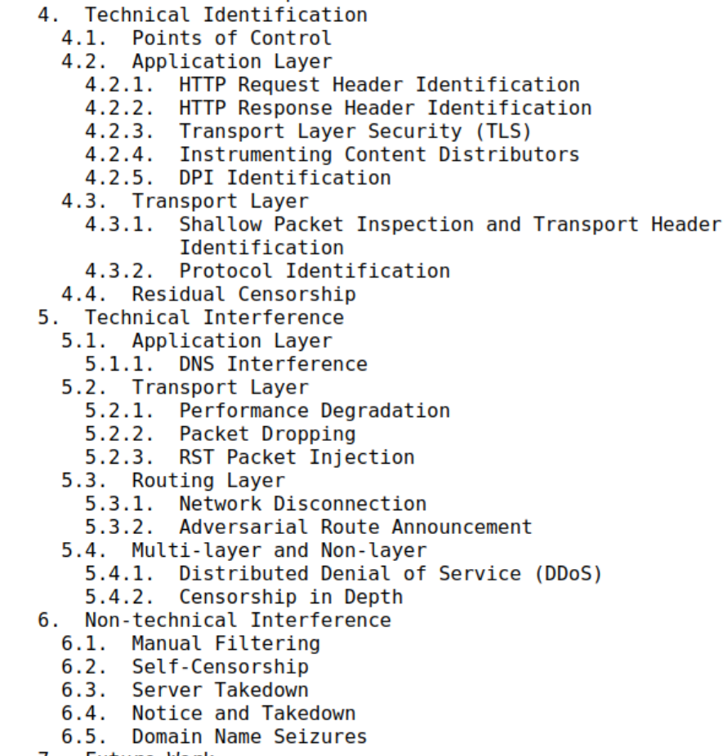
RFC9505: A Survey of Worldwide Censorship Techniques
Published in 2023 based on text accumulated since 2014, so inevitably outdated
Nonetheless, a good reference

Slide 11
Physical Layer
Regulatory: prohibit use of frequencies or operating a business
  https://www.semafor.com/article/07/18/2024/elon-musks-starlink-battles-africa-regulators
Radio jamming, e.g. against voice of America in China
  https://www.sigidwiki.com/wiki/Chinese_Firedrake_Jammer
Many (other) jammers are illegal!

Slide 12
Link Layer
Link layer (e.g. WiFi/mobile-data) connection could be dropped if censor detects misbehaviour at this or other layer(s)
  I heard anecdotal reports of that behaviour some years ago
Requires binding between higher-layer data visible to censor and link layer (which may be a random MAC address) so we need to worry about creating such bindings within networks
  Such bindings could also be used for access-control if long-lived identifiers are used (or forced to be used) at the link layer
  Proposals for exactly that have been promoted by some in industry: “Source Address Validation Improvements” (savi)
Not much else for censors here directly

Slide 13
IP layer
Lots of IP address based blocking, typically configured via address-ranges, e.g. “134.226/16” (for IPv4) or “2001:770:10::/48” (IPv6) would block all of TCD
  Overblocking is therefore common
Just throw away packets destined for an IP on the block-list
  Can be done in a normal router easily enough or using special kit
  Simple and scalable for the censor, if the to-be-censored site/content has stable IP addresses
Or, rate-limit packets to that destination so the destination isn’t “blocked” but becomes too slow to be usable
Or, use Deep Packet Inspection (DPI) to only drop/limit some packets for that destination

Slide 14
IP layer/Routing
A way to censor an entire network is to publish bad routing information about that network, using BGP
  BGP announcements include AS number and specifiy the set of related IP addresses - If you’re a BGP speaker then you can lie
  If other BGP speakers (are coerced to) believe you, or don’t notice, then they’ll mis-route packets for destinations you’ve chosen
Pakistan attempting to block youtube locally, but in fact causing a brief global outage is the classic example
  https://www.wired.com/2008/02/pakistans-accid/
Perhaps not the censor’s favourite technique as it’s pretty public and people do carefully monitor BGP announcements for accidental misconfigurations as those happen all the time, so the censor’s attempts will likely be spotted
  Doesn’t stop nation states trying though, though perhaps more to inspect mis-routed traffic rather then to censor

Slide 15
Transport Layer Reset
Censors might not just drop packets – they may instead send RST (reset) packets to try convince both sides of a transport connection to drop the connection - pretending to both sides that an error has occurred
This can be “easier” for the censor as they can just copy some possibly-matching packets off the “fast-path” and, when desired, send the few(ish) RST packets needed from off-path devices
  The “fast-path” of routers is expensive kit so better for the censor to interfere with that as little as possible

Slide 16
Transport Layer
Port-blocking – as well as IP addresses transport protocol have source and destination ports, e.g. destination port 25 is for SMTP (email), port 53 is for DNS etc. A censor can block by port number.
Many (enterprise) networks (including TCD) block outbound connections by destination port in order to try prevent use of some protocols or try force hosts/users into using “local” services such as DNS
  TCD block outbound port 53 in order to force those of us using the TCD network to use TCD’s DNS services

Slide 17
TLS for multiple web sites
Web Server
TLS session
TLS
Client
(browser)
TLS
server
Web
Site
Web
Site
Web
Sites
ClientHello->
(incl. SNI)
<-ServerHello
...

Slide 18
Transport Layer/SNI
The Transport Layer Security (TLS) protocol is used to encrypt at the tranport layer for the web, email transport security and many other protocols
The first packet in a TLS session is a ClientHello packet, inside of which is the server-name-indication (SNI) that tells the server with which service (e.g. web site) the client wishes to establish an encrypted transport connection
  SNI is needed as many services can be run on the same port, e.g. a single web server install can be used for many different web sites, and the server has to disambiguate in order to pick the right keys for the TLS session
Censors commonly examine the SNI in ClientHello messages and block if that matches a block-list
  More on this later (spoiler: Encrypted ClientHello or ECH:-)
South Korea has used this method to block things, including pornography
  https://www.technadu.com/south-korea-extend-site-blocking-snooping-sni/58125/

Slide 19
(Transport) Protocol Fingerprinting
A censor can examing the set of protocol options used to “fingerprint” specific clients or implementations and then block those
  This is easier than you might think, developers make seemingly inconsequential choices all the time and those can end up reflected in protocol options, e.g. the order of fields in a packet or the set of cryptographic algorithms supported
  Similar to the panopticon: https://coveryourtracks.eff.org/
This is a bit like DPI but typically applied against ClientHello-like messages that initiate an encrypted transport connection
This has been used against Tor:
  https://blog.torproject.org/browser-fingerprinting-introduction-and-challenges-ahead/

Slide 20
The “Great Cannon”
The GFW also actively probes, partly to inform itself on what to block, but also sometimes as an attack
In 2015 citizenlab documented DDoS attacks against greatfire.org and github originating from hosts co-located with the GFW and coined the “great cannon” phrase
  Not clear how often this is used
  https://citizenlab.ca/2015/04/chinas-great-cannon/

Slide 21
DNS Censorship
Many protocols start with a DNS request
If you want to censor clients in your location, then having DNS servers tell lies is a good option for you as a censor
  Rather than the real IP address, the censor might return the IP address for a web server only hosting a “forbidden” web page
One technique that could be used for this is DNS RPZ (response policy zone) - https://dnsrpz.info/
  That involves DNS servers getting a “feed” of names and the related lies to tell, so can scale well
DNS RPZ can be (and is) also used for good – if you get a feed for “domains less than 1 day old” then you may want to not help your email users to click on links to those domains from emails
  Huge probability super-fresh domains are being used for phishing

Slide 22
Application Layer
Human and/or machine-learning systems that (auto)delete posts
  Some level of that is seemingly required in all large-scale systems with user-generated content (UGC)
This extends to memes and images, e.g. of Winnie-the-pooh
    https://www.theguardian.com/world/2018/aug/07/china-bans-winnie-the-pooh-film-to-stop-comparisons-to-president-xi
Meta/facebook censoring Palestinian content
  This is the 1st place we mention a private sector entity being in control of censorship (as opposed to for-profit co-operation with nation states which is common)
    https://www.hrw.org/report/2023/12/21/metas-broken-promises/systemic-censorship-palestine-content-instagram-and

Slide 23
Application Layer
Child Sexual Abuse Material (CSAM) is a horrible, and criminal, problem for which better solutions are pressingly needed
CSAM is also regularly used to argue for the kind of controls that censors would really like to have
Client-side scanning proposals:
  Apple (abandoned) https://educatedguesswork.org/posts/apple-csam-intro/
  EU Chatcontrol (keeps coming back) https://www.patrick-breyer.de/en/posts/chat-control/
Issue: with even a 0.001% false positive rate, these schemes would utterly overwhelm law enforcement with bogus alerts
  There are more issues;-)

Slide 24
Application Layer
Many censorship schemes depend on surveillance as an enabler
Commercial surveillance (advertising) builds profiles of people/interests based on knowing who is involved in a particular e.g. web interaction
If you know who is attempting access then you could control what they have access to and on the basis of advertising profiles, e.g. religious affiliation

Slide 25
Application Layer
In places where censorship is “strict,” posting critical comments can get you in trouble:
  Nov 2024: Co Tyrone man detained in Dubai over online review
    https://www.rte.ie/news/ireland/2024/1113/1480697-craig-ballentine/
  Oct 2020: US man avoids jail in Thailand over bad resort review left on Tripadvisor and Google
    https://www.abc.net.au/news/2020-10-09/us-man-wesley-barnes-avoid-jail-thailand-over-bad-resort-review/12748666
Be careful what you say when (and before/after!) you travel to places with very different expectations/rules
The “before/after” aspect here is why this relates to censorship

Slide 26
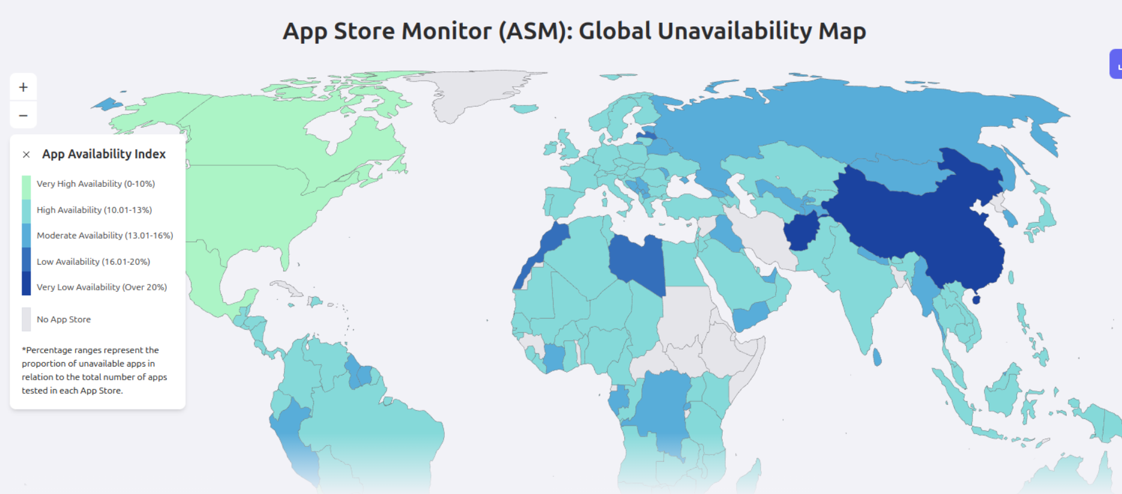
App Stores
Censors and app store curators may block or remove applications considered undesirable
Curators can be coerced or may co-operate (even if gruddingly)
Same issues could
arise with any s/w
distribution scheme
https://applecensorship.com/

Slide 27
Internet Kill Switches
Rather than censor at various layers some governments (also) like to have an Internet kill switch, at national or regional level
Usually requires forcing ASes to each implement this (with a turn-it-on-again switch!), which is somewhat non-trivial
India/Kashmir
  https://internetshutdowns.in/
Gabon on election day:
  https://netblocks.org/reports/internet-cut-in-gabon-on-election-day-Q8oxM3An

Slide 28
Coverage
Each nation seems to have a different way of distributing censorship instructions, with varying consequences
  This also changes over time
China: highly efficient (in terms of coverage) and scaleable (seemingly both bottom-up and top-down)
  “The total number of people employed to monitor opinion and censor content on the internet – a role euphemistically known as “internet public opinion analyst” – was estimated at 2 million in 2013. “ https://www.theguardian.com/news/2018/jun/29/the-great-firewall-of-china-xi-jinpings-internet-shutdown
Russia: instructions from centre sent to AS/ISPs who choose HOWTO implement, leading to spotty coverage
  Some indications this may change via hardware distributed from the centre and to be installed in each ISP
India: coverage has been both regional and per-AS/ISP, perhaps being part of the motiviation for liking kill switches

Slide 29
Censorship Business
For ever: Internet equipment vendors will sell specialised kit to censors
2025 Turkmenistan – the censors sell uncensored access
  Censors here seemingly didn’t care about collatoral damage; turns out overblocking is fine if you also sell an unblocked VPN service
  https://blog.torproject.org/Corruption-Control-Turkmenistan-internet-censorship-business/
2025 China exporting the GFW
  “Geedge Networks” exporting/replicating GFW capability in Kazakhstan, Ethiopia, Pakistan, Myanmar
  https://interseclab.org/wp-content/uploads/2025/09/The-Internet-Coup_September2025.pdf

Slide 30
Circumvention techniques

Slide 31
Caution!
In some places, having circumvention technology on your device, or attempting to use such technologies, can itself get you in trouble
  https://www.businessinsider.com/chinese-police-search-banned-foreign-apps-phones-2022-11
Presumably part of this is to encourage more self-censorship
SO – be careful and consider what you’re doing before adopting the the things discussed in this part
OTOH, it’d be bad if we all self-censor just in case

Slide 32
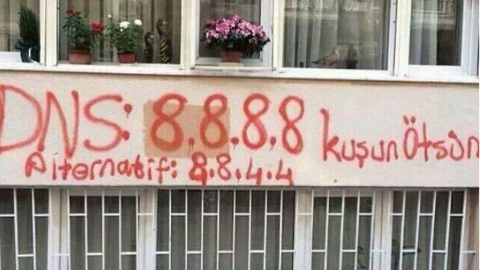
DNS
2014 incident: https://www.bortzmeyer.org/dns-routing-hijack-turkey.html

Slide 33
Choose your DNS preferences
DoT – for your (home?) upstream
DoH – for your browser(s)
There’s no point in round-robin’ing your queries, as each server will basically learn everything eventually, so choose well!
The above would basically take your ISP out of the loop for DNS but replace that with your chosen public recursive servers

Slide 34
Public Recursive Filtering
Many public recursives offer service at a few different IPs, some with various kinds of filtering, e.g for malware sites, net-nanny stuff etc. You can choose which to configure.
Is that censorship? Depends who controls which services are allowed/forced to do what.
  https://www.quad9.net/service/service-addresses-and-features/

Slide 35
Virtual Private Networks (VPN)
A VPN will “move” the source location of your traffic to a VPN egress node
That can get you “outside” a censorship regime
Or, make it a bit harder for a censor to track the actual origin of traffic (you!)
VPNs vary hugely in levels of trustworthiness
Often used for access to geo-blocked content
If you really depend on the VPN for hiding your origin, then you need to be much more sure that no traffic (e.g. DNS, NTP) is leaking so as to be visible to a censor

Slide 36
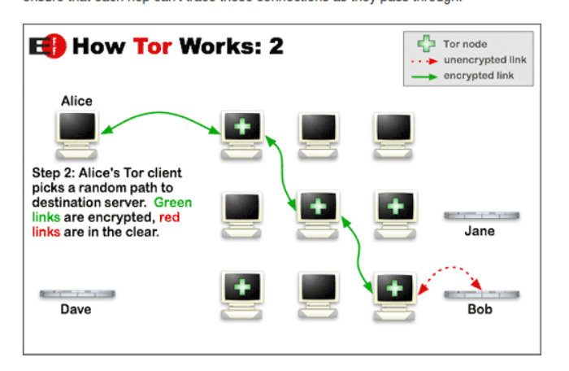
Tor
https://2019.www.torproject.org/about/overview.html.en

Slide 37
Tor Browser
Easiest way to use Tor is via the Tor browser
  A special build of firefox using Tor for it’s HTTP traffic
Brave browser supports “new private window with Tor”
  A bit more deniable!
You won’t be able to connect to the Tor network from everywhere – “bridges” exist to try help here by obfuscating the connection from you to the ingress node and using a (hopefully not well known) bridge for ingress
  This is to help people get connection to “outside” the censor
Remember: if you are the only one using Tor in your local network, then that fact is detectable
  Corollary: if we use Tor when we don’t really need to, we’re maybe helping others a teeny bit

Slide 38
Psiphon
Windows + phones VPN-like tool
Obfuscates traffic to ingress, otherwise similar ideas as Tor
Supports “pluggable transports” to enable flexibility if censor blocks some methods of connecting to ingress
  https://www.psiphon.ca

Slide 39
Browser/Stack Tricks
Both sides can ignore (some) RST messages
The TLS ClientHello message can be split into two, with the SNI value spanning the split
  Many censors no longer find the value
Similar tricks are discovered from time to time, used in circumvention tools, eventually become public and likely result in censors changing their setup

Slide 40
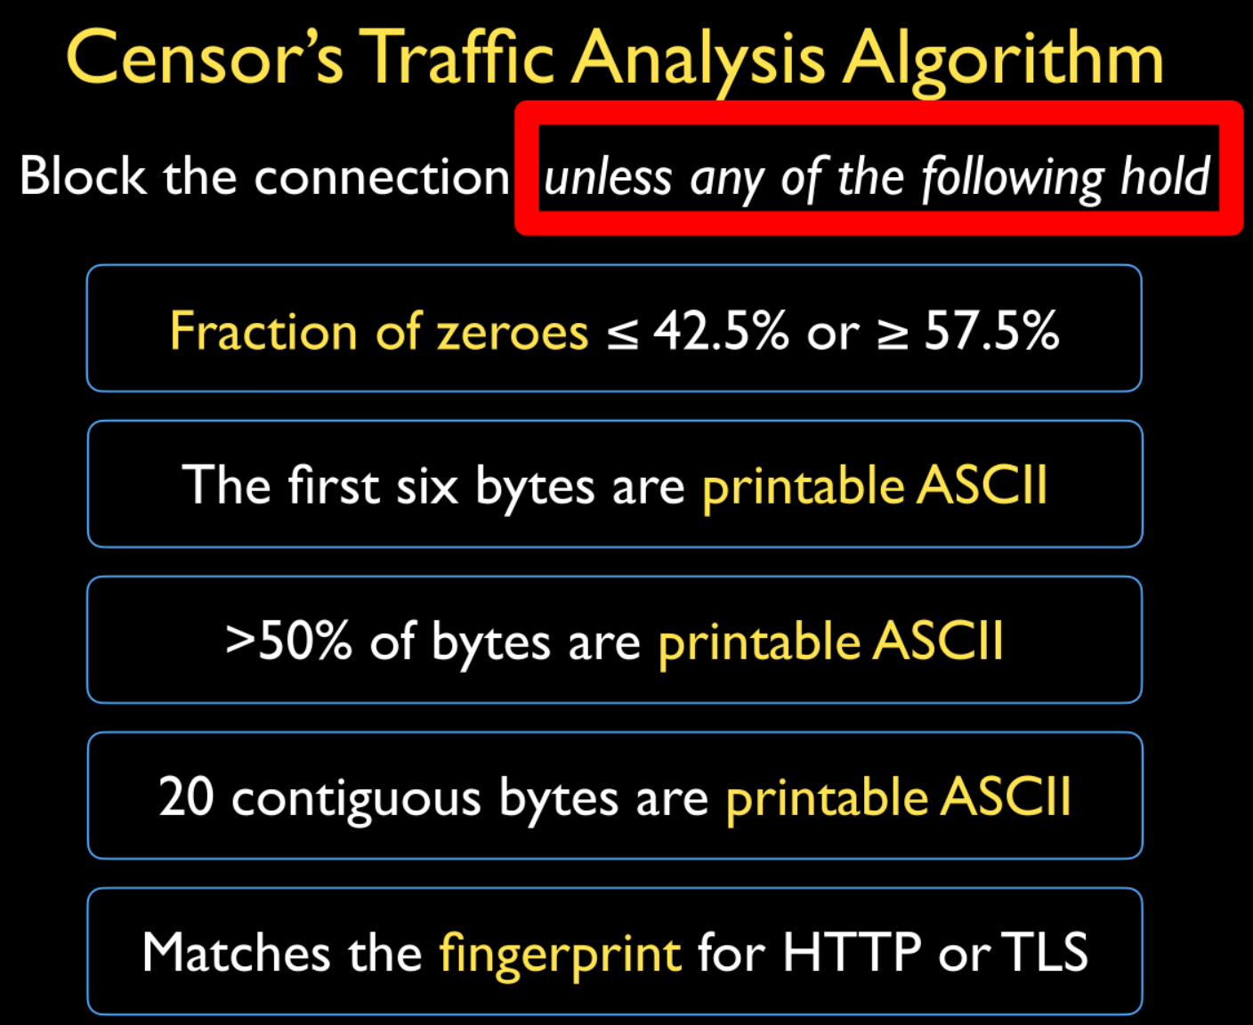
IP Layer Mitigation
A recent paper reverse-engineered GFW blocking rules
  https://gfw.report/publications/usenixsecurity23/en/
Adding non-random data (cleverly) mitigated these checks

Slide 41
Sneakernet
Passing around censored content and/or tools on a physical storage medium (e.g. USB stick) has often been a good fallback
The Cuban El Paquette was(?) perhaps the best known example
  https://laredcubana.blogspot.com/search/label/paquete
This was a weekly distribution of content, including web sites, TV shows etc
Source unclear
May have fallen victim to pandemic:
https://web.archive.org/web/20200123173814/http://paquetedecuba.com/

Slide 42
Weaponizing Censorship Infrastructure
Since a censor (like the GFW) may send RST packets towards endpoints, that can be used to mount attacks on those if the attacker spoofs source addresses
  Attack effective due to “residual censorship” – censor may ovcerblock for an extended period if it sees something it wants to block
  Attack is conceptually simple but making it effective is tricky and details differ by country (China, Iran, Kazakhstan in the paper)
“Your Censor is My Censor: Weaponizing Censorship Infrastructure for Availability Attacks”
  https://geneva.cs.umd.edu/papers/woot21-weaponizing-availability.pdf
Take away: censors can damage themselves, but it likely won’t convince them to stop

Slide 43
Measurement

Slide 44
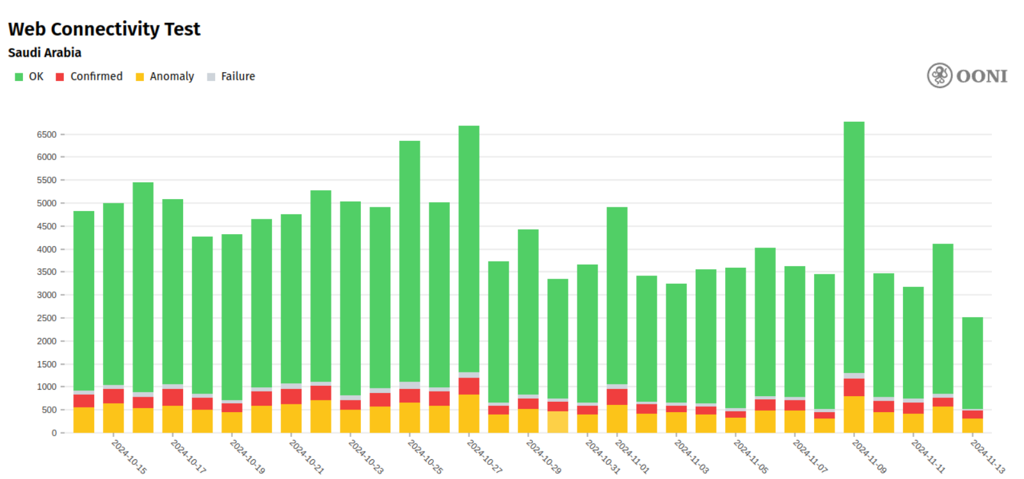
Open Observatory of Network Interference (OONI)
ooniprobe is an (open-source) installable app that tries to access a curated list of Internet resources (DNS names, web sites) and reports back
Data:
  https://explorer.ooni.org/

Slide 45
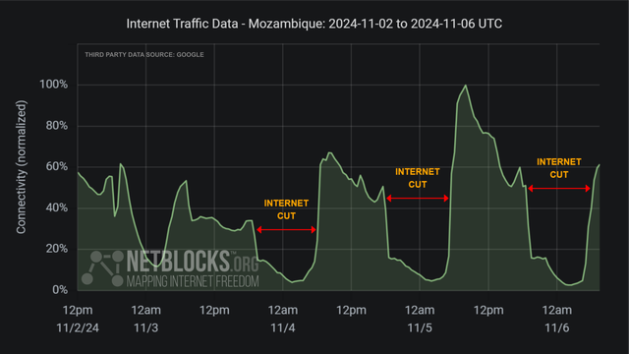
Netblocks
Monitors BGP and other visible traffic to detect network outages and generally correlates those with ongoing events
  https://netblocks.org/
Image from Nov 6 2024
shows outages in
Mozambique, seemingly
related to election results

Slide 46
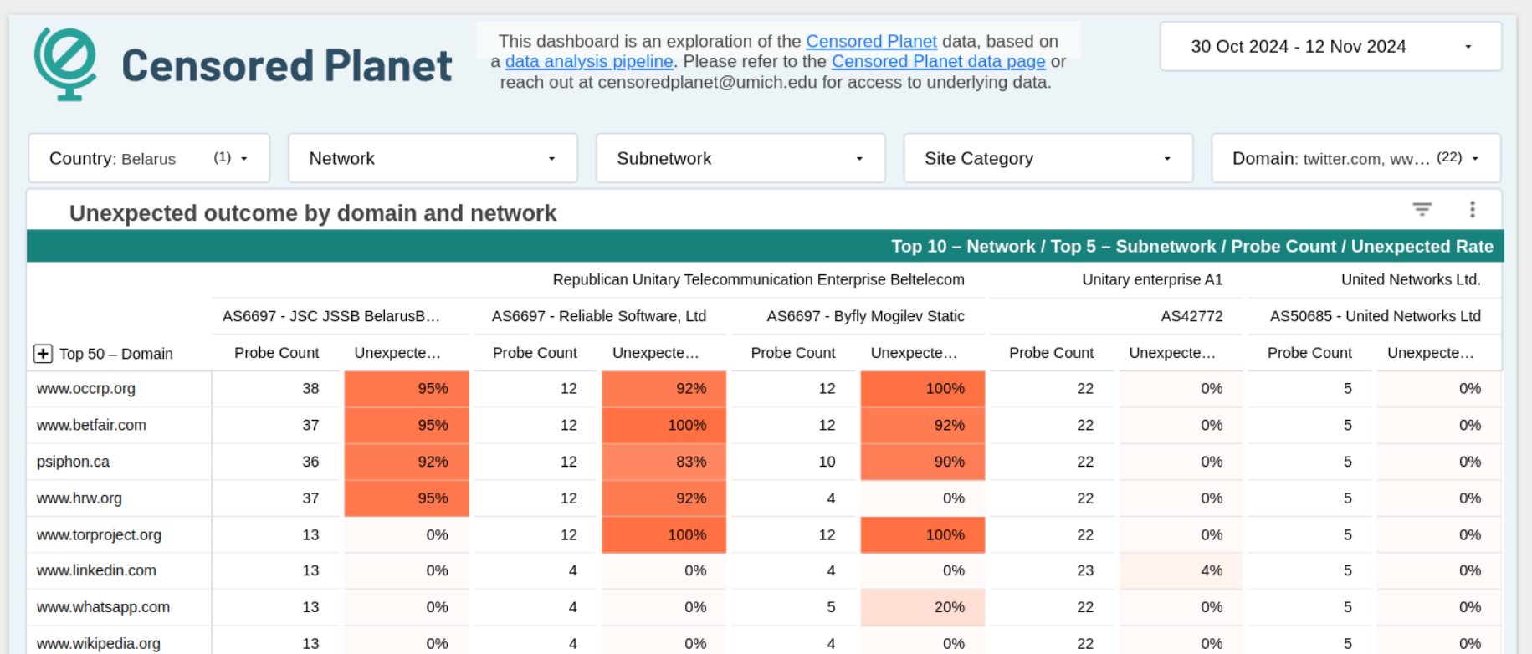
CensoredPlanet
More academic observatory, multiple sources and projects ongoing, plenty of publications
  https://data.censoredplanet.org/

Slide 47
Encrypted ClientHello (ECH)

Slide 48
Overview
As well as knowing about today’s Internet it might be useful to know a bit about what’s coming and how some things evolve
So I’ll describe some work I’ve been helping with for the last couple of years, how that might go and how it might ultimately affect you
That’s a thing called “Encrypted ClientHello” (ECH)
The goal is to improve privacy and to partly mitigate the kind of SNI censorship mentioned earlier

Slide 49
TLS for multiple web sites
Web Server
TLS session
TLS
Client
(browser)
TLS
server
Web
Site
Web
Site
Web
Sites
ClientHello->
(incl. SNI)
<-ServerHello
...

Slide 50
What we’d like, and can do now
(“co-located” variant)
Web Server
TLS session
TLS
Client
(browser)
TLS
server
Cover
Site(s)
Cover
Site(s)
ClientHello->
(incl. “Cover”
or no SNI)
<-ServerHello
...
Hiddden
Site
Hiddden
Site(s)

Slide 51
ECH Spec/Status
Solution being developed in the IETF TLS WG: https://datatracker.ietf.org/doc/html/draft-ietf-tls-esni
Current draft is version -25, in development since mid-2018, with the spec “stable” since Aug 2021. should be done and an RFC “soon”
Multiple implementations exist, including mine
  https://github.com/openssl/openssl/tree/feature/ech is the OpenSSL ECH “feature branch” – OpenSSL is a very widely used TLS/encryption library that can be used with apache, nginx, lighttpd (web server implementations) and haproxy versions I’ve modified to support ECH
  Code upstreamed to curl, haproxy, apache2
Deployed in most browsers now, and by Cloudflare for their web site customers
Next big step will be released versions of the above plus OpenSSL, nginx...
(I have some funding from OTF to help get some of this done)

Slide 52
How ECH Works
DNS
Look up A/AAAA
and HTTPS
TLS
Client
(browser)
TLS session
Cover
Site
Hiddden
Site

Slide 53
How does ECH work?
Needs ability to create/consume new DNS resource records
Needs TLS1.3 (earlier versions send server cert in clear)
DNS privacy (DoT/DoH) not strictly needed but if you don’t use that maybe there’s less point in using ECH (Browsers may couple the two)
Web site publishes a new public key/value in the DNS (“SVCB” or “HTTPS”) with some additional keys (HPKE public values) for ECH
ECH-aware client (e.g. browser) can check if DNS record exists and has ECH keys
All going well, use those ECH keys with HPKE (RFC 9180) to derive a new shared-secret and send the “real” ClientHello message encrypted in side an “outer” ClientHello message
The fact that ECH is being used is still visible

Slide 54
GREASEing ECH
The fact that ECH is being used is still visible
That may be countered via “GREASEing” - having browsers that are not using ECH sometimes send a ClientHello that looks like it does use ECH
GREASEing is an anti-ossification TLS implementation trick – clients and servers include garbage values for optional things in order to decrease the probability that middleboxes fixate on currently deployed protocol options - RFC8701

Slide 55
November 2024
Russia started blocking ECH when used with Cloudflare
They actually issued a statement saying so!
Be interesting to see how this evolves

Slide 56
Russian Statement
The Center for Monitoring and Control of Public Communications Networks (CMU SSOP) of Roskomnadzor recommends that owners of Internet resources stop using the CDN service of CloudFlare, since the extension used by default violates Russian legislation and is blocked in Russia. "The American company CloudFlare, a CDN service provider, enabled the use of the TLS ECH (Encrypted Client Hello) extension by default on its servers in October. This technology is a means of bypassing restrictions on access to information prohibited in Russia. Its use violates Russian legislation and is limited by technical means of countering threats (TSPU)," the center's website says. We recommend that owners of information resources disable the TLS ECH extension or, more correctly, use domestic CDN services that ensure reliable and secure operation of resources and protection from computer attacks," the center added.
Official confirmation: https://www.interfax.ru/russia/990568

Slide 57
Conclusion

Slide 58
Conclusion
Remember that “ancient” Irish censorship?
Brave new world:
  https://www.theguardian.com/us-news/2024/nov/13/florida-book-bans-removals-education-department-list
  That said, the article does not describe what kinds of school, nor ages, so it’s maybe too easy to consider this ridiculuous
Bottom line: we can go back, maybe as quickly as we advanced, and it’s your future, so be informed, consider what you’d like to see, and work towards that! (as much as that’s relevant to you)

