Slide 1
TEU00311
What is the Internet doing to me?
(witidtm)
Stephen Farrell
stephen.farrell@cs.tcd.ie
https://github.com/sftcd/witidtm
https://down.dsg.cs.tcd.ie/witidtm

Slide 2
Legal Stuff
IANAL (I am not a lawyer)
  And even if I were, you’d not be getting “legal advice” unless you’re paying for it!
We’ll have a real laywer (Simon McGarr) on Thursday
  Who’ll also not be giving us “legal advice” :-)

Slide 3
Thursday guest: Simon McGarr
Examples of online text describing Simon:-)
Simon McGarr is a graduate of UCD and GMIT. Prior to entering the legal profession he worked in the public sector. Simon concentrates on Civil and Commercial litigation matters. He has particular experience in the areas of IP and internet law and is regularly called on to comment in the media.
Simon McGarr is recognised as one of Ireland’s leading experts in Data Protection. A practising solicitor, Data Protection consultant and external DPO, he has lectured in the Law Society, regularly appears on national media discussing data issues and was recently invited by the Irish parliament to give evidence on the implementation of the GDPR. He has been involved in many of the landmark cases developing Data Protection law in the EU and focuses much of his work on helping organisations to understand their data protection law needs.Simon McGarr is recognized as one of Ireland’s leading experts in data protection. A practicing solicitor, he has guest lectured at Irish Universities and the Irish Law Society. His ability to convey specialized information painlessly has made him a regular contributor to media discussions of data issues.
Simon was involved in the two landmark cases developing data protection law in the European Union, Digital Rights Ireland and Schrems. His consultancy firm, Data Compliance Europe focuses on helping organizations, from multinationals to non-profits, towards GDPR compliance.

Slide 4
Legal Stuff
Again: IANAL
But I have stumbled over some legal issues that are relevant to our topic over the years:
  Copyright
  Terms and conditions
  Export controls
  Privacy regulations
And I have another assignment for you (yay!)

Slide 5
(so-called) “Intellectual Property”
My fundamental problem is a lack of belief in so-called “intellectual property”
  For me IP == Internet Protocol :-)
Authors do have a right to be acknowledged, and people should be fairly paid for their labour
  But that doesn’t require (so-called) Intellectual Property Rights (IPR)
Argument by induction:
  Before the document containing my patent filing or carefully crafted poetry was finished, I had to make the last change...
  Before that I made the 2nd last change...
  ...my document started out as an empty open-office document, which is the same as every else’s empty document
    modulo device based tracking:-)
  When did my document become imbued with some intellectual property?
There are legal answers to the above, but they all seem to reduce to “when the overall content became novel”
  Does that mean autogenerated random language is also (so-called) “intellectual property”?

Slide 6
(so-called) “Intellectual Property”
However, despite my doubts, the rest of the world treats information as if it can be owned...
  I’m an outlier and there are people I respect who disagree with me on this
There are many €€€ involved in all this, which seems (in my experience) to be correlated with people being willing to suspend disbelief
I’d encourage you to ponder what you think about this topic
  While (IMO) so-called “intellectual property” is a not real thing, I don’t do pirate video/audio
  Pick your battles wisely!
If you form an opinion and are consistent in following that, you may change your behaviour
  For example, you might be less likely to work for a company that values patents highly
    Like a patent troll – and they do exist
So, whatcha think about all that?

Slide 7
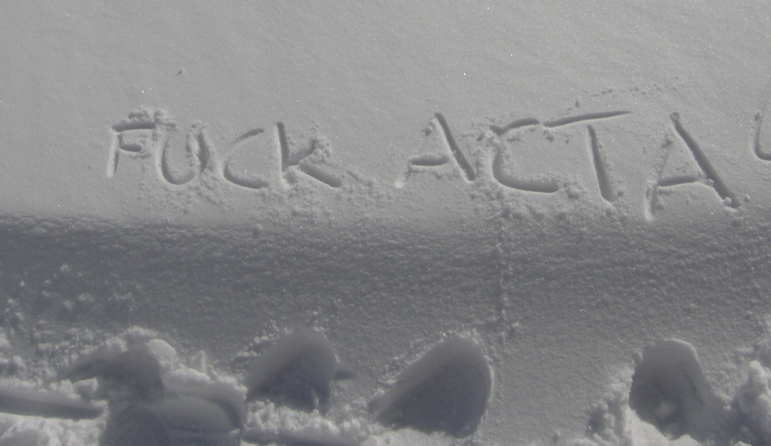
2012 – ACTA was a bad thing
Snow graffiti, photographed (by me) at about 2000m in the Alps near Grindlewald
ACTA was a proposed international treaty on “anti-counterfeiting” that overreached a lot
  https://en.wikipedia.org/wiki/Anti-Counterfeiting_Trade_Agreement - killed eventually by Eorupean parliament
Over-reach is a common side-effect of trying to protect (IMO non-existent) IPR

Slide 8
Copyright
Copyright != patents != trademarks != trade secrets
The rules vary by jurisdiction
  https://www.copyright.gov/help/faq/faq-general.html
  https://en.wikipedia.org/wiki/Copyright_law_of_the_European_Union
You can assert your copyright over almost anything you author
  I do that for code I write, according to whatever is right for the upstream project
Copyleft – Gnu Public License (GPL)
  https://www.gnu.org/licenses/gpl-3.0.en.html
  Idea is: license code and make available for free, but anyone using that has to also adhere to the GPL
  “Viral” spread – if you use GPL code in your stuff, your stuff (probably) becomes GPL

Slide 9
Distributed Rights Management
DRM refers to technologies that seek to preserve the rights of copyright owners
  https://en.m.wikipedia.org/wiki/Digital_rights_management
Fact is though, that equipment owners have the upper hand
DRM attempts to prevent the equipment owner from fully controlling access to content (e.g. movies, audio) on their own devices
Technologies: secure boot, s/w licenses, HDMI, DVD protection etc.
Often: backed up by laws, regulation, e.g. DMCA
  https://en.wikipedia.org/wiki/Digital_Millennium_Copyright_Act
Fairly long history of ineffectiveness of DRM
But... from the copyright owner’s perspective, speed bumps that convince people to pay via some service provider may be sufficient

Slide 10
Creative Commons
Extends ideas arising from GPL to other kinds of content (video, images, music, essays, whatever...)
  https://creativecommons.org/
Defines a range of licenses, not all of which are “nice,” (but most are)
Example license: CC-BY-SA is similar to GPL
  https://creativecommons.org/licenses/by-sa/2.0/

Slide 11
Terms and Conditions
I don’t feel morally compelled to pay any attention to things that are deliberately obfuscatory, such as tens of pages of terms and conditions
  But a court would likely disagree
  I’m hoping someday one will call a halt to the nonsense
A paper arguing that these agreements are beyond the reading ability of the “average American” and hence unfair for that reason
  Benoliel, Uri, and Shmuel I. Becher. "The Duty to Read the Unreadable." (2019).
  https://papers.ssrn.com/sol3/papers.cfm?abstract_id=3313837
End-user license agreements (EULA) for software and services are similar

Slide 12
Export controls
Governments do control the export of certain technologies, mostly related to military or dual-use goods or technologies – for example centrifuges for enriching Uranium
  1990’s crypto-wars – strong cryptography was treated the same as munitions, in terms of export controls
Wassenar arrangement – occasional but ongoing fears that that might impact on security research and the communicating results
  https://www.wassenaar.org/
Some goverments may try this route to control (use of) technologies like cryptography and algorithms used in artificial intelligence applications
  There are understandable reasons why people (voters) may “like” to see regulation of technologies
Is that a good plan? What’d be a good plan?

Slide 13
Thought Experiment on Regulation
I don’t like the idea of regulating development, use or export of Internet technologies
  Those are really just ideas, regulating them is as silly as patenting them
My silly thought experiment:
  What if jurisdictions regulated any entity that has a database of more than N users?
  Say where N==150M in the US, and N==2M in Ireland
What’d be a reasonable set of regulations for such entities?

Slide 14
General Data Protection Regulation
The GDPR entered into force in May 2018
It’s an EU framework that gives data subjects (people:-) rights and imposes responsibilities on data controllers and data processors (companies, basically)
GDPR imposes responsibilities any time data can be personally identifying
  It is consistent with the GPDR that IP addresses, as used in the Internet protocol, can sometimes be personally identifying, and hence data controllers may be required to handle them specially
https://en.wikipedia.org/wiki/General_Data_Protection_Regulation
https://eur-lex.europa.eu/legal-content/EN/TXT/HTML/?uri=CELEX:32016R0679&from=EN
https://ec.europa.eu/info/law/law-topic/data-protection_en

Slide 15
GDPR principles, roughly
Your consent is needed
Data must be collected for a stated reason, if new uses are developed, consent may need to be re-acquired
Consent can be withdrawn any time
Data subjects have a right to request a copy of the information held about them by a data controller

Slide 16
Assignment #4
Do a GDPR subject access request to a service provider you use, document the process followed, anonymise the results and report on those, analyse the capabililty of that service provider to influence/track you and report on your conclusions
Marks: 30%
  I would like some diversity in terms of chosen service providers – marks will be deducted in cases where >3 students choose the same service provider
  Deductions: 4 students: 20%, 5-7 students: 30%, 8+ students: 50%
Expectation: 4-5 pages, could be more
Anonymisation: we won’t publish your submissions, but write them as if we (or you) were going to publish
  The submission should still reflect the fine-grained information in the service provider’s data about you
Deadline: Nov 30th
Happy to discuss details and maybe modify – this is my 1st time setting such an assignment!
Submissions open: later today (modulo blackboard being crap;-)

