Slide 1
TEU00311
What is the Internet doing to me?
(witidtm)
Stephen Farrell
stephen.farrell@cs.tcd.ie
https://github.com/sftcd/witidtm
https://down.dsg.cs.tcd.ie/witidtm

Slide 2
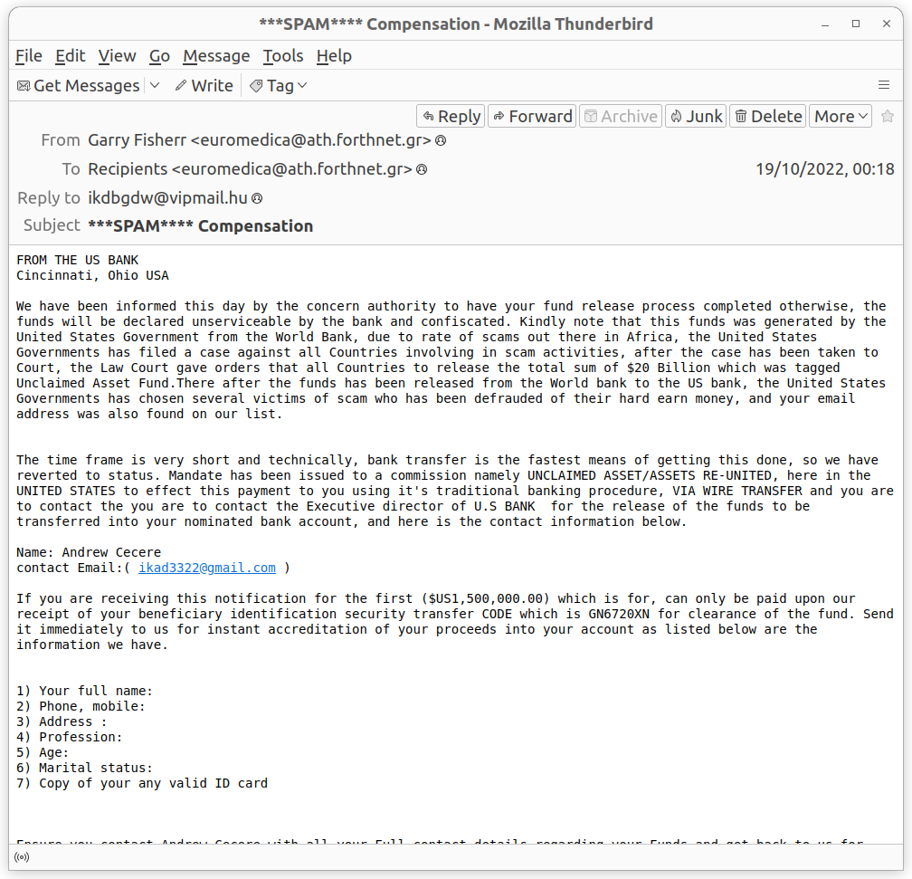
What do we think about this?

Slide 3
Overview
Email Architecture
Spam
End-to-end email security
A few lessons to learn along the way

Slide 4
Mail pre-history
There used to be non-Internet email systems
  uucp, X.400, other proprietary
Internet email “won” - largely because it could connect all the others
Fundamental basis of email is that anyone can (try) send mail to anyone, without needing permission first
  Contrast with Twitter, FB etc. walled gardens
Prime requirement: deliver the message, at all costs!
  There really is no marginal cost:-)
  That allows mail to be the basis for most other Internet/web services (e.g. so you can sign-up or do a password reset)
  That also allows spam and other nasties
Though there is no real per-message cost, running an effective mail server does have increasing costs
  Often imposed by anti-spam measures and their ecosystem effects

Slide 5
Mail Addresses
Mail address: user@example.com
  “user” is left-hand-side (LHS) of the “@”
  Right Hand Side of the “@” is the email domain and is almost always a DNS domain
RHS (plus DNS) is basically how mail gets routed to recipients – at example.com in the above
LHS is (or should be) only interpreted at the recipient’s server(s)
Internationalisation (I18N) for canonical mail addresses can be done but support isn’t so good, so we often see “decorated” forms of the email address:
  “provost@tcd.ie” <notthat@example.com>
  What you see in your mail user agent will vary
  But it’s the bit in “<>” that counts – the decoration can be forged

Slide 6
A helpful trick: LHS “+”
For some mail services you can customise the LHS, e.g. if you have to give your email to some web site
Instead of user@example.com you give them user+place@example.com
  Other characters (not just “+”) can work sometimes
Mail to user+place@example.com will still arrive in the mailbox for user@example.com
That allows you to spam-folder them later and see who else got your address from them
Can also avoid username collisions in services where email address is username and you want some form of separation, e.g. between work and personal accounts when forced to setup a web account somewhere
Suggestion: try it out – doesn’t work for tcd.ie, but does for many mail providers though

Slide 7
Use plaintext!
If you want good email hygiene send plaintext email and render received emails as plaintext
Why?
  To locally avoid tracking pixels that are in almost all commercial email
  Better interoperability
  Much smaller attack surface for you (and to an extent, your correspondents)
How?
  Instructions at: https://useplaintext.email

Slide 8
A recent battle...
TCD started adding a “not from here” banner this year
Mostly people do that by modifying the subject line
TCD chose to add the banner to the message body, but did it wrong in a way that breaks things badly
After much discussion, they stopped doing that for my account because I convinced them of the breakage
I expect they’ll forget and I’ll have to fight that battle again
They broke e2e email encryption (PGP & S/MIME) but the worst of it was how they handle “multipart/alternative” email bodies...

Slide 9
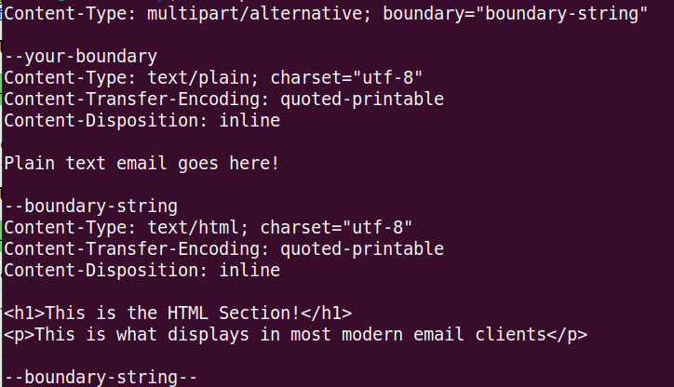
The cause...

Slide 10
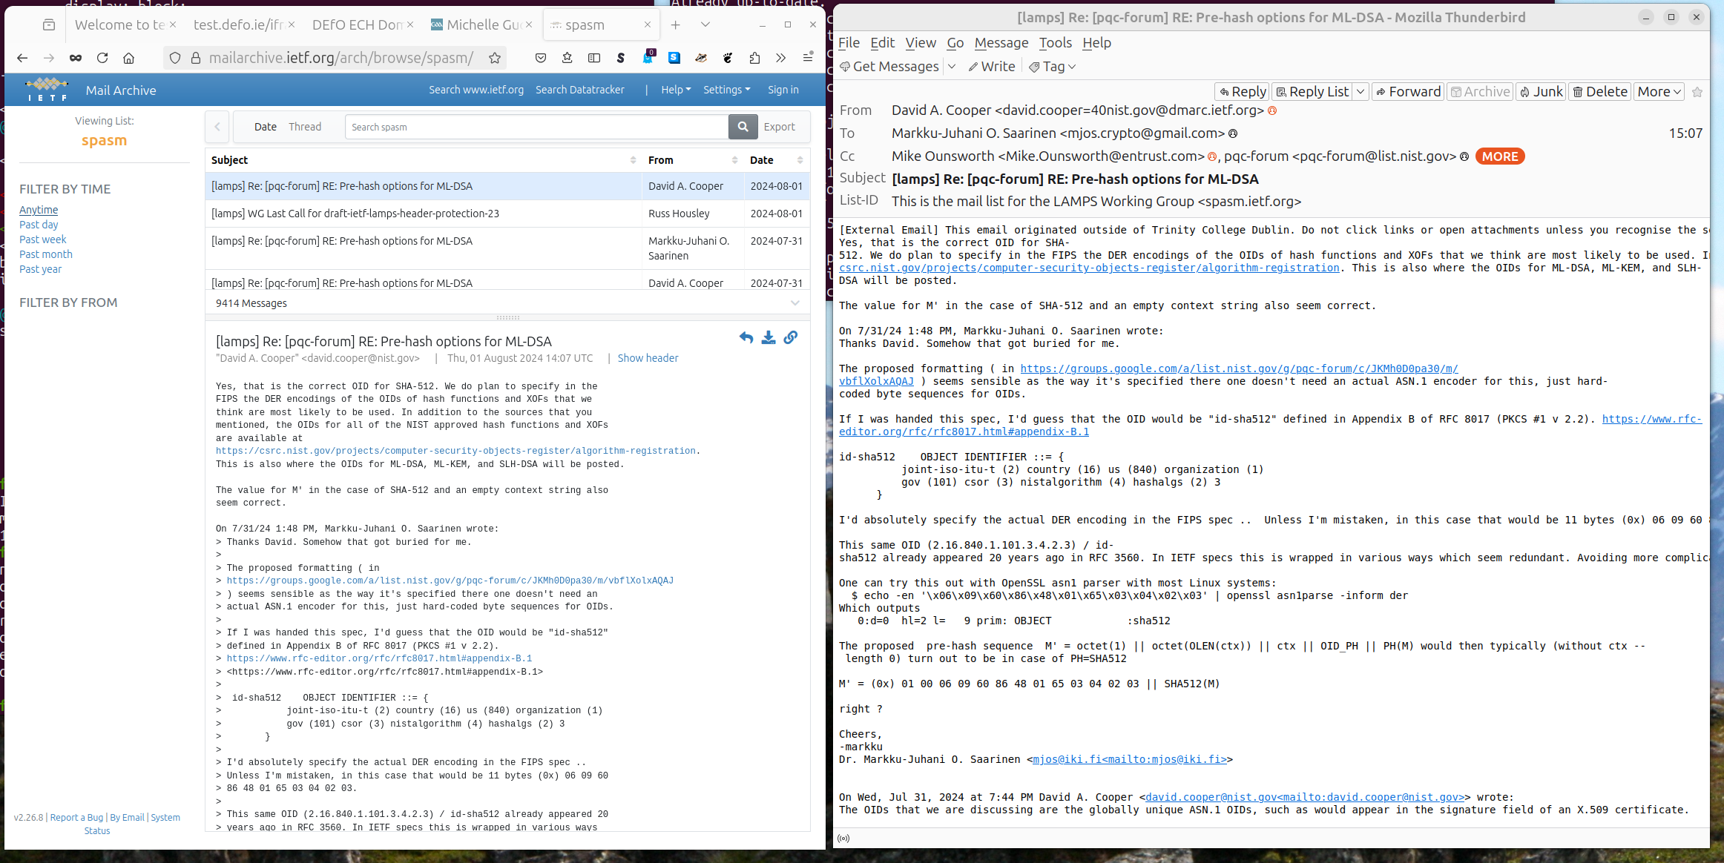

Slide 11
Email Architecture
RFC5598 - https://www.rfc-editor.org/rfc/rfc5598
MTA
MTA
MSA
MDA
MUA
MS
DNS
(MX)
DNS
Blocklist
MUA

Slide 12
Component Terminology
As a prompt for me, so I cover the basics, we’ll chat about various parts of the email ecosystem
Mail User Agent (MUA) – that’s the “client” you use, which could be outlook, thunderbird, a phone-app, or a Web User Agent, where you access your mail via a normal web browser
Mail Submission Agent (MSA) – the thing to which email is submitted by an MUA, often via the SMTP or SMTP/SUBMIT protocol
Mail Transmission Agent (MTA) – a server that receives mail routes it to the next MTA on it’s way to the recipient, and that can do other things, e.g. scan for spam/malware using the SMTP protocol, hopefully, and often, over TLS so the mail is encrypted in-transit
Mail Delivery Agent (MDA) – mail delivery agents delivery of email into a message store or generating a bounce message e.g. if no such mailbox exists
Message Store (MS) – is where your email messages live before (and after) you read ‘em and is how you can see the same messages from different MUAs (e.g. laptop/phone)

Slide 13
Protocol Terminogy
Protocols for fetching messages from MS to MUA:
  Internet Message Access Protocol (IMAP)
  Earlier similar thing: Post office Protocol (POP/POP3)
Protocol for sending messages from MUA to MTA, or between MTAs: Simple Mail Transfer Protocol (SMTP)
Today: all of those should really be run over TLS, which is true for about 99% of messages
  If not, you’re using the wrong service!
Not all email interactions are standardised (actually a significant %):
  Web MUA<->MS protocol generally proprietary stuff done via Javascript
  Outlook/MS-Exchange also does proprietary stuff

Slide 14
Mailing Lists
Mailing lists are (mostly) handled via special MUAs – you send to the list address and then a list server creates new email messages (with the same content) and sends those to a set of list subscribers
Might seem v. basic, but that is how most Internet standardisation still happens!

Slide 15
Message Terminology
Message = envelope + body
Envelope = sequence of header fields:
  E.g. From:, Date:, Subject:, Resent-From: ...
Body = set of MIME body-parts
  MIME = Multimedia Internet Media Extensions is how cat images are added to emails, which were originally just ASCII bodies

Slide 16
Message Attachments
Messages can have attachments, e.g. images, ms-word files, pdfs
Those can trigger applications, e.g. if you click to open the attachment
Some of those can be dangerous, e.g.
  ms-word files can contain macros (small programs) that might be run when you open the file – that should be turned off (I’m not sure what the default is nowadays with “cloudy” office licensing etc.)
  An attachment might be a specially crafted file that triggers a bug in a common application used to open that file format – that’s a typical way to attempt to distribute malware
  An attachment might contain an “executable” file – a program that you can run – you’ll be warned but it’s easy to go wrong on when having a bad day
When sending: try send the least dangerous format attachment, often that’d be a PDF or raw image file (JPEG, PNG)
When receiving: try setup your MUA to be more conservative and don’t just open random attachments even if they’re from people you know

Slide 17

Spam
A container of Spam rests at 4,947 meters on the slopes of a canyon leading to the Sirena Deep in the Mariana trench. Photograph: Noaa Office of Ocean Exploration
https://www.theguardian.com/environment/2017/feb/13/extraordinary-levels-of-toxic-pollution-found-in-10km-deep-mariana-trench#img-1

Slide 18
What do we think about this?

Slide 19
Advance fee fraud
“We have been informed this day by the concern authority to have your fund release process completed otherwise...”
Method:
100: I’ll send you €1M once you send me €1
200: Receive €1
300: GOTO 100
Why is the language in such emails often poor?
Don’t be disparaging of those who fall for fraud! We’ll all have a bad day some day.

Slide 20
What is spam?
Various acronyms:
  Unsolicited bulk email (UBE)
  Unsolicited commercial email (UCE)
Spam is bad:
  Would overwhelm utility of mail if not countered
  Resource consumption
    Filters, scanners etc. cost time & money
  Malware
  Phishing attempts

Slide 21
Original spam tricks
Just send email!
  Ahh…the naivety of it all!
Email to list:
  List servers got better, e.g. subscriber only with controlled subscription
Forge headers and submit to your own server
  Mostly outbound messages are sanity checked now
Send via open relay
  Used to be a lot of these, very few now

Slide 22
Originating Spam
Rent a botnet for 48 hours, send some millions of spam
  Ideally using the mail credentials of the botted device’s true owner
  Georgoulias, Dimitrios, et al. "Botnet business models, takedown attempts, and the darkweb market: A survey." ACM Computing Surveys 55.11 (2023): 1-39. APA https://backend.orbit.dtu.dk/ws/portalfiles/portal/289728739/Survey_on_Botnet_Economics_3_.pdf
Can be done via single compromised hosts but those’ll quickly be closed down
Spend a few quid, setup a supposedly “legitimate” domain, wait a month or two, then send millions of spams before you’re shut down
  Cost: maybe O(10k€) @ high-end, but might still make a profit
State of the art in originating spam will always be ahead of defenders so long as there’s money to be made

Slide 23
Sometimes hard to know…
- Is this spam?
“HILARY TERM GREETINGS FROM THE COLLEGE CHAPLAINS The College Chaplains send best wishes to all, and would like to bring the following upcoming events to your attention. They are open to any students or staff members who wish to join us. ...”
- There are “legitimate” bulk email senders – for announcements, marketing, support, newsletters,...
- Those can easily start to look like spam (esp. marketing)

Slide 24
More spam tricks…
Confusion:
  accounts@paypa1.com
  support@eboy.com
  postmaster@boi-support.com
  About to get worse thanks to I18N
  security@bigbаnk.com
  ^ Unicode 0430 is cryllic small ‘a’
Throwaway domains/addresses
Zombie hosts
Trojans
Fake ISPs

Slide 25
HTML messing
Originally mail was text based, then we added MIME, one kind of MIME body is “text/html” which turns your MUA into a dangerous web browser
Vulnerabilities created by HTML rendering in your MUA:
  Colour-related trickery
  Font size 0: break words with zero width spaces
  Presentation of nice-looking link-text not clearly-dodgy URL
Web-bugs: use of image URL that includes a value related to you allows sender to track when you open a mail if you render images

Slide 26
Solution to HTML messing
Solution: turn off images and all HTML rendering in your MUA!
While there: turn off clever fonts too if you can
Both can be tricky on phones – in that case turn it off on your laptop and wait to read possibly dodgy mails there
You do NOT have to buy into other people’s idea of what is urgent!

Slide 27
How much spam is there?
Lots
  Hard to get good figures, these are ones I’ve overheard
ISP backbones:
  70% + of email traffic
Delivered mail:
  40% + delivered
Increasing or not?
  Harder to tell if MTAs silently filter

Slide 28
Some Anti-spam techniques
Content filtering (Bayesian, etc.)
DNS Block Lists (SORBS, DNSBL)
Register of known spam operators (ROKSO)
Greylisting
Sender Policy Framework (SPF)
Domain Keys Identified Mail (DKIM)
Domain Message Authentication Reporting and Conformance (DMARC)

Slide 29
End-to-end (e2e) email security
That’s where you use cryptography to protect messages between the sender and recipient
  Rather than just between each “hop” on the path the mail follows
There are two different standards for how to do that: S/MIME and PGP
  S/MIME is mostly used inside enterprises/govt
  PGP is mostly used by nerds or smallish groups

Slide 30
Deployment
Most MUAs suport s/mime or PGP either built-in or as an option
  There are also “plug-in” products
And mostly then can work together
  I’ve used both, PGP more usable (via Thunderbird/Enigmail)
But secure mail is not ubiquitous
  Why?

Slide 31
e2e email security barriers
Designs pre-date web user agent which changes trust model (where's the private key kept? Needs new infrastructure)
Needs all major email service providers (yahoo, hotmail, gmail) to deploy the same thing which also needs to be implemented by all major user agent developers (microsoft, mozilla, apple, google)
Public key retrieval needs to be fixed (doable if the above done, but a killer if not done), likely with some new PKI (doable but who's gonna pay?)
Mail headers need to be protected as users don't get that S/MIME and PGP only protect body and not e.g. Subject, From (new enveloping protocol needed, can be done but kludgy)
We need to unify S/MIME and PGP or pick one or we'll lose interop (it's ok if the other soldiers on for some niches)
Users don't care much, so it has to be entirely transparent for them (needs significant UI work, co-ordinated across MUAs and significant web-UAs)

Slide 32
What can you do?
Target diversity – don’t all use the same service(s)
Use LHS “+” trick if it works for your service
Don’t react immediately
Take much longer to write mails than to read mails
  Always re-read before you send
Don’t render mails as HTML if your MUA allows that
  It’s ok to wait until you’re using a laptop to process mail
Don’t assume any names/links displayed to you are real
Treat all mails and and especially attachments with caution

