Slide 1
TEU00311
What is the Internet doing to me?
(witidtm)
Stephen Farrell
stephen.farrell@cs.tcd.ie
https://github.com/sftcd/witidtm
https://down.dsg.cs.tcd.ie/witidtm

Slide 2
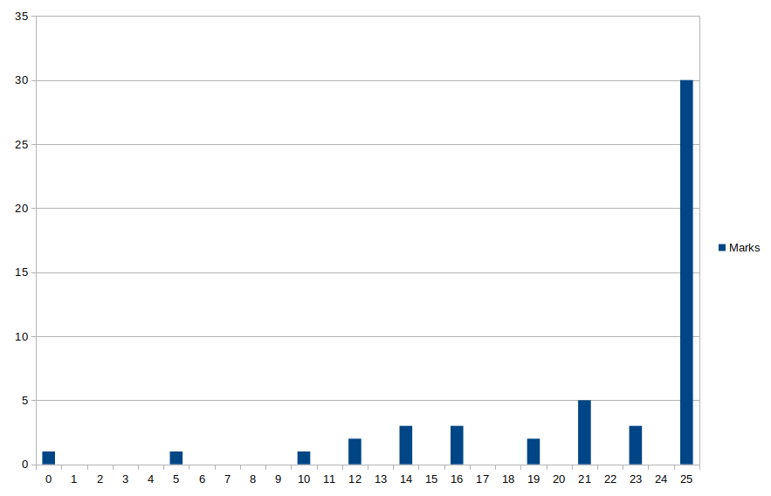
Thanks!
I’ve enjoyed chatting with you this semester
Feel free to mail me anytime (next year, whenever) if there’s relevant stuff with which I can help or you just want to ask something
Number of people
Marks from 25
Attendance marks as of 2024-11-18 (with some sessions and absences still to include)

Slide 3
Sorry!
I hope you enjoyed the module, learned stuff and aren’t too depressed about it all
I’m really sorry that the technical community of which I’ve been part has produced this crap surveillance capitalism stuff
I also hope it annoys you sufficiently that you think about how to do something more about it

Slide 4
Do Stuff!
There are alternative tools and practices you can adopt with not too much work – do that! You are not at all near helpless!
It’s entirely ok that you don’t try fix everything at once – as your interests and priorities change, figure out how you want to change your interactions with technology and the Internet
And remember: you do have rights you can exercise that aren’t much work

Slide 5
Feedback
If we’ve time…
  What’d you take from the module?
  What could’ve been better?
  What was missing?
  Was there too much of something?
There is a TCD feedback survey or something for electives, apparently you got an email about that
  I do look at those results, but find ‘em hard to interpret being from a self-selecting and typically tiny subset of this already self-selected set;-)
Or, just send me mail (before or after you get your marks are both fine:-)

