Slide 1
TEU00311
What is the Internet doing to me?
(witidtm)
Stephen Farrell
stephen.farrell@cs.tcd.ie
https://github.com/sftcd/witidtm
https://down.dsg.cs.tcd.ie/witidtm
URLs accessed 2026-09-03 (not all content updated)

Slide 2
The Internet is not the web
An important point!
The web is (roughly) the set of computers that speak the HTTP protocol
  HTTP == HyperText Transfer Protocol (http://example.com)
  HTTPS == HTTP/Transport Layer Security (https://example.com)
Email doesn’t use HTTP, but rather (mostly) the Simple Mail Transfer Protocol (SMTP) which is a couple of decades older than HTTP
Mobile network internals (3G, 4G, 5G...) mostly run over IP using a bunch of protocols you’d prefer to never have to know about
But lots of our interactions with the Internet are via the web
  Many phone “apps” are just a simple user interface using an on-device web library

Slide 3
The web has fantastic things!
Too many to list really but here’s some...
The Internet archive, includes the wayback machine
  https://archive.org/
Wikipedia (‘nuff said)
  https://en.wikipedia.org/wiki/Trojan_Room_coffee_pot
Project Gutenberg, out of copyright books, in various formats
  https://www.gutenberg.org/
  In 2021 : “Italy blocks Gutenberg book publishing website” https://ooni.org/post/2021-italy-blocks-gutenberg-book-publishing-website/
  Still seems partially blocked according to OONI
I like OpenStreetMap
  https://www.openstreetmap.org/
DuckDuckGo is a reasonable search engine (but can track your clicks)
  https://duckduckgo.com/
As is Brave’s search
  https://search.brave.com/
Arxiv.org and domain-specific friends are good
  https://arxiv.org/
Google scholar is academically useful (there are others too)
  https://scholar.google.com/
What web sites do you people like?

Slide 4
Mechanics of the Web
(Plumbing:-)

Slide 5
So you click a link...
What do you think happens?

Slide 6
So you click a link...
10 minute video that’s a bit simplified and out of date, but that might be a good thing:-
  https://gizmodo.com/what-actually-happens-when-you-click-on-a-link-1665573786
Link (URL) is part of a rendered HTML page (or typed/bookmarked) and is clicked…
Domain Name System (DNS) resolution...DNS is a recursive protocol that uses a world-wide piece of infrastructure (the DNS) that depends on a complex name registration system (next slides)
Transport Connection Established (TCP)… that’s the network connection between your browser and a web server instance
Transport Layer Security (TLS, which used be called SSL) session established… that (usually) authenticates the server and sets up encryption of traffic between browser and web server instance - Not mentioned in video but now happens >80% of the time as HTTPS URLs are used
HTTP request sent… may include site-specific parameters, e.g. amount of money to transfer to where or which bit of a map you want to see
HTTP response received… probably contains HTML with links, some of which are automatically fetched (e.g. images), so GOTO step 1 for each of those
Actual browser behaviour is much more complex (pre-fetching, caching, QUIC instead of TLS/TCP, Javascript, tab isolation...)

Slide 7
What’s a URL?
A web “link” is really a Uniform Resource Locator (URL)
Knowing what a URL looks like or should look like can save you from being phished!
URI/URL definitions are in RFC3986
  https://datatracker.ietf.org/doc/html/rfc3986
  URI = Uniform Resource Identifier is a kind of generalisation of URL
  RFC3986 has been sorta “forked” by browser makers (a fine example of a boring controversy;-)
    https://url.spec.whatwg.org/
URIs are used as web links but also for many other things, e.g. voice over IP signalling, e.g. SIP URIs can represent phone numbers
  sip:1-999-123-4567@voip-provider.example.net
  https://en.wikipedia.org/wiki/SIP_URI_scheme

Slide 8
Parts of a URI/URL
foo://example.com:8042/over/there?name=ferret#nose
\_/ \______________/\_________/ \_________/ \__/
| | | | |
scheme authority path query fragment
“Real” example:
https://down.dsg.cs.tcd.ie/witidtm/examples/stuff.html#middle
Mostly, the URL schemes you’ll see will be “https” or “http” but there are many more
The “authority” part is essentially the DNS name of the host (with an optional port number)
The “path” can be thought of as a directory/folder name in a web server’s document root
The “query” part provides a way to parameterise URLs sent to programs
The “fragment” provides a way to “land” your browser at some place in a web page

Slide 9
Referring to URLs in academic work
In academic work, e.g. a publication, or assignment, its an excellent idea to add the date on which you accessed the URL as part of the reference
Because the content that a browser gets at that URL can change anytime
Example text you might see in a paper/report:
  Bibtex provides a way to note the date on which a resource was accessed. [1]
  [1] “How to add ‘date accessed’ or ‘date retrieved’ in BibLaTeX?”,https://tex.stackexchange.com/questions/111630/how-to-add-date-accessed-or-date-retrieved-in-biblatex, accessed 2026-09-03

Slide 10
Domain Name System (DNS) 1/3
Internet Assigned Numbers Authority (IANA, https://iana.org/) keeps lists of “top level domain names” (TLDS, e.g. .com, .ie), IP address allocations and protocol numbering registrations
  That’s a fantastic bit of bookkeeping but no more than that, policies are set elsewhere despite what some “Internet Governance” folks might say
  IANA is homed in ICANN which is one of the policy setting/operations entities
  The Regional Internet Regisgtries (RIRs) are another, and the IETF controls the protocols that create the space in which the policies operate
The DNS is structured as a tree with a single root, below which we have .com, .ie, etc. and below those we have example.com, tcd.ie etc. and within tcd.ie we have whatever e.g. TCD might want e.g. down.dsg.cs.tcd.ie
There are a set of (13 logical, physically: ~1000) DNS root servers on the Internet that serve as the DNS “root zone” and who can tell you set of IP addresses where you can find more authoritative information about .com or .ie. or any of the Top Level Domains (TLDs)
  Entities that do the bookkeeping for a TLD are called registries

Slide 11
Domain Name System (DNS) 2/3
There are currently about 1500 TLDs, all recent ones being outrageously expensive, about 200 of those are country-code TLDs (ccTLDs), e.g. for “.ie” or “.de”
  https://www.iana.org/domains/root/db
DNS supports internationalised domain names (IDNs) because the world has many languages and writing systems (the Internet started out in ASCII)
  ουτοπία.δπθ.gr is a Greek IDN https://en.wikipedia.org/wiki/Internationalized_domain_name
    There’s no working web site there at the moment
  another representation for that is (in Punycode) is xn—kxae4bafwg.xn--pxaix.gr)
  You may (rarely) see IDNs listed in punycode as xn--<<stuff>>
  IDNs create lots of confusion possibilities!
DNS authoritative servers store the canonical information for some “zone” (e.g. all the names in/below tcd.ie) but can also delegate to another server as happens in the case of cs.tcd.ie
When you want a new name (e.g. jell.ie) you have to go to a registrar who works with the relevant registry (e.g. Tolerant Networks Limited is me-as-a-registrar for .ie) and then pay to rent that for a few years (IEDR, rebranded as https://weare.ie/ is the name of the Irish ccTLD registry)
  Not all names are available – could be taken or a trade mark – some lawyers love this stuff!

Slide 12
Domain Name System (DNS) 3/3
You need a server machine with an IP address for a DNS name to be useful
  You often get from a hosting company or cloudy service provider like AWS or Azure or whomever
And then that machine’s name and IP address need to be published in the DNS of the parent zone
Then you can e.g. install nginx (a web server) and make your web site and interact with e.g. LetsEncrypt.org to get a public key certificate for your DNS name so TLS to your server will work
  Then browsers can nicely visit your web site
Web crawlers and attackers of all sorts will also constantly ping your server, all the time
At that point you may decide to be an advertiser or not, if you do, you’ll probably start to record things about people who visit you and maybe you’ll sign up to some advertising platform to make money for you and them
But you might also decide not to track anyone (what I do)
  Modulo normal web logs!

Slide 13
IP Addresses
There are two versions of the Internet Protocol (IP) in use – versions 4 and 6
They are incompatible at the IP layer but mostly the same from the transport or application layer view
An IPv4 address: 134.226.36.81 (that’s the address of down.dsg.cs.tcd.ie)
An IPv6 address: 2001:770:10:20b:a47a:3ff:fed2:9d22 (forget what that is, but it’s in TCD)
There are “private” address ranges as well as public IPv4 and IPv6 addresses. Often private IPv4 addresses (e.g. 10.0.0.1 or 192.168.1.1) are used within home networks and Network Address Translation (NAT) is used to map those to shared public IP addresses
NAT is mainly to get around the fact that all 4 billion IPv4 addresses have been allocated by IANA already, modulo few corner cases and a grey-market in re-sold addresses
There are plenty of IPv6 addresses to go around – my home network gets 2⁷² of those from Eir!
IP addresses sometimes are and sometimes are not personally identifying information (PII) – has been established in some court cases

Slide 14
IP Addressing and Routing
How does a browser make that TCP connection to a web site after it gets the IP address?
Regional Internet Registries (RIRs) such as RIPE allocate Autonomous System (AS) numbers and blocks of IP addresses to network operators (e.g. ISPs, enterprises, hosting companies)
Addresses are further allocated downstream, eventually to e.g. your laptop via DHCP, or (semi-)manually to a server hosting a web site in a data centre
ASes tell one another about who has what blocks of addresses and how to route packets to one another via the Border Gateway Protocol (BGP) – remember there are tens of thousands of ASes – that’s done by announcing prefixes to peers, e.g. “134.226/16” is TCD as is “2001:770:10::/48”
Once your browser has a source IP address and knows the web site (destination) IP address then they can establish the TCP connection, assuming the relevant ISPs have done a good job with BGP, and with managing their routers, which mostly happens
  The source address is needed to get the answer from the web site

Slide 15

TCP and TLS session
Image is from https://hpbn.co/transport-layer-security-tls/ which also has lots of text describing what’s going on.
Copyright © 2013 Ilya Grigorik. Published by O'Reilly Media, Inc. Licensed under CC BY-NC-ND 4.0.
I think I’m ok with using the diagram according to https://creativecommons.org/faq/#can-i-reuse-an-excerpt-of-a-larger-work-that-is-licensed-with-the-noderivs-restriction

Slide 16
HyperText Transfer Protocol (HTTP)
HTTP/0.9 was an early version that saw a lot of deployment
HTTP/1.1 is a text-based protocol and still widely used
HTTP/2 (aka h2) is semantically the same but binary and with a few other efficiency improvements – go-faster-stripes basically, but with TLS as an almost-MUST
HTTP/3 (aka h3) standardised in 2022, is HTTP over QUIC (QUIC is a recent alternative that does what TLS over TCP does)
HTTP/TLS => HTTPS URL scheme

Slide 17

HTTP
Diagram is from a long, detailed description of HTTP at:
https://personal.ntu.edu.sg/ehchua/programming/webprogramming/HTTP_Basics.html
That used to be at: https://www.ntu.edu.sg/home/ehchua/programming/webprogramming/HTTP_Basics.html
...but the university wanted to disclaim responsibility for “personal” content, or something...there’s some legal text at https://personal.ntu.edu.sg/ ...sigh – this is an example of link rot!

Slide 18
“link rot”
That’s where some URL is included in some document (HTML or other) but later, when someone clicks that URL, they get an error
HTTP 404 – file not found most commonly
Is the existence of “link rot” a good or bad thing?

Slide 19
HyperText Markup Language (HTML)
Simplistically, the web pages that you download via HTTPS are HTML files
  There’s also lots of non-HTML content: video, Javascript, images
  Reality is nowhere near this simple… but it can be!
HTML describes the structure of the web page
Browser renders that
Key concept: hypertext links

Slide 20
HTML for a trivial web page
https://down.dsg.cs.tcd.ie/witidtm/examples/trivial.html
<!DOCTYPE html PUBLIC "-//W3C//DTD XHTML 1.0 Transitional//EN"
"http://www.w3.org/TR/xhtml1/DTD/xhtml1-transitional.dtd">
<html xmlns="http://www.w3.org/1999/xhtml">
<head>
<title>A trivial web page</title>
</head>
<!-- Background white, links blue (unvisited), navy (visited), red (active) -->
<body bgcolor="#FFFFFF" text="#000000" link="#0000FF" vlink="#000080" alink="#FF0000">
<p>The trivial content is just a link to the
<a href="https://jell.ie/news/">jell.ie news</a>
</p>
</body>
</html>

Slide 21
A link on our trivial web page
https://down.dsg.cs.tcd.ie/witidtm/examples/trivial.html
<!DOCTYPE html PUBLIC "-//W3C//DTD XHTML 1.0 Transitional//EN"
"http://www.w3.org/TR/xhtml1/DTD/xhtml1-transitional.dtd">
<html xmlns="http://www.w3.org/1999/xhtml">
<head>
<title>A trivial web page</title>
</head>
<!-- Background white, links blue (unvisited), navy (visited), red (active) -->
<body bgcolor="#FFFFFF" text="#000000" link="#0000FF" vlink="#000080" alink="#FF0000">
<p>The trivial content is just a link to the
<a href="https://jell.ie/news/">jell.ie news</a>
</p>
</body>
</html>

Slide 22
TLS Sessions per “front page”
During 2019Q1, I did some tests, loading the “front page” of these sites and recording the network traffic. The numbers below are the number of separate TLS sessions that were created when the initial page HTML is rendered, to display content and (mostly) ADs
N = count of tests done
Min,max,stdev,avg refer to
the number of TLS sessions
for each test
Automation tool used was
Selenium on Ubuntu which
mostly used FF, but also
chrome/opera for some tests
Browsers/selenium drivers
are “out of the box” with no
special config, nor plug-ins,
extensions etc.

Slide 23
Why did the Irish Times front page have an average of 120+ TLS sessions?
Why did tcd.ie have an average > 92?

Slide 24
Why did the Irish Times front page have an average of 120+ TLS sessions?
Why did tcd.ie have an average > 92?
With a desktop browser... you can
see what’s happening: “shift-ctrl-I”
(but we’re getting a bit ahead with that)

Slide 25
Scaling and Content Delivery Networks

Slide 26
Big web sites aren’t trivial
Caveat: I don’t run a big web site! So I don’t really know this stuff in full detail.
There’s a web called “high scalability” that publishes “war stories” for people who manage large systems
  https://highscalability.com/ (hasn’t been updated much recently though)
One article gives a nice perspective from a sys admin point-of-view – probably too much detail for us, but good as a description of how a “middle-sized” web site has developed in the back-end over the last decade
  https://www.betabrand.com/ - that used to say: “Best. Pants. Ever.” (sigh;-)
  https://boxunix.com/2018/12/10/from-bare-metal-to-kubernetes/
  If you do read that, I’d say the take-away is that there’s enough complexity in even a middle-sized merchant web site that many things can go wrong on their end, including some that could affect you (e.g. data leaks, which we’ll look at later)
Another article talks about how Netflix do stuff...

Slide 27
“Netflix: What Happens When You Press Play?”
We’ll look at some quotes from this Dec. 2017 article about Netflix (author: Todd Hoff)
  https://highscalability.com/blog/2017/12/11/netflix-what-happens-when-you-press-play.html
  2026 stats at https://www.businessofapps.com/data/netflix-statistics/
Some Netflix statistics (some are old, from ~2017/2018):
Netflix had 315 million subscribers in 2025 (2021: 209 million, 2022: 220 million)
  30% “ad-supported”
Netflix operate in more than 190+ countries https://help.netflix.com/en/node/14164
Netflix had $45 billion revenue in 2025 (2021: $29.6 billion, 2022: $31.6)
Netflix spent $17 billion on content in 2025
(old) Netflix played 250 million hours of video on a single day in 2017
Netflix accounted for 18.3% of streaming minutes in the US in 2024
  Still says 18.3% this year, so maybe not accurate?

Slide 28
The quotes... (1)
“Netflix collects a lot of information. Netflix knows what everyone has watched when they watched it and where they were when they watched. Netflix knows which videos members have looked at but decided not to watch. Netflix knows how many times each video has been watched…and a lot more.”
“When browsing around looking for something to watch on Netflix, have you noticed there’s always an image displayed for each video? That’s called the header image. The header image is meant to intrigue you, to draw you into selecting a video. The idea is the more compelling the header image, the more likely you are to watch a video. And the more videos you watch, the less likely you are to unsubscribe from Netflix.”

Slide 29
The quotes... (2)
“Everyone used to see the same header image. Here’s how it worked. Members were shown at a random one picture from a group of options, like the pictures in the above Stranger Things collage. Netflix counted every time the video was watched, recording which picture was displayed when the video was selected. For our Stranger Things example, let’s say when the group picture in the center was shown, Stranger Things was watched 1,000 times. For all the other pictures, it was watched only once each. Since the group picture was the best at getting members to watch, Netflix would make it the header image for Stranger Things forever. ”
“That’s why Netflix now personalizes all the images they show you. Netflix tries to select the artwork highlighting the most relevant aspect of a video to you. How do they do that? Remember, Netflix records and counts everything you do on their site. They know which kind of movies you like best, which actors you like the most, and so on. Let’s say one of your recommendations is the movie Good Will Hunting. Netflix must choose a header image to show you. The goal is to show an image that lets you know about a movie you’ll probably be interested in. Which image should Netflix show you?”

Slide 30
Content Deliery Networks
Netflix use “hundreds of thousands” of Amazon EC2 instances for their application logic – stuff that happens before video is streaming
  Anyone know what “Amazon EC2” is? If not, you wanna?
For video, Netflix built their own Content Delivery Network (CDN) – most web sites use 3rd party CDNs like Akamai, Cloudflare etc.
  CDNs represent a kind of Internet centralisation that you may not have known about?
Basic idea is to put large data files near where the customer is so data (video) gets there faster, and to be more reliable when failures happen
So where are Neflix CDN points-of-presence (PoPs)?

Slide 31
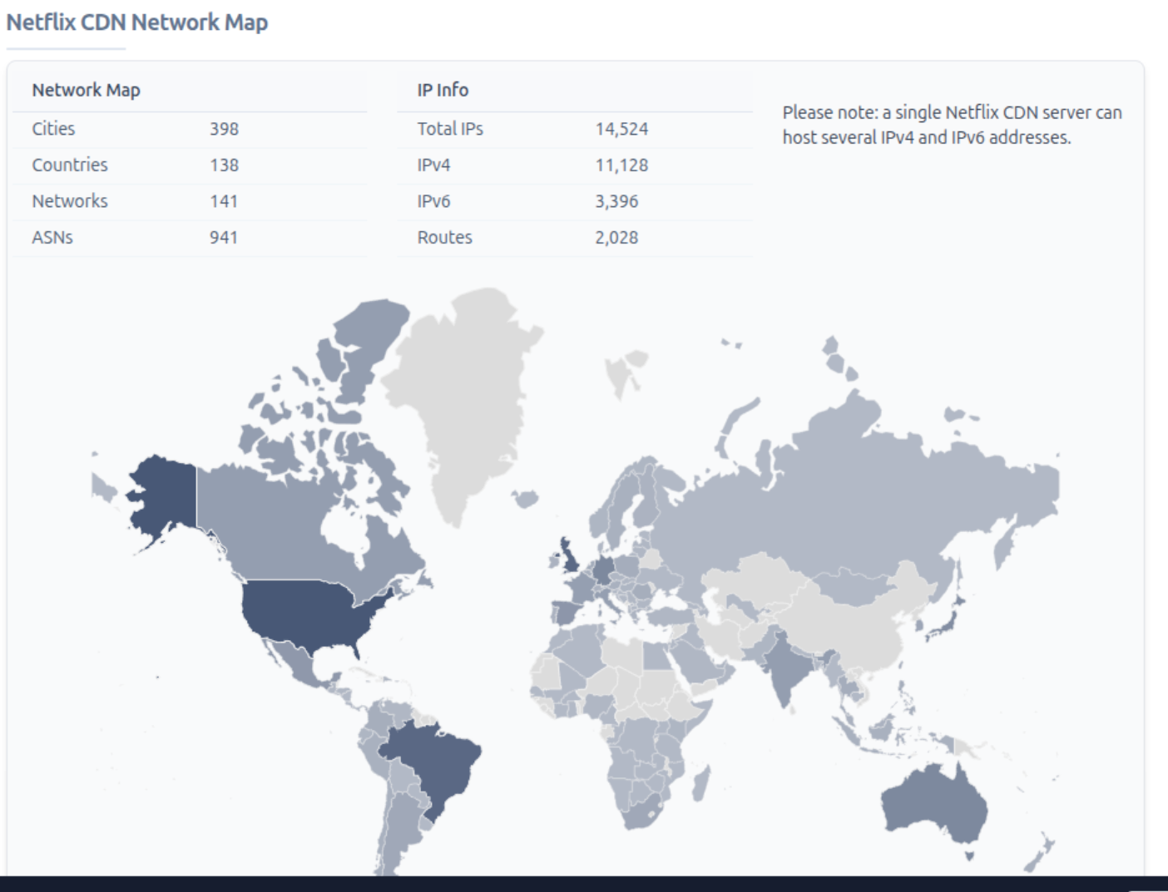
Netflix PoPs
PoPs are mostly hosted by ISPs or IXPs
Because Netflix send lots of data (37% of the 2017 internet traffic in the US) and otherwise the ISPs would have to pay interconnect charges to the ISPs between them and the content
That’s done with Neflix-designed hardware physically located in the ISP’s network – called an Open Connect Appliacnce (OCA)
A newly installed OCA takes about 2 days to “fill”
https://www.netify.ai/resources/cdn/netflix-cdn/

Slide 32



So what happens when you press Play?

Slide 33

More up to date pic
I have no idea if the differences in these diagrams are significant:-)
https://openconnect.netflix.com/Open-Connect-Overview.pdf

Slide 34
Browsers & Browser Hygiene

Slide 35
Web Browsers...
Generic software used as a web client is called a browser, e.g. safari, chrome, firefox, brave
Some platforms (android, iOS) include a “browser” that can be embedded into other apps – often those apps are just a thin shim layer on top of the embedded browser
So it’s interesting to consider how that can affect you

Slide 36
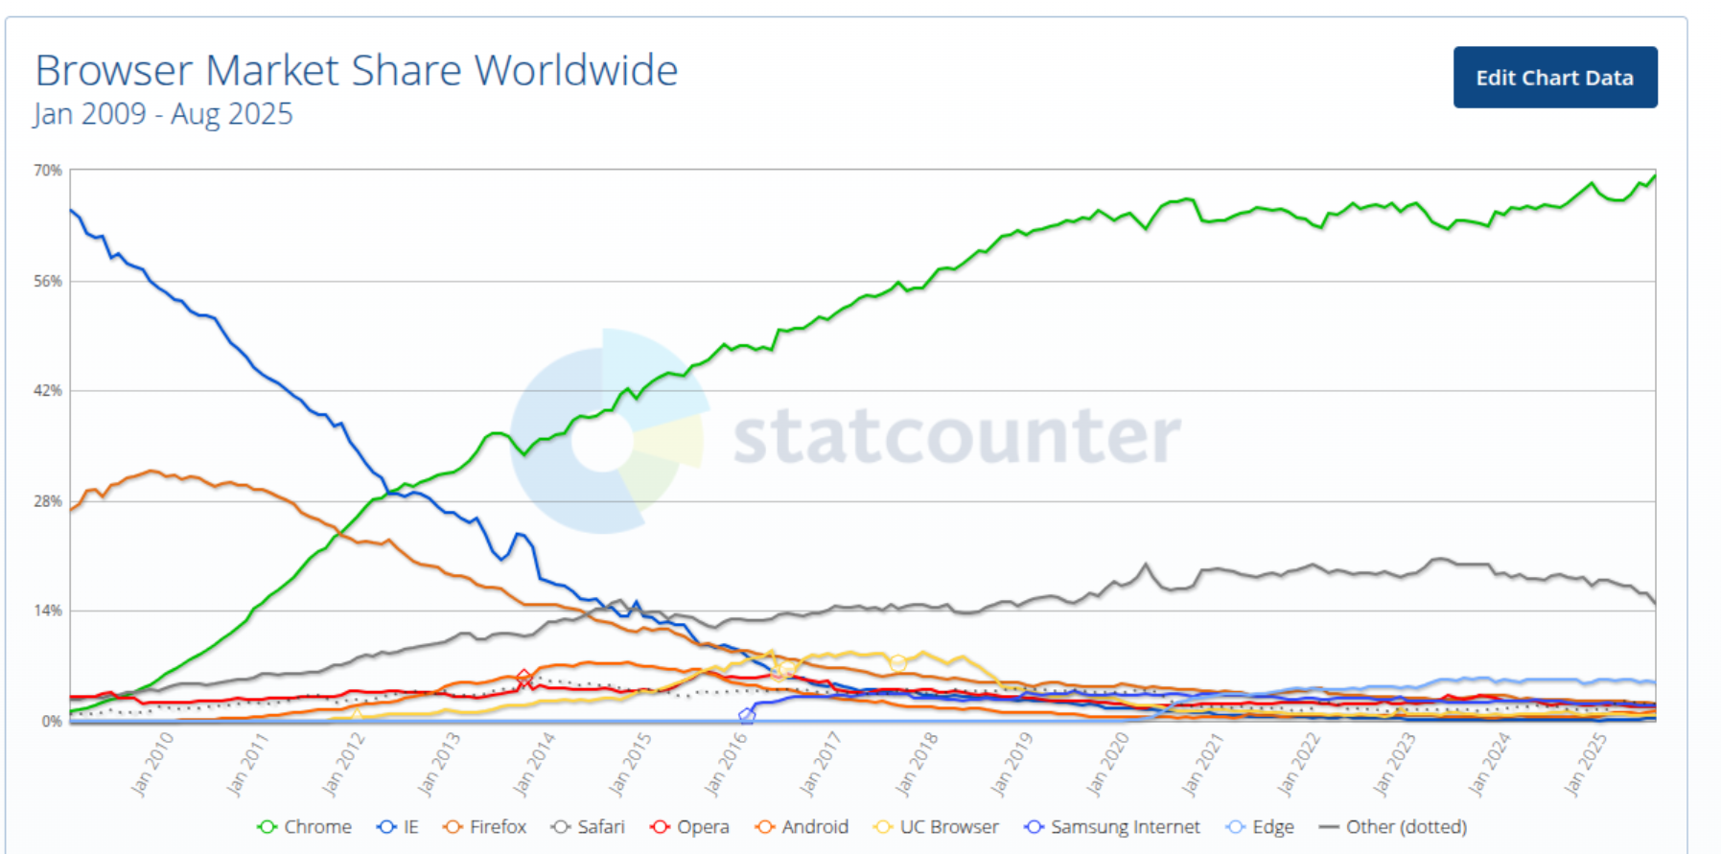
Browser worldwide market share
2009-2025
Chrome 69.39% !!
Safari
Edge
Firefox: 2.98% !!
Opera
Android
UC browser
...
Brave
Vivaldi
https://gs.statcounter.com/browser-market-share#monthly-200901-202608

Slide 37
Overall browser landscape
Browser defaults are chosen by browser implementers (Google, Mozilla, Microsoft, Apple, Handset vendors...)
  Generally they allow Javascript and cookies, do telemetry, try get you to login, keep lots of state ...
Historically, browser-makers seemed to care most about market share
  Performance and rendering were their main concerns as they lose market share if they’re slower or sites don’t render (well)
They started getting significantly better at security a while back (2013+)
Some browser-makers are starting to get a bit better at privacy, perhaps esp. Brave
IMO they don’t behave as if they think you should be the one in control

Slide 38
Why browser hygiene matters...
Developer of popular (300k installs) chrome ad blocking extension hadn’t time to keep maintaining that...
Someone offered to buy the code and promised to maintain it...
That someone added malware to the code that stole cookies and session tokens, and maybe more...
  That “someone” seems to have been a repeat offender
Result: 300k very unhappy people changing passwords all over and one very very embarassed original maintainer whose name is now mud (for some).
Happened in 2020: https://github.com/jspenguin2017/Snippets/issues/2

Slide 39
My browser setup (1)
Default browser: FF “nightly” + NoScript/Ghostery & disallowing cookies, with some white-listed sites, and search via brave search
    This is the only browser that saves logins, but not for sensitive things (we’ll consider passwords later)
    Some sites don’t work with the above; mostly: screw ‘em
Opera for managing home network, Brave for TCD stuff, Vivaldi for github
Tor Browser: If searching for anything sensitive (e.g. medical info)
If-need-be: chromium/incognito setup to delete-all on exit (at least I hope so;-)
    Use that e.g. for airline/hotel bookings
If-all-else-fails: google-chrome – for e.g. RTE player very rarely

Slide 40
My browser setup (2)
On phone: Sailfish OS (not Apple and not Android) - sailfish browser with no JS/no cookies and 2ndary open-kimono browsers if-need-be (Webcat/Web pirate)
  Or a 2nd phone phone (android, yuk!) with Brave or FF
On phone: e/OS de-googled android with Brave set for no cookies
    Backup: FF nightly, zero’ing on exit

Slide 41
My Browser Setup (3)
Sadly, due to (LLM) bot scraping, more and more web sites require JS as part of bot-mitigation
So I need to fall back to secondary browsers much more commonly than even in 2024

Slide 42
Your browser setup?
What do you do?
Recommend you figure out some browser-hygiene you consider ok and follow that
Requires some self-discipline!
Be willing to help others do the same!

