Slide 1
TEU00311
What is the Internet doing to me?
(witidtm)
Stephen Farrell
stephen.farrell@cs.tcd.ie
https://github.com/sftcd/witidtm
https://down.dsg.cs.tcd.ie/witidtm

Slide 2
Online Advertising
(what I want you to ponder...)
What’s your attitude to online advertising?
What do you know about how it works?
  What do you want to know?
What concerns do you have about online ads?
Are you ok with being the product when using “free” services?
  Always or just sometimes?
What kinds of thing would you do to avoid being the product?

Slide 3
Overview
A very quick overview of web ads:
  Walled gardens (like FB/Twitter) do it differently
  Real-Time Bidding for your eyeballs
  Cui Bono?
Assignment #2 (device & cookie tracking as it affects you)
  We can talk more about it Monday
  Part of the goal with this one is that you find stuff out yourselves
  And then decide what you think about it

Slide 4
Facebook Advertising
Fairly reasonable description: Andreou, Athanasios, et al. "Measuring the facebook advertising ecosystem." 2019.
  https://hal.archives-ouvertes.fr/hal-01959145/file/Andreou-etal_FacebookAds_NDSS2019.pdf
Points:
  Anyone can be an advertiser there (5 clicks), so it’s not the same game as on the web
  FB’s walled garden allows them to be less visible
  Targeting based on PII and interests seems creepy to me

Slide 5
A more general survey paper
Estrada-Jiménez, José, et al. "Online advertising: Analysis of privacy threats and protection approaches." Computer Communications 100 (2017): 32-51.
  https://upcommons.upc.edu/bitstream/handle/2117/99742/Online%2Badvertising%2Bprivacy%2Bthreats%2Band%2Bsolutions.pdf
Some of the slides here are based on that
  Any tables or diagrams without a reference are from there
That’s based on work in or before 2016
  So changes will have occurred since then, and will continue

Slide 6

Some Actors
User: you and your browser(s)
Publisher: gets paid for display of ad - web site (e.g. google search, CNN, rte.ie)
Ad platform: intermediaries who help advertiser target ads - Google, FB, ...
Advertiser: pay for display of ads - company selling widgets, travel, ...

Slide 7

What I imagine advertisers want...
https://www.theregister.co.uk/2019/09/23/microsofts_connected_store_dynamics_365_announcement_connects_online_and_physical_retail/
From an el Reg article about a Microsoft product to support retailers, so not quite the same, but a nice/ickky illustration.
And it’s not clear to me how that’d scale (but maybe they don’t care?).

Slide 8

Moar Actors
Real time bidding (RTB):
Publisher -> Ad platform: “I have <this> inventory (of display space)”
Ad platform -> Advertisers: “how much will you pay for <this>?”

Slide 9

Another view
Yuan, Shuai, Jun Wang, and Xiaoxue Zhao. "Real-time bidding for online advertising: measurement and analysis." Proceedings of the Seventh International Workshop on Data Mining for Online Advertising. ACM, 2013. https://arxiv.org/pdf/1306.6542.pdf

Slide 10
Brave’s view...
Brave is a browser competing with others (chrome, FF, safari...)
  AFAIK, they have negligible market share at the moment
As a company, Brave describe themselves as being privacy focused
  They are trying to promote an alternative to current advertising models
In 2018-2019, Brave (the company) have lodged compaints against real-time-bidding (RTB) in general and e.g., Google’s advertising behaviour with various European data protection agencies
  https://brave.com/wp-content/uploads/2018/09/Behavioural-advertising-and-personal-data.pdf
  https://brave.com/rtb-updates/
Bid request examples:
  https://brave.com/wp-content/uploads/2019/02/3-bid-request-examples.pdf
  Note: These are from Google API samples, not clear to me what’s deployed in the wild

Slide 11

Brave’s view of RTB...
https://brave.com/wp-content/uploads/2018/09/Behavioural-advertising-and-personal-data.pdf

Slide 12

Sample request
https://brave.com/wp-content/uploads/2019/02/3-bid-request-examples.pdf

Slide 13
RTB Waterfall vs. Header Bidding
Waterfall model is (apparently) where SSP tries 1st DSP:
  If auction won, then render Ad
  If not, move to next DSP
  Repeat until done (with possible fallbacks to non DSP Ad sources)
Header bidding model has some of the action happen in the user’s browser, but is newer and still in flux (also apparently)
One claim I’ve seen: in 2019, 14% of top 50k sites using header bidding, 70+% (presumably) using waterfall RTB

Slide 14
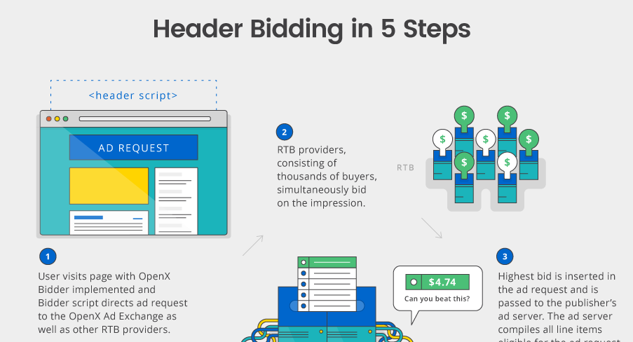
OpenX (an Ad exchange)
http://welcome.openx.com/rs/745-BUQ-779/images/Header%20Bidding%20Infographic.png

Slide 15


Header bidding
https://arxiv.org/pdf/1907.12649.pdf

Slide 16
Twitter Backend Sharing (1)
Companies engaged in advertising may say that they do or do not share/sell data but humans are very good at apparently not recognising when they breach/avoid such policies in an entirely self-serving manner
Twitter advertising example from Oct 2019
  https://help.twitter.com/en/information-and-ads
  Still there in Nov 2020
Advertising partner uploads database incl. Identifiers
Twitter match that with their user database, sometimes based on phone numbers supplied to twitter for 2-factor authentication
  Presumably: someone then sends targetted ads to twitter users

Slide 17
Twitter Backend Sharing (2)
Are twitter correct in saying “No personal data was ever shared externally with our partners or any other third parties.” ?
IMO no. Ads may have contained web bugs (1x1 pixel images) allowing “partners or other third parties” to track matching twitter users.
I’d characterise the above as twitter selling trackable access to their user database.
I would be extremely surprised if twitter were alone in acting like this. It makes money. Seemingly without harming anyone.
All of the above is extremely non-transparent.

Slide 18
Who gets to see what?
In principle: anyone who signs up to an Ad exchange gets request data
  Could well be nation state actors as well as real commercial entities
  Some researchers use these advertising platforms to do experiments too
“Cookie matching” correlates over time and multiple properties
  Kind of a collusion between Ad platform and advertisers
  https://developers.google.com/authorized-buyers/rtb/cookie-guide#examples
    Includes explanation of how they recover if user clears cookies! (Thanks, google_user_id!)
Same kind of thing happens with Google user ID and Apple advertising ID
And location, device identifiers, user agent string/application IDs...
Independent data brokers also exist (more in the US perhaps) that may be able to match non-web data items, e.g. if SSN in both data sets somehow

Slide 19
Some More Papers
Olejnik, Lukasz, and Claude Castelluccia. "To bid or not to bid? Measuring the value of privacy in RTB." (2015).
  https://www.inrialpes.fr/planete/people/lukasz/rtb2.pdf
Pachilakis, Michalis, et al. "No More Chasing Waterfalls: A Measurement Study of the Header Bidding Ad-Ecosystem." arXiv preprint arXiv:1907.12649 (2019).
  https://arxiv.org/pdf/1907.12649.pdf

Slide 20
Scale (again)
To render the Ad, the auction must be done asap
  To win the auction, a speedy response is needed
Speed of light means needing a presence near the auctioneer, e.g. within 120ms => (nearly) the same city as wherever the auctioneer’s data centre
  120ms is a Google number, and hey, they’ll also sell you cloudiness so you can meet that number;-)
Implication:
  To deal with big Ad platforms SSP’s and DSP’s need to be big
  => centralisation++

Slide 21
Who benefits?
User: Sees “relevant” Ads, fewer repeat Ads
  Cost: privacy, tracking, bandwidth, latency, creepiness
Publisher: gets revenue
    +4% for cookies? https://www.eff.org/fa/deeplinks/2019/06/research-shows-publishers-benefit-little-tracking-ads
  Cost: control -> others (AdX, SSP...), dependency , GDPR costs, technology costs
  New control issue: Web packaging (AMP etc.)
Advertiser: presumably gets more sales (or just clicks?)
  Cost: revenue share with exchanges, technology costs
Ad platform: YES YES YES
  Cost: technology costs, so far as I know, little cost due to privacy
That said, I have not (and have no interest in) chasing the money flows, I’d prefer it just didn’t!
  There is a LOT of money flowing though

Slide 22
Assignment 2
Research and report on:
  Part-1) the ways in which a real device/OS you possess or use exposes you to potential device-based tracking, as you normally use the device/OS
  Part-2) how the browser(s) you use accumulate cookies and other state and how you could reduce or avoid that
Report: ~4-5 pages, more if needed but try keep it short, use URLs/references/appendices for tech detail or screen shots
Content:
  For (1): say how that tracking could work, describe your exposure, say what you think about that and what you will or will not do about it - justify that last part, esp. If you conclude you’ll do nothing
  For (2): watch how cookies are managed in a browser
Marks: 40%,higher marks for the unexpected and for thorough research!
Deadline: Dec 2nd
Feel free to ask questions.... esp. In Monday “office-hour”

Slide 23
Assignment 2 Part-1
If you were to use location-in-EXIF for the assignment (which you can’t:-) then your assignment might look like:
  Intro para: summarise all below like a paper abstract
  Para describing the general vulnerability: device tracking as a risk to device-owner
  Para describing EXIF, GPS, how your camera uses that (or used to, if that’s the case)
  Describe potential for tracking: uploaded images giving a location history
  What’d you do about it?
    Default to location-services off, scrub images before upload (say how), check earlier uploaded images (and do what with ‘em?), get a new device/camera
    Or, if your response is “do-nothing,” then justify that, e.g. I don’t upload images but get lost a lot so need location-services:-) Or maybe argue that image locations aren’t a big deal except in unrealistic movie-plot scenarios
  References – if reference is to peer-reviewed paper, good; if reference is URL then include “accessed-at date”

Slide 24
Assignment 2 Part-2
Investigate and write-up how the set of cookies stored in your desktop browser evolves with your normal web usage

Slide 25
Watching Cookies
How might you do it? Up to you!
One option:
  Install a browser (e.g. chromium, opera) that’s new for you
  Explore it’s settings (advanced/privacy), zap all it’s cookies etc.
  Visit site(s) of interest, in various states (e.g. logged into to FB/Gmail first or not different browser privacy settings...)
  Record state of cookies at various stages and with various options
  Analyse cookie origins, names and content (some extensions/plugins may make that easier)
Another option: use dev-mode and HAR files
Caution:
  Be careful if you zap cookies in a browser you use day-to-day – you might break some login for which you’ve forgotten the password!
  If you do install some new addon/extension, check it out first, and consider keeping or deleting it later

Slide 26
Cookie Resources
Background on cookies:
  fairly simple overview
    https://www.gohacking.com/how-browser-cookies-work/
  Wikipedia: lots of (probably too much) detail
    https://en.wikipedia.org/wiki/HTTP_cookie
  Dabrowski, Adrian, et al. "Measuring Cookies and Web Privacy in a Post-GDPR World." International Conference on Passive and Active Network Measurement. Springer, Cham, 2019.
    https://www.johannaullrich.eu/assets/papers/dabrowski2019_pam.pdf

Slide 27
Assignment 2 – Both Parts
Report should state: system, browser, (incl. OS/versions) site(s), states, tools-used, process used (incl. tidy-up), results found, your interpetation of those and actions you may (or may not) take
  Basic idea: if you handed your report to someone else, they should be able to attempt to re-produce your results
  Tables are fine for the more tech bits, and info about origins/cookies, text for interpretation/conclusions – total amount of prose likely only needs be ~1 page, maybe a couple of pages of tables
  Co-operation is ok – just say with whom you’ve worked, who did what etc.
For better marks:
  Explain the mechanisms involved (e.g. perhaps differences due to logged in gmail or FB account, settings) as well as the consequences of those and cover what you might (or might not) do about what you find
  Anonymise your text – write text that could be published online without you feeling any additional loss of privacy with which you’re uncomfortable
  For super-duper marks:
    Try delve into cookie data content (a web search may help decoding, it’s not that hard sometimes)
    Consider non-cookie based tracking mechanisms between web sites and browsers

Slide 28
Assignment 2 Overall
Try make it something you’d not be embarassed to show your buddies in a year’s time
PLEASE submit a PDF
It’s ok to work together on this one, but do say with whom you’ve worked but the conclusions must be your own
Effort:
  4-5 pages is fine, as is more
Marks: 40% of module
Multiple submissions vis Blackboard are fine, last one will be marked
Due-date: Dec 2nd

Slide 29
Online Advertising
What’s your attitude to online advertising?
What do you know about how it works?
  What do you want to know?
What concerns do you have about online ads?
Are you ok with being the product when using “free” services?
  Always or just sometimes?
What kinds of thing would you do to avoid being the product?

