Slide 1
What is the Internet doing to me?
(witidtm 2022/2023 - TEU00311)
Lab Sessions
Stephen Farrell
stephen.farrell@cs.tcd.ie
https://github.com/sftcd/witidtm
https://down.dsg.cs.tcd.ie/witidtm

Slide 2
Initial Goals
Sort yourselves into groups of 2-3
Login to SCSS account on lab machine and/or get your laptop online
Fire up a “new”/“clean” browser
Explore settings, esp security/privacy related
Watch HTTP traffic (shift-ctrl-I)
Find the “worst” site you can
  NSFW disallowed!!!
  You define/justify “worst”
  Report back from group

Slide 3
Stretch goal
If we get the above done great, if not, that’s ok
Could be some people get to the stretch goal today or we look at it in future...
Stretch goal: HTTP archive (.har) file generation and a bit of analysis

Slide 4
Login/get-online
Desktop logins: no “domain”, use SCSS password, not your TCD password (if those differ), so e.g. if your TCD email is bloggsj14@tcd.ie then you enter “bloggsj14” as the username
Get online: we’ll deal with things as they arise
After you’re done: see if anyone else needs help

Slide 5
I did check that username... :-)
“Your message to bloggsj14@tcd.ie couldn't be delivered.
A custom mail flow rule created by an admin at tcdud.onmicrosoft.com has blocked your message.
5.1.1 The e-mail service at tcd.ie does not know this email address.”

Slide 6
Go do stuff!

Slide 7
Play with “new” browser
Don’t use one that has e.g. stored credentials for some account you care about – basically don’t muck up your daily-driver setup
Lab machine browsers can probably be reset easily enough (TBC)
On own laptop: maybe install one you’ve not used before
  Possibles: Firefox, edge, vivaldi, brave, opera...
  More exist, but start being careful if you go beyond the above as esp. less widely used browser downloads have been known to contain malware from time to time (but mostly on phones)

Slide 8
Browser settings
Defaults are important and not always what you would want!
Play about in settings and see what you find – ask if not sure or comment if you think you should tweak
As they differ a bit, you might want do this for all browsers you use: e.g. lab machine, laptop, phone
Things to check/set:
Telemetry
Search engine/Search suggestions
Locations/Camera/Microphone/Notification permissions
DNS over HTTPS (DoH)
Cookies
Blockers/Tracking protection
Logins/passwords
Javascript/NoScript
Site data
Clear things on exit

Slide 9
Watch web traffic
Open browser
Type shift-ctrl-I (or equivalent) to open developer interface
Re-size screens to taste
Choose “network” tab in developer pane
Try loading a few sites and watch what happens
  DO NOT load NSFW sites!
Look about on the web and decide which site is the “worst” from your POV and why
  Just yell/put up hand when you have a “worst” to nominate
  We’ll pick a winner if we’ve time – Prize == applause:-)

Slide 10
Shift-ctrl-I for macs...
Macs differ:
  Firefox: Option + Command + I
  Safari: Option + Command + C
  Chrome: Option + Command + C
Access to developer tools in Safari has to be activated in the settings first. If anyone has problems with that they can find detailed information on how to do this here: https://support.apple.com/en-ie/guide/safari/sfri20948/mac
Thanks to Luca Schäfer (2021 student) for the above

Slide 11
Stretch goal
Figure out how to save an HTTP archive file (.har)
Figure out how to view .har files
Figure out how to diff .har files
See what changes between seemingly identical browser sessions
  ...any tracking?

Slide 12
Go do stuff!

Slide 13
More goals
Find the location of an image
Consider what facial recognition means for us
Stretch goal: minimal image manipulation to defeat recognition
DO NOT use any image that has a reasonable probability of upsetting anyone

Slide 14
Images and the Internet
Why are details of images relevant to this module?

Slide 15
Why are details of images relevant to this module?
We upload lots of images
Automated image capture is near ubiquituous
  CCTV, ANPR, ...
Other people upload images of us
Organisations with image databases analyse those

Slide 16
Data vs. Metadata
Typically we talk about the “data” as being the main thing being processed or communicated or stored...
  E.g: the bits rendered for an image or video, the content of an email, the messages in a text chat or the audio packets in a voice call
So-called “metadata” is also data but is “about” the above rather than part of the above
  E.g. timing of a communication, sender/receiver IP addresses, the size of data fields, etc
Even if data is well-protected (e.g. encrypted), metadata can leak separately (or be deliberately stored/exposed) so meta-data creates risk
For someone surveilling, metadata can be more attractive than data, e.g. law enforcement may benefit more from building a social graph of criminals compared to seeing the content of a few messages, or, facebook might learn enough from whatapp metadata that they no longer need to see the content to sell advertising
  Metadata is also often more structured and hence easier to process for those who want to see what people are doing
Metadata can also be a little unexpected to end-users, e.g. author information in documents, or, in images...

Slide 17

Image Metadata: EXIF
https://photographylife.com/what-is-exif-data
https://helpdeskgeek.com/how-to/how-to-remove-exif-data-from-your-photos/
exif DSCN0010.jpg
EXIF tags in 'DSCN0010.jpg' ('Intel' byte order):
--------------------+----------------------------------------------------------
Tag |Value
--------------------+----------------------------------------------------------
Image Description |
Manufacturer |NIKON
Model |COOLPIX P6000
Orientation |Top-left
X-Resolution |300
Y-Resolution |300
Resolution Unit |Inch
Software |Nikon Transfer 1.1 W
Date and Time |2008:11:01 21:15:07
YCbCr Positioning |Centered
Compression |JPEG compression
X-Resolution |72
Y-Resolution |72
Resolution Unit |Inch
Exposure Time |1/75 sec.
F-Number |f/5.9
Exposure Program |Normal program
ISO Speed Ratings |64
Exif Version |Exif Version 2.2
Date and Time (Origi|2008:10:22 16:28:39
Date and Time (Digit|2008:10:22 16:28:39
Components Configura|Y Cb Cr -
Exposure Bias |0.00 EV
Maximum Aperture Val|2.90 EV (f/2.7)
Metering Mode |Pattern
Light Source |Unknown
Flash |Flash did not fire, compulsory flash mode
Focal Length |24.0 mm
Maker Note |3298 bytes undefined data
User Comment |
FlashPixVersion |FlashPix Version 1.0
Color Space |sRGB
Pixel X Dimension |640
Pixel Y Dimension |480
File Source |DSC
Scene Type |Directly photographed
Custom Rendered |Normal process
Exposure Mode |Auto exposure
White Balance |Auto white balance
Digital Zoom Ratio |0.00
Focal Length in 35mm|112
Scene Capture Type |Standard
Gain Control |Normal
Contrast |Normal
Saturation |Normal
Sharpness |Normal
Subject Distance Ran|Unknown
North or South Latit|N
Latitude |43, 28, 2.81400000
East or West Longitu|E
Longitude |11, 53, 6.45599999
Altitude Reference |Sea level
GPS Time (Atomic Clo|14:27:07.24
GPS Satellites |06
GPS Image Direction |
Geodetic Survey Data|WGS-84
GPS Date |2008:10:23
Interoperability Ind|R98
Interoperability Ver|0100
--------------------+----------------------------------------------------------
EXIF data contains a thumbnail (6702 bytes).
https://raw.githubusercontent.com/ianare/exif-samples/master/jpg/gps/DSCN0010.jpg

Slide 18

52100 Arezzo, Province of Arezzo, Italy
Took about 5 minutes to find this in Google street view
Most of that was finding a way to map degree, minutes, seconds to fractional Lat,Long
All automatable, could easily produce location history from a set of images
How could such a “leak” be damaging to you or to someone else in your images?
https://www.google.ie/maps/@43.4673702,11.8852196,3a,75y,23.31h,83.05t/data=!3m6!1e1!3m4!1sFBuQ4s_rnPpfgkeoZ3uQhw!2e0!7i13312!8i6656

Slide 19
Viewing EXIF Data
Local: Right-click and “properties”
Better local: install something allowing you to scan multiple images
  E.g. “sudo apt install exiftool” in Linux
On web: save image to local then GOTO above

Slide 20
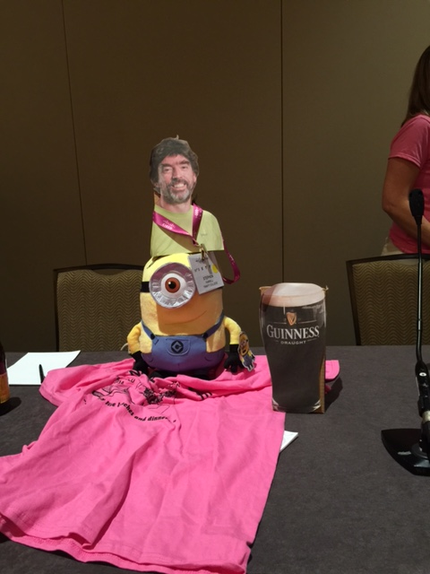
My Pictures
I scanned the 27,733 files in my Pictures directory and found 499 of those contained EXIF GPS lat/long values
  Earliest was from 2009, most recent from 2019
  Latitidue ranged from 67° N, to 3° S
  Longitude ranged from 157° W, to 67° E
    The 157° W pic: a conference in Hawaii I attended remotely;-(
On the linux command line that looked like:
$ exiftool -gpslatitude -gpslongitude -createdate -csv -r ~/Pictures

Slide 21
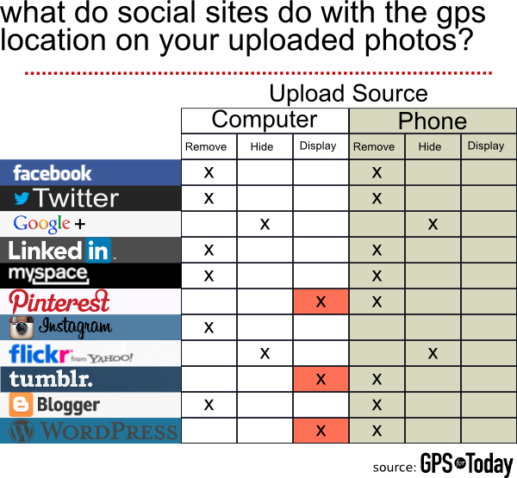
Uploads?
What happens when you upload photos to web sites?
It varies... a 2013 test showed the results on the right
That’s probably changed for the better, but be aware that YMMV, so test what you use, if interested
Worth noting that some people, esp. Photo enthuiasts, do want all the EXIF data preserved/shared
https://www.gpsfortoday.com/what-social-networks-protect-your-exif-and-gps-location-data-from-other-users/

Slide 22
Your EXIF task...
Find some image(s) online or locally
Determine if they contain EXIF location data
Find the location of that image in e.g. Google street view
As time permits: GOTO 1
What can you infer from the above?
What could you infer if you did the above for a number of images of related subjects?

Slide 23
Go do stuff!

Slide 24
Facial recognition
A kind of “biometric” (more later on the imperfections of biometrics:-)
Nice overview, including tricky issues at: https://en.wikipedia.org/wiki/Facial_recognition_system (accessed 20210927)
Basic idea: program analyses image bits, search for pattern that looks like a face (eyes, nose, mouth, ...), classifies that (based on machine learning using image collections), compare results from two images – if close enough, declare match
  False positives and negatives will happen
Note: this is not my area of expertise!

Slide 25
Facial recognition (ab)uses
Find a photo of “this person”
  Find local pics of your mum, organise your image gallery
Find people with outstanding arrest warrants in a crowd
  Recognition of faces in moving crowd is harder than individually, but likely, not that much harder
Determine ethnicity of people using public transport
  Critics may say things like the above - proponents might talk about improving efficiency but build systems that have this effect

Slide 26
Your facial recognition task
GOTO https://www.kairos.com/demos
  I’ve no opinion of that system, other than that it offers the comparison I wanted for the lab
  Hopefully it doesn’t stop working on us (e.g. because we used it too much;-)
Play with various image pairs, with/without the same person visible, to try understand how well/badly this particular face verification works
  Hint: a web search for images of a well known figure (politician, musician, ...) should produce a fairly good range of images of the same subject
If you can do such comparisons some other way, great, but do tell us about it
What do you infer about images uploaded to web sites or “the cloud”?
What do you infer about images you capture or upload?

Slide 27
Stretch goal
Find an image that matches itself when tested with your facial recogniser (easy:-)
Pick an image editor
  My suggestion: gimp, https://www.gimp.org/
  But there may be simpler options
Try find the “smallest” change (not perceptible to a human) that causes matching to fail
General topic: adversarial images
  https://davideliu.com/2020/05/27/introduction-to-adversarial-attacks-on-images/ accessed 20210927
  Same concepts apply to other machine learning settings, e.g. text, audio, ...

Slide 28
Go do stuff!

Slide 29
Yet Moar goals
Join my hotspot
  SSID: witidtm-lab
  WPA Password: bal-mtditiw
We’ll watch some traffic wireshark, and chat about a few ways to affect that
Stretch goal: repeat this at home if interested

Slide 30


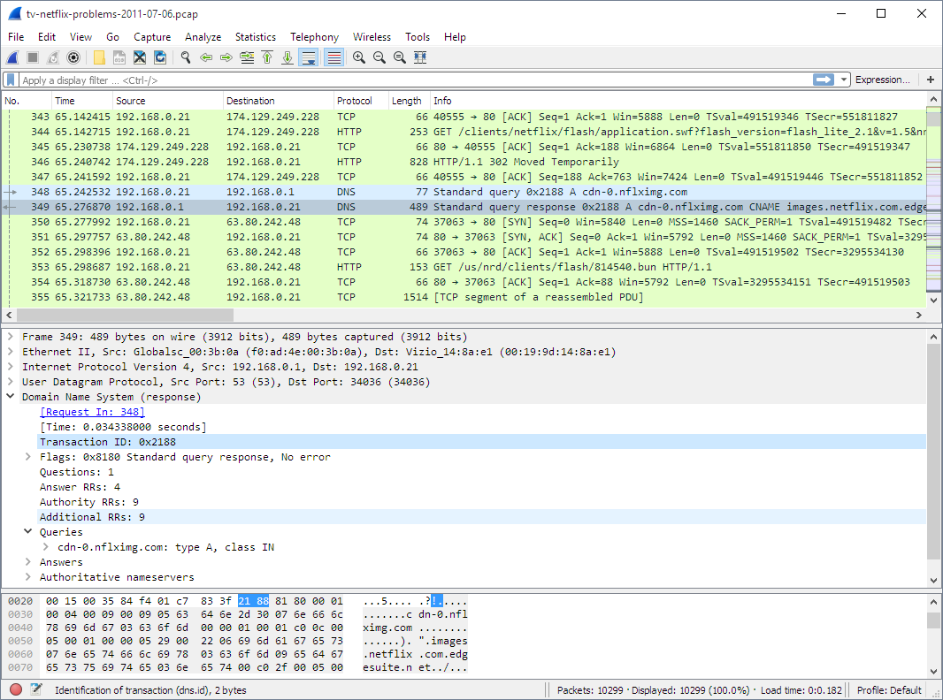
Hotspot setup
WiFi
SSID: witidtm-lab WPA Password: bal-mtditiw
Turris Home Router
Doing WiFi, DHCP, DNS,
NAT and forwarding
Conncected upstream to my laptop
TCD network
My laptop
Forwarding
Running Wireshark
Conncected upstream to college
(also via WiFi)

Slide 31
Wireshark
Fine tool to observe network traffic
  https://www.wireshark.org/
The network-side equivalent of what you saw in a browser with shift-ctrl-I
But not limited to web traffic, you see it all as it is “on the wire”
Let’s try look at some

Slide 32
MAC Addresses
Device-tracking often (ab)uses long-term hard-coded identifiers such as MAC addresses (or IMEI/IMSI in mobile n/w)
MAC address: layer 2 address (mostly) hardcoded to radio or other network chip
  Same form of address used in WiFi and most other network protocols at layer 2, e.g. Bluetooth
  Roughly how two devices on the same local area network (LAN) identify one another
Looks like “6C:9C:ED:87:27:60” (48 bits) - 1st half is manufacturer ID (Cisco), 2nd half device-ID (a WiFi router in TCD SCSS)
  You can look up the manuf ID in the registry: https://www.adminsub.net/mac-address-finder/84:C7 gives a list that includes Sony
MAC address is often fixed for the lifetime of the device; There is now a 64-bit version, not sure how widely used yet
  You can probably see these in the “about device” tab or similar

Slide 33
Randomised MACs
MAC address randomisation is a good idea and starting to be deployed
  Often, the MAC address only really needs to be stable for a session, so can be randomised
  But – if you paid for the hotel WiFi that might be based on your MAC address, or an enterprise network might use MAC addresses to decide which machines are allowed on the local network, or the machine may be a switch/router/server where changing MAC address would break stuff or be inefficient
So you can’t always randomise, and doing so well needs higher-layer controls
HOWTO turn on varies by OS and version
On an android 10 phone I have:
  Developer options/Enhanced Wi-Fi MAC randomisation
  You may need to turn on developer options first (search for HOWTO)

Slide 34
Some traffic
Display wireshark and see what’s visible

Slide 35
DNS names
Today, we can mostly see the DNS names being queried as that’s cleartext
Starting to see more use of encrypted DNS traffic
Two flavours: DoT and DoH
We’ll look quickly at that but chat more about it later
On my android crappy device:
  Settings/Connections/More Connection Settings/Private DNS
  BUT that won’t work with college as upstream as DoT uses port 853 and college block that port – it should work fine at home and with your mobile data provider

Slide 36
Brave Browser
Not a bad browser on mobiles
Has various “shields up/down” settings
  Settings/Brave Sheilds and Privacy/Use Secure DNS
  DoH – that does work in college
    There may be a set of known services from which to choose
    Or you can add a custom one:
      For cloudflare try: https://1.1.1.1/dns-query

Slide 37
Do53 vs DoT vs DoH
Do53 == old style cleartext DNS
Who do you want to/care about seeing your DNS traffic?
  Your ISP, TCD, coffee-shop and their ISP, Cloudflare, Google ?
Pros and cons to each of these

Slide 38
Stretch Goal
Repeat this at home if interested
  Can help with, but not mandatory for, my assignment
Setup hotspot using laptop
Install wireshark
Inspect traffic and learn

Slide 39
Go do stuff!

Slide 40
Router Admin
Demo OpenWRT/Foris/Luci

Slide 41
Some traffic
Display wireshark and see what’s visible

Slide 42
Fake a real web site
https://highscalability.com/ re-directs to an insecure http:// URL -- BAD PRACTICE!!!
Inside my laptop I’m running a web server
I can “easily” re-direct the traffic for the insecure URL to that but let the secure stuff go through
# start lighttpd
$ ./testlighttpd.sh
$ sudo sysctl -w net.ipv4.conf.all.route_localnet=1
$ sudo iptables -t nat -A PREROUTING -i enxa0cec80097d6 \
-p tcp -d 172.67.173.147 --dport 80 \
-j DNAT --to-destination 127.0.0.1:8099
$ sudo iptables -t nat -A PREROUTING -i enxa0cec80097d6 \
-p tcp -d 104.21.30.199 --dport 80 \
-j DNAT --to-destination 127.0.0.1:8099

Slide 43
Lab Conclusions...
What do you conclude?
  <add stuff here>

