Slide 1
TEU00311
What is the Internet doing to me?
(witidtm)
Stephen Farrell
stephen.farrell@cs.tcd.ie
https://github.com/sftcd/witidtm
https://down.dsg.cs.tcd.ie/witidtm
URLs accessed: 2026-09-03

Slide 2
Online Advertising
(what I want you to ponder...)
What’s your attitude to online advertising?
What do you know about how it works?
  What do you want to know?
What concerns do you have about online ads?
Are you ok with being the product when using “free” services?
  Always or just sometimes?
  What would you do to avoid being the product?

Slide 3
Overview
Microphones
A bit of IP and cookie background
A very quick overview of web ads
Real-Time Bidding for your eyeballs
(Your) conclusions?

Slide 4
Microphones
Is my device listening to me to enable ads related to what I’m saying?
Probably not, all companies deny doing that
Likely other tracking gives that impression though, and you’re not alone if you think so:
  https://journals.sagepub.com/doi/pdf/10.1177/20563051241288448
Otherwise, the only contrary evidence I’ve seen relates to:
  https://www.fastcompany.com/90999277/cox-cmg-active-listening-phones-targeted-advertising
  The materials that caused the reporting:https://www.documentcloud.org/documents/24224884-how-voice-data-works-and-how-you-can-use-it-in-your-business-cmg-local-solutions/?ref=404media.co
  Followed by a denial: https://www.cmg.com/news/cmg-responds-reports-about-discontinued-active-listening-product/ISJO7MQD5VDFHAN6VQGP47FS2Y/
If you choose to use audio assistants (e.g. siri) then you are more at risk and some audio snippets ave leaked when supposedly being used for training

Slide 5
Proxying to hide client IP address
One of the most basic ways advertisers can track you is to record your client IP address, which may or may not be relatively stable
There are a number of proxy-based technolgies being developed that could hide the client’s IP address from (web) servers
  masque, odoh, ohttp, ...
  These are a bit like lightweight VPNs
Apple have deployed their “private relay” service for paid subscribers
Seems like a reasonable trend, but some caution warranted (who operates proxies and for what reasons?)
  Good overview: https://blog.apnic.net/2023/03/23/hiding-behind-masques/

Slide 6
Apple also advertise
Within the Apple ecosystem, they also make money from ads:
In 2024, Apple’s U.S. ad business totaled $6.47 billion
  https://digiday.com/marketing/when-it-comes-to-ads-apple-isnt-playing-coy-anymore/

Slide 7
Cookie Resources
Fairly simple overview
  https://www.cloudflare.com/learning/privacy/what-are-cookies/
Wikipedia: lots of (probably too much) detail
  https://en.wikipedia.org/wiki/HTTP_cookie
Dabrowski, Adrian, et al. "Measuring Cookies and Web Privacy in a Post-GDPR World." International Conference on Passive and Active Network Measurement. Springer, Cham, 2019.
  https://eprints.cs.univie.ac.at/6632/1/201903%20-%20ADabrowski%20-%20Measuring%20Cookies.pdf
Gotze, Matthias, et al. "Measuring web cookies in governmental websites." Proceedings of the 14th ACM Web Science Conference 2022. 2022.
  https://dl.acm.org/doi/fullHtml/10.1145/3501247.3531545

Slide 8
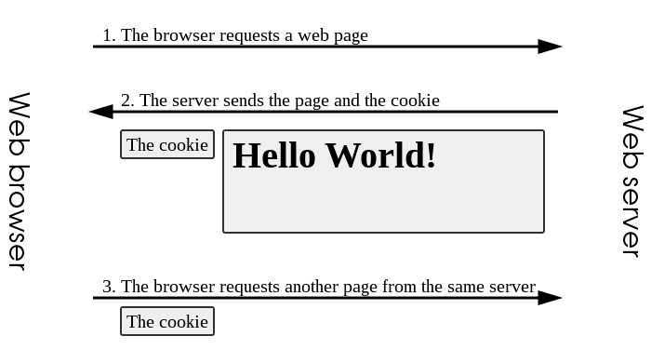
Cookies
When your browser/app contacts a web site, the HTTP response may attempt to “set-cookie”
If cookies are turned on (the default) then your browser/app will store the accompanying name/value pair in some long term storage (e.g. disk) for the amount of time requested by the web server
When your browser re-visits (another URL at) that same web site, it will send the cookie name/value pair in the HTTP request
That allows you to login and not have to keep presenting your password
That also allows horrendous tracking that’s a large part of the web advertising model
Image: https://en.wikipedia.org/wiki/HTTP_cookie

Slide 9
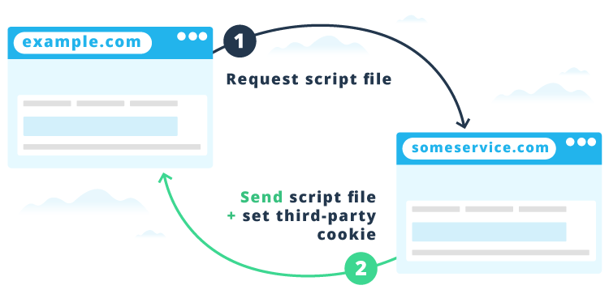
3rd Party Cookies
1st party: set by the site you’re “visiting” (what appears on the URL bar)
3rd party: set by other sites from which resources (e.g. images) are retrieved while rendering the web page
1st party can load a resource (e.g. Javascript that’ll eventually lead to an ad being rendered) that includes a URL parameter that identifies user in some way
3rd party resource can also do all this again before/while being rendered
Image: https://cookie-script.com/all-you-need-to-know-about-third-party-cookies.html

Slide 10
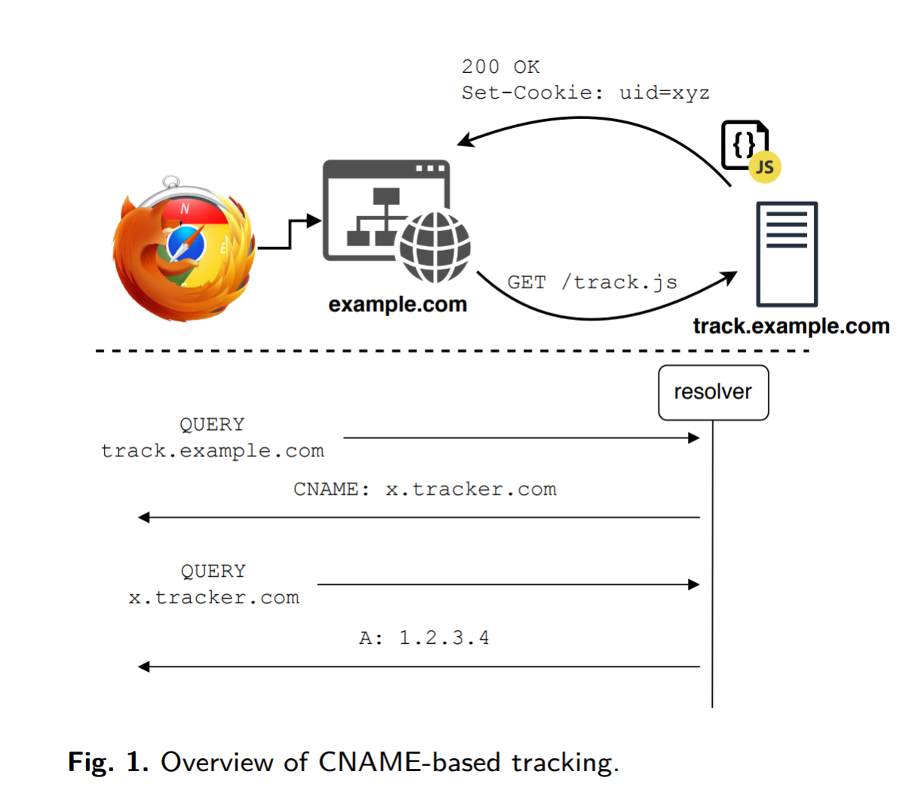
Browser Security Model and CNAME Tracking
Browser security model requires only sending cookies back to where they’ve come from (Same Origin Policy aka SOP)
Browsers are now implementing more controls over 3rd party cookies (blocking/protection)
Trackers can instead use DNS CNAMEs to achieve a similar effect
  Dimova, et al, “The CNAME of the Game: Large-scale Analysis of DNS-based Tracking Evasion” PETS 2021
    https://arxiv.org/abs/2102.09301
    Image to the right from the paper
https://www.theregister.com/2021/02/24/dns_cname_tracking/
Mitigation in brave: check for CNAME and if found treat requests as if they were being sent to x.tracker.com and not track.example.com
  https://brave.com/privacy-updates/6-cname-trickery/

Slide 11
Facebook advertising...
Chouaki, Salim, et al. "Exploring the Online Micro-targeting Practices of Small, Medium, and Large Businesses." Proceedings of the ACM on Human-Computer Interaction 6.CSCW2 (2022): 1-23.
  https://arxiv.org/pdf/2207.09286.pdf
Points:
  Good overview of FB ads in first few pages
  Lots of “micro targeting” happens, perhaps increasingly done by FB now vs. via advertiser specification
  FB pixel on other web sites for tracking: 81% of small businesses seen have done that; 69% or larger businesses

Slide 12
Two More Documents
Estrada-Jiménez, José, et al. "Online advertising: Analysis of privacy threats and protection approaches." Computer Communications 100 (2017): 32-51.
  https://upcommons.upc.edu/bitstream/handle/2117/99742/Online%2Badvertising%2Bprivacy%2Bthreats%2Band%2Bsolutions.pdf
Some of the slides here are based on that (tables or diagrams without a reference are from there)
That’s based on work done in or before 2016
UK Information Commissioner’s Office report from June 2019
  https://ico.org.uk/media2/migrated/2615156/adtech-real-time-bidding-report-201906-dl191220.pdf

Slide 13
Real-Time Bidding (RTB)
...as presented by fans
“When the page starts loading, an ad request is generated by the
header bidding wrapper and sent to ad exchange(s), ad networks, ad exchanges, and ad networks. The bid requests includes information such as page URL, location, age, gender, etc., so advertisers know whether the user is relevant.”
  https://headerbidding.co/real-time-bidding/
“Let's say Silk is a UK-based beauty brand that just launched a new brow line and is running a campaign. They set up their campaign on a Demand-Side Platform (DSP) and are targeting users who regularly shop for makeup products, are located in the Manchester area, and are between 18 to 30 years of age. The brand also wants its ads to only show on sites related to beauty and lifestyle.”
  https://blog.hubspot.com/marketing/real-time-bidding

Slide 14
Real-Time Bidding (RTB)
...as presented by detractors
“The online advertising's Real-Time Bidding (RTB)is the biggest data breach ever recorded. It tracks and shares what people view online and their real-world location with countless companies. This happens 178 Trillion times every year in U.S. & Europe.”
  https://www.iccl.ie/rtb/
“We show, first, that the GDPR requires prior consent of the internet user for RTB, as other legal bases are not appropriate. Second, we show that it is difficult—and perhaps impossible—for website publishers and RTB companies to meet the GDPR’s transparency requirements.”
  Veale et al, “Adtech and real-time bidding under European data protection law." German Law Journal 23.2 (2022): 226-256.
  https://www.cambridge.org/core/journals/german-law-journal/article/adtech-and-realtime-bidding-under-european-data-protection-law/017F027B4E78EBCAE1DCBC1E12B93B9D

Slide 15
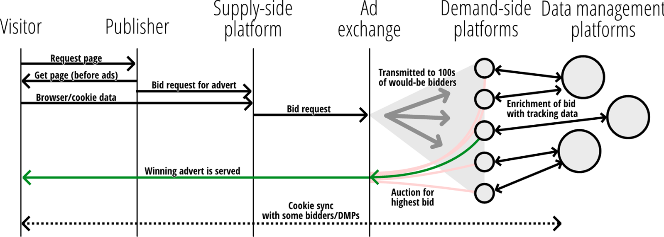
RTB Diagram (from Veale et al)

Slide 16
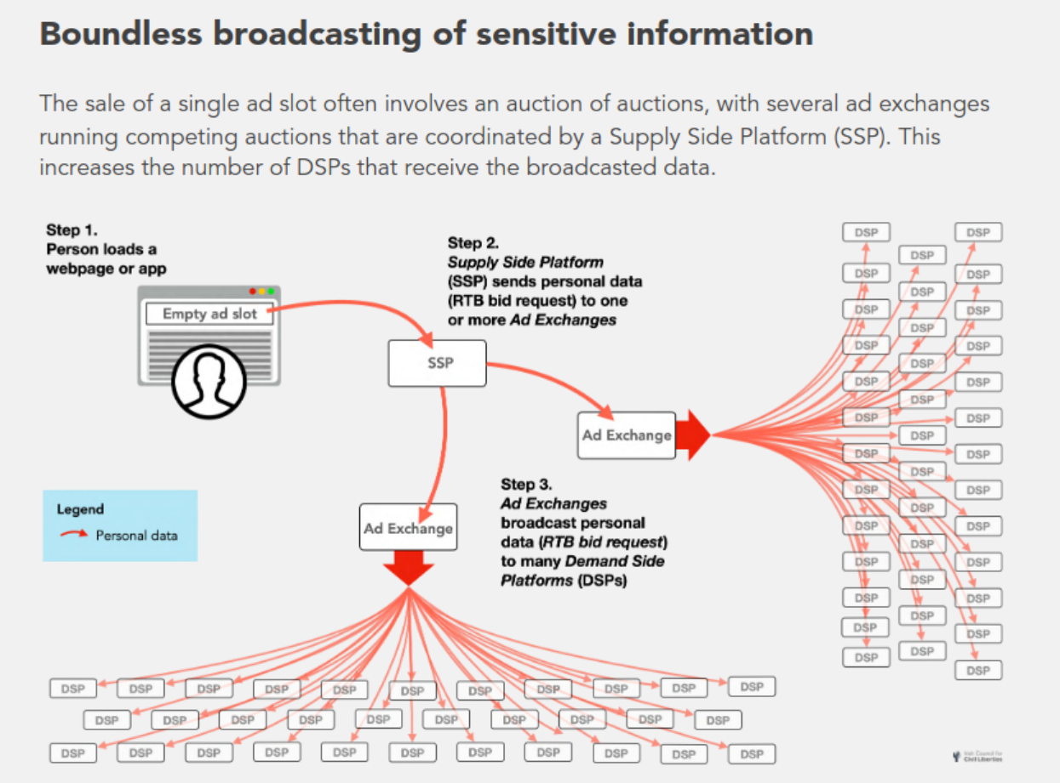
Same thing, but worse looking
https://www.iccl.ie/wp-content/uploads/2024/07/Australias-RTB-security-crisis-report.pdf

Slide 17

What I imagine advertisers want...
https://www.theregister.co.uk/2019/09/23/microsofts_connected_store_dynamics_365_announcement_connects_online_and_physical_retail/
From an el Reg article about a Microsoft product to support retailers, so not quite the same, but a nice/ickky illustration.
And it’s not clear to me how that’d scale (but maybe they don’t care?).

Slide 18
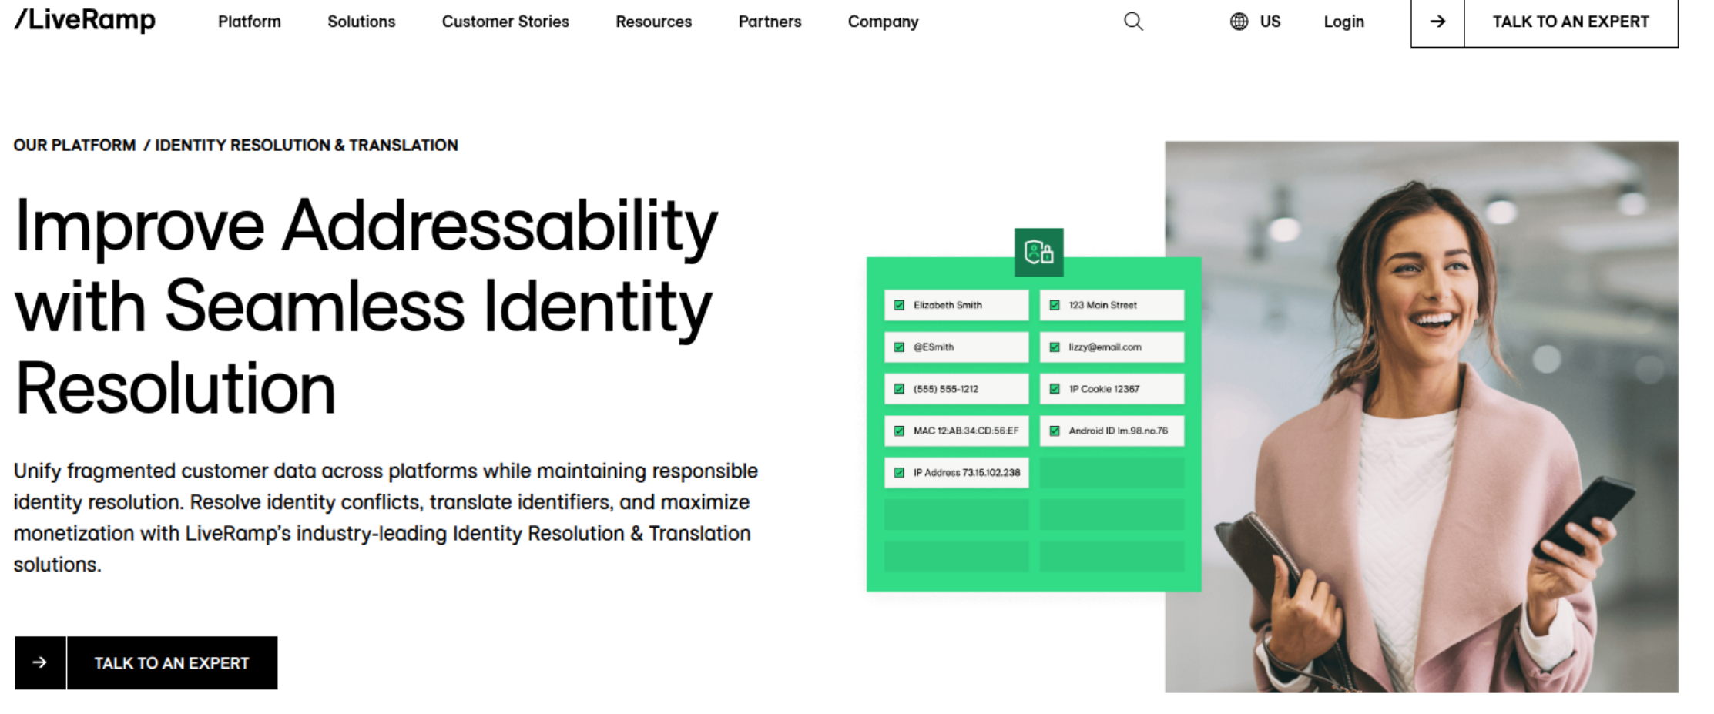
What I imagine advertisers want
https://liveramp.com/our-platform/identity-resolution-translation/

Slide 19

Some Actors
User: you and your browser(s)
Publisher: gets paid for display of ad - web site (e.g. google search, CNN, rte.ie)
Ad platform: intermediaries who help advertiser target ads - Google, FB, ...
Advertiser: pay for display of ads - company selling widgets, travel, ...

Slide 20

Moar Actors
Real time bidding (RTB):
Publisher -> Ad platform: “I have <this> inventory (of display space)”
Ad platform -> Advertisers: “how much will you pay for <this>?”

Slide 21

Another view
Yuan, Shuai, Jun Wang, and Xiaoxue Zhao. "Real-time bidding for online advertising: measurement and analysis." Proceedings of the Seventh International Workshop on Data Mining for Online Advertising. ACM, 2013. https://arxiv.org/pdf/1306.6542.pdf

Slide 22
Brave’s view...
Brave is a browser competing with others (chrome, FF, safari...)
  AFAIK, they have negligible market share at the moment
As a company, Brave describe themselves as being privacy focused
  They are trying to promote an alternative to current advertising models
In 2018-2019, Brave (the company) lodged compaints against real-time-bidding (RTB) in general and e.g., Google’s advertising behaviour with various European data protection agencies
  https://brave.com/wp-content/uploads/2018/09/Behavioural-advertising-and-personal-data.pdf
Bid request examples:
  https://brave.com/wp-content/uploads/2019/02/3-bid-request-examples.pdf
  Note: These are from Google API samples, not clear to me what’s deployed in the wild now
The relevant Brave employee (Johnny Ryan) is now with ICCL and continues work to challenge RTB
  https://www.iccl.ie/rtb/

Slide 23

Brave’s view of RTB...
https://brave.com/wp-content/uploads/2018/09/Behavioural-advertising-and-personal-data.pdf

Slide 24

Sample request
https://brave.com/wp-content/uploads/2019/02/3-bid-request-examples.pdf

Slide 25


Header Bidding (1)
Pachilakis, Michalis, et al. "No more chasing waterfalls: a measurement study of the header bidding ad-ecosystem." Proceedings of the Internet Measurement Conference. 2019. https://arxiv.org/pdf/1907.12649.pdf

Slide 26
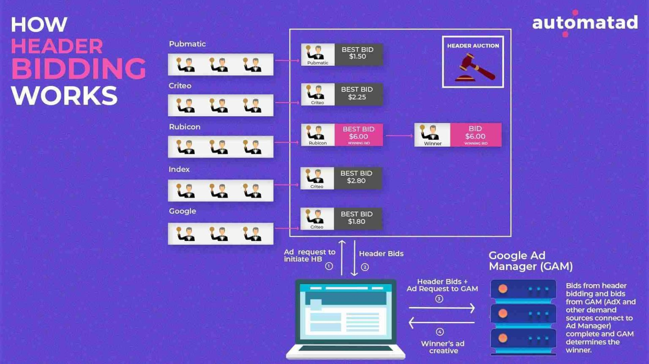
Header Bidding (2)
Implemented as Javascript on web site that interacts with bidders
Your CPU/network resources are expended for that
Structure of bids has similar privacy problems
Yet another reason to not/selectively enable Javascript?
Source: https://headerbidding.co/header-bidding/

Slide 27
RTB Waterfall vs. Header Bidding
RTB Waterfall model is (apparently) where SSP tries 1st DSP:
  If auction won, then render Ad
  If not, move to next DSP
  Repeat until done (with possible fallbacks to non DSP Ad sources)
Header bidding model has much of the action happen in the user’s browser via Javascript
Newer (mostly since 2016) than waterfall model
Header bidding may represent an adtech attempt to work around Google’s exchange
One claim: in 2022, 16% of top 100k US sites were using header bidding as were 70% of online publishers
  https://headerbidding.co/header-bidding/

Slide 28
Twitter/X Backend Sharing (1)
Companies engaged in advertising may say that they do or do not share/sell data but humans are very good at apparently not recognising when they breach/avoid such policies in an entirely self-serving manner
Twitter advertising example from Oct 2019
  https://help.twitter.com/en/information-and-ads
  Still there in Sep 2025
Advertising partner uploads database including identifiers
Twitter match that with their user database, sometimes based on phone numbers supplied to twitter for 2-factor authentication
  Presumably: someone then sends targetted ads to twitter users

Slide 29
X/Twitter Backend Sharing (2)
Are twitter correct in saying “No personal data was ever shared externally with our partners or any other third parties.” ?
IMO no. Ads may have contained web bugs (1x1 pixel images) allowing “partners or other third parties” to track matching twitter users.
I’d characterise the above as twitter selling trackable access to their user database.
I would be extremely surprised if twitter were alone in acting like this. It makes money. Seemingly without harming anyone.
All of the above is extremely non-transparent.

Slide 30
Who gets to see what?
In principle: anyone who signs up to an Ad exchange gets request data
  Could be nation state actors as well as real commercial entities
“Cookie matching” correlates over time and multiple properties
  Kind of a collusion between Ad platform and advertisers
  https://developers.google.com/authorized-buyers/rtb/cookie-guide#examples
    Includes explanation of how they recover if user clears cookies! (Thanks, google_user_id!)
Same kind of thing happens with Google user ID and Apple advertising ID
While most of the above refers to web browsers as the client, all the same things happen with mobile apps (e.g. via Google firebase) and with far less control for the user
And location, device identifiers, user agent string/application IDs...
Independent data brokers also exist (more in the US perhaps) that may be able to match non-web data items, e.g. if SSN in both data sets somehow

Slide 31
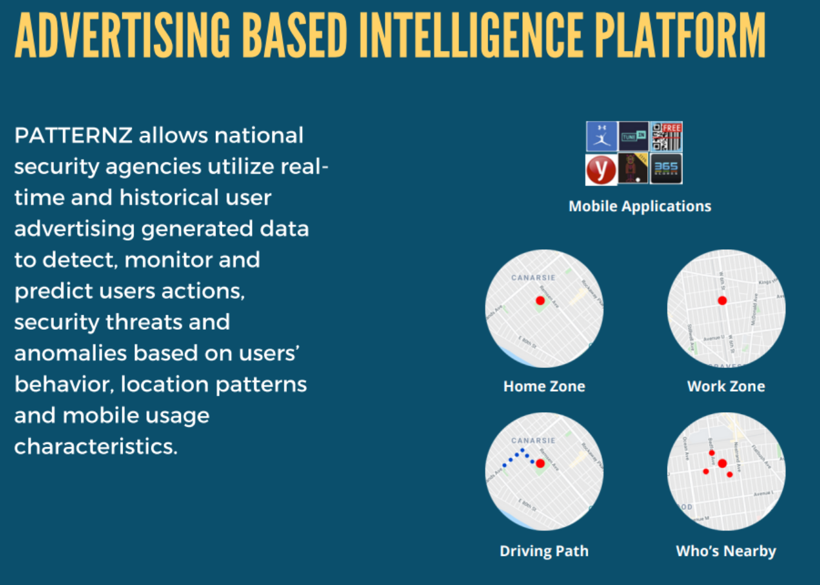
ICCL’s RTB/security Report
Outlines how RTB data can be abused by “security” entities
Not 100% clear what’s really deployed, but pretty horrible IMO
https://www.iccl.ie/wp-content/uploads/2024/07/Australias-RTB-security-crisis-report.pdf
https://web.archive.org/web/20231003181009/https://sovsys.co/wp-content/uploads/2020/04/PATTERNZ-NATIONAL-SECURITY-PATTERN-DETECTION.pdf

Slide 32
Scale (again)
To render the Ad, the auction must be speedy
Speed of light means needing a presence near the auctioneer, e.g. within 120ms => (nearly) the same city as wherever the auctioneer’s data centre
  120ms is a Google number, and hey, they’ll also sell you cloudiness so you can meet that number;-)
Implication: To deal with big Ad platforms, SSP’s and DSP’s need to be big
=> centralisation++

Slide 33
Google “Privacy Sandbox”
Chrome repeatedly announced an intent to phase out 3rd party cookies (in ~Q3 2024), this wastheir replacement, presumably aimed at maintaining their advertising revenue, while trying to appear more privacy friendly. That also didn’t work, so they scapped it.
  http://privacysandbox.com/timeline
Most of this was controversial and confusing (the change the names of things quite a bit)
Topics API – browser infers “topics” based on ~weekly analysis of browsing
  https://developer.chrome.com/docs/privacy-sandbox/topics/
Protected Audience API – on-device ad auctions
  https://developer.chrome.com/docs/privacy-sandbox/protected-audience/
BUT: July 2024: “Google now says it will not deprecate third-party cookies after all”
  https://martech.org/googles-privacy-sandbox-what-you-need-to-know/
And in April 2025: Next steps == do nothing
  https://privacysandbox.com/news/privacy-sandbox-next-steps/

Slide 34
Ads: Who benefits?
User: Sees “relevant” Ads, fewer repeat Ads
  Cost: privacy, tracking, bandwidth, latency, creepiness
Publisher: gets revenue
  +4% for cookies? https://www.eff.org/fa/deeplinks/2019/06/research-shows-publishers-benefit-little-tracking-ads
  Cost: control -> others (AdX, SSP...), dependency , GDPR costs, technology costs
  New control issue: Web packaging (AMP etc.)
Advertiser: presumably gets more sales (or just clicks?)
  Cost: revenue share with exchanges, technology costs
Ad platform: YES YES YES
  Cost: technology costs, so far as I know, little cost due to privacy
That said, I have not researched (and have no interest in researching) the money flows, I’d prefer it just didn’t!
  There is a LOT of money flowing though

Slide 35
Online Advertising
What’s your attitude to online advertising?
What do you know about how it works?
  What do you want to know?
What concerns do you have about online ads?
Are you ok with being the product when using “free” services?
  Always or just sometimes?
  What would you do to avoid being the product?

