Slide 1
TEU00311 – witidtm
2026 backgrounder survey results
https://down.dsg.cs.tcd.ie/witidtm

Slide 2
Context/numbers
100 registered students for 2026 TEU00311 module (as of Sep 16th)
74 responses (thanks!)
Respondents more or less haven’t met (much), but have a lot in common
Slides from before are at the end of this deck in case you’re interested

Slide 3
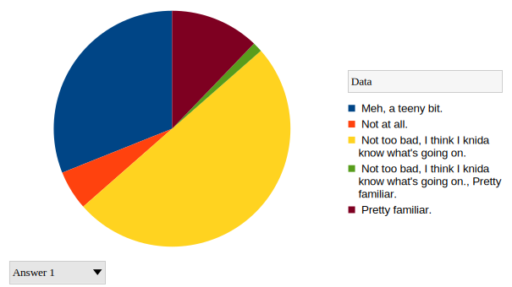
Q1: How familiar would you say you are with how the Internet works?
Not at all – 5%
Meh, a teeny bit - 31%
Not too bad, I think I knida know what's going on - 51%
Pretty familiar – 12%

Slide 4
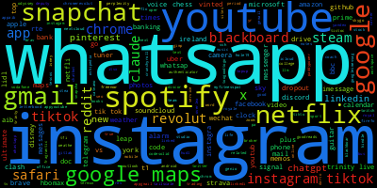
Q2: 2026: Please provide a list of the top-10 (or so) apps/tools and services that are most important to you (e.g. whatsapp, netflix etc.).
That’s kind of as-expected and (IMO) a bit sad.
Questions:
What do you think about that?
What would you do about that if you were ruler of the universe?
What should societies do about that?

Slide 5
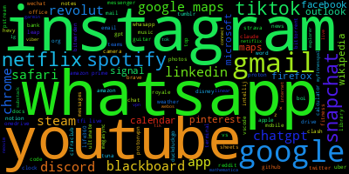
Q2: 2025: Please provide a list of the top-10 (or so) apps/tools and services that are most important to you (e.g. whatsapp, netflix etc.).
That’s kind of as-expected and (IMO) a bit sad.
Questions:
What do you think about that?
What would you do about that if you were ruler of the universe?
What should societies do about that?

Slide 6
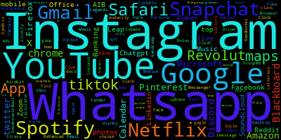
Q2: 2024: Please provide a list of the top-10 (or so) apps/tools and services that are most important to you (e.g. whatsapp, netflix etc.).
That’s kind of as-expected and (IMO) a bit sad.
Questions:
What do you think about that?
What would you do about that if you were ruler of the universe?
What should societies do about that?

Slide 7
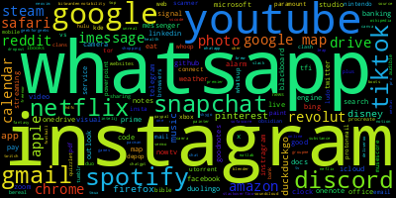
Q2: 2023: Please provide a list of the top-10 (or so) apps/tools and services that are most important to you (e.g. whatsapp, netflix etc.).
That’s kind of as-expected and (IMO) a bit sad.
Questions:
What do you think about that?
What would you do about that if you were ruler of the universe?
What should societies do about that?

Slide 8
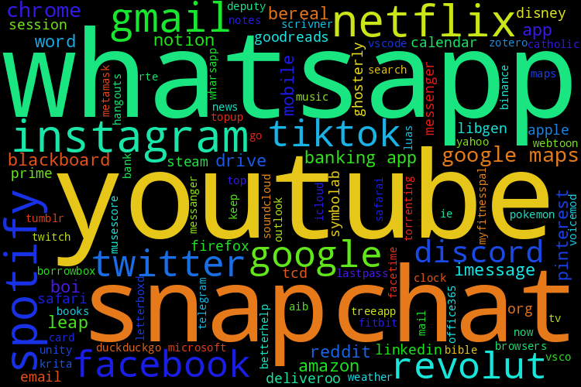
Q2: 2022: Please provide a list of the top-10 (or so) apps/tools and services that are most important to you (e.g. whatsapp, netflix etc.).
That’s kind of as-expected and (IMO) a bit sad.
Questions:
What do you think about that?
What would you do about that if you were ruler of the universe?
What should societies do about that?

Slide 9
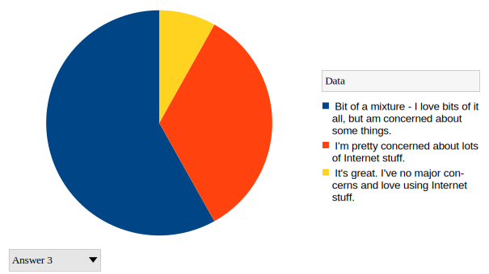
Q3 2026: How would you characterise your overall impression of how you interact with the Internet?
It's great. I've no major concerns and love using Internet stuff - 8%
Bit of a mixture - I love bits of it all, but am concerned about some things. - 58%
I'm pretty concerned about lots of Internet stuff - 33%
That's a dim question, it's much more subtle than that – 0%
Thank you to the people who said
“dim” – I was hoping for more of those tbh as it is a bit of a dim question! Why?

Slide 10
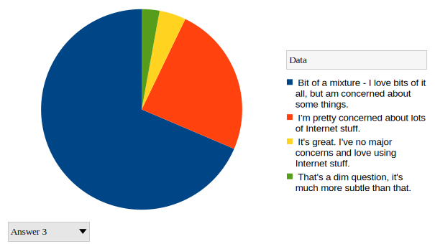
Q3 2025: How would you characterise your overall impression of how you interact with the Internet?
It's great. I've no major concerns and love using Internet stuff - 4%
Bit of a mixture - I love bits of it all, but am concerned about some things. - 69%
I'm pretty concerned about lots of Internet stuff - 24%
That's a dim question, it's much more subtle than that – 3%
Thank you to the people who said
“dim” – I was hoping for more of those tbh as it is a bit of a dim question! Why?

Slide 11
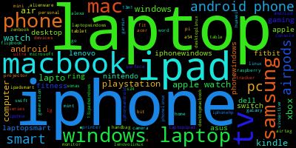
Q5 Devices 2026
Pretty much as expected?

Slide 12
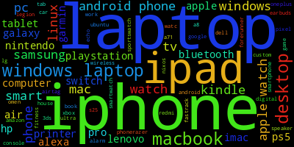
Q5 Devices 2025
Pretty much as expected?

Slide 13
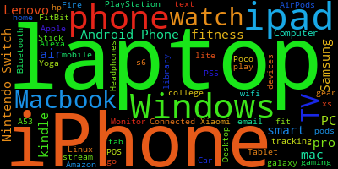
Q5 Devices 2024
Pretty much as expected?

Slide 14
Q4 Concerns
Question: “Write a sentence or two about things that concern you related to the Internet. For example you might be worried about some privacy or security or misinformation issue. If you can be more specifc, that's great but there's no need to reveal anything about yourself, so generic concerns are fine too”
There are too many to present in slides, so I randomised the list order then picked some with common themes.
  I did a bit of light editing for grammar etc.
I’ll show that as a PDF

Slide 15
More 2024 and older slides from here on, if you’d like to compare us and them

Slide 16
Q4 Answers (1/4)
I am worried about deepfakes (especially in politics and spreading mis- or dis-information) and my ability to recognize them, and the security of my personal information.
I am concerned about how much of my personal data is collected by internet services and how that might be used without my knowledge.
Identity Theft, Device Fingerprinting, Facial Age Verfication, Force Linking Digital accounts to real identify, Metadata tracking, Wifi Vision, Advertising ID
I find it worrying that although I don't generally trust information on the internet to be true or data to be secure, I still subconsciously accept a lot of this info and willingly put forward personal data. The internet also allows for manipulation of populations on a much larger scale and terrible amounts of addiction/jealousy/depression.

Slide 17
Q4 Answers (2/4)
One thing that started to concern me recently, was payment processors trying to censor video games, and the age estimation on Youtube and consequently their censorship of videos with restricted mode.
Bots in social media, algorithms pushing inflammatory content, Internet being managed by few companies, AI replacing search engines and ruining websites
I constantly have to change passwords for websites as I often get emails about my passwords ending up in data leaks.
Toxicity is a huge problem and it comes with the cost of freedom of speech.

Slide 18
Q4 Answers (3/4)
I'm concerned about internet privacy, but since I'm already signed up to all these apps and services, I feel I've accepted that I no longer have privacy and it's too late to change that.
My main concern is AI agents, as useful as they can be, the fact that they are growing exponentially and being used to build their own next iteration is more concerning than exciting as I can imagine a not so far away future where every government organisation would have their own model/agent that will be more capable than any human at performing any task you could think of, which can be quite intimidating.
Social media companies are increasingly frequently abusing their administrative powers to censor and restrict content to directly target minorities or to push often far right agendas. A prime example of these practices in the last few years being elon musk after buying twitter and changing the site rules on the fly to restrict or promote whatever speech he saw fit. But any company can do this and there's little to nothing anyone can do should they become the target of such restrictions.
I am worried about how addicted I find myself being to it. It also alters my perception of the real world

Slide 19
Q4 Answers (4/4)
I am worried about what ChatGPT knows about me since I share almost everything with it. (Work, School, private life)
The fact that whenever I search some random topic on the internet, many ads that I've never seen before related to that topic appear for me in many other apps (also the fact that it usually happens really fast – a few minutes is enough sometimes)
One thing I am concerned about is the idea that a lot of our personal Information is accessible to a select group of people like hackers or people who know how to use the dark web. Like for example when the HSE was held ransom a few years back when there was a cyber attack on the systems. I wonder if one tried how much could someone find on me like eg. my health records, biometrics, daily habits and then other personal information like addresses, banking details. I wonder how much of myself is available online. like when I log into an online account apple tells me my password has appeared in a data leak or when Ticketmaster had a huge data leak and it was just swept under the rug. This really interests me.
As a political science student from the US, my greatest concern with the internet is censorship and propaganda.

Slide 20
Conclusions
Mine (tentative):
  We’re a self-selected group, so common concerns are to be expected
  There are real reasons to know/worry about this stuff (though the survey questions are “leading”)
  We are not good at achieving target diversity
Your conclusions?

Slide 21
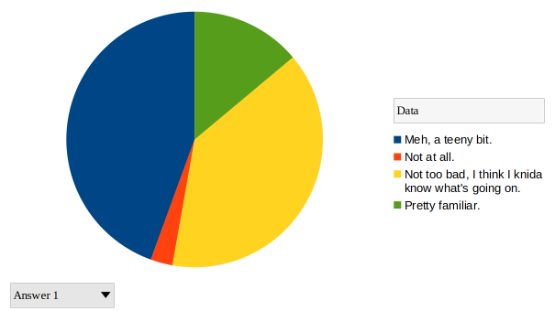
Q1: How familiar would you say you are with how the Internet works?
Not at all – 3%
Meh, a teeny bit - 44%
Not too bad, I think I knida know what's going on - 36%
Pretty familiar – 14%

Slide 22
Q2: 2024: Please provide a list of the top-10 (or so) apps/tools and services that are most important to you (e.g. whatsapp, netflix etc.).
That’s kind of as-expected and (IMO) a bit sad.
Questions:
What do you think about that?
What would you do about that if you were ruler of the universe?
What should societies do about that?

Slide 23
Q2: 2023: Please provide a list of the top-10 (or so) apps/tools and services that are most important to you (e.g. whatsapp, netflix etc.).
That’s kind of as-expected and (IMO) a bit sad.
Questions:
What do you think about that?
What would you do about that if you were ruler of the universe?
What should societies do about that?

Slide 24
Q2: 2022: Please provide a list of the top-10 (or so) apps/tools and services that are most important to you (e.g. whatsapp, netflix etc.).
That’s kind of as-expected and (IMO) a bit sad.
Questions:
What do you think about that?
What would you do about that if you were ruler of the universe?
What should societies do about that?

Slide 25
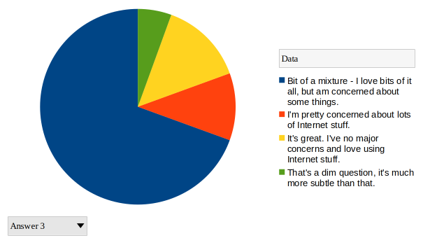
Q3: How would you characterise your overall impression of how you interact with the Internet?
It's great. I've no major concerns and love using Internet stuff - 14%
Bit of a mixture - I love bits of it all, but am concerned about some things. - 69%
I'm pretty concerned about lots of Internet stuff - 11%
That's a dim question, it's much more subtle than that – 6%
Thank you to the people who said
“dim” – I was hoping for more of those tbh as it is a bit of a dim question! Why?

Slide 26
Q5 Devices
Pretty much as expected?

Slide 27
Q4 Concerns
Question: “Write a sentence or two about things that concern you related to the Internet. For example you might be worried about some privacy or security or misinformation issue. If you can be more specifc, that's great but there's no need to reveal anything about yourself, so generic concerns are fine too”
I randomised the order, then edited a little to remove some redundancy

Slide 28
Q4 Answers (1)
Sometimes I am concerned about my privacy disclosure such as my phone number and email address. I remember when I first came to Ireland and registered a new phone number, I got some scam calls a few days later. It was easy to recognize scam calls but I know people who have been scammed out of a lot of money.
I am worried about the censorship of free speech.
Concerned privacy, my private data being accessed by others.
I find the use of 'bots' designed to spread misinformation or to amplify hate to be concerning as there appears to be little policy to try and tackle this issue from tech companies.
Privacy and tracking of your activity from companies

Slide 29
Q4 Answers (2)
Personally, I am concerned about the increasing lack of privacy present while I am browsing the web. Instances where ads become extremely personalized based on conversations my friends and I have have happened to often to be considered a coincedence.
I think that the effect of the internet on politics can be greatly damaging to a stable democracy and well-informed voters. I am interested in the regulation and policy surrounding tech companies such as Meta and their ongoing audit by the FTC.
I wonder what we blindly agree to in the cookies or terms and conditions. I'm also curious how ad tracking works, like how instagram knows what people are likely to buy and other things of that nature.
The ethics of corporate ai companies using artists work without consent.
How long data is/ can be stored by online servers

Slide 30
Q4 Answers (3)
Something I want to understand more is about 'cookies'. I have just recently started making sure I uncheck all the tracking cookies I can when I sign onto a new website, but I'm still not quite sure what any of that is doing. I would like to understand more how the websites I use can track my data (and what info they have acess to) and how that is used.
Where data goes and how it is manipulated by different parties i.e. to who it is sold and how the data is used
I would like to know where my cookies go in the case I accept them.
I am worried about how most people from I've seen do not read the terms and conditions before signing up for a service, but they're real.
Living in an age where you're always connected to everyone all the time gets annoying. There's no real way to be offline. at the same time it makes you paranoid that you're missing out on something if you don't touch any social media for a while.

Slide 31
Q4 Answers (4)
I am worried about privacy and security. I am nervous about someone finding out where I live or my bank information.
AI using all kinds of personal data for training. It has also been seen making up references to non existent medical cases in relation to a diagnosis.
Surveillance, censorship, misuse of data and concentration of power are some topics that concern me when thinking about the internet.
Violations of laws such as the GDPR are too common. Breaches happen every day and private data of people is being used against them
My face/pictures being on the internet. them being used somehow without my permission or ending up in sites/profiles without my permission.

Slide 32
Q4 Answers (5)
China is an example of a country that censors the internet for its citizens but western countries such as Ireland and the US have imposed laws to censor content online. Some of this I believe is rightly censored like CSAM but this can be used as an excuse to prohibit encryption.
Accepting cookies on websites and what that does
Privacy: many times I have seen people getting their data leaked to hackers causing a lot of problems.
Illegal stuff happening on internet eg dark web.
Edward Snowden revealed to the world years ago that the US spies on practically everyone and everything online. This surveillance has destroyed the privacy of not only US citizens but every person online.

Slide 33
Q4 Answers (6)
A recent statistic I heard caught my attention and raised my concern. The stat, which I heard on The Last Word with Matt Cooper or some radio show while in the car, was the over the course of the pandemic, roughly 42% of Tweets produced were in fact written by bots. The idea of, in the midst of a time when confusion and fear over the nature of the Coronavirus was rampant, and the public was susceptible more than ever to the spread of misinformation, that one of the premier arenas in which information and discourse is spread was polluted with robots cosplaying as real people with the ability to influence this space in such a fraught period was extremely concerning for me.
I am worried about how free apps can make millions in revenue.
I don't really understand how the internet works. However, I do understand that some major threats come with being an avid internet user. So I guess I am just concerned that I am not aware of those threats and therefore living in the dark.
Clothes I've taken photos of on my friends appear on my ads
How much information apps I use have of me. Why passwords get leaked. How much iCloud and storage space I use and how we're forced to pay for extra storage space.

Slide 34
Q4 Answers (7)
Obtaining and selling of my information and the creation of shadows profiles that know huge amounts about my personal life. The spreading of misinformation and / or Censorship from large corporations or governments.
Woried about companies and malicious groups colllecting and more so retaining data that is of no need to be collected or retained. Woried about threat actors abusing vulnerabilities to have access to lots of my personal data most of which I probably dont even know a company or my computer has. Woried about fundamental rights to privacy being violated by governments and this being used to persecute journalists, political enemies or even everyday people who dissent. Woried less so about misinformation spread as it is a problem but limiting free speech is against my beliefs and against freedom that the internet should be able to give people and thus I dislike the large amount of algorithmic censoring of people on platforms although many of whom I still don't agree with.
Misinformation
I always feel very insecure when using credit cards on shopping websites and I am afraid of giving out my bank details.

Slide 35
Q4 Answers (8)
I no longer have tik tok as i read their terms and conditions and in it they are able to acess almost all data on your phone. With the exception of passwords, this scares me
Security during web browsing or when our data gets leaked and sold to data buyers
A small number of organisations such as Google and Facebook control a large amount of the internet. This gives very few companies a large amount of power over billions of people who use the internet and centralises the internet more.
Concerned around the privacy of online chat systems.
The constant expansion of content and personal data thats present on the internet is alarming to me. however its not whats on the internet that scares me, its the people who carelessly upload info/content without knowing the consequences and how it effects them and everyone else online. Some people are slowly becoming desensitised.
My concern about the internet is how my information is being displayed (whether its being displayed for everyone without my knowledge or nobody can see, specifically when paying for things online)

Slide 36
2023 Slides from here on if you’d like to compare us to them:-)

Slide 37
Context/numbers
65 registered students for 2022 TEU00311 module (as of Sep 14th)
50 responses (thanks!)
Respondents more or less haven’t met (much), but have a lot in common
2022/2021 slides are at the end of this deck in case you’re interested

Slide 38
Q1: How familiar would you say you are with how the Internet works?
Not at all – 8% !!
Meh, a teeny bit - 32%
Not too bad, I think I knida know what's going on - 28%
Pretty familiar – 32%

Slide 39
Q2: 2023: Please provide a list of the top-10 (or so) apps/tools and services that are most important to you (e.g. whatsapp, netflix etc.).
That’s kind of as-expected and (IMO) a bit sad.
Questions:
What do you think about that?
What would you do about that if you were ruler of the universe?
What should societies do about that?

Slide 40
Q2: 2022: Please provide a list of the top-10 (or so) apps/tools and services that are most important to you (e.g. whatsapp, netflix etc.).
That’s kind of as-expected and (IMO) a bit sad.
Questions:
What do you think about that?
What would you do about that if you were ruler of the universe?
What should societies do about that?

Slide 41
Q3: How would you characterise your overall impression of how you interact with the Internet?
It's great. I've no major concerns and love using Internet stuff - 4%
Bit of a mixture - I love bits of it all, but am concerned about some things. - 76%
I'm pretty concerned about lots of Internet stuff - 16%
That's a dim question, it's much more subtle than that – 4%
Thank you to the people who said
“dim” – I was hoping for more of those tbh as it is a bit of a dim question! Why?

Slide 42
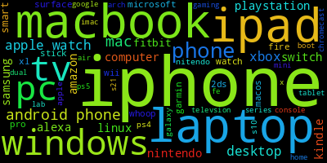
Q5 Devices
Pretty much as expected?

Slide 43
Q4 Concerns
Question: “Write a sentence or two about things that concern you related to the Internet. For example you might be worried about some privacy or security or misinformation issue. If you can be more specifc, that's great but there's no need to reveal anything about yourself, so generic concerns are fine too”
I randomised the order, then edited (and a bit of a spellcheck:-) the answers to mostly make one bullet per sentence

Slide 44
Q4 Answers (1)
Data protection and the information they have access to, especially regarding uncontrolled data breaches. Specifically at the moment in regards to the new update coming to chrome.
Even if i feel like I have a good understanding of it, Privacy and what is done with my data worries me. I am missing information on subject, I think.
websites or applications having access to my camera when I don't want them to,
giving websites or applications access to my bank information and then having it stolen if that website gets hacked.
how easy it is to share misinformation on websites like facebook and twitter. This has led to real-world harm to many marginalised groups.
the use of cookies on every website I access and detection of my location.
leakage of passwords and private information
how I spend my time when I'm using the internet. When I think about the productive things I could have done instead of consuming content I often wish I used the internet differently.
Selling my data can be concerning depending on what it is used for.

Slide 45
Q4 Answers (2)
the ways in which companies will use my data or what they collect.
hostile invasions of my privacy or devices
governments outlawing encryption
the mental health of individuals. I think the internet can idealize overwhelming expectations of people while in a way pushing them away from a positive life style. For example the new trend that has arisen on social media is “hussle culture” which is teaching younger adults that if you are not working all of the time or constantly doing something then you are falling behind on your peers
I am not always 100% sure where my data is going. There are certain apps that I know are keeping track of my data and personal information, but I have no idea where it is going and what is being done with it.
It is very easy for hackers to get my private information and I worry that I will lose much of my privacy. Also how people can find out personal information about myself if they look hard enough without my consent.
the lack of well-intentioned civil discourse between people with opposing views enabled by the internet.
Yeah, it's a bit of an unsettling thought that if someone really wanted to, they could find out pretty much everything about me. It also doesn't sit well that apps have all this information to try and get/keep me addicted to my phone and make me spend more money.
After reading about the likes of Snowdon's leak when I was a kid, the idea of privacy is very important to me. The pull between having a social life in the 2020s and valuing what's left of my privacy is a strong one that feels increasingly impossible to mediate. Similarly, seeing the wildfire-like effects of how information (and particularly targeted misinformation) spreads has a particularly crushing effect on someone's faith in humanity.

Slide 46
Q4 Answers (3)
the spread of misinformation/disinformation on a large scale. Almost everyone should be scared if a random person has their personal data, however, when people's beliefs aren't rooted in reality the consequences can be much greater.
How our searches are tracked, and in the name of Better search results and Fine tuning; the experience, we are sent targeted ads and calls etc and we become an open book for anyone with enough time and motive to stalk us. Openly posting our daily lives opens us up to the threat of social hacking where an individual could chart our typical behaviour and manipulate us to their whims.
The terms and agreements of certain apps, permisions need to be optimised, why does spotify need to know my location at all times? Why does netflix need to access my contacts? Unrealistic demands to operate the apps.
internet services becoming more monopolised with larger entities controlling most services.
When I look something up or speak about something I frequently receive ads relating to the topics discussed which is concerning.
private data collection and distribution, as it seems every service does this now.
problems with social media and how it affects people.
privacy and security of misinformation. i am also concerned as to the amount of information the internet has collected about me, and how tailored my algorithms have become.

Slide 47
Q4 Answers (4)
privacy, especially around government surveillance or data brokers selling/monitoring people without their knowledge.
the idea of a permanent “digital footprint”
companies like Facebook sharing people's private messages with the police
general censorship of the internet.
as we become more accustomed to using the internet we let our guards down and click things like 'accept cookies' and 'accept the harvesting of my personal data' without thinking. I feel that this is a slippery slope
the right of privacy with the ever growing desire for targeted advertisement based on harvested data
Always having to agree to cookies on every website and not really knowing what I am agreeing to.
When websites ask for personal info or card details for payment.
how much power a few companies e.g. Amazon and Google have over the internet and the resulting impact everywhere else.
I'm concerned about information security, for example when I pay online.

Slide 48
Q4 Answers (5)
Security and misinformation, especially with regards to things like scams and how fast information spreads.
general security issues of user privacy
Privacy, how much information is stored about us, Security
General misinformation, monopolisation of services like aws, browsers, social media etc (creates predatory practices)
internet scams. I think I'm quite gullible and I have little awareness when I'm using the internet.
extremism which is present online thanks to anonymity. Privacy is also concerning, particularly around the security of privacy and how security systems to protect privacy can be breached.
google tracking all searches and activities and other websites and apps tracking activities outside the app gathering information.
while using the internet is how little it takes to lose you data. Even a misclick can result in massive breach
misleading information and news

Slide 49
Q4 Answers (5)
looking at ChatGPT, for instance, I am worried that, with people outsourcing their thinking, this could be destructive for human thought and even potentially society? I definitely do not have a technical understanding, but it is all pretty scary to me; and I am eager to learn more.
Deploying a vulnerable website
I can live with my information being somewhere else but its how easy it can be revealed to the rest of the world that concerns me the most.
How much noise there is on the web now with AI generated content, ads etc. - It's becoming increasingly harder to find genuinely good stuff
When we pay for stuff online, I am concerned about giving my card details.
that everything is connected to the internet these days (all the smart appliances and things that really don't need to connect to the internet but still do). But we carry around cameras and microphones and even explicitly type things right into our phones!
It worries me that generative AI tools are taking in my data when I feed them with information. I also worry about the spread of misinformation and fake news across the internet in that now AI can generate completely realistic videos of people given just images of them as well as eerily realistic voice cloning.

Slide 50
Q4 Answers (6)
the amount of social media consumption that younger generations are consuming daily. Specifically TikTok and Instagram because I feel that they dramatically effect attention spans and one's ability to focus.
my data and privacy - how much information do the companies and their services I use have on me and what are they using it for? Is there any way I can get it back from them?
Being monitored/tracked on the internet
It can be hard to tell how secure a company's systems are from the outside.
Peoples attention spans and diminishing due to the algorithms that prioritize short, attention grabbing content, fostering a culture of constant distraction on the internet.
A mixture of misinformation and privacy. The lack of regulation which allows state funded misinformation campaigns to wreck havoc upon many nations.
Privacy issues like what kind of information companies etc have about me that I am unaware of. The spread of harmful misinformation
I am worried about how I can be tracked on the internet, particularly based on my non-Internet activities.
No concerns at all

Slide 51
2022 Slides from here on if you’d like to compare us to them:-)

Slide 52
Context/numbers
74 registered students for 2022 TEU00311 module (as of Sep 19th)
42 responses (thanks!)
Respondents more or less haven’t met (much), but have a lot in common
2021 slides are at the end of this deck in case you’re interested

Slide 53
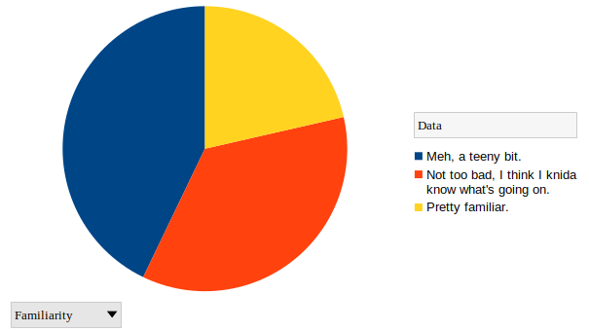
Q1: How familiar would you say you are with how the Internet works?
Not at all – 0% !!
Meh, a teeny bit - 43%
Not too bad, I think I knida know what's going on - 36%
Pretty familiar – 21%

Slide 54
Q2: 2022: Please provide a list of the top-10 (or so) apps/tools and services that are most important to you (e.g. whatsapp, netflix etc.).
That’s kind of as-expected and (IMO) a bit sad.
Questions:
What do you think about that?
What would you do about that if you were ruler of the universe?
What should societies do about that?

Slide 55

Q2: 2021: Please provide a list of the top-10 (or so) apps/tools and services that are most important to you (e.g. whatsapp, netflix etc.).
That’s kind of as-expected and (IMO) a bit sad.
Questions:
What do you think about that?
What would you do about that if you were ruler of the universe?
What should societies do about that?

Slide 56
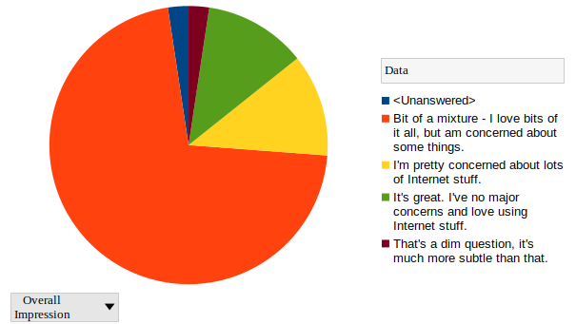
Q3: How would you characterise your overall impression of how you interact with the Internet?
It's great. I've no major concerns and love using Internet stuff - 12%
Bit of a mixture - I love bits of it all, but am concerned about some things. - 71%
I'm pretty concerned about lots of Internet stuff - 12%
That's a dim question, it's much more subtle than that – 2%
Unanswered – 2%
Thank you to the person who said
“dim” – I was hoping for more of those tbh as it is a bit of a dim question! Why?

Slide 57
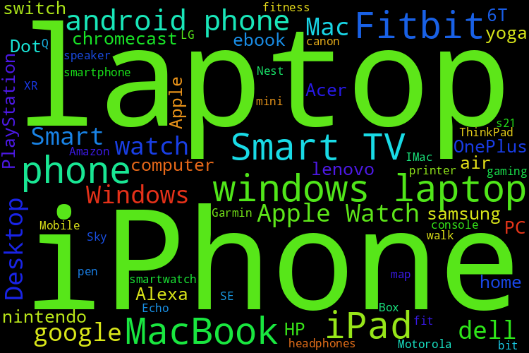
Q5 Devices
Pretty much as expected?

Slide 58
Q4 Concerns
Question: “Write a sentence or two about things that concern you related to the Internet. For example you might be worried about some privacy or security or misinformation issue. If you can be more specifc, that's great but there's no need to reveal anything about yourself, so generic concerns are fine too”
I did formatting (and a bit of a spellcheck:-) on the answers to make one bullet per sentence, randomised the order and then bolded a few common/key terms

Slide 59
Q4 Answers (1)
What cookies really are - what information is given away
It generally often feels like people nowadays have both no internet privacy and no way to gain back control of their data privacy
There is a lot of misinformation on the internet which tends to lead to people being confused on certain topics. I think its most prominent on Facebook. News pages will post misleading article titles or just plain wrong information, and many people will fall for the false information without going to further research and investigate.
Worried about scams and how realistic they've become - worried about accidentally falling for one or missing out on opportunities because i think they might be a scam.
Concerned over becoming too reliant on the internet for information and concerned about how my data is used
The ease of spread of misinformation is scary. Very few people online actually fact-check their sources. Moreover, ads and content are targeted and keep you in your bubble of beliefs which can lead even more people down rabbit holes and conspiracies.
The prevalence of scams and phishing everywhere online is equally worrying

Slide 60
Q4 Answers (2)
Apart from advertising or catering content, how can companies use the data they collect from me
Government control, the end of anonymity.
Lack of security against bots on sites made by billion+ euro businesses (ie. twitter is roughly 80% bot activity).
Lack of decentralisation and silencing of information/code due to centralised nature of 99% of sites and power of gov vs open source code (ie. us sanctioning a protocol and then github taking down their code) tradeoff between decentralisation and usability has to be made but not to the extent that it is currently.
Biggest concern would be about security- worried about hacking or bank details being taken
My biggest concern is how good they've gotten at firstly collecting data about users, but also at how good the analysis of the data has gotten to allow them to know things they haven't technically observed.
Don't know where my information goes/ how it is stored/ where it is stored and for how long it is stored. Where is the cloud really and how safe is the security? What happens when I click okay for cookies and what difference does it make?
Access to card details

Slide 61
Q4 Answers (3)
Mostly concerned the most about privacy and security.
I dislike hidden features that aren't showcased such as phones using listening devices and selling that data to advertisers.
Have had that happen when planning to go on holiday and am then given suggestions based on audio from my house.
I'm also in general concerned about safety of passwords since I don't create a wholly unique password for everything.
There are a few concerns to me on one level its privacy rights which i value but on the other its more so the behavioural effects it has which concerns me also
I am mainly worried about my privacy and that (or rather to what extend) companies sell my data. I would also like to know what companies do with my personal information and why they need them.
I also don't trust Apps like Instagram claiming that they don't use our microphones to listen what we are saying.
I'm concerned what I view on the internet will be used against me.
i am concerned with how much information i am unwillingly exposing when on the internet. sometimes it feels like i think about something and I'm suddenly seeing ads for it on every social media platform and it makes me uncomfortable.
I love using the internet but I know there are dangers and concerns regarding the internet that I am not fully aware of.

Slide 62
Q4 Answers (4)
A profile being made about me.
I am worried about the large amounts of blatant misinformation available on the internet that people readily consume, as it does nought but drive people apart and fill them with hate.
I also hate cryptocurrency
Very easy to get access about a certain person like you can type in someone's name and a lot can come up about them
It is very easy to give out more information than you think. It's not as safe or private as we may be led to believe.
What my data is being used for. Who has access to the data.
Who has access to my data, can things actually be deleted or will it always be there
How easy it is for underage children to access content that is not necessarily suitable for them.
Anonymous cyberbullying
Mental health - what spending so much time online does to the brain and how we feel

Slide 63
Q4 Answers (5)
Relationships built online with people you don't know
Private information security
The fact that almost everyone and anyone has access to the internet
Do the pros outweigh the cons?
Pretty concerned about AI and the things it can do. Also concerned about how if I'm talking to my friends about swimming for example, I'll start to get adds for swimming on my phone. Is my phone listening to me???
Data protection is a concern when it comes to corporations based in foreign countries obtaining personal information.
Also the hacking of my software and the effectiveness of internet security packages in preventing such incidents.
The only concern I have is about where my personal data is stored and who has access to it.
Concerned about location and bank account privacy
I'm worried that the information I consume is very biased towards my views and that I don't get a well rounded view of the world. I only see what I want to see

Slide 64
Q4 Answers (6)
I am concerned about what cookies even are. I feel like I click accept all too easily. I also feel like the internet has all my data.
It is concerning when I feel as though I have been discussing a topic and it suddenly appears on my screen as an advert. It is like it is listening. I would just like to see how this is the case.
Psychological issues - particularly related to 'scrolling' algorithms that encourage addiction, and exposure to graphic/existential content
Privacy issues - that personal files and apps like the camera are accessible and controllable by others
I am concerned about the data retention
Cookies and digital footprint
Selling of data
Spread of misinformation/ conspiracy theories
I'm not too sure how my data is used so I'd like to know about that.

Slide 65
Q4 Answers (7)
Access to information and contact details
I'm worried about my digital footprint... how available is my online presence to potential employers, academic institutes, etc? Do companies sell this information, are we safer under GDPR, etc..
I love using the internet and i think it is is a fantastic tool but its always in the back of my mind how badly it is affecting my life in terms of over reliance, sleep interruption and loss of human contact
The problem of online banking and credit card scammers, the spreading of false and potentially harmful information, accepting 'cookies' and websites and apps policies/terms and conditions without necessarily knowing what they contain.
I'd very much be worried about privacy on the internet and how much access service/app providers have of your own PC, accounts etc. For many apps, I'd be worried about how many permissions they ask for or what they get from you that they don't ask for and how much of what I do is logged, saved and used and for what purpose (an example would be an alexa I use with the concern of since it is always recording how much of what it hears, be it using the prompt to use it for or otherwise, being stored or used somewhere). While definitely a generic concern, It's a pretty prevalent one in my opinion as so many websites and apps log info now
I have heard that cyber security is in fact a myth and anything can be accessed if needed, is this true

Slide 66
(My tentative) Conclusions
Target diversity is a good, but takes work, maybe too much work
As a group our concerns seem to have a fair bit in common (but we are self-selecting!)
Payments, mis/dis-information and social impacts maybe of more concern this year
Perhaps this group are a bit more confident in your opinions than last year’s? (But last year, people were stuck doing this from home still, which may have affected their answers.)

Slide 67
What our 2021 folk thought...
All the slides from 2021 below here for comparison

Slide 68
Context/numbers
49 registered students for 2021 TEU00311 module
39 responses (thanks!) to blackboard survey (announced twice) over 4 days in Sep 2021
Respondents more or less haven’t met
Everyone responded to all questions (thanks moar!)

Slide 69

Q1: How familiar would you say you are with how the Internet works?
Not at all - 7.692%
Meh, a teeny bit - 38.461%
Not too bad, I think I kinda know what's going on - 25.641%
Pretty familiar – 28.205%
I expected more “meh.” I might ask a form of this question again at the end of the module!
(please remind me:-)

Slide 70
Q2: Please provide a list of the top-10 (or so) apps/tools and services that are most important to you (e.g. whatsapp, netflix etc.).
That’s kind of as-expected and (IMO) a bit sad.
Questions:
What do you think about that?
What would you do about that if you were ruler of the universe?
What should societies do about that?

Slide 71

Q3: How would you characterise your overall impression of how you interact with the Internet?
It's great. I've no major concerns and love using Internet stuff - 10.256%
Bit of a mixture - I love bits of it all, but am concerned about some things. - 74.358%
I'm pretty concerned about lots of Internet stuff - 12.82%
That's a dim question, it's much more subtle than that- 2.564%
Thank you to the person who said
“dim” – I was hoping for more of those tbh as it is a bit of a dim question! It could even be used as a sneaky question. Why?

Slide 72
Q4: Write a sentence or two about things that concern you related to the Internet. For example you might be worried about some privacy or security or misinformation issue. If you can be more specifc, that's great but there's no need to reveal anything about yourself, so generic concerns are fine too.

Slide 73
Q4: Answers
It is the driving force behind societal changed that strike me as deeply concerning - Overemphasis on information techonology leading to greater polarisation and a growing inability to collectively solve problems. However, the genie is out of the bottle so its worth trying to fix.
The only real concern I have with the internet is data leaks which could compromise my passwords to mobile banking or my email.
I am a bit concered about how much of my data is spread around the internet. Whenever I get ads that are targeted towards me with things I've been interested in recently, I get a bit worried about my privacy over the internet.
I am concerned about how much access the general public have to fake news. I am also concerned about my privacy, or lack thereof whilst using the internet.
I am concerned about how companies track what websites I have visited and use that information to display relevants ads.
I suppose the vagueness surrounding the legality of what an individual and companies can and can't do on the internet leaves the door easily open for bad faith actors to exploit others.
I worry slightly about the security and safety of the internet, especially with its young, vulnerable, and impressionable users.
when going into a new web page, it always makes me select to accept all cookies or just partial cookies.
sometimes i become weary when entering credit card details into certain websites in certain scenarios. when using smaller, lesser known websites, this can be a problem
Where my personal information ends up, passwords, cookies, personal information/photos from social media's.
The ever present surveillance by the government frequent data breaches leading to invasion of privacy
I am sometimes concerned regarding about my security and privacy. I get worried about hackers leaking my personal details.
the usage and extrapolation of my personal data my right to be forgotten

Slide 74
Q4: Answers
One issue would probably be the tendencies that allow people to continue to be exposed to a sort of echo chamber. The kind where platforms would tend to send the same kind of content or information which further strengthens a user's views and beliefs without challenging them. Algorithms playing a massive role. This would be one of the factors which contribute to the groups of people who end up having more extreme/radical variations of beliefs and opinions. Another is the general privacy concerns anyone would have when it comes to sharing information.
My only real concern is about data leaks, where I may have saved login details to a particular website and these details were then part of a leak as I have been informed in the past.
I believe that one of the biggest issues concerning the internet is the problem over misinformation, which can be seen in so many aspects of our daily lives, particulary in relation to misinformation spread about the COVID-19 pandemic. The fact that anyone, without the need for qualifications or fact-checks, can write anything about anything and everything is extremely worrying. As a result of this misinformation crisis in this 'information age', I believe that it is becoming harder to find the truth amoung all the lies. If this problem continues to escalate, the truth may never be discerned again.
I'm worried about how algorithms can push people into rabbit holes of misinformation and radicalisation
I do not like cookies and how data is collected about your internet behaviour, I would rather be anonomous.
I do not like how addicting it is. My screen time averages at >30 hours a week which means I spend at least >50 days a year on my phone. This is not time well spent
I do not like how everyone believes everything they see on social media. This causes misinformation to spread. No one checks sources of peoples information ever. This is especially common in the younger generation when certain political campaigns things trend on social media.

Slide 75
Q4: Answers
Different apps collecting data about me and my interests to then use for targeted advertisement.
Lots of personal data leaks are happening, lots of misinformation being spread on social media platforms daily and the dark web.
How traceable I am through various accounts I made when I was younger
I don't like the prevalence and implied necessity of all the tracking and data collection. I would rather that stuff worked without having to have such an online presence
being overmarketed to By seeing the same content all the time my idea of the world is becoming too reinforced - for example I only see the videos or news articles that reinforce my own political ideology. Therefore I think that I'm right and become inflexible to other viewpoints. I also may think that the world is like what I see on my phone all the time when all I'm actually seeing is a one sided viewpoint.
Identity theft based on the information I leave on the internet through social media and shopping. Profits made from our interactions with websites and apps are not transparent.
I really like the internet, but I am a bit afraid of how easy it is to spread misinformation on there. Also I do not like the idea, that my internet activities could be used to track what I do or even my location.
The amount of data being collected and where and how it is being stored.
Privacy and security are generally the main concern regarding the Internet. What I have always found daunting is the fact that, once you upload something/ put something up on the internet, it's always there, in some form or the other. One cannot do anything to take it down. Therefore one should always be vigilant about what they're putting up on the internet.

Slide 76

Q5: How enthusiastic are you to get back to face-to-face sessions in the first half of this semester?
I can't wait. I'm really keen to get back to campus so would like to attend all sessions I can - 51.282%
I'd be happy to get to some face-to-face sessions in the next few weeks, but maybe not all - 35.897%
I'd be a bit concerned about attending in person in the next few weeks, so online suits me better, for now - 10.256%
I have real logistical (e.g. no Dublin accommodation) or health reasons why I mostly or completely can't be there in person for the next few weeks, so even if I'd like to be there, it's not possible right now. (But I can do online.) - 2.564%
I’ve asked if we can get a room for Thursdays. I don’t know if or how soon we might. I’ll keep you up to date. I hope we get one. We won’t forget still-remote people if so.

Slide 77
Q6: If you can get to some but not all face-to-face sessions in the next few weeks, what are your priorities for the ones you can attend? For example, you might be more interested in meeting fellow students, or in group discussions, or doing a bit of lab-like work Or you might even yearn for a traditional lecture, who knows:-) Just a couple of sentences here is fine.

Slide 78
Q6: Answers
I don't mind, any form of it will do/
I hope from my in person lectures to get the real college experience. I believe this involves a healthy mix of traditional lectures along with small bits of group work to keep things fresh and give us a shot to get to know eachother.
I would like to attend for sessions that have some sort of lab-like work.
I am happy to gradually progress into face to face lectures. I am learning how to manage my schedule with college and personal commitments so the next few weeks will be about learning how to adapt.
A few lectures would be nice here and there
I have no preference as to what form the in person activity is, I will take anything that is going.
I hope to meet some fellow classmates since I am an international student and newer to the area.
I think any activities are fine with me for going into face to face. personally I don't have too many preferences on things to do.

Slide 79
Q6: Answers
i like the online lectures as they can be recorded and rewatched, ensuring they are better for when the time comes to study the material. however, the in person lectures stick with me alot more as it is very easy to zone out when the online lecture is in effect
I would rather not be in person for the next few weeks however if I were to be I would rather meet fellow students in the module for a traditional lecture
Lab- like work and meeting fellow students would be my priority
I'm so excited to meet new peiople and get to know them. I also feel like I could engage more in classes as I will have more concentration in face - to - face lectures then online lectures.
meeting fellow students, as our year has never been into college and we are basically first years with the level of knowledge and participation we have regarding college life i work best when in a classroom surrounded by people, working online provides many distractions that are hard to ignore
PRESENCE, PRESENCE, PRESENCE. There is no more to say. actually, there is: if I had to decide how to prioritize your 3 topics: 1. group discussions in presence (and meet fellow students) 2. presence lectures and eventually 3. lab-like word in presence
i havent been into college once so i am looking forward to everything it has to offer
I would be happy with all, but for now I would not consider myself knowledgable enough in this area to meaninfully contribute to a discussion on this topic

Slide 80
Q6: Answers
I would prioritise F2F sessions that are for group work or other work that emphasises interaction with other students.
I'd be interested in more or less everything mentioned here. I'd look forward to meeting other students in group scenarios.
I think meeting students is my main priority, I don't have too much of an issue doing my actual work at home but having regular labs/ tutorials/ group discussions encourages people to come into campus and then we all get to meet each other more and more.
I would be interested in meeting fellow students and engage in group discussions about the elective. I feel as though I learn best through the inspiration of others and having the ability to bounce ideas off of each other!
Lab work or interactive work
Not a tradional lecture anyway, these are actually good to have online so that you can pause or rewind if you don't understand some materials. Probably group discussions or lab work.
Would actually like to be on campus and feel like a Trinity student again.
I would love opportunities to work with other students and get to know them. Coming in for some lab work or group work could be really nice and a fun way to get more engaged with the content.
traditional lecture
Real interaction with other students and lecturers is the top priority for f2f, so group work is preferred to traditional lectures.
I would attend all in person sessions, because of meeting fellow students, having the student life on campus, and doing lab-work in person is so much better than online.

Slide 81
Q6: Answers
Would like to get to know other students on the module. If this means traditional lectures, labs or group discussions I am prepared to do whatever we can. It is very difficult to get to know anyone on the module via a computer screen which I am sure you can understand.
A mix of traditional lectures and group discussions will be very interesting. It will be nice to meet fellow students.
I think attending live lectures is important for me, as it adds to student engagement and participation. Otherwise group work and discussions would be the next priority as meeting people is one of the many joys of going to college. Doing an elective gives me the opportunity to meet people outside of my course, so keeping these interactions online would severely restrict any social engagement.
A traditional lecture would be great!
I would really like to meet everyone and maybe do some group activities?
In the least rude way possible, I genuinely could not care less
I would attend any and all in person college as I am paying for accomodation up here
Group discussions sound good!
Just wishing to see something that's not my screen.
I would like to meet other students, but only in the case, that we can actually sit next to each other in the classrooms. This could be a great way to get to know new people and create discussions on the topic. However, I think this would be only possible if there are no firm restrictions in place (i.e. leaving 2m distance between students in the room).
I wouldnt have any priorities, just to go in would be enough for me.
After spending better part of 2 years learning from home I came to the conclusion that online learning is just not good enough when compared to traditional lectures. I really enjoy interacting with my peers, getting to know everyone's opinions and thought proccesses regarding the subject we are studying, It just feels more natural.

Slide 82
(My tentative) Conclusions
It may be some of you are not envisaging the swan’s legs thrashing away:-)
Target diversity is a good, but takes work, maybe too much work.
As a group our concerns seem to have a fair bit in common (but we are self-selecting!)
The loss of contact is glaringly apparent.
We should meet!

