Slide 1

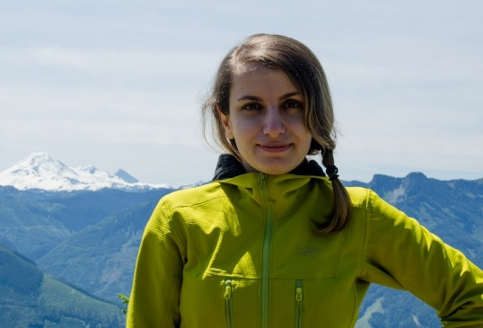
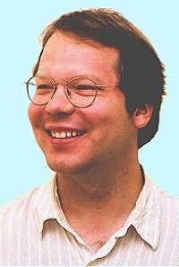
Identifying Unusual Players and Teams
.
Fatemeh Riahi, Oliver Schulte
SSCI, Dec 2015
Notes:
Note that each oral will be 20 minutes, to consist of 15 minutes presentation of the paper, followed by 5 minutes of questions and transition to the next speaker. Note that laptops will not be provided, and speakers should use their own laptop for their presentation

Slide 2
Overview
Background on data mining and anomaly/outlier detection
Finding teams and players with unusual statistics
Definition of “unusual” = outlier metric
Our outlier metric correlates with success

Slide 3
intro: Anomaly Detection

Slide 4
Data Mining
Data Mining = find “interesting” patterns in large datasets.
More descriptive than predictive statistics.
Different notions of “interesting”.
Today: statistically unusual.
unusual frequencies.
unusual associations/correlations.

Slide 5
Problem Definition
Most of outlier detection method work with a single data table or attribute value format.
One of the main data models for structured data is Object-relational data model.
Object Identity; Class Membership; Object Relationships
Object1: Player
Object1 Instance
PlayerID
TeamID
1123
1(ManU)
PlayerID | MatchID | Shot_Eff | Pass_Eff | TimePlayed
1123 | 2 | High | High | Low
1123 | 3 | Low | Low | High
1324 | 21 | Med. | Med. | Low
1324 | 16 | High | Low | Low
Object2: Team
Object2 Instance
TeamID
1
Object2: MatchID
Object2 Instance
MatchID
3
Notes:
Many outlier detection methods have been developed for data that are represented in an attribute-value format [3]. In a single data table a row represents a data point, a column represents an attribute of a data point, and a table entry represents an attribute value for a data point.
This thesis proposal addresses outlier detection For object relational data which is one of the main data models for structured data. The main characteristics of data objects that we utilize in this thesis are the following. (1) Object Identity. Each object has a unique identifier that is the same across contexts. For example, a player has a name that identifies him in different matches. (2) Class Membership. An object is an instance of a class, which is a collection of similar objects. In particular, objects in the same class share a set of attributes. For example, van Persie is a player object that
belongs to the class striker, which is a subclass of the class player. (3) Object Relationships. Objects are linked to other objects. Both objects and their links have attributes. A common type of object relationship is a component relationship between a complex objects and its parts. For example, a match involves two teams, and each team comprises a set of players for that match. A difference between relational and vectorial data is therefore that an individual object is characterized not only by a list of attributes, but also by its links and by attributes of
the object linked to it. We refer to the substructure comprising
this information as the object data

Slide 6

Motivation
Information loss when using hand crafted features or aggregation based features.
Aggregation
Avg(ShotEff)=0.45
Avg(Goals)=0.5
PlayerID | MatchID | Venue | Shot_Eff | Goals
1123 | M1 | Home | 0.9 | 1
1123 | M2 | Away | 0 | 0
1123 | M3 | Home | 0.9 | 1
1123 | M4 | Away | 0 | 0
Notes:
Most of outlier detection methods that work with single data table use aggregation. For example they aggregate over the features of a player in different matches; however aggregation tend to loose the informaiton.

Slide 7
Contributions
The first approach to outlier detection for relational data that is based on probabilistic model
A new model-based outlier score based on model likelihood comparison.
The outlier score is
accurate
interpretable
correlates with independent success metrics

Slide 8
BasIC Idea Model Likelihood = Outlier Score

Slide 9

Model-Based Outlier Detection for I.I.D. data
ID | Attribute1 | Attribute2 | Attribute3
1 | W | rich | 10
2 | .... | ... | ...
Learning
ID | Att1 | Att2 | Att3
1000 | M | rich | 8
Attribute1
Attribute2
Attribute3
Likelihood of potential outlier
low likelihood ➔outlier

Slide 10

Model-Based Outlier Detection for Relational Data
Population Database e.g. Premier League games
First-Order Bayesian network
Individual Profile e.g. MU games
Likelihood of individual database
low likelihood ➔outlier
Notes:
cite Blockeel on learning from interpretations
like learning from interpretations

Slide 11
First-Order Bayesian Network
First-Order Variable indexes/refers to a population.
e.g. P for Player, M for Match
A relational random variable is of the form f(A₁,...,A_{k}) where A₁,...,A_{k} are first-order variables of the right type.
Shoteff(P,M)
TackleEff(P,M)
DribbleEff(P,M)
P(DribbleEff(P,M) = low|
Shoteff(P,M) = hi, TackleEff(P,M)= medium)
= 38%
Notes:
in logic, known as terms.

Slide 12
The Random Selection Pseudo-Likelihood
Let x be an assignment to all nodes in the Bayes net.
Compute P_{B}(x).
Let n_{x} be the number of instances matching x in the individual profile database.
Take the geometric mean of all instance probabilities:

Slide 13
The Random Selection Pseudo-Likelihood
joint frequency of child node value and parent state support e.g. P_{D}(low,hi,medium) = 1/8
Parameter of Bayes net ln (confidence) e.g. P(low|hi, medium) =38%
hi
medium
Shoteff(P,M)
TackleEff(P,M)
For Edin Dzeko: 1/8 x ln(38%) ≈ -0.12
low
P(DribbleEff(P,M) = low|
Shoteff(P,M) = hi, TackleEff(P,M)= medium)
= 38%
DribbleEff(P,M)
Notes:
can also think: for each instantiation, assign joint probability, multiply together joint probabilities

Slide 14
Evaluation Methodology

Slide 15
Synthetic Datasets
Synthetic Datasets: Should be easy! Two Features per player per match.
high correlation | ShotEff | Match Result
Normal | 1 | 1
 | 1 | 1
 | 0 | 0
 | 0 | 0
Outlier | 1 | 1
 | 1 | 0
 | 0 | 0
 | 0 | 1
low correlation | ShotEff | Match Result
Normal | 1 | 1
 | 1 | 0
 | 0 | 0
 | 0 | 1
Outlier | 1 | 1
 | 1 | 1
 | 0 | 0
 | 0 | 0
Notes:
we also know the ground truth about the Bayesian network
We generated three synthetic datasets for a soccer domain with normal and outlier players using the distributions represented in the three Bayesian networks
of Figure 2. Each player participates in 38 matches. Each match assigns a value to each attribute Fi; i = 1; 2 for each player.
High Correlation Normal individuals exhibit a strong association between their attributes, outliers no association. Both normals and outliers have a
close to uniform distribution over single attributes. See Figure 2(a). Low Correlation Normal individuals exhibit no association between their at-
tributes, outliers have a strong association. Both normals and outliers have a close to uniform distribution over single attributes. See Figure 2(b).
Single attributes Both normal and outlier individuals exhibit a strong association between their attributes. In normals, 50% of the time, attribute 1
has value 0. For outliers, attribute 1 has value 0 only 10% of the time. See Figure 2(c).

Slide 16
Evaluation
Use precision as evaluation metric.
Set the percentages of outliers to be 1% and 5%.
How many outliers were correctly recognized
Similar results with AUC, recall.
pseudo log-likelihood does not have perfect recall ☹
Notes:
cite Jiawei Han

Slide 17
Refinements OF Model Log-LikelIhood

Slide 18
Likelihood Ratio
Shoteff(P,M)
TackleEff(P,M)
Class Parameters
Log-Likelihood:
1/8 x ln(38%) ≈ -0.12
P(DribbleEff(P,M) = low|
Shoteff(P,M) = H, TackleEff(P,M)= M)
= 38%
DribbleEff(P,M)
Shoteff(ed,M)
TackleEff(ed,M)
Edin Dzeko Parameters
P(DribbleEff(ed,M) = low|
Shoteff(ed,M) = H, TackleEff(ed,M)= M)
= 50%
Log-Ratio:
1/8 x (ln(38%) – ln(50%)) ≈ -0.034
DribbleEff(ed,M)
Ratio does even worse on synthetic data!
The problem: positive and negative differences cancel out.
Notes:
can also think: for each instantiation, assign joint probability, multiply together joint probabilities

Slide 19
Solution: Avoid Cancelling
Shoteff(ed,M)
TackleEff(ed,M)
For Edin Dzeko
|Log-Ratio|
1/8 x |ln(38%) – ln(50%)| ≈ -0.034
P(DribbleEff(ed,M) = low|
Shoteff(ed,M) = H, TackleEff(ed,M)= M)
= 50%
DribbleEff(ed,M)
ELD is even better: Apply mutual information decomposition 16% x |ln(16%)-ln(51%)| + prior for E.D. prior for striker class DribbleEff = low 1/8 x |ln(38%/16%) – ln(50%/51%)| DribbleEff = low|H,M lift for E.D. lift for striker class
Notes:
also discovered by Peter Flach’s group

Slide 20
Evaluation Results

Slide 21
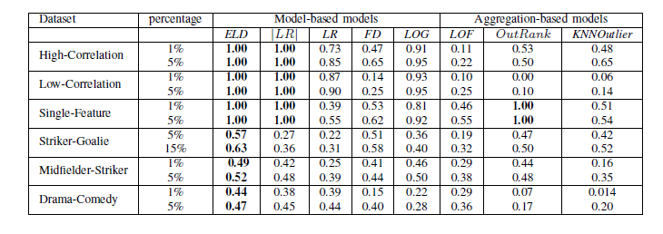
Evaluation: Finally Perfect
Use precision as evaluation metric.
Set the percentages of outliers to be 1% and 5%.
How many outliers were correctly recognized
Notes:
cite Jiawei Han

Slide 22
1D Scatter-Plots
Red points are outliers and blue points are normal class points
Notes:
eld maps outliers to largest range
Eventually want to order as follows: LOG, FD, LR, |LR|, ELD
LR = G-test

Slide 23
Case Study: Strikers
Player Name | Position | ELD Rank | ELD Max Node | FD Max Value | Object Probability | Class Probability
Edin Dzeko | Striker | 1 | Dribble Efficiency | DE = Low | 0.16 | 0.5
Paul Robinson | Goalie | 2 | SavesMade | SM = Medium | 0.3 | 0.04
Michel Vorm | Goalie | 3 | SavesMade | SM = Medium | 0.37 | 0.04
Striker = Normal
MovieTitle | Genre | ELD Rank | ELD Max Node | FD Max feature Value | Object Probability | Class Probability
Brave Heart | Drama | 1 | Actor_Quality | a_quality=4 | 0.93 | 0.42
Austin Powers | Comedy | 2 | Cast_position | cast_num=3 | 0.78 | 0.49
Blue Brothers | Comedy | 3 | Cast_position | cast_num=3 | 0.88 | 0.49
Drama = Normal

Slide 24
Conclusions

Slide 25
Summary and Future Work
Relational anomaly detection: how different is the feature distribution of an individual from the feature distribution of its class?
Basic idea: compare individual model likelihood of with class model likelihood of class features.
Key point: avoid cancellations in log-likelihood comparison -> use distances, not differences.
Bayesian network model:
computationally feasible
accurate
interpretable

Slide 26
Future Work
Learn both a model and parameters for each individual
c.f. Riahi et al. 2013.
exceptional model mining for subgroup discovery.
Explore correlations between anomaly score and success metrics.
e.g. ρ(ELD, TimePlayed) = 0.83, ρ(ELD, Salary) = 0.60.
Notes:
Arno Knobbe’s group in Utrecht

Slide 27

Thank you!
Any questions?

Slide 28
Correlation between Time Played and ELD
Notes:
is there a phase transition?

