Slide 1

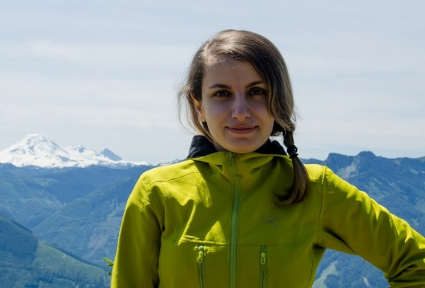
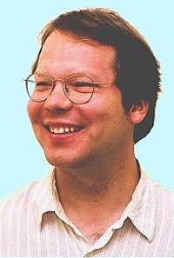
Identifying Unusual Players and Teams
.
Fatemeh Riahi, Oliver Schulte
SSCI, Dec 2015

Slide 2
Overview
Background on data mining and anomaly/outlier detection
Finding teams and players with unusual statistics
Definition of “unusual” = outlier metric
Our outlier metric correlates with success

Slide 3
intro: Anomaly Detection

Slide 4
Data Mining
Data Mining = find “interesting” patterns in large datasets.
More descriptive than predictive statistics.
Different notions of “interesting”.
Today: statistically unusual.
unusual frequencies.
unusual associations/correlations.

Slide 5
Examples
Feature/Attribute Distributions
Player Name | Position | Most Unusual Feature | Most Unusual Value | Individual Probability | Class Probability
Edin Dzeko | Striker | Dribble Efficiency | DE = Low | 0.16 | 0.5
Paul Robinson | Goalie | SavesMade | SM = Medium | 0.3 | 0.04
Michel Vorm | Goalie | SavesMade | SM = Medium | 0.37 | 0.04
Associations
ShotEfficiency = high, TimePlayed = high ➔ ShotsOnTarget = high
Conditional Probability =
70% for van Persie
52% for a random striker

Slide 6
Subgroup Discovery
Find “interesting” subgroups in data.
statistically unusual subtables.
e.g. is Burnaby different from White Rock, Surrey, Vancouver?
For sports/network data: outlier detection = subgroup discovery for groups of size 1.
Exceptional Model Mining
Searching for unusual association rules
Notes:
demo in excel spreadsheet.

Slide 7
Association Rule Mining
Intuitive way to represent associations/correlations.
As seen on Amazon!
The original data mining problem.
ShotEfficiency = high, TimePlayed = high ➔ ShotsOnTarget = high
LHS = Body
RHS = Head
Confidence = P(RHS|LHS)
Support = P(RHS, LHS)
Want both to be above threshold.

Slide 8
Exception Mining
Look for subgroups/individuals with “unusual” association rules.
“Unusual” support and or confidence.
Multiple deviation metrics proposed.
ShotEfficiency = high, TimePlayed = high ➔ ShotsOnTarget = high
Confidence = 70% for van Persie 52% for a random striker
Novak, P. K.; Lavrac, N. & Webb, G. I. (2009), 'Supervised descriptive rule discovery: A unifying survey of contrast set, emerging pattern and subgroup mining', The Journal of Machine Learning Research 10, 377--403.

Slide 9
Our Approach
Outlier/deviation metric: measures divergence of joint feature distribution for target individual from joint feature distribution of random individual.
Multivariate multinomial divergence.
Use Bayesian network model to represent joint feature distribution.

Slide 10
Method DEtails

Slide 11

Model-Based Outlier Detection for Relational Data
Population Database e.g. Premier League games
represents random individual distribution
First-Order Bayesian network
Individual Profile e.g. MU games
High divergence of individual database from Bayesian network ➔outlier
Notes:
cite Blockeel on learning from interpretations
like learning from interpretations

Slide 12
Bayesian Networks
Widely used graphical model class.
Judea Pearl Turing Award 2011.
Decomposes a joint probability into conditional probabilities.
Compactness: exponentially fewer parameters.
Interpretability.

Slide 13
Compactness

Slide 14
Interpretability
LHS ➔ RHS is like P(child node|parent nodes).
Joint distribution is decomposed into association rules!

Slide 15
The Random Selection Pseudo-Likelihood
joint frequency of child node value and parent state support e.g. P_{D}(low,hi,medium) = 1/8
Parameter of Bayes net ln (confidence) e.g. P(low|hi, medium) =38%
hi
medium
Shoteff(P,M)
TackleEff(P,M)
For Edin Dzeko: 1/8 x ln(38%) ≈ -0.12
low
P(DribbleEff(P,M) = low|
Shoteff(P,M) = hi, TackleEff(P,M)= medium)
= 38%
DribbleEff(P,M)
Notes:
can also think: for each instantiation, assign joint probability, multiply together joint probabilities

Slide 16
Outlier metrics

Slide 17
Likelihood Ratio (KLD)
Shoteff(P,M)
TackleEff(P,M)
Class Parameters
Log-Likelihood:
1/8 x ln(38%) ≈ -0.12
P(DribbleEff(P,M) = low|
Shoteff(P,M) = H, TackleEff(P,M)= M)
= 38%
DribbleEff(P,M)
Shoteff(ed,M)
TackleEff(ed,M)
Edin Dzeko Parameters
P(DribbleEff(ed,M) = low|
Shoteff(ed,M) = H, TackleEff(ed,M)= M)
= 50%
Log-Ratio:
1/8 x (ln(38%) – ln(50%)) ≈ -0.034
DribbleEff(ed,M)
Ratio does poorly on synthetic data!
The problem: positive and negative differences cancel out.
Notes:
can also think: for each instantiation, assign joint probability, multiply together joint probabilities

Slide 18
Solution: Avoid Cancelling
Shoteff(ed,M)
TackleEff(ed,M)
For Edin Dzeko
|Log-Ratio|
1/8 x |ln(38%) – ln(50%)| ≈ -0.034
P(DribbleEff(ed,M) = low|
Shoteff(ed,M) = H, TackleEff(ed,M)= M)
= 50%
DribbleEff(ed,M)
ELD is even better: Apply mutual information decomposition 16% x |ln(16%)-ln(51%)| + prior for E.D. prior for striker class DribbleEff = low 1/8 x |ln(38%/16%) – ln(50%/51%)| DribbleEff = low|H,M lift for E.D. lift for striker class
Notes:
also discovered by Peter Flach’s group

Slide 19
Evaluation Results

Slide 20
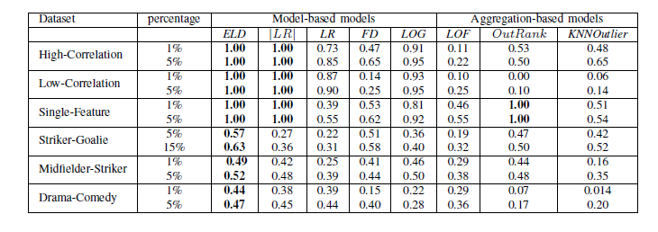
Evaluation: Finally Perfect
Use precision as evaluation metric.
Set the percentages of outliers to be 1% and 5%.
How many outliers were correctly recognized
Notes:
cite Jiawei Han

Slide 21
1D Scatter-Plots (synthetic data)
Red points are outliers and blue points are normal class points
Notes:
eld maps outliers to largest range
Eventually want to order as follows: LOG, FD, LR, |LR|, ELD
LR = G-test

Slide 22
Case Study: Strikers
Player Name | Position | ELD Rank | ELD Max Node | FD Max Value | Object Probability | Class Probability
Edin Dzeko | Striker | 1 | Dribble Efficiency | DE = Low | 0.16 | 0.5
Paul Robinson | Goalie | 2 | SavesMade | SM = Medium | 0.3 | 0.04
Michel Vorm | Goalie | 3 | SavesMade | SM = Medium | 0.37 | 0.04
Striker = Normal
MovieTitle | Genre | ELD Rank | ELD Max Node | FD Max feature Value | Object Probability | Class Probability
Brave Heart | Drama | 1 | Actor_Quality | a_quality=4 | 0.93 | 0.42
Austin Powers | Comedy | 2 | Cast_position | cast_num=3 | 0.78 | 0.49
Blue Brothers | Comedy | 3 | Cast_position | cast_num=3 | 0.88 | 0.49
Drama = Normal

Slide 23
Correlation with success

Slide 24
Correlation between Time Played and ELD
ρ(ELD, Salary) = 0.60.
Notes:
is there a phase transition?

Slide 25
Conclusions

Slide 26
Summary
Relational anomaly detection: how different is the feature distribution of an individual from the feature distribution of its class?
Basic idea: compare individual model likelihood of with class model likelihood of class features.
Key point: avoid cancellations in log-likelihood comparison -> use distances, not differences.
Bayesian network model:
computationally feasible
accurate
interpretable

Slide 27
Future Work
Learn both a model and parameters for each individual
c.f. Riahi et al. 2013.
exceptional model mining for subgroup discovery.
Explore further the correlation with success.
Statistical foundations:
ELD is new statistic (f-divergence).
Suitable for detecting large deviations?
p-values?
Bahadur efficiency?
Notes:
Arno Knobbe’s group in Utrecht

Slide 28

Thank you!
Any questions?

Slide 29
Evaluation Methodology

Slide 30
Synthetic Datasets
Synthetic Datasets: Should be easy! Two Features per player per match.
high correlation | ShotEff | Match Result
Normal | 1 | 1
 | 1 | 1
 | 0 | 0
 | 0 | 0
Outlier | 1 | 1
 | 1 | 0
 | 0 | 0
 | 0 | 1
low correlation | ShotEff | Match Result
Normal | 1 | 1
 | 1 | 0
 | 0 | 0
 | 0 | 1
Outlier | 1 | 1
 | 1 | 1
 | 0 | 0
 | 0 | 0
Notes:
we also know the ground truth about the Bayesian network
We generated three synthetic datasets for a soccer domain with normal and outlier players using the distributions represented in the three Bayesian networks
of Figure 2. Each player participates in 38 matches. Each match assigns a value to each attribute Fi; i = 1; 2 for each player.
High Correlation Normal individuals exhibit a strong association between their attributes, outliers no association. Both normals and outliers have a
close to uniform distribution over single attributes. See Figure 2(a). Low Correlation Normal individuals exhibit no association between their at-
tributes, outliers have a strong association. Both normals and outliers have a close to uniform distribution over single attributes. See Figure 2(b).
Single attributes Both normal and outlier individuals exhibit a strong association between their attributes. In normals, 50% of the time, attribute 1
has value 0. For outliers, attribute 1 has value 0 only 10% of the time. See Figure 2(c).

Slide 31
Evaluation
Use precision as evaluation metric.
Set the percentages of outliers to be 1% and 5%.
How many outliers were correctly recognized
Similar results with AUC, recall.
pseudo log-likelihood does not have perfect recall ☹
Notes:
cite Jiawei Han

