Slide 1

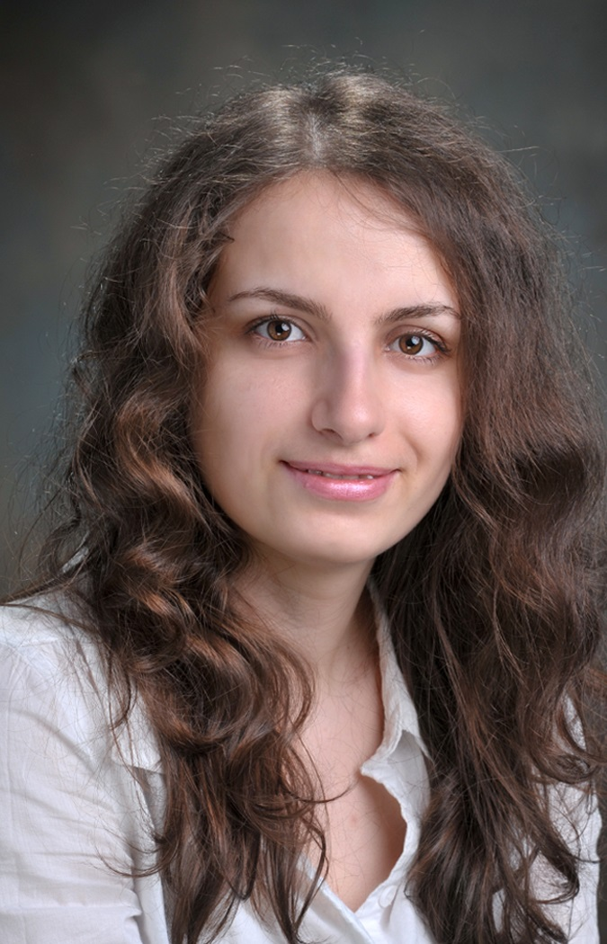
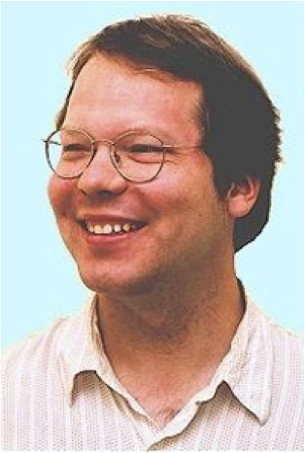
Model-based Exception Mining for Relational Data
School of Computing Science
Simon Fraser University
Vancouver, Canada
Oliver Schulte | Fatemeh Riahi
Extended from 2015 IEEE Symposium Series on Computational Intelligence
Best Student Paper Award
Notes:
If you use “insert slide number” under “Footer”, that text box only displays the slide number, not the total number of slides. So I use a new textbox for the slide number in the master.
This is a version of “Equity”.

Slide 2

Relational Exception Mining
The task: identify exceptional individuals (entities, nodes, objects) in relational data
Approach: apply the Exceptional Model Mining (EMM) framework (Duivesteijn, Knobbe et al. 2016)
EMM
Model/parameter learning method
exception mining method
Notes:
*creator of Safarii, dissertation on multi-relational data mining
*attractive for SRL because we can leverage all our work on model and parameter learning

Slide 3
Exceptional Model Mining: I.I.D Single-Table Data
Entire Population Data
Subgroup Data
attribute 1 | attribute 2 | attribute 3
attribute 1 | attribute 2 | attribute 3
learning
subgroup model
learning
Quality Measure =
Measure of dissimilarity between population and subgroup models
population model
the research challenge

Slide 4



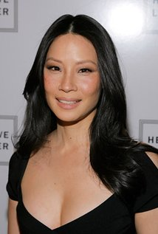


EMM: Multi-relational Data
Entire Observed Network
Subnetwork Centered on Individual aka egonet, interpretation
$0.5M
$5M
$2M
$5M
learning
relational learning
individual SRL model
Outlierness Metric (quality measure) = Measure of dissimilarity between population and individual SRL models
statistical-relational population model
we investigate several metrics based on log-linear likelihood functions

Slide 5
Model Type and Outlierness Metrics
We use first-order Bayesian networks with a log-linear likelihood function (Wang et al. 2008, Schulte 2011).
Outlierness metrics = variants of Kullback-Leibler divergence (some are novel)
log-linear + KLD ➔ total outlier score = sum of feature-wise differences
works for other log-linear models, e.g. Markov Logic Networks
gender(A)
Drama(M)
ActsIn(A,M)
population model for random actor A
gender(uma_t)
Drama(M)
ActsIn(uma_t,M)
individual model for A = uma_t

Slide 6
Case Study: Strikers and Movies
Player Name | Position | ELD Rank | ELD Max Node | Max Value | Individual Probability | Ref. Class Probability
Edin Dzeko | Striker | 1 | Dribble Efficiency | DE = Low | 0.16 | 0.5
Paul Robinson | Goalie | 2 | SavesMade | SM = Medium | 0.3 | 0.04
Michel Vorm | Goalie | 3 | SavesMade | SM = Medium | 0.37 | 0.04
MovieTitle | Genre | ELD Rank | ELD Max Node | Max Value | Individual Probability | Ref. Class Probability
Brave Heart | Drama | 1 | Actor_Quality | a_quality=4 | 0.93 | 0.42
Austin Powers | Comedy | 2 | Cast_position | cast_num=3 | 0.78 | 0.49
Blue Brothers | Comedy | 3 | Cast_position | cast_num=3 | 0.88 | 0.49

