Slide 1

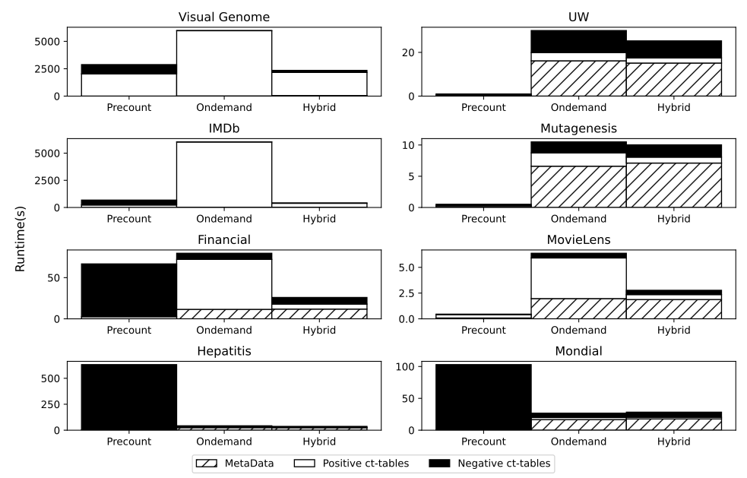
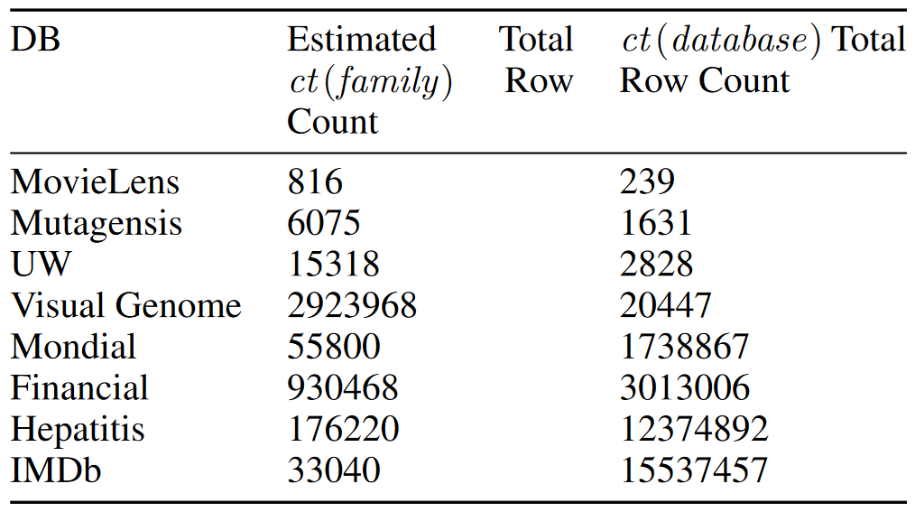
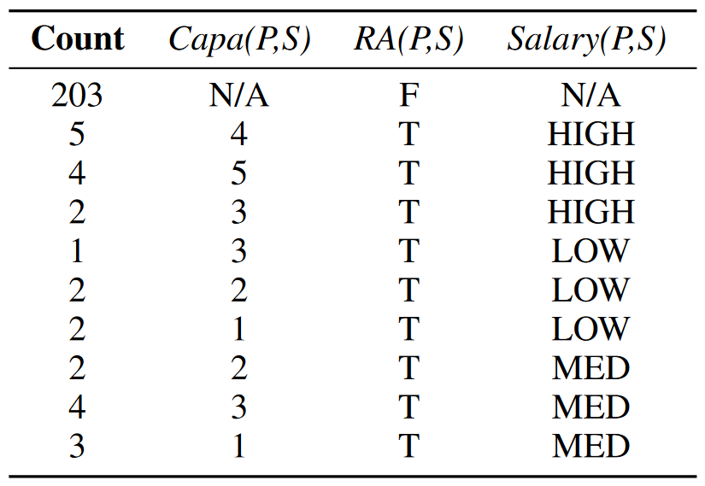
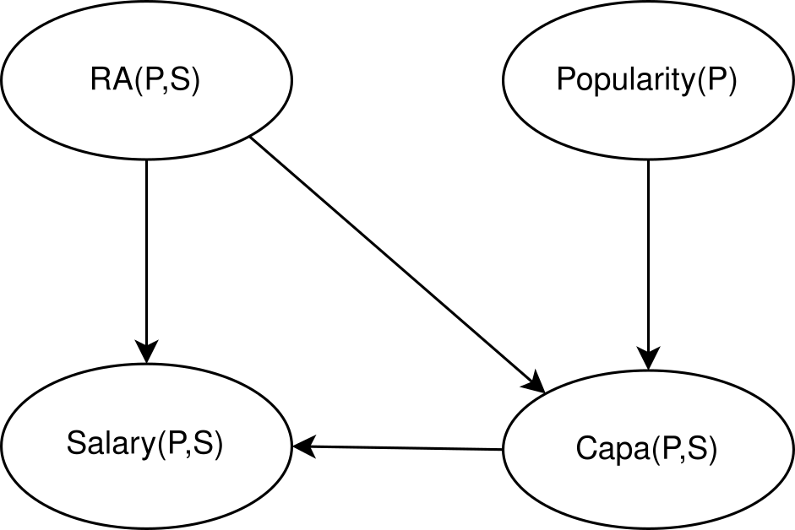
Pre and Post Counting for Scalable Statistical-Relational Model Discovery
Richard Mar and Oliver Schulte
School of Computing Science Simon Fraser University, Vancouver, Canada
Code Repository: https://github.com/sfu-cl-lab/FactorBase
When to Count?
Results
Learning
Times
Conditional Log-likelihood
Conclusion
Instantiation counts are a key computational bottleneck for relational learning
Caching is important to avoid recomputing counts
Precounting for all possible patterns is faster than plain on-demand counting during model search * Assuming enough memory and moderate predicates (20 or less)
Hybrid is even faster: precount for existing relationships, on-demand for negations
Overview
A key problem for relational learning is to count how often a pattern occurs in the data (e.g. pairs of women users who are friends)
For propositional i.i.d. data, need only to filter a subset of existing rows
Relational counting is much harder:
Need to consider new tuples (e.g., pairs, triples of users): the Join Problem
Need to consider non-existing links (e.g. pairs of users who are not friends): the Negation Problem
Insights from graphical model learning:
caching counts to avoid recounting is important for scalability
Important issue is when to count.
Precounting collects a large number of patterns before model search
Ondemand counting computes counts only for patterns generated during model search
Conclusion: Use
precounting for the Join Problem
ondemand counting for the Negation Problem.
This hybrid method can scale to 15M facts
Precount: compute CTs for all variables/predicates in data
Postcount/on-demand: compute CTs for relational dependency (clause) only if generated during model search
Method | Level | Memory | Count time | Model Search Support
Precount P | Global | x Exponential e.g. 2²⁰ for 20 predicates | x exponential ✔️ dynamic programming | ✔️ (lookup)
On-demand O | Local | ✔️ near constant | ✔️ near constant | x generates many separate CTS
New Hybrid Method H:
Precount for existing relationships (Joins)
On-demand for non-existing relationships (Negation) Naïve SRL methods use on-demand without caching
Evaluation: Datasets
MP/N = Average BN indegree
Contingency Tables (CTs)
Used for storing and transforming counts
Maximum Resident Set Size
References
Zhensong Qian, Oliver Schulte, and Yan Sun. Computing Multi-Relational Sufficient Statistics for Large Databases. CIKM 2014, 1249–1258.
2. Lv, Q.; Xia, X. & Qian, P. A fast calculation of metric scores for learning Bayesian networks International Journal of Automation and Computing, 2012, 9, 37-44

