Slide 1
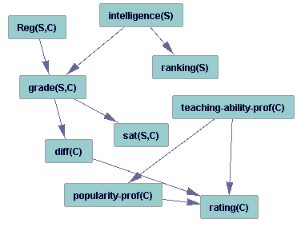
attribute-relation table
Intelligence(S) | Rank(S) | Rating(C) | Diff(C) | P-prof(C) | t-a-prof(C) | Reg(S,C) | R.Grade(S,C) | R.Sat(S.C)
3 | 1 | 3 | 1 | 3 | 1 | T | A | 1
3 | 1 | 2 | 2 | 2 | 1 | T | B | 2
3 | 1 | 3 | 2 | 3 | 1 | F | ⊥ | ⊥
2 | 1 | 3 | 1 | 3 | 1 | F | ⊥ | ⊥
2 | 1 | 2 | 2 | 2 | 1 | T | A | 1
2 | 1 | 3 | 2 | 3 | 1 | T | A | 1
1 | 2 | 3 | 1 | 3 | 1 | T | B | 1
1 | 2 | 2 | 2 | 2 | 1 | T | C | 2
1 | 2 | 3 | 2 | 3 | 1 | F | ⊥ | ⊥
Course
C-id | Prof | Rating | Difficulty | T-a-prof | P-prof
101 | Oliver | 3 | 1 | 1 | 3
102 | David | 2 | 2 | 1 | 2
103 | Oliver | 3 | 2 | 1 | 3
Student
S-id | Intelligence | Ranking
Jack | 3 | 1
Kim | 2 | 1
Paul | 1 | 2
Registration
S-id | C.nr | Grade | Satisfaction
Jack | 101 | A | 1
Jack | 102 | B | 2
Kim | 102 | A | 1
Kim | 103 | A | 1
Paul | 101 | B | 1
Paul | 102 | C | 2
Entity join table
S= S-id | C = C-id | Intelligence(S) | Rank(S) | Rating(C) | Diff(C) | P-prof(C) | T-a-prof(C) | Reg(S,C) | R.Grade(S,C) | R.Sat(S,C)
Jack | 101 | 3 | 1 | 3 | 1 | 3 | 1 | T | A | 1
Jack | 102 | 3 | 1 | 2 | 2 | 2 | 1 | T | B | 2
Jack | 103 | 3 | 1 | 3 | 2 | 3 | 1 | F | ⊥ | ⊥
Kim | 101 | 2 | 1 | 3 | 1 | 3 | 1 | F | ⊥ | ⊥
Kim | 102 | 2 | 1 | 2 | 2 | 2 | 1 | T | A | 1
Kim | 103 | 2 | 1 | 3 | 2 | 3 | 1 | T | A | 1
Paul | 101 | 1 | 2 | 3 | 1 | 3 | 1 | T | B | 1
Paul | 102 | 1 | 2 | 2 | 2 | 2 | 1 | T | C | 2
Paul | 103 | 1 | 2 | 3 | 2 | 3 | 1 | F | ⊥ | ⊥

