Slide 1




Computing Multi-Relational Sufficient Statistics for Large Databases
School of Computing Science
Simon Fraser University
Vancouver, Canada
Zhensong Qian | Oliver Schulte | Yan Sun
Notes:
assume 15 min total time.
Please note: To prepare talks, note that all main conference regular paper presentations are of 20 minutes in length (and allow 2.5 minutes Q/A).
Shorter talks are actually encouraged to allow more Q/A time.
November 6th (Thursday)
KM Session 16: Large- Scale Machine Learning Time: 10:00am - 12:00noon

Slide 2
Multi-Relational Sufficient Statistics
Why
Find correlations involving relationships. e.g.
Compactness: summarize original data by counts.
user searches for item
user watches video about item.
?
user does not search for item
user does not watch video about item
Previous Approaches
Single-table data: row counts (σ selection only).
Multiple tables: Table joins ⋈.
Notes:
relationships are underlined
To our knowledge, no system does this.
Positive only: join, relatively more straightforward
Negative : enumerate, cross product of primary keys → grows exponentially with the number of involved entity sets → too expensive

Slide 3
Contribution
New approach for storing and computing multi-relational sufficient statistics including Negative relationships.
Virtual Join Algorithm: compute cross-table counts without materializing join.
Multi-relationship
(positive, negative )
Virtual Join
Storing &
Computing

Slide 4
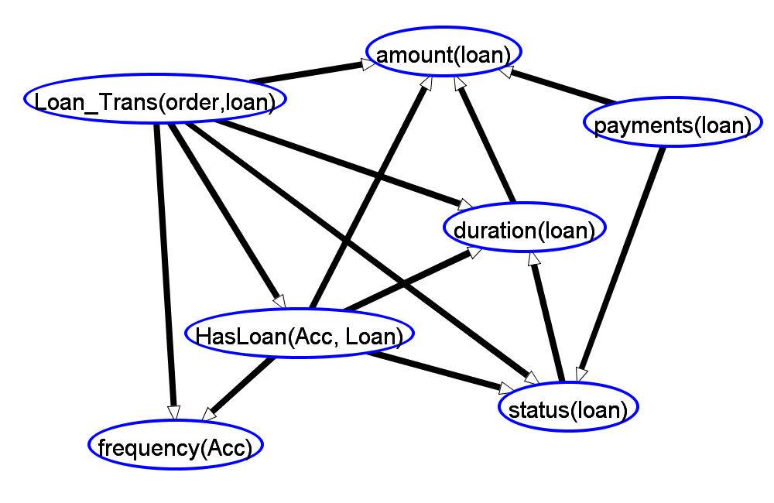
Applications
Feature Selection.
Does frequency of bank statement predict whether customer has loan?
Association Rules.
statement freq.(Acc) = monthly → HasLoan(Acc, Loan) = ? .
Bayesian Network Learning.
...
Notes:
Why choose these three applications? decision-making
Feature/information → convert to knowledge, remove the redundant information
Rule based model→ intuitive/natural/easy to understand
Examples are from Financial Dataset. BN show Markov blanket of HasLoan.

Slide 5
E-R Diagram: Single Relationship
We assume a database in Entity-Relationship format.
Example for University domain with single Relationship.
salary
p_id
ranking
professor
RA
student
intelligence
popularity
s_id
teachability
capability
Professor
p_id | popularity | teachingability
Jim | 2 | 1
Oliver | 3 | 1
David | 2 | 2
RA
p_id | s_id | salary | capability
Oliver | Jack | High | 3
Oliver | Kim | Low | 1
Jim | Paul | Med | 2
David | Kim | High | 2
Student
s_id | intelligence | ranking
Jack | 3 | 1
Kim | 2 | 1
Paul | 1 | 2
Entity table: primary key; Relationship table: many-many, many-one

Slide 6
Contingency Tables (ct-table)
Counts for conjunctive queries:
capability = value1, intelligence = value2.
capability = n/a: wasn’t RA.
Conditional ct-table :
e.g. given capability = 1.
capability | intelligence | count
1 | 2 | 3
1 | 3 | 2
2 | 2 | 3
2 | 3 | 1
3 | 1 | 2
3 | 2 | 4
3 | 3 | 1
4 | 1 | 1
4 | 3 | 4
5 | 1 | 1
5 | 2 | 3
N/A | 1 | 80
N/A | 2 | 65
N/A | 3 | 58
Sum(count) : |  | 228
Total Tuples : |  | 14
Entity Table | Primary Key | # Tuples
Professor | p_id | 6
Student | s_id | 38
Cross Product | 228
Notes:
To do : use RA;
select sum(`MULT`) as Count, `capability(prof0,student0)`as capability,`intelligence(student0)` as intel from `a_CT` group by intel,capability;
total number of students, professors, and size of cross product.

Slide 7
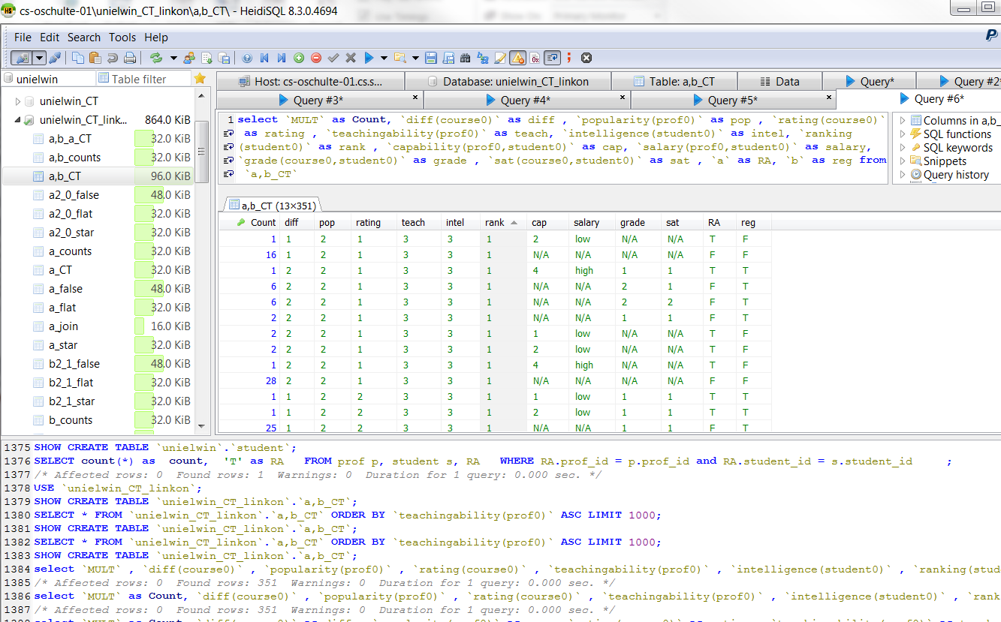
Storing Sufficient Statistics in Database Tables
New: large contingency table stored as database table.
Manipulate using SQL, Index, ...
Notes:
new thing:
store the ct table in the database
Motivate: ct-tables can be large.
Can manipulate using SQL.
Can index them.

Slide 8
Computing Sufficient Statistics: positive relationships only (e.g.RA=True)
CREATE TABLE ct_{T}(RA) AS
SELECT count(*) as count, pop, teach, intel, rank, cap, salary, 'T' as RA
FROM Professor P, Student S, RA
WHERE RA.p_id = P.p_id AND RA.s_id = S.s_id
GROUP BY pop, teach, intel, rank, cap, salary
cross-table count
count | pop | teach | intel | rank | cap | salary | RA
2 | 2 | 2 | 3 | 1 | 4 | high | T
2 | 2 | 3 | 1 | 4 | 3 | med | T
1 | 1 | 2 | 2 | 2 | 1 | med | T
1 | 1 | 2 | 2 | 2 | 2 | med | T
1 | 1 | 2 | 2 | 2 | 3 | low | T
1 | 1 | 2 | 3 | 1 | 3 | high | T
... | ... | ... | ... | ... | ... | ... | ...
Notes:
could mention tuple ID propagation;
Mention that this is a single RA relationship.
Real query for table a-counts:
Select count(*) as "Count" , prof0.popularity AS `pop` , prof0.teachingability AS `teach` , student0.intelligence AS `intel` , student0.ranking AS `rank` , `a`.capability AS `cap` , `a`.salary AS `salary` , 'T' as `a` from unielwin.prof AS prof0 , unielwin.student AS student0 , unielwin.RA AS `a` where `a`.prof_id = prof0.prof_id and `a`.student_id = student0.student_id group by `pop` , `teach` , `intel` , `rank` , `cap` , `salary` ;

Slide 9
Negative relationships: Contingency Table Algebra
Novel Contingency Table Algebra (ct-algebra):
Selection, Projection, Conditioning, Addition, Subtraction, Cross Product
Like relational algebra but with count column.
Can be implemented using SQL queries.
New contingency algebra equation: basis for virtual join.
Think “1-minus trick”: P(not R) = 1 - P(R).
Notes:
mention the operator, just the symbols : 6 operators in total, e.g. union, projection etc.
ct(professor)
Select count(*) as "Count" , prof0.popularity AS `popularity` , prof0.teachingability AS `teach` from unielwin.prof AS prof0 group by`popularity` , `teach`

Slide 10
Computing Sufficient Statistics: Negative Relationship (e.g.RA=False)
Equation for ct-table given RA = False : ct(Pop, Teach, Intelligence, Rank | RA = False) = ct(Prof) x ct(Student) – ct(Pop, Teach, Intelligence, Rank | RA = True)
Compute counts for Negative relationship from true relationship and unspecified.
Instantiates a general equation for arbitrary number of positive and negative relationships.

Slide 11
Example ct table Computation for Single Relationship
Attributes of relationships omitted for simplicity only.
Key property:
never enumerate cross product of primary keys.
e.g. don’t materialize cross product of Students and Professors.
implemented using SQL queries.

Slide 12
Step 1: Contingency Table Cross Product
x
Example: ct(Professor) ct(Student)
→ ct*(RA)
Count | pop | teach
2 | 1 | 2
1 | 2 | 2
3 | 2 | 3
ct(Professor)
Count | pop | teach | intel | rank
12 | 1 | 2 | 1 | 4
16 | 1 | 2 | 1 | 5
10 | 1 | 2 | 2 | 2
14 | 1 | 2 | 2 | 3
2 | 1 | 2 | 2 | 4
16 | 1 | 2 | 3 | 1
6 | 1 | 2 | 3 | 2
6 | 2 | 2 | 1 | 4
8 | 2 | 2 | 1 | 5
5 | 2 | 2 | 2 | 2
7 | 2 | 2 | 2 | 3
... | ... | ... | ... | ...
x
ct*(RA)
ct(Student)
Count | intel | rank
6 | 1 | 4
8 | 1 | 5
5 | 2 | 2
7 | 2 | 3
1 | 2 | 4
8 | 3 | 1
3 | 3 | 2
Notes:
Cross product of sufficient statistics, not the primary keys.
Add animation, to show tables in order ct(s) → ct(p) → ct*(ra)

Slide 13
Step 2: Contingency Table Subtraction
Count | Pop | Teach | Intel | Rank
16 | 1 | 2 | 3 | 1
15 | 2 | 3 | 2 | 2
18 | 2 | 3 | 1 | 4
… | … | … | … | …
Count | Pop | Teach | Intel | Rank
1 | 1 | 2 | 3 | 1
1 | 1 | 2 | 2 | 2
1 | 2 | 2 | 2 | 4
… | … | … | … | …
RA
T
ct*(RA)
ct_{T}(RA)
Count | Pop | Teach | Intel | Rank
15 | 1 | 2 | 3 | 1
16 | 2 | 3 | 2 | 3
21 | 2 | 3 | 3 | 1
… | … | … | … | …
RA
F
∪
Count | Pop | Teach | Intel | Rank | RA
15 | 1 | 2 | 3 | 1 | F
1 | 1 | 2 | 3 | 1 | T
1 | 1 | 2 | 2 | 2 | T
... | ... | ... | ... | ... | ...
ct(RA)
Final Result: Contingency Table for RA relationship
Notes:
Mention slide no. for ct* and ctT
Emphasize: no joins of data tables, no cross product.
drop last two intermediate tables.

Slide 14
Computation for Multiple Relationships: Dynamic Programming
Build contingency tables for larger relationship chains from smaller ones using ct-algebra equation.
Registration, RA, Teaches
Level 3
Registration, RA
Registration, Teaches
RA, Teaches
Level 2
Registration
RA
Teaches
Level 1
Student
Course
Professor
Level 0
Lattice of Relationship Chains (Metapaths)
Notes:
DP

Slide 15
Datasets for Evaluation
7 Real-world Datasets (over 1M rows).
Dataset | #Relationship Tables/ Total | # Columns | # Rows
UW-CSE | 2/4 | 14 | 712
Mondial | 2/4 | 18 | 870
Hepatitis | 3/7 | 19 | 12,927
Mutagenesis | 2/4 | 11 | 14,540
Financial | 3/7 | 15 | 225,932
Movielens | 1/3 | 7 | 1,010,051
IMDB | 3/7 | 17 | 1,354,134
Computing Sufficient Statistics Qian, Schulte, Sun CIKM 2014 @ Shanghai, China
Notes:
To do:
Self-relationship example: Borders(Country1, Country2).
Tuples = rows
Attributes = columns
maybe order by #Tuples
Drop self-relationship

Slide 16
Computation Time
Never enumerates cross product of primary keys.
Complexity: nearly linear in size of the required output.
(non-trivial) #ct_operation = O(#SS * log (#SS))
Dataset | #Sufficient Statistics (SS) | Cross Product Time | Our Dynamic Program Time
Movielens | 252 | 703.99 | 2.70
Mutagenesis | 1,631 | 1,096.00 | 1.67
UW-CSE | 2,828 | 350.30 | 3.84
Mondial | 1,746,870 | 132.13 | 1,112.84
Financial | 3,013,011 | N.T. | 1,421.87
Hepatitis | 12,374,892 | N.T. | 3,536.76
IMDB | 15,538,430 | N.T. | 7,467.85
Notes:
MJ -> our dynamic program
CP -> corss product.
#sufficient stastistics computed
bold better numbers.
r -> #Counts.
In other words, nearly linear in the size of the required output.
Optimal. Upper bound is not trivial.
N.T. indicates Not Terminated

Slide 17
Link Analysis Finds New Association Rules
Link Analysis Off: only positive relationships occur.
Link Analysis On: both positive and negative relationships may occur.
E.g. 12 rules with relationship correlation out of top-20 most interesting rules.
statement freq.(Acc) = monthly → HasLoan(Acc, Loan) = T.
Computing Sufficient Statistics Qian, Schulte, Sun CIKM 2014 @ Shanghai, China
Notes:
new type of association rule is possible to learn.
Interestingness = lift.

Slide 18
Link Analysis Finds New Relevant Features for Classification
Dataset | Target Variable | # Selected Features
 |  | Link Analysis Off | Link Analysis On / Relationship Indicators
MovieLens | Horror | 2 | 2/0
Mutagenesis | inda | 3 | 3/0
Financial | balance(trans) | 3 | 2/1
Hepatitis | sex | 1 | 2/1
IMDB | avg_revenue | 5 | 2/1
Mondial | percentage | Empty CT | 4/0
UW-CSE | courseLevel | 1 | 4/2
New Features are selected with link analysis on.
E.g. amount(trans), type(trans), frequency(acc) v.s. operation(trans), loan_trans(trans, loan)
Computing Sufficient Statistics Qian, Schulte, Sun CIKM 2014 @ Shanghai, China
Notes:
Rvars -> Relationship indicators.
drop distinctness. Give siingle row with example.

Slide 19
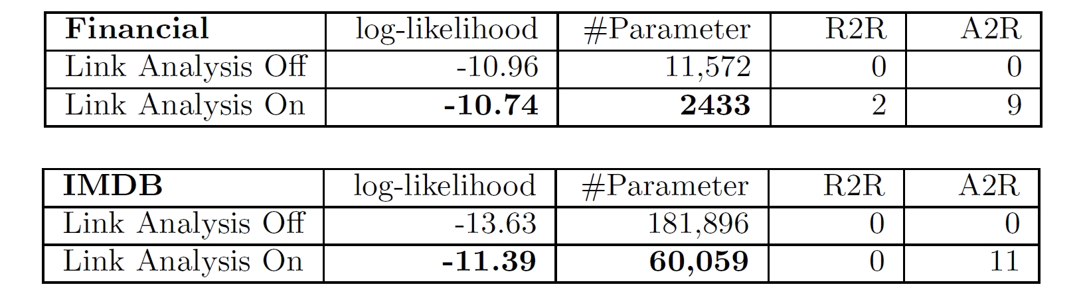
Link Analysis Finds better Bayes Nets
link analysis on: BNs achieve better model selection scores.
Loan_Order(order, loan) → Has_loan(acc,loan)
R2R: correlation between relationships.
Loan_Order(order, loan) → Frequency(acc)
A2R: correlation between attribute and relationship.
Notes:
Only show the most challenge ones.
Relationship indicators.
Show single A2R edges, single R2R edge.

Slide 20
Conclusion
Storing Sufficient statistics in database tables.
Proposed contingency table algebra to support Virtual Join: compute cross-table counts without materializing joins.
New DP Algorithm for computing multi-relational sufficient statistics with negative relationships.
Efficient computation time.

Slide 21
Conclusion
Useful for
association rule learning.
feature selection.
generative modelling.
...
MySQL/Java implementation available on-line.
Future Work
Scales well in number of rows in data tables.
Does not scale well with number of columns/variables.
Notes:
missing or noisy data? Closed-world assumption.
MySQL Implementation has restrictions.
backup slide for compression

Slide 22

Thanks for your attention.
Notes:
missing or noisy data? Closed-world assumption.
MySQL Implementation has restrictions.
backup slide for compression

Slide 23
Backup Slide: count distribution

Slide 24
Backup Slide: Full tables for ct*(RA)
MULT | pop | teach | intel | rank
12 | 1 | 2 | 1 | 4
16 | 1 | 2 | 1 | 5
10 | 1 | 2 | 2 | 2
14 | 1 | 2 | 2 | 3
2 | 1 | 2 | 2 | 4
16 | 1 | 2 | 3 | 1
6 | 1 | 2 | 3 | 2
6 | 2 | 2 | 1 | 4
8 | 2 | 2 | 1 | 5
5 | 2 | 2 | 2 | 2
7 | 2 | 2 | 2 | 3
1 | 2 | 2 | 2 | 4
8 | 2 | 2 | 3 | 1
3 | 2 | 2 | 3 | 2
18 | 2 | 3 | 1 | 4
24 | 2 | 3 | 1 | 5
15 | 2 | 3 | 2 | 2
21 | 2 | 3 | 2 | 3
3 | 2 | 3 | 2 | 4
24 | 2 | 3 | 3 | 1
9 | 2 | 3 | 3 | 2
Count | pop | teach
2 | 1 | 2
1 | 2 | 2
3 | 2 | 3
ct(Professor)
x
Count | intel | rank
6 | 1 | 4
8 | 1 | 5
5 | 2 | 2
7 | 2 | 3
1 | 2 | 4
8 | 3 | 1
3 | 3 | 2
ct(Student)
ct(Student) X ct(Professor)→ct*(RA)
Notes:
6 operators in total, e.g. union, projection etc.
To do : use RA;
Change to real table, be consistent
ct(professor)
Select count(*) as "Count" , prof0.popularity AS `popularity` , prof0.teachingability AS `teach` from unielwin.prof AS prof0 group by`popularity` , `teach`

Slide 25
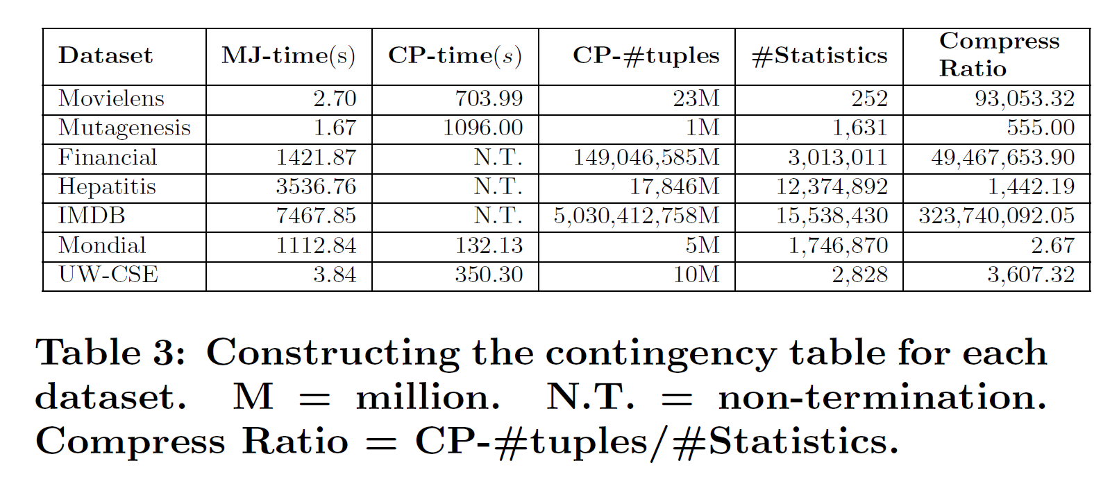
Backup Slide: Compression Ratio
Computing Sufficient Statistics Qian, Schulte, Sun CIKM 2014 @ Shanghai, China

Slide 26
Backup Slide: Lattice with functor notation
Registration(S,C),RA(S,P),Teaches(P,C)
Level 3
Registration(S,C),RA(S,P)
Registration(C,S),Teaches(C,P)
RA(S,P),Teaches(P,C)
Level 2
Registration(S,C)
RA(S,P)
Teaches(P,C)
Level 1
Student(S)
Course(C)
Professor(P)
Level 0

Slide 27
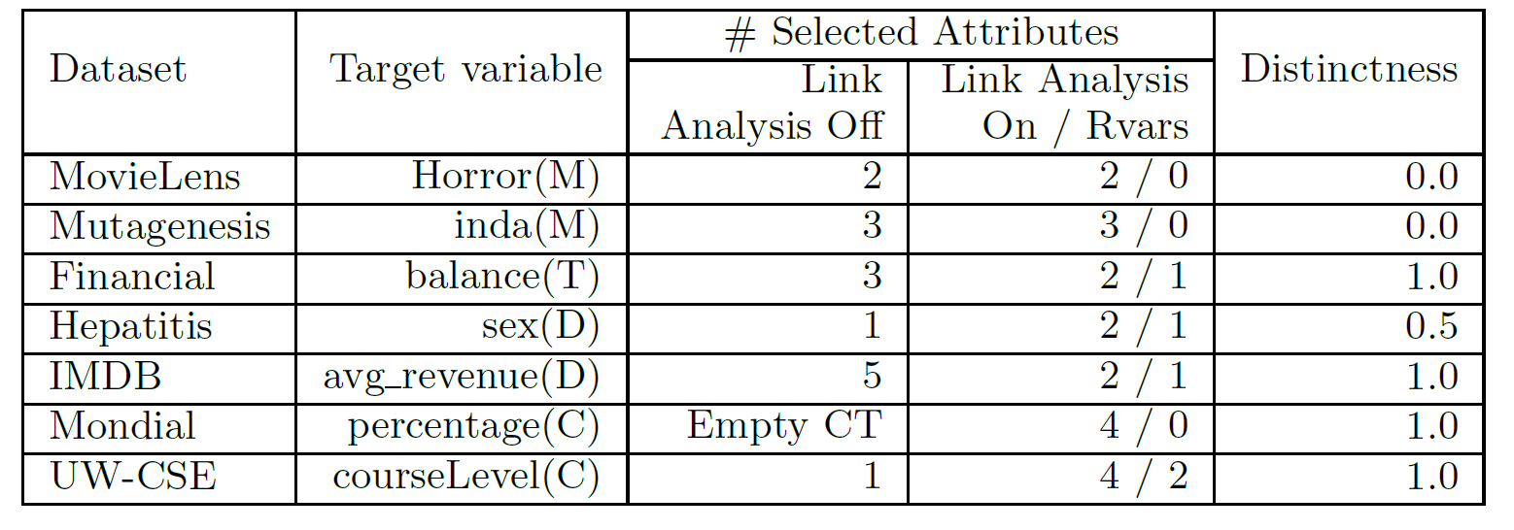
Dataset | Target Variable | # Selected Features
 |  | Link Analysis Off | Link Analysis On / Relationship Indicators
MovieLens | Horror | 2 | 2/0
Mutagenesis | inda | 3 | 3/0
Financial | balance | 3 | 2/1
Hepatitis | sex | 1 | 2/1
IMDB | avg_revenue | 5 | 2/1
Mondial | percentage | Empty CT | 4/0
UW-CSE | courseLevel | 1 | 4/2

