Slide 1

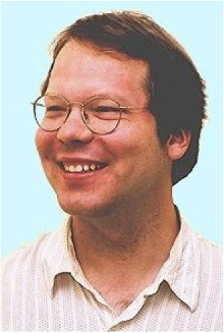
BayesBase: Learning Bayes Nets with Relational Algebra
School of Computing Science
Simon Fraser University
Vancouver, Canada
Oliver Schulte | Hassan Khosravi | Arthur Kirkpatrick | Tianxiang Gao | Yuke Zhu
Notes:
BayesBase: Relational Learning with Relational Algebra
BayesBase: Learning Bayes Nets with Relational Algebra
BayesBase: Learning Bayes Nets with Relational Algebra
BayesBase: Managing Meta-information for Database Learning
BayesBase: Managing Schema Information for Machine Learning
BayesBase: Managing Schema Information for Machine Learning with Relational Databases
BayesBase: Managing Meta-information for Machine Learning
Managing Relational Database Schemata for Learning Graphical Models
Ref: Mlbase, bayestore?

Slide 2
Misc points
SQL for describing and manipulating structured data.
Also for describing and manipulating structured random variables and structured models.

Slide 3
Motivation and contributions
Key computational challenge in learning: sufficient statistics.
Precomputation/caching approach: precompute before learning.
Data accessed once only.
Can be done off-line,used for different learning tasks.
Dynamic programming.
First precomputation approach for large relational datasets.
Application for BN learning: generative SRL model, over 1 million records.
Challenge for relational data: materialization, necessary tables don’t exist.
Joins.
Negated relationships. We treat any number of positive and negated links.
Generality challenge: want algorithms to work on any SQL database. Solution: use schema information as meta information to define random variables and models.
Notes:
Feb 21 2014

Slide 4
General Machine Learning for Single-Table Data
e.g. Weka, R, Matlab.
Input is single flat data matrix .
Represents independent and identically distributed data points (i.i.d. data).
No need to describe connections between tables (e.g., no foreign key constraints).
Default set of random variables = attribute columns.
Computing sufficient statistics = counting matching rows in data table.
Notes:
Preprocessing that data into a flat table: lose important information or introduce some redundancy infor, and usually time-consuming
Getoor2001. :
real data often contain strong correlations between attributes (For example a census database might contain highly correlated attributes such as Income and Home-Owner. The attribute value independence assumption would lead to an overestimate of the result size of a query that asks for low-income home-owners.)

Slide 5
Relational Learning With Multiple Database Tables
Models information from different related tables simultaneously.
Uses both links and attributes to discover probabilistic dependencies.
Applications: Visualizing correlations, query optimization, missing/uncertain data (BayesStore).
Data is not i.i.d. -> statistical issues discussed elsewhere.
We are focusing on developing general learning algorithms that can be applied to different databases directly.
No preprocessing.
No feature engineering.
Use of SQL for development and optimization.
Notes:
look up domingos’ paper on relational learning challenges.
maybe mention recursive dependencies here

Slide 6
General and Scalable Machine Learning with Relational Databases: SQL
Graphical model = structured object with structured components.
All structured objects are treated as 1st-class citizens, represented in database meta-tables.
Can be manipulated using SQL.
Can be combined with machine learning algorithms using SQL.
Notes:
linear algebra = relational algebra for implementation.
if you make good use of database techniques, can achieve general scalable machine learning.

Slide 7
Functors vs. relations
Translate basic information from database schema into 1st-order logic notation, functor-based.
type of attributes (unary, binary).
Input types for attributes.
number of possible values for each attribute.
number of relationships, type of each relationship (self-relationship, same type, many-one).
Populations.
Logic relates to domain relational calculus.
Notes:
*descriptive attributes of links?
*functors?
self-relationship: relation tables involve the same entity table, border(country1,country2)
same type :different relation tables involve two same entity tables, bond(a_id,m_id), moleatm(a_id,m_id)

Slide 8
Goal: Learning Bayes Net Models
Why?
visualize correlations.
support what-if queries.
Generative model, complex machine learning task.
compiles database statistics for quick queries (cite Getoor, Schulte et al.)
can be converted to other model types (e.g., MLNs).
Notes:
cite BayesStore, Getoor and others.

Slide 9
Example
Show Bayes net.
give example and semantics.
Notes:
Still use University but with the non-numerical ranking?

Slide 10
Registration(S,C),RA(S,P),Teaches(P,C)
Level 3
Registration(S,C),RA(S,P)
Registration(C,S),Teaches(C,P)
RA(S,P),Teaches(P,C)
Level 2
Registration(S,C)
RA(S,P)
Teaches(P,C)
Level 1
Student(S)
Course(C)
Professor(P)
Level 0
Notes:
make picture consistent.
Add arrows to indicate propagating edges.

Slide 11
BN for University Database
Relational Attribute
Relationship Indicator
Capability(prof0,student0)
Salary(prof0,student0)
RA(prof0,student0)
Entity Attribute
Registration(course0,student0)
Popularity(prof0)
Intel(student0)
Teachingability(prof0)
Ranking(student0)
Rating(course0)
Grade(course0,student0)
Satisfaction(course0,student0)
Diff(course0)
Notes:
Node :::Descriptive Attributes(Entity and Relation)
Intel(student0) : Intelligence is the Descriptive Attributes, Student0 is the Entity table
deterministic functions of key fields.
add RA. Maybe add link between relationships.
Maybe show an example of a BN that you learned.

Slide 12
High-level Algorithm
Find functor nodes from database.
Generate candidate Bayes net.
Score candidate Bayes net.
Estimate parameters.
Notes:
just describe it in English? Do not need to add algorithm in the paper?

Slide 13
Constructing Nodes from Database

Slide 14
Finding Functor Nodes
Relational Data tables are not self-describing.
Schema information needs to be accessed dynamically during learning.
Relational data tables do not fix a set of random variables.
Sufficient statistics must be computed for derived tables not given in the database.

Slide 15
Finding Functor Nodes
In single table case, can just use attribute columns.
Can’t just use attribute columns.
Need Rnodes for relationships.
Autocorrelation: make “copies” of nodes.
Need to exploit meta data to detect self-relationships automatically.
Show examples of SQL queries (setup queries).
Notes:
Prepare the sample set-up queries?

Slide 16
Generate Candidate Bayes nets

Slide 17
Hierarchical Lattice Search
Like our slide in aaai-final.pptx.
Show SQL doing this. (maybe view).
Notes:
Level-wise search, big graph
1.Generating the required/forbidden edges with views
2.Propagating the knowledge from the lower level to upper level

Slide 18
Hierarchical Search
Level-wise search through table join lattice.
Build contingency table for each relationship chain, apply Bayes net learner.
Results from shorter paths are propagated to longer paths (Bottom-Up).
Registration(C,S),RA(S,P),Teaches(C,P)
Level 3
Registration(C,S),RA(S,P)
Registration(C,S)Teaches(C,P)
RA(S,P),Teaches(C,P)
Level 2
Registration(C,S)
RA(S,P)
Teaches(C,P)
Level 1
Student(S)
Course(C)
Professor(P)
Level 0
Notes:
make picture consistent.
Add arrows to indicate propagating edges.

Slide 19
Scoring Bayes Nets
Notes:
Bdeu scores

Slide 20
Computing Sufficient Statistics
Representation: Contingency Table.
For single table, can use group by. (examples/screenshot)
Use Meta-SQL query: dynamically exploit schema during learning.
Problems:
need to count events in join tables.
need to count events in complement tables.
For 1), can still use group by. [highly optimized even for joins]. (examples/screenshot)
For 2), no optimization available (unsafe query).
propose CT-algebra, extension of relational algebra.
Notes:
Meta-SQL query: [Column-List(Table)]
[Column-List(student)]:
[Column-List(prof)]:
[Column-List(course)]:
[Column-List(RA)]:
[Column-List(Reg)]:

Slide 21
Contingency tables
Snapshot of CT table for unielwin
Columns: parameterize variables
Row: possible values
Conjunctive queries in domain relational calculus
Counts, result size of query

Slide 22
Contingency table algebra
Unary operators : selection, projection, conditioning (can be defined as selection followed by projection.)
need notation of complement of columns
Binary operators:
set difference (addition, substraction)
cross product,

Slide 23
Eliminating false relationship

Slide 24
Computing the CT table
Input: a list of Rnodes (R1,R2,R3)
Find CT table for T[R1=T,R2=T,R3=T] = ct(Anodes(R1,R2,R3)|R1=T,R2=T,R3=T)
Set the pivot to R3. Let T[R2=T,R1=T, R3=star] := ct(Anodes(R1,R2)|R1=T,R2=T) x ct(1NodesR3-1Nodes(R1,R2)).
T[R2=T,R1=T,R3=F] = T[R2=T,R1=T, R3_star]- Project_{2Nodes(R3)-comp} T[R1=T,R2=T,R3=T]
Let R3_fill := (1,n/a for all 2Nodes of R3).
Ct(Anodes(R1,R2,R3)|R1=T,R2=T) = T[R2=T,R1=T,R3=F]xR3_fill union T[R1=T,R2=T,R3=T]
Notes:
% Need to project so that both T[R2=T,R1=T, R3_star] and Project_{2Nodes(R3)-comp} T[R1=T,R2=T,R3=T]

Slide 25


CT(1Nodes(X)) x CT(1Nodes(Y))
X,Y are the population variables involved in R
CT(1Nodes(R)|R = *)
CT(1nodes(R), 2nodes(R)|R=T)
Join of existing tables via meta-query
$$π_{\overline{2Nodes(R})}$$
$$−$$
CT(Anodes(R)|R=F)
Add columns R=F,2Nodes(R)= N/A
Add column R=T
∪
CT(Anodes(R),R)
Notes:
Flow chart

Slide 26
ct*
Count | Pop | Teach | Intel | Rank
16 | 1 | 2 | 3 | 1
15 | 2 | 3 | 2 | 2
18 | 2 | 3 | 1 | 4
… | … | … | … | …
Count | Pop | Teach | Intel | Rank | Cap | Sal
1 | 1 | 2 | 3 | 1 | 3 | high
1 | 1 | 2 | 2 | 2 | 3 | low
1 | 2 | 2 | 2 | 4 | 3 | med
… | … | … | … | … | … | …
ct_{T}
CREATE TABLE ct* AS SELECT p_ct.count * s_ct.count as count, CL(p),CL(s) FROM p_ct , s_ct
CREATE TABLE ct_{T} AS SELECT count(*) as count, CL(p), CL(s), CL(RA) FROM p, s, RA WHERE RA.p_id = p.p_id and RA.s_id = s.s_id
GROUP BY CL(p), CL(s), CL(RA)
-
π_{Nodes}
ct_{F}
Count | Pop | Teach | Intel | Rank
15 | 1 | 2 | 3 | 1
16 | 2 | 3 | 2 | 3
21 | 2 | 3 | 3 | 1
… | … | … | … | …
Count | Pop | Teach | Intel | Rank
1 | 1 | 2 | 3 | 1
1 | 1 | 2 | 2 | 2
1 | 2 | 2 | 2 | 4
… | … | … | … | …
temp
CREATE TABLE ct_{F} AS SELECT (ct*.count - temp.count) AS count, CL(temp)
FROM ct* , temp WHERE CL(ct*) = CL (temp)
UNION SELECT (ct*.COUNT) AS COUNT, CL(ct*) FROM ct* WHERE
CL(ct*) NOT IN (SELECT CL(temp) FROM temp )
CREATE TABLE temp AS SELECT SUM(ct_{T}.count) AS count,
CL(p), CL(s) FROM ct_{T} GROUP BY CL(p), CL(s)
RA
T
RA | Cap | Sal
F | n/a | n/a
ct_{T}⁺
ct_{F}⁺
Count | Pop | Teach | Intel | Rank | Cap | Sal | RA
15 | 1 | 2 | 3 | 1 | n/a | n/a | F
12 | 1 | 2 | 1 | 4 | n/a | n/a | F
7 | 1 | 2 | 2 | 2 | n/a | n/a | F
… | … | … | … | … | … | … | …
Count | Pop | Teach | Intel | Rank | Cap | Sal | RA
1 | 1 | 2 | 3 | 1 | 3 | high | T
1 | 1 | 2 | 2 | 2 | 3 | low | T
1 | 2 | 2 | 2 | 4 | 3 | med | T
… | … | … | … | … | … | … | …
∪
CL(P) | Pop,Teach
CL(S) | Intel, Rank
CL(RA) | Cap, Sal
CL(CT*) | [CL(P), CL(S)]
CL(CT) | [CL(CTT) , RA]
CL(CTT) | [CL(CT*) ,CL(RA)]
Count | Pop | Teach | Intel | Rank | Cap | Sal | RA
15 | 1 | 2 | 3 | 1 | n/a | n/a | F
1 | 1 | 2 | 3 | 1 | 3 | high | T
1 | 1 | 2 | 2 | 2 | 1 | med | T
... | ... | ... | ... | ... | ... | ... | ...
CREATE TABLE ct AS
SELECT * FROM ct_{F}⁺ UNION SELECT * FROM ct_{T}⁺
ct
Notes:
Replace CT with ct, Feb 25th, 2014, added columns list table
sub.jpg
Fixed typos for temp table. Jan 13rd
CL(CT*) = CL(temp) = Pop, Teach, Intel, Rank
CL(CT_{T}) = Pop, Teach, Intel, Rank, Cap, Sal
CL(CT_{F}) = Pop, Teach, Intel, Rank
CL(CT) = CL(CT_{F}⁺) = CL(CT_{T}⁺) = Pop, Teach, Intel, Rank, Cap, Sal, RA
CL(p) = Pop, Teach
CL(s) = Intel, Rank
CL(RA)= Cap, Sal

Slide 27
ct*
Count | Pop | Teach | Intel | Rank
16 | 1 | 2 | 3 | 1
15 | 2 | 3 | 2 | 2
18 | 2 | 3 | 1 | 4
… | … | … | … | …
Count | Pop | Teach | Intel | Rank | Cap | Sal
1 | 1 | 2 | 3 | 1 | 3 | high
1 | 1 | 2 | 2 | 2 | 3 | low
1 | 2 | 2 | 2 | 4 | 3 | med
… | … | … | … | … | … | …
ct_{T}
Stu(S)
x
Prof(P)
RA(P,S)
Stu(S)
Prof(P)
CREATE TABLE ct* AS SELECT p_ct.count * s_ct.count as count, CL(p),CL(s) FROM p_ct , s_ct
CREATE TABLE ct_{T} AS SELECT count(*) as count, CL(p), CL(s), CL(RA) FROM p, s, RA WHERE RA.p_id = p.p_id and RA.s_id = s.s_id
GROUP BY CL(p), CL(s), CL(RA)
-
π_{Nodes}
ct_{F}
Count | Pop | Teach | Intel | Rank
15 | 1 | 2 | 3 | 1
16 | 2 | 3 | 2 | 3
21 | 2 | 3 | 3 | 1
… | … | … | … | …
Count | Pop | Teach | Intel | Rank
1 | 1 | 2 | 3 | 1
1 | 1 | 2 | 2 | 2
1 | 2 | 2 | 2 | 4
… | … | … | … | …
temp
CREATE TABLE ct_{F} AS SELECT (ct*.count - temp.count) AS count, CL(temp)
FROM ct* , temp WHERE CL(ct*) = CL (temp)
UNION SELECT (ct*.COUNT) AS COUNT, CL(ct*) FROM ct* WHERE
CL(ct*) NOT IN (SELECT CL(temp) FROM temp )
CREATE TABLE temp AS SELECT SUM(ct_{T}.count) AS count,
CL(p), CL(s) FROM ct_{T} GROUP BY CL(p), CL(s)
RA
T
RA | Cap | Sal
F | n/a | n/a
ct_{T}⁺
ct_{F}⁺
Count | Pop | Teach | Intel | Rank | Cap | Sal | RA
15 | 1 | 2 | 3 | 1 | n/a | n/a | F
12 | 1 | 2 | 1 | 4 | n/a | n/a | F
7 | 1 | 2 | 2 | 2 | n/a | n/a | F
… | … | … | … | … | … | … | …
Count | Pop | Teach | Intel | Rank | Cap | Sal | RA
1 | 1 | 2 | 3 | 1 | 3 | high | T
1 | 1 | 2 | 2 | 2 | 3 | low | T
1 | 2 | 2 | 2 | 4 | 3 | med | T
… | … | … | … | … | … | … | …
∪
CL(P) | Pop,Teach
CL(S) | Intel, Rank
CL(RA) | Cap, Sal
CL(CT*) | [CL(P), CL(S)]
CL(CT) | [CL(CTT) , RA]
CL(CTT) | [CL(CT*) ,CL(RA)]
Count | Pop | Teach | Intel | Rank | Cap | Sal | RA
15 | 1 | 2 | 3 | 1 | n/a | n/a | F
1 | 1 | 2 | 3 | 1 | 3 | high | T
1 | 1 | 2 | 2 | 2 | 1 | med | T
... | ... | ... | ... | ... | ... | ... | ...
CREATE TABLE ct AS
SELECT * FROM ct_{F}⁺ UNION SELECT * FROM ct_{T}⁺
ct
Notes:
Add Oliver’s net comments Jun 10th 2014
beside the ct_T table we can draw the part of the lattice that shows the RA(S,P) chain with the S and P tables below it. Perhaps beside the ct_* table, we can draw the Student and Professor nodes, with an x between them
Replace CT with ct, Feb 25th, 2014, added columns list table
sub.jpg
Fixed typos for temp table. Jan 13rd

Slide 28
ct*
Count | Pop | Teach | Intel | Rank
16 | 1 | 2 | 3 | 1
15 | 2 | 3 | 2 | 2
18 | 2 | 3 | 1 | 4
… | … | … | … | …
Count | Pop | Teach | Intel | Rank | Cap | Sal
1 | 1 | 2 | 3 | 1 | 3 | high
1 | 1 | 2 | 2 | 2 | 3 | low
1 | 2 | 2 | 2 | 4 | 3 | med
… | … | … | … | … | … | …
ct_{T}
Stu(S)
x
Prof(P)
RA(P,S)
Stu(S)
Prof(P)
_{Line 5 in Alg. 2}
CREATE TABLE ct* AS SELECT p_ct.count * s_ct.count as count, CL(p),CL(s) FROM p_ct , s_ct
CREATE TABLE ct_{T} AS SELECT count(*) as count, CL(p), CL(s), CL(RA) FROM p, s, RA WHERE RA.p_id = p.p_id and RA.s_id = s.s_id
GROUP BY CL(p), CL(s), CL(RA)
_{Line 6 in Alg. 2}
_{PIVOT}
_{Line 1 in Alg. 1}
-
π_{Vars}
_{Line 1 in Alg. 1}
Count | Pop | Teach | Intel | Rank
15 | 1 | 2 | 3 | 1
16 | 2 | 3 | 2 | 3
21 | 2 | 3 | 3 | 1
… | … | … | … | …
Count | Pop | Teach | Intel | Rank
1 | 1 | 2 | 3 | 1
1 | 1 | 2 | 2 | 2
1 | 2 | 2 | 2 | 4
… | … | … | … | …
ct_{F}
temp
CREATE TABLE ct_{F} AS SELECT (ct*.count - temp.count) AS count, CL(temp)
FROM ct* , temp WHERE CL(ct*) = CL (temp)
UNION SELECT (ct*.COUNT) AS COUNT, CL(ct*) FROM ct* WHERE
CL(ct*) NOT IN (SELECT CL(temp) FROM temp )
CREATE TABLE temp AS SELECT SUM(ct_{T}.count) AS count,
CL(p), CL(s) FROM ct_{T} GROUP BY CL(p), CL(s)
RA
T
RA | Cap | Sal
F | n/a | n/a
_{Line 2 in Alg. 1}
_{Line 3 in Alg. 1}
ct_{T}⁺
ct_{F}⁺
Count | Pop | Teach | Intel | Rank | Cap | Sal | RA
15 | 1 | 2 | 3 | 1 | n/a | n/a | F
12 | 1 | 2 | 1 | 4 | n/a | n/a | F
7 | 1 | 2 | 2 | 2 | n/a | n/a | F
… | … | … | … | … | … | … | …
Count | Pop | Teach | Intel | Rank | Cap | Sal | RA
1 | 1 | 2 | 3 | 1 | 3 | high | T
1 | 1 | 2 | 2 | 2 | 3 | low | T
1 | 2 | 2 | 2 | 4 | 3 | med | T
… | … | … | … | … | … | … | …
∪
_{Line 4 in Alg. 1}
CL(P) | Pop,Teach
CL(S) | Intel, Rank
CL(RA) | Cap, Sal
CL(CT*) | [CL(P), CL(S)]
CL(CT_{T}) | [CL(CT*) ,CL(RA)]
CL(CT) | [CL(CT_{T}) , RA]
Count | Pop | Teach | Intel | Rank | Cap | Sal | RA
15 | 1 | 2 | 3 | 1 | n/a | n/a | F
1 | 1 | 2 | 3 | 1 | 3 | high | T
1 | 1 | 2 | 2 | 2 | 1 | med | T
... | ... | ... | ... | ... | ... | ... | ...
CREATE TABLE ct AS
SELECT * FROM ct_{F}⁺
UNION
SELECT * FROM ct_{T}⁺
ct
Notes:
Updated on Aug. 19, 2014 for CIKM camera ready
Add Oliver’s net comments Jun 10th 2014
beside the ct_T table we can draw the part of the lattice that shows the RA(S,P) chain with the S and P tables below it. Perhaps beside the ct_* table, we can draw the Student and Professor nodes, with an x between them
Replace CT with ct, Feb 25th, 2014, added columns list table
sub.jpg
Fixed typos for temp table. Jan 13rd

Slide 29

DataBase
original data
SQL Script Utilizing information schema
DataBase_RV
Random variables
Node id | FunctorName | Type
intelligence(S) | intelligence | 1Node
satisfaction(C,S) | satisfaction | 2Node
Registration(C,S) | Registration | Rnode
Edge Constraints
Model Manager
Lattice Search
Virtual Join Algorithm
PathBayesNet
DataBase_CT
Contingency Tables
Count | Pop | Teach | Intel | Rank
1 | 1 | 2 | 3 | 1
1 | 1 | 2 | 2 | 2
1 | 2 | 2 | 2 | 4
… | … | … | … | …
Rchain | Child | Parent
Registration(C,S), RA (S,P) | ranking(S) | intelligence(S)
RA(S,P) | popularity(P) | teachingability(P)
Registration(C,S) | diff(C) | grade(C,S)
DataBase_BN
Bayes Nets
Notes:
Feb 25, 2014
general-flow-chart.png
Expend the bayes net table and replace Student and Course with S,C

Slide 30
Random variable database
Contingency table algebra
Lattice search structure learning
(model manager)
Level-wise CT-tables computation
Complexity analysis
Evaluation (MLE parameter learning)
Notes:
Paper organization Jan 24

Slide 31
DB
original data
SQL Script Utilizing information schema
DB_RV
Random variables
Edge Constraints
Model Manager
Lattice Search
Virtual Join Algorithm
DB_CT
Contingency Tables
DB_BN
Bayes Nets
Notes:
general-flow-chart.png

Slide 32
Bayes Net (ER Design) | Table Headers in Random Variable Database
Pvariables (Entity Tables) | pvid | table_name
 | course0 | course
 | prof0 | prof
 | student0 | student
1Nodes (Entity Attributes) | 1nid | pvid
 | diff(course0) | course0
 | intelligence(student0) | student0
 | popularity(prof0) | prof0
 | ranking(student0) | student0
 | rating(course0) | course0
 | teachingability(prof0) | prof0
2Nodes (Relationship Attributes) | 2nid | pvid1 | pvid2
 | capability(prof0,student0) | prof0 | student0
 | grade(course0,student0) | course0 | student0
 | salary(prof0,student0) | prof0 | student0
 | sat(course0,student0) | course0 | student0
Rnodes (Relation Tables) | rnid | pvid1 | pvid2
 | RA(prof0,student0) | prof0 | student0
 | registration(course0,student0) | course0 | student0
Bayes Net (ER Design) | Table Headers in Random Variable Database
Pvariables (Entity Tables) | pvid | table_name
 | C | course
 | P | prof
 | S | student
1Nodes (Entity Attributes) | 1nid | pvid
 | diff(C) | C
 | intelligence(S) | S
 | popularity(P) | P
 | ranking(S) | S
 | rating(C) | C
 | teachingability(P) | P
2Nodes (Relationship Attributes) | 2nid | pvid1 | pvid2
 | capability(P,S) | P | S
 | grade(C,S) | C | S
 | salary(P,S) | P | S
 | sat(C,S) | C | S
Rnodes (Relation Tables) | rnid | pvid1 | pvid2
 | RA(P,S) | P | S
 | registration(C,S) | C | S
Table Name | Table Columns
KeyColumns
ForeignKeyColumns
AttributeColumns
EntityTables
RelationTables
Notes:
Random variable database (set up )
rv_db_tables.png

Slide 33
Pvariables | pvid | table_name
 | course0 | course
 | prof0 | prof
 | student0 | student
1Nodes | 1nid | pvid
 | diff(course0) | course0
 | intelligence(student0) | student0
 | popularity(prof0) | prof0
 | ranking(student0) | student0
 | rating(course0) | course0
 | teachingability(prof0) | prof0
2Nodes | 2nid | pvid1 | pvid2
 | capability(prof0,student0) | prof0 | student0
 | grade(course0,student0) | course0 | student0
 | salary(prof0,student0) | prof0 | student0
 | sat(course0,student0) | course0 | student0
RNodes | rnid | pvid1 | pvid2
 | RA(prof0,student0) | prof0 | student0
 | registration(course0,student0) | course0 | student0
Table Name | Table Columns
KeyColumns
ForeignKeyColumns
AttributeColumns
EntityTables
RelationTables
Notes:
Random variable database (set up )

Slide 34
INFORMATION_SCHEMA
COLUMNS
TABLES
KEY_COLUMN_USAGE
Schema_Position_Info
Schema_Key_Info
KeyColumns
AttributeColumns
EntityTables
ForeignKeyColumns
2Nodes
PVariables
1Nodes
ForeignKeys_pvars
RelationTables
RNodes_MM_Selff
RNodes_MM_NotSelf
RNodes
Notes:
rv_db.png

Slide 35
ER Diagram | Bayes Net | Example | Term Notation
Entity Tables | Population Variables | Student, Course | S, C
Relation Tables | RNodes | Registration | Registration(C,S)
Entity Attributes | 1Nodes | intelligence, ranking | {intelligence(S), ranking(S)} = 1Nodes(S)
Relationship Attributes | 2Nodes | satisfaction, grade | {satisfaction(C, S), grade(C,S)} = 2Nodes(Registration(C,S))
Notes:
In latex version
translation.png

Slide 36
Metaqueries | Entries
CREATE TABLE Select_List AS SELECT rnid, CONCAT(‘COUNT(*)',' as "count"') AS Entries FROM RNodes UNION DISTINCT SELECT rnid, 1nid AS Entries FROM RNodes_1Nodes | COUNT(*) as “count"
 | `popularity(prof0)`
 | `teachingability(prof0)`
 | `intelligence(student0)`
 | `ranking(student0)`
CREATE TABLE From_List AS SELECT rnid, CONCAT('@database@.',TABLE_NAME) AS Entries FROM RNodes_pvars UNION DISTINCT SELECT rnid, CONCAT('@database@.',TABLE_NAME) AS Entries FROM RNodes | @database@.prof AS prof0
 | @database@.student AS student0
 | @database@.RA AS `RA`
CREATE TABLE Where_List AS SELECT rnid, CONCAT(rnid,'.',COLUMN_NAME,' = ', pvid,'.', REFERENCED_COLUMN_NAME) AS Entries FROM RNodes_pvars; | `RA`.prof_id = prof0.prof_id
 | `RA`.student_id =student0.student_id
Notes:
meta-query.png

Slide 37
Course
c_id | rating | difficulty
101 | 3 | 2
102 | 2 | 1
103 | 2 | 1
Registration
s_id | c_id | grade | satisfaction
Jack | 101 | A | 1
Jack | 102 | B | 2
Kim | 102 | A | 1
Paul | 101 | B | 1
Student
s_id | intelligence | ranking
Jack | 3 | 1
Kim | 2 | 1
Paul | 1 | 2
(a)
(b)
(c)
CT(Registration)
count | intelligence | ranking | rating | difficulty | grade | satisfaction | Registration
2 | 1 | 2 | 2 | 1 | n/a | n/a | F
1 | 1 | 2 | 3 | 2 | B | 1 | T
1 | 2 | 1 | 2 | 1 | A | 1 | T
1 | 2 | 1 | 2 | 1 | n/a | n/a | F
… | … | … | … | … | … | … | …
1 | 3 | 1 | 3 | 2 | A | 1 | T
(d)
Notes:
duplicated student Jack and course 103. Should probably use Moore’s notation #.

Slide 38
Student
s_id | intelligence | ranking
Jack | 3 | 1
Kim | 2 | 1
Paul | 1 | 2
Professor
p_id | popularity | teachingability
Jim | 2 | 1
Oliver | 3 | 1
David | 2 | 2
(a)
(b)
capability(P,S)
RA
s_id | p_id | salary | capability
Jack | Oliver | High | 3
Kim | Oliver | Low | 1
Paul | Jim | Med | 2
Kim | David | High | 2
salary(P,S)
RA(P,S)
popularity(P)
intelligence(S)
teachingability(P)
ranking(S)
(c)
(d)
Notes:
duplicated student Jack and course 103. Should probably use Moore’s notation #.

Slide 39
Student
s_id | intelligence | ranking
Jack | 3 | 1
Kim | 2 | 1
Paul | 1 | 2
Course
c_id | rating | difficulty
101 | 3 | 2
102 | 2 | 1
103 | 2 | 1
Professor
p_id | popularity | teachingability
Jim | 2 | 1
Oliver | 3 | 1
David | 2 | 2
(a)
(b)
(c)
RA
s_id | p_id | salary | capability
Jack | Oliver | High | 3
Kim | Oliver | Low | 1
Paul | Jim | Med | 2
Kim | David | High | 2
Registration
s_id | c_id | grade | satisfaction
Jack | 101 | A | 1
Jack | 102 | B | 2
Kim | 102 | A | 1
Paul | 101 | B | 1
(d)
(e)

Slide 40
capability(P,S)
salary(P,S)
RA(P,S)
popularity(P)
intelligence(S)
teachingability(P)
ranking(S)
Capability(P,S)
Salary(P,S)
RA(P,S)
intelligence(S)
Popularity(P)
Teachingability(P)
Ranking(S)

Slide 41
Course
c_id | rating | difficulty
101 | 3 | 2
102 | 2 | 1
103 | 2 | 1
Registration
s_id | c_id | grade | satisfaction
Jack | 101 | A | 1
Jack | 102 | B | 2
Kim | 102 | A | 1
Paul | 101 | B | 1
Student
s_id | intelligence | ranking
Jack | 3 | 1
Kim | 2 | 1
Paul | 1 | 2
(a)
(b)
(c)
CT(Registration)
count | intelligence | ranking | rating | difficulty | grade | satisfaction | Registration
2 | 1 | 2 | 2 | 1 | n/a | n/a | F
1 | 1 | 2 | 3 | 2 | B | 1 | T
1 | 2 | 1 | 2 | 1 | A | 1 | T
1 | 2 | 1 | 2 | 1 | n/a | n/a | F
… | … | … | … | … | … | … | …
1 | 3 | 1 | 3 | 2 | A | 1 | T
(d)
Notes:
duplicated student Jack and course 103. Should probably use Moore’s notation #.

Slide 42
Registration(C,S)
intelligence(S)
rating(S)
grade(C,S)
ranking(S)
satisfaction(C,S)
difficulty(C)
Registration(c,s)
intelligence(s)
(e)
ranking(s)
rating(c)
grade(c,s)
satisfaction(c,s)
difficulty(c)
Notes:
Node :::Descriptive Attributes(Entity and Relation)
Intel(student0) : Intelligence is the Descriptive Attributes, Student0 is the Entity table
deterministic functions of key fields.
add RA. Maybe add link between relationships.
Maybe show an example of a BN that you learned.

Slide 43
Learning
CT
Reg,RA
BN
Reg,RA
View
Constraints
CT
RA
BN
RA
View
Constraints
CT
student
BN
student
Notes:
view-flow.png

Slide 44
grade
satisfaction
registration
course_id
rating
diff
student
intelligence
course
student_id
ranking
professor
RA
prof_id
popularity
teachingability
salary
capability
CREATE VIEW InheritedEdges AS
SELECT DISTINCT
LatticeRel.child AS Rchain,
PathBayesNet.child AS child,
PathBayesNet.parent AS parent
FROM
PathBayesNet, LatticeRel
WHERE
LatticeRel.parent = PathBayesNet.Rchain
AND PathBayesNet.parent <> '';
Remove Teaches, ER Digram for University
Notes:
university-schema.png

Slide 45
grade
satisfaction
registration
course_id
rating
diff
student
intelligence
course
student_id
ranking
Teaches
professor
RA
prof_id
popularity
teachingability
salary
capability
CREATE VIEW InheritedEdges AS
SELECT DISTINCT
LatticeRel.child AS Rchain,
PathBayesNet.child AS child,
PathBayesNet.parent AS parent
FROM
PathBayesNet, LatticeRel
WHERE
LatticeRel.parent = PathBayesNet.Rchain
AND PathBayesNet.parent <> '';
ER Digram for University
Notes:
university-schema.png

Slide 46
CREATE OR REPLACE VIEW Path_Forbidden_Edges AS
SELECT DISTINCT
RNodes_pvars.rnid AS Rchain,
Entity_Complement_Edges.child AS child,
Entity_Complement_Edges.parent AS parent
FROM
(RNodes_pvars, Entity_Complement_Edges)
WHERE
(RNodes_pvars.pvid = Entity_Complement_Edges.pvid)
UNION
SELECT DISTINCT
lattice_rel.child AS Rchain,
Path_Complement_Edges.child AS child,
Path_Complement_Edges.parent AS parent
FROM
Path_Complement_Edges, lattice_rel
WHERE
lattice_rel.parent = Path_Complement_Edges.Rchain
AND Path_Complement_Edges.parent <> ''
and (lattice_rel.child , Path_Complement_Edges.child,
Path_Complement_Edges.parent)
not in (select * from Path_Required_Edges)
UNION
SELECT * FROM Path_Aux_Edges
UNION
SELECT * FROM Knowledge_Forbidden_Edges;
Rchain | Child | Parent
Registration(Course, Student), RA (Student, Prof) | ranking(Student) | intelligence(Student)
RA (Student, Prof) | popularity(prof0) | teachingability(prof0)
RA (Student, Prof) | ranking(student0) | intelligence(student0)
Registration(Course, Student), | diff(course0) | grade(course0,student0)
Registration(Course, Student), | ranking(student0) | intelligence(student0)
Registration(Course, Student), RA (Student, Prof) | diff(course0) | grade(course0,student0)
Rchain | Child | Parent
Registration(C,S), RA(S,P) | ranking(S) | intelligence(S)
RA(S,P) | popularity(P) | teachingability(P)
RA S,P) | ranking(S) | intelligence(S)
Registration(C,S) | diff(C) | grade(C,S)
Registration(C,S) | ranking(S) | intelligence(S)
Registration(C,S), RA (S, P) | diff(C) | grade(C,S)
... | ... | ...
Notes:
path-bn.png

Slide 47
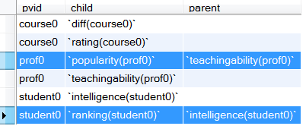
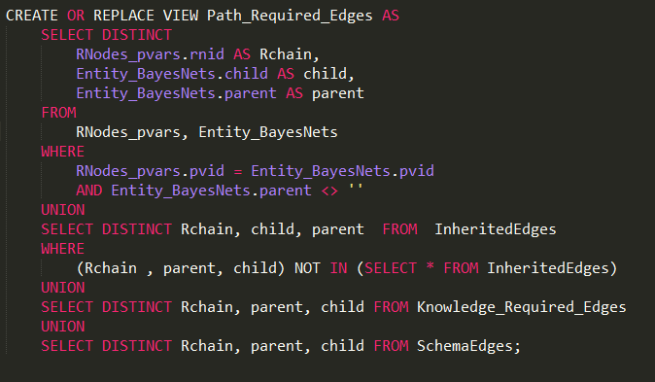
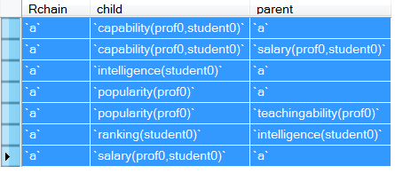
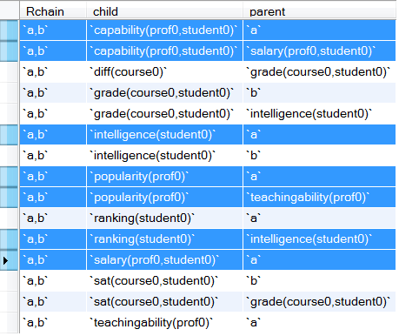

Slide 48
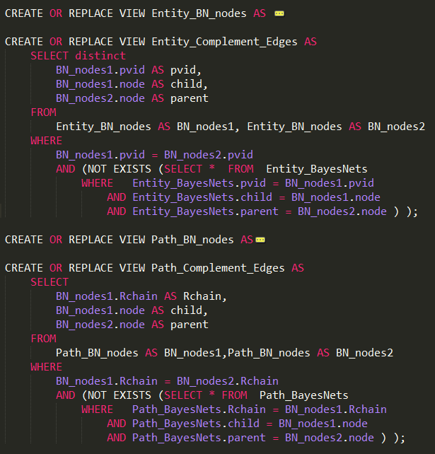
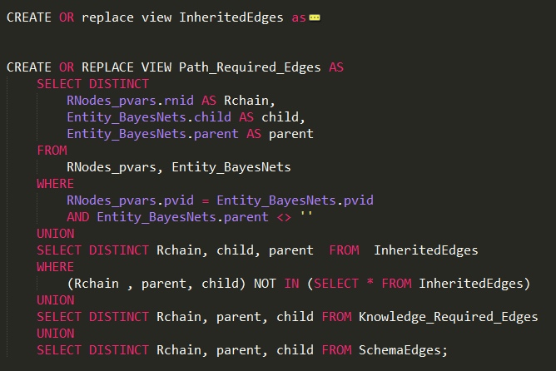
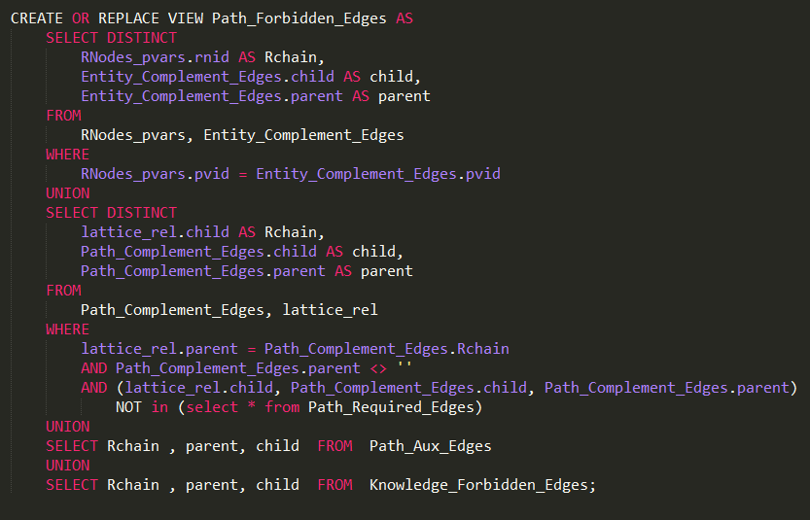
Notes:
ch(5,1)*1 +ch(5,2)*2 +ch(5,3)*3 +ch(5,4)*4 +ch(5,5)*5 = sigma[1,5, ch(5,k)*k] = 80

Slide 49
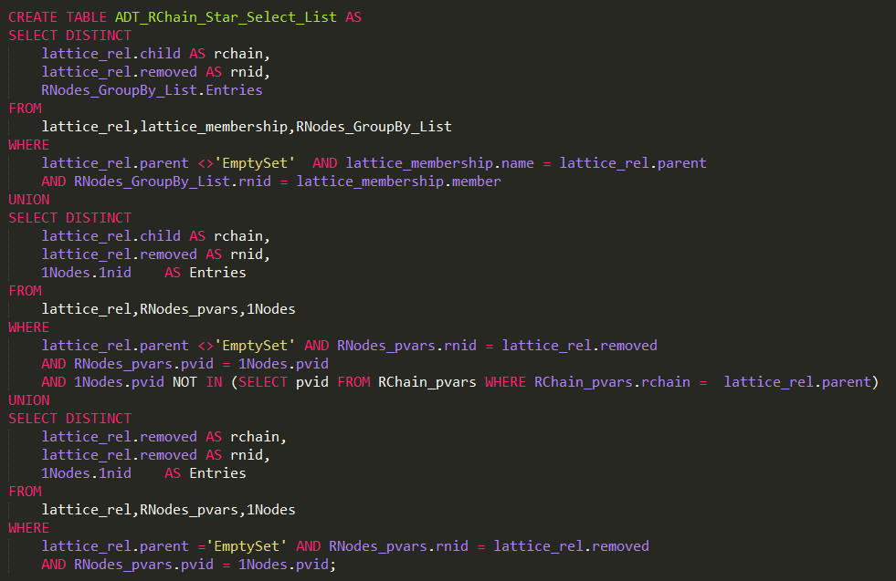
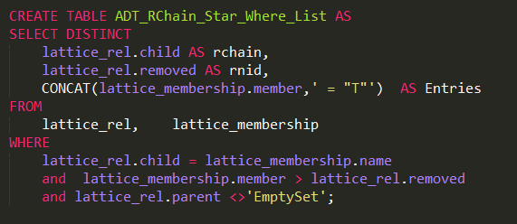
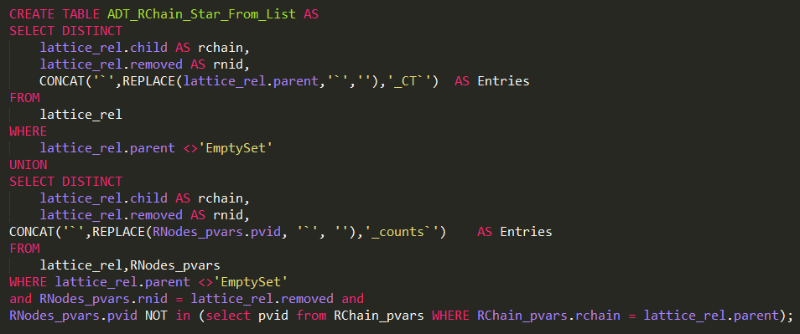
CREATE TABLE CT_{F} AS
SELECT (CT*.COUNT - CT_{T}.COUNT) AS COUNT, Pop, Teach, Intel, Rank
FROM CT* ,CT_{T}
WHERE
CT*.Pop = CT_{T}.Pop AND CT*.Teach = CT_{T}.Teach AND CT*.Intel = CT_{T}.Intel AND CT*.Rank = CT_{T}.Rank
UNION
SELECT (CT*.COUNT) AS COUNT, Pop, Teach, Intel, Rank
FROM CT*
WHERE (Pop, Teach, Intel, Rank) NOT IN (SELECT Pop, Teach, Intel, Rank FROM CT_{T} )
CREATE TABLE CT_{F} AS SELECT (CT*.count - CT_{T} .count) AS count,
Pop, Teach, Intel, Rank FROM CT* , CT_{T} WHERE
CT*.Pop = CT_{T} .Pop AND CT*.Teach = CT_{T} .Teach
AND CT*.Intel = CT_{T} .Intel AND CT*.Rank = CT_{T} .Rank
UNION SELECT (CT*.COUNT) AS COUNT, Pop, Teach, Intel, Rank
FROM CT* WHERE (Pop, Teach, Intel, Rank)
NOT IN (SELECT Pop, Teach, Intel, Rank FROM CT_{T} )
CREATE TABLE CT_{F}⁺ AS SELECT count , Pop, Teach, Intel, Rank, Cap, Sal, (select "F" ) AS RA,(select "n/a") AS cap,(select "n/a") AS Sal FROM CT_{F}
CREATE TABLE CT_{T}⁺ AS SELECT count , Pop, Teach, Intel, Rank, Cap, Sal, (select "T" ) AS RA FROM CT_{T}
Notes:
create table `a_CT` as select `MULT` , `popularity(prof0)` , `teachingability(prof0)` , `intelligence(student0)` , `ranking(student0)` , `capability(prof0,student0)` , `salary(prof0,student0)` , `a` from `a_counts` union select `MULT` , `popularity(prof0)` , `teachingability(prof0)` , `intelligence(student0)` , `ranking(student0)` , `capability(prof0,student0)` , `salary(prof0,student0)` , `a` from `a_false`, `a_join`;

Slide 50
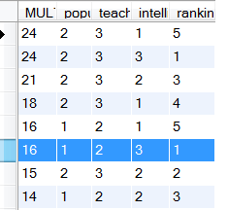
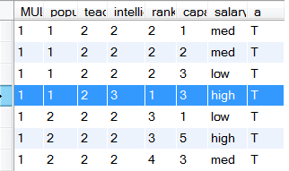
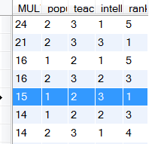
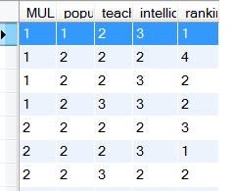

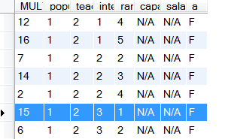
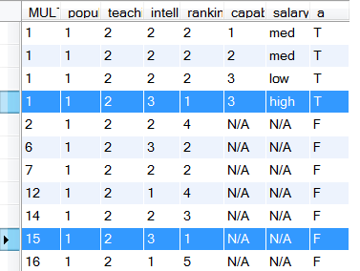







$$a_star$$
$a_$true
-
$$π_{\overline{2Nodes(R})}$$
$a_$flat
Add column a=T
$a_$flase
$a_$CT
$$union$$
Notes:
Snapshot of generating a_ct based on unielwin_CT, Jan 2nd

Slide 51








CT(Nodes | $\vec{R}$ = T , $R_{pivot}$ = * )
CT(Nodes, 2Nodes($R_{pivot}$) | $\vec{R}$ = T , $R_{pivot}$ = T )
$$−$$
$$π_{\text{Nodes}}$$
CT(Nodes | $\vec{R}$ = T , $R_{pivot}$ = F)
Add columns
$R_{pivot}$=F, 2Nodes($R_{pivot}$) = N/A
Add column
$R_{pivot}$=T
∪
CT(Nodes, $R_{pivot}$, 2Nodes($R_{pivot}$) | $\vec{R}$ = T)
Oliver’s version
Precondition: The set Nodes does not contain any of the 2Nodes($R_{pivot}$) and $R_{pivot}$
Notes:
Thursday, Dec. 19
PivotCT(Nodes, $R_{pivot}$, $\vec{R}$ )
Input:
CT(Nodes |$\vec{R}$ = T , $R_{pivot}$ = * )
CT(Nodes, 2Nodes($R_{pivot}$) | $\vec{R}$ = T , $R_{pivot}$ = T )
Output:
CT(Nodes, $R_{pivot}$, 2Nodes($R_{pivot}$) | $\vec{R}$ = T)
Note:
ordered relationship list : $\vec{R}=\left\{R_{1},R_{2}, …,R_{m}\right\}= \left\{\vec{R} ∪R_{pivot} \right\}$ , m ≥ 1 , $R_{pivot}$is the ith relationship
When m = 1, then $R_{pivot}$= $R_{1}$ and $\vec{R_{pivot}}$ = NULL
Nodes : all nodes but not 2Nodes($R_{pivot}$) nor $R_{pivot}$

Slide 52


Pivot(Nodes, R_{pivot} , $\vec{R}$ )
CT(1Nodes(X)) x CT(1Nodes(Y))
X,Y are the population variables involved in R
CT(1Nodes(R)|R = *)
CT(1nodes(R), 2nodes(R)|R=T)
Join of existing tables via meta-query
Pivot(1Nodes(R),R)
$\vec{R}$ is empty, R_{pivot} = R
CT(1nodes(R), 2nodes(R), R )
For single Relationship $\vec{R}$ is empty, R_{pivot} = R
Notes:
Thursday, Dec. 19
For one relationship , R = R_{pivot}

Slide 53


CT(1Nodes(X)) x CT(1Nodes(Y))
X,Y are the population variables involved in a and not involved in b.
CT(1Nodes(b),2Nodes(b)|b=T)
Computed at stage 1
CT(1Nodes(a,b),2Nodes(b))|a = *, b=T)
$\vec{R_{}}$ = b, Rpivot = a
CT(1nodes(a,b), 2nodes(a,b)|a=T,b=T) Join of existing tables via meta- query
Pivot(1Nodes(a,b),2Nodes(b), a, b)
CT(1Nodes(X)) x CT(1Nodes(Y))
X,Y are the population variables involved in b and not involved in a.
CT(1Nodes(a),2Nodes(a),a)
CT(1nodes(a,b), 2nodes(a), a| b=* )
CT(1nodes(a,b), 2nodes(a,b), a| b=T )
Pivot(1Nodes(a,b),2Nodes(a), a, b)
$\vec{R_{}}$ is empty, Rpivot = b
CT(1nodes(a,b), 2nodes(a,b), a,b)
For multiple relationships: a,b
Notes:
Thursday, Dec. 19
Pivot(Nodes, R_{pivot} , $\vec{R}$ )
For multiple relationships: a,b
1.R_{pivot} = a, R_{arrow} = b
1.R_{pivot} = b, R_{arrow} = empty

Slide 54
Explain Moebius transform
Define operators.
Discuss implementations.
sort-merge? compressing columns?
Go to previous slides for workshop.

Slide 55
Evaluation

Slide 56
Constructing Contingency Tables
Metric: how long to build the biggest table.
Also how much space?
Methods:
simple join.
join with indices. [Postgress?] [Column limitations?]
Moebius transform method.
Question: is it scalability or runtime even on small datasets.
Depends on system resources.
And join algorithm.

Slide 57
Statistical Evaluation
Databases:
University
MovieLens(1M)
Mutagenesis
Financial
Hepatitis
IMDB
Mondial
UW-CSE
Metrics
Pseudo_BIC
Pseudo_AIC
Norm_log-likelihood
# Para
Methods:
BBH3/Flat/Complete/Disconnected

Slide 58
Backup slides
Notes:
Jan 2nd

Slide 59
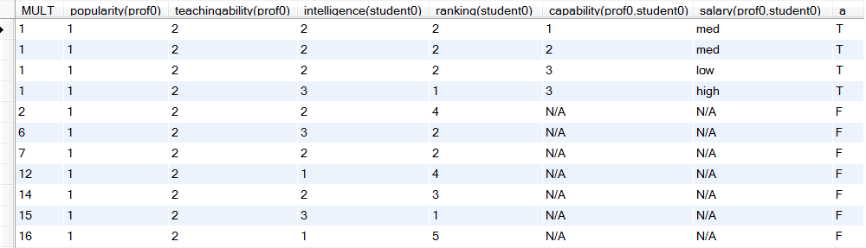
Count | Diff. | Rat. | Pop. | Teach. | Intel. | Rank. | Cap. | Sal. | Grade | Sat. | RA | Reg.
1 | 1 | 1 | 1 | 2 | 3 | 1 | 3 | High | 1 | 1 | T | T
1 | 1 | 2 | 1 | 2 | 2 | 2 | n/a | n/a | 2 | 2 | F | T
3 | 1 | 2 | 1 | 2 | 2 | 2 | 1 | Med | n/a | n/a | T | F
24 | 2 | 1 | 1 | 2 | 1 | 5 | n/a | n/a | n/a | n/a | F | F
… | … | … | … | … | … | … | … | … | … | … | … | …
1 | 2 | 1 | 2 | 2 | 1 | 4 | n/a | n/a | 3 | 2 | F | T
Notes:
uni-ct-table.JPG

Slide 60
Count | Diff. | Rat. | Pop. | Teach. | Intel. | Rank. | Cap. | Sal. | Grade | Sat. | RA | Reg.
1 | 1 | 1 | 1 | 2 | 3 | 1 | 3 | High | 1 | 1 | T | T
1 | 1 | 2 | 1 | 2 | 2 | 2 | n/a | n/a | 2 | 2 | F | T
3 | 1 | 2 | 1 | 2 | 2 | 2 | 1 | Med | n/a | n/a | T | F
24 | 2 | 1 | 1 | 2 | 1 | 5 | n/a | n/a | n/a | n/a | F | F
… | … | … | … | … | … | … | … | … | … | … | … | …
1 | 2 | 1 | 2 | 2 | 1 | 4 | n/a | n/a | 3 | 2 | F | T
Notes:
uni-ct-table.JPG

Slide 61
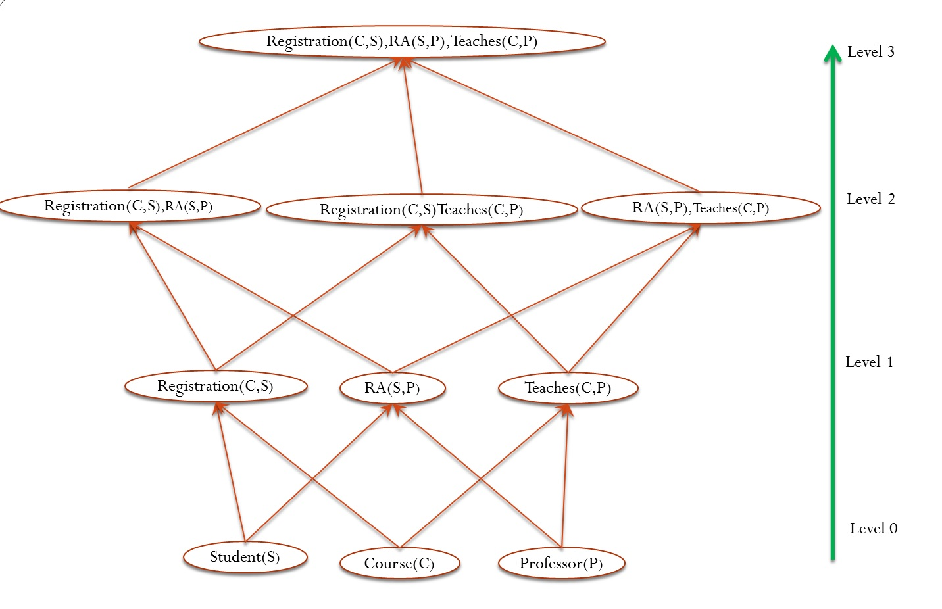
Notes:
uni-big-lattice.jpg

Slide 62
Registration(S,C),RA(P,S),Teaches(P,C)
Level 3
Registration(S,C),RA(P,S)
Registration(S,C),Teaches(P,C)
RA(P,S),Teaches(P,C)
Level 2
Registration(S,C)
RA(P,S)
Teaches(P,C)
Level 1
Student(S)
Course(C)
Professor(P)
Level 0
Notes:
make picture consistent.
Add arrows to indicate propagating edges.

Slide 63
Registration(S,C),RA(P,S),Teaches(P,C)
Level 3
lines 9-23
l = 3
Registration(S,C),RA(P,S)
Registration(S,C),Teaches(P,C)
RA(P,S),Teaches(P,C)
Level 2
lines 9-23
l = 2
Registration(S,C)
RA(P,S)
Teaches(P,C)
Level 1
lines 4-8
Student(S)
Course(C)
Professor(P)
Level 0 lines 1-3
Notes:
make picture consistent.
Add arrows to indicate propagating edges.

Slide 64
Registration(S,C),RA(P,S)
relationship chain
lines | Operation | Resulting ct-table
11 | Reg(S,C) = T, RA(P,S) = T | Current_ct
13, 14 | i = 1, Reg(S,C) = *, RA(P,S) = T | ct*
20 | PIVOT | Current_ct
16, 18 | i = 2, RA(P,S) = * | ct*
20 | PIVOT | Final ct-table for Registration(S,C),RA(P,S)
Notes:
Aug. 20, 2014, rchain-loop.pdf

Slide 65
lines | Operation | Resulting ct-table
11 | Reg(S,C) = T, RA(P,S) = T | Current_ct
13-14 | i = 1, Reg(S,C) = *, RA(P,S) = T | ct*
20 | PIVOT | Current_ct
16-18 | i = 2, RA(P,S) = * | ct*
20 | PIVOT | Final ct-table for Reg(S,C),RA(P,S)
Notes:
Aug. 20, 2014, rchain-loop.jpg

Slide 66
Registration(S,C),RA(S,P),Teaches(P,C)
Level 3
Registration(S,C),RA(S,P)
Registration(C,S),Teaches(C,P)
RA(S,P),Teaches(P,C)
Level 2
Registration(S,C)
RA(S,P)
Teaches(P,C)
Level 1
Student(S)
Course(C)
Professor(P)
Level 0
Notes:
make picture consistent.
Add arrows to indicate propagating edges.

Slide 67
CT*
Count | Pop | Teach | Intel. | Rank
16 | 1 | 2 | 3 | 1
15 | 2 | 3 | 2 | 2
18 | 2 | 3 | 1 | 4
24 | 2 | 3 | 1 | 5
Count | Pop | Teach | Intel. | Rank | Cap | Sal.
1 | 1 | 2 | 3 | 1 | 3 | high
1 | 1 | 2 | 2 | 2 | 3 | Low
1 | 2 | 2 | 2 | 4 | 3 | Med
1 | 1 | 2 | 2 | 2 | 1 | Med
CT_{T}
-
π_{Nodes}
CT_{F}
Count | Pop | Teach | Intel. | Rank
15 | 1 | 2 | 3 | 1
16 | 2 | 3 | 2 | 3
21 | 2 | 3 | 3 | 1
24 | 2 | 3 | 1 | 5
Count | Pop | Teach | Intel. | Rank
1 | 1 | 2 | 3 | 1
1 | 1 | 2 | 2 | 2
1 | 2 | 2 | 2 | 4
1 | 1 | 2 | 2 | 2
RA | Cap | Sal
F | n/a | n/a
RA
T
CT_{F}⁺
CT_{T}⁺
Count | Pop | Teach | Intel. | Rank | Cap | Sal. | RA
15 | 1 | 2 | 3 | 1 | n/a | n/a | F
12 | 1 | 2 | 1 | 4 | n/a | n/a | F
7 | 1 | 2 | 2 | 2 | n/a | n/a | F
6 | 1 | 2 | 3 | 2 | n/a | n/a | F
Count | Pop | Teach | Intel. | Rank | Cap | Sal. | RA
1 | 1 | 2 | 3 | 1 | 3 | high | T
1 | 1 | 2 | 2 | 2 | 3 | Low | T
1 | 2 | 2 | 2 | 4 | 3 | Med | T
1 | 1 | 2 | 2 | 2 | 1 | Med | T
∪
CT
Count | Pop | Teach | Intel. | Rank | Cap | Sal. | RA
15 | 1 | 2 | 3 | 1 | n/a | n/a | F
1 | 1 | 2 | 3 | 1 | 3 | High | T
1 | 1 | 2 | 2 | 2 | 1 | Med | T
7 | 1 | 2 | 2 | 2 | n/a | n/a | F
Notes:
Sample CT based on uniewlin
Label the table without the dots

Slide 68


Count | Pop | Teach | Intel. | Rank
16 | 1 | 2 | 3 | 1
15 | 2 | 3 | 2 | 2
18 | 2 | 3 | 1 | 4
24 | 2 | 3 | 1 | 5
Count | Pop | Teach | Intel. | Rank | Cap | Sal.
1 | 1 | 2 | 3 | 1 | 3 | high
1 | 1 | 2 | 2 | 2 | 3 | Low
1 | 2 | 2 | 2 | 4 | 3 | Med
1 | 1 | 2 | 2 | 2 | 1 | Med
-
$$π_{\overline{2Nodes(Ra})}$$
Count | Pop | Teach | Intel. | Rank
15 | 1 | 2 | 3 | 1
16 | 2 | 3 | 2 | 3
21 | 2 | 3 | 3 | 1
24 | 2 | 3 | 1 | 5
Count | Pop | Teach | Intel. | Rank
1 | 1 | 2 | 3 | 1
1 | 1 | 2 | 2 | 2
1 | 2 | 2 | 2 | 4
1 | 1 | 2 | 2 | 2
RA
T
RA | Cap | Sal
F | n/a | n/a
$$union$$
Count | Pop | Teach | Intel. | Rank | Cap | Sal. | RA
15 | 1 | 2 | 3 | 1 | n/a | n/a | F
12 | 1 | 2 | 1 | 4 | n/a | n/a | F
7 | 1 | 2 | 2 | 2 | n/a | n/a | F
6 | 1 | 2 | 3 | 2 | n/a | n/a | F
Count | Pop | Teach | Intel. | Rank | Cap | Sal. | RA
15 | 1 | 2 | 3 | 1 | n/a | n/a | F
1 | 1 | 2 | 3 | 1 | 3 | High | T
1 | 1 | 2 | 2 | 2 | 1 | Med | T
7 | 1 | 2 | 2 | 2 | n/a | n/a | F
Notes:
Bigger tables, but looks messy

Slide 69
CT*
Count | Pop | Teach | Intel. | Rank
16 | 1 | 2 | 3 | 1
15 | 2 | 3 | 2 | 2
18 | 2 | 3 | 1 | 4
24 | 2 | 3 | 1 | 5
… | … | … | … | …
Count | Pop | Teach | Intel. | Rank | Cap | Sal.
1 | 1 | 2 | 3 | 1 | 3 | high
1 | 1 | 2 | 2 | 2 | 3 | Low
1 | 2 | 2 | 2 | 4 | 3 | Med
1 | 1 | 2 | 2 | 2 | 1 | Med
… | … | … | … | … | … | …
CT_{T}
-
π_{Nodes}
CT_{F}
Count | Pop | Teach | Intel. | Rank
15 | 1 | 2 | 3 | 1
16 | 2 | 3 | 2 | 3
21 | 2 | 3 | 3 | 1
24 | 2 | 3 | 1 | 5
… | … | … | … | …
Count | Pop | Teach | Intel. | Rank
1 | 1 | 2 | 3 | 1
1 | 1 | 2 | 2 | 2
1 | 2 | 2 | 2 | 4
1 | 1 | 2 | 2 | 2
… | … | … | … | …
RA | Cap | Sal
F | n/a | n/a
RA
T
CT_{F}⁺
CT_{T}⁺
Count | Pop | Teach | Intel. | Rank | Cap | Sal. | RA
15 | 1 | 2 | 3 | 1 | n/a | n/a | F
12 | 1 | 2 | 1 | 4 | n/a | n/a | F
7 | 1 | 2 | 2 | 2 | n/a | n/a | F
6 | 1 | 2 | 3 | 2 | n/a | n/a | F
… | … | … | … | … | … | … | …
Count | Pop | Teach | Intel. | Rank | Cap | Sal. | RA
1 | 1 | 2 | 3 | 1 | 3 | high | T
1 | 1 | 2 | 2 | 2 | 3 | Low | T
1 | 2 | 2 | 2 | 4 | 3 | Med | T
1 | 1 | 2 | 2 | 2 | 1 | Med | T
… | … | … | … | … | … | … | …
CT
∪
Count | Pop | Teach | Intel. | Rank | Cap | Sal. | RA
15 | 1 | 2 | 3 | 1 | n/a | n/a | F
1 | 1 | 2 | 3 | 1 | 3 | High | T
1 | 1 | 2 | 2 | 2 | 1 | Med | T
7 | 1 | 2 | 2 | 2 | n/a | n/a | F
... | ... | ... | ... | ... | ... | ... | ...
Notes:
Label the table, added the dots Dec 24,updated on Jan 2nd,
Add some queries?

Slide 70
Count | Pop | Teach | Intel. | Rank
16 | 1 | 2 | 3 | 1
15 | 2 | 3 | 2 | 2
18 | 2 | 3 | 1 | 4
24 | 2 | 3 | 1 | 5
… | … | … | … | …
Count | Pop | Teach | Intel. | Rank | Cap | Sal.
1 | 1 | 2 | 3 | 1 | 3 | high
1 | 1 | 2 | 2 | 2 | 3 | Low
1 | 2 | 2 | 2 | 4 | 3 | Med
1 | 1 | 2 | 2 | 2 | 1 | Med
… | … | … | … | … | … | …
CT*
CT_{T}
CREATE TABLE CT* AS SELECT p_ct.count * s_ct.count as count, Pop ,Teach, Intel, Rank FROM p_ct , s_ct
CREATE TABLE CT_{T} AS SELECT count(*) as count , Pop, Teach, Intel, Rank, Cap, Sal FROM p, s, RA WHERE RA.p_id = p.p_id and RA.s_id = s.s_id
GROUP BY Pop, Teach, Intel, Rank, Cap, Sal
-
π_{Nodes}
CT_{F}
Count | Pop | Teach | Intel. | Rank
15 | 1 | 2 | 3 | 1
16 | 2 | 3 | 2 | 3
21 | 2 | 3 | 3 | 1
24 | 2 | 3 | 1 | 5
… | … | … | … | …
Count | Pop | Teach | Intel. | Rank
1 | 1 | 2 | 3 | 1
1 | 1 | 2 | 2 | 2
1 | 2 | 2 | 2 | 4
1 | 1 | 2 | 2 | 2
… | … | … | … | …
CREATE TABLE temp SELECT count , Pop, Teach, Intel, Rank FROM CT_{T}
CREATE TABLE CT_{F} AS SELECT (CT*.count - temp .count) AS count,
Pop, Teach, Intel, Rank FROM CT* , temp WHERE
CT*.Pop = temp.Pop AND CT*.Teach = temp.Teach
AND CT*.Intel = temp.Intel AND CT*.Rank = temp.Rank
UNION SELECT (CT*.COUNT) AS COUNT, Pop, Teach, Intel, Rank
FROM CT* WHERE (Pop, Teach, Intel, Rank)
NOT IN (SELECT Pop, Teach, Intel, Rank FROM temp )
CREATE TABLE CT_{F}⁺ AS SELECT count , Pop, Teach, Intel, Rank, Cap, Sal,(select "n/a") AS Cap,(select "n/a") AS Sal, (select "F" ) AS RA FROM CT_{F}
CREATE TABLE CT_{T}⁺ AS SELECT count , Pop, Teach, Intel, Rank, Cap, Sal, (select "T" )as RA FROM CT_{T}
RA | Cap | Sal
F | n/a | n/a
RA
T
CT_{F}⁺
CT_{T}⁺
Count | Pop | Teach | Intel. | Rank | Cap | Sal. | RA
15 | 1 | 2 | 3 | 1 | n/a | n/a | F
12 | 1 | 2 | 1 | 4 | n/a | n/a | F
7 | 1 | 2 | 2 | 2 | n/a | n/a | F
6 | 1 | 2 | 3 | 2 | n/a | n/a | F
… | … | … | … | … | … | … | …
Count | Pop | Teach | Intel. | Rank | Cap | Sal. | RA
1 | 1 | 2 | 3 | 1 | 3 | high | T
1 | 1 | 2 | 2 | 2 | 3 | Low | T
1 | 2 | 2 | 2 | 4 | 3 | Med | T
1 | 1 | 2 | 2 | 2 | 1 | Med | T
… | … | … | … | … | … | … | …
CT
∪
CREATE TABLE CT AS
SELECT * FROM CT_{F}⁺ UNION SELECT * FROM CT_{T}⁺
Count | Pop | Teach | Intel. | Rank | Cap | Sal. | RA
15 | 1 | 2 | 3 | 1 | n/a | n/a | F
1 | 1 | 2 | 3 | 1 | 3 | High | T
1 | 1 | 2 | 2 | 2 | 1 | Med | T
7 | 1 | 2 | 2 | 2 | n/a | n/a | F
... | ... | ... | ... | ... | ... | ... | ...
Notes:
Label the table, added the dots Dec 24,updated on Jan 2nd, Add some queries, Jan 3^{rd,} updated on Jan 13rd
create table `a_star` as Select `prof0_counts`.`MULT` * `student0_counts`.`MULT` as `MULT` ,`popularity(prof0)` , `teachingability(prof0)` , `intelligence(student0)` , `ranking(student0)` from `prof0_counts` , `student0_counts`
create table `a_counts` as Select count(*) as "MULT" , prof0.popularity AS `popularity(prof0)` , prof0.teachingability AS `teachingability(prof0)` , student0.intelligence AS `intelligence(student0)` , student0.ranking AS `ranking(student0)` , `a`.capability AS `capability(prof0,student0)` , `a`.salary AS `salary(prof0,student0)` , `a` from unielwin.prof AS prof0 , unielwin.student AS student0 , unielwin.RA AS `a` , (select "T" as `a`) as `temp_a` where `a`.prof_id = prof0.prof_id and `a`.student_id = student0.student_id group by`popularity(prof0)` , `teachingability(prof0)` , `intelligence(student0)` , `ranking(student0)` , `capability(prof0,student0)` , `salary(prof0,student0)` , `a`
create table `a_flat` as Select sum(`a_counts`.`MULT`) as "MULT" , `popularity(prof0)` , `teachingability(prof0)` , `intelligence(student0)` , `ranking(student0)` from `a_counts` group by`popularity(prof0)` , `teachingability(prof0)` , `intelligence(student0)` , `ranking(student0)`
create table `a_CT` as select `MULT` , `popularity(prof0)` , `teachingability(prof0)` , `intelligence(student0)` , `ranking(student0)` , `capability(prof0,student0)` , `salary(prof0,student0)` , `a` from `a_counts` union select `MULT` , `popularity(prof0)` , `teachingability(prof0)` , `intelligence(student0)` , `ranking(student0)` , `capability(prof0,student0)` , `salary(prof0,student0)` , `a` from `a_false`, `a_join`;

Slide 71
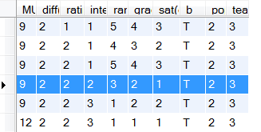
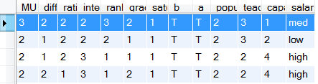
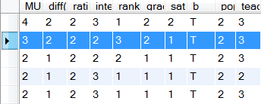
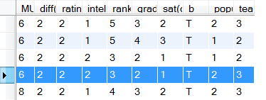





$a,b_$true
$$_star$$
$$π_{\overline{2Nodes(}Rpivot)}$$
$_$flat
-
$_$temp
Notes:
For rchain “a,b” .
Current Pivot : a

Slide 72
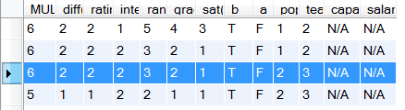
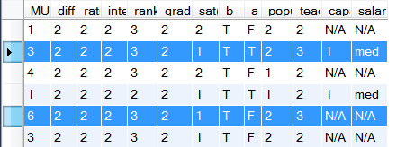





$_$temp
$a,b_$true
$_$flase
Add column a=T
$$union$$
$a,b_a_$CT
Notes:
Current Pivot : a

Slide 73
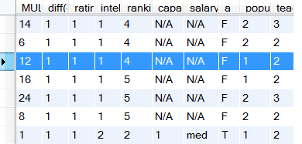
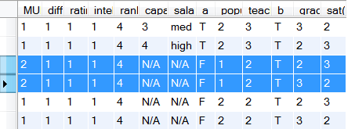
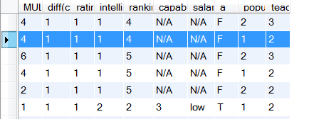
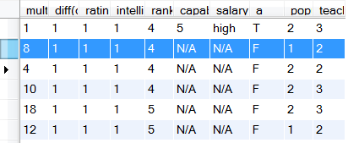





$$_star$$
$a,b_a_$CT
$$π_{\overline{2Nodes(}Rpivot)}$$
-
$_$flat
$_$temp
Notes:
Current Pivot : b
Previous Pivot : a

Slide 74
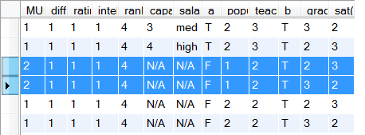

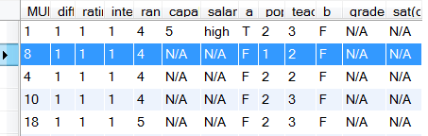
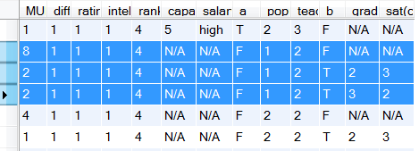





$a,b_a_$CT
$_$temp
Add column b=T
$_$flase
$$union$$
$a,b_$CT

Slide 75




CT(Nodes | $\vec{R_{pivot}}$ = T , $R_{pivot}$ = * )
CT(Nodes, 2Nodes($R_{pivot}$) | $\vec{R_{pivot}}$ = T , $R_{pivot}$ = T )
$$−$$
$$π_{\text{Nodes}}$$
CT(Nodes | $\vec{R_{pivot}}$ = T , $R_{pivot}$ = F)
Add columns
$R_{pivot}$=F, 2Nodes($R_{pivot}$) = N/A
Add column
$R_{pivot}$=T
∪
CT(Nodes, $R_{pivot}$, 2Nodes($R_{pivot}$) | $\vec{R_{pivot}}$ = T)
Zhensong version
Notes:
PivotCT(Nodes, $R_{pivot}$, $\vec{R_{pivot}}$ )
Input:
CT(Nodes | $\vec{R_{pivot}}$ = T , $R_{pivot}$ = * )
CT(Nodes, 2Nodes($R_{pivot}$) | $\vec{R_{pivot}}$ = T , $R_{pivot}$ = T )
Output:
CT(Nodes, $R_{pivot}$, 2Nodes($R_{pivot}$) | $\vec{R_{pivot}}$ = T)
Note:
ordered relationship list : $\vec{R}=\left\{R_{1},R_{2}, …,R_{m}\right\}= \left\{ \vec{R_{pivot}} ∪R_{pivot} \right\}$ , m ≥ 1 , $R_{pivot}$is the ith relationship
When m = 1, then $R_{pivot}$= $R_{1}$ and $\vec{R_{pivot}}$ = NULL
Nodes : all nodes but not 2Nodes($R_{pivot}$)

Slide 76


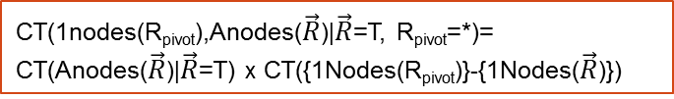


CT(1nodes(R_{pivot}),Anodes($\vec{R}$)|$\vec{R}$=T, R_{pivot}=*)=
CT(Anodes($\vec{R}$)|$\vec{R}$=T) x CT({1Nodes(R_{pivot})}-{1Nodes($\vec{R}$)})
CT(Anodes(R_{pivot},$\vec{R}$)|R_{pivot}=T,$\vec{R}$=T)
Join of existing tables
$$π_{\overline{2Nodes(}Rpivot)}$$
$$−$$
CT(1nodes(R_{pivot}),Anodes($\vec{R}$)|R_{pivot}=F, $\vec{R}$=T)
Add columns R_{pivot}=F,2Nodes(R_{pivot})= N/A
Add column R_{pivot}=T
∪
CT(Anodes(R_{pivot ,} $\vec{R}$), R_{pivot}|$\vec{R}$=T)
Notes:
copy

Slide 77

CT(1nodes(R1),Anodes(R2)|R2=T,R1=*)=
CT(Anodes(R2)|R2=T) x CT(1Nodes(R1)-1Nodes(R2))
CT(Anodes(R1,R2)|R1=T,R2=T)
Join of existing tables
$$π_{\overline{2Nodes(R}1)}$$
$$−$$
CT(Anodes(R1)|R1=F,R2=T)
Add columns R1=F,2Nodes(R1)= N/A
Add column R1=T
∪
CT(Anodes(R1),R1|R2=T)

Slide 78

CT(1nodes(R1),Anodes(R2)|R2=T,R1=*)=
CT(Anodes(R2)|R2=T) x CT(1Nodes(R1)-1Nodes(R2))
CT(Anodes(R1,R2)|R1=T,R2=T)
Join of existing tables
$$π_{\overline{2Nodes(R}1)}$$
$$−$$
CT(Anodes(R1,R2)|R1=F,R2=T)
Add columns R1=F,2Nodes(R1)= N/A
Add column R1=T
CT(Anodes(R1),R1) x
CT(1Nodes(R2)-1Nodes(R1))
∪
CT(Anodes(R1),R1,1Nodes(R2)|R2=*)
CT(Anodes(R1,R2),R1|R2=T)
$$π_{\overline{2Nodes(R}2)}$$
CT(Anodes(R1),R1,1nodes(R2|R2=T)

Slide 79
Metaqueries | Entries for rnid = RA(S,P)
CREATE TABLE Select_List AS SELECT rnid, CONCAT(‘COUNT(*)',' as "count"') AS Entries FROM RV.RNodes UNION DISTINCT SELECT rnid, CONCAT(pvid,'.',COLUMN_NAME,' AS ',1nid) AS Entries FROM RV.RNodes_1Nodes | COUNT(*) as “count"
 | prof0.popularity AS `popularity(prof0)`
 | prof0.teachingability AS `teachingability(prof0)`
 | student0.intelligence AS `intelligence(student0)`
 | student0.ranking AS `ranking(student0)`
CREATE TABLE From_List AS SELECT rnid, CONCAT('@database@.',TABLE_NAME) AS Entries FROM RV.RNodes_pvars UNION DISTINCT SELECT rnid, CONCAT('@database@.',TABLE_NAME) AS Entries FROM RV.RNodes | @database@.prof AS prof0
 | @database@.student AS student0
 | @database@.RA AS `RA`
CREATE TABLE Where_List AS SELECT rnid, CONCAT(rnid,'.',COLUMN_NAME,' = ', pvid,'.', REFERENCED_COLUMN_NAME) AS Entries FROM RV.RNodes_pvars; | `RA`.prof_id = prof0.prof_id
 | `RA`.student_id =student0.student_id

Slide 80
Metaqueries | Entries
CREATE TABLE Select_List AS SELECT rnid, CONCAT(‘COUNT(*)',' as "count"') AS Entries FROM RNodes UNION DISTINCT SELECT rnid, CONCAT(pvid,'.',COLUMN_NAME,' AS ',1nid) AS Entries FROM RNodes_1Nodes | COUNT(*) as “count"
 | prof0.popularity AS `popularity(prof0)`
 | prof0.teachingability AS `teachingability(prof0)`
 | student0.intelligence AS `intelligence(student0)`
 | student0.ranking AS `ranking(student0)`
CREATE TABLE From_List AS SELECT rnid, CONCAT('@database@.',TABLE_NAME, ' AS ', pvid) AS Entries FROM RNodes_pvars UNION DISTINCT SELECT rnid, CONCAT('@database@.',TABLE_NAME, ' AS ', rnid) AS Entries FROM RNodes | @database@.prof AS prof0
 | @database@.student AS student0
 | @database@.RA AS `RA`
CREATE TABLE Where_List AS SELECT rnid, CONCAT(rnid,'.',COLUMN_NAME,' = ',pvid,'.', REFERENCED_COLUMN_NAME) AS Entries FROM RNodes_pvars; | `RA`.prof_id = prof0.prof_id
 | `RA`.student_id =student0.student_id

Slide 81
CT*
Count | Pop | Teach | Intel | Rank
16 | 1 | 2 | 3 | 1
15 | 2 | 3 | 2 | 2
18 | 2 | 3 | 1 | 4
… | … | … | … | …
Count | Pop | Teach | Intel | Rank | Cap | Sal
1 | 1 | 2 | 3 | 1 | 3 | high
1 | 1 | 2 | 2 | 2 | 3 | low
1 | 2 | 2 | 2 | 4 | 3 | med
… | … | … | … | … | … | …
CT_{T}
CREATE TABLE CT* AS SELECT p_ct.count * s_ct.count as count, CL(p),CL(s) FROM p_ct , s_ct
CREATE TABLE CT_{T} AS SELECT count(*) as count, CL(p), CL(s), CL(RA) FROM p, s, RA WHERE RA.p_id = p.p_id and RA.s_id = s.s_id
GROUP BY CL(p), CL(s), CL(RA)
-
π_{Nodes}
CT_{F}
Count | Pop | Teach | Intel | Rank
15 | 1 | 2 | 3 | 1
16 | 2 | 3 | 2 | 3
21 | 2 | 3 | 3 | 1
… | … | … | … | …
Count | Pop | Teach | Intel | Rank
1 | 1 | 2 | 3 | 1
1 | 1 | 2 | 2 | 2
1 | 2 | 2 | 2 | 4
… | … | … | … | …
temp
CREATE TABLE CT_{F} AS SELECT (CT*.count - temp.count) AS count, CL(temp)
FROM CT* , temp WHERE CL(CT*) = CL (temp)
UNION SELECT (CT*.COUNT) AS COUNT, CL(CT*) FROM CT* WHERE
CL(CT*) NOT IN (SELECT CL(temp) FROM temp )
CREATE TABLE temp AS SELECT SUM(CT_{T}.count) AS count,
CL(p), CL(s) FROM CT_{T} GROUP BY CL(p), CL(s)
RA
T
RA | Cap | Sal
F | n/a | n/a
CT_{T}⁺
CT_{F}⁺
Count | Pop | Teach | Intel | Rank | Cap | Sal | RA
15 | 1 | 2 | 3 | 1 | n/a | n/a | F
12 | 1 | 2 | 1 | 4 | n/a | n/a | F
7 | 1 | 2 | 2 | 2 | n/a | n/a | F
… | … | … | … | … | … | … | …
Count | Pop | Teach | Intel | Rank | Cap | Sal | RA
1 | 1 | 2 | 3 | 1 | 3 | high | T
1 | 1 | 2 | 2 | 2 | 3 | low | T
1 | 2 | 2 | 2 | 4 | 3 | med | T
… | … | … | … | … | … | … | …
∪
Count | Pop | Teach | Intel | Rank | Cap | Sal | RA
15 | 1 | 2 | 3 | 1 | n/a | n/a | F
1 | 1 | 2 | 3 | 1 | 3 | high | T
1 | 1 | 2 | 2 | 2 | 1 | med | T
... | ... | ... | ... | ... | ... | ... | ...
CREATE TABLE CT AS
SELECT * FROM CT_{F}⁺ UNION SELECT * FROM CT_{T}⁺
CT
Notes:
sub.jpg
Fixed typos for temp table. Jan 13rd
CL(CT*) = CL(temp) = Pop, Teach, Intel, Rank
CL(CT_{T}) = Pop, Teach, Intel, Rank, Cap, Sal
CL(CT_{F}) = Pop, Teach, Intel, Rank
CL(CT) = CL(CT_{F}⁺) = CL(CT_{T}⁺) = Pop, Teach, Intel, Rank, Cap, Sal, RA
CL(p) = Pop, Teach
CL(s) = Intel, Rank
CL(RA)= Cap, Sal

Slide 82
DataBase
original data
SQL Script Utilizing information schema
DataBase_RV
Random variables
Fid | Functor Name | Type
intelligence(Student) | intelligence | 1Node
satisfaction(Course, Student) | satisfaction | 2Node
Registration(Course, Student) | Registration | Rnode
Edge Constraints
Model Manager
Lattice Search
DataBase_CT
Contingency Tables
Virtual Join Algorithm
Count | Pop | Teach | Intel | Rank
1 | 1 | 2 | 3 | 1
1 | 1 | 2 | 2 | 2
1 | 2 | 2 | 2 | 4
… | … | … | … | …
Rchian | Child | Parent
Registration(Course, Student), RA (Student, Prof) | ranking(Student) | intelligence(Student)
DataBase_BN
Bayes Nets
Notes:
general-flow-chart.png

Slide 83
CREATE TABLE ct_{T} AS SELECT count(*) as Count , professor.popularity, professor.teachingability, student.intelligence, student.ranking , RA.capability, RA.salary
FROM professor, student, RA
WHERE RA.prof_id = professor.prof_id and RA.student_id = student.student_id
GROUP BY professor.popularity, professor.teachingability, student.intelligence, student.ranking , RA.capability, RA.salary
Notes:
\begin{quote}
CREATE TABLE $\ct_{T}$ AS SELECT count(*) as Count , professor.popularity, professor.teachingability, student.intelligence, student.ranking , RA.capability, RA.salary \\
FROM \\professor, student, RA \\
WHERE \\RA.p\_id = professor.p\_id and RA.s\_id = student.s\_id \\
GROUP BY \\professor.popularity, professor.teachingability, student.intelligence, student.ranking , RA.capability, RA.salary
\end{quote}

